Slide 1
MID REVIEW
TapMap
An Autonomous Percussive Defect-Mapping Rover
Robotic automation of ASTM-style tap testing — finds hidden hollow tiles and
concrete delamination, and turns them into a spatial defect map.
GROUP
DOMAIN
BUDGET
11 · CSE-AI · Batch A
ROS 2 · Robotics · Deep Learning
₹3,000 of ₹6,000 cap
Notes:
Open with the one-line pitch: inspectors find hollow tiles by tapping and listening. TapMap does the tapping, the listening, and the mapping — autonomously.

Slide 2
THE PROBLEM
Structural defects you cannot see
A floor tile, façade cladding or concrete deck can look perfectly intact while the adhesive layer beneath it has failed — leaving a hidden air gap called debonding or delamination.
SOUNDING PHYSICS
Bonded tile
Façade tiles fall
Detached cladding drops from buildings onto pedestrians — a recurring cause of injury and death in Indian cities.
sharp "tick" · ~2 kHz · fast decay
Debonded tile
Bridge decks fail
Rebar corrodes, expands, and cracks the concrete cover from inside. Delamination is the earliest visible symptom.
AIR GAP
dull "thud" · ~500 Hz · slow decay
Homes crack
The air gap changes the acoustic response.
That difference is what TapMap measures.
Hollow floor tiles pop, crack under load, and require full re-laying instead of a spot repair.
Notes:
Emphasise that percussion sounding is an accepted NDT method — ASTM D4580 — not something we invented. We are automating an existing accepted practice.

Slide 3
EXISTING SOLUTIONS
Two options today — both inadequate
MANUAL TAP TESTING
COMMERCIAL NDT INSTRUMENTS
An inspector strikes the surface with a rod and judges the sound by ear.
GPR, infrared thermography, ultrasonic array scanners.
Subjective
depends entirely on one person’s ear and experience
Cost
several lakh rupees per instrument
No record
no map, no coordinates, no repeatable evidence
Skill
requires a trained operator to interpret
Slow & tiring
fatigue degrades accuracy over a large area
Access
out of reach for municipal bodies and housing societies
Not repeatable
two inspectors, two different results
Manual
still hand-held — no autonomous area coverage
The gap: nobody has cheaply robotised percussion sounding with spatial mapping. TapMap costs ₹3,000.
Notes:
This slide sets up the gap our project fills. Expect a question on why not thermography — answer: cost, and it needs a thermal gradient which indoor floors rarely have.

Slide 4
CONCEPT OF OPERATION
How the robot works
Placed at any corner of a room. Everything after that is autonomous — including discovering the size of the area it must scan.
1
EXPLORE
2
CALIBRATE
3
COVER
4
TAP
Drives the room boundary using the ToF sensor to discover the scan rectangle
10 taps on a known-good area learn this surface’s baseline signature
Boustrophedon (lawnmower) grid generated over the discovered area, 8 cm spacing
Stop → settle 400 ms → 30 ms solenoid strike → 100 ms gated audio capture
5
CLASSIFY
6
MAP
7
RETURN
8
REPORT
MFCC features → CNN → bonded / debonded with a confidence score
Tap stamped at tapper_link pose into a live occupancy-grid heat map
Drives back to origin; reports its own position error as an accuracy audit
Refined defect regions exported as a PDF inspection report
Notes:
Stress step 1 and step 7. Step 1 is the autonomy claim; step 7 is how we prove the map is trustworthy.

Slide 5
PHASE 1 — EXPLORE
The robot finds its own workspace
No dimensions are typed in. Using a single forward-facing ToF sensor, the rover itself acts as the pan mechanism: it drives, sees a wall, turns on gyro heading, and drives again.
DISCOVERED RECTANGLE
A
Placed at a corner; odometry zeroed, map frame anchored here
B
Drives forward until ToF < 15 cm → wall found → records length L
W
C
Rotates 90° closed-loop on fused gyro heading
start
L
D
Drives until the next wall → records width W
Phase 2 then fills this rectangle with the
tap grid — 8 cm spacing, ~150 taps per m².
E
Returns to origin; the L × W rectangle becomes the scan area
ROS 2 impact: a second action server /discover_area feeding /scan_area, sequenced by a mission-planner state machine.
Notes:
Expected question: what if the room is not rectangular? Answer: v1 assumes a convex rectangular workspace and a max_area safety parameter; non-convex perimeter tracing is future work.

Slide 6
HARDWARE IMPLEMENTATION
Hardware architecture
Thin real-time client, thick onboard brain. The rover is fully autonomous — a laptop, when present, is only an RViz viewer.
POWER
RASPBERRY PI 4
SENSORS & ACTUATORS
12 V battery
THE BRAIN · ROS 2 Jazzy
2× N20 + encoders
source
Coverage planner · EKF localisation · CNN classifier · defect mapper · PDF report
700 ticks/rev → 0.19 mm
XL4015 buck
12 V solenoid
→ 5 V / 3 A for Pi
30 ms strike, rubber tip
INMP441 I²S mic
L298N driver
USB serial · micro-ROS
digital → immune to PWM noise
12 V-rated motor stage
MPU6050 IMU
MOSFET stage
ESP32-WROOM-32
yaw for straight rows
IRLZ44N + 1N5822 + 1000 µF
THE REFLEXES · micro-ROS client
VL53L0X ToF
E-stop
100 Hz motor PID · encoder ISR counting · solenoid gate · I²S audio capture (<2 ms jitter)
boundary discovery + drift fix
cuts actuator power only
SSD1306 OLED
on-robot status
Notes:
Key defence: the Pi cannot do jitter-free 100 ms audio gating because Linux preempts it; the ESP32 cannot run ROS 2 or a CNN. The split IS the architecture.

Slide 7
HARDWARE JUSTIFICATION
Engineering decisions we can defend
Encoder motors, not the lab BO motors
Differential drive, not 4-wheel skid steer
Encoders ARE the localisation. Without tick counting there is no position, no map — the project reduces to a robot that taps randomly.
Skid steer drags wheels sideways through every turn. That slip corrupts odometry and visibly smears the defect map.
L298N, not DRV8833
Digital I²S microphone, not analog
The 12 V battery exceeds DRV8833’s 10.8 V absolute maximum. L298N is 12 V-rated; its ~2 V drop lands the motors at a safe ~10 V.
An analog electret picks up motor PWM switching noise. I²S output is digital at the sensor — the noise never enters the signal path.
Solenoid, not a servo hammer
Local 1000 µF reservoir
A solenoid delivers repeatable impulse energy. Consistent strike energy is what makes tap acoustics comparable between cells.
The 1 A strike transient is served by local capacitance so the 5 V rail never dips and reboots the Pi mid-scan.
Total build cost ₹3,000 — against commercial acoustic NDT instruments at several lakh rupees.
Notes:
Every one of these is a question a reviewer may ask. Knowing why we did NOT choose the obvious alternative is worth more than the choice itself.

Slide 8
SOFTWARE IMPLEMENTATION
ROS 2 computation graph
One micro-ROS driver node on the ESP32; nine processing nodes on the Pi. Three are managed lifecycle nodes.
ESP32
base_controller
LC
surface_classifier
firmware
(micro-ROS)
ticks → /odom + TF
DL-2 · surface type
ekf_localization
audio_classifier
LC
publishes
/wheel_ticks
/imu/data_raw
/tof/range
/audio/tap_window
/battery
subscribes
/cmd_vel
serves
/tapper/fire
odom ⊕ IMU fusion
DL-1 · MFCC → CNN
boundary_explorer
defect_mapper
/discover_area action
builds the heat map
coverage_planner
LC
defect_refiner
/scan_area action · FSM
DL-3 · region cleanup
tap_scheduler
report_generator
settle timing, tap retry
PDF export
LC = managed lifecycle node (configure → activate) for deterministic, scriptable bring-up
Notes:
Point out that node count is not the metric — the reason for the split is. ESP32 holds one node with many interfaces to minimise DDS overhead on a memory-constrained MCU.

Slide 9
SOFTWARE IMPLEMENTATION
ROS 2 interfaces and engineering depth
TOPICS
SERVICES
ACTIONS
/wheel_ticks 50 Hz
/imu/data_raw 100 Hz
/odometry/filtered 50 Hz
/cmd_vel 20 Hz
/audio/tap_window event
/tap/classification event
/defect_grid 1 Hz
/defect_markers event
/tapper/fire
/calibrate_surface
/generate_report
/reset_odom
/estop
/discover_area
goal: max_len, max_wid
result: L, W
/scan_area
feedback: % complete,
taps done, defects found
result: return_error
QoS differentiation
TF tree correctness
Why NOT Nav2
Sensor streams BEST_EFFORT; audio and classification RELIABLE / KEEP_ALL — losing a tap corrupts the map, losing an IMU packet does not.
map → odom → base_link → tapper_link. Taps are stamped at the striker pose, 6 cm ahead of robot centre — otherwise the whole map shifts.
Nav2 assumes obstacle-rich costmap navigation. On a flat scan surface it is unjustifiable overhead; a purpose-built coverage planner matches the problem.
Notes:
Custom interfaces: TapResult.msg, ScanArea.action, DiscoverArea.action in package ss_interfaces. Being able to say why NOT Nav2 scores more than using it decoratively.

Slide 10
AI IMPLEMENTATION
Where Deep Learning is used — and why
Three models, each solving a problem that rules genuinely cannot. Learning is applied to perception, not to motion control.
DL-1
CORE
DL-2
SUPPORT
DL-3
SUPPORT
Tap Acoustic Classifier
Surface Type Classifier
Defect Region Refiner
In 100 ms window → MFCC (13 × 9)
Net small CNN, <100 k params, ~2 ms on Pi
Out bonded / debonded + confidence
In 10 calibration taps
Net lightweight classifier on MFCC statistics
Out ceramic / concrete / marble / plaster
In raw defect occupancy grid
Net compact U-Net-lite over the grid
Out contiguous defect regions + area
A single threshold cannot separate the classes — the difference lives in the joint pattern of spectral centroid, decay envelope and resonance peaks, and it shifts with tile type and thickness.
A model trained on ceramic tile fails on concrete. DL-2 detects the surface during calibration and loads matching classifier weights — this is what makes TapMap deployable beyond one panel.
Real debonding is spatially contiguous. One red cell surrounded by eight green cells is noise. DL-3 removes isolated false positives and merges scattered hits into coherent regions.
Safety net: a spectral-centroid + decay-time rule classifier ships alongside DL-1 as a fallback — and doubles as the ablation baseline for the paper.
Notes:
If asked why navigation is not learned: on a known rectangular grid a learned controller adds training burden and failure modes with zero accuracy gain. Classical control is the correct engineering choice.

Slide 11
CORE OUTPUT
How the defect heat map is built
1
Grid initialised
A nav_msgs/OccupancyGrid is created over the discovered area — 5 cm cells, origin at the start corner, every cell = −1 (unknown, grey).
LIVE IN RVIZ 2
2
Pose resolved at the striker
On each classification the mapper does a TF lookup at tapper_link, not base_link. The striker sits 6 cm ahead of centre; using robot centre would shift the entire map.
3
Confidence-weighted write
solid → cell = 0. hollow → cell = round(100 × confidence). The map encodes certainty, not a binary yes/no. Repeat taps are combined as a running average.
4
Two visual layers
/defect_grid renders as the heat map; /defect_markers drops a green or red dot at each individual tap point so the exact strike locations stay visible.
green = bonded · red = debonded
5
DL-3 refinement
The region refiner smooths isolated false positives and merges scattered hits into contiguous defect regions with area estimates.
Directly measured, not interpolated
Export
Every coloured cell was physically struck at that coordinate. Nothing between samples is estimated or diffused — a stronger claim than an interpolated field map.
6
report_generator renders the final grid to PDF with the tap table, spectrograms of flagged cells, total defect area and the return-home error.
Notes:
This is the slide reviewers will dig into. The tapper_link TF detail and the confidence weighting are the two points that show engineering maturity.

Slide 12
CURRENT STATUS
Where we are today
✓
ROS 2 Jazzy running on the robot’s onboard Pi 4
NEXT
Ubuntu 24.04 Server 64-bit flashed, ROS 2 Jazzy installed, headless over SSH. The full tapmap_ws workspace builds and runs on the robot itself — not on a laptop.
Done
Pi flashed · ROS 2 Jazzy · tapmap_ws running onboard
Done
Autonomous scan · heat map · 1.47 cm return error
✓
Full autonomous scan verified end to end
187 tap points over 0.8 x 0.5 m at 5 cm spacing. 16 defect cells correctly localised over a hollow region the robot was never told about. Returned to origin with 1.47 cm error.
Now
Chassis assembly · power tree · XL4015 set to 5 V
Wk 1
micro-ROS firmware · encoder ticks · motor PID
✓
Live defect heat map rendering in RViz 2
Wk 2
Odometry calibration · gate: 2 m out-and-back < 2 cm
Green markers on bonded taps, red block over the debonded region, occupancy grid filling in real time as the rover rasters.
Wk 3
Tapper · gated I²S capture · record 600+ taps · DL-1
Hardware procured; assembly underway
Wk 4
Boundary discovery · DL-2 · DL-3 · PDF report
✓
Pi 4, ESP32, MPU6050, VL53L0X, OLED, L298N and chassis from the lab. Encoder motors, solenoid, INMP441, buck converter and wiring received. Firmware toolchain in setup.
Wk 5
Hardening · 5 clean scans · demo · paper draft
Software is ahead of hardware by design — when the parts land we plug them into a stack that already works.
Notes:
If they ask to see something running, open the simulation live: ros2 launch tapmap sim.launch.py, then send a scan goal and show RViz.

Slide 13
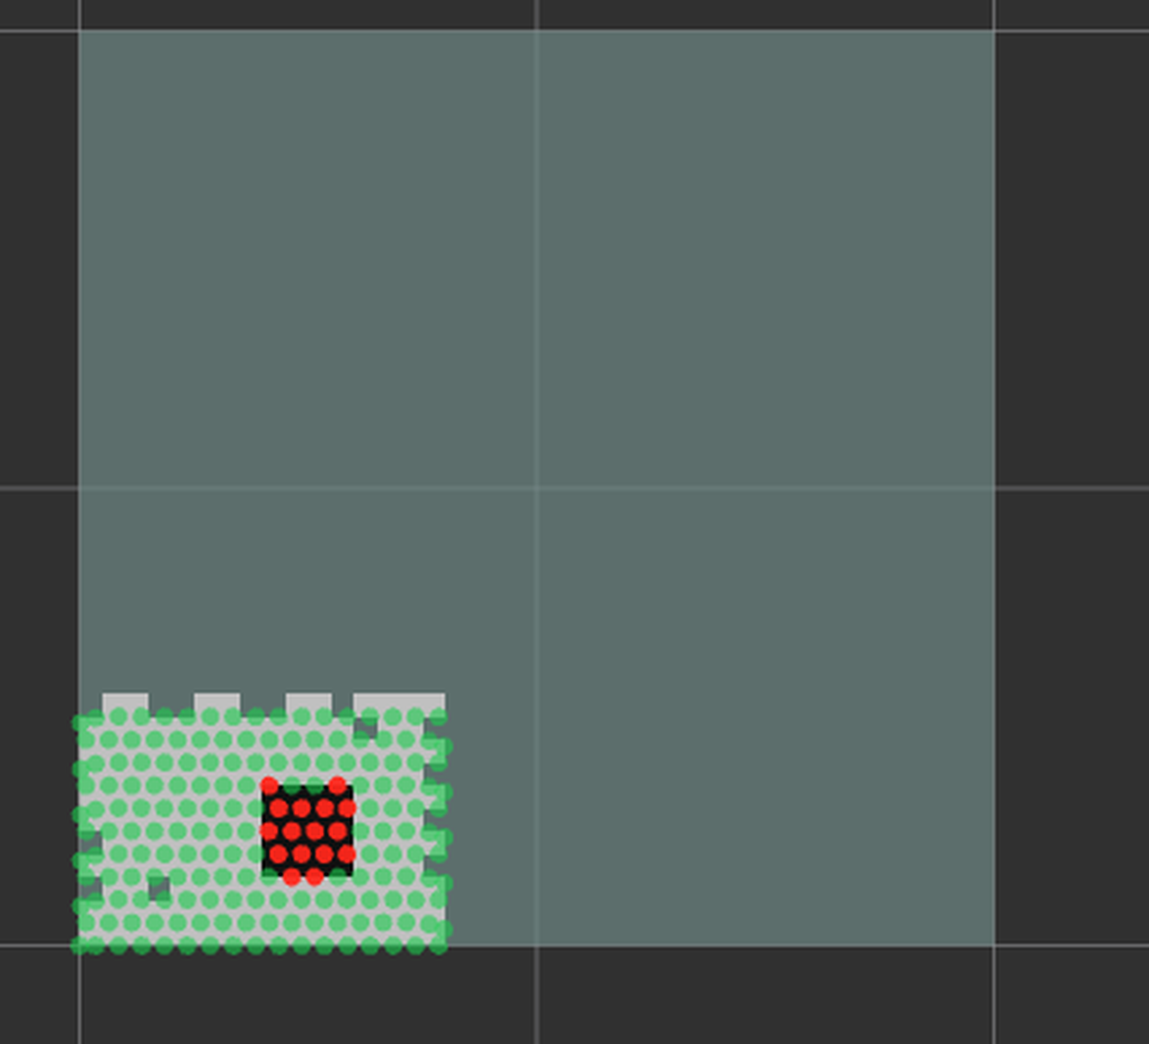
LIVE OUTPUT
Verified result — a defect it was never told about
Full autonomous scan on the onboard Raspberry Pi. The rover covered the area, classified every tap, and localised a hollow region that exists only in the simulated panel — it had no prior knowledge of its position.
DEFECT HEAT MAP — RVIZ 2
187
TAP POINTS
0.8 x 0.5 m area at 5 cm grid spacing
16
DEFECT CELLS
spatially matching the planted hollow region
1.47 cm
RETURN ERROR
position error after the full 187-tap scan
0.008 / 0.997
CLASS SEPARATION
band-energy ratio: bonded vs debonded
Green = bonded tap · Red = debonded tap
Every coloured cell was physically struck at that coordinate — nothing is interpolated.
Notes:
The return error is the self-audit: if odometry had drifted, the robot would not land within 1.47 cm of its start mark after 187 taps, and every coordinate on the map would be suspect.

Slide 14
CONTRIBUTION
Why this stands apart
1
First low-cost robotic percussion sounding
2
Repeatable strike energy
Manual tap testing is accepted NDT practice. Automating it with autonomous coverage and spatial mapping has no student-project precedent and almost no low-cost precedent at all.
A solenoid + hardware-gated capture makes taps comparable cell to cell. A human hammer cannot deliver constant impulse energy — this is what makes the acoustics learnable.
3
Self-validating accuracy
4
Audience-verifiable result
The rover returns to origin and reports its own position error. Map trustworthiness is demonstrated, not asserted.
Hand a judge a coin. They tap the panel and hear the hollow spot exactly where the robot marked it. Independently confirmed in five seconds.
5
A dataset that does not exist
6
Deployable economics
A labelled bonded/debonded tap-acoustic dataset is a publishable contribution in its own right.
₹3,000 against several lakh for commercial acoustic NDT — the difference between a lab instrument and something a municipality could actually buy.
Notes:
Close on point 4 — the interactive verification. It is the single most memorable thing in the whole project.

Slide 15
TapMap
Turning a human ear-based safety check into an objective,
repeatable, documented robotic survey.
₹3,000
~150
0.19 mm
3
TOTAL BUILD COST
TAPS PER M²
ODOMETRY RESOLUTION
DEEP LEARNING MODELS
Questions
Notes:
Anticipated questions: ambient noise (answer: 100 ms gated capture, tap transient SNR is huge), non-rectangular rooms (future work), why not a camera (no visual signature — the defect is subsurface).

