Slide 1
Visualising Employee attendance Trends with Excel charts
STUDENT NAME: J. Syed ali fathima
REGISTER NO: 312207810
DEPARTMENT: Commerce
COLLEGE: The Quaide milleth college for men

Slide 2
PROJECT TITLE
Visualising Employee attendance Trends with Excel charts

Slide 3


AGENDA
Problem Statement
Project Overview
End Users
Our Solution and Proposition
Dataset Description
Modelling Approach
Results and Discussion
Conclusion
3/21/2024 Annual Review

Slide 4

PROBLEM STATEMENT
1. Monitor attendance rates over time for individual employees and 2. Compare attendance performance across departments and locations. 3. Identify top performers and employees with poor attendance records. 4. Detect patterns and anomalies in attendance data, such as seasonal fluctuations or unusual absences. 5. Communicate insights and trends to management and team leaders to inform data-driven decisions.

Slide 5

PROJECT OVERVIEW
Employee Attendance Trends Visualization Objective: Track and analyze employee attendance trends Deliverables: Excel dashboard, user guide, data dictionary KPIs: Attendance Rate, Absenteeism Rate, Average Days Absent Top Performers and Poor Attendance Records Timeline: 10 days Resources: Excel software, HR attendance data Project team: HR manager, data analyst, Excel expert Create an interactive and dynamic Excel dashboard Enable HR managers to make data-driven decisions
.

Slide 6

WHO ARE THE END USERS?
1. HR Managers 2. Team Leaders 3. Department Heads 4. Operations Managers 5. Business Analysts 6. Management Team 7. Supervisors 8. Employee Relations Specialists 9. Payroll Managers 10. Decision-makers who need attendance insights

Slide 7

OUR SOLUTION AND ITS VALUE PROPOSITION
Solution: Interactive Excel dashboard visualizing employee attendance trends and patterns. Value Proposition: - Improve attendance tracking and analysis - Inform data-driven decisions - Boost productivity and reduce absenteeism - Enhance employee management and insights - Save time and reduce costs.

Slide 8
Dataset Description
+ Employee ID + Name + Department + Location + Date + Attendance Status (Present, Absent, Late, Left Early) + Reason for Absence (optional) _Format:_ + Date: MM/DD/YYYY + Attendance Status: Categorical _Volume:_ + 100-1000+ employees + 1000-10,000+ attendance records + 1-2 years of data

Slide 9

THE "WOW" IN OUR SOLUTION
Key "Wow" Elements:
1. Live Attendance Dashboards: Real-time insights into employee attendance trends.
2. Predictive Analytics: Forecast absenteeism and identify areas for improvement.
3. Customizable Charts: Personalized views for HR, management, and employees.
4. Automated Reporting: Scheduled reports for timely decision-making.
5. Data-Driven Insights: Uncover hidden trends and correlations to inform HR strategy.
3/21/2024 Annual Review
9

Slide 10
MODELLING
Data Modeling: - Source: HR attendance records - Transformation: Clean, format, and aggregate data - Visualization: Interactive Excel charts and dashboards Key Models: - Attendance Rate - Absenteeism - Predictive - Correlation Modeling Techniques: -Descriptive Analytics - Diagnostic Analytics - Predictive Analytics - Prescriptive Analytics _Excel Tools:_ - PivotTables - Charts - Conditional Formatting - Macros
10

Slide 11
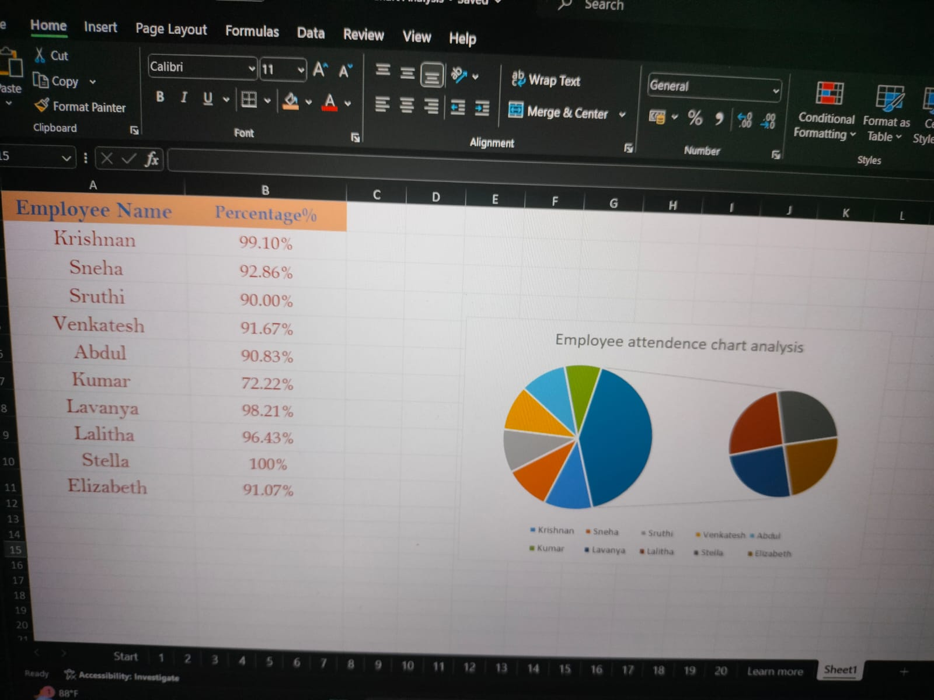
RESULTS
11

Slide 12
conclusion
Visualizing employee attendance trends with Excel charts allows for a straightforward analysis of attendance patterns over time. By leveraging Excel’s charting tools, such as line graphs or bar charts, you can effectively track key metrics, identify trends, and spot any anomalies in attendance data. This visual approach simplifies complex data, making it easier to interpret and use for informed decision-making. Consequently, it enhances workforce management by providing clear insights into attendance behaviors and helping forecast future staffing needs.

