Slide 1


Slide 2

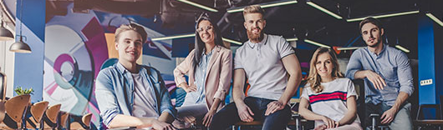
TAKING YOUR BRAND TO NEW HEIGHTS Logo Aspire is a creative digital agency, having years of experience, over 100 in-house production unit and 7000+ satisfied clients around the globe. Logo Aspire is comprised of some of the most talented, skilled and experienced professionals from the industry. Our dedication, work ethics, quality of deliverables, market competitive pricing, fast turnaround timelines and 24/7 support after project deployment are some of the factors that make us stand out from our competitors. The purpose of this digital marketing proposal is to provide you with the information about the various digital marketing services we offer, along with information and pricing for a custom digital marketing solution based on your needs. Based on our previous discussion, We feel like we are a good fit for one another. Our team is excited to get to work helping you reach your marketing goals. Once you’re happy with the services and prices for your custom digital marketing solutions, go ahead and e-sign at the bottom of this proposal and we’ll move forward from there! Regards, Team Logo Aspire

Slide 3

ABOUT Logo Aspire
Logo Aspire is a digital branding company that has years of experience, We are proud of creating some of the most well-renowned brands that list up among the top 500 companies.
We provide innovative marketing solutions for start-ups, small, medium and large scale businesses globally. Our team has expertise in marketing and designing creative brand identities with professionally managed services, unique designs, well planned strategies and in depth market research. We have the marketing expertise that you don’t, and we do it all for a flat monthly rate. You can focus on what you do best and we’ll focus on bringing you more qualified leads. Over the past decade, we have executed thousands of projects, websites, logo designs, search engine optimization, social media marketing, branding, and have closed more than hundreds of thousands of dollars in lead generation and conversion. Design Vocals has years of experience and already works with some of the USA's biggest brands and now you can benefit from the same expertise.

Slide 4

CONFIDENTIALITY NOTE
Logo Aspire is a creative digital agency comprising of some of the most talented, skilled, and experienced developers and designers in the industry. Our dedication, work ethics, quality of deliverables, market competitive pricing, fast turn-around times, quick timelines, and extended support post-project deployment & support are just some of the factors that make us stand out from the rest.
This document outlines our mutual agreement on the following: Nothing presented in this document or pertaining to the project shall be disclosed to any third person or entity without the consent of the client.
Neither party will, without prior approval of the other party, use any information in parts or on its whole or otherwise disclose the existence of the terms of this Agreement.
We present this project scope as a start of a long-term relationship between both parties. If you have any queries, please feel free to contact us.

Slide 5








WHY CHOOSE US?
BRANDING SOLUTIONS TO UPLIFT YOUR BRAND
Our team of expert designer & developers focus on client & customer satisfaction as the ultimate goal for all our projects. This is one of the many reasons why our work is acclaimed and recognized around the world.
24/7 Customer Support
Goal Oriented Projects
100% Ownership Rights
Secure Money Back Guarantee
Recognized Team of Experts
Fastest Turnaround Time

Slide 6
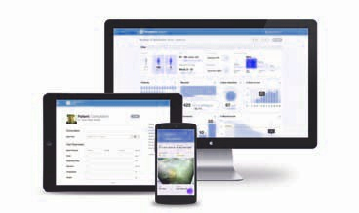
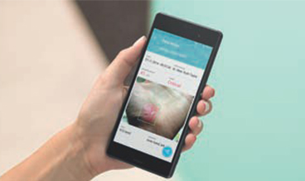
PROJECT SUMMARY & FEATURES
The scope of this project is to design and develop an interactive, responsive, easy-to-use, and aesthetically attractive Health/Support application for the users. The visitors get to register on the mobile app and then the registered users will be able to upload pictures of their wound(s) and the mobile app will be able to read the picture on the phone and operate with the color, size, depth of a wound, and diagnose accordingly.
The user will just need to take the picture of the wound and send it to the doctor via the application.
The primary purpose of the mobile application is to reduce the clinical compound so that people don’t have to visit the doctor. The doctor will inform the patient when they have to visit a clinic or a hospital if necessary.
The functionalities of the mobile application will be highly focused on AI-based technology and will be improved with time. The main functions of the app will include understanding/identifying the wound, whether it is a cut or a scratch, or a bump, the mobile application with AI-based technology will check the size, and depth of a wound to define its intensity.
Security Features like Facial-recognition during registration will be used for both the patients and the doctors.
Each picture of the wound will be scanned and analyzed by the application and will be sent to doctors so they’ll know what they’re about to deal with, and how to treat it.

Slide 7
PROJECT DELIVERABLES
UI/UX
Custom Application Designs will be provided according to the flow of the app.
Color theme will be determined, which will compliment the logo of the mobile app.
Color theme will be decided as per client’s approval.
Interactive and engaging animations.
Registration & Account Area for The Users
Users will signup on the application, no features can be used of the app without signing up.
They will have to provide all the required details in the form, including their past medical history/records.
Once the user has signed up successfully on the application with the registered credentials/facial recognition/Biometric verification. They can start using the mobile application features.
Forget/Reset Password
Users will be able to request a new password in case they forget their current password or if their facial recognition/biometric scan feature is not working.
A link to reset the password will be sent to the client
Manage Profile
Users can edit/delete their account on request.
Users will be able to view their history/records and be able to upload profile pictures as well.
Medical/Results History
Users will be able to view the list of their previous history and records.

Slide 8
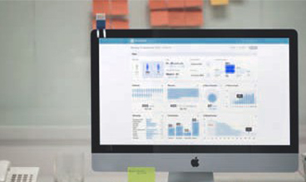
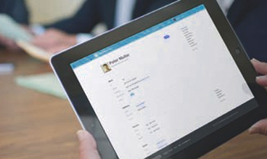
PROJECT DELIVERABLES
Admin Panel
Admin will be able to view all the registered users & doctors registered on the application.
Admin will be able to view all the details of the registered users/doctors.
Admin will be able to remove/ban a user from using the application.
Admin will be able to view all the medical records and results of each user.
Admin will be able to see the total number of active users, using the mobile application.
Online Dashboard
We will make it easy for you to access and manage your team and all your patients from any location in a simple-to-use online dashboard. Optimized for use on Pc or tablet, the secure and clinician-based dashboard will show you a real-time breakdown of patients’ progress over time.
It will be used mostly by doctors to check the details of a picture sent from a patient using the mobile application.
And then track the treatment/progress of each patient accordingly.

Slide 9
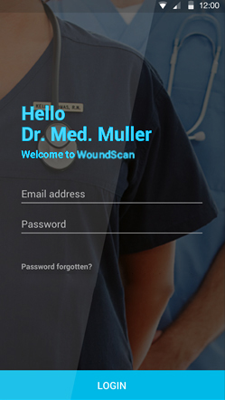
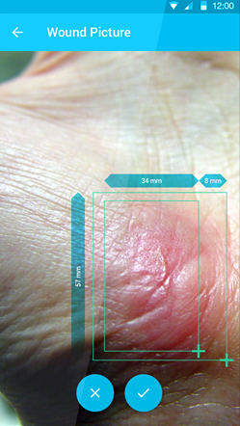
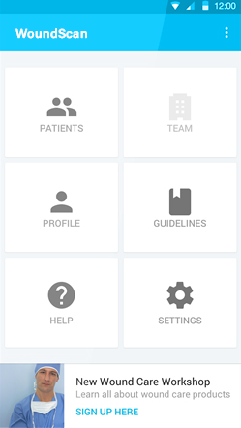
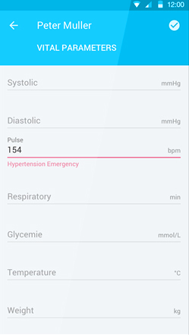
Initial Mock Screens

Slide 10
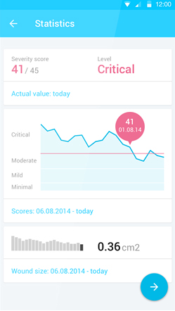
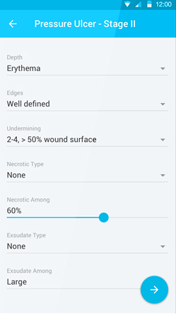
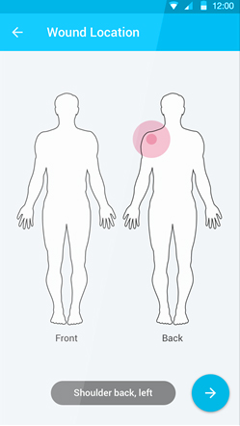
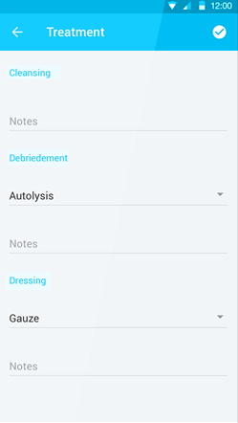
Initial Mock Screens

Slide 11
