Slide 1
Real/Fake
News Prediction
NLP CLASSIFICATION – P252
Internship - Project
By Excelr with AI Variant

Slide 2

Meet Our Team
P252-Group4
SYED SHAHID NAZEER
ROHIT MUKUND SHELAR
SUNNY HIRALAL DONGARE
Project Guide:
NEHA GUPTA from @Excelr team
SHRUTIN DILIP SALASKAR
SWEETY KUMARI
MANOJ KUMAR KUNA

Slide 3
CONTENTS
OBJECTIVES
ABSTRACT
PROJECT TIMELINE
PROJECT LIFECYCLE
INTRODUCTION
PROBLEM STATEMENT
SOLUTION OVERVIEW
APPROACH AND METHODOLOGY
LIMITATIONS
BENEFITS AND INSIGHTS
FUTURE ENHANCEMENTS
CONCLUSION
SYSTEM REQUIREMENTS

Slide 4
OBJECTIVES
This dataset consists of about 40000 articles consisting of fake as well as real news. Our aim is train our model so that it can correctly predict whether a given piece of news is real or fake. The fake and real news data is given in two separate datasets with each dataset consisting around 20000 articles each.
Business Objective:
Need to classify the fake and real news accurately.
Architecture level analysis:
Data transformation/Text processing using R/Python
Need to get sentiments Analysis and n-gram analysis with some charts like histogram, Density plot, barplot , pie-plot etc.
Deployment through R Shiny/Flask/Streamlit.

Slide 5
ABSTRACT
Ever wonder if a news article is real or fake? Ever wonder how to recognize real news from fake news?
The spread of fake news is a major problem in society today and detecting such fake news is vital. How can we detect fake news you ask? With machine learning The effects of fake news on social media can be Destabilizing. - Fake news can be used to sow discord and division among people, and to undermine trust in institutions. Harmful. - Fake news can have a negative impact on people's health, finances, and safety. For example, fake news about the COVID-19 pandemic has led to people refusing to get vaccinated, which has put them at risk of getting sick. Dangerous. - In some cases, fake news has been used to incite violence or hatred. For example, in India, fake news stories about religious minorities have led to mob violence.
Thus, for purposes of detecting fake news from real news, we used ML algorithms to help predict fake news from real news. Join us on this journey to help identify fake news.

Slide 6
PROJECT TIMELINE
EDA
Word Count
Data Cleaning
N-grams
Data Redundancy
Model Evaluation
Null Values
Model Selection
Duplicate Values
Feedback
week1
week2
week3
week4
week5
Project Kickoff Meeting
Presentation
Model Building
Objective Discussion
Portfolio
Pipeline Creation
Dataset Details
Simple Portfolio
Deployment
Modern Portfolio
Testing
Presentation
Presentation

Slide 7
PROJECT LIFECYCLE
DATA VISUALIZATION
VECTORIZER SELETION
DEPLOYMENT
Word Cloud,
Bar Chart,
Pie Chart,
Box Plot.
Word2vec,
Countvectorizer ,
TF_IDF.
Using Flask For Deploying Our NLP CLASSIFICATION APPLICATION.
DATA CLEANING
N-GRAM SELECTION
PIPELINE CREATION
Duplicate Values,
Null Values,.
UNI-Gram,
BI-Gram,
TRI-Gram.
Logistic Regression,
Decision Trees,
Naïve Bayes.

Slide 8
INTRODUCTION
Welcome, everyone! Today, I'm thrilled to introduce "FactDetective," an innovative application dedicated to unraveling truth and deciphering fact from fiction. In an era dominated by misinformation, FactDetective utilizes cutting-edge technologies like Natural Language Processing (NLP) and machine learning to uncover the authenticity of information. By employing sophisticated algorithms and intelligent text analysis, FactDetective equips users with the tools to make informed decisions based on verified facts. With its intuitive interface and powerful features, FactDetective empowers individuals to navigate the vast realm of information with clarity and confidence. Thank you for joining us, and get ready to embark on a truth-seeking mission with FactDetective.

Slide 9
PROBLEM STATEMENT
The rise of social media and digital platforms has made it increasingly challenging to distinguish truth from fiction.
Misinformation can have severe consequences, leading to the spread of falsehoods, erosion of trust, and social polarization.
The rapid dissemination of news articles on various platforms has increased the risk of misinformation and fake news.
Our objective is to develop a web application that can classify news articles, providing users with a tool to assess the credibility and potential bias of the information they encounter.

Slide 10
SOLUTION OVERVIEW
FactDetective is the answer to this pressing need. It leverages advanced technologies like Natural Language Processing (NLP) and machine learning to uncover the truth and detect misinformation.
Our web application harnesses the power of intelligent algorithms and linguistic analysis to analyze textual information, enabling users to verify the authenticity and credibility of news articles, social media posts, and other online content.

Slide 11
APPROACH AND METHODOLOGY
We have implemented a multi-step approach for our NLP News Analyzer,Data Collection, Gathered a diverse dataset of news articles spanning different sources and topics.
Preprocessing: Cleaned and processed the text data, including techniques like tokenization, stopword removal, and lemmatization.
Feature Extraction: Utilized TF-IDF vectorization to convert the text into numerical features for model training and prediction.
Model Training: Employed logistic regression, a powerful classification algorithm, to train our model on labeled data.
Flask Web Application: Built an interactive web app using Flask to make the model accessible to users.

Slide 12
LIMITATIONS
It's important to acknowledge that news is a dynamic domain, and the limitations of our logistic regression model include, Evolving Language, News articles often include new or trending terms, which may not be adequately captured by the model's existing vocabulary.
Contextual Bias: The model may struggle to account for subtle contextual nuances and potential bias that can emerge from current events or changing societal dynamics.
Data Timeframe: The model's training data may not include the most recent news articles, potentially impacting its accuracy in classifying current news content

Slide 13
BENEFITS AND INSIGHTS
Despite the limitations, the NLP News Analyzer offers several benefits and insights, Increased Awareness, Users gain awareness about potential bias, credibility, and sentiment associated with news articles.
Enhanced Critical Thinking: The tool encourages users to approach news content with a critical mindset, making more informed judgments.
Analytical Support: Users can access valuable insights to aid their decision-making processes based on the classification results

Slide 14
FUTURE ENHANCEMENTS
To address the limitations and improve the NLP News Analyzer, future enhancements may include Continual Model Training, Regularly updating the model with the latest labeled data to adapt to evolving language and contextual biases.
Real-time Data Integration: Incorporating real-time data sources to capture the most recent news articles and enhance the model's accuracy.
Advanced NLP Techniques: Exploring advanced NLP techniques, such as deep learning models or ensemble methods, to improve classification performance.

Slide 15
CONCLUSION
Our NLP News Analyzer is an important step towards empowering users to critically assess news articles and make informed decisions.
While acknowledging the limitations, we remain committed to continually improving the model and web application to provide a more comprehensive and reliable news analysis tool.

Slide 16
SYSTEM REQUIREMENTS
HARD DISK
OPERATING SYSTEM
IDE
EMPTY SPACE UPTO 1GB.
WINDOWS 10/11.
VISUAL STUDIO CODE,
ANACONDA SPYDER
RAM
PROCESSOR
WEB BROWSER
Minimum : 8GB
Maximum : 16GB
INTEL i5,i7,i9
AMD RYZEN 5,7,9.
CHROME,
MICROSOFT EDGE.

Slide 17
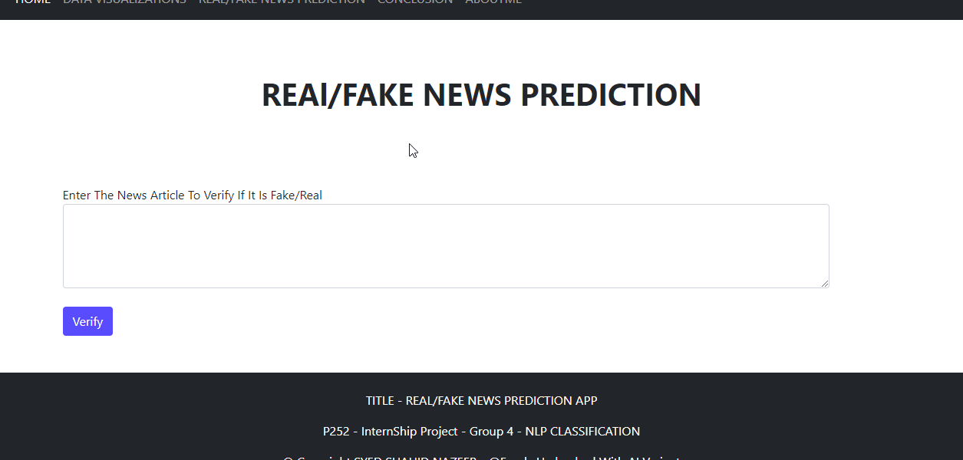
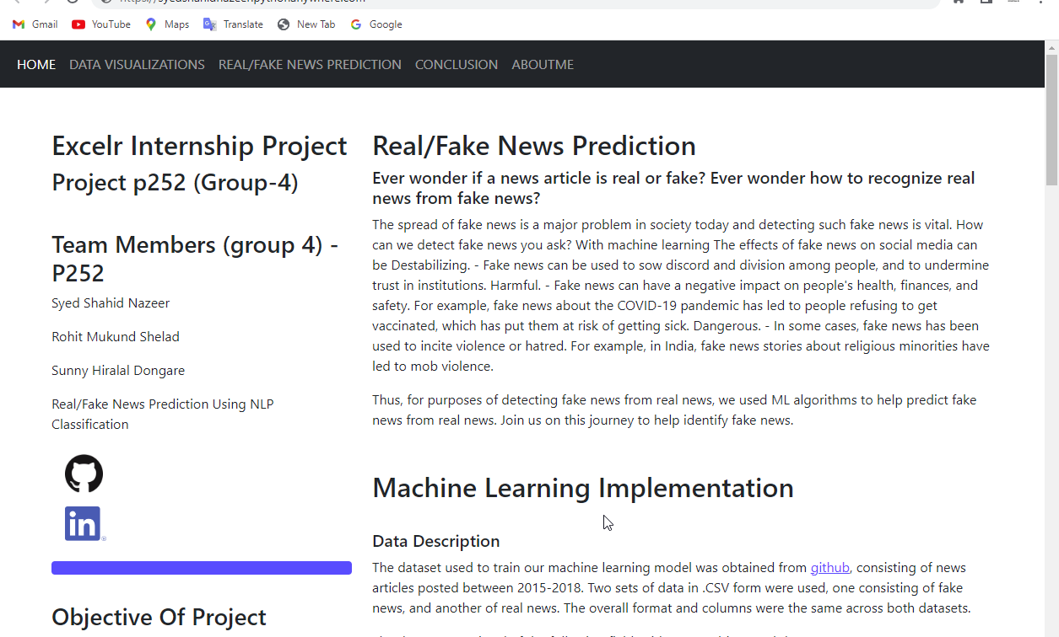
FLASK WEB APP-
FakeDetective
HOME PAGE
DATA VISUALIIZATIONS
REAL/FAKE NEWS PREDICTION
CONCLUSION
ABOUTME

Slide 18
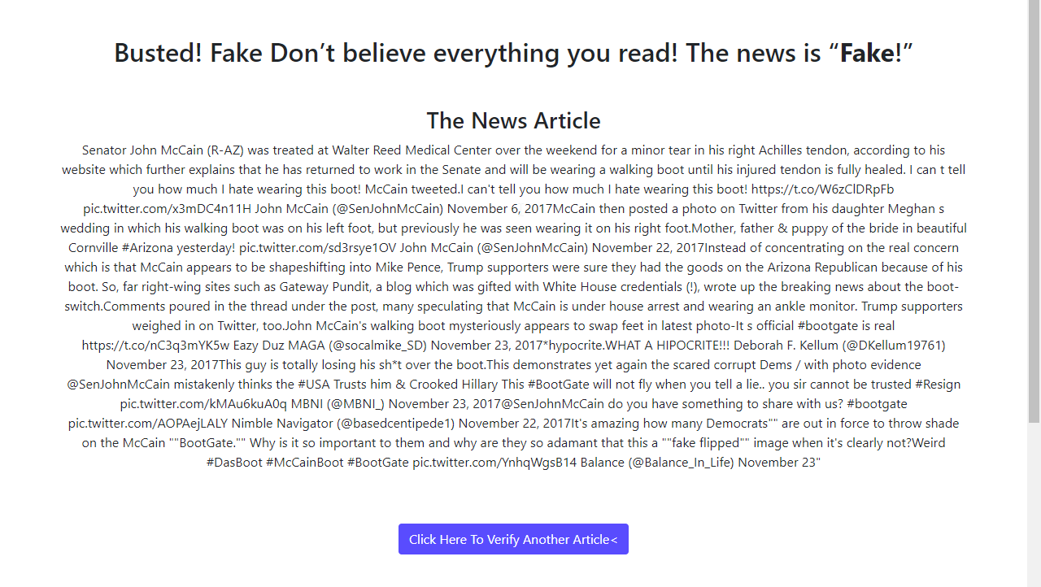
PREDICTION SAMPLES –FAKE NEWS

Slide 19
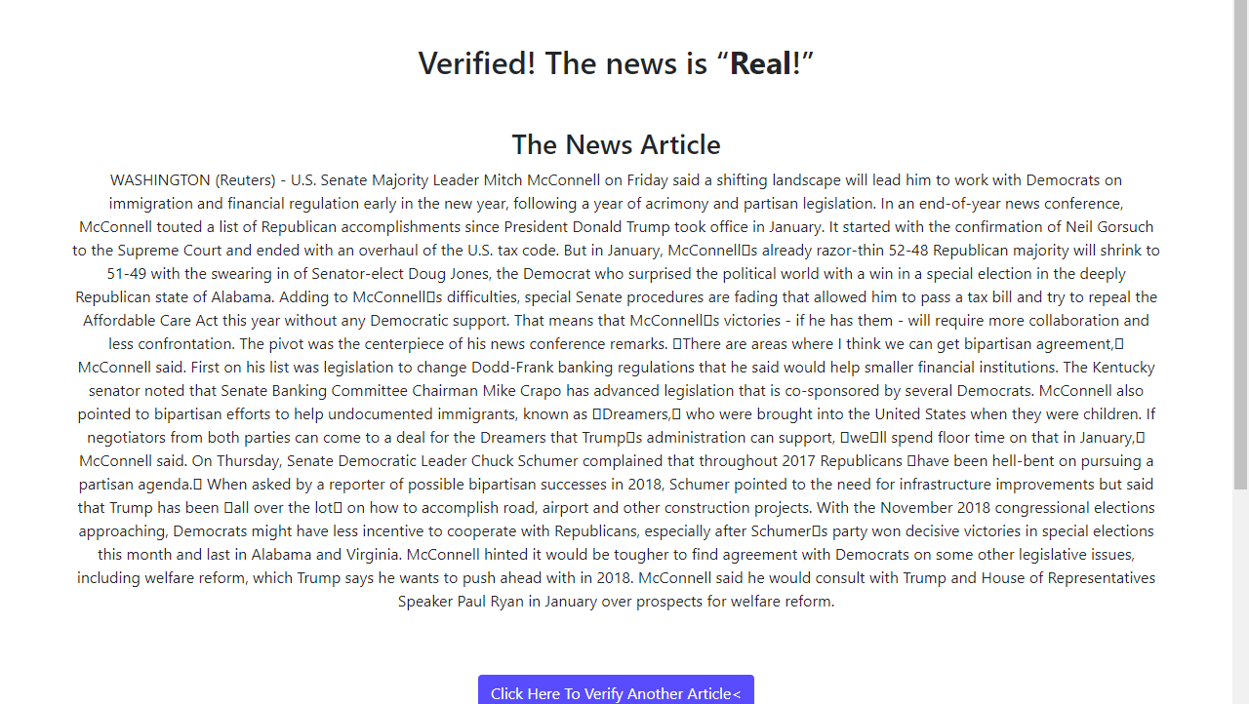
PREDICTION SAMPLES –REAL NEWS

Slide 20
THANK YOU
YOUR’S HONESTLY SYED SHAHID NAZEER
Looking forward to further conversations and collaborations.

