Slide 1
Computer Architecture
Instructions

Slide 2
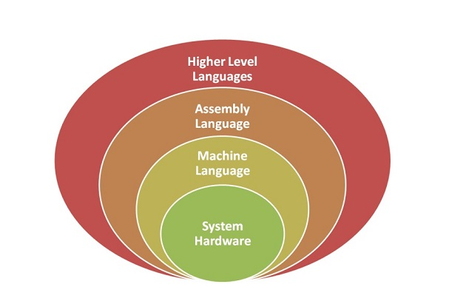
Hierarchy of Computer Languages

Slide 3
Instruction Codes
Program
A program is a set of instructions that specify the operations, operands and the sequence by which processing has to occur.
Computer Instruction
A computer instruction is a binary code that specifies a sequence of micro-operations for the computer.
The computer reads each instruction from memory and places it in a control register.
The control then interprets the binary code of the instruction and proceeds to execute it by issuing a sequence of micro-operations.
Instruction Code
An instruction code is a group of bits that instruct the computer to perform a specific operation.
Example
Operation Code (Opcode)
The operation code of an instruction is a group of bits that define such operations as add, subtract, multiply, shift, and complement.
The number of bits required for the operation code of an instruction depends on the total number of operations available in the computer.
The operation code must consist of at least n bits for a given 2^{n} (or less) distinct operations.
ADD 1547
Unique Binary code is assigned to every Opcode

Slide 4
Stored Program Organization
Memory
4096 x 16
15
12
11
0
Opcode
Address
Instructions
(program)
Instruction Format
Operand
(data)
15
0
Binary Operand
Opcode: Specifies the type of operation to be performed.
Operand: Provides information on the data needed for the instruction execution.
Processor Register (accumulator or AC)

Slide 5
Stored Program Organization
The simplest way to organize a computer is to have one processor register(AC) and an instruction code format with two parts.
The first part specifies the operation (opcode) to be performed and the second specifies an address (operand).
The memory address tells the control where to find an operand in memory.
This operand is read from memory and used as the data to be operated on together with the data stored in the processor register.
Instructions are stored in one section of memory and data in another.
For a memory unit with 4096 words, we need 12 bits to specify an address since 2¹² = 4096.
If we store each instruction code in one 16-bit memory word, we have available four bits for operation code (opcode) to specify one out of 16 possible operations, and 12 bits to specify the address of an operand.
The control reads a 16-bit instruction from the program portion of memory.
It then executes the operation specified by the operation code.

Slide 6
Instruction: The words of a computer language is called instruction
Instruction set : The vocabulary of computer language is called instruction set.
Goal of the computer designer:
To find a language that makes it easy to build the hardware and compiler while maximizing performance and minimizing cost.

Slide 7
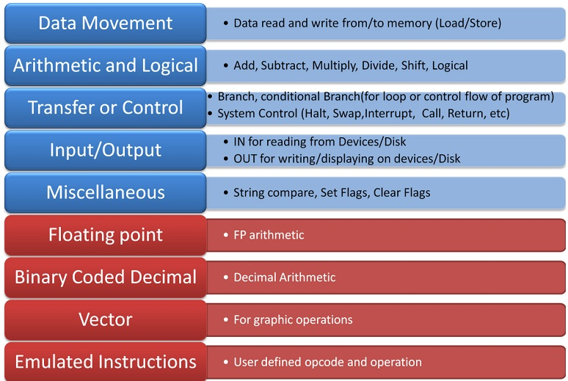
Instruction Set Classification

Slide 8
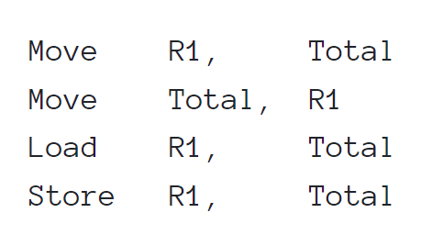
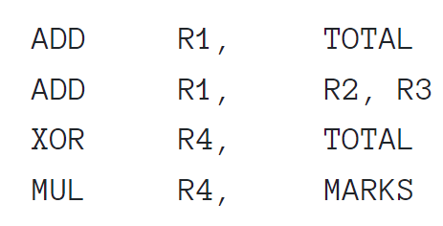
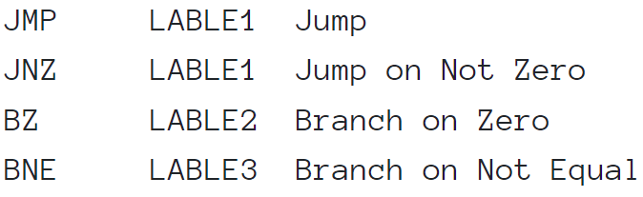
Data Movement Instructions: These support movement of data between registers, registers to memory, memory to register.
Arithmetic and Logical Instructions: This category of instructions carry out calculations. The minimum in this category is ADD, SUB, AND, OR, XOR, SHIFT. Multiply and Divide can always be emulated using successive addition or subtraction.
Transfer or Control Instructions: This category of instructions facilitate change in program flow described by the control structures in the high-level language. BRANCH or JMP instructions along with Condition Code flags achieve the requirement. Subroutine CALLS, RETURNS are categorized here.

Slide 9
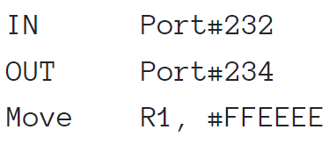
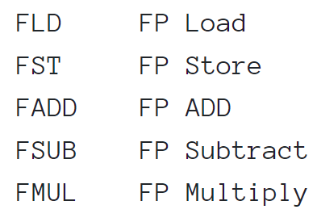
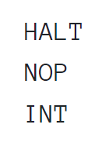
Input/Output Instructions: There are two ways of doing Input/Output operations.
Miscellaneous Instructions: NOP (No Operation) is a famous dummy instruction but a very useful one in this category. The NOP instruction does nothing, effectively consuming one clock cycle without performing any action.
Floating Point Instructions: We had seen in the previous chapter that specialised hardware is required for efficient Floating-point operations.
Binary Coded Decimal Instructions: Decimal Number system hardware speeds up decimal calculations.

Slide 10
CPU architecture design radically differs based on the size of the Instruction set. Accordingly, there are two categories namely Reduced Instruction Set Computer (RISC) and Complex Instruction Set Computer (CISC). As the name implies, RISC has

Slide 11
Instruction Formats and Classification
The components to be considered while deciding and designing instruction format is:
The number of instructions in the instruction set
The number of CPU registers to be addressed
Size of Main memory to be addressed and organization
Addressing modes to be mapped
Encoding of Instructions is called Instruction Format. There are two generic ways to encode instructions.
Fixed length Instruction Format - RISC uses fixed-length encoding.
Variable Length Instruction Format - CISC uses variable-length encoding.

Slide 12
Variable Length Instruction format(CISC)
Fixed Length Instruction format(RISK)
Each instruction occupies only the space required by it to convey the operands. No redundant use of memory space.
Essentially this format provides more options to address more operands.
Calculating the next instruction location is complex and depends on the current instruction type.
The fetch and decode logic and Control Unit design is complex.
Code efficiency is possible, but frequent memory reference implies relatively reduced efficiency.
A Large number of instructions have different opcodes but same function, implying varying addressing modes.
Each Instruction occupies the same amount of space. The length of the instruction is fixed irrespective of the opcode.
The instruction fetch process is simpler. The next instruction address is obtained by incrementing the Program Counter by a fixed count.
The instruction decoding process is also simpler and hence the Control Unit design is less complex comparing variable-length format.
Faster and better performance, as the design, makes use of CPU Registers more effectively.
The program code (machine code) for these machines is longer and proportional to the number of instructions.
Few simple instructions equivalent to HALT, NOP which do not require any operand also occupies the same length and size of memory. A little waste of memory space at the cost of CPU efficiency.

Slide 13
RISC | CISC
Focus on software | Focus on hardware
Uses only Hardwired control unit | Uses both hardwired and microprogrammed control unit
Transistors are used for more registers | Transistors are used for storing complex Instructions
Fixed sized instructions | Variable sized instructions
Can perform only Register to Register Arithmetic operations | Can perform REG to REG or REG to MEM or MEM to MEM
Requires more number of registers | Requires less number of registers
Code size is large | Code size is small
An instruction executed in a single clock cycle | Instruction takes more than one clock cycle
An instruction fit in one word. | Instructions are larger than the size of one word
Simple and limited addressing modes. | Complex and more addressing modes.
RISC is Reduced Instruction Cycle. | CISC is Complex Instruction Cycle.
The number of instructions are less as compared to CISC. | The number of instructions are more as compared to RISC.
It consumes the low power. | It consumes more/high power.
RISC is highly pipelined. | CISC is less pipelined.
RISC required more RAM . | CISC required less RAM.
Here, Addressing modes are less. Smartphones, IoT devices, basic embedded tasks | Here, Addressing modes are more. Laptops, PCs, advanced embedded systems

Slide 14
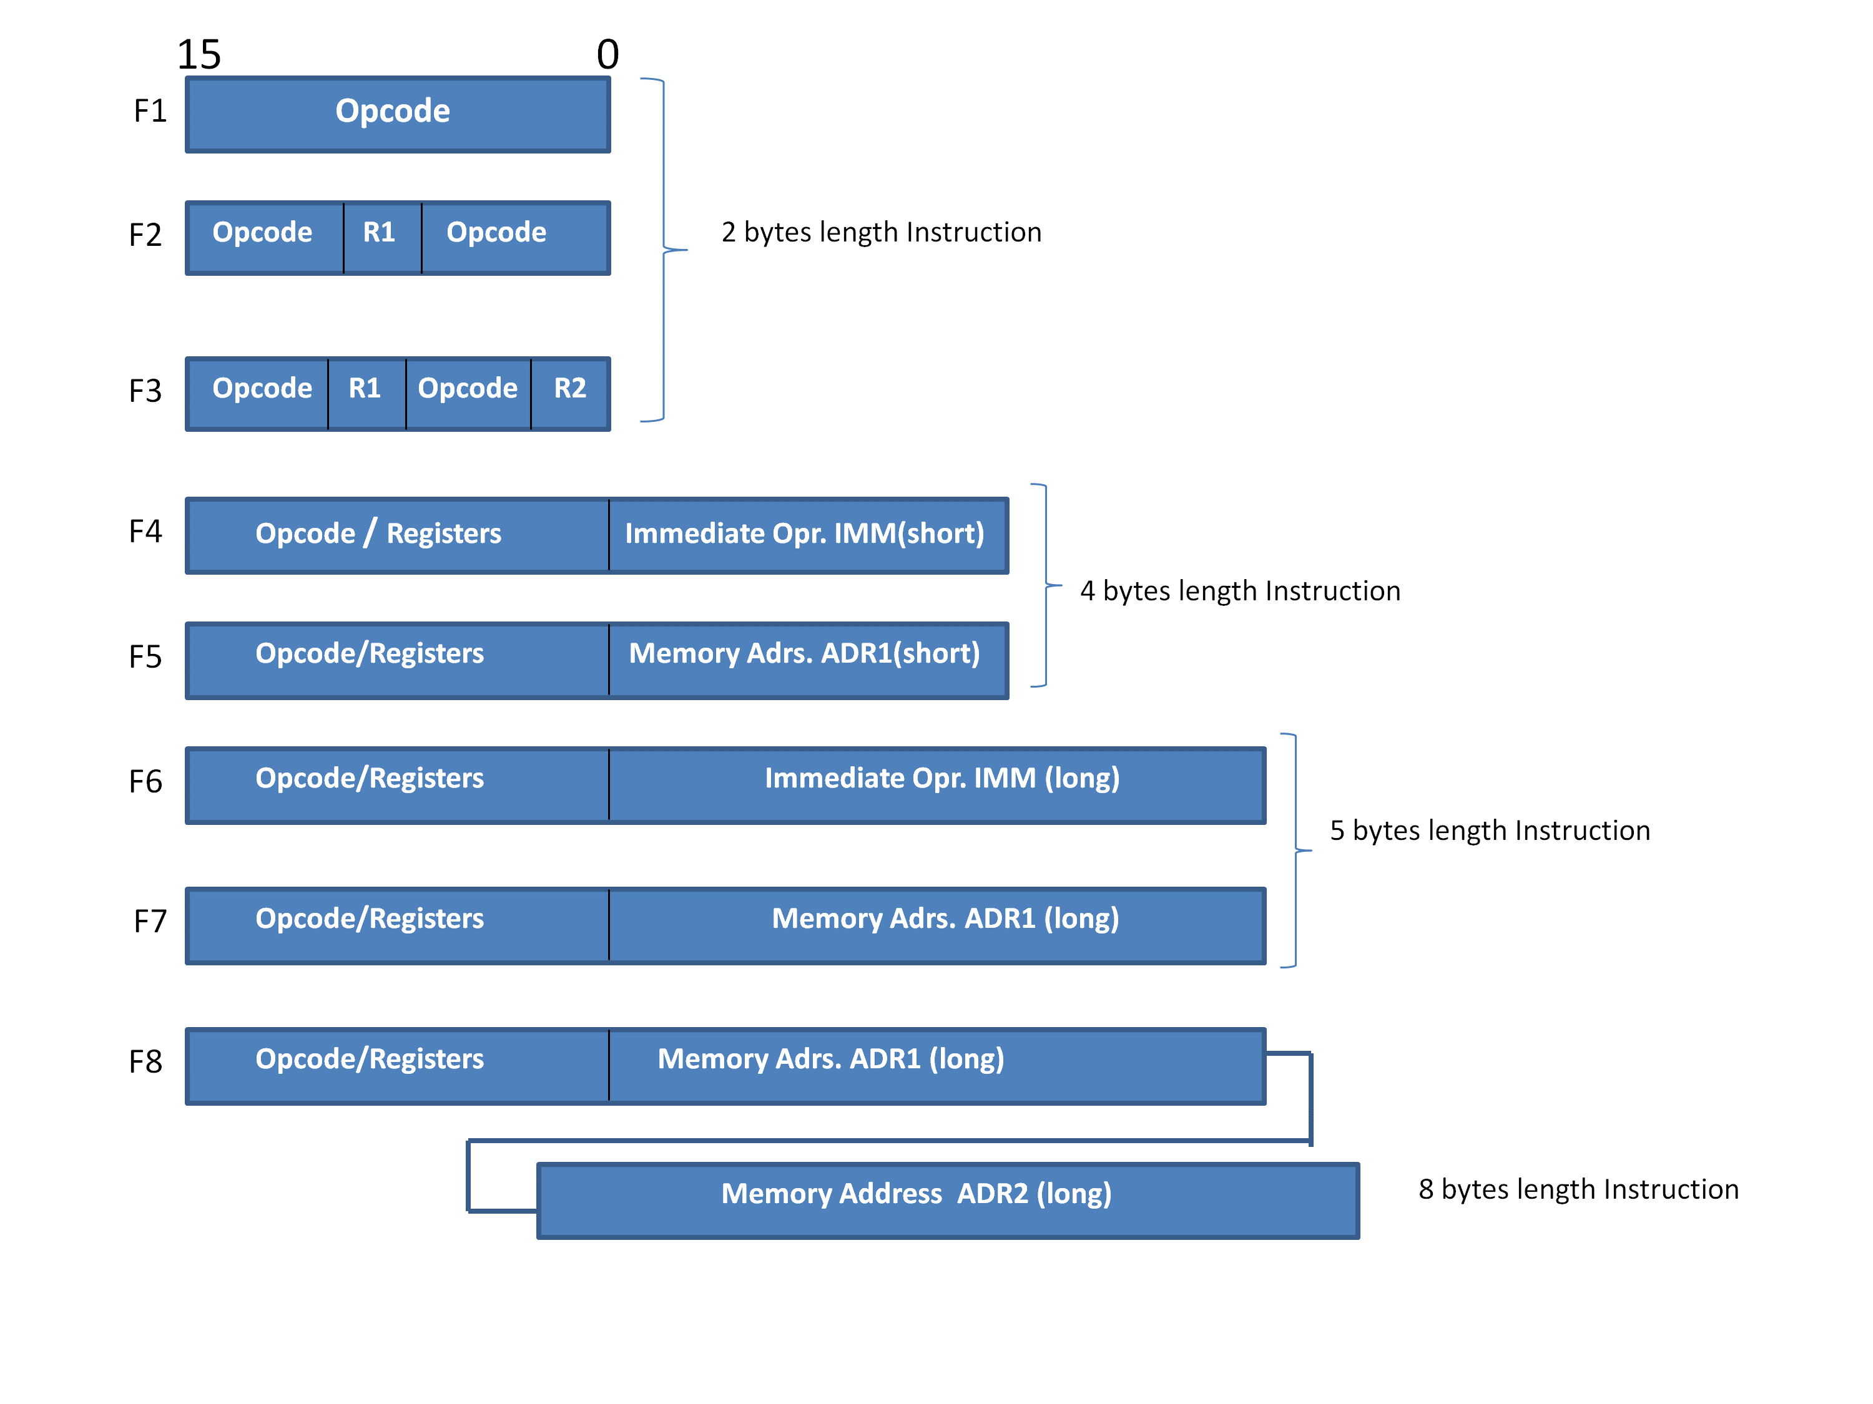
NOP / HALT
Variable Length Instruction format
LOAD R1
IMM = Immediate Operand
ADD R1,R2
ADD R1, #5
LOAD R1, [ADR1]
ADD R1, #123456
STORE R1, [ADR1]
MOV [ADR1], [ADR2]

Slide 15
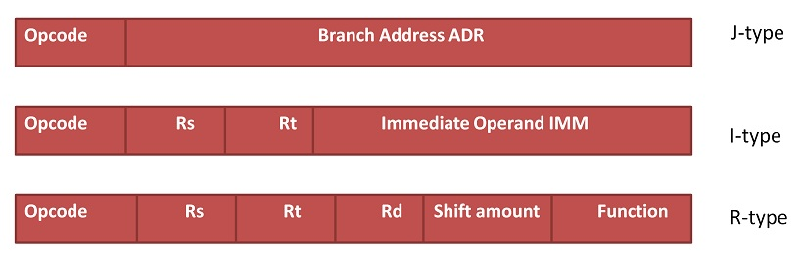
Fixed Length Instruction format
J LABEL: Jump to a specific memory address (LABEL).
ADDI R2, R1, 5
ADD R3, R1, R2
Rs (Source Register): Specifies the first source register.
Rt (Target Register): Specifies the destination register.
Rd (Destination Register): Specifies where the result is stored.
Shift Amount: Indicates how much a value should be shifted (used in shift operations).
Function: Specifies the exact operation (e.g., ADD, SUB).

Slide 16
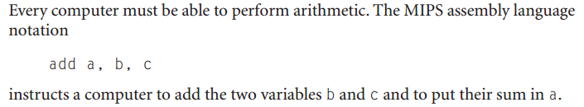
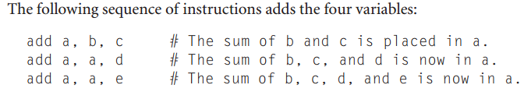
Operations of the computer hardware:
--per line one instruction
--must always have exactly three variables
MIPS (an acronym for Microprocessor without Interlocked Pipeline Stages) is a reduced instruction set computer (RISC) instruction set architecture (ISA) developed by MIPS Technologies (formerly MIPS Computer Systems)

Slide 17
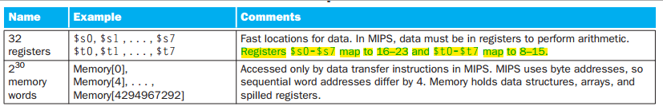
Operands of the computer hardware:
Memory is byte addressed – Each address identifies an 8-bit byte
Words are aligned in memory – Address must be a multiple of 4

Slide 18
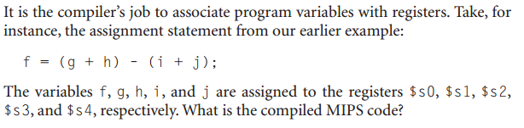

Answer:
$t0. $t1,…,$t9 for temporary data values
$s0,$s1,…,$s7 for saved variables
Word=32bit =4byte

Slide 19
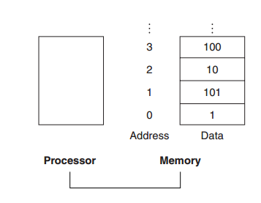
How computer hardware access large memory structure?
--- Data structures (array and structures) are used.
Data transfer instruction:
A command that moves data between memory and register
Memory to register = load
Register to memory = store

Slide 20

g=h + A[8]
Answer:
lw $t0, 8($s3) offset
base register
add $s1, $s2, $t0
Lw = load word
Suppose, g= $s1 h= $s2
Base address of A is $s3
Effective address = Base reg + Offset

Slide 21
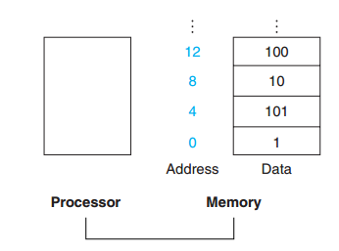
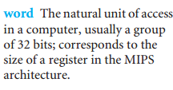
Alignment register:
Words must start at address that are multiples of 4.
Spilling register:
Process of putting less commonly used variable in a memory is called spilling register.

Slide 22
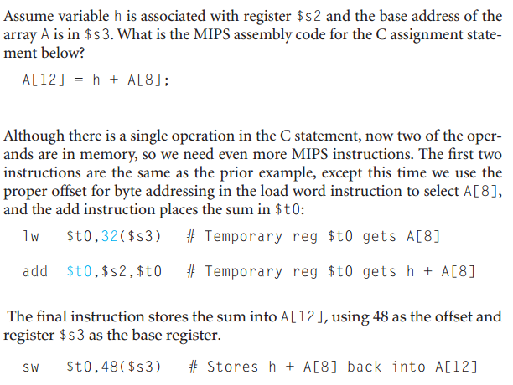

Slide 23
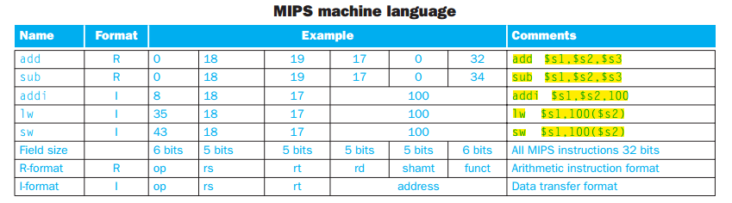
Representing Instructions in the computer:

Slide 24
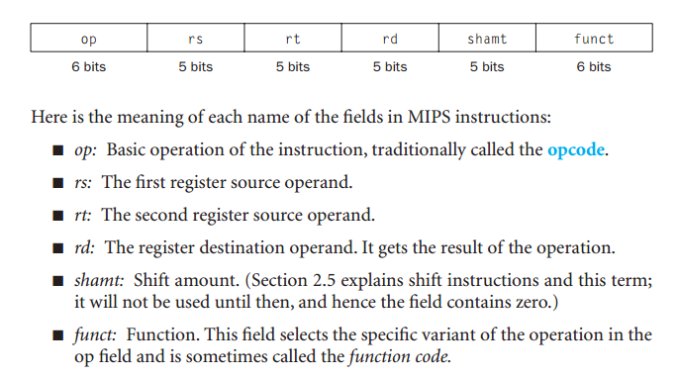
R-type:

Slide 25
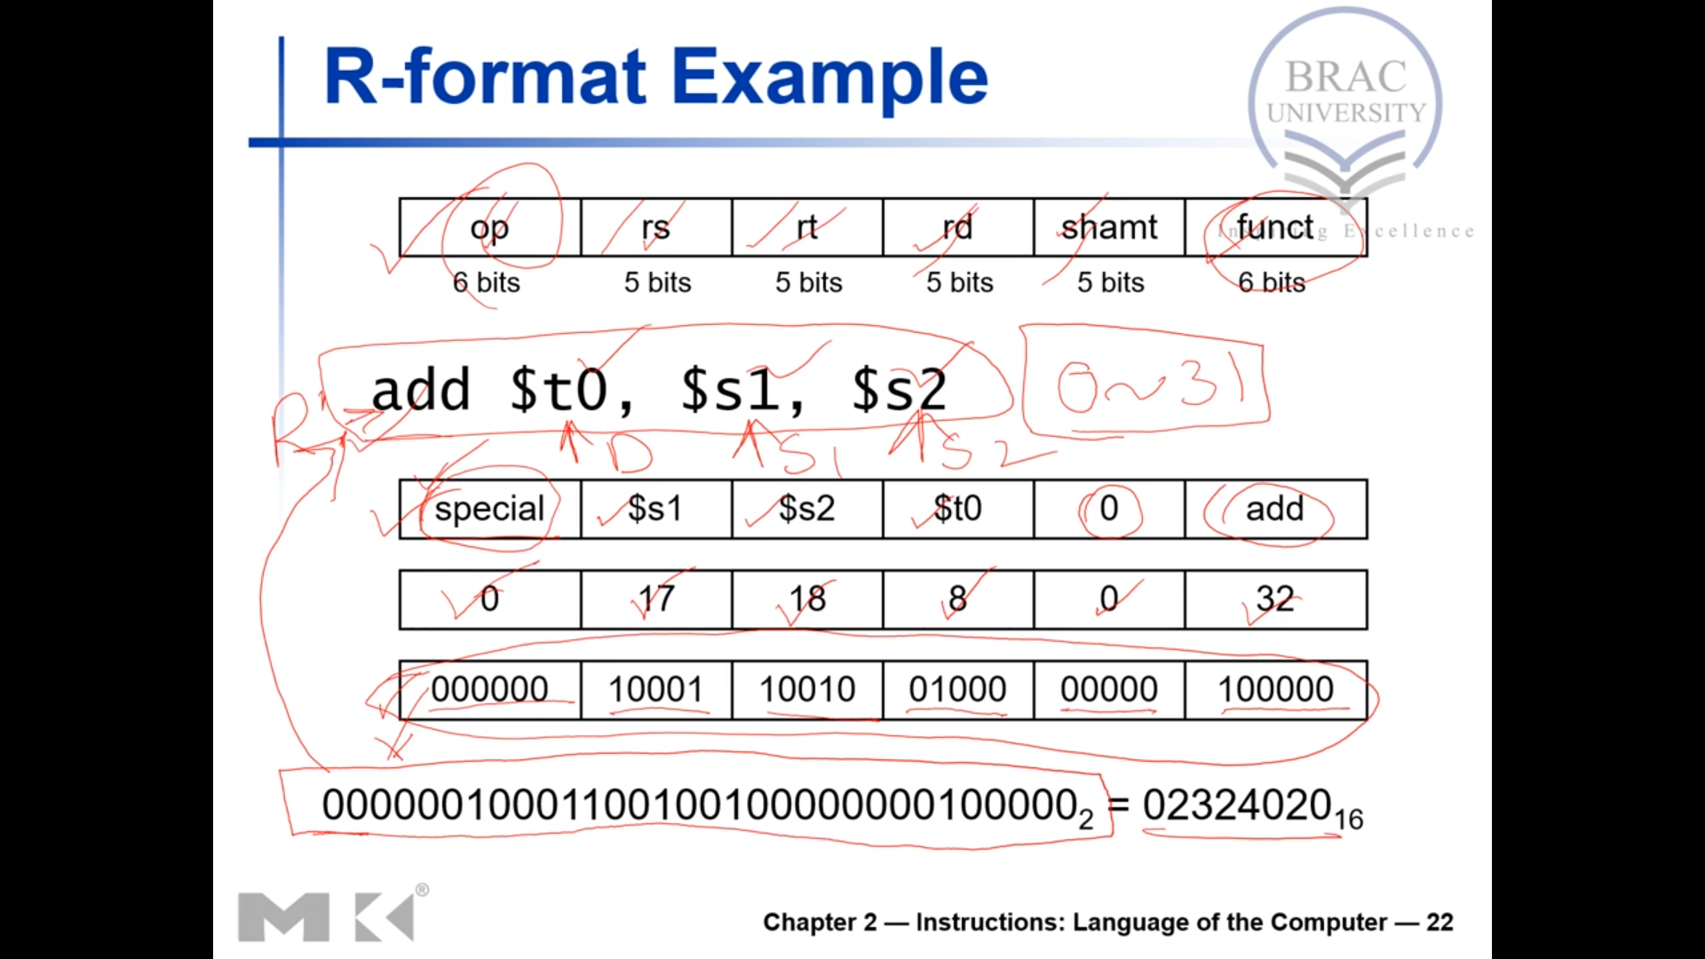
Example:
add $t0, $s1, $s2
op = 0
rd= $t0 = 8
rs= $s1 = 17
rt= $s2 = 18
Shmt = 0
Funct = 32
0 | 17 | 18 | 8 | 0 | 32
000000 | 10001 | 10010 | 0100 | 000000 | 100000

Slide 26

I – format :
Example:
lw $t0, 32($s1)
j- type:
Opcode=2
Address=given address/4;
35 | 17 | 8 | 32
Opcode (6 bits): The operation being performed is lw (load word), which has an opcode of 100011 in binary.
Rs (5 bits): (Source Reg) The base register used for the memory address is $s1. $s1 is register 17 in MIPS register encoding (binary: 10001).
Rt (5 bits): The destination register is $t0, which will store the loaded word. $t0 is register 8 in MIPS register encoding (binary: 01000).
Immediate (16 bits): The immediate value is 32, which is the offset added to the base address stored in $s1. In binary, 32 is represented as 0000 0000 0010 0000 (16 bits).
binary representation of lw $t0, 32($s1) is:
100011 10001 01000 0000 0000 0010 0000

Slide 27
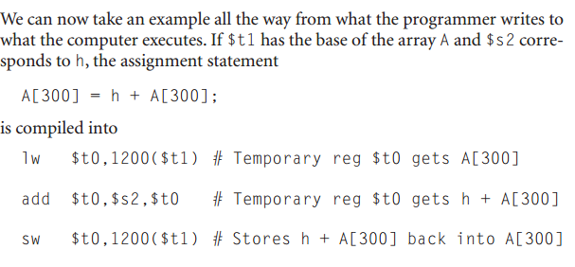
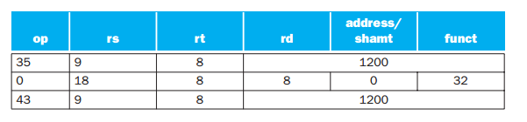

Slide 28
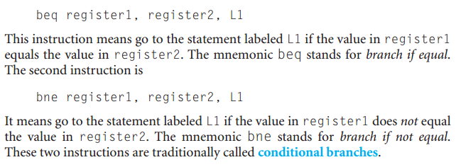
Decision making statement:

Slide 29
if ( i==j) go to L1;
f = g+h;
L1: f=f-i;
Convert this into MIPS assembly code.
Answer :
f= $s0, g= $s1, h= $s2, i= $s3, j= $s4
beq $s3, $s4, L1
add $s0, $s1, $s2
L1: sub $s0, $s0, $s3

Slide 30
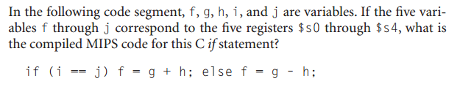
Answer:
bne $s3, $s4, ELSE
add $s0, $s1, $s2
j EXIT [j means jump to exit]
ELSE:
sub $s0, $s1, $s2
EXIT
N.B: use jump in case of if… else

Slide 31
Loop: g= g + A[i]
i=i+j
If (i!=h) go to LOOP.
What will be the MIPS assemble code?
Answer:
g=$s1, h=$s2, i=$s3, j=$s4, A=$s5
Loop:
add $t1, $s3, $s3 //$t1 = 2*i
add $t1, $t1, $t1 //$t1 = 4*I In MIPS, the size of each word (array element) is 4 bytes. Thus, multiplying the index i by 4 gives the byte offset for A[i].
add $t1, $t1, $s5 // $t1= address of A[i] = (4*i + $s5)
lw $t0, 0($t1) // used that address to load A[i] into a temporary register
add $s1, $s1, $t0 //g= g+A[i]
add $s3, $s3, $s4 // i=i+j
bne $s3, $s4, LOOP
Rule for getting address of an array:
1.Multiply the index I by 4
2. Add with the base of array

Slide 32
while (save[i] = k )
i= i+j
what will be the MIPS assembly code for this?
Answer:
i=$s3, j=$s4, k=$s5, save = $s6
LOOP:
add $t1, $s3, $s3 //$t1 = 2*i
add $t1, $t1, $t1 //$t1 = 4*i
add $t1, $t1, $s6 //$t1 = address of save[i] = (4*i + $s6)
lw $t0, 0($t1)
bne $t0, $s5, EXIT
add $s3, $s3, $s4
j LOOP
EXIT

Slide 33
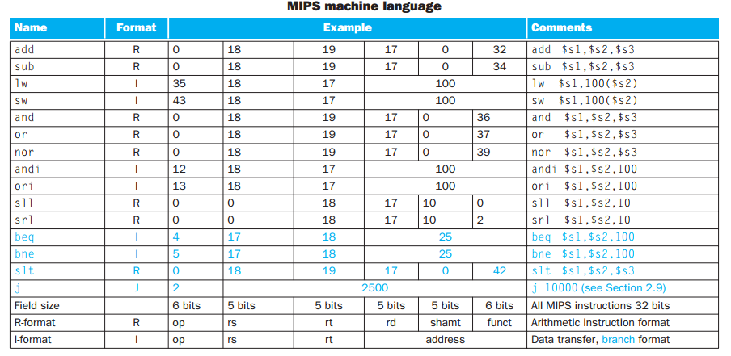

Slide 34
Slt = set if less than
Blt = branch if less than
What is the code to test if variable a (=$s0) is less than variable b (=$s1) and then branch to label LESS if the condition holds?
Answer:
Solution1:
slt $t0, $s0, $s1
bne $t0, $zero, LESS
Solution 2:
blt $s0, $s1, LESS # Branch to LESS if $s0 < $s1
LESS:
# Code to execute if $s0 < $s1
Solution 1 explanation: Uses a temporary variable to check if the condition is true/false
If $s0 < $s1
$t0=1
If $s0 > $s1
$t0=0

Slide 35
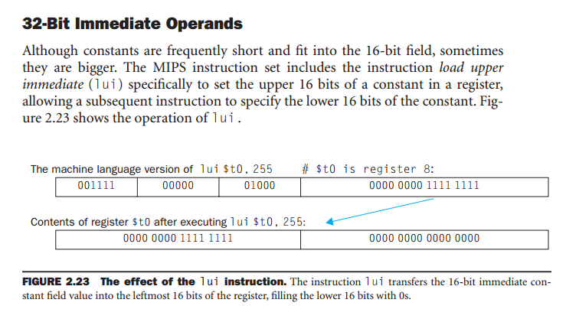
Ori = Bitwise or immediate

Slide 36
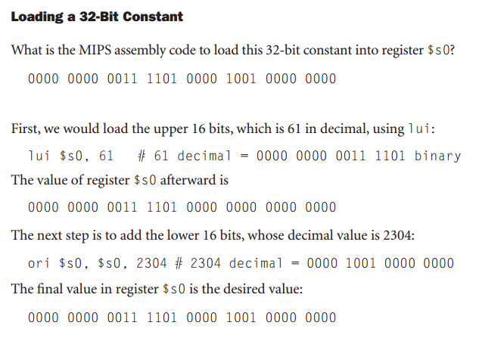

Slide 37
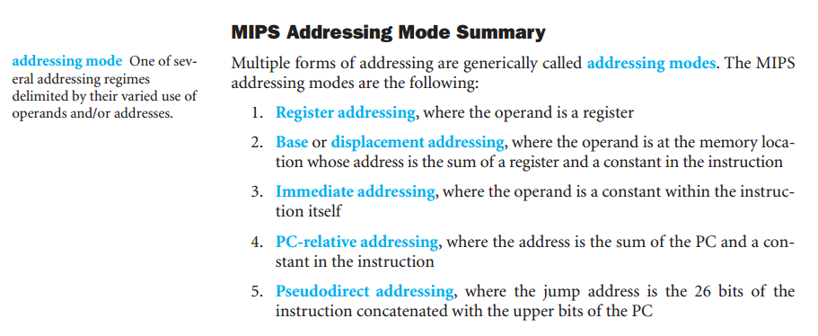

Slide 38
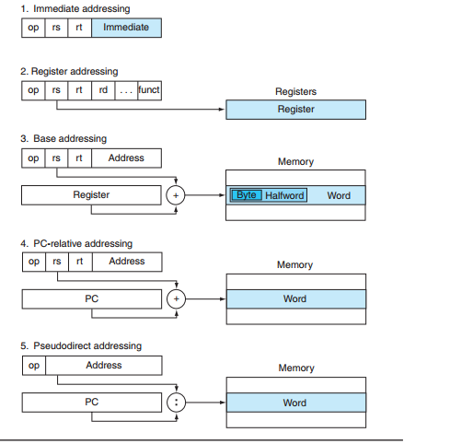
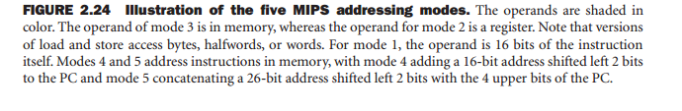

Slide 39
Register Addressing:
Register Addressing is a source or destination operand is specified as content of one of the registers.
Register Addressing is considered the simplest addressing mode. This is because both operands are in a register.
Which allow instructions to be executed much more faster in comparison with other addressing modes because they does not involves with memory access.
The number of registers is limited since only a few bits are reserved to select a register.
Register Addressing is a form of direct addressing , this is because we are only interested in the number in the register , rather than using that number as a memory address.
Here's an example of Register Addressing : add $s1 , $s2 , $s3 also means that $s1 ←$s2 + $s3
where ; $s1 = rd
$s2 = rs
$s3 = rt

Slide 40
Immediate Addressing:
Immediate Addressing is a numeric value embedded in the instruction in the actual operand.
In immediate addressing , the operand is a constant within the encoded instruction.
Immediate addressing has the advantage of not requiring an extra memory access to fetch the operand , hence will be executed faster. However , the size of operand is limited to 16 bits.
The jump instruction format also falls under immediate addressing , where the destination is held in the instruction.
Now an example of Immediate Addressing :
addi $t1 , $zero , 1 means $t1 ← 0 + 1
(add immediate , uses the I-type format)
where ; $t1 = rd
$zero = r1
1 = immediate value

Slide 41
Base Addressing:
Base Addressing is a data or instruction memory location is specified as a signed offset from a register.
Base addressing is also known as indirect addressing , where a register act as a pointer to an operand located at the memory location whose address is in the register.
The register is called base that may point to a structure or some other collection of data and immediate value is loaded at a constant offset from the beginning of the structure. The offset specifies how far the location of the operand data from the memory location pointed by the base.
The address of the operand is the sum of the offset value and the base value(rsHere's an example for Base Addressing :
Instruction : lw $t1 , 4 ($t2)
where $t1 = rs
$t2 = base (memory address)
4 = offset value
Thus ; $t1 = Memory [$t2 +4]

Slide 42
PC-Relative Addressing:
PC-Relative Addressing also known as Program Counter Addressing is a data or instruction memory location is specified as an offset relative to the incremented PC.
PC-relative addressing is usually used in conditional branches. PC refers to special purpose register , Program Counter that stores the address of next instruction to be fetched.
The effective address is the sum of the Program Counter and offset value in the instruction. The effective address determines the branch target.
In PC-relative addressing , the offset value can be an immediate value or an interpreted label value.
Another word of saying to explain PC-Relative Addressing :
The operand address = PC + an offset
Example: bne $10, $11, ELSE

Slide 43
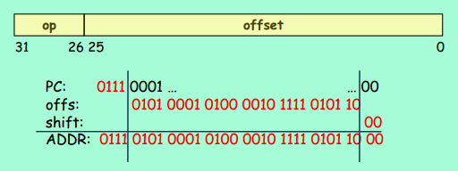
Pseudo-direct Addressing:
Pseudo-direct Addressing is the memory address which (mostly) embedded in the instructions.
Pseudo-Direct addressing is specifically used for J-type instructions. The instruction format is 6 bits of opcode and 26 bits for the immediate value (target).
In Pseudo-Direct addressing , the effective address is calculated by taking the upper 4 bits of the Program Counter(PC) , concatenated to the 26 bit immediate value , and the lower two bits are 00.

