Slide 1
Computer Architecture

Slide 2
Chapter - 2
Discusses how to measure, report, and summarize performance
Describe the major factors that determine the performance of a computer.

Slide 3
Why examining performance is important?
Hardware performance is often key to the effectiveness of an entire system.
The computer components are now updating and improving its technology frequently and speedy, and hence affected its price are rising. The computer hardware and software costs a lot of money in an organization. Therefore, it is very important that the IT department of an organization should choose and buy the most appropriate and cost-effective computer hardware.

Slide 4
Why assessing the performance is challenging?
The scale and intricacy of modern software systems, together with the wide range of performance improvement techniques employed by hardware designers have made performance assessment much more difficult.
For different types of applications, different performance metrics may be appropriate and different aspects of a computer system may be the most significant in determining overall performance.

Slide 5
Measuring Performance
Time is the measure of computer performance.
Program execution time is measured in seconds per program.
Wall-clock time / response time / elapsed time / execution time – total time to complete a task, including - disk accesses, memory access, I/O activity, OS overhead.
Throughput : the total amount of work done in a given time.

Slide 6
Performance analysis
Performance_{X} = | 1
 | Execution time_{X}
Performance of X is greater than the performance of Y
Performance_{X} > Performance_{Y}
X is faster than Y
1 | > | 1
Execution time_{X} |  | Execution time_{Y}
Execution time_{y} | > | Execution time_{x}

Slide 7
Continuation
X is n times faster than Y, it means,
Performance_{X} | = | n
Performance_{Y}
Performance_{X} | = | Execution time_{y} | = n
Performance_{Y} |  | Execution time_{x}

Slide 8
Relative performance
Example: If machine A runs a program in 10 seconds and machine B runs the same program in 15 seconds, how faster is A than B?
  A is n times faster than B if
  A is 1.5 times faster than B
Performance_{A} | = | n
Performance_{B}
 | Execution time_{B} | = n
 | Execution time_{A}
15 | = | 1.5
10

Slide 9
Continuation
We could also say that – Machine B is 1.5 times slower than machine A. since
Performance_{A} | = | n
Performance_{B}
Performance_{B} | = | Performance_{A}
 |  | n

Slide 10
CPU execution time / CPU time
is the time the CPU spends computing for a task and does not include time spent waiting for I/O or running other programs.
CPU execution time / CPU time < Response time

Slide 11
Continuation
User CPU time
CPU time
System CPU time
User CPU time – the CPU time spent in the program
System CPU time – the CPU time spent in the OS performing tasks on behalf of the program

Slide 12
Continuation
Execution Time
CPU time
For I/O and Others
User CPU time
System CPU time

Slide 13
Continuation
Example:
Unix time command –
90.7u 12.9s 2:39 65%
User CPU time
(90.7 seconds)
System CPU time
(12.9 seconds)
Elapsed time
2*60 + 39 = (159 seconds)
90.7 + 12.9 | = | 0.65
159

Slide 14
Continuation
Clock cycle – Almost all computers are constructed using a clock that determines when events take place. These discrete time intervals are called clock cycles (ticks / clock ticks / clock periods / clocks / cycles).
Clock rate – Inverse of clock period.

Slide 15
Relating the Metrics
CPU execution time for a program | = | CPU clock cycle for a program | × | Clock cycle time
CPU execution time for a program | = | CPU clock cycle for a program
 |  | Clock rate
Hardware designer can improve performance by reducing either the length of the clock cycle or the number of clock cycles required for a program.

Slide 16
Improving Performance
Our favorite program runs in 10 seconds on computer A, which has a 400 MHz clock. We are trying to help a computer designer build a machine B, that will run this program in 6 seconds. The designer has determined that a substantial increase in the clock rate is possible, but this increase will affect the rest of the CPU design, causing machine B to require 1.2 times as many clock cycles as machine A for this program. What clock rate should we tell the designer to target?

Slide 17
Improving Performance (Cont.)
CPU time_{A} | = | CPU clock cycle_{A}
 |  | Clock rate_{A}
10 Seconds | = | CPU clock cycle_{A}
 |  | 400 × 10⁶ cycles/sec
CPU clock cycle_{A} = 10 seconds × 400 × 10⁶ cycles/sec
= 4000 × 10⁶ cycles
CPU time_{B} | = | CPU clock cycle_{B}
 |  | Clock rate_{B}
CPU time_{B} | = | 1.2 × CPU clock cycle_{A}
 |  | Clock rate_{B}

Slide 18
Improving Performance (Cont.)
6 seconds | = | 1.2 × 4000 × 10⁶ cycles
 |  | Clock rate_{B}
Clock rate_{B} | = | 1.2 × 4000 × 10⁶ cycles
 |  | 6 seconds
= 800 MHz
Machine B must therefore have twice the clock rate of A to run the program in 6 seconds.

Slide 19
Hardware Software Interface
Since Machine had to execute the instructions to run the program, the execution time must depend on the number of instructions in a program.
CPU clock cycles (for a program) | = | Instructions for a program | × | Average clock cycles per instruction
CPI

Slide 20
Using the Performance Equation
Suppose, we have two implementations of the same instruction set architecture. Machine A has a clock cycle time of 1 ns and a CPI of 2.0 for some program, and machine B has a clock cycle time of 2 ns and a CPI of 1.2 for the same program. Which machine is faster for this program, and by how much?

Slide 21
Continuation
Let the number of instructions of the program be I
CPU clock cycles_{A} = I × 2.0
CPU clock cycles_{B} = I × 1.2
CPU time_{A} = CPU clock cycles_{A} × Clock cycle time_{A}
= I × 2.0 × 1 ns = 2I ns
CPU time_{B} = I × 1.2 × 2 ns = 2.4I ns
CPU performance_{A} | = | Execution time_{B} | = | 2.4I ns | = 1.2
CPU performance_{B} |  | Execution time_{A} |  | 2I ns
A is 1.2 times faster than B

Slide 22
Continuation
Basic performance equation
CPU Execution time = Instruction count × CPI × clock cycle time
CPU execution time | = | Instruction count × CPI
 |  | Clock rate

Slide 23
Continuation
It is possible to compute the CPU clock cycles by looking at the different types of instructions and using their individual clock cycle counts.
In such cases,
CPU clock cycles= summation of (CPIi*Ci)

Slide 24
Comparing Code Segments
Example
  The hardware designer supplied:
  Two code sequences requires the following:
  Which code sequence executes the most instructions?
  Which will be faster?
  What is the CPI for each sequence?
Instruction Class | CPI for this class
A | 1
B | 2
C | 3
Code Sequence | Instruction Counts for instruction class
 | A | B | C
1 | 2 | 1 | 2
2 | 4 | 1 | 1

Slide 25
Solution
Sequence 1 executes 2 + 1 + 2 = 5 instructions.
Sequence 2 executes 4 + 1 + 1 = 6 instructions.
So sequence 2 executes most instructions.

Slide 26
Solution
CPU clock cycles₁ = (2×1) + (1×2) + (2×3) = 2 + 2 + 6 = 10 cycles
CPU clock cycles₂ = (4×1) + (1×2) + (1×3) = 4 + 2 + 3 = 9 cycles
So code sequence 2 is faster.

Slide 27
Solution
CPI₁ | = | CPU clock cycles₁ | = | 10 | = | 2
 |  | Instruction count₁ |  | 5
CPI₂ | = | CPU clock cycles₂ | = | 9 | = | 1.5
 |  | Instruction count₂ |  | 6
When comparing two machines, we must look at all three components, which combine to form execution time.

Slide 28
Processor | Clock Rate | CPI
P1 | 4GHz | 1.25
P2 | 3GHz | 0.75
Instruction count= 10^6
Prove the fallacy, “ Largest clock rate has largest performance”
Here,
CPU execution time , p1= (CPI * Instructions) / clock rate
= (1.25* 10^6)/ (4*10^9)
CPU execution time, p2 = (0.75*10^6)/ (3*10^9)

Slide 29
Performance p1 : performance p2 =
((0.75*10^6)/ (3*10^9) ) / ((1.25* 10^6)/ (4*10^9) )
= 0.8
So, performance p1 = 0.8 * performance p2
Here,
P1 has highest clock rate but performance is lower.
So, the fallacy is wrong.

Slide 30
Check yourself:
Processors | Clock rate | CPI
P1 | 2GZ | 1.5
P2 | 1.5GZ | 1.0
P3 | 3GZ | 2.5
Instruction set is same.
Which processor has the highest performance?
If the processors each execute a program in 10s, find the number of cycles and number of instructions.
If execution time is 30% reduced and CPI is 20% increased then what clock rate should be given?

Slide 31

MIPS (Millions instructions per second)
A measurement of program execution speed based on the number of millions of instructions.
Limitations of MIPS:
Firstly, MIPS specifies the instruction execution rate but does not specify the capabilities of the instructions.
Secondly, MIPS varies between program on the same computer. Thus, a machine should not have a same MIPS ratings.
Finally, MIPS inversely related to performance!!

Slide 32
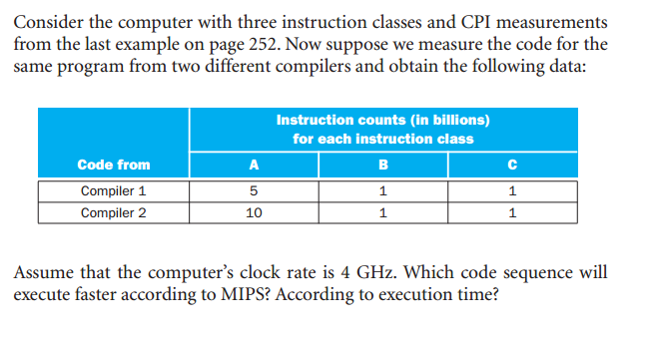
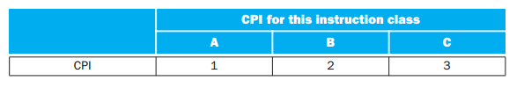
MIPS as a Performance Measure

Slide 33
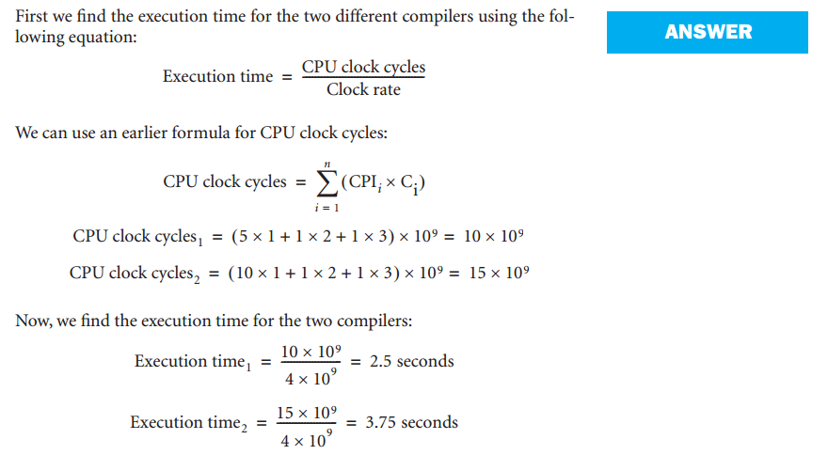

Slide 34
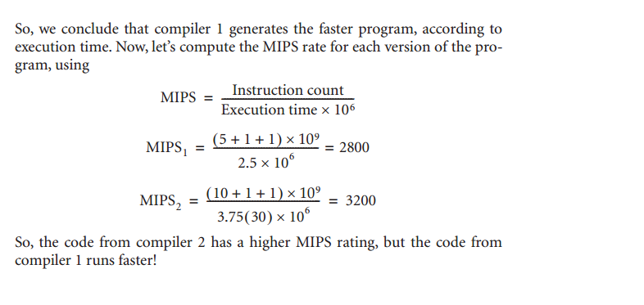

Slide 35
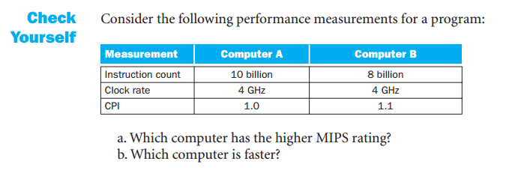

Slide 36
A 400 MHz processor was used to execute a benchmark program with the following instruction mix and clock cycle counts.
Determine the effective CPI,MIPS rate and execution time
Instruction Type | Instruction Count | CPI
Integer Arithmetic | 450000 | 1
Data Transfer | 320000 | 2
Floating Point | 150000 | 2
Control Transfer | 80000 | 2

Slide 37
MFLOPS (Million floating point operation per second)– Performance Metric
MFLOPS=(Number of floating point operations in a program) / (Execution time * 1e6)

Slide 38


Amdahl’s Law (self)
Earlier version of Amdahl’s law:
Latest version (second law) of Amdahl’s law:
Speed up = (Performance after improvement) / (Performance before improvement)
= (Execution time before improvement) / Execution time after improvement)

Slide 39
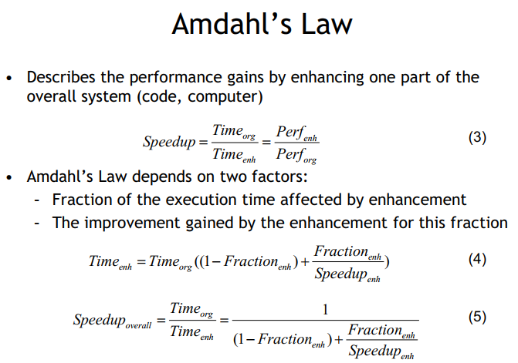
Continue

Slide 40
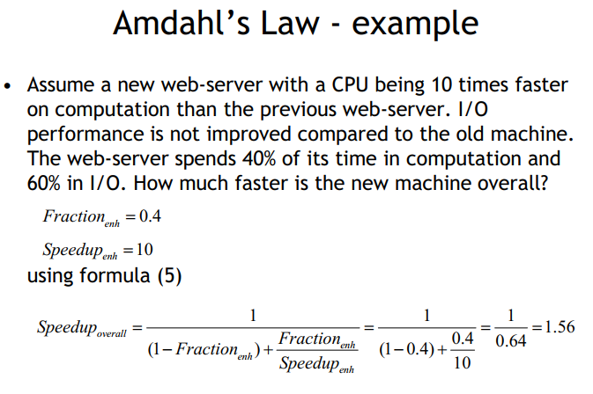
Continue

Slide 41
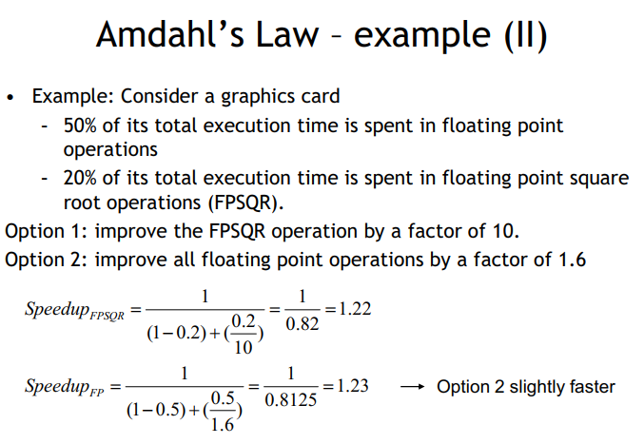
Continue

Slide 42
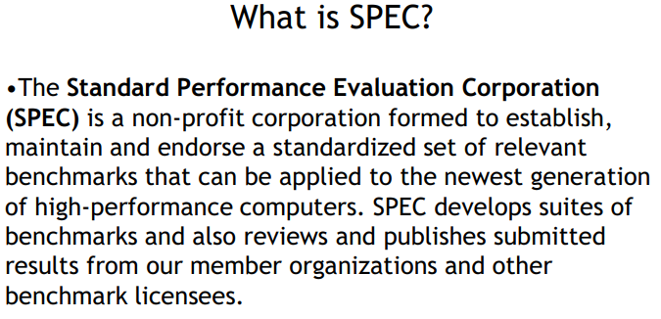
SPEC Benchmark

Slide 43
Spec & Benchmark
Measures such as MIPS and MFLOPS have proven inadequate to evaluating the performance of processors.
Because of differences in instruction sets, the instruction execution rate is not a valid means of comparing the performance of different architectures.
Performance of a given processor on a given program may not be useful in determining how that processor will perform on a very different type of application
Benchmarks provide guidance to customers trying to decide which system to buy, and can be useful to vendors and designers in determining how to design systems to meet benchmark goals.

Slide 44
Spec & Benchmark
Desirable characteristics of a benchmark program:
It is written in a high-level language, making it portable across different machines.
It is representative of a particular kind of programming domain or paradigm, such as systems programming, numerical programming, or commercial programming.
It can be measured easily.
It has wide distribution.
A benchmark is a test used to compare performance between multiple things, either against each other or against an accepted standard.
In the computer world, benchmarks are often used to compare the speeds or performances of hardware components, software programs, and even internet connections.

Slide 45
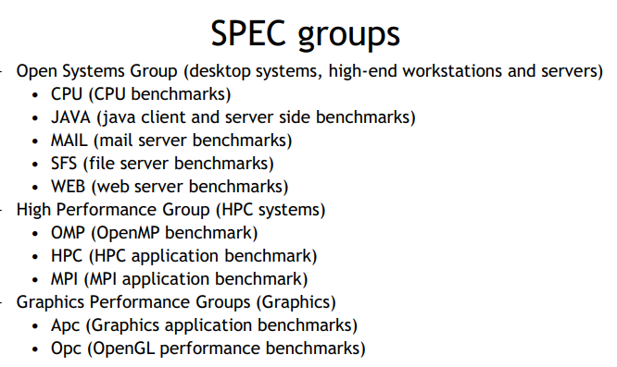
Spec & Benchmark

Slide 46
Terms Used in SPEC Documentation
Benchmark
  A program written in a high-level language that can be compiled and executed on any computer that implements the compiler
System under test
  This is the system to be evaluated
Reference machine
  This is a system used by SPEC to establish a baseline performance for all benchmarks
    Each benchmark is run and measured on this machine to establish a reference time for that benchmark
Base metric
  These are required for all reported results and have strict guidelines for compilation
Notes:
To better understand results published of a system using CPU2006, we define
the following terms used in the SPEC documentation:
■ Benchmark: A program written in a high-level language that can be compiled
and executed on any computer that implements the compiler.
■ System under test: This is the system to be evaluated.
■ Reference machine: This is a system used by SPEC to establish a baseline performance
for all benchmarks. Each benchmark is run and measured on this
machine to establish a reference time for that benchmark. A system under test
is evaluated by running the CPU2006 benchmarks and comparing the results
for running the same programs on the reference machine.
■ Base metric: These are required for all reported results and have strict guidelines
for compilation. In essence, the standard compiler with more or less
default settings should be used on each system under test to achieve comparable
results.
■ Peak metric: This enables users to attempt to optimize system performance by
optimizing the compiler output. For example, different compiler options may
be used on each benchmark, and feedback-directed optimization is allowed.
■ Speed metric: This is simply a measurement of the time it takes to execute a
compiled benchmark. The speed metric is used for comparing the ability of a
computer to complete single tasks.
■ Rate metric: This is a measurement of how many tasks a computer can accomplish
in a certain amount of time; this is called a throughput , capacity, or rate
measure. The rate metric allows the system under test to execute simultaneous
tasks to take advantage of multiple processors.
© 2016 Pearson Education, Inc., Hoboken, NJ. All rights reserved.

Slide 47
Peak metric
  This enables users to attempt to optimize system performance by optimizing the compiler output
Speed metric
  This is simply a measurement of the time it takes to execute a compiled benchmark
    Used for comparing the ability of a computer to complete single tasks
Rate metric
  This is a measurement of how many tasks a computer can accomplish in a certain amount of time
    This is called a throughput, capacity, or rate measure
    Allows the system under test to execute simultaneous tasks to take advantage of multiple processors

Slide 48
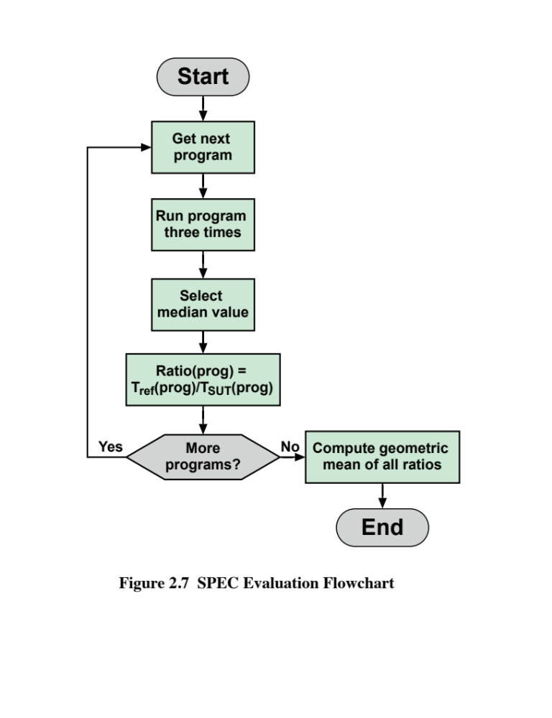
Notes:
We now consider the specific calculations that are done to assess a system. We
consider the integer benchmarks; the same procedures are used to create a floating-point
benchmark value. For the integer benchmarks, there are 12 programs in the
test suite. Calculation is a three-step process (Figure 2.7):
© 2016 Pearson Education, Inc., Hoboken, NJ. All rights reserved.

