Slide 1
SECURE DATA HIDING IN IMAGES USING STEGANOGRAPHY
CAPSTONE PROJECT
Presented By:
Student Name : SYED UMEERA
College Name & Department : PBR VISVODAYA INSTITUTE OF TECHNOLOGY AND SCIENCE , CSE DEPT.

Slide 2
OUTLINE
Problem Statement
Technology used
Wow factor
End users
Result
Conclusion
Git-hub Link
Future scope

Slide 3
Problem Statement
The challenge of secure data hiding in images using steganography lies in developing an effective method to embed confidential information within digital images while maintaining the image quality and ensuring the hidden data remains undetectable to unauthorized parties. The solution must address the issues of data integrity, robustness against various attacks, and compatibility with different image formats. Furthermore, the system should ensure the embedded data can be accurately extracted by authorized users without compromising the security of the hidden information. This approach aims to enhance secure communication and data protection in digital mediums.

Slide 4
Technology used
Libraries:
OpenCV (cv2): Used for image processing tasks, such as reading and writing images.
OS: Used for interacting with the operating system, such as opening the image file.
String: Provides constants and classes for string operations (though not directly used in the provided code).
Platforms:
Python: The programming language used for implementing the steganography technique.
Python IDLE or any Integrated Development Environment (IDE): For writing and executing the Python code.

Slide 5
Wow factors
Stealthy Data Embedding: The ability to hide confidential data within seemingly ordinary images
without altering their visual quality.
Enhanced Security: Utilizes advanced algorithms to ensure data remains undetectable and
protected from unauthorized access and attacks.
Versatility: Compatible with various image formats and adaptable to different use cases,
making it a flexible solution for secure communication.
Robustness: Resistant to common attacks and image manipulations, ensuring data integrity
even when images are compressed or edited.
User-friendly Interface: Easy-to-use tools for embedding and extracting hidden data,
accessible to users with varying levels of technical expertise.

Slide 6
End users
Government Agencies: To securely transmit sensitive information and confidential communications.
Military and Defense: For secure communication and data protection in strategic operations.
Healthcare Institutions: To protect patient records and sensitive medical data.
Financial Services: For secure handling of financial transactions and confidential client information.
Law Enforcement: To securely share investigative data and intelligence.
Individuals: For personal privacy and secure sharing of confidential information.

Slide 7
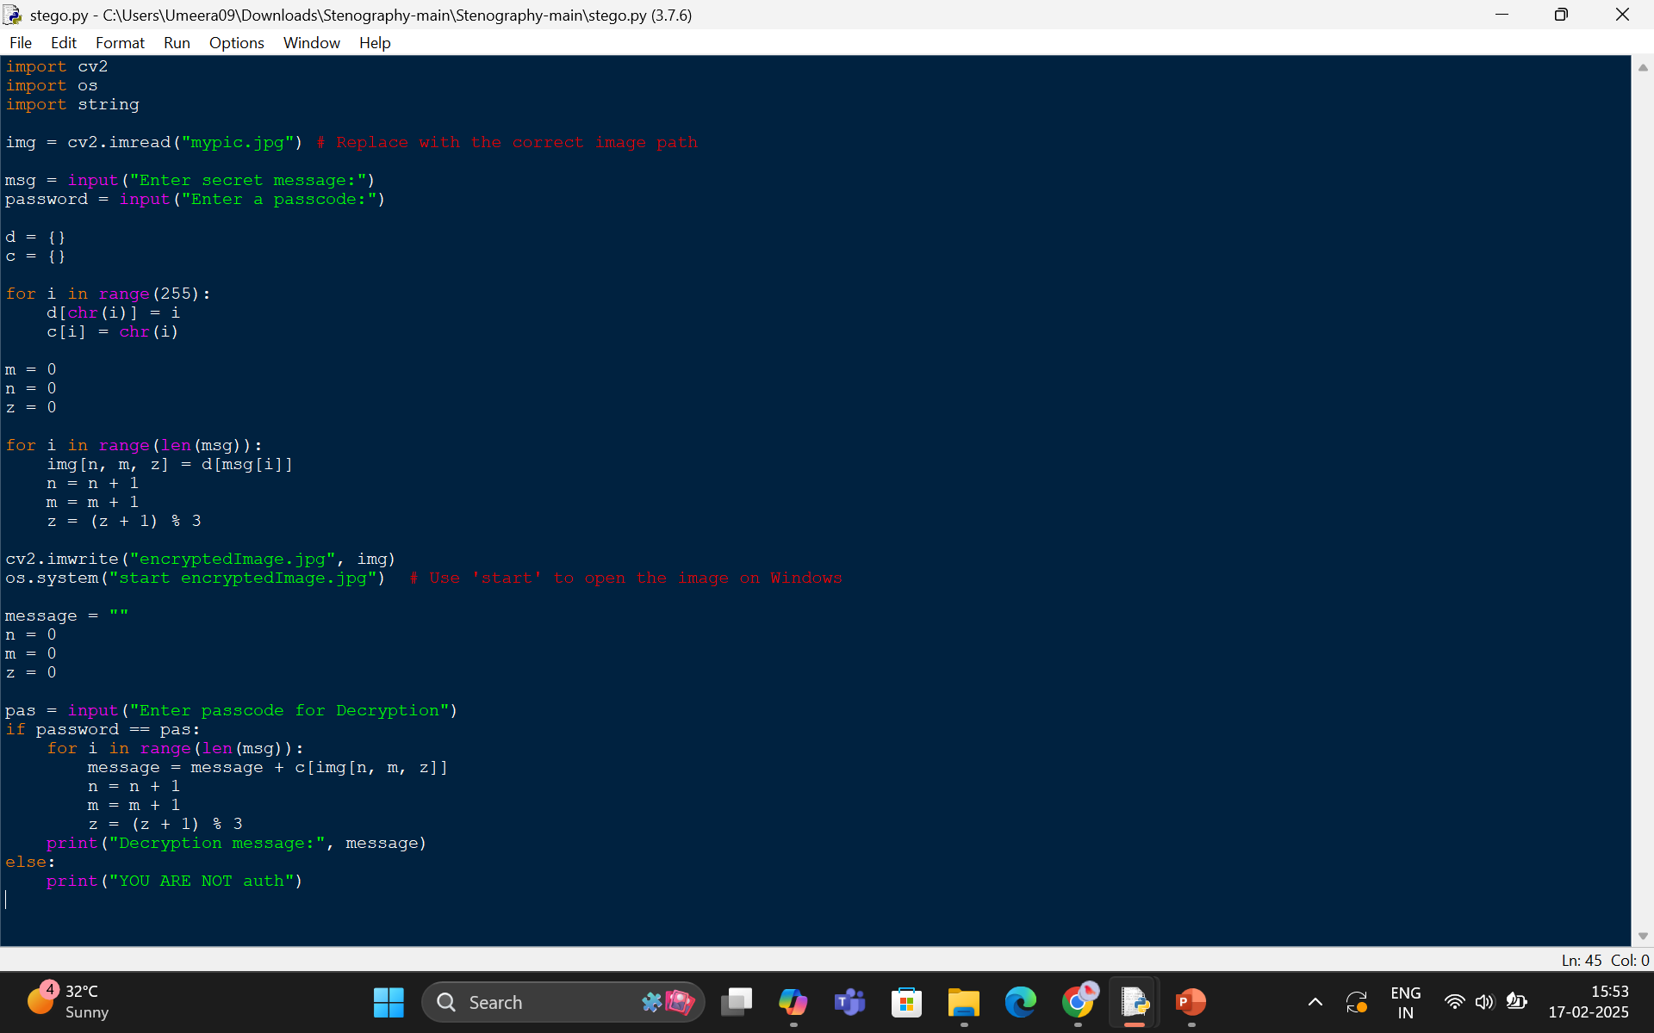
Results

Slide 8
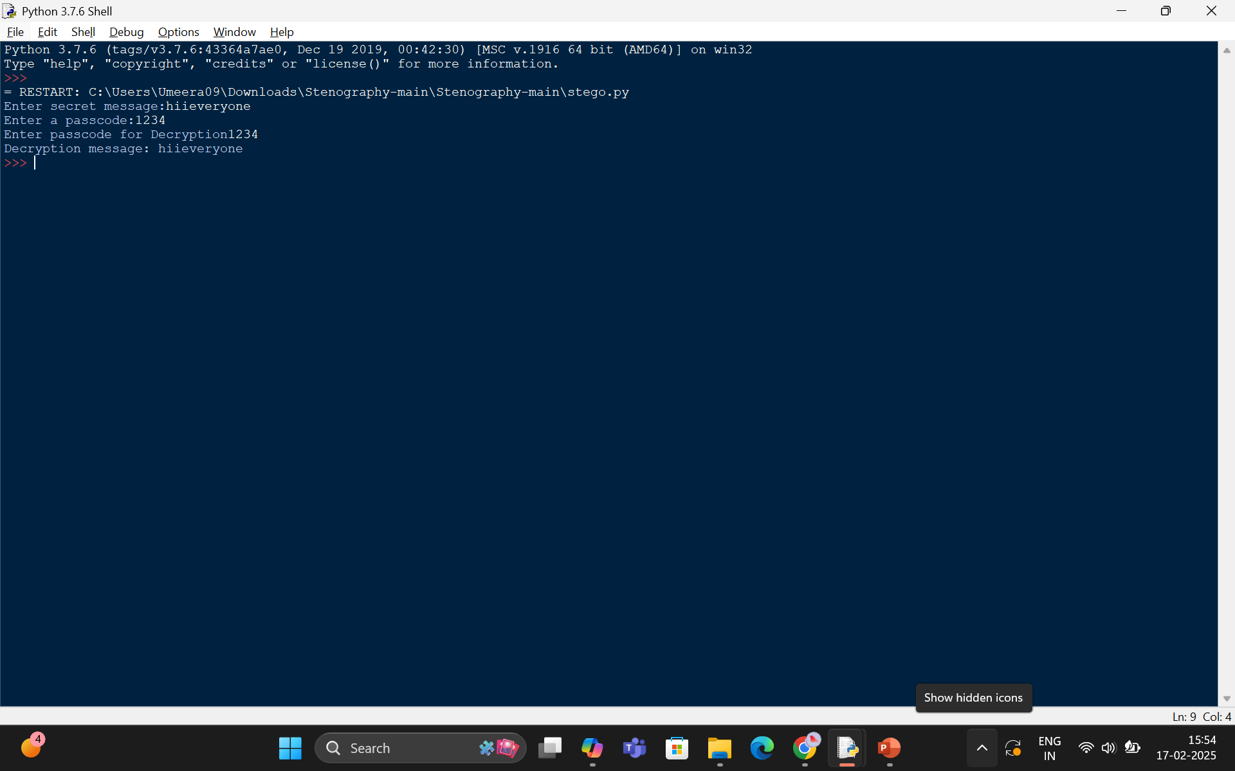

Slide 9
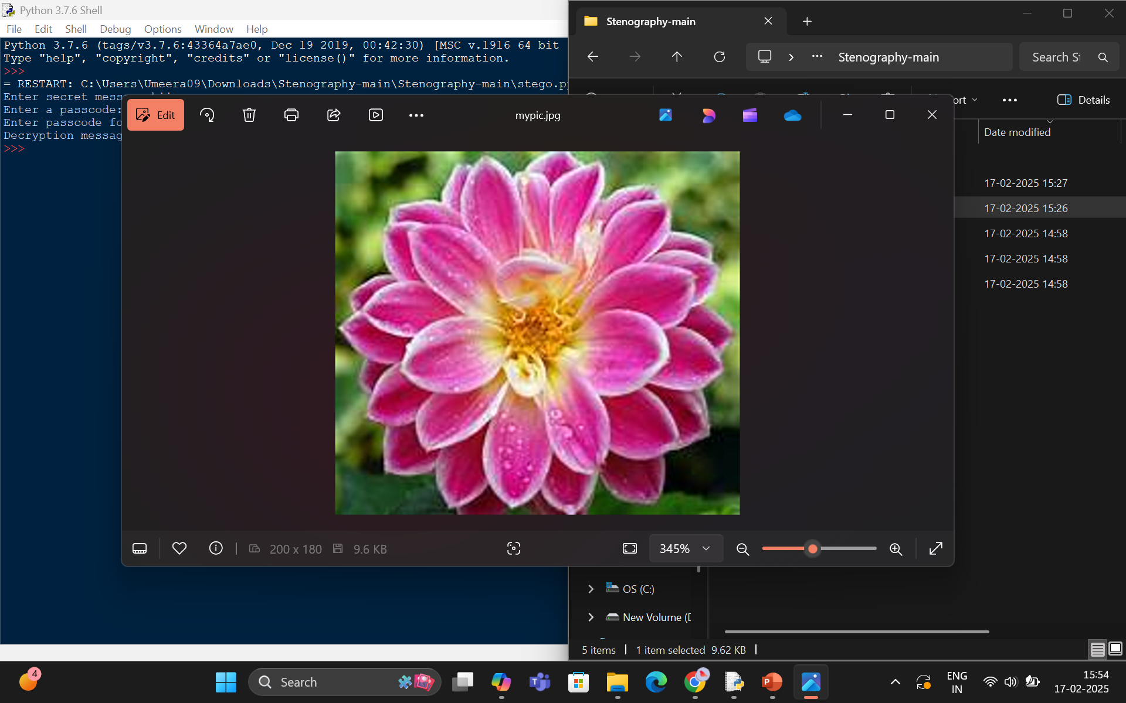

Slide 10


Slide 11
Conclusion
The development of a robust steganography technique for secure data hiding in images effectively addresses the challenges of data integrity, image quality preservation, and resistance to unauthorized detection. By ensuring the seamless embedding and accurate extraction of confidential information, this approach significantly enhances the security of digital communication and data protection. The successful implementation of this solution will contribute to the advancement of secure information exchange, safeguarding sensitive data from potential cyber threats and unauthorized access, thereby fostering trust and confidence in digital mediums.

Slide 12
GitHub Link
https://github.com/Syedumeera/EDUNET_AICTE.git
https://github.com/Syedumeera/EDUNET_AICTE

Slide 13
Future scope
The field of secure data hiding in images using steganography has vast potential for advancements. Future research can focus on developing more robust and efficient steganographic algorithms, enhancing resistance to steganalysis attacks, and increasing real-time applications in various sectors like healthcare and military. Integration with emerging technologies such as blockchain and AI can further bolster security. Additionally, creating user-friendly tools and ensuring cross-platform compatibility will broaden the accessibility and utility of steganography.

Slide 14
THANK YOU

