Slide 1
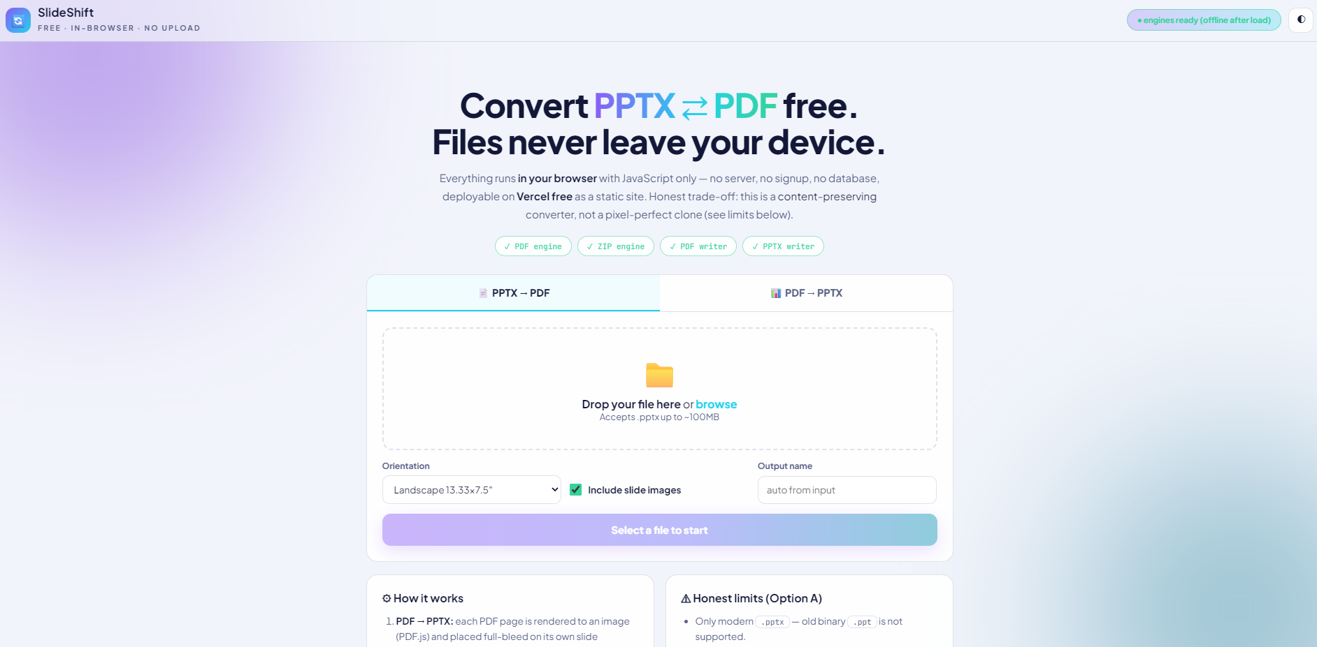
SlideShift: Free PPT ⇄ PDF Converter, 100% In-Browser
No server • No signup • Files never leave your device
HTML • CSS • JS + PDF.js, JSZip, jsPDF, PptxGenJS — static site, free hosting ready

Slide 2
The Problem
• Online converters force you to upload private decks to someone else’s server — privacy risk
• Paywalls, watermarks, queues and forced accounts for a 10-second task
• Desktop suites are heavy; old tools don’t handle modern .pptx properly
• People need conversion that is free, instant, and private

Slide 3
The Solution — SlideShift
• A converter that runs entirely inside the browser tab — pure HTML, CSS and JS
• Both directions: PPTX → PDF and PDF → PPTX, auto-detected from the dropped file
• Drag & drop / paste, quality + layout options, live progress + log, one-click download
• Zero backend, zero database, zero tracking — works offline after the page loads

Slide 4
How It Works (4 client-side engines)
• PDF → PPTX: PDF.js renders each page to an image → PptxGenJS places it full-bleed on its own slide (16:9 / 4:3)
• PPTX → PDF: a .pptx is a ZIP — JSZip opens it, slides read in presentation order, text + images extracted → jsPDF rebuilds a clean PDF
• Direction, validation and naming are automatic; conversion counter lives in localStorage
• Proof of privacy: DevTools Network shows zero file traffic during conversion

Slide 5
Features
• Tabs for each direction; file type auto-switches the tab (.pptx / .pdf only, ~100MB guard)
• Options: render quality (Standard / High / Ultra), slide size, PDF orientation, image toggle, custom output name
• Live progress bar + per-slide log; result auto-downloads, button kept as backup
• Engine status pills, dark / light theme, responsive layout, toast feedback

Slide 6
Honest Limits
• Modern .pptx only — legacy binary .ppt is not supported
• PPTX → PDF keeps content, not pixel fidelity: fonts, animations, charts, SmartArt, video don’t survive
• PDF → PPTX slides look identical but are images — text isn’t selectable or editable
• Password-protected PDFs are rejected; huge files can exhaust browser memory
• Pixel-perfect editable conversion needs a server engine (LibreOffice / paid API) — out of scope for a free static site

Slide 7
Evidence & Repro
• Repo: public/ is the whole app — index.html, styles.css, app.js + 4 CDN libraries
• Try it: npx serve public → drop a .pptx → get a .pdf; drop a .pdf → get a .pptx
• Verify privacy: convert with DevTools Network open — nothing leaves the tab
• node --check public/app.js passes; no fetch / XHR / API calls anywhere in the code

Slide 8
Demo (2.5 min)
• 0:00 Problem + why uploads are the pain • 0:20 Drop PPTX → PDF with log + download
• 1:00 Drop PDF → PPTX, flip quality options • 1:40 Limits + Network-tab zero-traffic proof
• 2:10 Stack + free static deployment • Live: convert a real file in the browser
• Video: unlisted YouTube / Loom link in README + submission

Slide 9
Thank You
SlideShift — convert free, keep your files yours • Repo + video on submission
Stack: HTML, CSS, JavaScript, PDF.js, JSZip, jsPDF, PptxGenJS

