Slide 1

Master’s Thesis
in Information Technology
Faculty of Computer Science and Engineering
Efficient Machine Learning Approaches in Medicine : Predicting Equity in Outcomes After Hematopoietic Cell Transplantation
Supervised by:
Prof. Dr. Doina Logofatu
Prof. Dr. Eicke Godehardt
Presented by:
Md Abu Syeem DIPU
Matriculation no.: 1324442
Email: md.ulalam@stud.fra-uas.de
Notes:
"Good [morning/afternoon], everyone. My name is Md Abu Syeem Dipu, and I'm presenting my Master's Thesis titled Efficient Machine Learning Approaches in Medicine: Predicting Equity in Outcomes After Hematopoietic Cell Transplantation . This work was supervised by Prof. Dr. Doina Logofatu and Prof. Dr. Eicke Godehardt."

Slide 2
Agenda
Background and Motivation
Models and Algorithms
Gradient Boosting Framework
Methodology
Data Preprocessing
Model implementation
Results and analysis
Conclusions
2
Notes:
"Here's the roadmap of today's talk. We'll begin with the background and motivation, then go over the models and algorithms, followed by methodology and data preprocessing. Next, I'll present model implementation, results and analysis, and finally, conclude with key findings and future directions."

Slide 3
Objectives
Investigate disparities in post-HCT survival outcomes across demographic groups.
Develop machine learning models (LightGBM, XGBoost) to predict survival more accurately and fairly.
Compare model performance in terms of accuracy, interpretability, and fairness.
Analyze feature importance using SHAP to understand clinical decision influence.
Evaluate bias and performance gaps across subgroups (e.g., race, gender).
3
Notes:
“The main objectives of my thesis were:
Investigate disparities in survival outcomes after HCT across different demographic groups.
Develop machine learning models—LightGBM and XGBoost—for accurate and fair survival prediction.
Compare these models in terms of accuracy, interpretability, and fairness.
Use SHAP analysis to understand which features drive predictions and where biases may appear.”

Slide 4
Background And Motivation
Participated in Kaggle Competition: Equity in Post-HCT Survival Predictions.
HCT is a critical treatment for blood-related cancers and disorders.
Notable disparities exist in survival outcomes across demographic groups.
Traditional survival models lack flexibility for complex clinical data.
Machine learning offers potential for both accurate and fair predictions.
4
Notes:
I'll first provide an overview of the key elements:
This study was motivated by the GECCO competition where I had evalute the optimized path of hospital lab logistic system using abstract swarm. Hospital logistics is a prime area for improvement due to its dynamic nature, requiring adaptive solutions to manage patient flow, resource allocation, and supply chain needs. Traditional centralized optimization methods often fall short in such environments, lacking the flexibility needed for real-time adjustments. This study leverages Particle Swarm Optimization (PSO), an adaptive and decentralized approach, to overcome these limitations. By optimizing machine learning models with PSO, we aim to evaluate their performance in enhancing hospital logistics efficiency.

Slide 5
Research Question
What is the performance of real-world (clinical and demographic) data-based gradient boosting (LightGBM and XGBoost) models for post-HCT survival prediction?
How do these methods differ in terms of predictive performance, computational efficiency, and stability over cross-validation folds?
Are there differential predictions based on race, ethnicity, or other demographic subgroups between these models? If it is, how can these discrepancies be identified and interpreted?
How does model interpretability help in the discovery of inﬂuential factors and explanations of bias in the prediction?
5

Slide 6
Models AND ALGORITHMS
Model Optimizer
● RandomizedSearchCV
Models Used in Study
● Extreme Gradient Boosting (XGBoost)
● Light Gradient Boosting Machine (LightGBM)
6
Notes:
In this study, I employed Swarm Intelligence as our model optimizer, specifically using Particle Swarm Optimization (PSO).
For the models themselves, we used Support Vector Classification (SVC) and Random Forest. SVC is effective for classification tasks, allowing us to predict and manage patient flow. Random Forest, as an ensemble method, excels in decision-making processes, .making it suitable for supply hospital logistics.
Together, these algorithms and models provide a powerful combination to address the complexities of hospital logistics and improve operational efficiency.

Slide 7
Light Gradient Boosting Machine (LightGBM)
High Performance: Designed for fast training and low memory usage.
Histogram-Based Learning: Speeds up training by grouping continuous values into discrete bins.
Leaf-Wise Tree Growth: Improves accuracy by choosing leaves with the largest loss reduction.
Scalable: Efficiently handles large datasets with high-dimensional features.
Built-In Handling of Missing Values: Reduces preprocessing needs.
7
Notes:
Binary and Multi-Class Classification: SVC is commonly used for both binary and multi-class classification problems, making it versatile across various applications.
Effective in High-Dimensional Spaces: SVC is particularly useful when dealing with high-dimensional data, where it can handle large feature spaces effectively.
Robust to Overfitting: By maximizing the margin between classes, SVC reduces the risk of overfitting, especially when used with the right kernel.
Customizable with Different Kernels: SVC offers flexibility with various kernels (e.g., linear, polynomial, RBF) to capture complex patterns in data.

Slide 8
Extreme Gradient Boosting (XGBoost)
High Accuracy: Optimizes performance through advanced boosting techniques.
Regularization: Includes L1 and L2 penalties to reduce overfitting.
Second-Order Optimization: Uses gradient and hessian information for more precise updates.
Parallel Processing: Trains models faster by utilizing multiple CPU cores.
Native Missing Value Handling: Learns the best direction for missing data during training.
8
Notes:
Ensemble Learning Method: Random Forest is an ensemble method that builds multiple decision trees and combines their outputs to improve accuracy and reduce overfitting.
Handles High-Dimensional and Large Datasets: Effective at handling datasets with a large number of features and samples, making it suitable for both structured and unstructured data.
Reduces Overfitting: By averaging multiple trees, Random Forest reduces overfitting, leading to better generalization on unseen data.
Feature Importance: Random Forest provides insights into which features are most important for predictions, which is helpful for feature selection.
Handles Missing Data Well: Random Forest can handle missing values by calculating averages across trees, making it robust for real-world datasets.

Slide 9
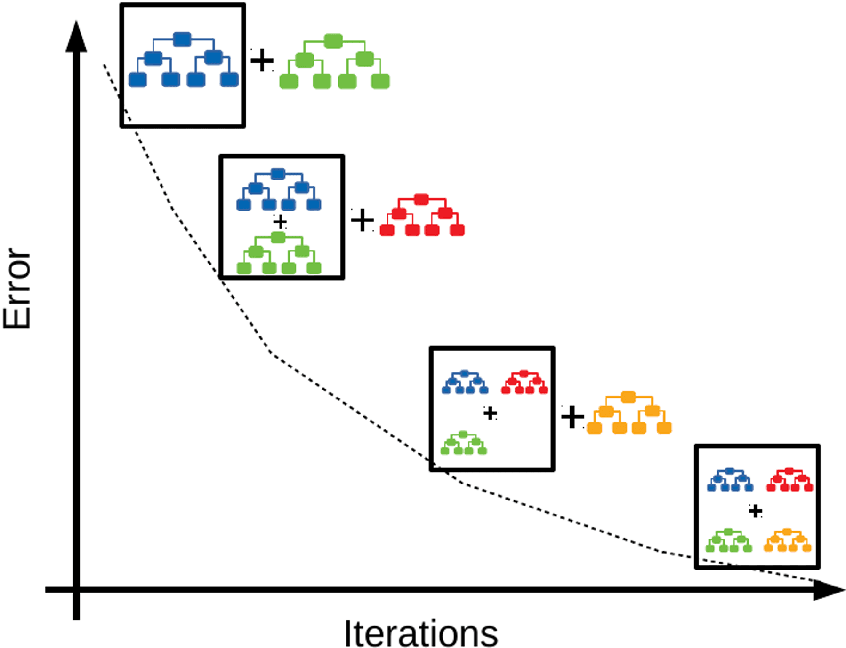
Why Gradient Boosting Algorithm?
High predictive accuracy – sequentially builds models to minimize errors, improving performance with each iteration.
Handles complex, nonlinear relationships – captures intricate patterns in high-dimensional clinical data.
Robustness to overfitting – uses regularization and learning rate control to enhance generalization.
Flexibility – works with various loss functions suitable for survival prediction tasks.
Feature importance insights – provides interpretability via methods like SHAP for clinical decision-making.
Figure: Gradient Boosting process reducing error over iterations.
Image source:
https://medium.com/@hemashreekilari9/understanding-gradient-boosting-632939b98764.
8
Notes:
Ensemble Learning Method: Random Forest is an ensemble method that builds multiple decision trees and combines their outputs to improve accuracy and reduce overfitting.
Handles High-Dimensional and Large Datasets: Effective at handling datasets with a large number of features and samples, making it suitable for both structured and unstructured data.
Reduces Overfitting: By averaging multiple trees, Random Forest reduces overfitting, leading to better generalization on unseen data.
Feature Importance: Random Forest provides insights into which features are most important for predictions, which is helpful for feature selection.
Handles Missing Data Well: Random Forest can handle missing values by calculating averages across trees, making it robust for real-world datasets.

Slide 10
Hyper-parameter Tuning
Definition – The process of selecting the best set of configuration values (hyperparameters) for a machine learning model before training begins.
Purpose – Optimizes model performance by balancing bias and variance.
Difference from Parameters – Model parameters are learned during training, whereas hyperparameters are set manually or via search strategies.
Common Methods – Grid Search, Randomized Search, Bayesian Optimization.

Slide 11
RandomizedSearchCV
Randomly samples hyperparameter combinations from a defined search space, rather than testing all possible options.
More efficient than Grid Search, especially with large parameter ranges.
Works with cross-validation to ensure reliable performance evaluation.
Suitable for tuning both discrete and continuous hyperparameters.
Model Hyper-parameter Tune steps
Define Search Space​
Randomly Select Parameters ​
Train Model ​
Cross-Validate ​
Select Best Parameters

Slide 12
Methodology
Data Sourcing
Data Pre-processing
Model Training and Tuning
Evaluation
11

Slide 13
Data Sourcing
Data Source: Kaggle competition – Equity in Post-HCT Survival Predictions, based on CIBMTR clinical data.
Key Datasets:
● training.csv
● test.csv
● data_dictionary.csv
File Format: CSV– widely supported format for structured tabular data, enabling efficient preprocessing and analysis in Python.
12
Notes:
For this study, I sourced data from the MIMIC database, a comprehensive clinical dataset containing extensive patient records. The two primary datasets we used are patients.parquet and admissions.parquet, which provide detailed information about patient demographics and hospital admissions.
These datasets are stored in Parquet format, an efficient, columnar storage format optimized for distributed systems. This format allows us to handle large data volumes effectively, ensuring that our data processing and analysis remain fast and scalable.

Slide 14
Data Preprocessing
Data Cleaning – Handled missing values (categorical labeled as “Missing,” numerical imputed with median), removed duplicates, and treated outliers using the IQR method.
Data Transformation – Applied label encoding and one-hot encoding for categorical features, normalized numerical variables, and engineered new clinically relevant features..
Exploratory Analysis – Visualized distributions across demographic subgroups to detect potential disparities in the dataset.
13
Notes:
In the data preprocessing stage, we focused on three main steps to ensure data quality and suitability for our models.
Data Cleaning: This involved addressing missing values, removing duplicates, and handling outliers to maintain data integrity and accuracy.
Data Transformation: We encoded categorical variables, normalized numerical features, and engineered new features as needed. This transformation allowed us to standardize the data and prepare it for analysis.
Graph-Based Structuring: To represent the hospital layout, we modeled departments as nodes and pathways as edges. This graph-based structure allowed us to simulate patient and resource flow accurately, essential for optimizing hospital logistics.
Together, these steps prepared our data for effective model training and PSO optimization.

Slide 15
Pre-processing for Learning Models
Feature Representation – Converted raw clinical variables into numerical and categorical encodings suitable for ML algorithms.
Feature Scaling & Normalization – Applied transformations where necessary to stabilize model training.
Handling Missing Data – Imputed missing values using median (numerical) or “Missing” label (categorical).
14
Notes:
To prepare for Particle Swarm Optimization (PSO), we focused on defining each particle and initializing key parameters.
Particle Representation: Each particle was defined with key features relevant to our hospital logistics problem, such as resource allocation and patient flow parameters.
Velocity and Position Initialization: I set the initial position and velocity of each particle based on historical data. This helped the particles start closer to feasible solutions, enhancing the optimization process.
These preprocessing steps were essential to make PSO effective in finding optimal solutions for dynamic hospital logistics.

Slide 16
Gradient Boosting Models (LightGBM & XGBoost)
Inspired by iterative learning where each new tree corrects errors from previous trees.
Advantages in HCT Prediction:
High accuracy with structured clinical data.
Ability to handle missing values naturally.
Flexible with various loss functions for survival analysis.
15
Notes:
Particle Swarm Optimization, or PSO, is inspired by the social behavior of birds and fish, which use simple, collective rules to find optimal solutions in complex environments.
In the context of hospital logistics, PSO offers several advantages:
Efficient Optimization: PSO can quickly find optimal or near-optimal solutions, improving resource allocation and scheduling.
Adaptable to Real-Time Changes: It adjusts to dynamic conditions, ideal for environments where demands fluctuate rapidly.
Decentralized Decision-Making: Each particle operates independently, which mirrors the decentralized nature of hospital logistics.
These features make PSO a powerful tool for enhancing operational efficiency in healthcare settings.

Slide 17
Model Tuning with RandomizedSearchCV
RandomizedSearchCV applied to train and optimize LightGBM and XGBoost models for post-HCT survival prediction.
Evaluated multiple hyper-parameter combinations using multiple cross-validation to ensure robust performance.
16
Notes:
In this study, Particle Swarm Optimization (PSO) was applied to train and optimize the Support Vector Classification and Random Forest models. By using swarm intelligence, we were able to tune model parameters iteratively. Each swarm agent adjusts its position based on both its own and the swarm’s best experiences, allowing the models to achieve higher accuracy and adaptability.
This tuning process enables both SVC and Random Forest to respond more effectively to complex, dynamic environments, making them better suited for hospital logistics optimization.

Slide 18
Tuning LightGBM Model with RandomizedSearchCV
Hyper-parameter | Best value
Learning Rate (η) | 0.01
Maximum Depth | 8
Number of Leaves | 50
Number of Estimators | 1500
Minimum Child Samples | 10
Subsample Ratio | 1.0
Column Subsample by Tree | 0.6
L1 Regularization (α) | 0.1
L2 Regularization (λ) | 0.0
RandomizedSearchCV fine-tuned LightGBM parameters (e.g., learning rate, max depth, num leaves) to maximize C-index.
Iterative tuning improved model’s predictive power and subgroup fairness.
Table: Best Hyperparameter Confguration for the Tuned LightGBM Model.
19
Notes:
To assess model performance, we used three key evaluation metrics: Accuracy, Precision, and Recall.
Accuracy measures the overall correctness of the model’s predictions, providing a general sense of performance.
Precision evaluates how often the model’s positive predictions are correct, focusing on the reliability of specific predictions.
Recall indicates the model’s ability to capture all relevant instances, showing how well it identifies true positives.
These metrics collectively give a comprehensive view of model effectiveness, helping us understand how accurately and reliably each model performs in hospital logistics.

Slide 19
Tuning XGBoost Model with RandomizedSearchCV
Hyper-parameter | Best value
Learning Rate (η) | 0.01
Maximum Depth | 7
Subsample | 0.8
Colsample by Tree | 0.6
Number of Estimators | 1000
Min Child Weight | 5
Gamma | 0.1
L1 Regularization (α) | 0.05
L2 Regularization (λ) | 0.0
RandomizedSearchCV optimized parameters such as learning rate, max depth, gamma, and subsample ratio.
Iterative tuning enhanced the model’s ability to handle complex clinical patterns and reduce bias.
Table: Best Hyperparameter Confguration for the Tuned XGBoost Model.
19
Notes:
To assess model performance, we used three key evaluation metrics: Accuracy, Precision, and Recall.
Accuracy measures the overall correctness of the model’s predictions, providing a general sense of performance.
Precision evaluates how often the model’s positive predictions are correct, focusing on the reliability of specific predictions.
Recall indicates the model’s ability to capture all relevant instances, showing how well it identifies true positives.
These metrics collectively give a comprehensive view of model effectiveness, helping us understand how accurately and reliably each model performs in hospital logistics.

Slide 20
Evaluation & Performance Matrix
C-index
RMSE
Fairness Assessment
19
Notes:
To assess model performance, we used three key evaluation metrics: Accuracy, Precision, and Recall.
Accuracy measures the overall correctness of the model’s predictions, providing a general sense of performance.
Precision evaluates how often the model’s positive predictions are correct, focusing on the reliability of specific predictions.
Recall indicates the model’s ability to capture all relevant instances, showing how well it identifies true positives.
These metrics collectively give a comprehensive view of model effectiveness, helping us understand how accurately and reliably each model performs in hospital logistics.

Slide 21

Evaluation Metric: Concordance Index (C-index)
Measures how well predicted survival scores rank patients by their survival times.
$$C−index=\frac{Number of concordant pairs}{Number of comparable pairs}$$
Interpretation Range:
• < 0.6 → | Needs improvement
• 0.6–0.7 → | Acceptable baseline
• 0.7–0.8 → | Reliable for clinical use
• > 0.8 → | Exceptional, but may indicate overfitting if not validated properly
19
Notes:
To assess model performance, we used three key evaluation metrics: Accuracy, Precision, and Recall.
Accuracy measures the overall correctness of the model’s predictions, providing a general sense of performance.
Precision evaluates how often the model’s positive predictions are correct, focusing on the reliability of specific predictions.
Recall indicates the model’s ability to capture all relevant instances, showing how well it identifies true positives.
These metrics collectively give a comprehensive view of model effectiveness, helping us understand how accurately and reliably each model performs in hospital logistics.

Slide 22
LightGBM Model Performance: Baseline vs Tuned
High C-index indicates strong model discrimination ability.
Tuned LightGBM achieved higher C-index compared to the untuned version, showing improved ranking accuracy for survival predictions.
Tuned LightGBM:
Baseline LightGBM:
Mean C-index: 0.7827 → Very good survival discrimination
Risk Stratification: Clear separation between low, medium, and high-risk groups
SHAP Interpretability: High — key features align with clinical intuition
Improvement over Baseline: +0.1086 C-index
Mean C-index: 0.6741 → Moderate to good discrimination
Highest Fold C-index: 0.6812 (Fold 6)
Lowest Fold C-index: 0.6679 (Fold 10) → Slight drop but above random
C-index Range: 0.6679 – 0.6812 → Stable performance across folds
19
21
Notes:
To assess model performance, we used three key evaluation metrics: Accuracy, Precision, and Recall.
Accuracy measures the overall correctness of the model’s predictions, providing a general sense of performance.
Precision evaluates how often the model’s positive predictions are correct, focusing on the reliability of specific predictions.
Recall indicates the model’s ability to capture all relevant instances, showing how well it identifies true positives.
These metrics collectively give a comprehensive view of model effectiveness, helping us understand how accurately and reliably each model performs in hospital logistics.

Slide 23
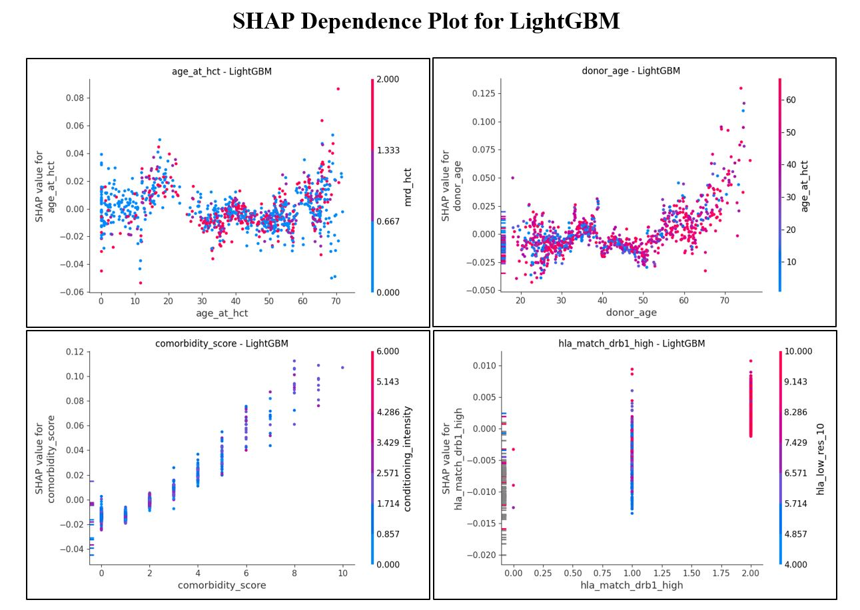
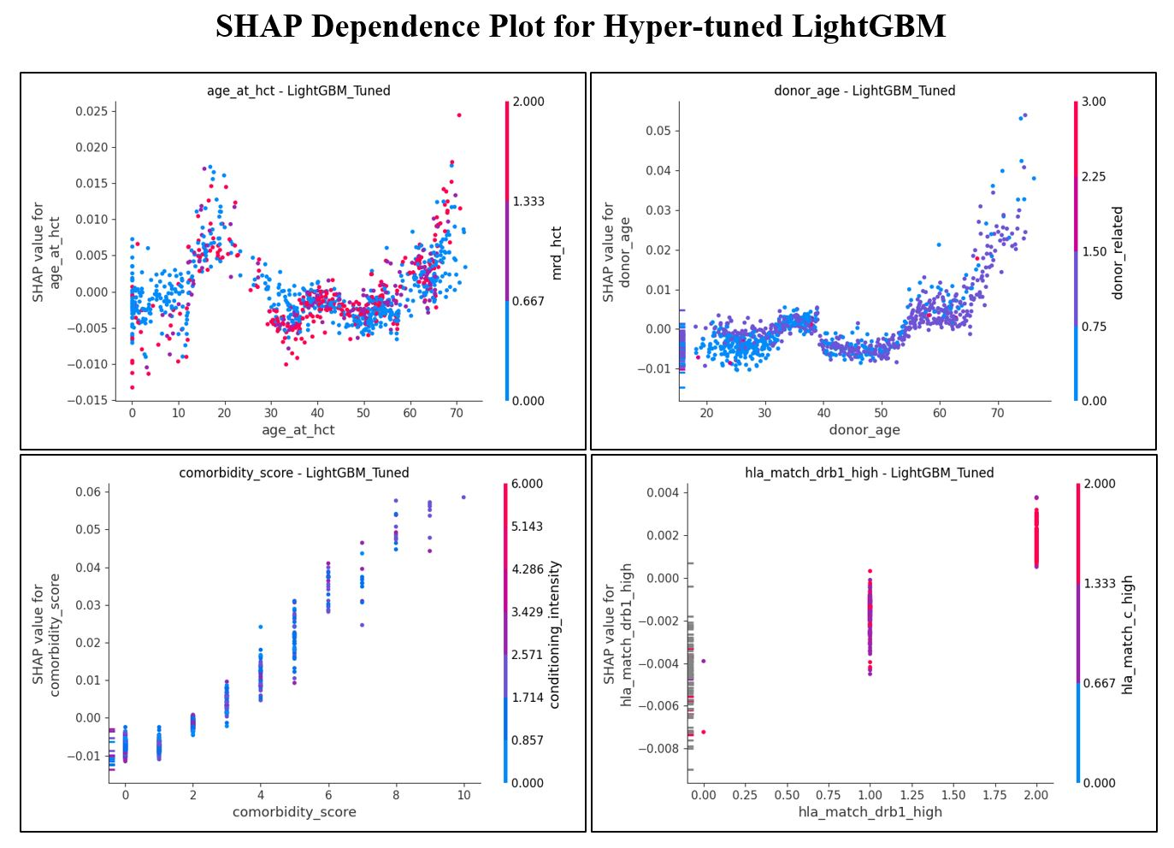
SHAP Feature Impact for LightGBM and Tuned LightGBM
Features:
age_at_hct | donor_age | comorbidity_score | hla_match_drb1_high
Figure: SHAP(SHapley Additive exPlanations) dependence plots for key predictive features in baseline LightGBM and hyperparameter-tuned LightGBM models.
21
Notes:
This slide displays the confusion matrix for the Support Vector Classification model, comparing results with and without PSO tuning.
On the left, the tuned model with PSO shows a high true positive rate, indicating improved accuracy in predicting patient flow. By optimizing the hyperparameters, the model achieves a more reliable performance with fewer false negatives and false positives.
On the right, the untuned model has a lower true positive rate and higher false positives and negatives, which impacts the model's reliability in identifying patient congestion points.
Overall, the PSO tuning process has significantly enhanced the model’s predictive accuracy, making it better suited for hospital logistics.
It is noticeable from the confusion matrix that the model performs but still there is chance to classify more positive class. It happens with imbalanced datasets, as they often orient towards the majority class.

Slide 24
XGBoost Model Performance: Baseline vs Tuned
Higher C-index in the tuned model indicates better survival ranking accuracy
However, gains were smaller compared to LightGBM, suggesting LightGBM handled feature patterns more efficiently.
Tuned XGBoost :
Baseline XGBoost :
Mean C-index: 0.7630 → Very good discrimination in survival ranking
Risk Stratification: KM curves show strong distinction between low, medium, and high-risk groups
SHAP Interpretability: High — clinically relevant feature patterns maintained
Improvement over Baseline: +0.0807 C-index
Mean C-index: 0.6823 → Good discrimination; above LightGBM baseline
Highest Fold C-index: 0.6887 (Fold 4)
Lowest Fold C-index: 0.6741 (Fold 9) → Minor performance drop observed
C-index Range: 0.6741 – 0.6887 → Stable performance across cross-validation
19
21
Notes:
To assess model performance, we used three key evaluation metrics: Accuracy, Precision, and Recall.
Accuracy measures the overall correctness of the model’s predictions, providing a general sense of performance.
Precision evaluates how often the model’s positive predictions are correct, focusing on the reliability of specific predictions.
Recall indicates the model’s ability to capture all relevant instances, showing how well it identifies true positives.
These metrics collectively give a comprehensive view of model effectiveness, helping us understand how accurately and reliably each model performs in hospital logistics.

Slide 25
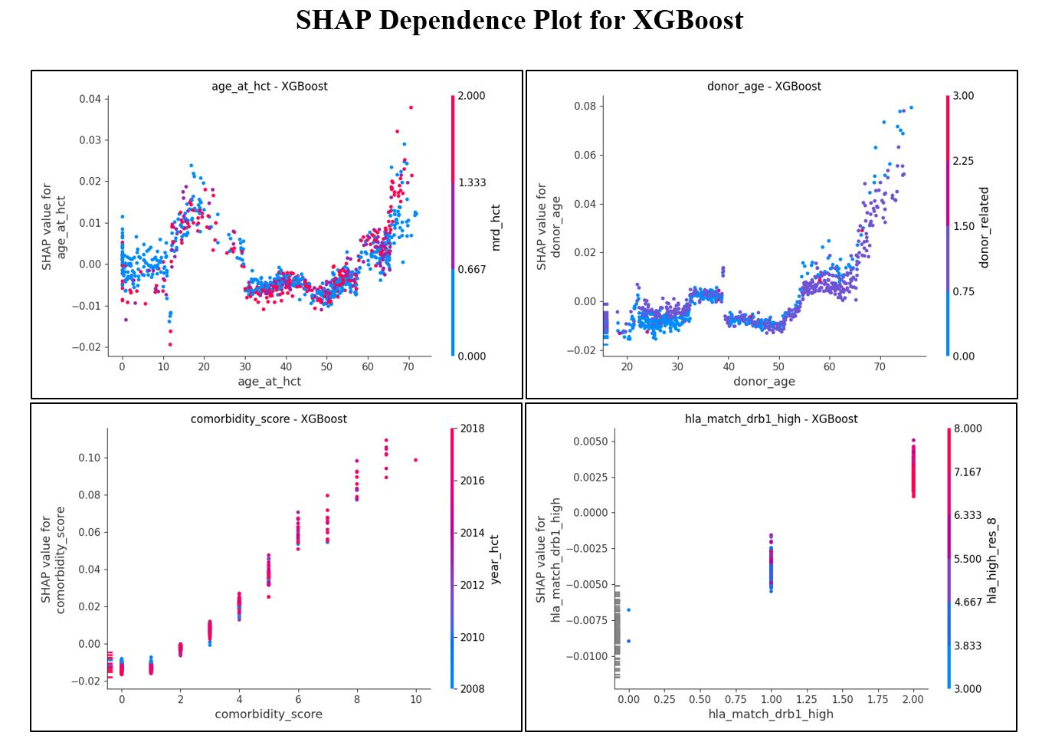
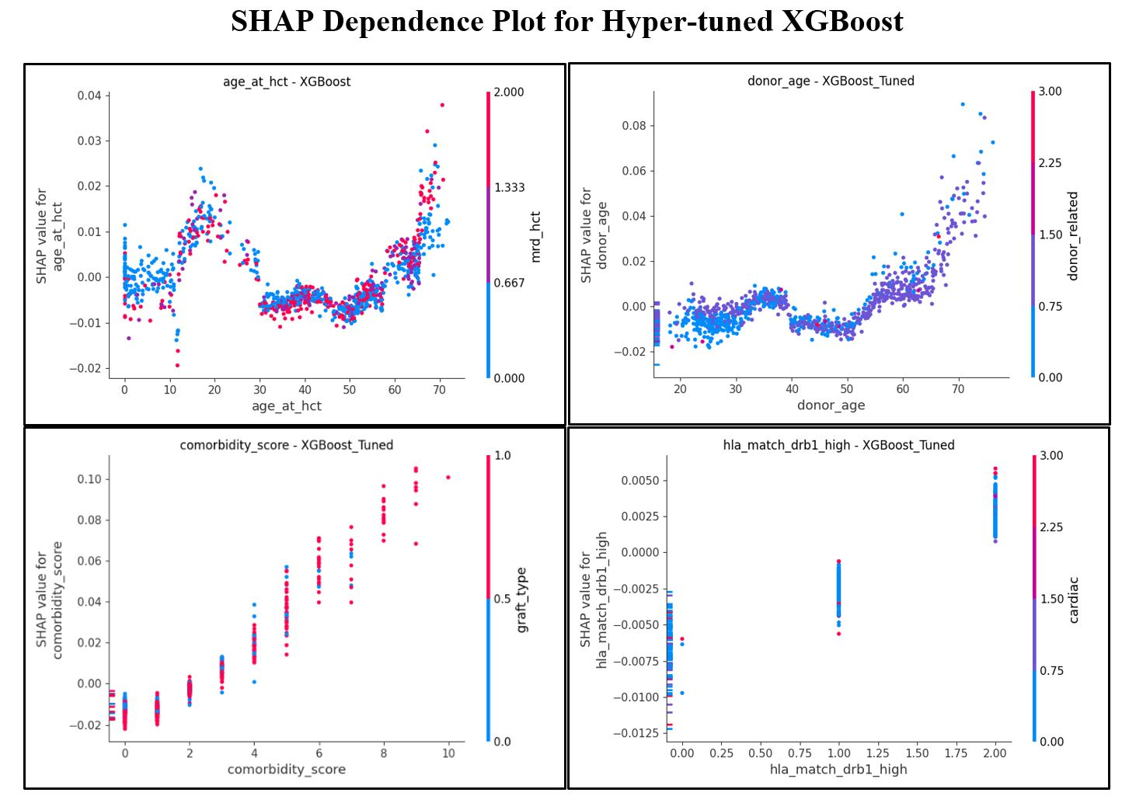
SHAP Feature Impact for XGBoost and Tuned XGBoost
Features:
age_at_hct | donor_age | comorbidity_score | hla_match_drb1_high
Figure: SHAP(SHapley Additive exPlanations) dependence plots for key predictive features in baseline XGBoost and hyperparameter-tuned XGBoost models.
21
Notes:
This slide displays the confusion matrix for the Support Vector Classification model, comparing results with and without PSO tuning.
On the left, the tuned model with PSO shows a high true positive rate, indicating improved accuracy in predicting patient flow. By optimizing the hyperparameters, the model achieves a more reliable performance with fewer false negatives and false positives.
On the right, the untuned model has a lower true positive rate and higher false positives and negatives, which impacts the model's reliability in identifying patient congestion points.
Overall, the PSO tuning process has significantly enhanced the model’s predictive accuracy, making it better suited for hospital logistics.
It is noticeable from the confusion matrix that the model performs but still there is chance to classify more positive class. It happens with imbalanced datasets, as they often orient towards the majority class.

Slide 26
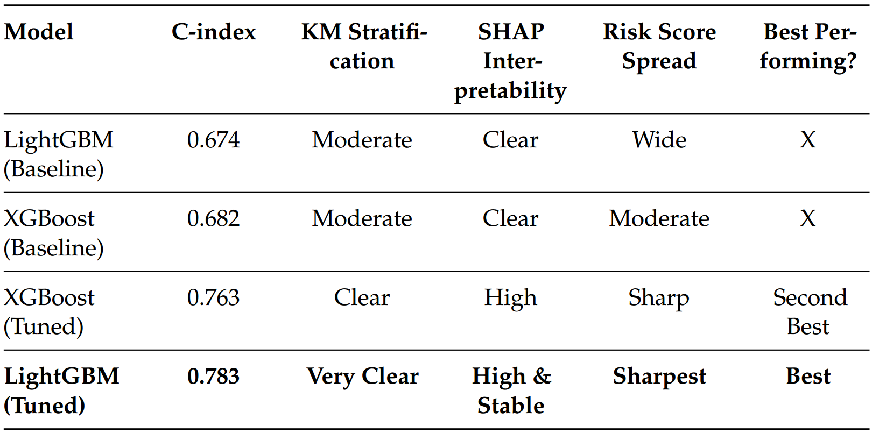
Performance Comparison: Tuned vs. Untuned Models
Table: Summary Comparison of All Models Across Predictive
Performance, Interpretability, and Calibration Metrics.
19
Notes:
To assess model performance, we used three key evaluation metrics: Accuracy, Precision, and Recall.
Accuracy measures the overall correctness of the model’s predictions, providing a general sense of performance.
Precision evaluates how often the model’s positive predictions are correct, focusing on the reliability of specific predictions.
Recall indicates the model’s ability to capture all relevant instances, showing how well it identifies true positives.
These metrics collectively give a comprehensive view of model effectiveness, helping us understand how accurately and reliably each model performs in hospital logistics.

Slide 27
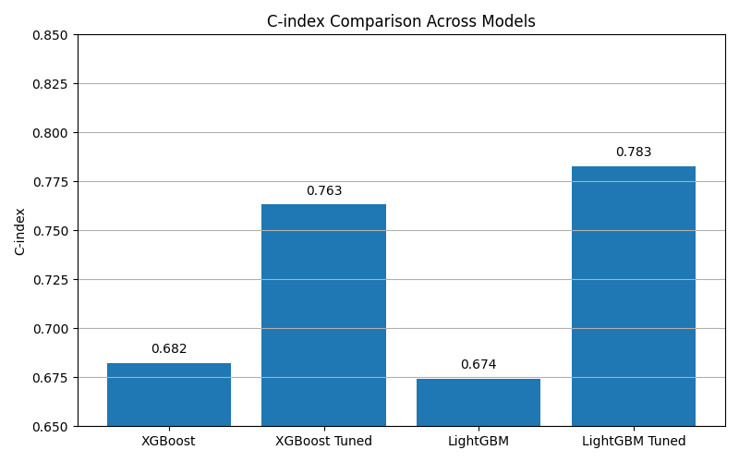
Bar Chart of Model Performance
Figure: Comparative Bar Chart of Mean C-index Values Across All Models
26

Slide 28
Results Analysis
Effectiveness of Hyperparameter Tuning:
Tuning with RandomizedSearchCV significantly improves model discrimination (C-index) and risk group separation in post-HCT survival prediction.
Performance Gains:
LightGBM: +0.1086 improvement in C-index over baseline, achieving 0.7827.
XGBoost: +0.0807 improvement in C-index over baseline, achieving 0.763.
Enhanced interpretability maintained through SHAP, ensuring clinically meaningful insights.
27
Notes:
The results highlight two key takeaways from the study:
Effectiveness of PSO: The Particle Swarm Optimization technique significantly enhances model adaptability, allowing real-time responsiveness to changes in dynamic hospital environments.
Performance Gains: Models tuned with PSO demonstrate improved accuracy, better resource utilization, and heightened responsiveness compared to their untuned counterparts.
These findings underscore PSO's value in optimizing machine learning models for hospital logistics, resulting in more effective and efficient operations.

Slide 29
Conclusion
Effectiveness of Hyperparameter Tuning: RandomizedSearchCV significantly enhanced both LightGBM and XGBoost, improving C-index and risk group separation while maintaining interpretability.
Clinical Relevance: Improved ability to stratify patients into low, medium, and high-risk groups supports better decision-making in post-HCT care.
Final Remark: LightGBM and XGBoost, when carefully tuned, offer robust, interpretable, and fair survival prediction models making them valuable tools for clinical decision support in transplantation outcomes.
28
Notes:
In conclusion, this study demonstrates the Effectiveness of PSO in significantly enhancing the adaptability and efficiency of both SVC and Random Forest models, outperforming traditional static methods.
For Hospital Logistics, this improvement translates into better patient flow management, optimized resource utilization, and streamlined supply chain processes, all critical in a dynamic hospital setting.
Final Remark: Swarm intelligence, particularly PSO, proves to be a powerful tool for addressing complex logistical challenges, offering a robust solution for real-time decision-making in healthcare environments.

Slide 30
Future Work
Hybrid Models: Explore combining LightGBM and XGBoost with deep survival models (e.g., DeepSurv) for capturing complex nonlinear survival patterns.
Real-Time Clinical Testing: Deploy tuned models in real-world hospital EMR systems to validate survival predictions and fairness in live environments.
Advanced Integrations: Incorporate demographic and SDoH (Social Determinants of Health) data for improved fairness, and integrate with clinical dashboards for real-time interpretability using SHAP.
29
Notes:
Looking ahead, there are several avenues for expanding this research:
Hybrid Models: Future work could involve combining PSO with other optimization techniques to enhance scalability and adaptability, creating even more robust solutions for complex environments.
Real-Time Testing: Implementing and testing PSO in live hospital settings would provide valuable real-world validation, helping to refine the model for dynamic, operational challenges.
Advanced Integrations: Integrating PSO with emerging technologies like AI and IoT could unlock predictive capabilities and enable real-time responsiveness, further improving hospital logistics.
These directions offer exciting potential for evolving PSO-based models into fully integrated, predictive systems.

Slide 31
References
Nicolo Cosimo Albanese. “How to Evaluate Survival Analysis Models”. In: Medium (Towards Data Science) (May 2022). URL: https://medium.com/datascience/how-to-evaluate-survival-analysis-models-dd67bc10caae.
Nenny Anggraini et al. A Comparative Analysis of Random Forest, XGBoost and LightGBM Algorithms for Emotion Classifcation in Reddit Comments. https://www.researchgate.net/publication/380736212_A_Comparative_Analysis_of _ Random _ Forest _ XGBoost _ and _ LightGBM _ Algorithms _ for _ Emotion _Classification_in_Reddit_Comments. Accessed: 2025-07-12. 2024.
James Bergstra and Yoshua Bengio. “Random Search for Hyper-Parameter Optimization”. In: Journal of Machine Learning Research 13 (2012), pp. 281–305. URL: https://www.jmlr.org/papers/volume13/bergstra12a/bergstra12a.Pdf
Ananya Basu et al. “SHAP-Explained Machine Learning Model for Predicting Mortality in Gastroschisis: A Multi-Institutional Study”. In: Journal of Neonatal Surgery 12.1 (2023). Accessed: July 17, 2025. URL: https://www.jneonatalsurg.com/index.php/jns/article/view/3235.
Jason Brownlee. XGBoost with Python: Gradient Boosted Trees with XGBoost and scikit-learn. https : / / pdfcoffee . com / xgboostwithpythonsamplepdf - pdf -free.html. Sample PDF retrieved from pdfcoffee.com; Accessed: 2025-07-16.2020.
Kaggle. Equity in Post-Transplant Survival: A Challenge to Improve Risk Prediction. https : / / www . kaggle . com / competitions / equity - post - HCT - survival - predictions. Accessed: July 2025. 2023.

Slide 32
THANK YOU

