Slide 1
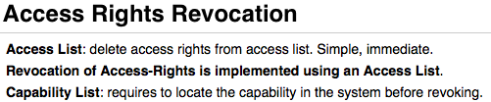
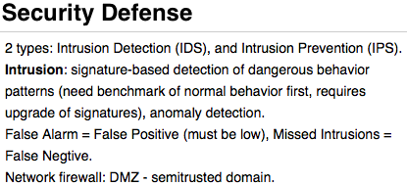
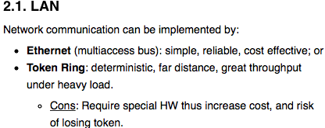

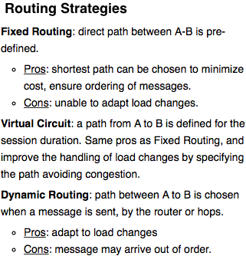


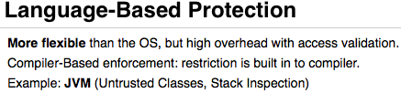

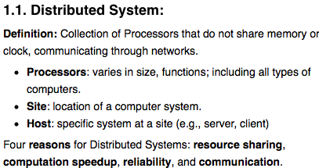
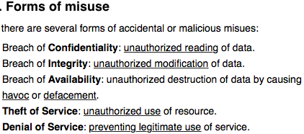
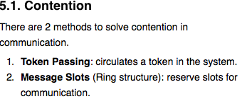
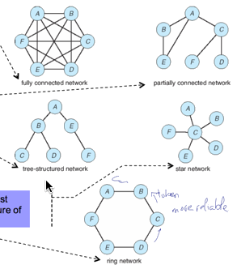
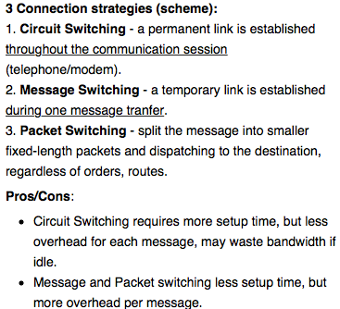
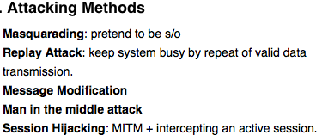
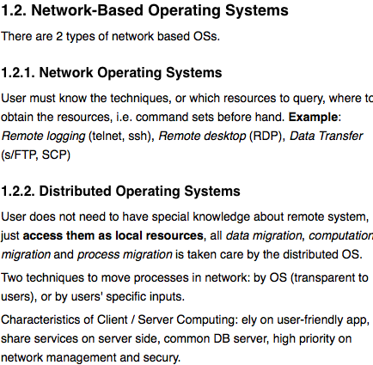
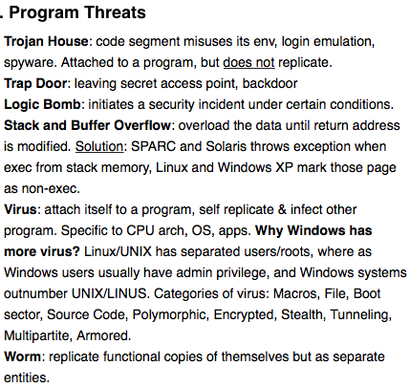
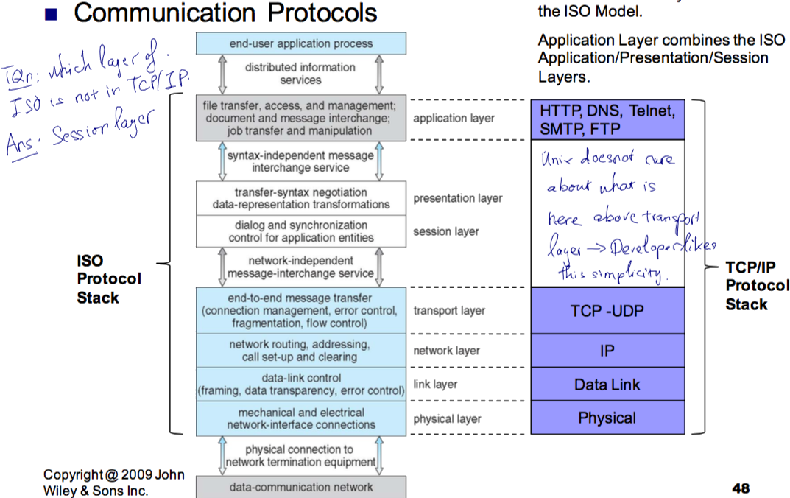
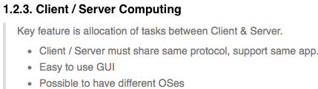
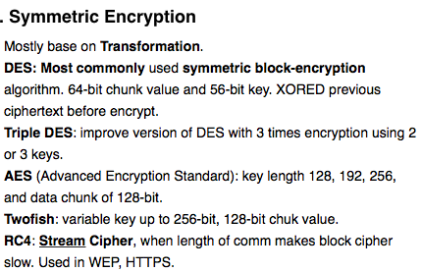
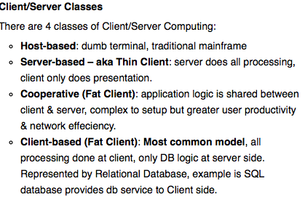
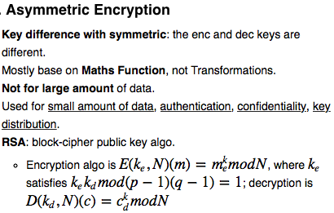
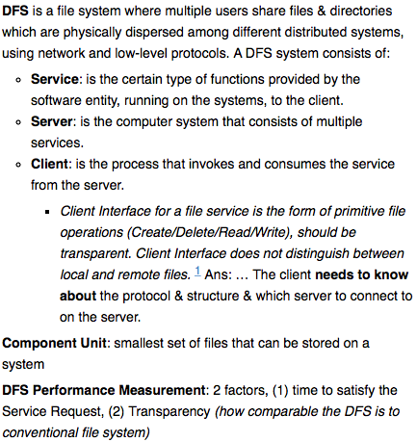
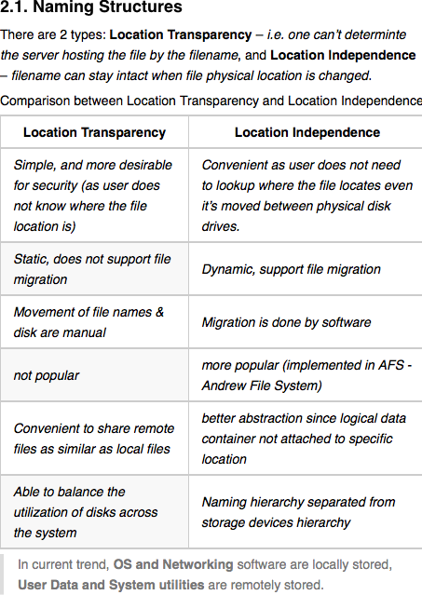
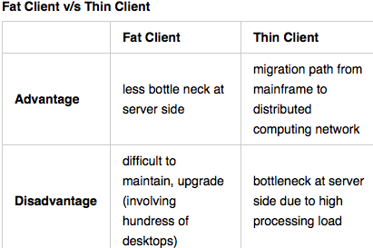
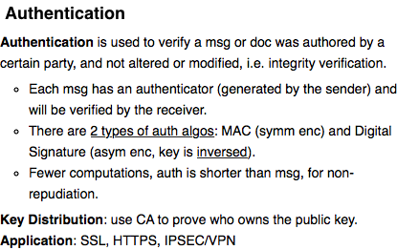
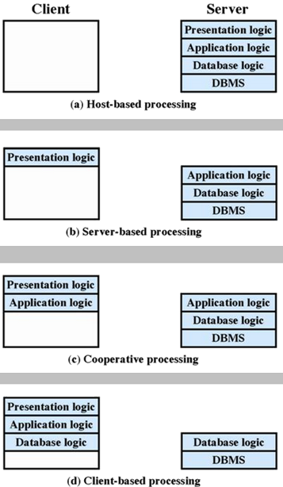
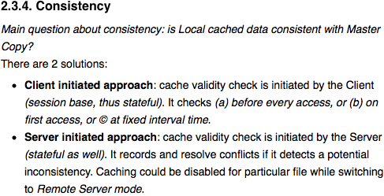

Network Topology
Has different topologies, such as Fully Connected Network, Partially Connected Network, Tree-Structured, Star Network, or Ring Network.
Communication Structure
5 basic problems to solve: Naming and name resolution, Routing strategies, connection strategies, and Contention.
Design Issues
To be considered when designing a distributed system structures:
Transparency
Fault Tolerance
Scalability
Clusters
Robustness
Able to detect link failure, site failure or message lost.
Reconfiguration
Ability to reconfigure & recover on failure and resume operation.

Slide 2
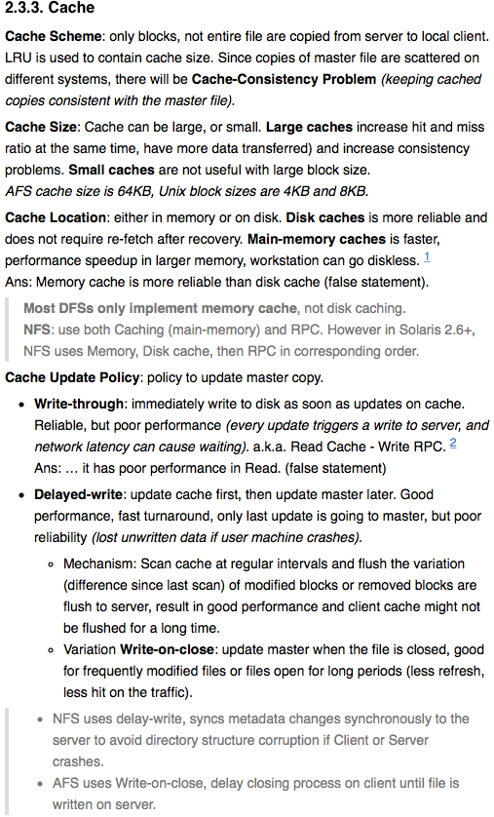
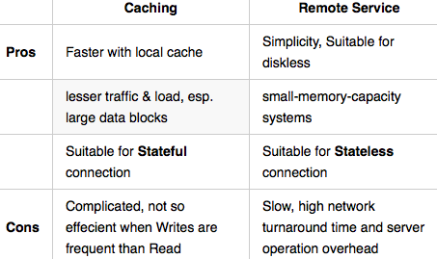
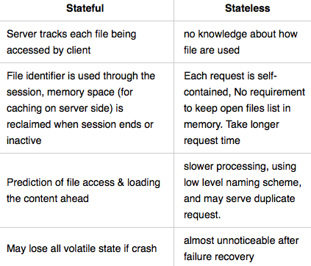
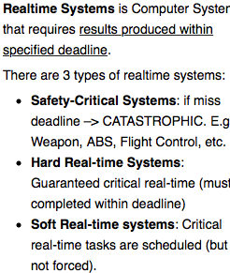
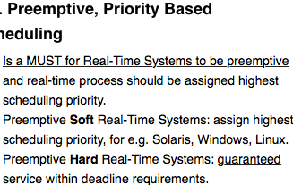
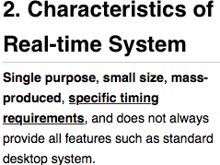

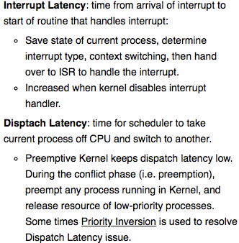
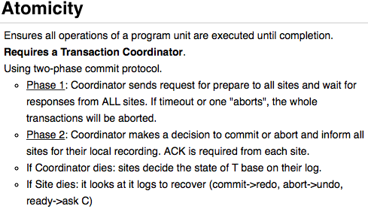
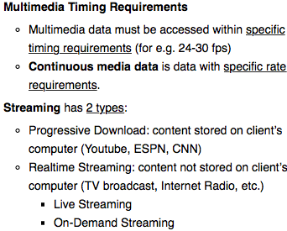
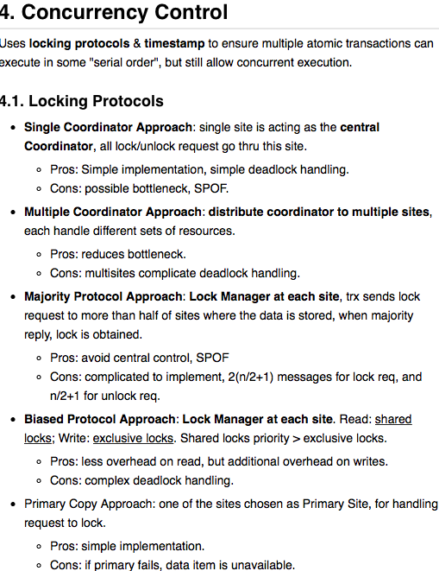
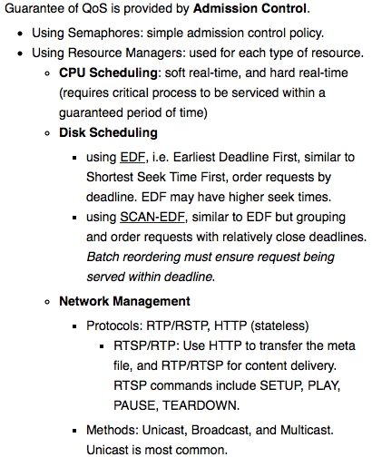
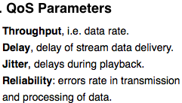
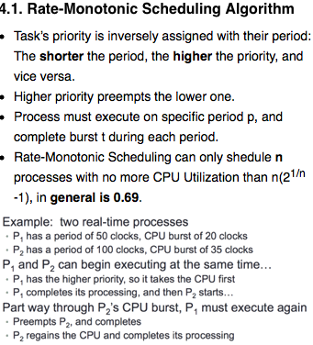
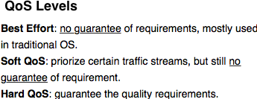
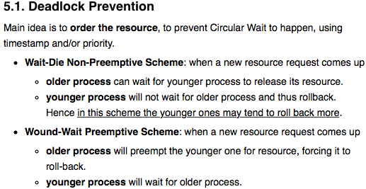
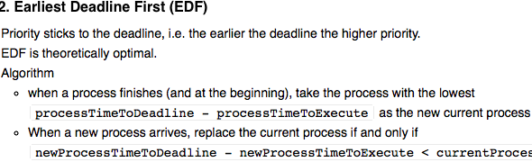
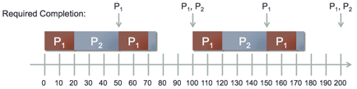
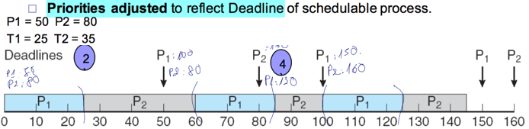
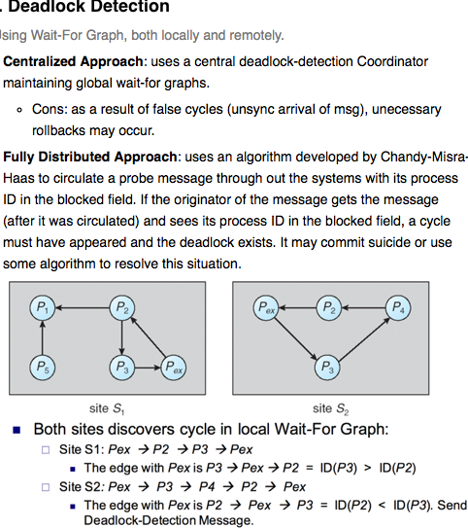
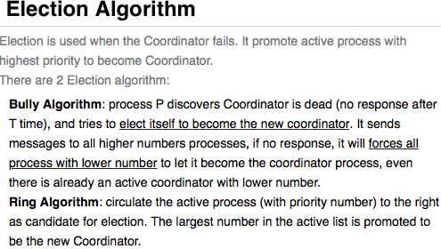
NFS V4
stateful, no mount protocol
support open() and close(), Client local cache, file locks (by client to server)
AFS
Has 2 namespaces: local, and shared.
Local: its root file system
Shared: made up of several component units (volumes), communicate to server through Vice, using fid to identifies the Vice. A fid contains:
Volume Number: access point to server, change if server change. (there is mapping of VolumeID to IP)
Vnode Number: inodes of files in single volume.
Uniquifier: unique identifier, allows reuse of vnode numbers for same file path.
Fid is location transparent, file moved on server does not affect fid. The Volume location is kept on Vice server thus Fid does not need to care about real location of the server.
Fundamental Architecture: Use whole file caching, 64KB cache size.
Open: Read cache from Vice
Close: write changes to Server.
Cache is assumed valid unless notified by Server using callback policy (consistency of files are managed by the server, using callback for notification of changes). > callback_policy: when a file is cached, the server makes a note of this and promises to inform the client if the file is updated by someone else. Callbacks are discarded and must be re-established after any client, server, or network failure, including a time-out. Re-establishing a callback involves a status check and does not require re-reading the file itself.
Security:
No execution of client program on Vice System.
Encrypted messages for communication
Protection: has Access Lists for access control.
Implementation: at UNIX kernel with a set of system calls, include
path-name translation (volume, file, fid)
Venus uses client’s disk for data caching. For file status caching, it uses virtual memory.
the Venus (AFS interface) and server use inodes for file access instead of path name.
Uses LRU algorithm for cache size containment.
Distributed coordination controls several mechanisms to ensure the Distributed Environment is working in order.
Event ordering
Mutual Exclusion
Atomicity
Concurrency Control
Deadlock Handling
Election Algorithms
Reaching Agreement
Mutual Exclusion - In Distributed Environment
Using one of these 2 approaches: event ordering & timestamp, token passing.
Event Ordering:
if other process is about to enter its CS, it will compare its clock v/s the timestamp in the message.
if its clock ≤ timestamp, it proceeds to CS and defer replying.
if its clock > timestamp, it replies immediately to the requestor and defer going to CS.
Proportional Share Scheduling
CPU shares are divided proportionally to the the deadline, if deadline is short, more shares.
VxWorks
VxWorks 5 does not distinguish between User mode and Kernel mode (only in v6).
Events are handled in kernel.
Quality of Service (QoS)
Requires both CPU, Disk, and Network. Rate requirements are most important to QoS
There are 3 or 4 MPEG schemes
MPEG-1:
Used for low-res video, 1.5Mbps.
MP3 audio
Compression ratio 200:1
MPEG-2:
Used for DVD and HDTV local playback.
Higer level (res) and profile (quality) video compression, 1.5Mbps to 15Mbps.
MPEG-3 (discontinued)
MPEG-4:
Used for transmitting audio/video via internet.
Scalable quality.
1. What is FALSE for distributed systems?
Site separated for security.
2. Which is not the behavior of Distributed OS?
Desktop migration used by OS to transfer GUI, etc.
3. Which is server based processing?
Client responsible for GUI, server do all the work.
4. FALSE statement about Token Ring?
All statements are true.
5. What is FQDN address?
sau@svuca.edu
6. Which routing is more adaptable to load changes?
Dynamic Routing.
7. Which message switching with variable length can take different path in the network?
Packet Switching.
8. Which layer of ISO is not in TCP/IP?
Session layer.
9. Which behavior does NOT belong to Network OS?
Need to know which resource to look for.
Token Passing Potential issues:
Lost token –> Re-election.
Failed process –> form a new logical ring.
1.What is the key security enabler?
Encryption.
2.Difference between Virus & Trojan Horse?
Trojan Horse does not replicate, while Virus does.
3.Why Windows has more virus?
- Windows is more popular, and Windows users usually have admin rights.
4.Difference between Virus and Worm?
Worm replicate itself as virus, but different entities (virus attaches itself to the host).
5. Is it feasible to derive Dec from End in Asymmetric, Symmetric?
No, Yes.
6. What are the key part in Authentication?
Authenticators, used to verify the authenticity of the messages.
7. Is Authentication Symmetric or Asymmetric?
Asymmetric, computer holding verification method can’t generate authenticator.
8. How many bits MD5 produces?
128 bits.
9. How many bits SHA-1/2 produces?
160 / 224 or 256
10. Which division of computer security is highest/lowest in US Department of Defense?
Highest: A, Lowest: D
Pthread API
Pthread API is used to manage real-time threads.
SCHED_FIFO - for FCFS with a FIO queue, no time slicing.
SCHEDRR - SCHEDFIFO with time-slicing for equal share of CPU time with same priority threads.
SCHED_OTHER: not sure.
1. Which is FALSE about Happen Before?
A->B, B->C and A does not have relationship with C.
2. If a process receives a message & about to enter its CS, what should it do?
Check its timestamp & compare before decide to reply or defer.
3. Which algorithm uses coordinator & receives requests from all process?
Centralized approach.
4. Which locking protocol is NOT concurrency control?
Exclusive Protocol (no such thing)
5. Which one favors younger process rolled back often?
Wait-Die
1. Which one is life threating hard realtime system scheduling?
ABS.
2. Why Virtual Mem is not good for hard Real-time system?
Translation Time.
3. Which is not related to Interrupt Latency?
Use the scheduler to schedule the highest priority ISR (in fact, dispatch latency)
4. Which one is NOT associate with Dispatch latency
Select the Interrupt Service Routine. (this is interrupt Routine)
5. Which statement is FALSE with Rate Monotonic?
The lower the rate, the lower the priority (should be higher)
6. Which one is NOT the parameter for Realtime scheduling?
SHED_NORMAL
1. False Statement about DFS?
The client needs to know about the protocol & structure & which service to connect to on the server.
2. What is wrong for memory cache?
Memory cache is MORE reliable than disk cache.
3. Which one False about Write Through?
It has poor performance in READ.
4. Which one is TRUE for stateless?
Each request identifies the file and position in full.
5. In AFS, consistency of files is managed by whom?
By server, relying on the callback provided by the client so the server can tell client when file got change.
6. What is the technique used by AFS?
Whole File Caching.

