Slide 1
FICAN-OSCAR DREAM Anti-PD1 Challenge
Teemu Daniel Laajala
April 9th, 2021
On behalf of team FICAN-OSCAR

Slide 2
The FICAN-OSCAR team
Collaborative effort between Uni. Turku & Helsinki and FICAN in Finland
Anni S. Halkola (ASH) 1
PhD student, University of Turku
Tuomas Mirtti (TM) 2,3
MD/PhD, University of Helsinki
Mikko I. Mäyränpää (MIM) 2
MD/PhD, University of Helsinki
Teemu Daniel Laajala (TDL) 1,4
PhD, FICAN Cancer Researcher, University of Turku
1: Department of Mathematics and Statistics, University of Turku, Finland, 2: Department of Pathology, Helsinki University Hospital and University of Helsinki, Finland, 3: Research Program in Systems Oncology (ONCOSYS), Faculty of Medicine, University of Helsinki, Finland, 4: FICAN Cancer Researcher, The Finnish Cancer Institute, Finland

Slide 3
Author contribution
Data curation and cleaning: ASH, TDL
Generic R coding for modelling, submissions and improving the OSCAR method and package: ASH, TDL
Final feature selection and mathematical modelling: TDL
Biological and clinical insight: TM, MIM
Supervision of the project: TDL
All authors read & contributed to write-up, and were part in overall participation in the challenge

Slide 4
Motivation for participation
Developing, benchmarking and use scenario for our OSCAR method
L0-quasinorm based R-package (unpublished)
Past success with penalized regression e.g. in Guinney, Wang, Laajala et al. Lancet Oncol 2017, DREAM 9.5 mCRPC Challenge
Rising interest in IO and its clinical applicability
Mirtti & Mäyränpää
End-point correlations PFS/OS/non-PD disease
Interesting aspect to explore, discovered during the challenge
Relevance to other on-going research (TDL), understanding especially the immune-related trends (e.g. BCG treatment in Bladder Cancer)

Slide 5
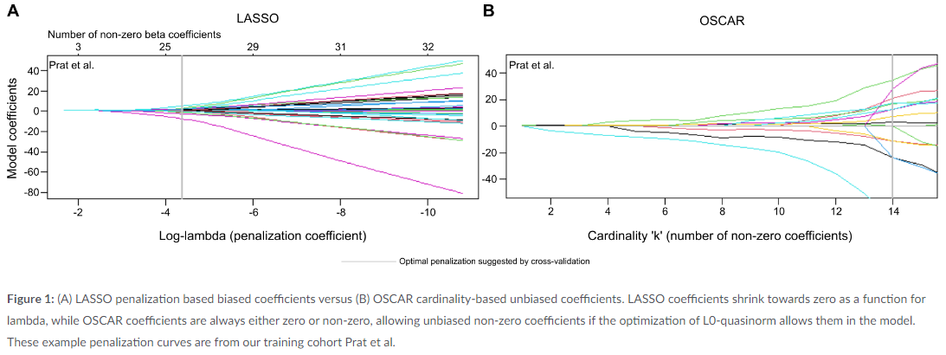
L0-quasinorm (OSCAR methodology)
Known as ‘best subset selection’, L0-penalization aims at identifying best features that are either included or excluded (vs. shrinking in LASSO)

Slide 6
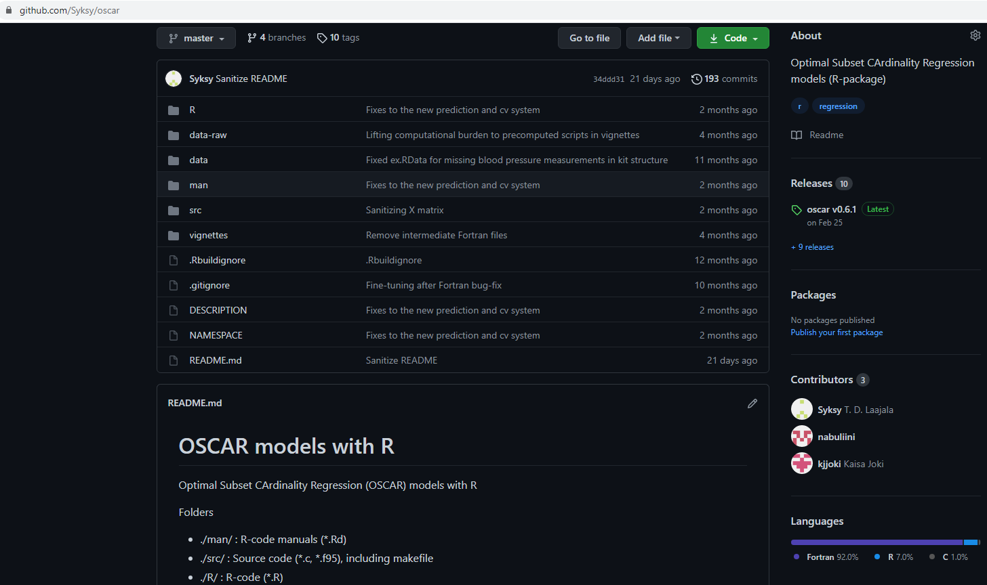
Optimal Subset CArdinality Regression (OSCAR)
L0-quasinorm penalized regression (gaussian, Cox, and logistic regr.)
10-fold cross-validation to select optimal model cardinality
Prefiltering of features based on literature
Single genes or gene sets connected to NSCLC, IO, anti-PD1
Run times to consider
Package under development

Slide 7
Multipurpose predictive model
Literature supports that for varying end points (PFS, OS, response yes/no), same features play a role despite differences in e.g. hazard ratio estimates
Gyawali B, Hey SP, Kesselheim AS. A Comparison of Response Patterns for Progression-Free Survival and Overall Survival Following Treatment for Cancer With PD-1 Inhibitors: A Meta-analysis of Correlation and Differences in Effect Sizes. JAMA Netw Open. 2018 Jun 1;1(2):e180416. doi: 10.1001/jamanetworkopen.2018.0416.
Shukuya T, Mori K, Amann JM, Bertino EM, Otterson GA, Shields PG, Morita S, Carbone DP. Relationship between Overall Survival and Response or Progression-Free Survival in Advanced Non-Small Cell Lung Cancer Patients Treated with Anti-PD-1/PD-L1 Antibodies. J Thorac Oncol. 2016 Nov;11(11):1927-1939. doi: 10.1016/j.jtho.2016.07.017.

Slide 8
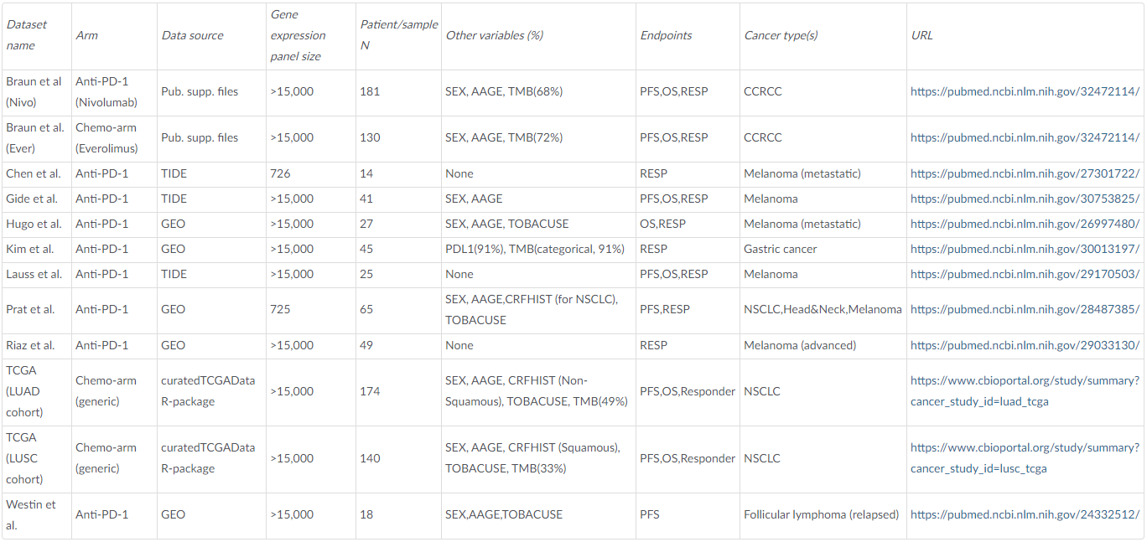
Training data
Chemo control arms
NSCLC data
Melanoma data
TMB available

Slide 9
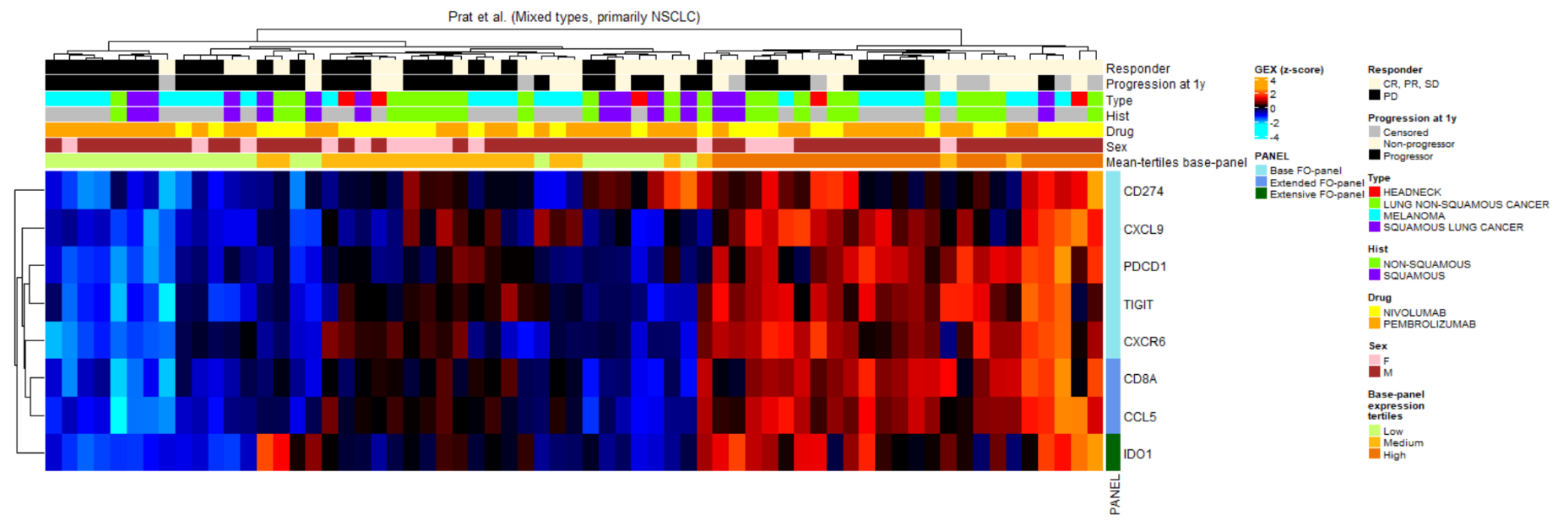
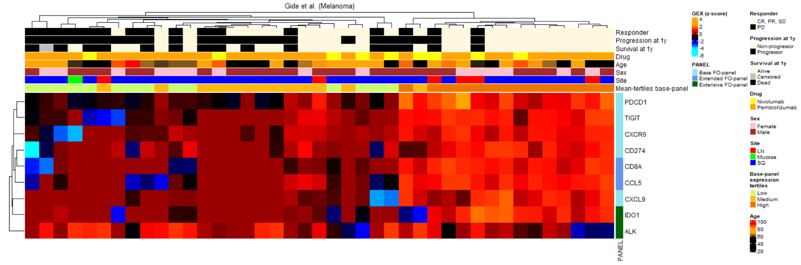
Training data predictive examples
End-point
associations

Slide 10
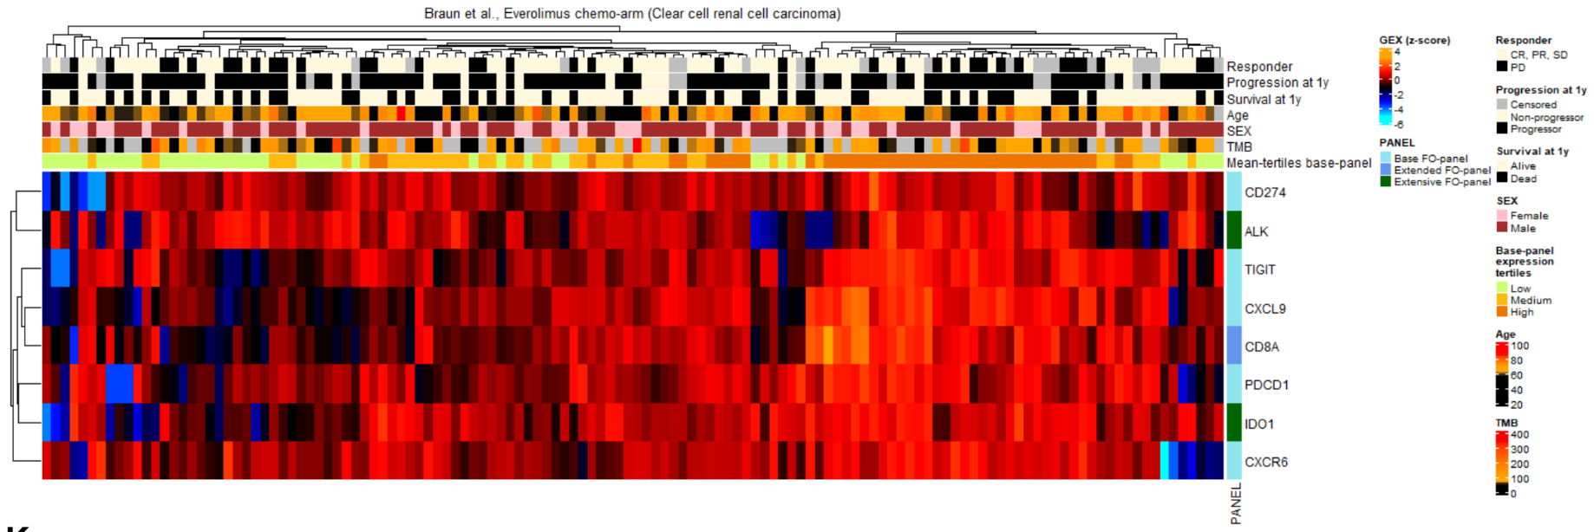
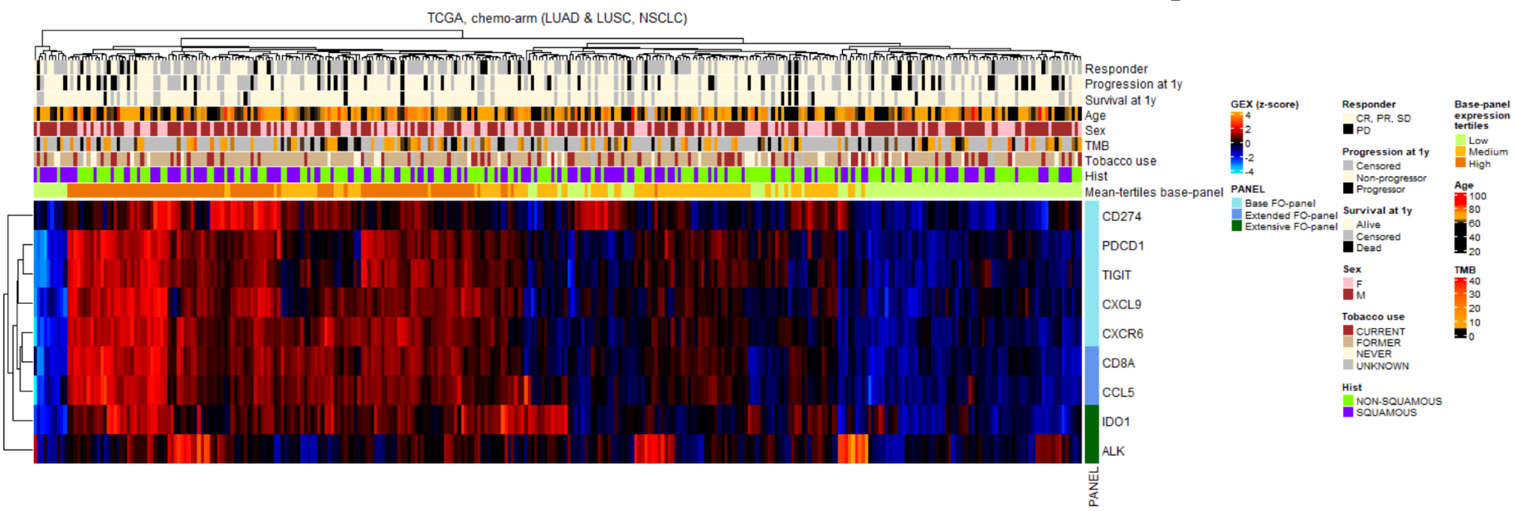
Training data prognostic chemo-arms
Here for example sorting by gene panel mean tertiles show no connection to end-points

Slide 11
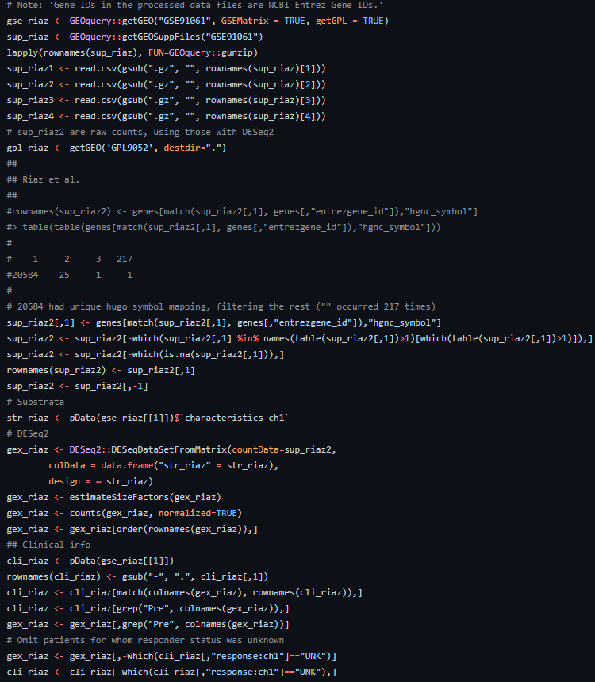
Processing of transcriptomic data
Data for which only readily normalized values were available were used without DESeq2; raw data was run through a standard DESeq2 pipeline
DESeq2
DESeqDataSetFromMatrix(…)
estimateSizeFactors(…)
counts(…, normalized=TRUE)
Transformation where necessary: log(x+1)
Effect size harmonization between cohorts

Slide 12
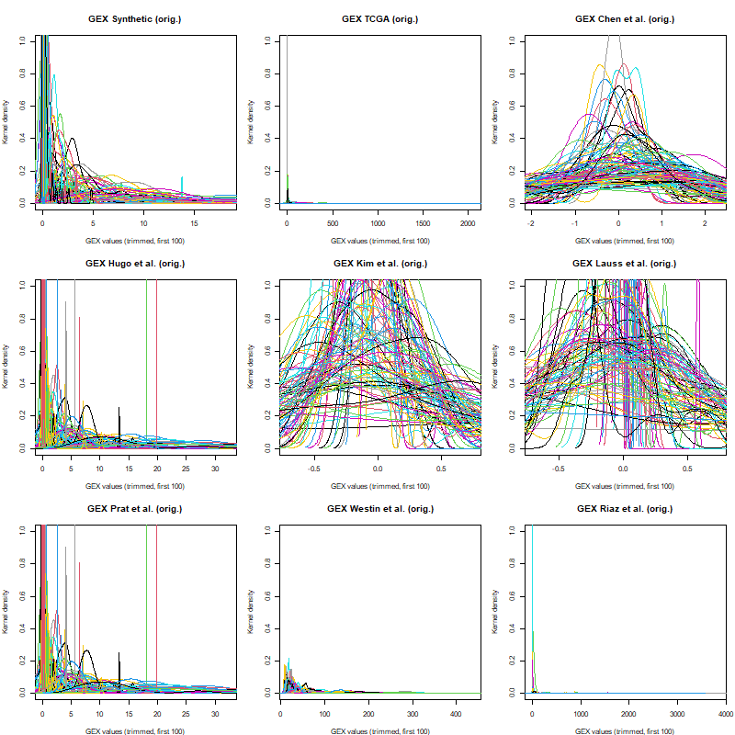
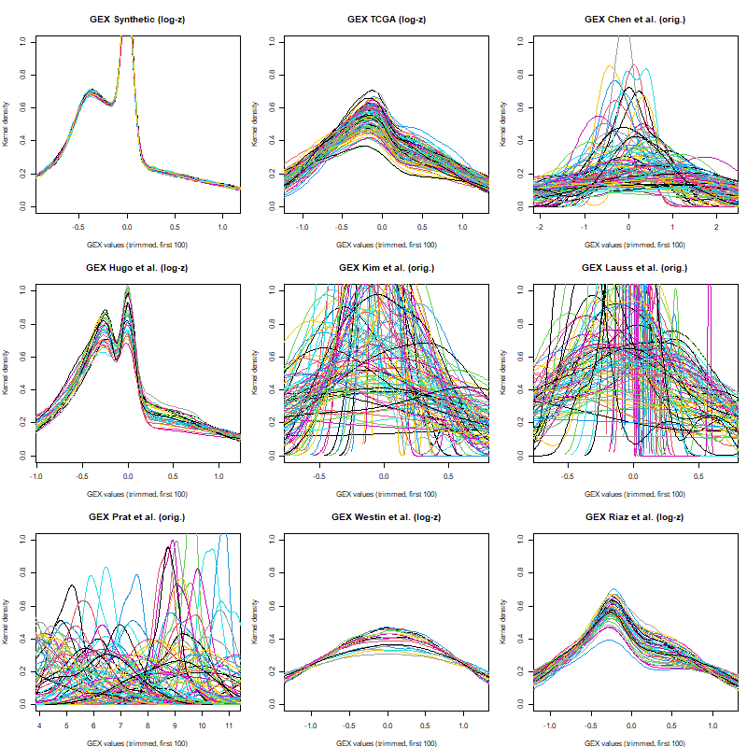
Simple log-transform to harmonize platforms
log(x+1) for count-like data

Slide 13
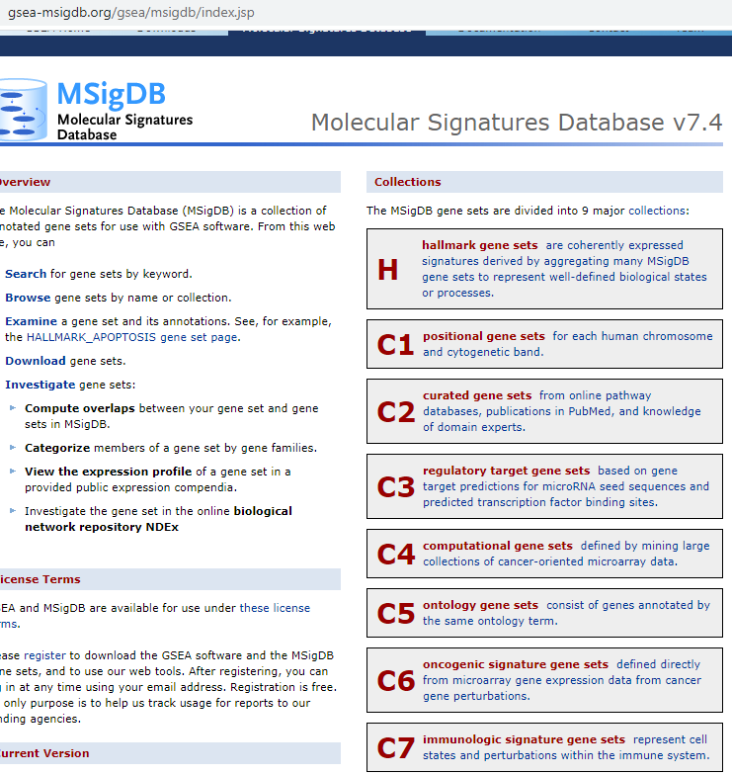
Derived variables (R-packages)
GSVA
Existing MSigDB GMT-pathways
Filtered down to most relevant pathways based on regular expressions
Custom GMT-pathways
Iteratively constructed by adding significant genes to the custom Anti-PD1 pathway (“FICAN-OSCAR panel”)
immunedeconv wrapper package, choosing methods that are least sensitive to underlying data distribution/normalization
xCell
MCP-counter
Used as input for OSCAR estimated with GSVA both with mx.diff = TRUE and FALSE, after regulator expression filtering and hand-picking relevant gene sets

Slide 14
Issues with derived variables
xCell
Fails without key genes (Prat et al., Chen et al. with targeted panels)
MCP-counter
Fails in the cloud, due to requiring internet access
We tried to compensate these by creating custom GMT files for MCP-counter scoring genes and corresponding cell types
GMTs (gene pathway annotation format)
In the smallest gene panels, some GMTs could not be given a reliable estimate via GSVA due to lack of gene overlap

Slide 15
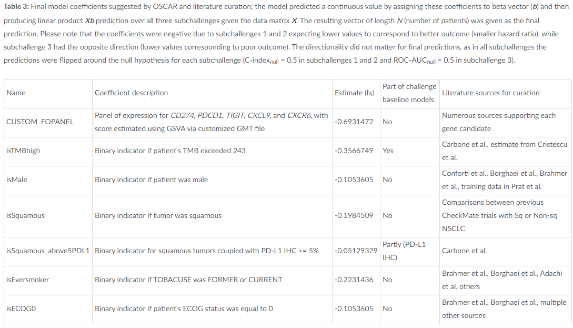
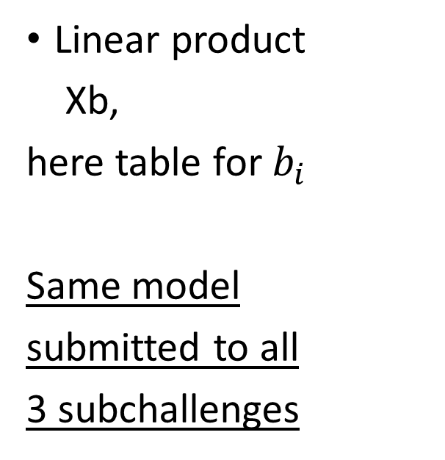
Final linear model
Linear product
Xb,
here table for$b_{i}$
Same model
submitted to all
3 subchallenges
beta-vector (most weight on our gene panel)

Slide 16
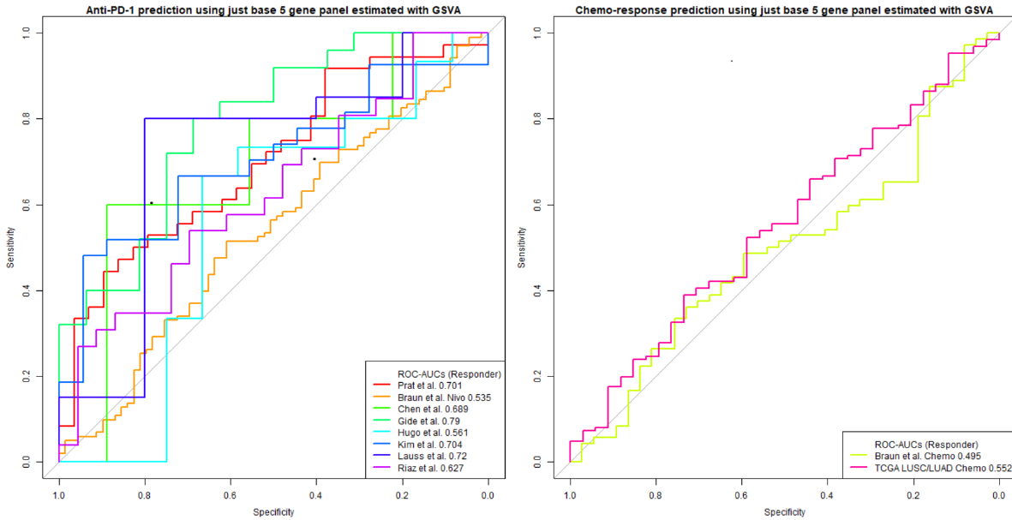
Model performance in training data (5 gene panel)
Generally high accuracy with c-index in PFS/OS, while random in chemo-arms
Varying ROC-AUC in subch 3, while random in chemo-arms

Slide 17
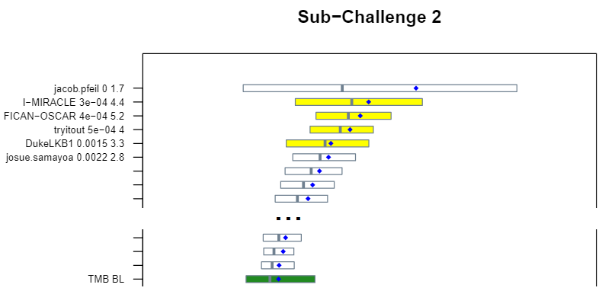
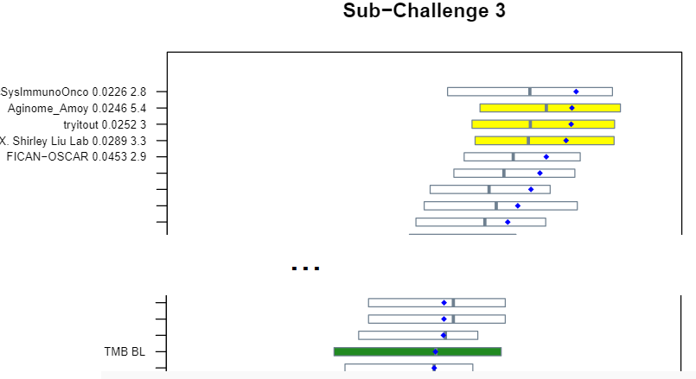
Model performance over subchallenges
Subch1: in top 10
Subch2: BF=5.2
Subch3: BF=2.9
in comparison with TMB baseline model (Figs from Synapse by Dr. Mason)

Slide 18
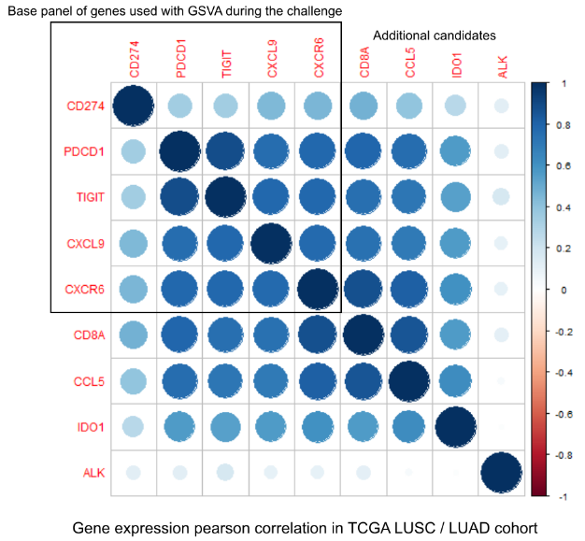
Used genes in challenge and early extensions
CD274, PDCD1, TIGIT, CXCL9, CXCR6
“Base panel” used as GMT
CD8A, CCL5, IDO1
Genes we’d first look into
ALK
ALK rearrangements probably play a different role in CSCLC

Slide 19
Biological interpretation
Key characteristics our model is able to capture:
“Cold vs. hot” tumors; such tumor microenvironment characterization has been found to be highly predictive of ICB effectiveness (Duan et al., 2020)
Recruitment of anti-tumor inflammatory cells to the tumors and thus crucial to IO-treatment efficacy (Tokunaga et al., 2018)
CD274, PDCD1 & TIGIT
CXCL9 (C-X-C Motif Chemokine Ligand 9)
CXCR6 (C-X-C Motif Chemokine Receptor 6)
For future, e.g. better characterizing tumor microenvironment:
CD8A (T-Cell Surface Glycoprotein CD8 Alpha Chain)
CCL5 (C-C Motif Chemokine Ligand 5)
IDO1 (Indoleamine 2,3-Dioxygenase 1)

Slide 20
Previously identified predictive factors
There were a number of previously identified factors presumably predictive for anti-PD1 efficacy that were could not be reproduced
Data representativeness
The reported sets were coded as GMT gene sets for GSVA
Either showed no predictive signal in our training data, or simultaneously showed signal in chemo-arms and were eliminated
INF-gamma related pathways (e.g. Ayers et al., 2017)
Tumor Inflammatory Signature (TIS) (Damotte et al., 2019)
Antigen Processing & Presentation Machinery (APM) (Thompson et al., 2020)
Multiple interesting GMTs, such as HALLMARK_EPITHELIAL-MESENCHYMAL_TRANSITION, PID_CD8_TCR_PATHWAY, …
Among others, PDCD1LG2, CD80, ATG7, HLA-E, ICOS, … appeared prognostic

Slide 21
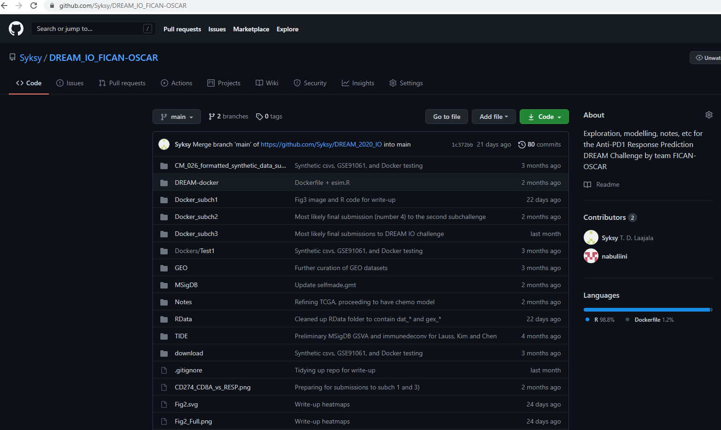
Participation in DREAM Anti-PD1 Challenge
TDL
Training data provided in our GitHub project page
Includes OSCAR training scripts, cross-validation, write-up figures, benchmarking etc.
ASH

Slide 22
Challenges during the challenge
Finding representative NSCLC data for the Checkmate 026 trial proved extremely difficult
Prat et al. was our only predictive training cohort containing NSCLC samples
Even non-NSCLC cohorts rarely reported key variables, e.g. TMB
Contacted corresponding authors without responses
Kim et al. (Gastric cancer) and Braun et al. (CCRCC) presented TMB without predictive signal
Timeline issues, e.g. access to DAC-controlled sequencing data / cohorts
E.g. we could not model BCR or TCR markers (MiXCR), and did not guess their effect
Generalizing between cancers
CCRCC proved to be badly representative (lack of TMB effect)
Melanoma is overrepresented in our conclusions
A lot of literature-supported “gut feeling” was utilized
Despite 10-f CV for OSCAR, there’s a lot of modeller’s subjectivity present

Slide 23
Future directions
We would be very interested in validating some of our gene candidates which did not end up in our final 5-gene panel
Possibility for later Docker-submission for Checkmate 026?
Gathering post-community benchmark datasets which we may have missed?
Further exploring of immune cell deconvolution methods
Immune-response (ir) end-points presented e.g. in Braun et al. and discussed in Gyawali et al 2018
irPFS, irOS, irRESP may provide more robust overview to clinical utility of the models
RECIST criteria representative in immuno-oncology? Neoprogression, other factors that may confound PFS? Etc
May partially explain e.g. patient cross-over in Kaplan-Meiers

Slide 24
Thank you for your attention!
Acknowledgements:
TDL was funded as a FICAN Cancer Researcher by the Finnish Cancer Institute.
MIM was funded by The Finnish Medical Foundation.
ASH was funded by University of Turku Graduate School (MATTI).

