Slide 1
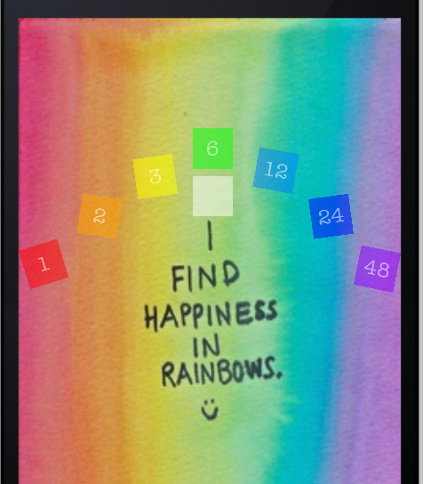



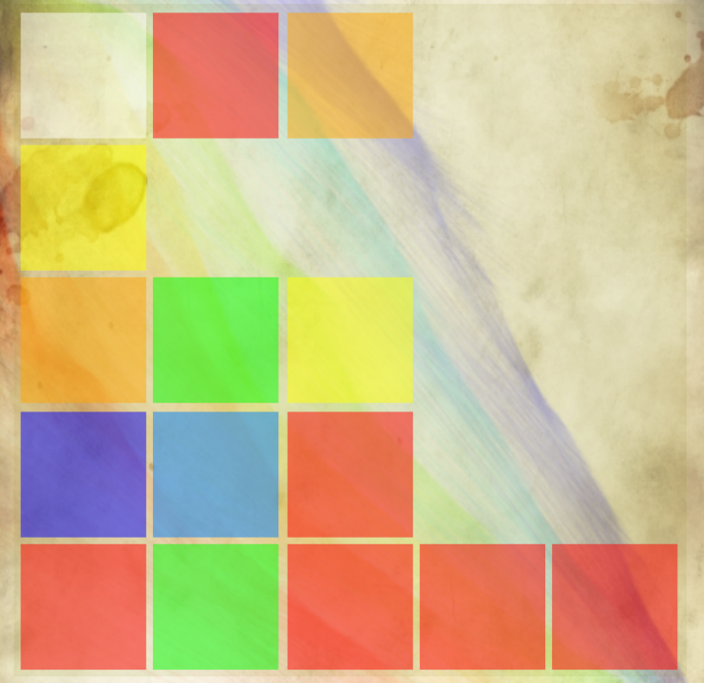
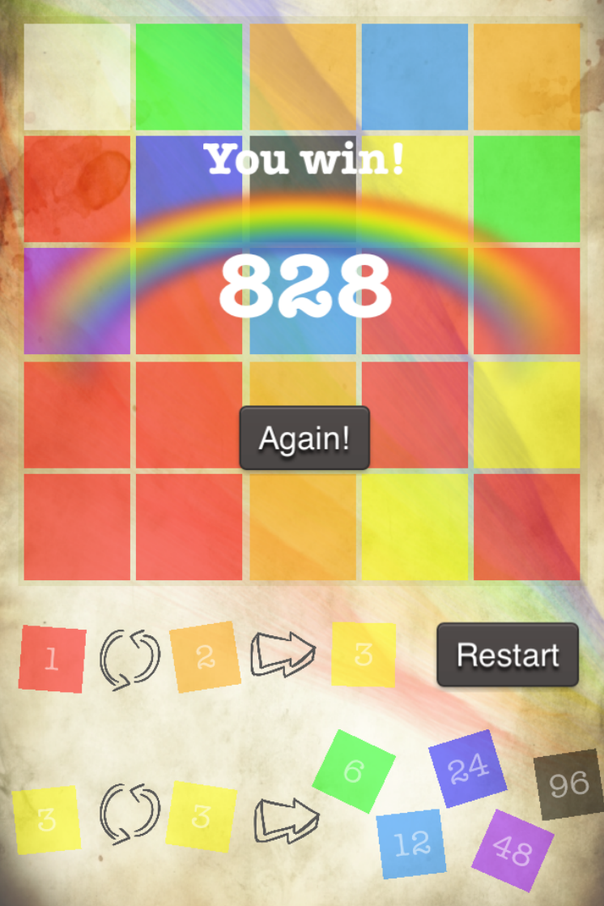
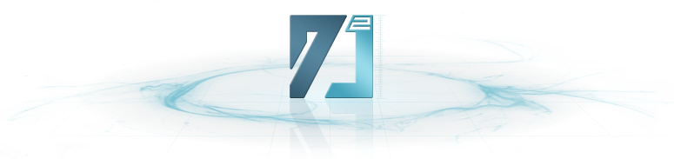
Rainbow Tiles Pinchao Wang
The Game
Simple, Elegant and Maddening Grid Puzzle Game!
A colorful puzzle that grows on you
Swipe and join the tiles with the same color to collect all the colors needed for forming a rainbow
Stay away from the clear tile, it may eat all the other tiles
Not all the same tiles can join together, always join red and orange tiles first to generate tiles that can be merged
Designed for the iPhone
Written in Objective-C
Built on Cocos2D Game Engine
Physics by
Challenges
Set Variable Colors to Tiles
Add a CCLableTTF to CCNodeColor of the Tile CCNode
Set an implicit value to the tile, and connect the value to its CCLableTTF value
Get the implicit value of the Tile CCNode, and update its color according to the value
Move the Tiles
For every column, detect the movement direction, and select the tiles that need to be moved
Determine how far it can be moved and get the farthest position
Repeat the first two steps until all tiles of the column have been moved
Merge Condition and Eat Condition
Reuse the implicit value of the tiles and compare the values to get the relationship between every pair of adjacent tiles
In most cases, merge the tiles with the same implicit value into one
Use 0 to represent clear tile, 1 and 2 to represent red and orange tiles. And set special merge methods for tiles with these implicit values
Notable Features
Simple to Operate
Swipe the screen to move and merge all the tiles
Restart the game whenever you want
Various Strategies
Join red and orange tiles first to generate tiles that can be merged
Merge tiles with the same color to generate tiles with other colors
Beware of the clear tile in case it eats some useful tiles, and try to use it to eliminate some useless tiles
Assets
Tiles - Varied colors, each with its own implicit value
Tiles - Randomly generated and distributed on screen, swipe to move and merge
Rainbows - Vivid artistic images with strong visual effect
Music - Wonderful background music and variable sound effects
Inheritance of a Wonderful and Bright Idea
Conceptually similar to 2048 by Gabriele Cirulli

