Slide 1
SKYROSEMARKETING AGENCY : ANALYZING COSUMER DEMAND
BY
SYLESH KUMAR PALANICHAMY GOMATHY

Slide 2
BACKGROUND:
SKYROSEMARKETING AGENCY
Vice President : Cynthia Wright
Services offered: Marketing insights
Team size : 4
Client domain : Beverages
Clients
New clients
Existing clients
Downtown Brew Co.
On the rocks Whiskey
Vintage Vino

Slide 3



PROBLEM STATEMENT:
Problems
Absence of a precise forecasting strategy
Poor work-life balance of the employees
Goal:
To predict the highly fluctuating and cyclical consumer demand of the products
Data:
Relative search popularity of the products from Google trends database
Craft beer
Whiskey
White wine

Slide 4
ASSUMPTION:
The time series data is free from outliners
Any existing random shock is randomly distributed.
The error is assumed to be randomly distributed.
The time series is stationary. The statistical properties of the time series do not depend on the time of observation

Slide 5
MODEL:
Exploratory Data Analysis
Model testing
Model Building
Mean baseline
Data preparation
Training data:2010-2014
Naive baseline
Data
Descriptive statistics
Forecasting
Seasonal naive baseline
Testing data:2015
Drift baseline
ADF test
SARIMAX
Prophet

Slide 6
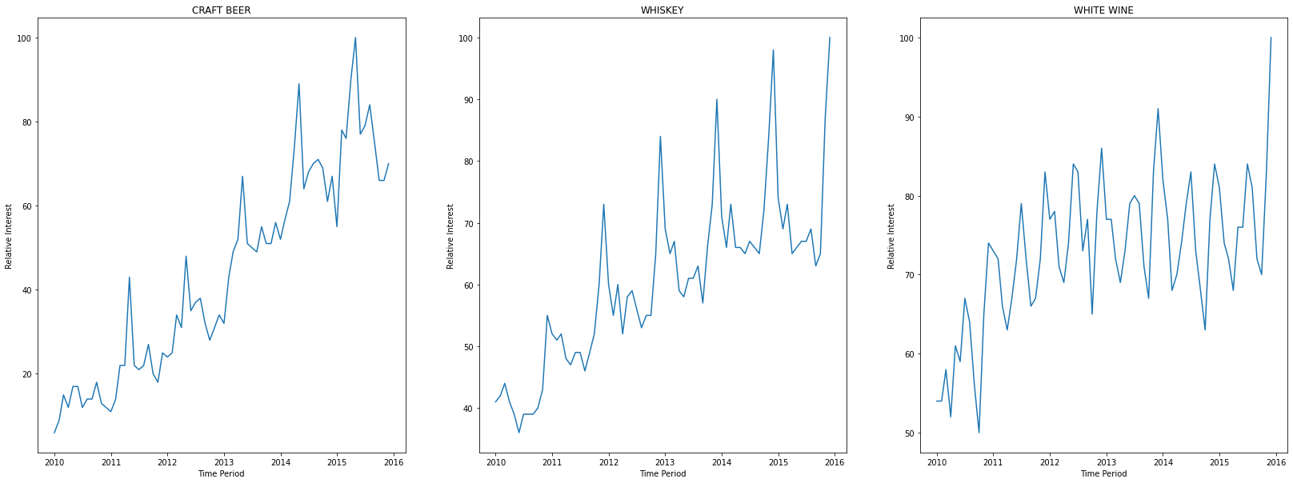
EXPLORATORY DATA ANALYSIS:
Relative Interest vs Time period

Slide 7
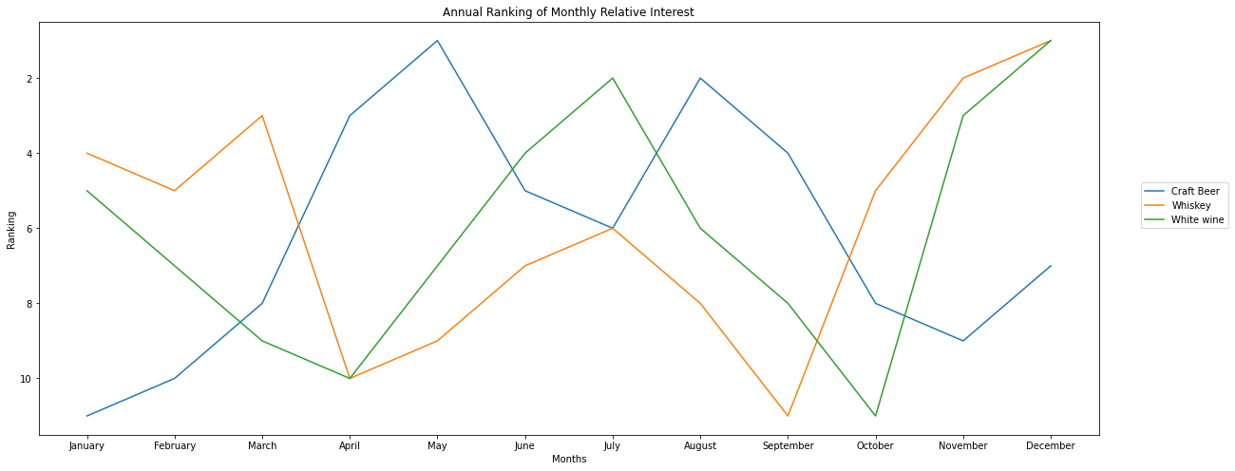
EXPLORATORY DATA ANALYSIS:
Month vs Ranking

Slide 8
EXPLORATORY DATA ANALYSIS:
Augmented Dickey–Fuller test
Time series Data
Stationary
Non Stationary
Whiskey
White wine
Craft Beer

Slide 9
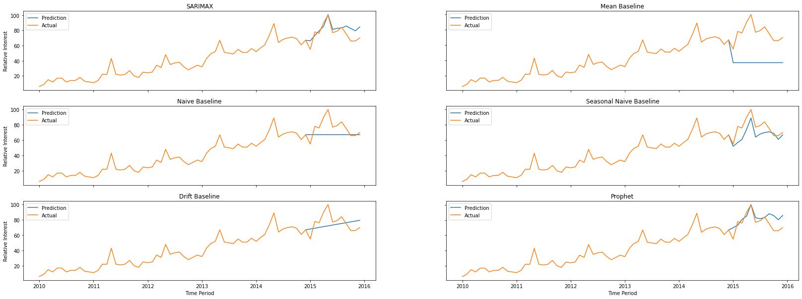
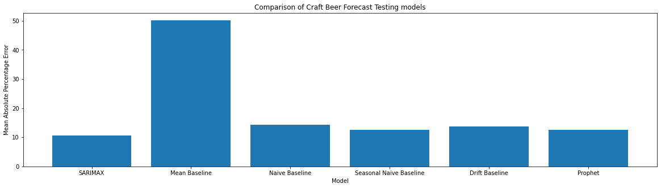
Model Testing – Craft Beer:

Slide 10
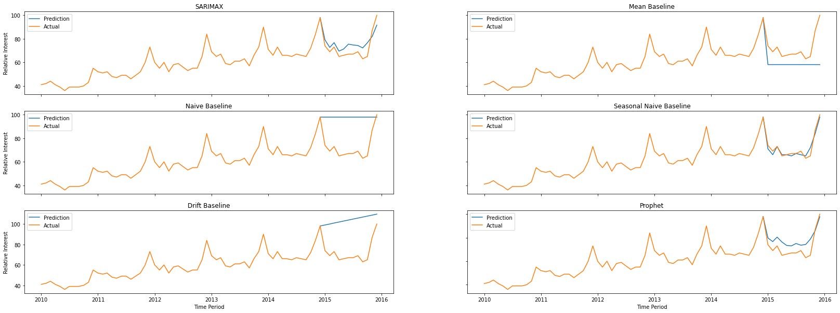
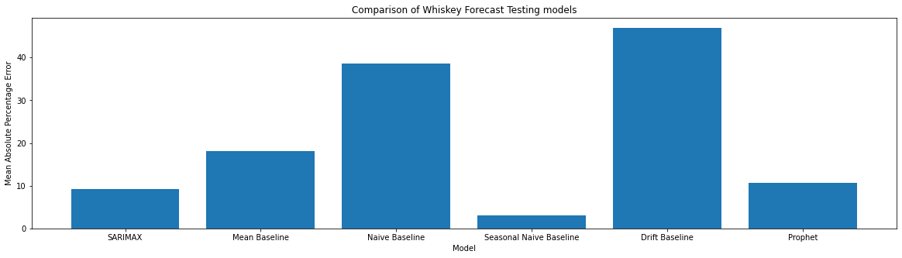
Model Testing -Whiskey:

Slide 11
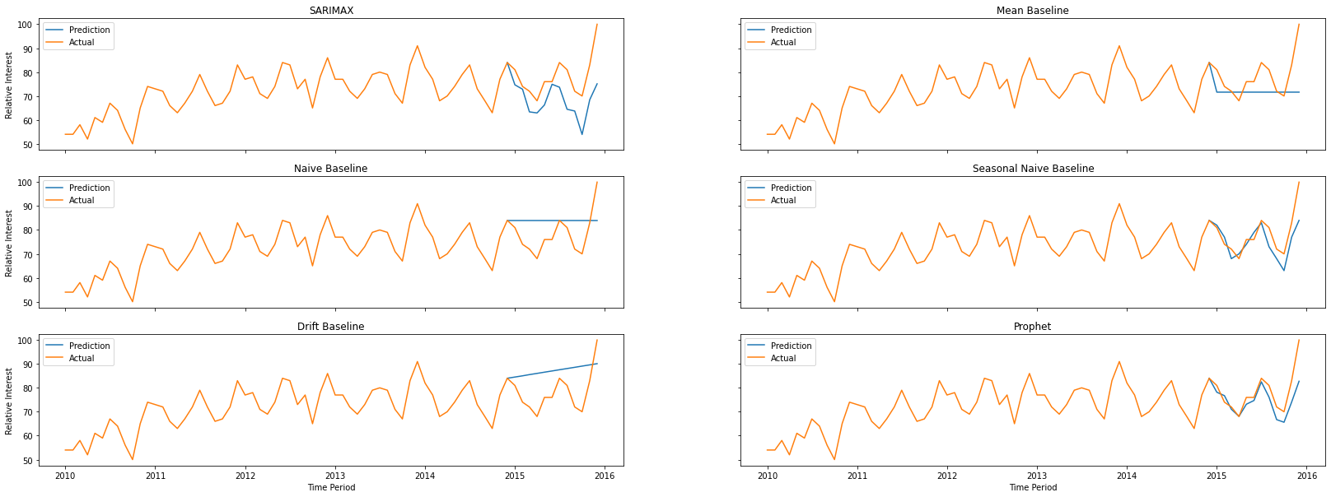
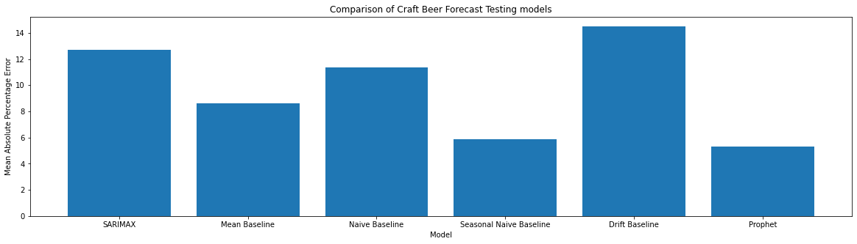
Model Testing - White wine:

Slide 12
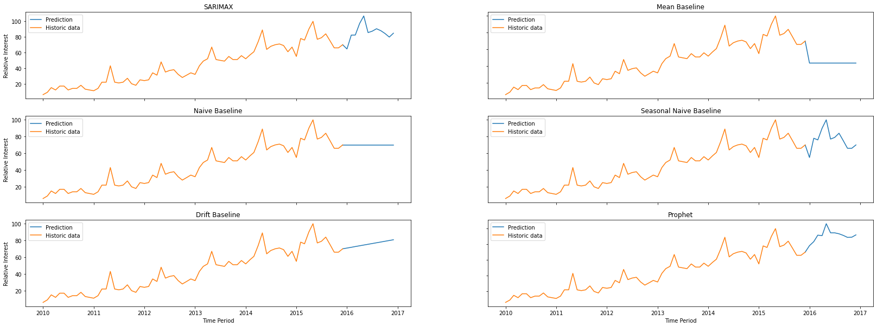
Forecast – Craft Beer:

Slide 13
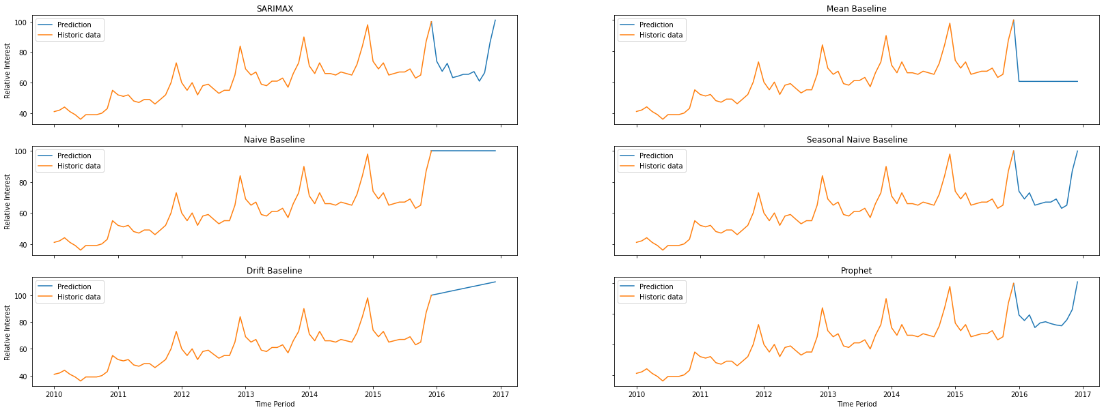
Forecast – Whiskey:

Slide 14
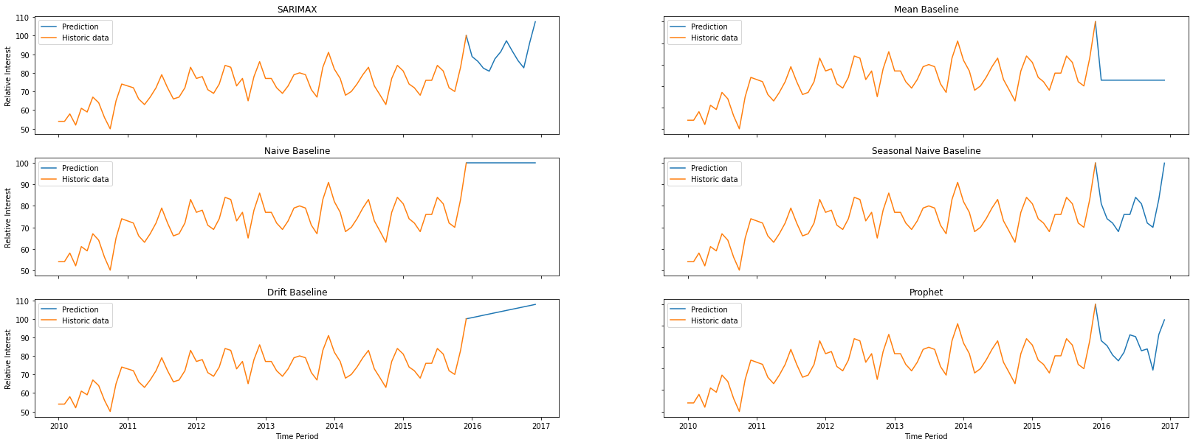
Forecast – White wine:

Slide 15
RECOMMENDATIONS
Recommendation 1: Demand analysis
A variable workforce model must be developed based on the demand distribution
Product launches must be aligned with above consumer behavior
Marketing initiatives must be launched to promote the sales during low selling months
Recommendation 2: Forecast accuracy analysis
Customized time series models must be used for every unique product rather than a single unified prediction model
Product | Highest selling month | Lowest selling month
Craft Beer | May | January
Whiskey | December | September
White Wine | December | October
Product | Most Accurate | Second most accurate | Third most accurate
Craft Beer | SARIMAX | Prophet | Seasonal Naive Baseline
Whiskey | Seasonal Naive Baseline | SARIMAX | Prophet
White Wine | Prophet | Seasonal Naive Baseline | Mean Baseline

Slide 16
RECOMMENDATIONS
Recommendation 3: Demand analysis
A variable workforce model must be developed based on the demand distribution
Product | Highest selling month | Lowest selling month
Craft Beer | May | January
Whiskey | December | September
White Wine | December | October

