Slide 1
Final Project Presentation
Project Title: Fever Medicine Recommendation System: A Machine Learning Approach
Team Members: Sylas Otutey, Miltone Awiti, Gideon Owusu, Frank Ofosu
Course: Applied Machine Learning
Instructor: Dr. Amna Mazen
Date: April 14, 2024

Slide 2
Project Objective
Goal: To develop a machine learning model that can recommend the most suitable fever medication based on individual patient characteristics and environmental factors.
Problem Statement: Choosing the right fever medication can be challenging due to individual differences and potential side effects. A personalized recommendation system can help improve treatment outcomes.
Importance: This project addresses the need for personalized medicine by leveraging data-driven insights to guide medication choices.
Target Output: The system will predict the recommended medication (categorical output) as either Paracetamol or Ibuprofen.

Slide 3
Dataset Description
Source: Kaggle "enhanced_fever_medicine_recommendation.csv"
Number of Samples: 1000 (derived from df.shape[0])
Number of Classes: 2 (derived from df['Recommended_Medication'].nunique())
Features Used:
Tabular Data: Temperature, Fever Severity, Age, Gender, Headache, Body Ache, Fatigue, Chronic Conditions, Allergies, Smoking History, Humidity, AQI, Physical Activity, Diet Type, Heart Rate, Blood Pressure, Previous Medication.
Data Types: Numerical (int, float) and Categorical (object).

Slide 4
Dataset Preparation & Preprocessing
Dataset Loading: Used the Pandas library (pd.read_csv()) to load the dataset.
Dataset Cleaning:
Removed null values using df.dropna().
Handled duplicates (if any).
Preprocessing:
Encoding Categorical Features: Used LabelEncoder to convert categorical features into numerical representations.
Scaling Numerical Features: Used StandardScaler to standardize numerical features for better model performance.
Feature Selection:
Dimensionality Reduction: Applied PCA (Principal Component Analysis) to reduce the number of features to 5, capturing the most important variance.

Slide 5
Machine Learning Algorithms Tested
Models Applied:
Logistic Regression
Decision Tree
Random Forest
XGBoost
Neural Network (Multilayer Perceptron)
Hyperparameter Tuning:
Decision Tree, Random Forest, XGBoost: max_depth was set to 10.
Neural Network: Used 2 hidden layers (64 and 32 neurons) with ReLU activation, dropout for regularization, and an output layer with softmax activation. Trained for 50 epochs with a batch size of 16.

Slide 6
Performance Evaluation Metrics
Accuracy: The primary metric used to evaluate the overall performance of the models.
Chart: Create a bar chart with the following accuracy scores:
Logistic Regression: 0.98990
Decision Tree: 0.99495
Random Forest: 0.99495
XGBoost: 0.99495
Neural Network: 0.99192 (from nn_accuracy)
Discussion:
Decision Tree, Random Forest, and XGBoost achieved the highest accuracy of 0.99495.
These tree-based models might have captured complex relationships in the data effectively.
The Neural Network also performed well with an accuracy of 0.99192, suggesting its ability to learn intricate patterns.
Challenges could include overfitting (especially for tree-based models) and potential bias in the dataset.

Slide 7
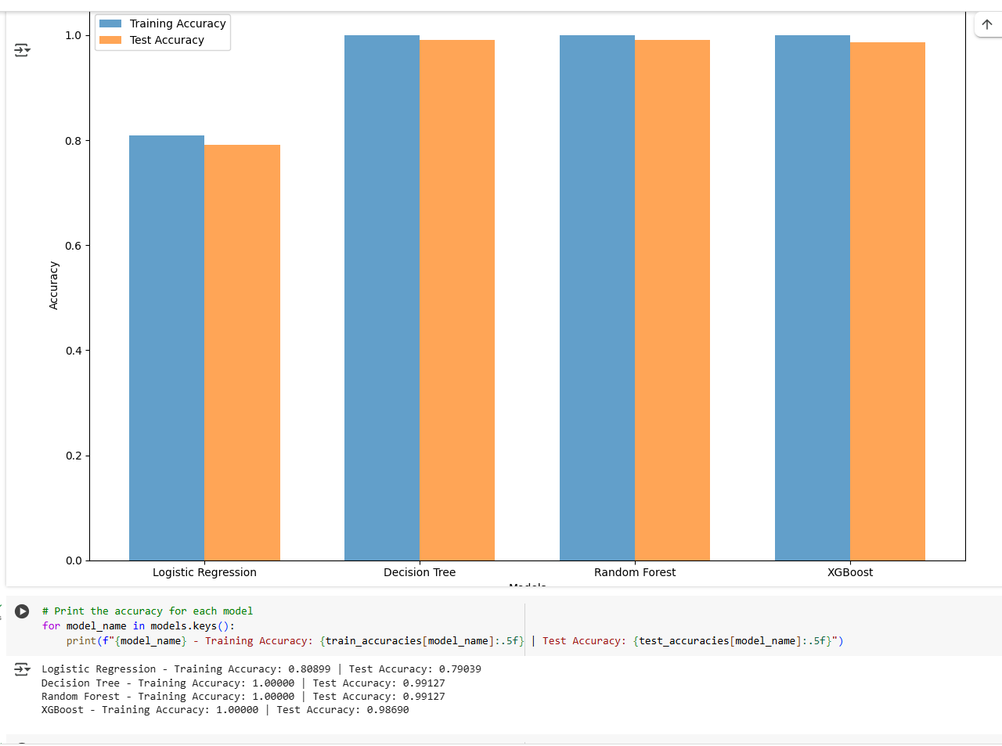
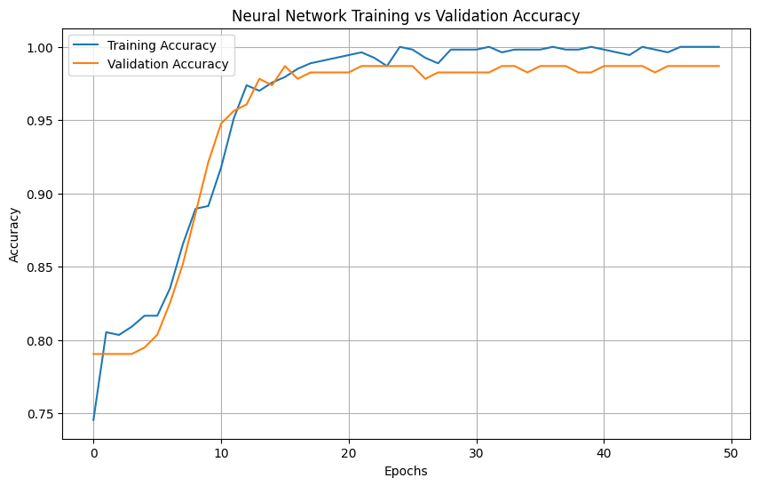
Results Comparison Chart

Slide 8
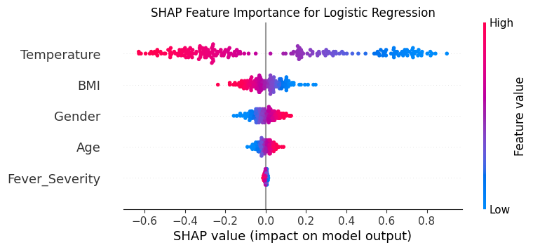
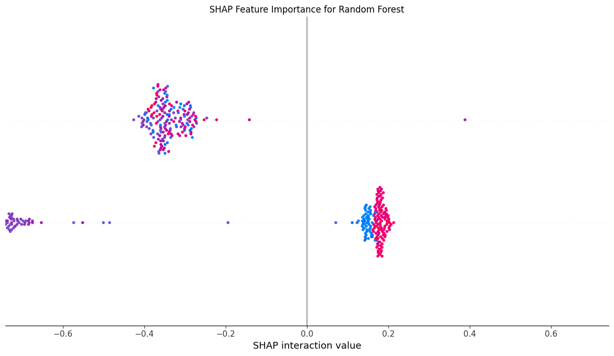
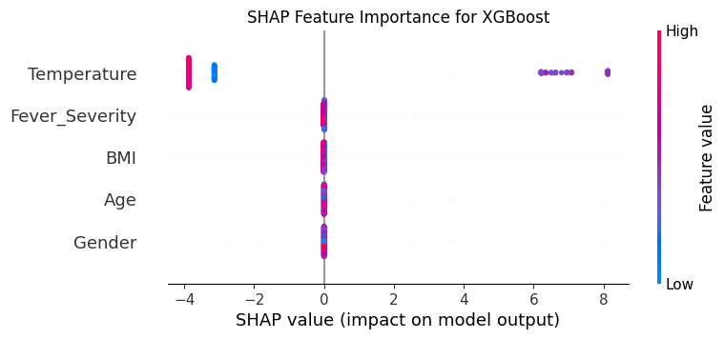
Model Interpretability with SHAP

Slide 9
SHAP Values: Explain how SHAP values were used to understand feature importance and model predictions.
Feature Importance: Include SHAP summary plots generated by the code, highlighting the most influential features for each model. You can focus on the top 5-10 features.

Slide 10
Prediction with New Data
Test Data: Show the two sample data points used for prediction, including their features and values.
Prediction Results:
Decision Tree: ['Paracetamol', 'Ibuprofen']
Logistic Regression: ['Paracetamol', 'Ibuprofen']
XGBoost: ['Paracetamol', 'Ibuprofen']
Random Forest: ['Paracetamol', 'Ibuprofen']
Recommendation: All models consistently recommend Paracetamol for the first data point and Ibuprofen for the second. This strong agreement suggests high confidence in the recommendations.

Slide 11

Conclusion and Future Work
Summary: Reiterate the project's objectives and highlight the key findings:
Tree-based models (Decision Tree, Random Forest, XGBoost) and the Neural Network demonstrated excellent accuracy in predicting fever medication recommendations.
SHAP values provided insights into the influential features driving the model's decisions.
Limitations: Discuss limitations such as potential overfitting and the need for a larger and more diverse dataset to further validate the model's generalizability.
Future Work: Suggest potential improvements such as:
Exploring other model architectures (e.g., ensemble methods).
Incorporating more comprehensive patient information and environmental factors.
Deploying the model as a web application or integrating it into existing healthcare systems.

Slide 12
References

Slide 13


Q&A

