Slide 1
Integration of COVID-19 Immunization Data Into Routine EHR Systems in Michigan
Instructor: Harikrishnan Changarnkothapeecherikkal
Presented by:
Mary Nnipaa Meteku & Syllas Otutey

Slide 2

Introduction
The COVID-19 pandemic highlighted the critical need for effective healthcare data management. In Michigan, a state with diverse populations and varying healthcare access, integrating COVID-19 vaccination records into existing Electronic Health Record (EHR) systems has become essential for improving vaccine distribution, tracking, and patient care.
This presentation explores Michigan's approach to linking EHRs with Immunization Information Systems (IIS), examining the benefits, challenges, and opportunities in this vital public health initiative. We'll investigate how interoperability standards like Health Level 7 (HL7) enable seamless data exchange while addressing concerns around data accuracy, privacy, and implementation costs.
MO

Slide 3




Impact To The Population/ Public Health Field
Seamless Access to Vaccination Data
Improved Public Health Monitoring
Healthcare providers need accurate, up-to-date vaccination records to deliver optimal patient care and make informed clinical decisions.
Integration supports real-time tracking of vaccination rates, enabling targeted interventions and efficient resource allocation.
Enhanced Coordination
Connected systems streamline communication between healthcare providers and public health agencies, creating a more responsive infrastructure.
This integration serves as a model for broader public health initiatives, supporting compliance with health mandates while addressing challenges in interoperability, data security, and healthcare disparities.

Slide 4
Related work by others conducting research in this area
Madhavan et al. (2021)
Rajamani et al. (2023)
Pavia et al. (2024)
Studied 15 academic medical centers, highlighting EHRs' critical role in real-time COVID-19 data reporting and vaccine tracking, while noting challenges in data standardization.
Developed interoperability tools linking disease surveillance with Immunization Information Systems, emphasizing the effectiveness of standardized data sharing.
Explored digital health integration with immunization strategies, stressing the need for accessible records within EHRs to enhance monitoring and policy decisions.
These studies collectively emphasize the importance of informatics tools in preventive healthcare while highlighting persistent challenges in technical complexity, data quality, and privacy concerns that mirror Michigan's experience.

Slide 5

Data Collection and Analysis Methodology
Tool Development
Standardized Data Collection
Design and implementation of specialized tools to improve data sharing between disease surveillance systems and immunization information systems.
Multi-site Study Approach
Surveys and qualitative feedback gathered from healthcare providers, using standardized data formats (HL7, FHIR) to ensure consistency.
Research conducted across different academic medical centers, extracting data from EHR systems to analyze public health response effectiveness.
This comprehensive methodology allowed researchers to evaluate the effectiveness of EHR integration across multiple dimensions, from technical implementation to practical outcomes in clinical settings throughout Michigan.

Slide 6
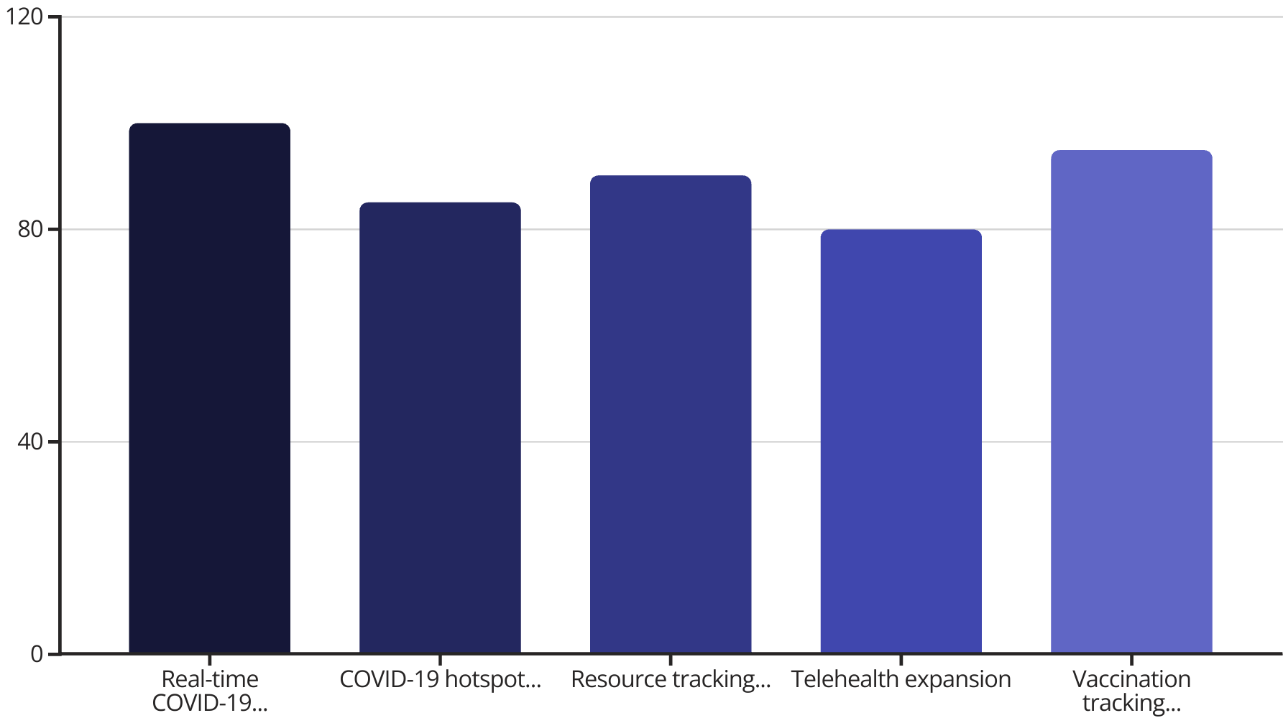
Key Findings from Research Studies
Additional findings showed 90% of agencies reported faster and more efficient data exchange, with a 40% improvement in data accuracy and 30% reduction in time needed to integrate immunization data. Furthermore, 85% of public health workers reported improved workflow efficiency after implementation.

Slide 7








Impact to the Population/ Public Health Field
Enhanced Crisis Preparedness
Creating frameworks for managing future public health emergencies
Data-Driven Decision Making
Supporting research, policy development, and targeted interventions
Improved Patient Care
Enabling informed clinical decisions and reducing administrative burden
Optimized Vaccine Distribution
Ensuring efficient allocation and monitoring of vaccination coverage
The integration of immunization data into EHR systems represents a critical advancement in public health infrastructure, with benefits extending beyond COVID-19 to broader healthcare delivery and population health management.

Slide 8








Challenges associated with the chosen research area topic
Technical Barriers
Interoperability Issues
Need for consistent adherence to standards like HL7 for seamless data exchange
Variability in EHR capabilities and lack of uniform standards across systems
Implementation Costs
Privacy Concerns
High expenses for technology, training, and maintenance, especially in rural areas
Ensuring HIPAA compliance while enabling necessary data sharing
Additional challenges include resistance to change among healthcare providers, limited IT infrastructure in rural areas, and ensuring data accuracy and completeness across diverse healthcare settings throughout Michigan.

Slide 9
Opportunities for new areas of research
Standardizing Data Exchange
Cost-Effective Implementation
Developing universal interoperability frameworks to ensure consistent, reliable data sharing across different EHR systems and jurisdictions.
Researching scalable, affordable models for underfunded healthcare systems and smaller providers to ensure equitable adoption.
Health Equity Advancement
Expanding Beyond COVID-19
Investigating how integrated data systems can identify and reduce disparities in immunization coverage among different socioeconomic and ethnic groups.
Exploring integration of other immunization records and broader public health data to create comprehensive health information systems.
Michigan's experience offers valuable insights that can inform nationwide strategies. Continued research and cross-sector collaboration are essential to overcome existing barriers and achieve improved healthcare outcomes across diverse populations, setting the stage for more resilient and responsive health systems.

Slide 10
Overall assessment and conclusion of this topic
Integrating COVID-19 immunization data into EHR systems in Michigan enhances healthcare delivery and public health readiness.
Key challenges include interoperability, data accuracy, privacy, cost, and system adoption.
Standardized data protocols like HL7 are crucial for effective integration.
Michigan’s healthcare diversity provides valuable lessons for scalable, equitable solutions.
Ongoing research and collaboration are essential for overcoming barriers and improving outcomes.

Slide 11
REFERENCES
Use of electronic health records to support a public health response to the COVID-19 pandemic in the United States: A perspective from 15 academic medical centers. Journal of the American Medical Informatics Association, 28(2), 393-401. https://doi.org/10.1093/jamia/ocaa287
Development and implementation of an interoperability tool across state public health agencies’ disease surveillance and immunization information systems. JAMIA Open, 6(3). https://doi.org/10.1093/jamiaopen/ooad055
) Integrating Digital Health Solutions with Immunization Strategies: Improving Immunization Coverage and Monitoring in the Post-COVID-19 Era. Vaccines, 12(8), 847. https://doi.org/10.3390/vaccines12080847
Achieving COVID-19 and routine immunization data systems integration on the Electronic Management of Immunization Data system in Nigeria. Global Health: Science and Practice, 12(Supplement 1). https://www.ghspjournal.org/content/12/Supplement_1/e2300149
The Effect of Electronic Health Record and Immunization Information System Interoperability on Medical Practice Vaccination Workflow. Applied Clinical Informatics, 16(01), 101-110. https://pubmed.ncbi.nlm.nih.gov/39909398/
Assessing the Immunization Information System and electronic health record interface accuracy for COVID-19 vaccinations, JAMIA Open, Volume 6, Issue 2, July 2023, ooad026, https://doi.org/10.1093/jamiaopen/ooad026
. Can Digital Tools Be Used for Improving Immunization Programs? Front Public Health. 2016 Mar 8;4:36.doi:10.3389/fpubh.2016.00036. PMID: 27014673; PMCID: PMC4782280 https://doi.org/10.3389/fpubh.2016.00036

