Slide 1
Figure edit thesis

Slide 2
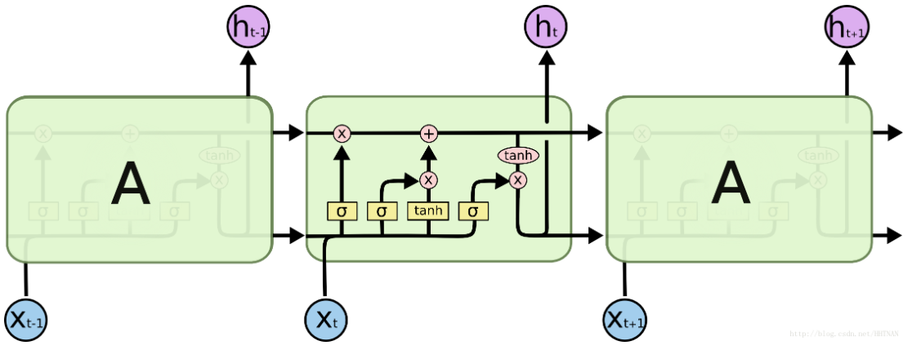
c_{t-1}
c_{t}
f_{t}
u_{t}
o_{t}
h_{t-1}
h_{t}

Slide 3
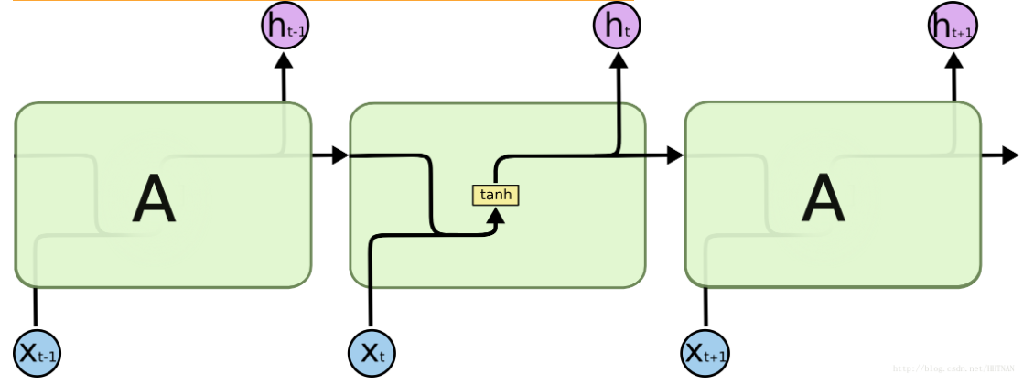

Slide 4
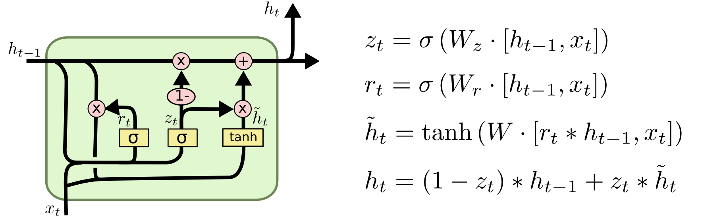
A
A

Slide 5
…
…
…
y_{t-1,1}
…
y_{t-1,s}
y_{t,1}
…
y_{t,s}
y_{p,1}
…
y_{p,s}
h_{t-1,1}
h_{t-1,m}
h_{t,m}
h_{p,1}
h_{p,m}
Parameters:
n input variables per time step
m hidden state dimension
p time steps
s output variables per time step
h_{t,1}
…
A
A
A
…
…
…
x_{t-1,1}
x_{t-1,n}
x_{t,1}
x_{t,n}
x_{p,1}
x_{p,n}
t-1st training sample
t^{st} training sample
p^{st} training sample

Slide 6
…
…
…
…
…
…
Hidden layers
inputs
outputs

Slide 7

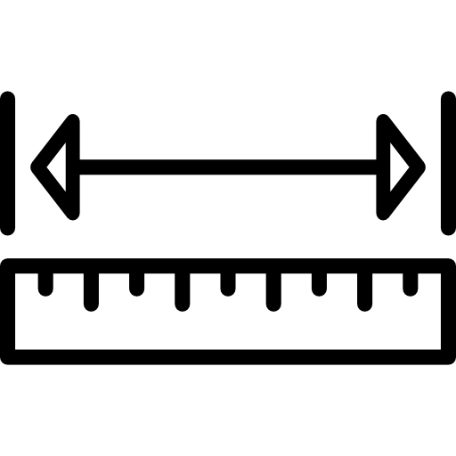







Create_mesh.py
Openfoam9-macos
Run/constant
Run/0
pimpleFoam
VTKtoPNG.py
Output format
Input parameters
Bloodflow_functions.py

Slide 8
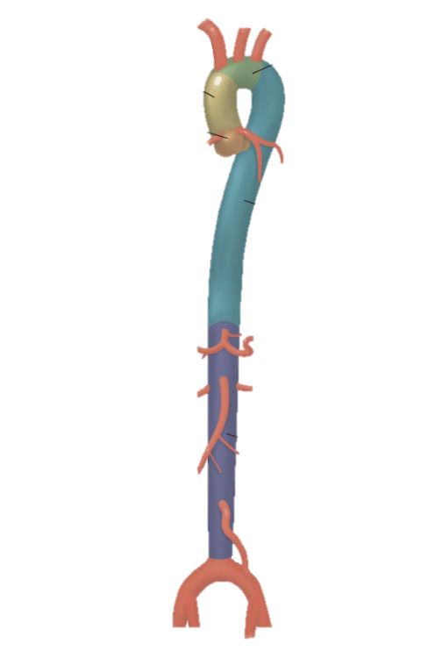
1
2
3

Slide 9



Slide 10
Image time t
Encoder
Time Network
Decoder
Image time t+1
Time Network
Decoder
Image time t+2
Time Network
Decoder
Image time t+3
Time Network
Decoder
Image time t+4
Time Network
Decoder
Image time t+5

Slide 11
Dense n1024
RepeatVector 5
RepeatVector 5
Dropout 0.1
LSTM n150
GRU n150
Dense n512
Dropout 0.1
Dropout 0.1
Dropout 0.1
Dense n150
Dense n150
Dense n150

Slide 12
ENCODER LEGENDA
Image input
2D Conv s1k3f16
2D Conv s1k3f16
Max Pooling (2,2)
Concatenate axis-1
Concatenate axis-1
Flatten
Dense
12288
96x128x32
48x64x48
24x32x64
150
192x256x16
96x128x16
48x64x16
24x32x16

Slide 13
DECODER LEGENDA
Image output
2D Conv s1k3f1
2D Conv s1k3f16
Up Sampling(2,2)
Addition
Reshape
Dense
150
24x32x16
48x64x16
96x128x16
192x256x16
192x256x1

Slide 14
LEGEND
Image
2D Conv s1k3f16
2D Conv s1k3f16
Max Pooling (2,2)
Concatenate axis-1
Concatenate axis-1
Flatten
Dense
Reshape
Addition
Up Sampling (2,2)
2D Conv s1k3f1
12288
96x128x32
48x64x48
24x32x64
150
150
192x256x16
96x128x16
48x64x16
24x32x16
24x32x16
48x64x16
96x128x16
192x256x16
192x256x1

Slide 15
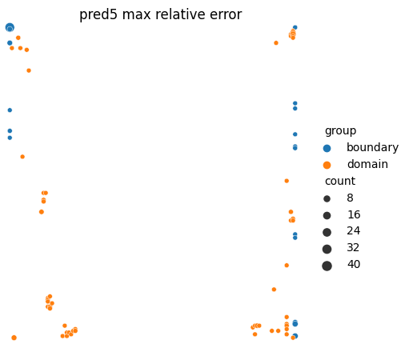
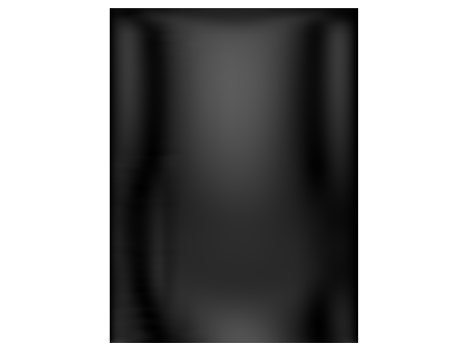
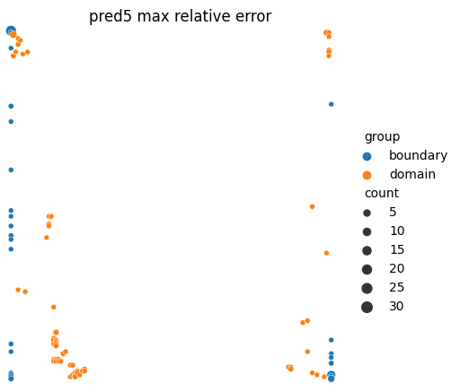
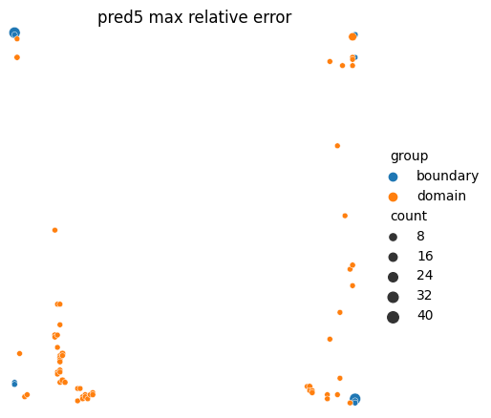

Slide 16
…
…
…
Enc IMG
t = i
vel1
Enc IMG
t = i
vel5
Enc IMG
t = i
diff1
Enc IMG
t = i
diff5
Enc IMG
t = i
diff1
Enc IMG t = i
diff5
Batch Normalization
Batch Normalization
Batch Normalization
LSTM n151
LSTM n151
LSTM n151
Dropout 0.1
…
Dropout 0.1
Dropout 0.1
…
Dropout 0.1
Dropout 0.1
Dropout 0.1
Dense n150
Dense n150
Dense n150
Dense n150
Dense n150
Dense n150
…
Enc IMG t = i+1
Enc IMG t = i+5
Enc IMG t = i+1
Enc IMG t = i+5
Delta
t = i+1
Delta
t = i+1
+
+
Enc IMG t = i+1
Enc IMG t = i+5

Slide 17
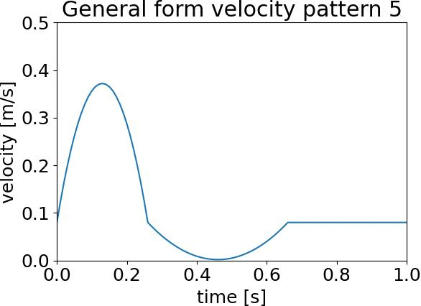
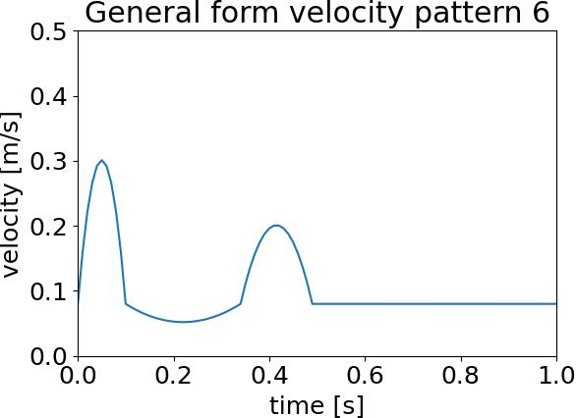
Umax
Uthree
td
tb
Umin
tp

Slide 18
Straight
Umax0.4Umin0.02tb0.35td0.25
Bend
Umax0.4Umin0.02tb0.35td0.25
Bifurcation
Umax0.4Umin0.02tb0.35td0.25
Bifurcation
Varied velocity inlet conditions
Encoder – NN - Decoder
Encoder – RNN LSTM - Decoder
Encoder – RNN LSTM - Decoder
Encoder – RNN LSTM - Decoder
Encoder – RNN LSTM - Decoder
Encoder – RNN LSTM - Decoder
+ velocity info in RNN
Encoder – RNN GRU - Decoder
Individual image sets
Individual image sets
Individual image sets
Velocity profile from training set
One heartbeat
One heartbeat using t+1
One heartbeat using t+1
Individual image sets
New velocity profile

Slide 19
Straight
Varied geometries and viscosities
Umax0.4Umin0.02tb0.35td0.25
Bend
Umax0.4Umin0.02tb0.35td0.25
Bifurcation
Umax0.4Umin0.02tb0.35td0.25
Bifurcation
Varied velocity inlet condition
Data sets
Increase in complexity first in geometry, then BC
Encoder
NN
Decoder
Encoder
RNN LSTM
Decoder
Encoder
RNN GRU
Decoder
Encoder
RNN LSTM
Decoder
Encoder
RNN LSTM
Decoder
Encoder
RNN LSTM
Decoder
Network Architectures
Test different time networks on straight data set, continue with best
Error calculation
MAE, ME, RMSE, conservation error
For boundary and domain, absolute and relative
Individual sets
One heartbeat
In 100 steps
Individual sets
One heartbeat
In 100 steps
Individual sets
One heartbeat
In 100 steps
Individual sets
One heartbeat
In 100 steps
Time step analysis
Using different predicted time steps to predict one whole heartbeat
One heartbeat
in 20 steps
One heartbeat
in 25 steps
One heartbeat
in 33 steps
One heartbeat
in 50 steps
Time step analysis
Using different predicted time steps to predict one whole heartbeat
Velocity profile in training set, different geometry
New velocity profile

Slide 20
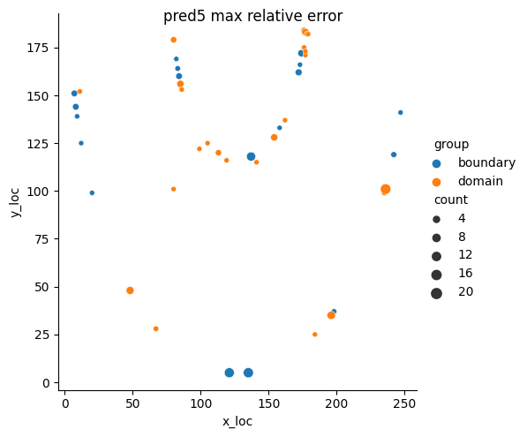

Slide 21
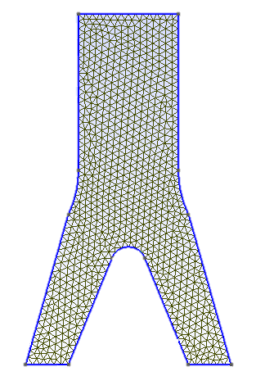
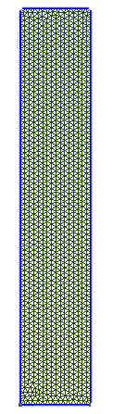
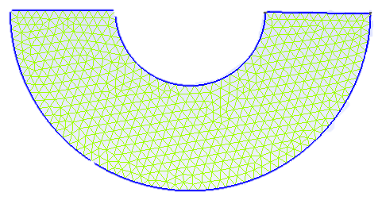
width
width
width
outlet
width
outlet
width

