Slide 1
Figure edit thesis

Slide 2
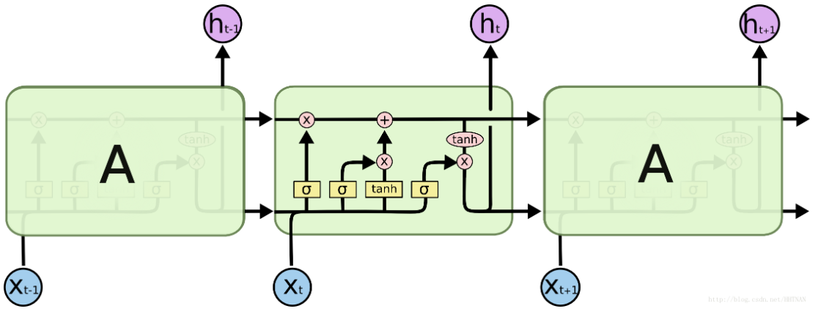
c_{t-1}
c_{t}
f_{t}
u_{t}
o_{t}
h_{t-1}
h_{t}

Slide 3
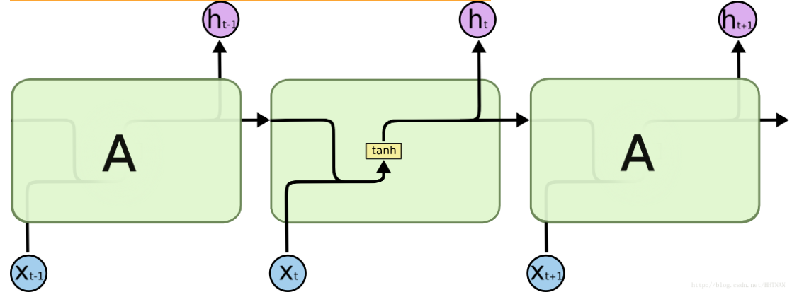

Slide 4
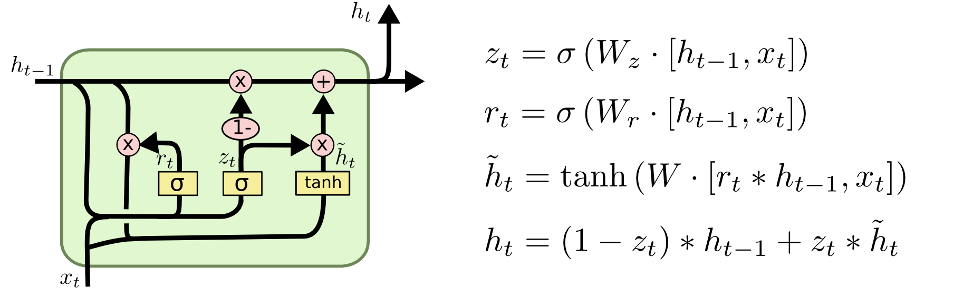
A
A

Slide 5
y_{t-1,1}
y_{t-1,s}
y_{t,1}
y_{t,s}
y_{p,1}
y_{p,s}
h_{t-1,1}
h_{t-1,m}
h_{t,m}
h_{p,1}
h_{p,m}
Parameters:
n input variables per time step
m hidden state dimension
p time steps
s output variables per time step
h_{t,1}
A
A
A
x_{t-1,1}
x_{t-1,n}
x_{t,1}
x_{t,n}
x_{p,1}
x_{p,n}
t-1st training sample
t^{st} training sample
p^{st} training sample

Slide 6
Hidden layers
inputs
outputs

Slide 7









Create_mesh.py
Openfoam-macos9
Run/constant
Run/0
pimpleFoam
VTKtoPNG.py
Output format
Input parameters
Bloodflow_functions.py

Slide 8
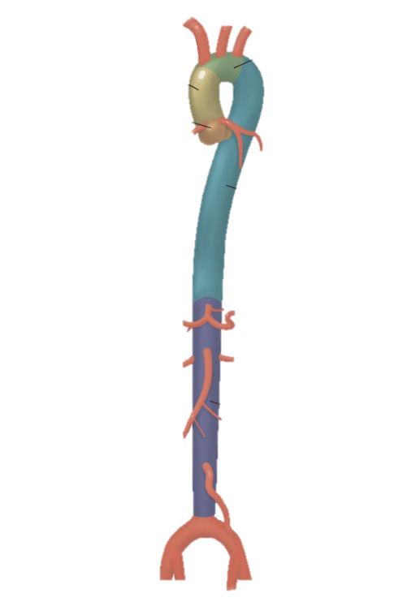
1
2
3
4

Slide 9



