Slide 1
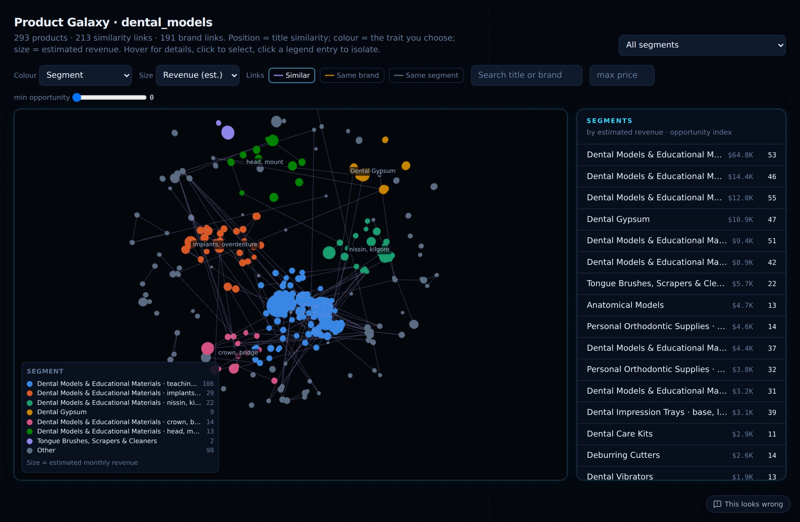
AMAZON US · STATISTICAL MARKET INTELLIGENCE
DMIS
Dental Market Intelligence OS
From SellerSprite exports to what to sell: every number estimated with a 95% interval, validated against known truth, in English and 中文.
Python · FastAPI · DuckDB
Next.js · three.js · ECharts
Notes:
Open with the one-line pitch: DMIS turns SellerSprite exports of Amazon US listings into a statistical picture of a category — how big it really is, who controls it, where the demand gaps are, whether it is growing, and which product to launch. Every number carries a 95% interval and its formula. The background image is the Product Galaxy of dental_models.

Slide 2
THE PROBLEM
Amazon shows sales badges, not sales
A badge like “200+ bought in past month” is a range. A listing with no badge still sells — just fewer than 50. Adding the badges up reports only the certain floor.
no badge
true sales somewhere in 0 – 49
50+
true sales somewhere in 50 – 99
100+
true sales somewhere in 100 – 199
200+
true sales somewhere in 200 – 299
300+
true sales somewhere in 300 – 399
…
true sales somewhere in …
Our fix: treat every badge as an interval, fit one demand model to all listings, and estimate the real total with a 95% interval — validated on markets where the true answer is known.
1K+
true sales somewhere in 1,000 – 1,999
DMIS · 2
Notes:
The core insight. SellerSprite's sales column is Amazon's 'N+ bought' badge: a ladder 50, 100, 200 … 1K, 2K … A badge is a range, and a listing without a badge sells between 0 and 49 — not zero. Summing badge floors gives a certain lower bound, which on synthetic markets is about 34% below the truth. DMIS treats each listing as interval-censored and models where inside the interval its real sales are. On markets with known truth the estimate's median error is 1.7%, and the 95% interval contained the truth in 100% of validation markets.

Slide 3
WHAT DMIS ANSWERS
Six questions DMIS answers
1
2
3
How big is it, really?
Who controls it?
Where is demand unmet?
Revenue & units with 95% intervals, certain floor, evidence grade A–D
Brand shares with intervals, P(#1), HHI, strengths & weaknesses
Statistically significant feature & price-band gaps (bootstrap + FDR)
4
5
6
Is it growing?
What if we launch it?
What should we sell?
Random-effects trend across monthly snapshots, forecasts with prediction intervals
Posterior-predictive simulation: units, revenue, profit, risks
Opportunity Board: every market's best concepts with all the evidence
DMIS · 3
Notes:
Frame the product around decisions, not dashboards. Each of these six questions maps to a module we'll demo: Market Analytics for size, Competitors for control, demand gaps for unmet demand, Growth & Forecast for trend, the Launch Simulator for what-ifs, and the Opportunity Board which joins them all.

Slide 4
ARCHITECTURE
How the pieces connect
Data lake
Parquet per market, queried by DuckDB (read_parquet)
Browser
React pages (Next.js 16), ECharts, three.js 3D
fetch /api/v2
Business DB
SQLAlchemy → SQLite (default) or PostgreSQL · 29 tables
FastAPI :8000
src/dip/api · auth & market scope · response cache · ~120 endpoints
Next.js server :3000
rewrites /api/v2/* → API (same origin, no CORS)
Knowledge graph
NetworkX embedded, or Neo4j
Vector store
Qdrant local or server · offline hashing embeddings
Gemini (optional)
rephrases computed facts only
Processing pipeline
runner.py · 20+ stages · thread or queue worker
Everything runs offline on a laptop; each server-grade store is switched on by one environment variable (DIP_POSTGRES_URL, DIP_NEO4J_URI, DIP_QDRANT_URL).
DMIS · 4
Notes:
Walk the request path: the browser loads a Next.js page; the page calls /api/v2 on the same origin; Next.js rewrites that to FastAPI on port 8000 (next.config.ts), so no CORS. FastAPI checks the role and market scope, then reads market tables from Parquet through DuckDB, and business records (users, projects, alerts, audit) through SQLAlchemy — SQLite by default, PostgreSQL with DIP_POSTGRES_URL; tables are created and migrated additively on first connect. The graph is NetworkX in-process or Neo4j; similarity vectors live in Qdrant (local file mode or server). The pipeline writes everything; uploads run in a background thread or, with DIP_JOB_MODE=queue, in a separate worker. Gemini is optional and only rephrases facts.

Slide 5
DATA PIPELINE
One upload, twenty stages, nothing dropped
1
Ingest
2
Clean
3
Relevance
Excel / CSV / JSON; columns auto-detected (Chinese headers too); Polars streaming
validate price, rating, dates; flag issues — never delete
category rules from categories.yaml (+ XGBoost); uncertain → review queue
4
Scope & segment
5
Resolve products
6
Metrics v3
which sub-categories belong; discover segments, keywords, EN/ZH descriptions
listings → products; Family → Segment → Model → Variant → Listing
demand model, 400 joint simulations, every estimate + 95% interval
7
Gaps · brands · pain
8
Graph · vectors · lake
9
Events
significant demand gaps, brand intelligence, quality gap
ontology with evidence; similarity index; Parquet tables
compare with last snapshot; alert only on significant changes
Every excluded listing keeps a reason (rejected / not relevant / low data quality). Stage timing and memory are shown live on Data Operations.
DMIS · 5
Notes:
src/dip/pipeline/runner.py. The upload returns a job id immediately; stages run in order and each writes status, seconds and peak memory to the jobs table, which the Data Operations page polls. Raw files in data/raw are never modified. Principle: never silently discard — every excluded row keeps an excluded_reason. Re-uploading the same snapshot period replaces that period in the history rather than double counting.

Slide 6
THE STATISTICAL ENGINE · METRICS V3
From badges to estimates with intervals
Detect
≥ 98% of values on the ladder → badge data (else exact sales)
Fit
log units = β·(price, rating, age, sub-category) + σε; error family by AIC; interval-censored likelihood
Bootstrap
60 parametric refits → parameter uncertainty + small-sample bias correction
Estimate
each listing: expected sales given its badge range, always inside the range
Simulate
400 joint draws → intervals for every total and share (width calibrated ×1.3)
Reconcile
every total = sum of its listings → listings, products, brands, segments, market add up exactly
Real exports: dental_models $175.8k (floor $64.9k), denture_base $114.1k, implants $12.7k in scope.
DMIS · 6
Notes:
This is metrics engine v3 — src/dip/metrics/observation.py, demand.py and engine.py. Badge detection is data-driven. The model is an interval-censored log-linear regression: a listing with a 200+ badge contributes the probability its sales lie in [200,300); no badge contributes P(sales < 50). Error family chosen by AIC among normal, t10, t5, t3. 60 parametric bootstrap refits capture parameter uncertainty and correct small-sample bias. Each listing gets its conditional mean inside its range. 400 joint simulations give intervals for any group; the width multiplier 1.3 was calibrated on 80 synthetic markets and verified on 80 others. Point estimates are the sum of listing means, so every level of the hierarchy reconciles exactly. The chart shows the three real markets with their intervals.

Slide 7
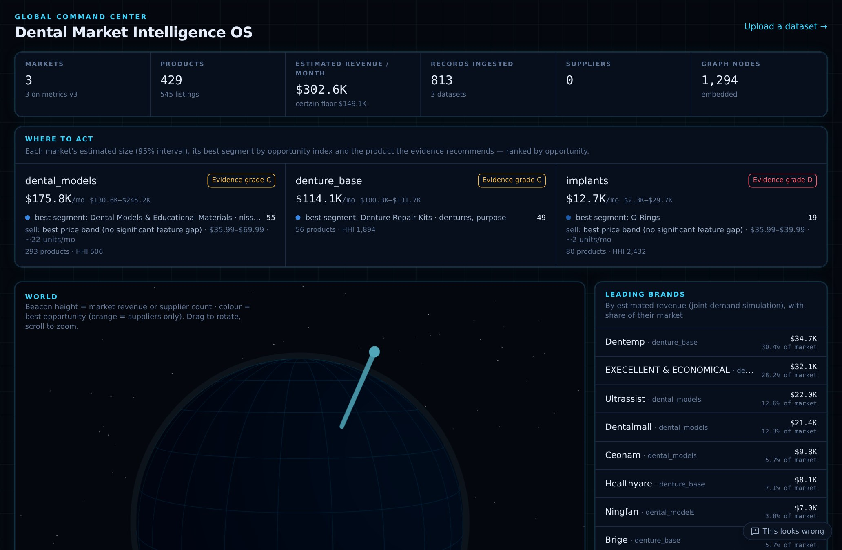
MODULE · INTELLIGENCE
Command Center — where to act
HOW IT WORKS
KPI strip: markets, products, estimated revenue with its certain floor, records, suppliers, graph size
“Where to act”: one card per market — size interval, evidence grade, best sub-category, recommended product
Leading brands by estimated revenue; 3D globe of markets and suppliers
IN DEPTH
Ranking: markets ordered by their top sub-category's opportunity index
Grade: A–D from listings, badge share and hold-out AUC
Globe: three.js; beacon height = revenue, colour = opportunity
/
DMIS · 7
Notes:
Start the demo here. The KPI strip shows estimated revenue $302.6k/month across three markets with the certain floor underneath. Each 'Where to act' card is a market with its 95% interval, evidence grade, best sub-category by opportunity index and the product the evidence recommends. On the right, leading brands by estimated revenue. The globe is react-three-fiber.

Slide 8
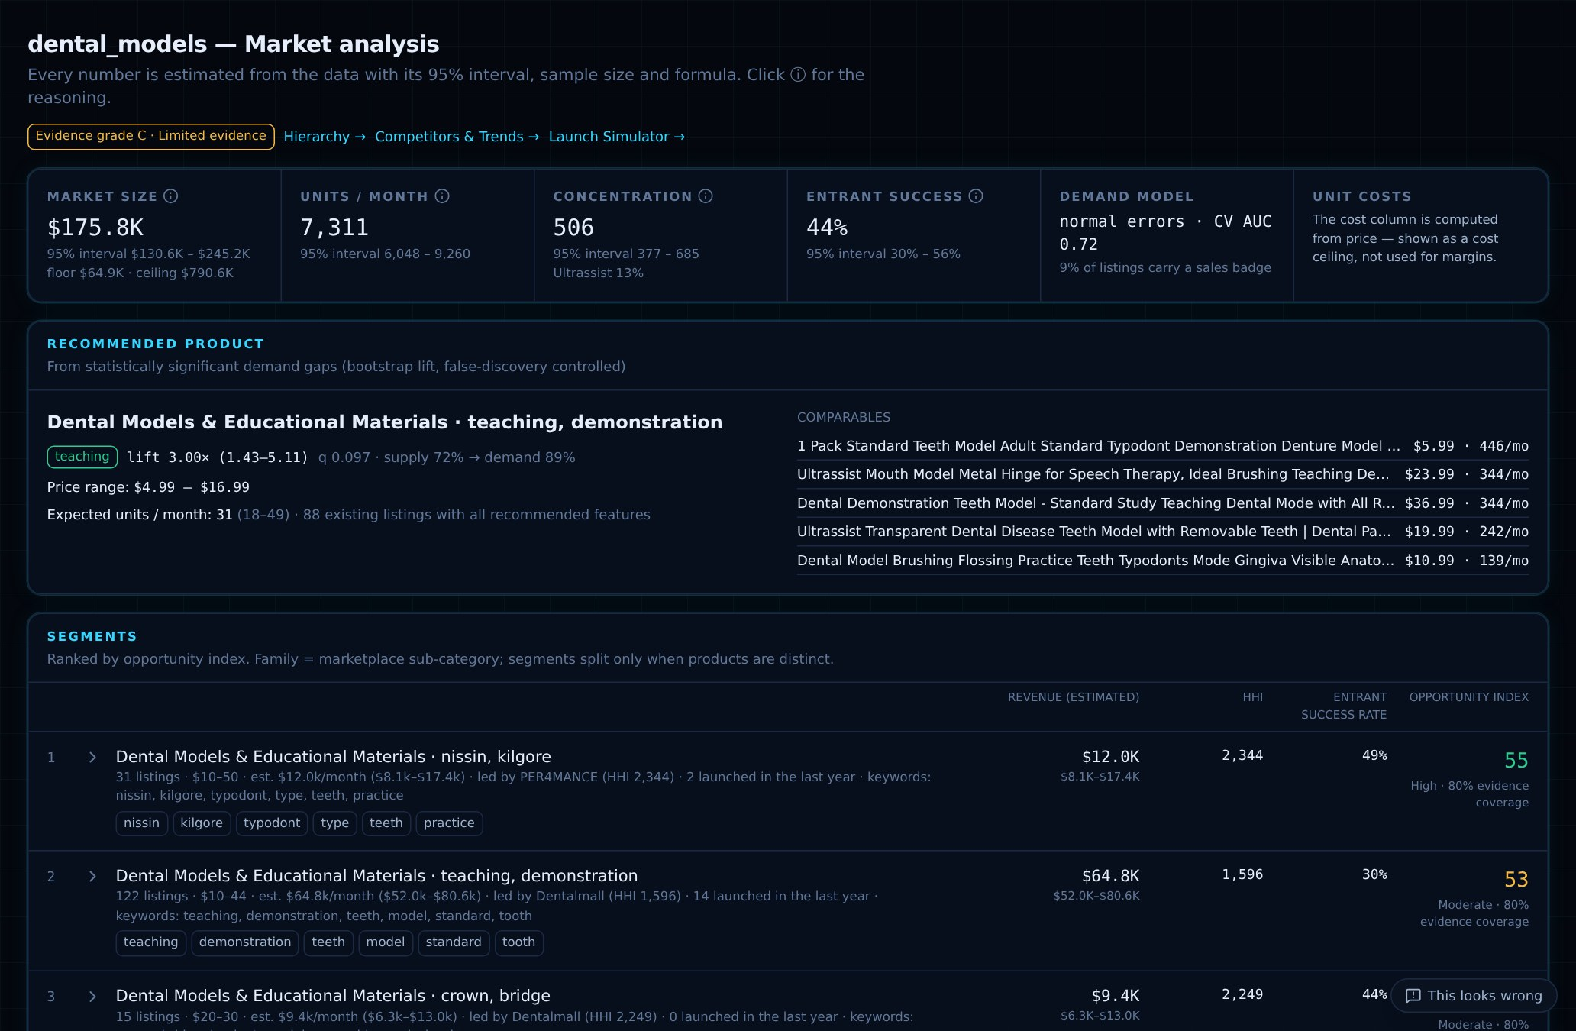
MODULE · INTELLIGENCE
Market Analytics — one market in depth
HOW IT WORKS
Size tiles: estimate, 95% interval, floor and ceiling; units; concentration; entrant success; demand model; unit costs
Recommended product from significant demand gaps
Sub-categories ranked by opportunity index, each with generated description and keywords
IN DEPTH
ⓘ on every number: value, interval, n, formula ID, basis, caveat
Evidence grade C: read intervals, not point estimates
Cost column: detected as derived from price → never used as a real cost
/markets/dental_models
DMIS · 8
Notes:
Click any ⓘ to show the explain payload: the value, its interval, sample size, formula ID linking to the Methodology page, the basis and caveats. Point out the recommended product ('teaching' feature, lift about 3×, q = 0.097) and that the source's cost column was detected as a fixed share of price, so margins are withheld rather than invented.

Slide 9
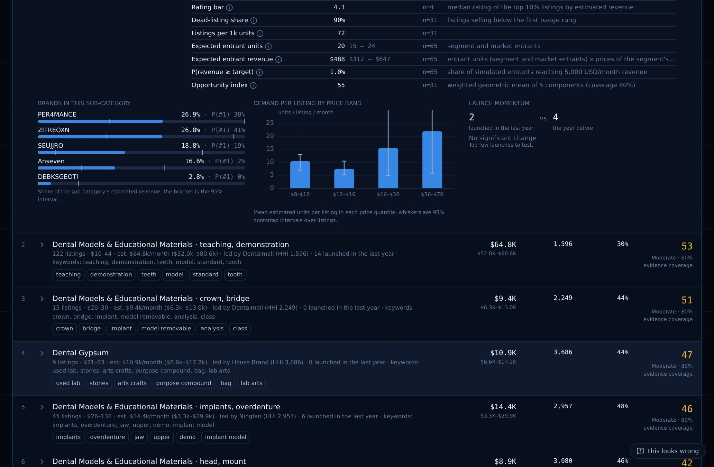
MODULE · INTELLIGENCE
Inside a sub-category
HOW IT WORKS
Opportunity components (demand, entry, margin, competition, quality gap, saturation)
Every segment metric with interval, n and basis
Brands with share interval and P(#1); demand per listing by price band; launch momentum
IN DEPTH
P(#1): share of 400 simulations in which the brand ranks first
Price bands: 4 within-segment price quantiles, 2,000-sample bootstrap, fixed seed
Momentum: exact binomial test, last 12 months vs the year before, BH-adjusted
/markets/dental_models → expand a sub-category
DMIS · 9
Notes:
Expanding a sub-category shows why it scores as it does. The brand bars show each leader's share with its 95% interval bracket and the probability it is really #1. The price-band chart shows mean units per listing with bootstrap whiskers — where demand concentrates by price. Momentum tells you whether launches are speeding up, with an exact binomial test.

Slide 10
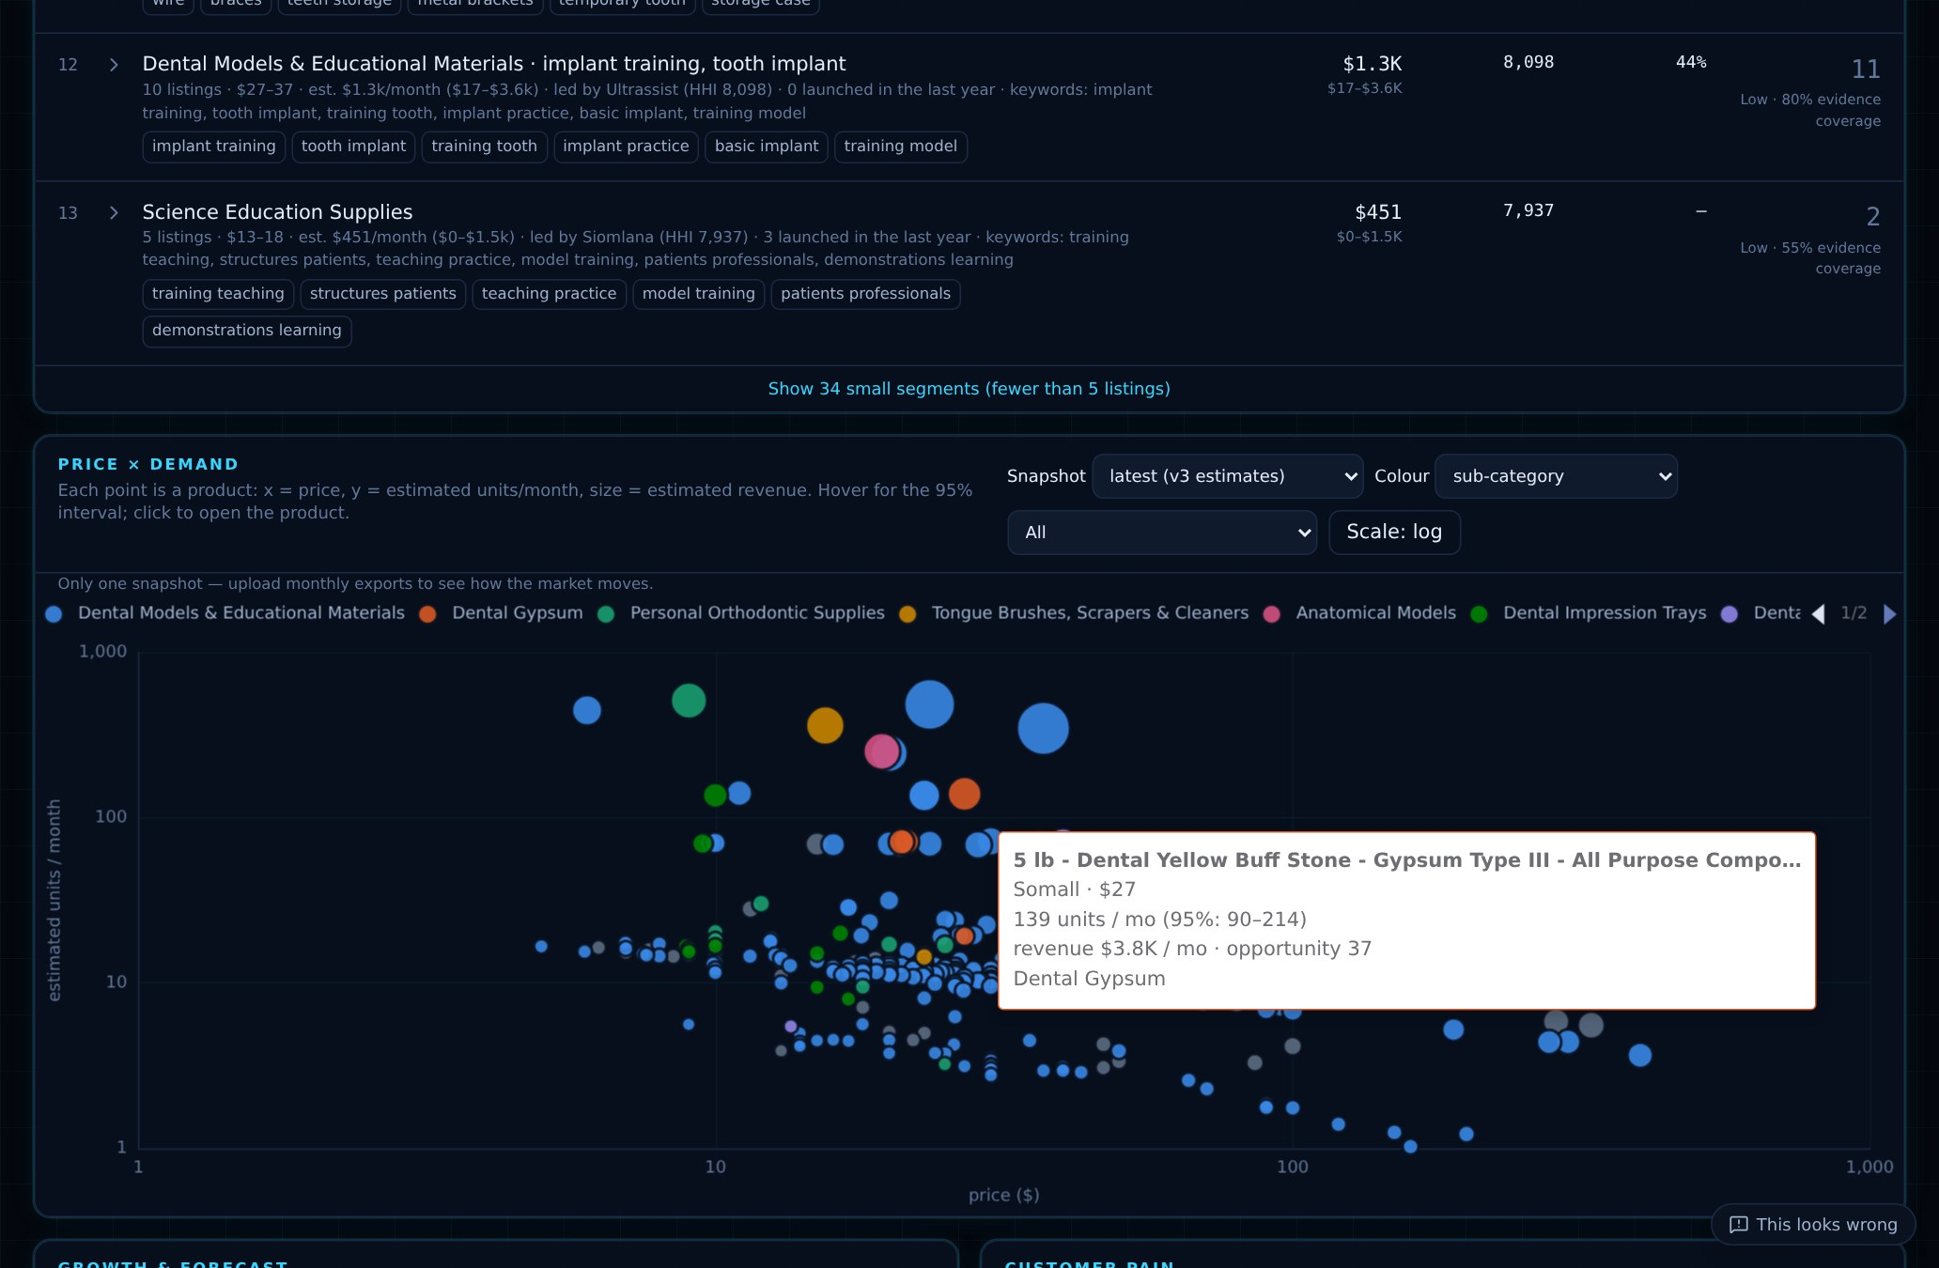
MODULE · INTELLIGENCE
Price × demand map
HOW IT WORKS
Each point is a product: x = price, y = estimated units / month, size = estimated revenue
Colour by sub-category, opportunity, or entrant vs established
Snapshot selector shows earlier uploads; click a point to open the product
IN DEPTH
Hover: the product's 95% interval and opportunity score
Log scales: prices and sales span orders of magnitude
Colours: a validated colour-blind-safe palette; >7 groups fold into “Other”
/markets/dental_models
DMIS · 10
Notes:
The matrix shows where products cluster by price and demand. Hovering shows each product's interval. The snapshot selector replays older exports (observed badge floors), which becomes a time-lapse once monthly uploads accumulate.

Slide 11
HOW OPPORTUNITY IS SCORED
Opportunity index (0–100)
Demand segment revenue, log scale: $1k → 0, $1M/mo → 1
Entry entrant success 0% → 0, 60% → 1 (shrunk to market)
Margin median margin 0% → 0, 40% → 1 (genuine costs only)
Competition HHI 5,000 → 0, 1,000 → 1
Quality gap demand on products rated < 4.0; upside only
Saturation share of listings below the first badge
Weighted geometric mean. One fatal weakness (e.g. impossible entry) drags the index down instead of being averaged away. Absolute scales make markets comparable; missing components are left out and coverage is shown.
DMIS · 11
Notes:
The index is explicit and configurable in config/platform/metrics.yaml, not hidden in code. Each component is mapped to 0–1 on an absolute scale so indices compare across markets. A weighted geometric mean punishes a single fatal weakness. A product's index is 0.7 × its segment index, 0.2 × its price-band position, 0.1 × its quality room. If asked 'why these weights?': they are documented, visible per component on every page, and will be revisited with launch-outcome calibration.

Slide 12
DEMAND GAPS → RECOMMENDED PRODUCT
Which features does demand reward?
Candidates
Lift
Test
Gap
Recommend
title terms (e.g. “teaching”), bucketed specs (e.g. rpm 40k–60k), price bands — in every sub-category with ≥ 8 listings
units per listing WITH the feature ÷ WITHOUT it; 400-sample bootstrap interval; ≥ 5 listings on each side
Benjamini–Hochberg false-discovery control at 10% across all tested features
significant lift AND under-supplied (demand share > supply share)
up to 3 co-occurring gaps + the best price band; otherwise “best price band” (stated)
›
›
›
›
Real result — dental_models: “teaching” demonstration models — lift 3.0× (95% interval 1.43–5.11), q = 0.097, supply 72% → demand 89%; recommended price $4.99–$16.99, about 31 units/month expected. Why FDR, not Bonferroni: we test hundreds of features — Bonferroni would hide real gaps.
DMIS · 12
Notes:
src/dip/metrics/gaps.py. For each sub-category and each candidate feature, lift is demand per listing with the feature divided by without, with a bootstrap interval. P-values across all features are corrected with Benjamini–Hochberg at a 10% false discovery rate. A gap is significant and under-supplied. The recommendation combines up to three co-occurring gaps with the best price band; when nothing is significant it says so and falls back to the best price band. The real finding on dental_models was the 'teaching' feature.

Slide 13
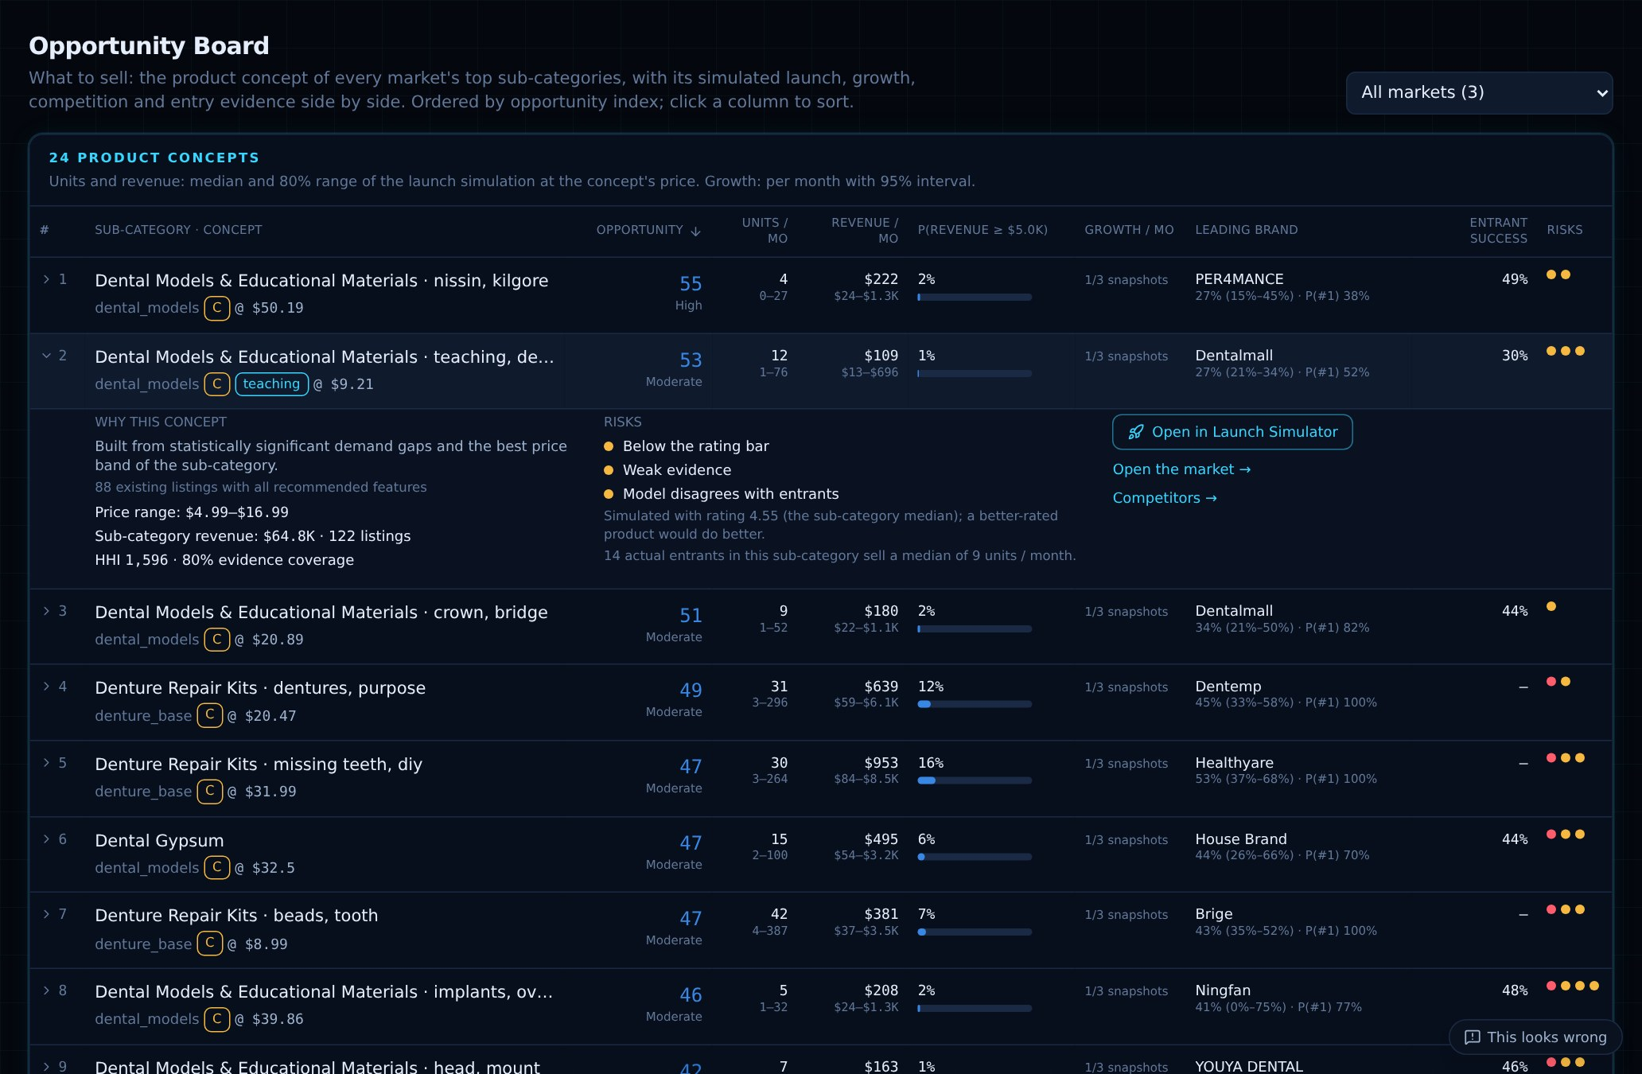
MODULE · DECISIONS
Opportunity Board — what to sell
HOW IT WORKS
Every market's top 8 sub-categories, each as a product concept (features + price)
Next to it: simulated launch, P(revenue ≥ $5k), growth, leading brand, entrant success, risks
Sort by any column; expand a row for “why this concept” and one-click simulation
IN DEPTH
Concept: gap recommendation at the geometric middle of its price range; small segments → typical product at median price (stated)
No re-scoring: same numbers as the other pages
Cache: per market run; about 3 s cold, instant after
/opportunities
DMIS · 13
Notes:
This is the direct answer to 'what should we sell?'. Each row joins the opportunity index, a launch simulation of the concept, the sub-category's growth test, the leading brand's share interval and P(#1), entrant success and the simulator's risk flags. The board never invents a new score; it lines up evidence already computed elsewhere. Expand row 2 to show the 'teaching' concept and click Open in Launch Simulator.

Slide 14
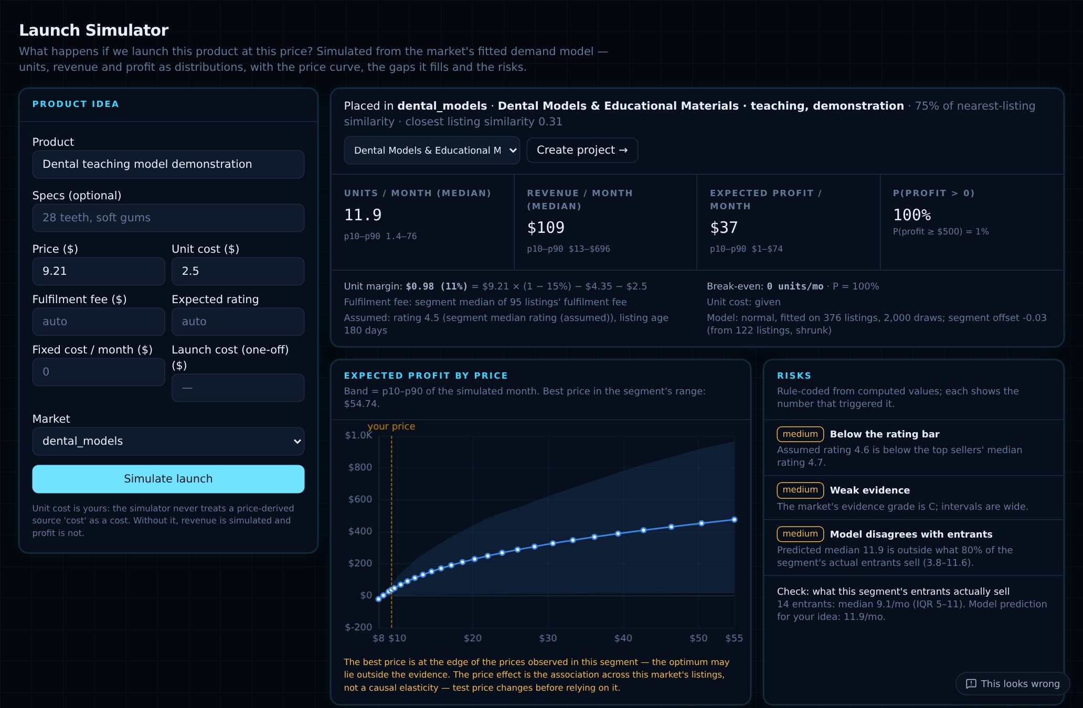
MODULE · DECISIONS
Launch Simulator — what if we launch X at $Y?
HOW IT WORKS
Describe the idea, price and your unit cost
Get units, revenue and profit as distributions (median, p10–p90), P(profit > 0), break-even, payback
Expected profit at every price in the segment's range; gaps covered; risks; what real entrants sell
IN DEPTH
Model card: stored fitted model; idea placed in nearest segment by text similarity + shrunk segment offset
Posterior predictive: 400 draws incl. parameter uncertainty, truncated at the top rung
Fair comparisons: common random numbers across scenarios; price effect is associational, not causal
/launch
DMIS · 14
Notes:
src/dip/metrics/launch.py. The simulator reuses the market's fitted demand model (the model card) to draw sales for a listing that doesn't exist yet. Without a genuine unit cost it shows no profit. Risks are rule-coded from computed values and each shows its number: concentrated segment, entrants struggle, below the rating bar, price extrapolation, weak evidence, model disagrees with real entrants. Scenario comparison uses the same random numbers so differences come from the scenario, not noise.

Slide 15
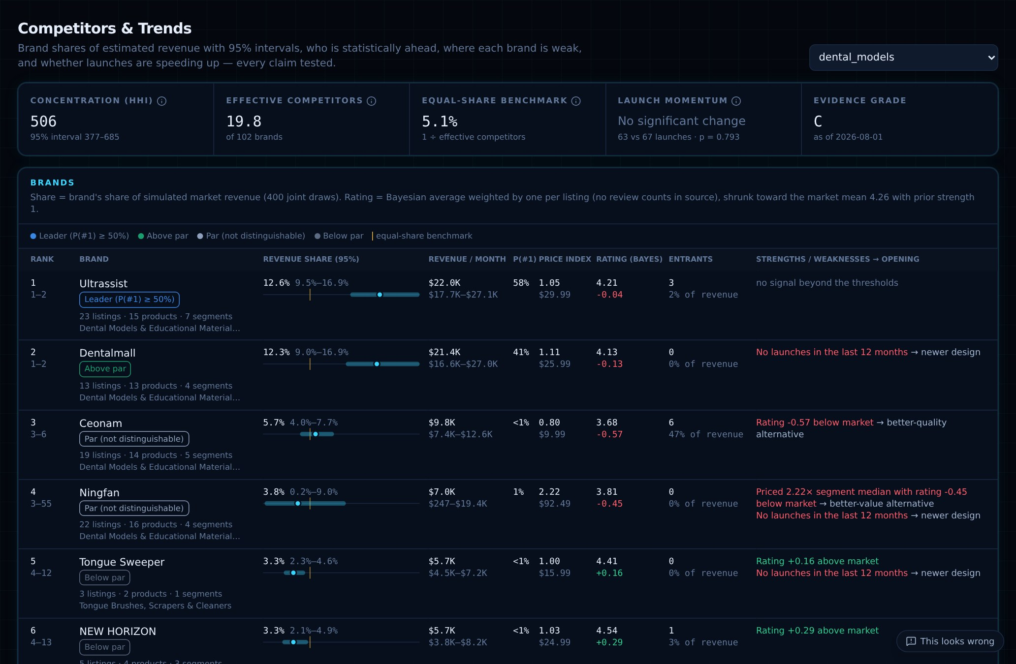
MODULE · DECISIONS
Competitors & Trends — who leads
HOW IT WORKS
HHI with interval, effective competitors, equal-share benchmark, launch momentum
Brand table: revenue share with interval, rank range, P(#1), price index, Bayesian rating
Strengths and weaknesses with the opening each creates; cohorts; snapshot changes
IN DEPTH
HHI: Σ(share×100)², 0–10,000; > 2,500 = concentrated
Leader: P(#1) ≥ 50%; above/below par only if the whole interval clears 1 ÷ effective competitors
Bayesian rating: shrunk toward the market mean by review count
/competitors
DMIS · 15
Notes:
src/dip/metrics/brands.py. Shares come from the joint simulation, so every share, rank and HHI has an interval. A brand is only called above par when its entire interval is above the equal-share benchmark. The Bayesian rating stops a brand with three 5-star reviews looking better than one with thousands of 4.6s. Changes between snapshots are shown as significant or within noise.

Slide 16
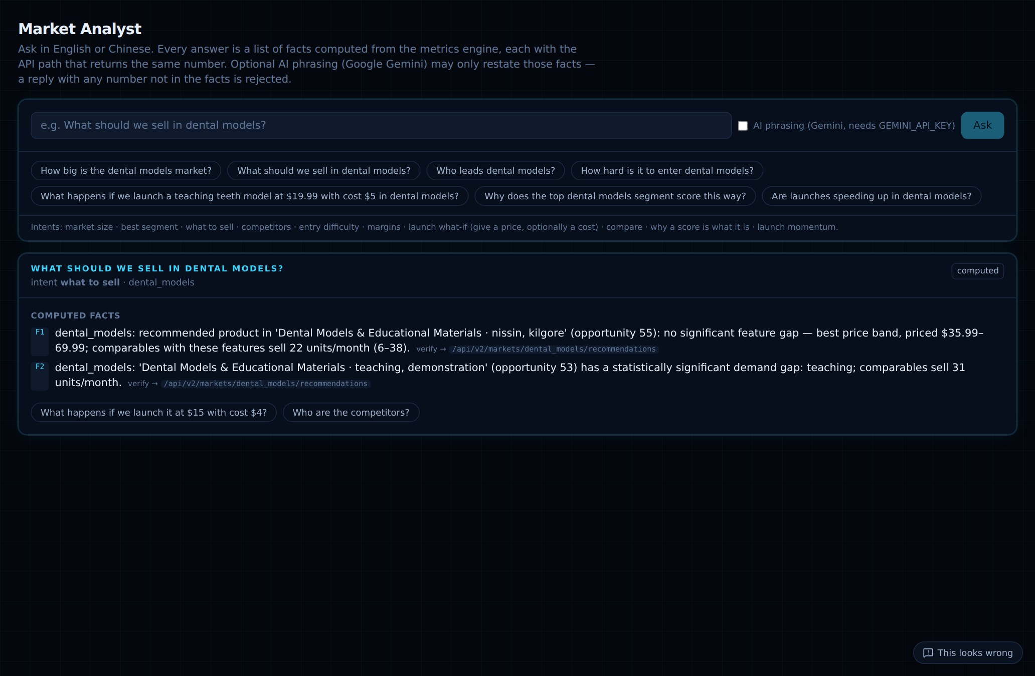
MODULE · DECISIONS
Market Analyst — ask in English or 中文
HOW IT WORKS
Detects the intent: size, opportunity, recommend, competitors, entry, economics, growth, launch, why, compare
Resolves the market, segment or brand named in the question
Answers with computed facts, each with a verify link to the page that shows the same number
IN DEPTH
Number guard: optional Gemini (gemini-2.5-flash) may only rephrase; any number not in the facts → reply rejected
Traceability: every AI call stored: model, prompt version, input hash, output, status
Bilingual: each fact written in both languages
/analyst
DMIS · 16
Notes:
src/dip/intelligence/analyst_v3.py and gemini.py. The key design choice: code computes, AI only phrases. The number guard extracts every number from the AI reply, handling %, k, M and 万, and rejects the reply if any number isn't in the computed facts within tolerance. Demo: ask 'What should we sell in dental models?' then switch to Chinese and ask again.

Slide 17
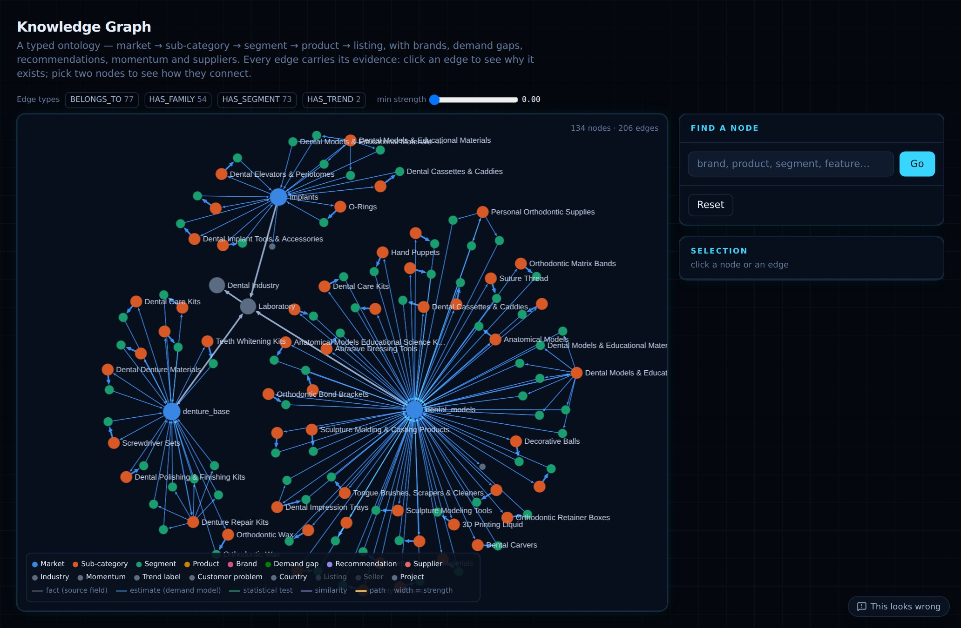
MODULE · INTELLIGENCE
Knowledge Graph and Product Galaxy
Graph: market → sub-category → segment → product → listing, plus brands, gaps, momentum, suppliers
Evidence on every edge: basis (fact / estimate / test / similarity) and strength 0–1; click an edge to see why it exists
Path finding: weights 1 + (1 − strength): the best-evidenced route wins; non-significant edges are never drawn
Galaxy: products as stars, placed by title similarity (SVD of offline hashing embeddings)
Colour & size: segment, brand, price quartile, opportunity, margin, entrant; size = revenue or units
Scale: draws the largest 3,000 products and states the share of revenue shown
DMIS · 17
Notes:
The graph is the ontology in src/dip/intelligence/ontology.py; the store is NetworkX embedded or Neo4j. Every edge carries evidence, a basis and a strength, and path finding prefers the strongest evidence. The galaxy is three.js; coordinates are computed during processing from the title embeddings. Good visual moment in the demo: click an edge, then pick two nodes and show the path.

Slide 18
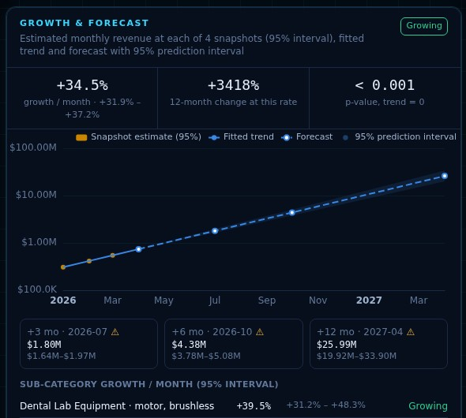
MODULE · INTELLIGENCE
Growth & forecast
HOW IT WORKS
Every upload stores the market's and each sub-category's revenue estimate with its interval, per snapshot date
With ≥ 3 dated snapshots: growth per month with a 95% interval, a trend test, 3/6/12-month forecasts
Fewer snapshots → the page says so and shows entry momentum instead; no trend is invented
IN DEPTH
log yᵢ = a + b·tᵢ + uᵢ + eᵢ
eᵢ ~ N(0, sᵢ²) from each snapshot's interval
uᵢ ~ N(0, τ²) real month-to-month variation
τ² by method of moments; weighted least squares with 1/(sᵢ² + τ²); growth = eᵇ − 1 with a t interval
Prediction intervals include τ²; ⚠ marks horizons beyond the observed history; seasonality needs 24 months
Validated: intervals covered the truth 96–100% on simulated series
Shown on a demo market with four monthly snapshots
DMIS · 18
Notes:
src/dip/metrics/forecast.py. It is a random-effects log-linear trend: each snapshot is weighted by its own measurement uncertainty plus real month-to-month variation estimated by DerSimonian–Laird style method of moments. The real exports are single snapshots, so on those markets the page honestly says it needs three dated monthly uploads — the screenshot is a demo market with four snapshots. Horizons beyond the history get a warning; seasonality is not modelled until 24 months exist.

Slide 19
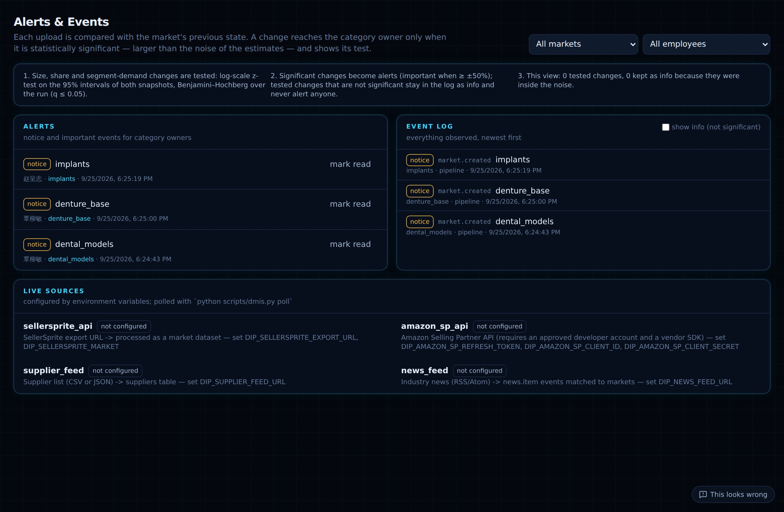
MODULE · DECISIONS
Alerts & Events — only significant changes
HOW IT WORKS
Each upload is compared with the market's previous state (size, brand shares, segment demand)
A change reaches the category owner only when it is statistically significant
Insignificant changes stay in the log as “info”; each event shows its test
IN DEPTH
Test: z = (log after − log before) / √(se₁² + se₂²), se from each 95% interval
Multiplicity: Benjamini–Hochberg across the run; q ≤ 0.05 is significant
Routing: alerts go to owners from employee ↔ category ownership
/alerts
DMIS · 19
Notes:
src/dip/significance.py. Alert fatigue is the enemy: a 20% move inside wide intervals is noise. Tests are on the log scale because revenues and shares are positive with asymmetric intervals. Exact data (no uncertainty) makes any change certain. Also shows live data connectors (SellerSprite API, Amazon SP-API, supplier feed, news) and whether each is configured.

Slide 20
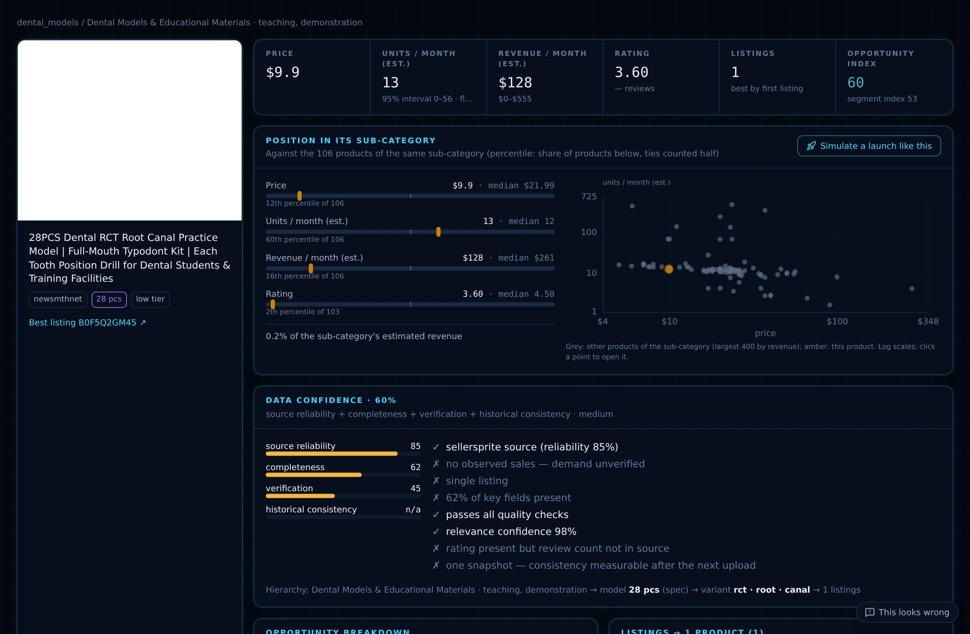
MODULE · WORKFLOW
Product page — one product in context
HOW IT WORKS
Estimates with intervals; opportunity index and its breakdown
Position in its sub-category: percentiles for price, units, revenue, rating + a peer scatter
“Simulate a launch like this” opens the simulator pre-filled
IN DEPTH
Percentile: (peers below + ½ tied) ÷ peers — mid-rank
Data confidence: source reliability + completeness + verification + historical consistency
Listing ≠ product: every listing of the product with how its sales were observed
/products/{id}
DMIS · 20
Notes:
The product page joins the product's estimates, its position among peers, the confidence breakdown with reasons, and its listings. Listing ≠ product is visible here: the listings table shows each ASIN that belongs to this product and how its sales were observed (badge, exact, below first badge).

Slide 21
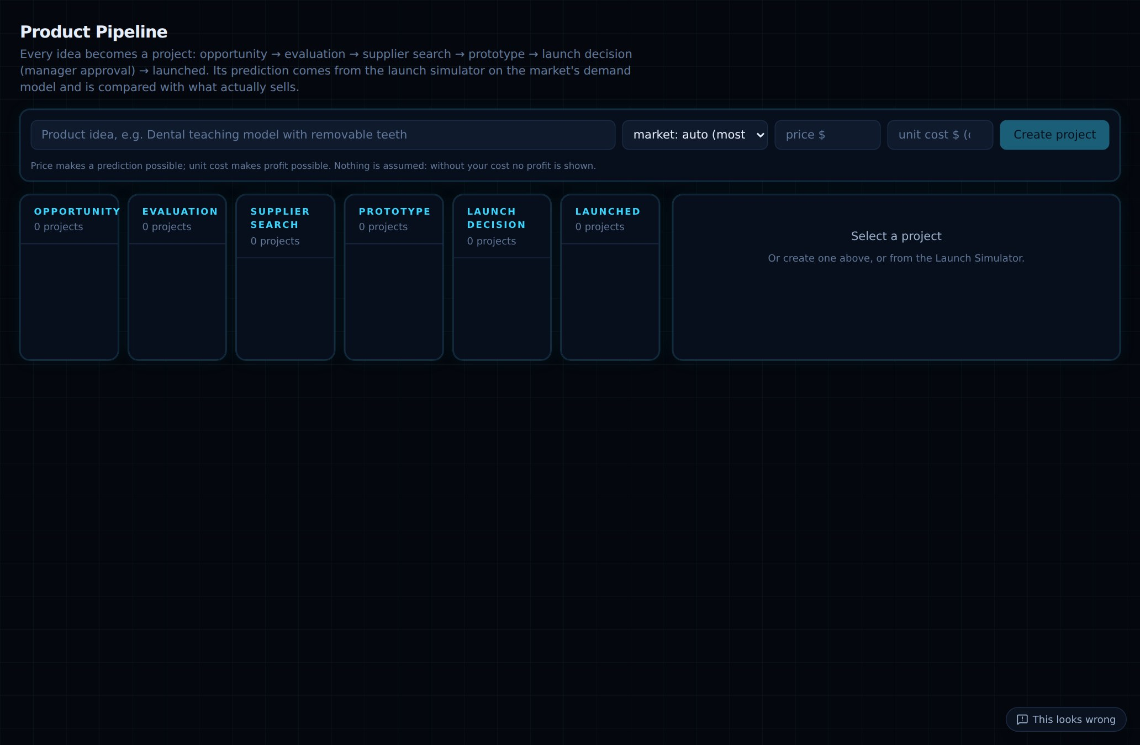
MODULE · WORKFLOW
Product Pipeline — from idea to launch
HOW IT WORKS
Stages: opportunity → evaluation → supplier search → prototype → launch decision → launched
Manager approval gates the launch decision; every change is audited
After launch, add the listing IDs: actual sales are checked against the prediction
IN DEPTH
Prediction: a v3 launch simulation on the market's model; inputs validated
Calibration: actual vs predicted p10–p90 feeds the Accuracy page
Roles: admin, manager, product_manager (scoped), supplier_manager, analyst, viewer, customer
/projects
DMIS · 21
Notes:
src/dip/projects.py. Every idea becomes a project with a prediction; loss-making inputs raise warnings; invalid inputs are rejected. The loop closes after launch, when actual sales are compared with the predicted range — this is how we will calibrate the model against real outcomes.

Slide 22
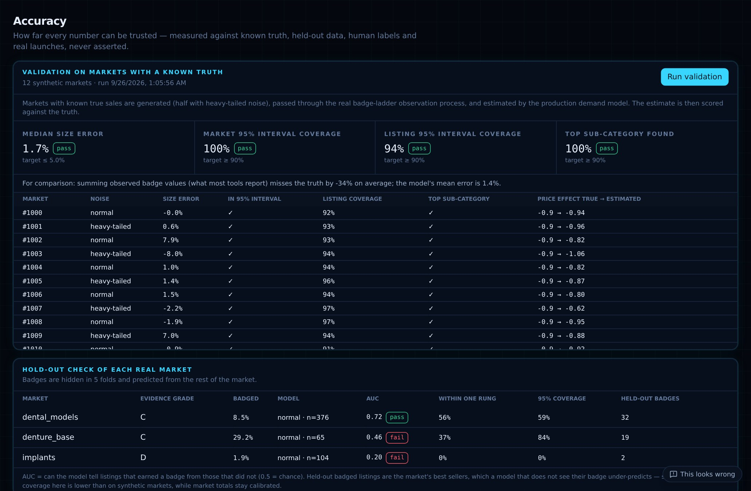
TRUST
Accuracy is measured, not asserted
1.7%
100%
median error of market size on synthetic markets with known truth
of true sizes inside the 95% interval
673
0.72
automated tests; CI on every push (Python + frontend + i18n)
hold-out AUC on dental_models (badges hidden, then predicted)
Acceptance test: a full bilingual user journey from two uploads to the Opportunity Board.
Synthetic ground truth: markets with known sales, real badge censoring; calibration and validation seeds kept apart
Invariants: totals reconcile at every level; shares sum to 1; every estimate inside its interval
Human labels & launches: precision/recall and launch calibration as data arrives
DMIS · 22
Notes:
src/dip/pilot/accuracy.py and metrics/synthetic.py. The validation button on the Accuracy page runs the production demand model on synthetic markets whose true sales are known (normal and heavy-tailed noise, price elasticity −0.9, missing covariates) with the real badge censoring applied. The per-market hold-out check hides badges in 5 folds and predicts them; denture_base fails (AUC 0.46) and is flagged, which is exactly the point. 673 tests pass; GitHub CI runs Python tests plus frontend lint, type-check, build and the i18n guard.

Slide 23
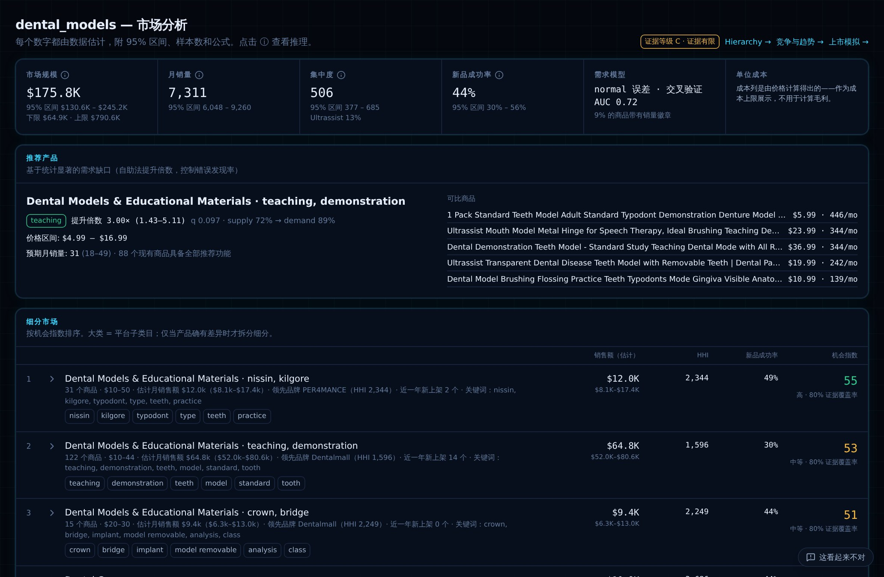
EVERYWHERE
Fully bilingual — English and 中文
HOW IT WORKS
Every page, chart label, tooltip and analyst answer in both languages
Segment descriptions generated in English and Chinese
Analyst understands questions in either language
IN DEPTH
Dictionaries: about 1,250 keys in messages/en.ts and zh.ts
Generated sentences: translated by pattern rules; anything unmatched stays English rather than guessed
Guard: CI fails on a missing key or hard-coded English in the UI
switch EN / 中文 at the bottom of the sidebar
DMIS · 23
Notes:
Switch the language live during the demo. The check-i18n script in CI makes sure both dictionaries have the same keys and that no English text is written straight into a page.

Slide 24
UNDER THE HOOD
Stack and code map
Backend
Frontend
Ops
config/
categories.yaml · platform/metrics.yaml (every statistical setting)
src/dip/pipeline/runner.py the upload pipeline
src/dip/metrics/
observation · demand · engine · gaps · brands
launch · shopping · forecast · bands · board
src/dip/intelligence/ analyst_v3 · gemini · ontology
src/dip/api/routes/ metrics · catalog · workflow …
src/dip/storage/ lake · business · graph · vectors
src/dmie/ v1 engine (wrapped)
frontend/app/<page>/ one folder per page
tests/ 673 tests · docs/METHODOLOGY.md
Python · FastAPI (~120 endpoints)
DuckDB over Parquet lake
SQLAlchemy → SQLite / PostgreSQL
NetworkX / Neo4j · Qdrant
Polars · NumPy · SciPy · scikit-learn · XGBoost
Next.js 16 · React 19 · TypeScript
Tailwind CSS
ECharts (charts)
three.js / react-three-fiber (3D)
i18n: EN / 中文
Docker · job-queue worker
Bearer tokens (SHA-256), 7 roles
Audit log · multi-tenant plans
Backup / restore CLI
Runs fully offline
Principles (PRINCIPLES.md): listing ≠ product · raw data never modified · code calculates, AI interprets · every exclusion has a reason · no hard-coded category rules.
DMIS · 24
Notes:
If asked how the database is connected: settings.py builds the URL — DIP_POSTGRES_URL if set, else sqlite:///data/platform/business.db; SQLAlchemy create_engine is cached, tables are created and additively migrated on first connect, and code uses business.session(). Market data lives as Parquet at data/lake/curated/<table>/market=<name>/data.parquet and DuckDB queries it with read_parquet, no server. Nothing category-specific is hard-coded: rules are in config/categories.yaml and every statistical setting in config/platform/metrics.yaml.

Slide 25
HONEST LIMITS · NEXT STEPS
The system says when it doesn't know
LIMITS TODAY
NEXT STEPS
Single snapshot per market → no growth claimed until 3 dated monthly exports
No review text yet → customer pain uses the rating-based quality gap
No supplier list yet → supplier matching is empty
Price effect is associational, not causal
Human labelling still needed for precision / recall
Upload 3–6 dated monthly exports per category
Add review text and the supplier list
Label ~50 products per market
Backtest on the monthly history
4-week pilot with 3–5 users → exit report
Every number with its interval, its formula and its evidence — so a launch decision knows the range of outcomes and whether a difference is real.
DMIS · 25
Notes:
Close on honesty as a feature: with one snapshot it refuses to claim growth; with weak evidence it grades the market D and widens the interval; implants is flagged because about 96% of that export is water flossers outside the category definition. Then the ask: monthly exports, reviews, supplier list, labelling time, and pilot users.

