Slide 1


OPEN SOURCE IN THE INDUSTRY

Slide 2



Who is this presentation for?
Software Engineer
Automation Engineer
Industrial IT Manager / Design office / Machine manufacturer

Slide 3
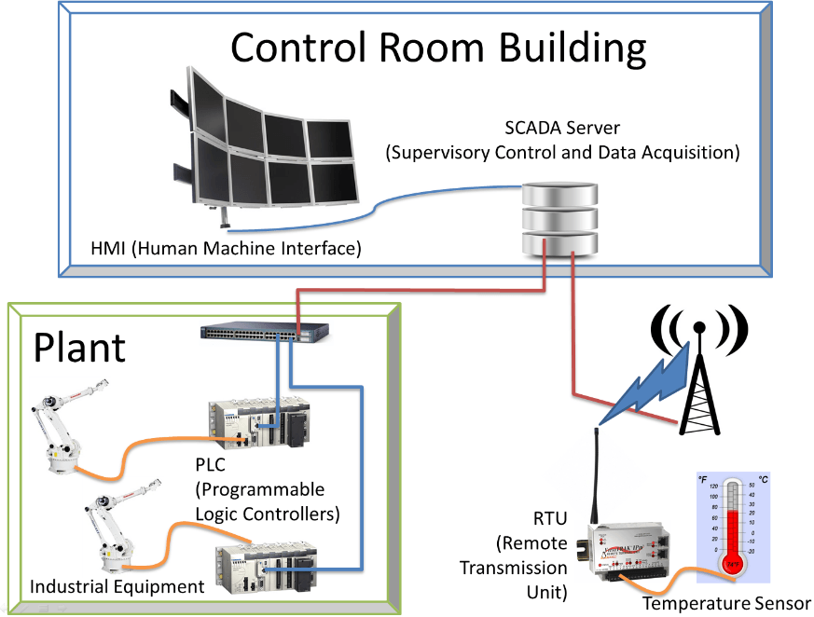
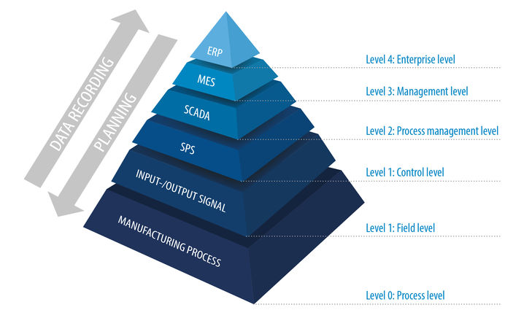
SCADA System Architecture

Slide 4
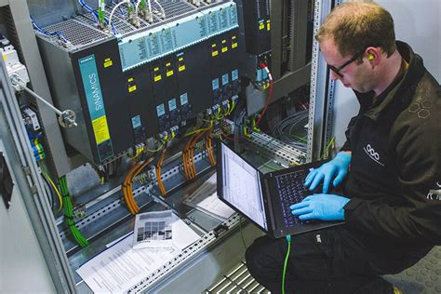
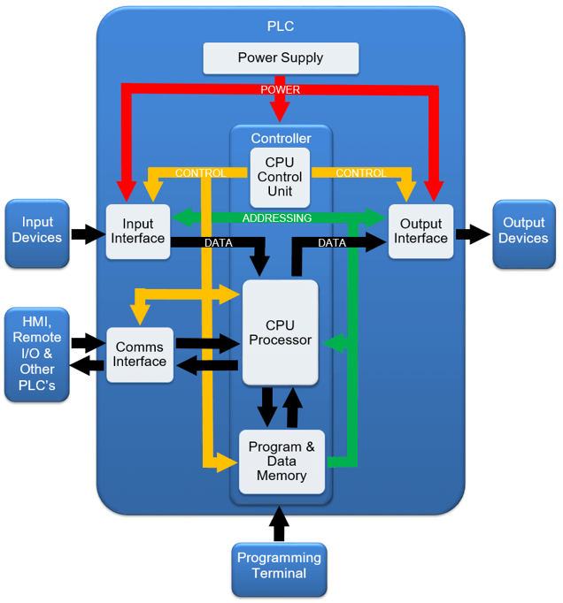

PLC (Programmable Logic Controller)
1
2
3
READ
PROCESS
WRITE

Slide 5
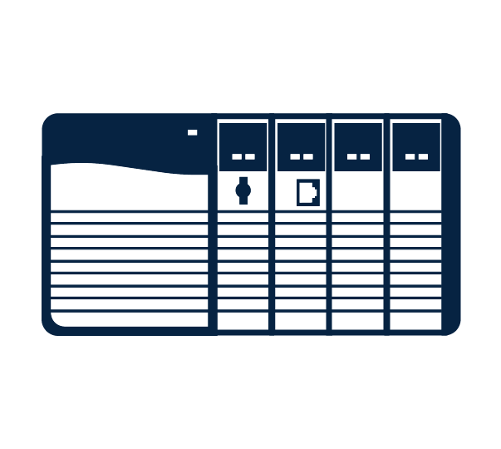

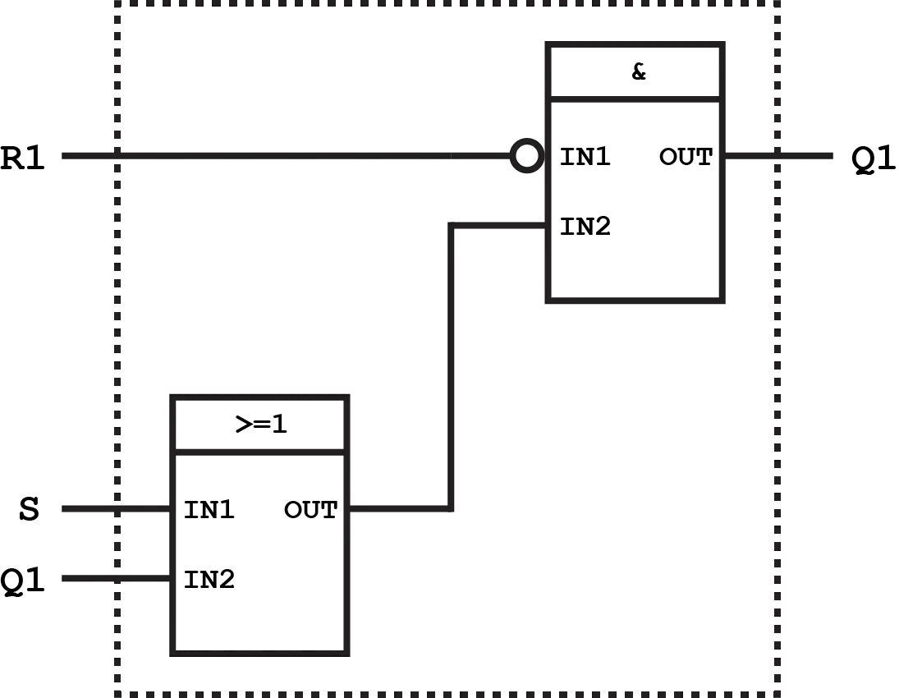

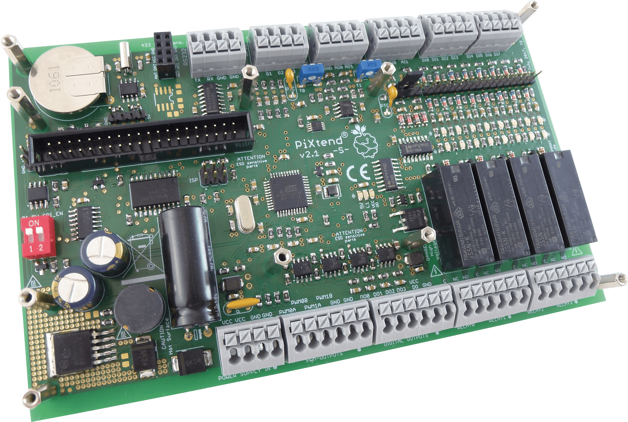
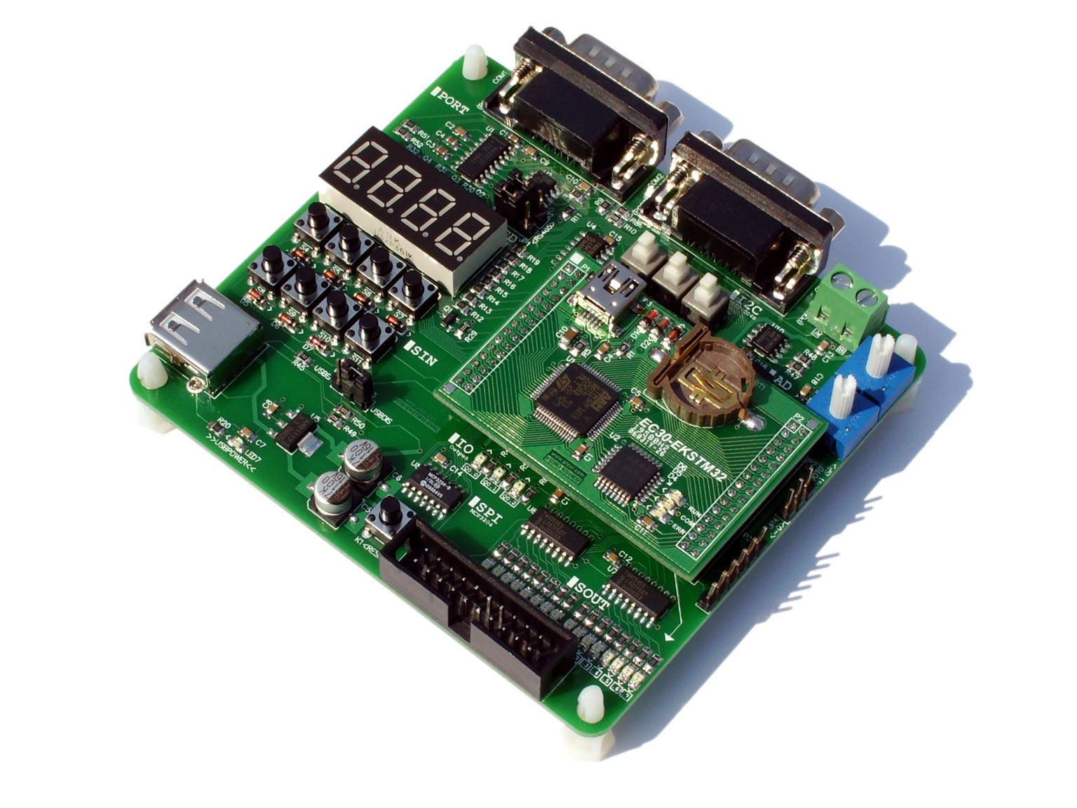
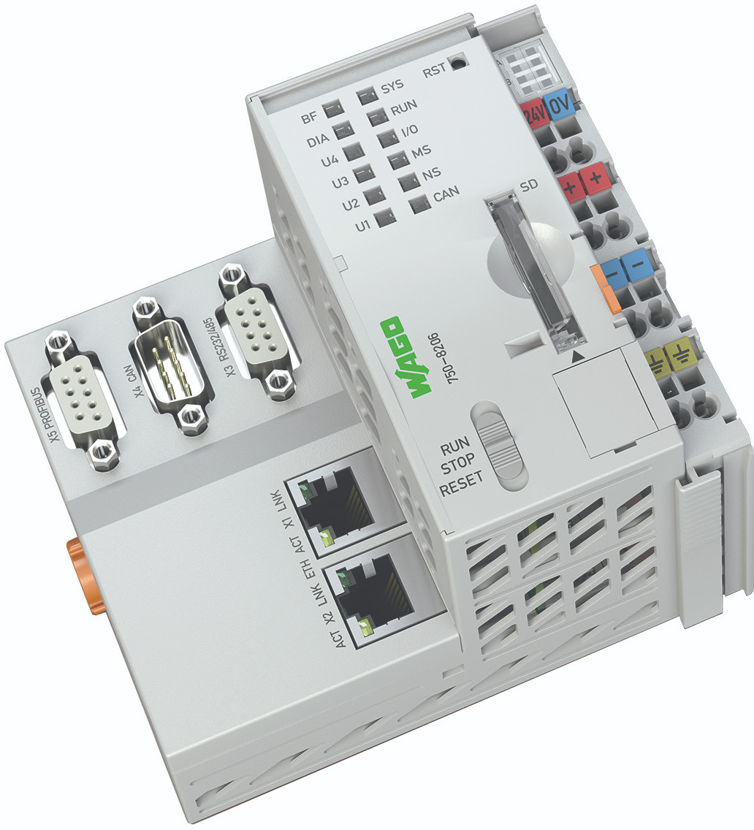
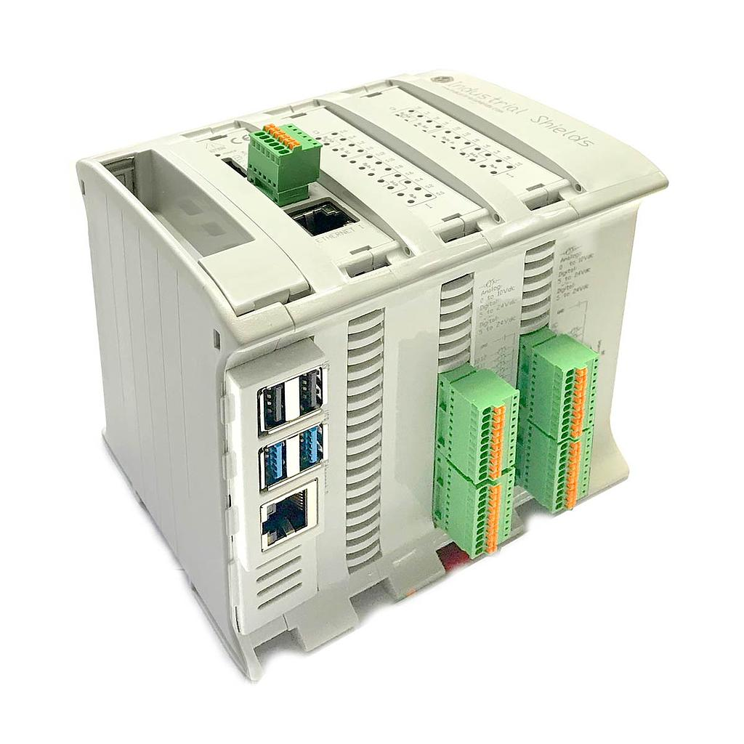
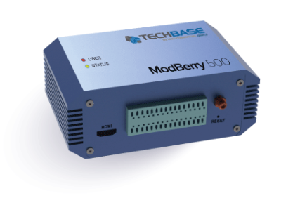
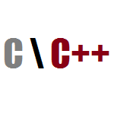
PLC - Open-source runtime
Runtime: Execution environment
Execute the program developed by the automation engineer written in standardized languages (like IEC-61132-3, IEC-61499, etc...)
Proprietary controllers
Open controllers
Embedded software engineer:
Integrates the runtime in the hardware platform,
Develops a hardware abstraction layer (HAL), adds protocols, etc...

Slide 6

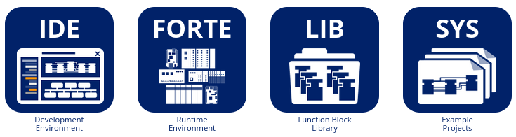

Eclipse 4DIAC
Open-source PLC framework for Industrial Automation and Control
https://eclipse.dev/4diac/

Slide 7



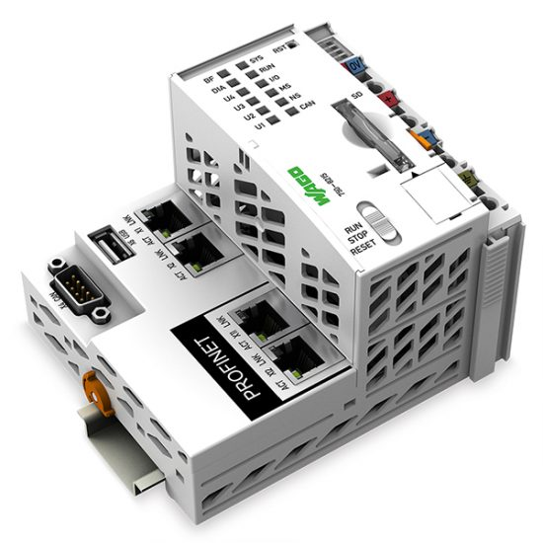
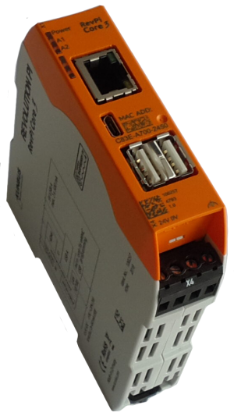


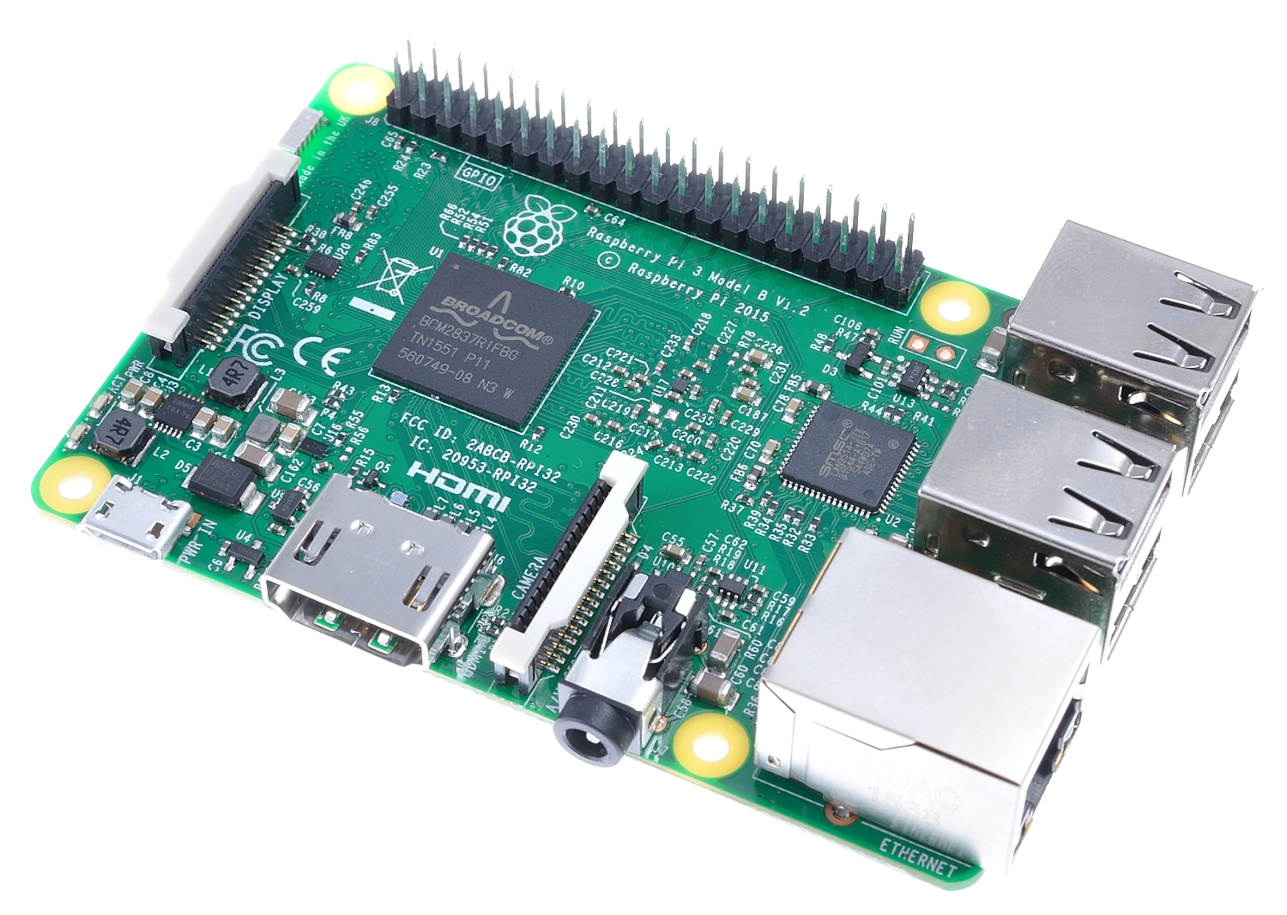



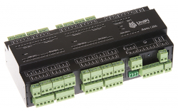
4DIAC-FORTE
* Non-exhaustive lists

Slide 8
Eclipse 4DIAC
Open-source PLC framework for Industrial Automation and Control
https://eclipse.dev/4diac/

Slide 9
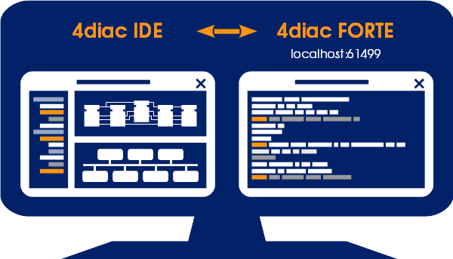
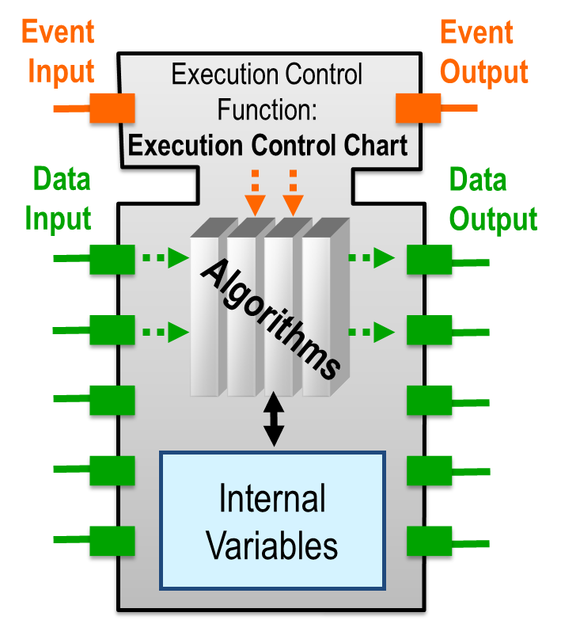
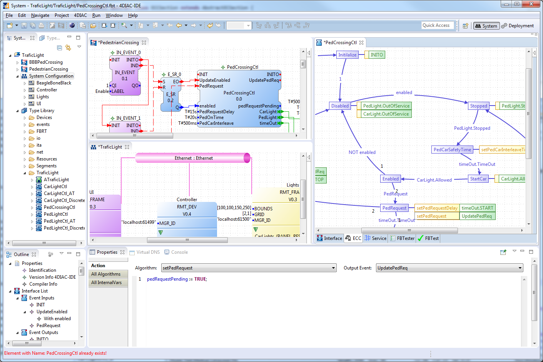
4DIAC IDE
IEC 61499 Compliant Development Environment
Based on the Eclipse framework
IDE features:
Application editor
Hardware editor
Type editors
Distribution editor
Deployment
Monitoring & debugging
Testing

Slide 10
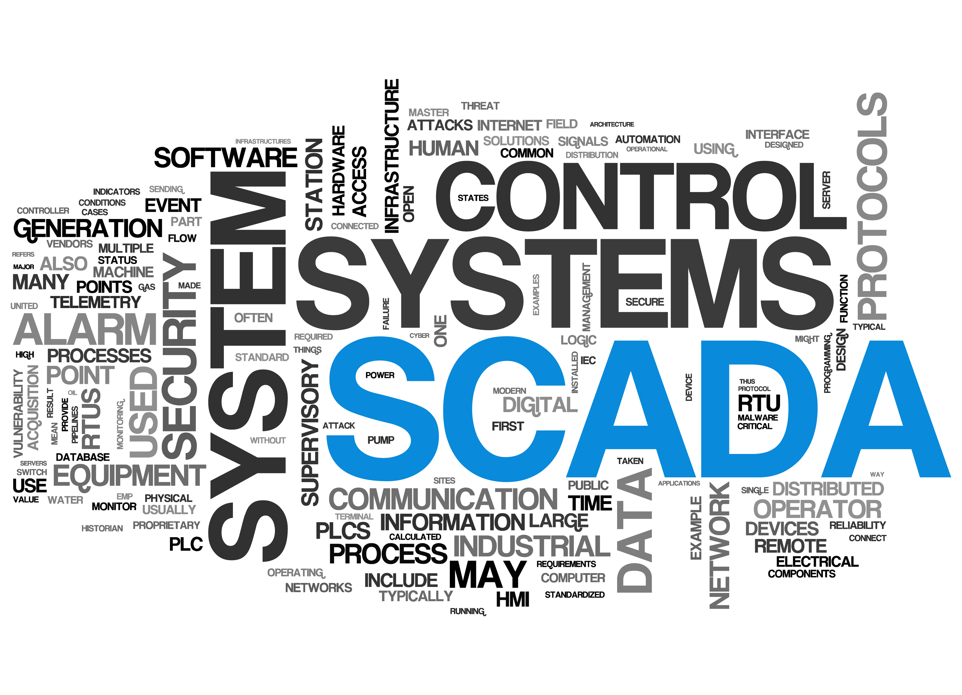
Open source Scada

Slide 11

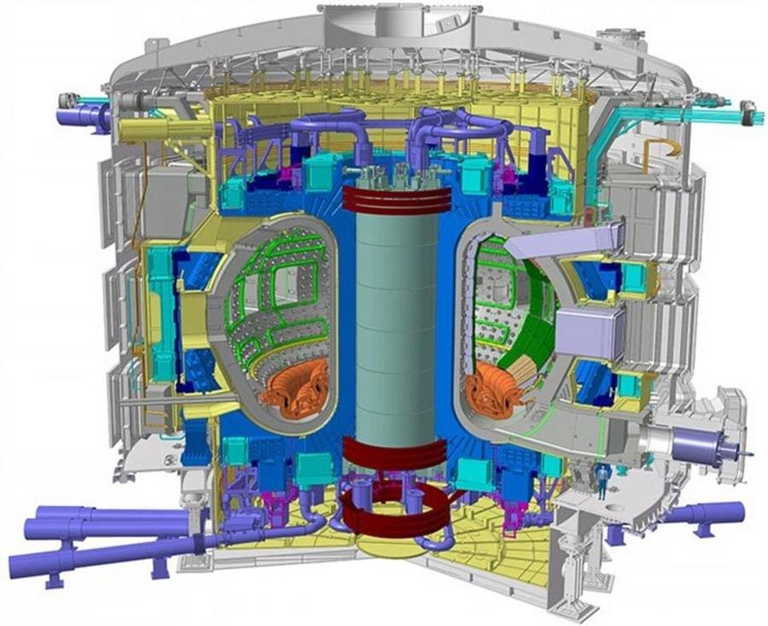
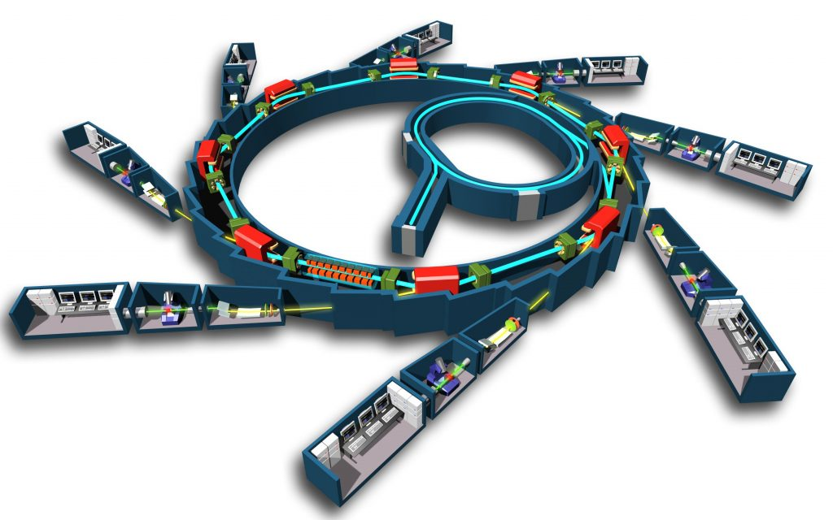

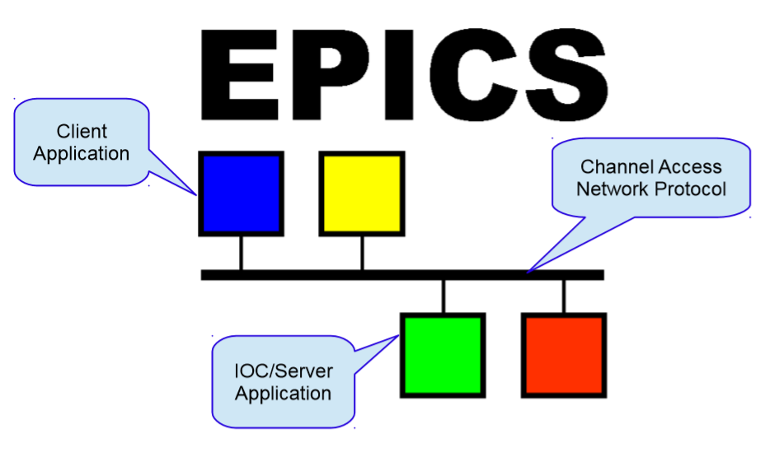


Open source scada
Who develops?
  Mainly by laboratories / research institutes / Universities
And why ?
  Very specific needs (functional and material), systems in perpetual evolution, etc…
My favorite projects:
  Tango Control System
  EPICS Control (Experimental Physics and Industrial Control System)

Slide 12


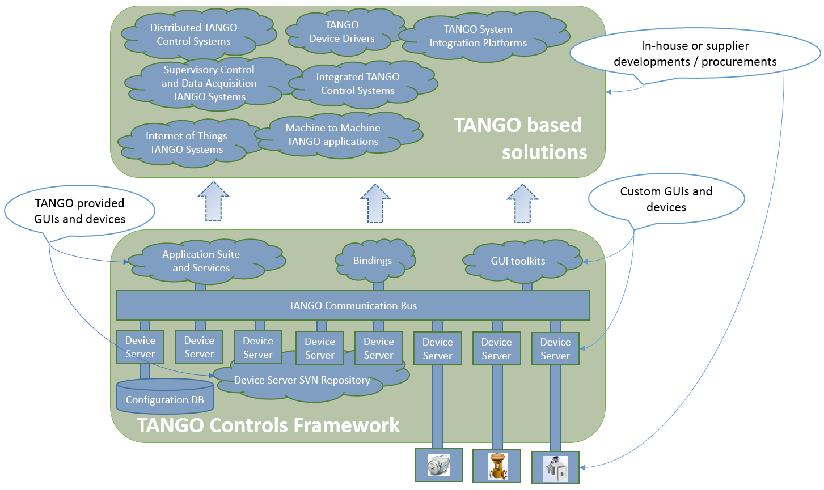
Tango Control
Short presentation
  The original proposal for Tango was made in a paper written in 31/7/1998 by W-D. Klotz, A. Götz, E. Taurel and J. Meyer

Slide 13
QUESTIONS

