Slide 1



Sylvain Pastor
Introduction to

Slide 2

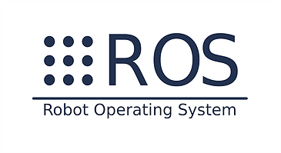
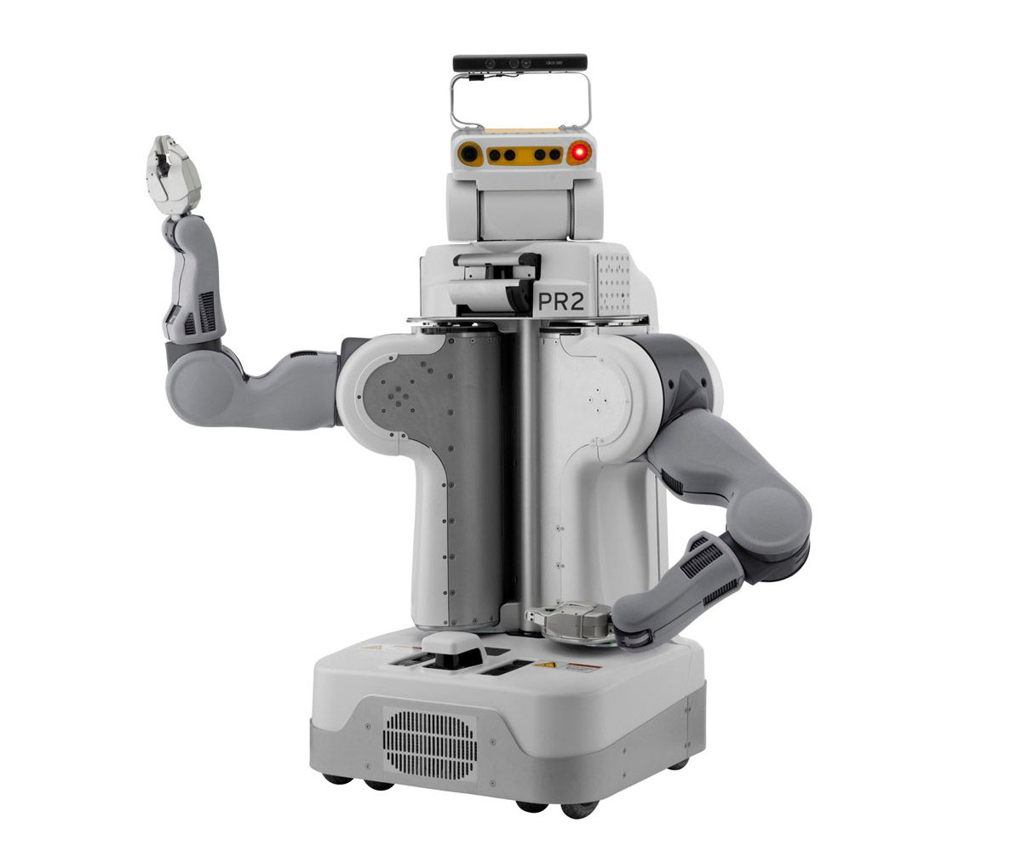

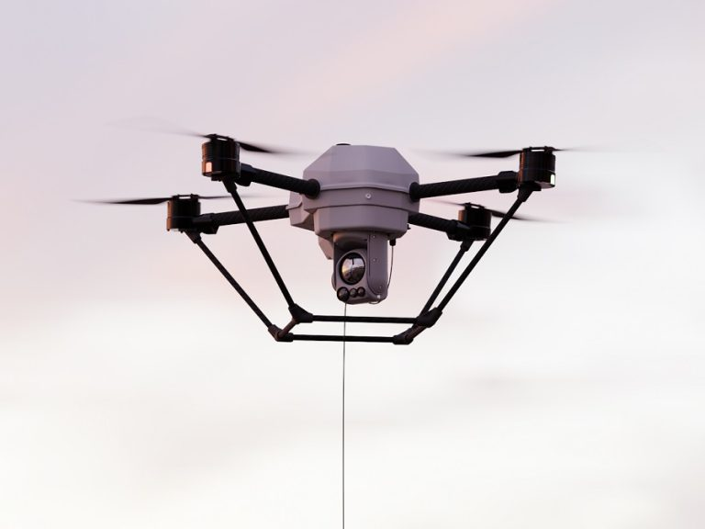
What is ROS ?
ROS:
Robot Operating System
Is NOT an operating system
Open-source robotics middleware suite
  Frameworks for robot software development (C, C++, Python, ...)
    Tools, Hardware abstraction, low-level device control, IPC, etc…
    Not a real-time OS (RTOS)
History:
Before 2007: The first pieces of what eventually would become ROS began coalescing at Stanford University
2007: Developed by Willow Garage for its PR2 robot
Today: Used to develop industrial robots, UGV or UAV, etc.

Slide 3
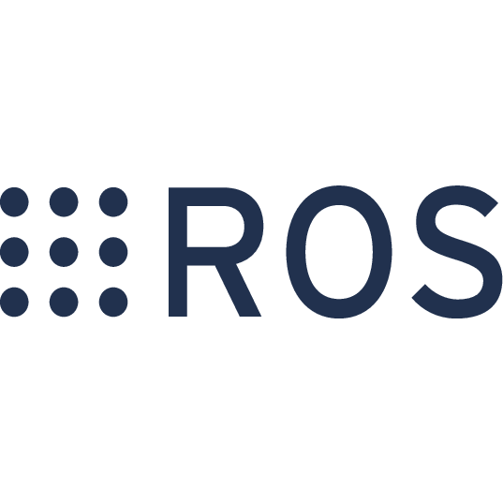


ROS versions
Versions:
ROS 1:
  Initially created in 2007 by Willow Garage,
  2025 End Of Life.
ROS 2:
  Many radical changes and would have made ROS 1 quite unstable,
  ROS2 was developed from scratch and is a completely new ROS.

Slide 4
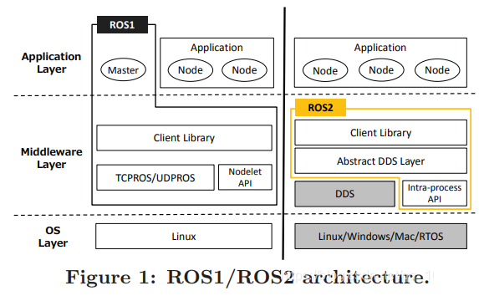
ROS versions
“Many radical changes”
ROS1 / ROS2 architecture

Slide 5
The main basics

Slide 6
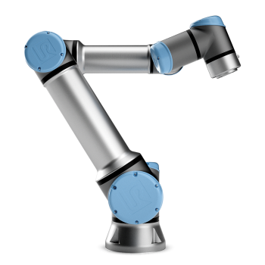
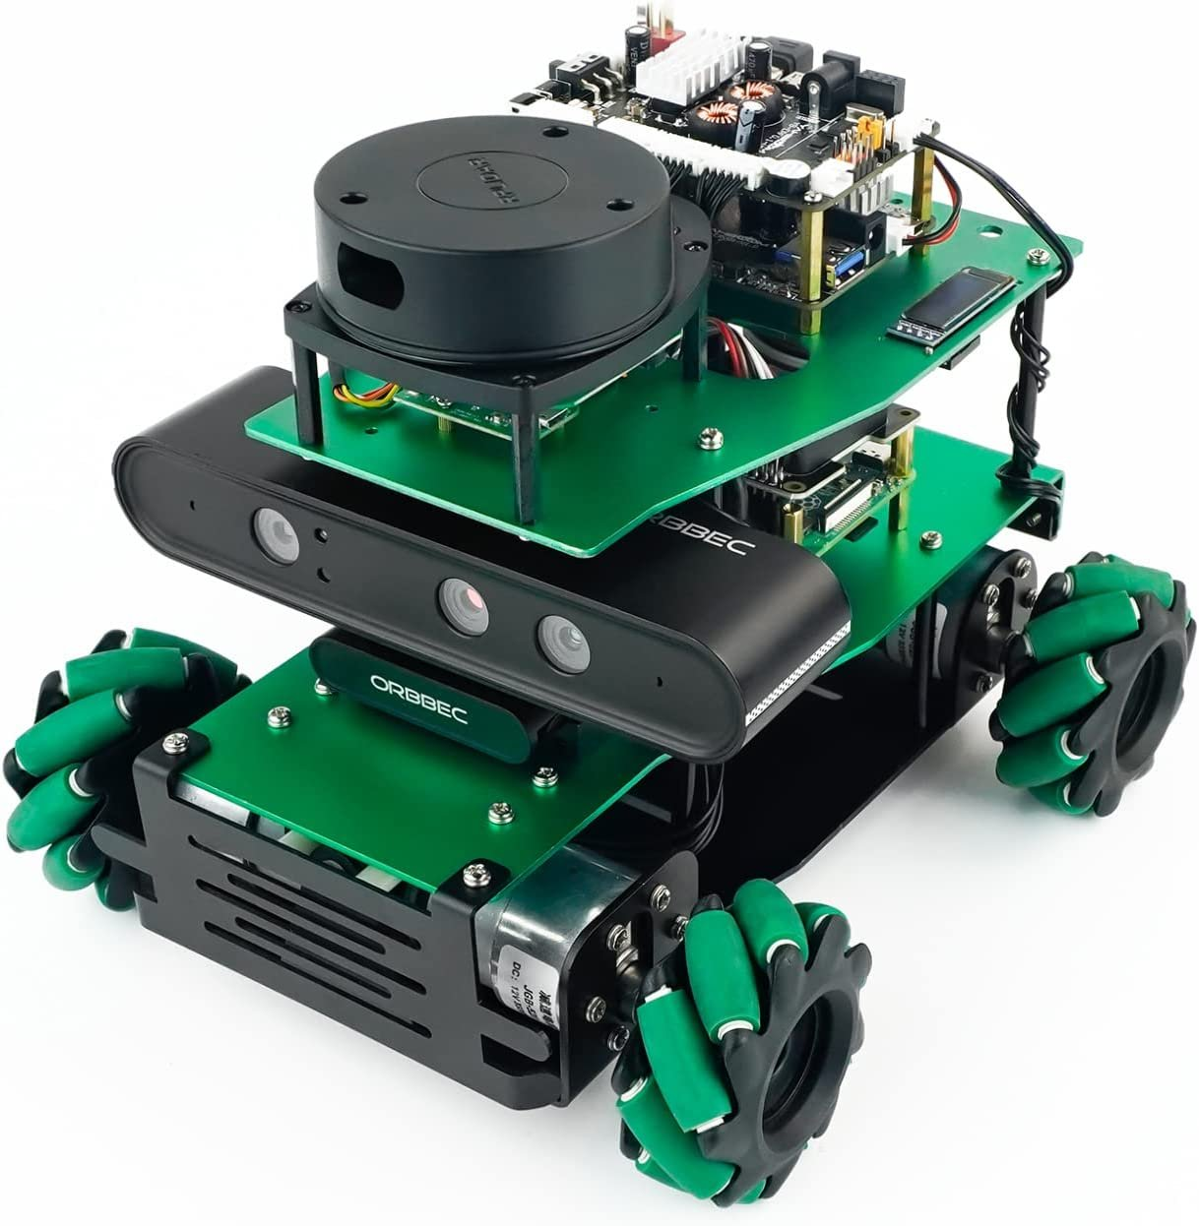
ROS Definitions
Node:
Nodes are the fundamental building blocks of a ROS2 system.
A node is “essentially a single process” that performs computations.
Each node is designed to perform a specific task within a robotic system, such as controlling a motor, processing sensor data, or communicating with other nodes.
This modular approach allows the development of complex robotic systems by combining multiple small, reusable and independent nodes.
Package:
A package can include multiple nodes and other resources.
Packages are designed to be reusable and modular, containing everything needed to run nodes, such as source code, launch files, and configuration files.

Slide 7
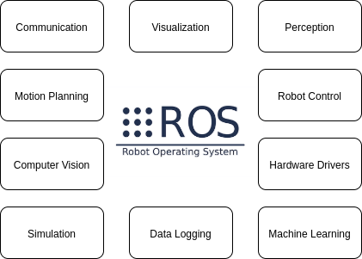
ROS packages
https://index.ros.org/packages/

Slide 8
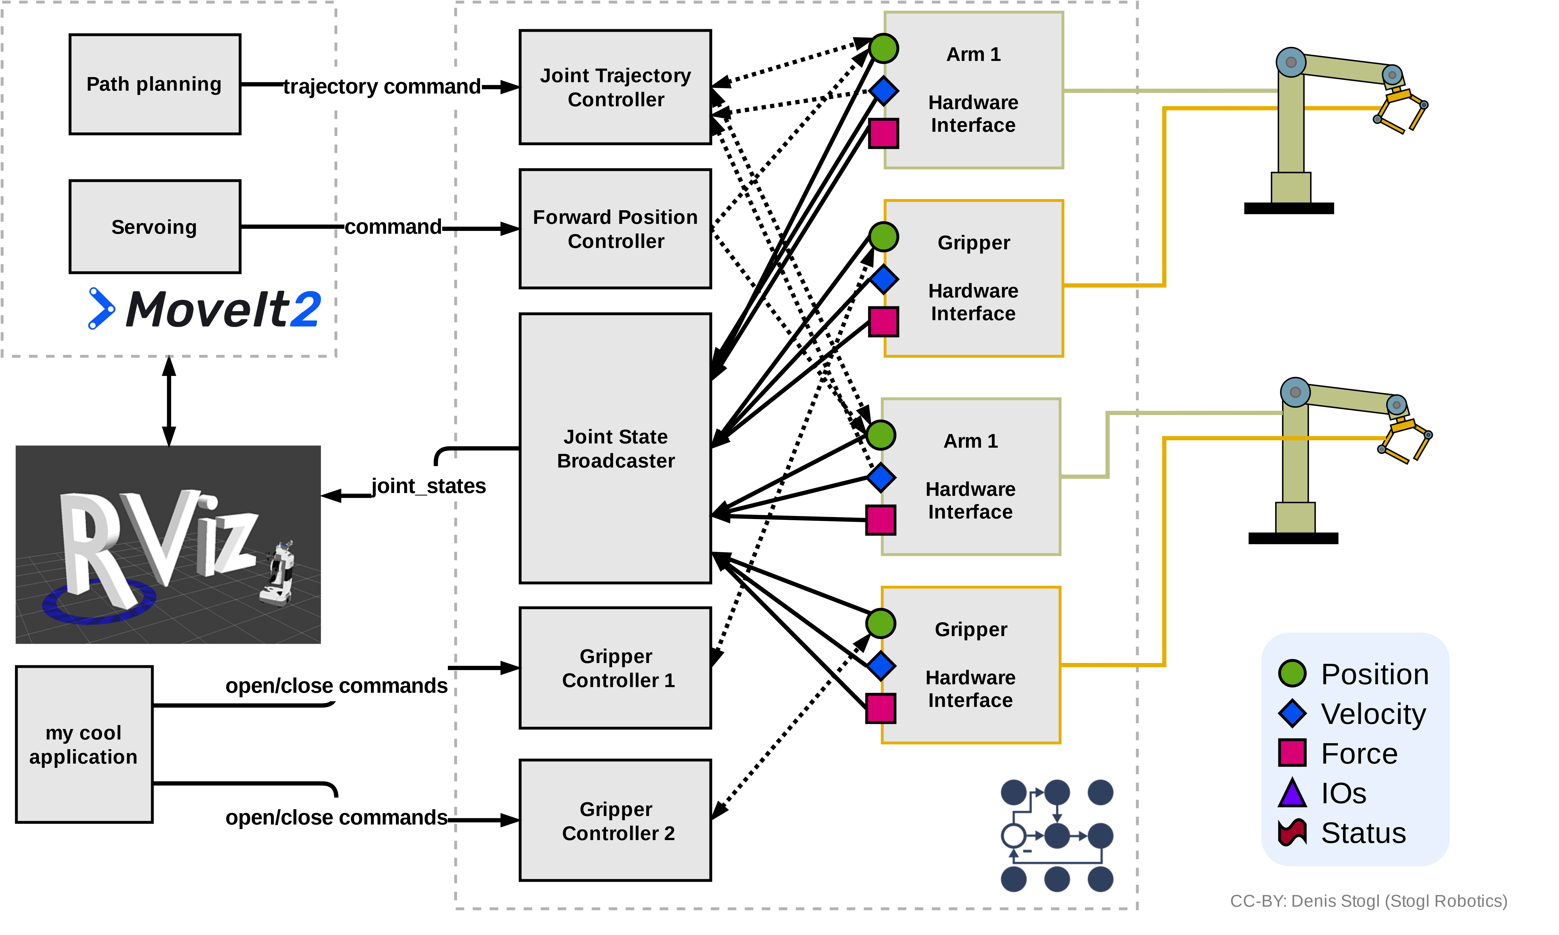
ROS packages
Example application by combining different packages

Slide 9

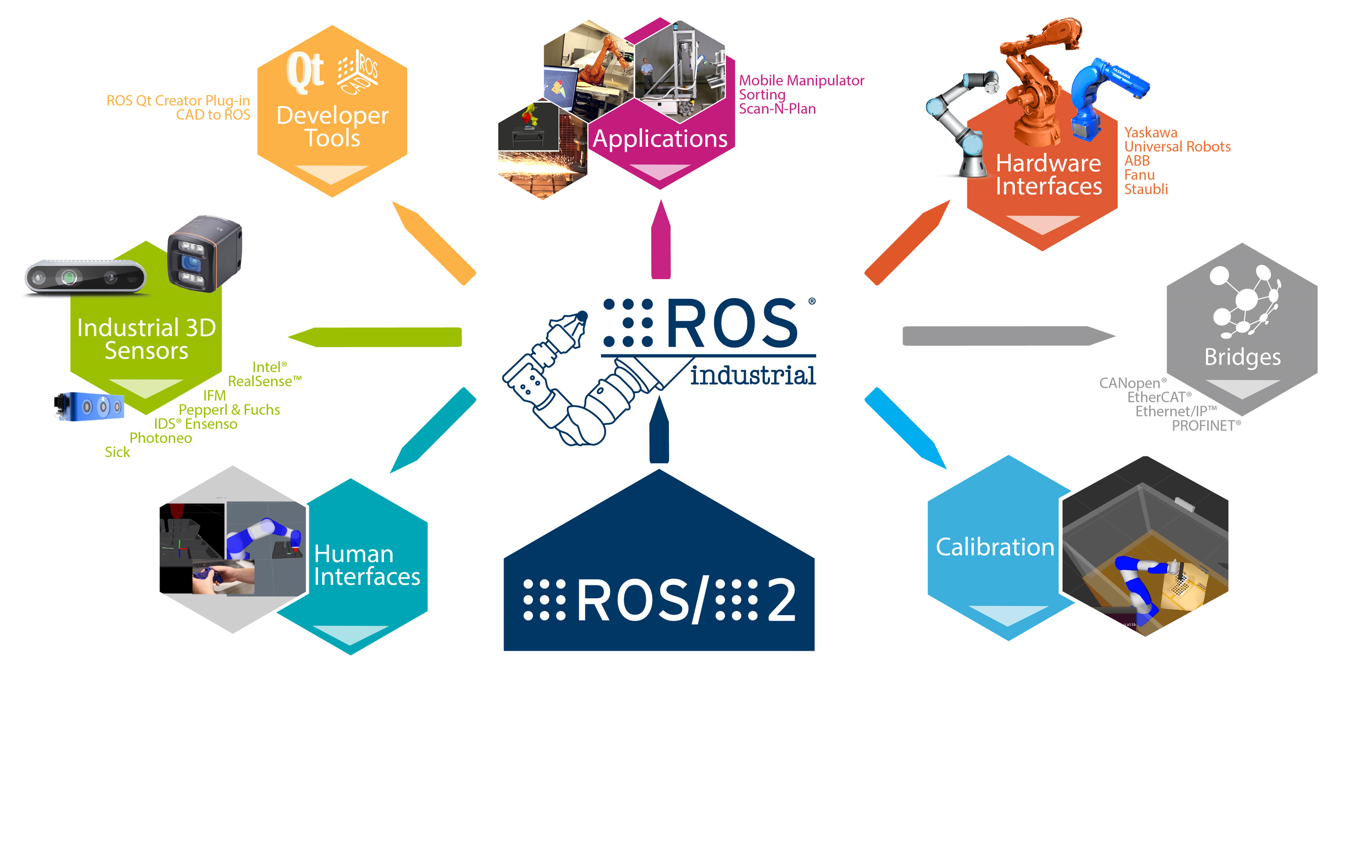
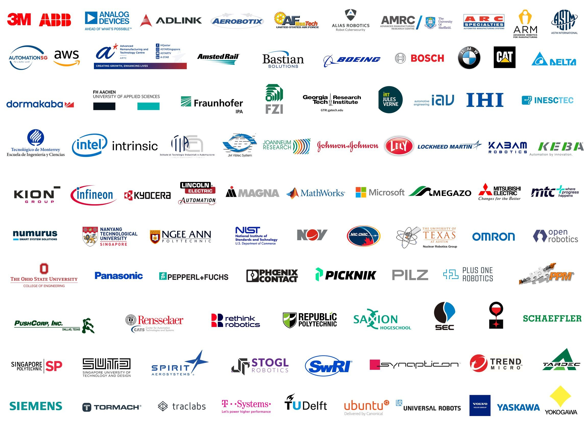
ROS Industrial
ROS-Industrial is an open-source project
that extends the advanced capabilities of ROS
to manufacturing automation and robotics.

Slide 10
ROS IPC
”Key points” for building your ROS system

Slide 11
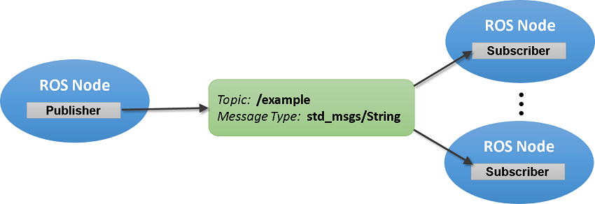
ROS intercommunication
Publication/Subscription mechanism
A node publishes a string data in a topic named “/example”,
Nodes subscribe to the “/example” topic to receive string data.

Slide 12
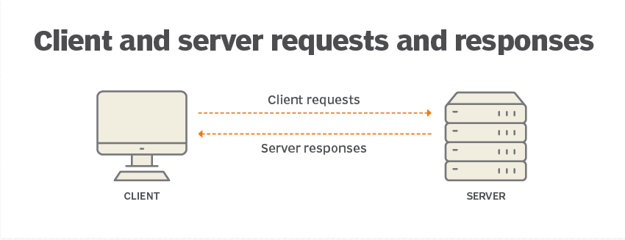
ROS intercommunication
Service (Request/Response) mechanism
ROS Node
ROS Node
REQUEST
CLIENT
RESPONSE
SERVICE
The client node sends a request to the service,
The service node returns a response to the client node.

Slide 13


ROS intercommunication
Publisher/Subscriber + Service = ????
Publisher
Subscriber
Service

Slide 14
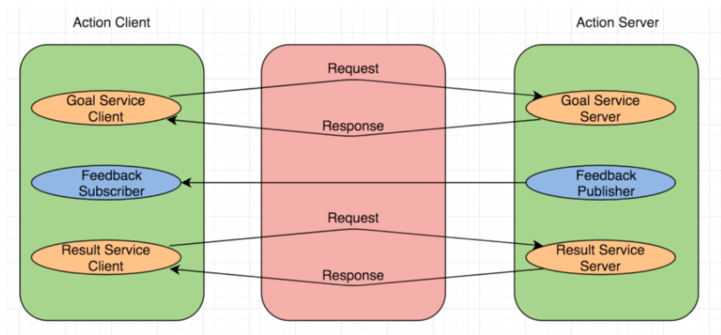
ROS intercommunication
Goal mechanism
ROS Node
ROS Node
REQUEST
RESPONSE
CLIENT
SERVER
feedbacks
1
Accept or refuse
2
Publishes the action data
(While the action is running)
3
Result of the action

Slide 15
ROS intercommunication
Distributed applications
MACHINE A
Node A
Node B
Publisher
Subscriber
Publisher
Subscriber
Action Server
Service srv
MACHINE B
Node C
Subscriber
Action Client
Service Client

