Slide 1
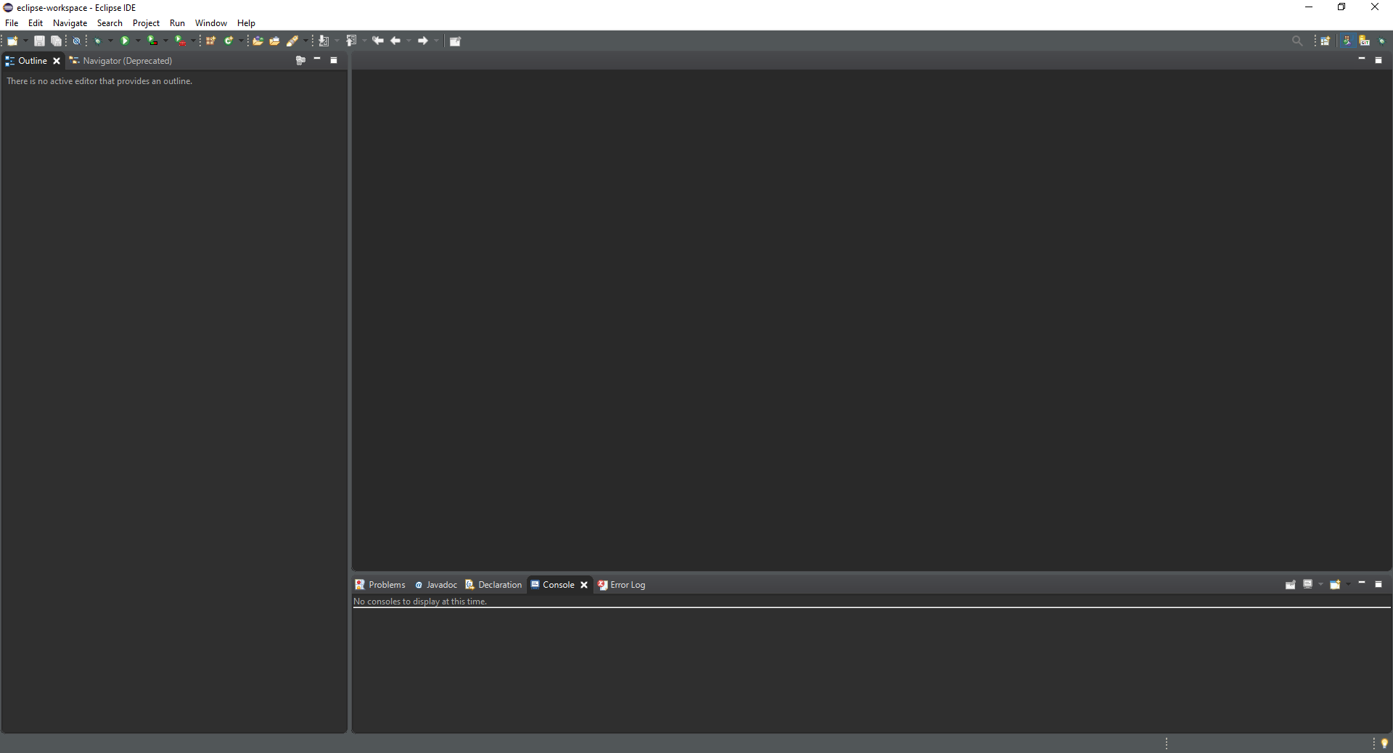
INTEGRETED DEVELOPEMENT ENVIRONMENT
Eclipse

Slide 2

INTRODUCTION
Was release in 2001 by IBM
It contains a base workspace and an extensible plug-in system for customizing the environment.
Everything is a plug-ins and you
can use them for programming in
other languages.

Slide 3

Eclipse is mostly use for JAVA application.
You can develop appliccation in other
languages with plug-ins.
Eclipse is free and open-source software.

Slide 4
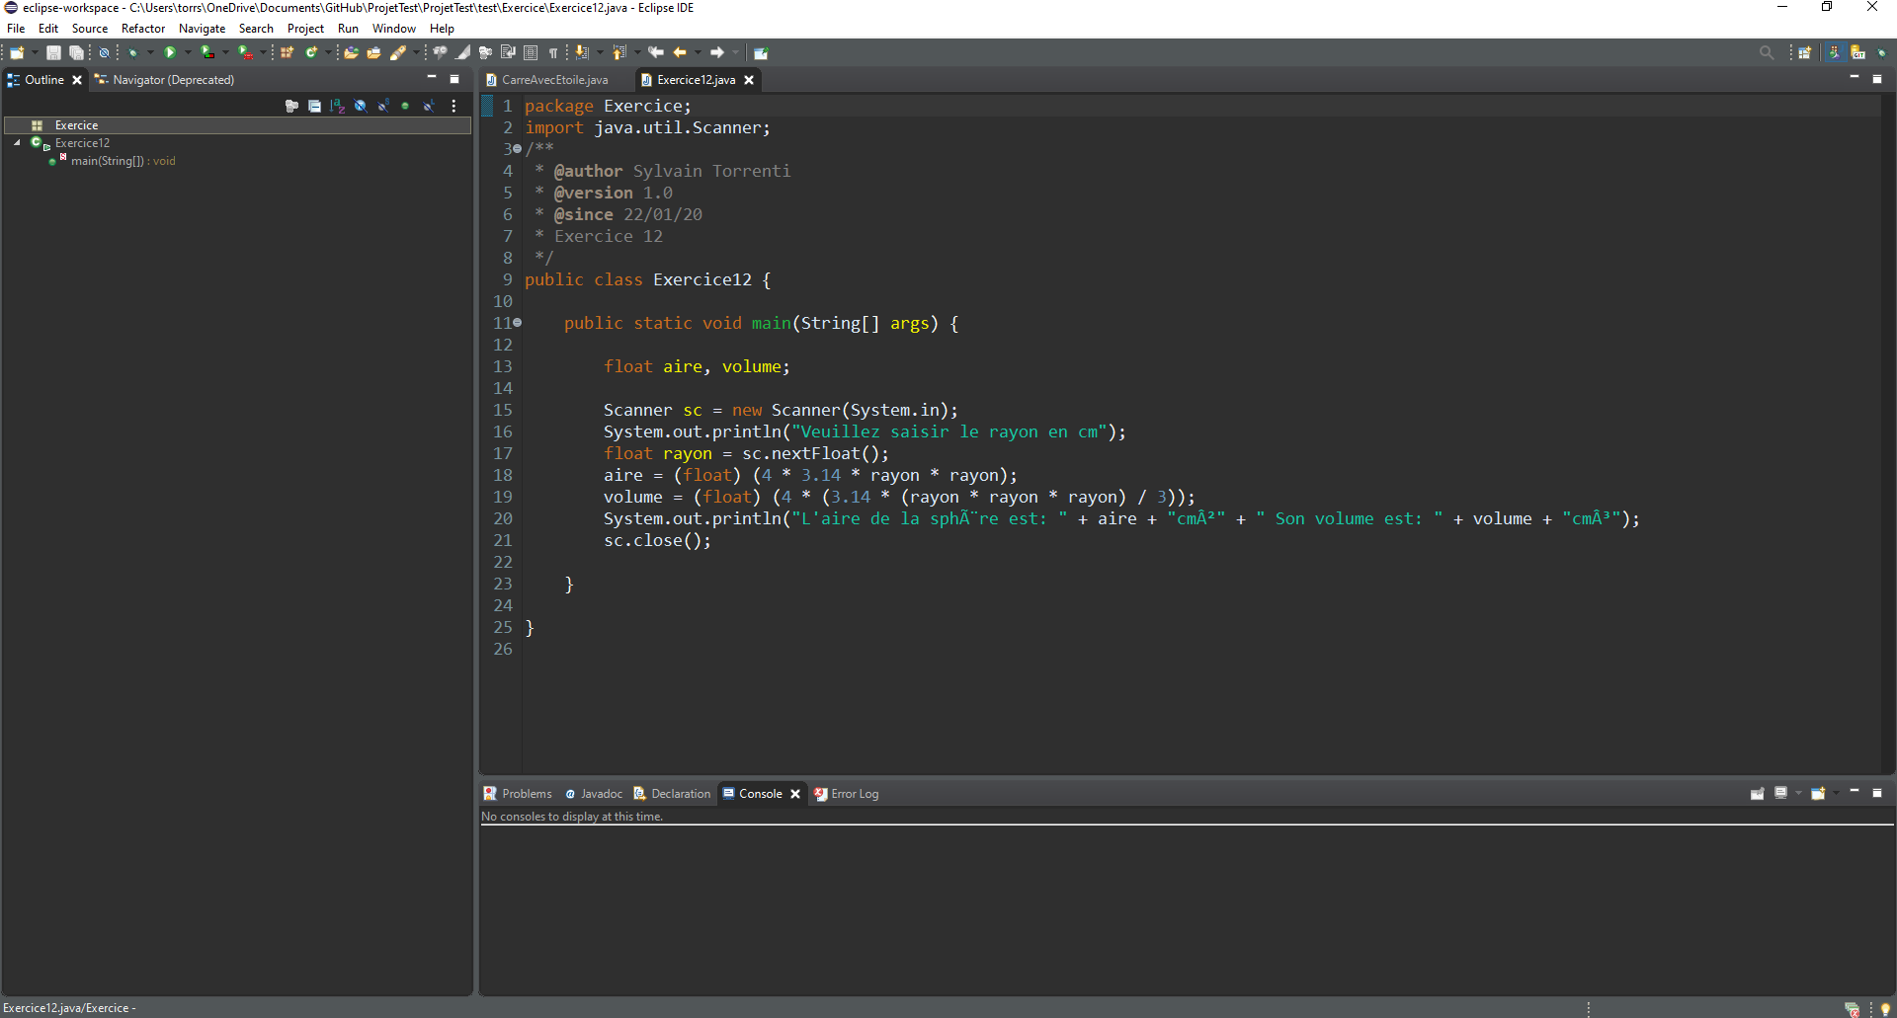
INTERFACE
Tool Bar
Menu bar
Editor
Views

