Slide 1
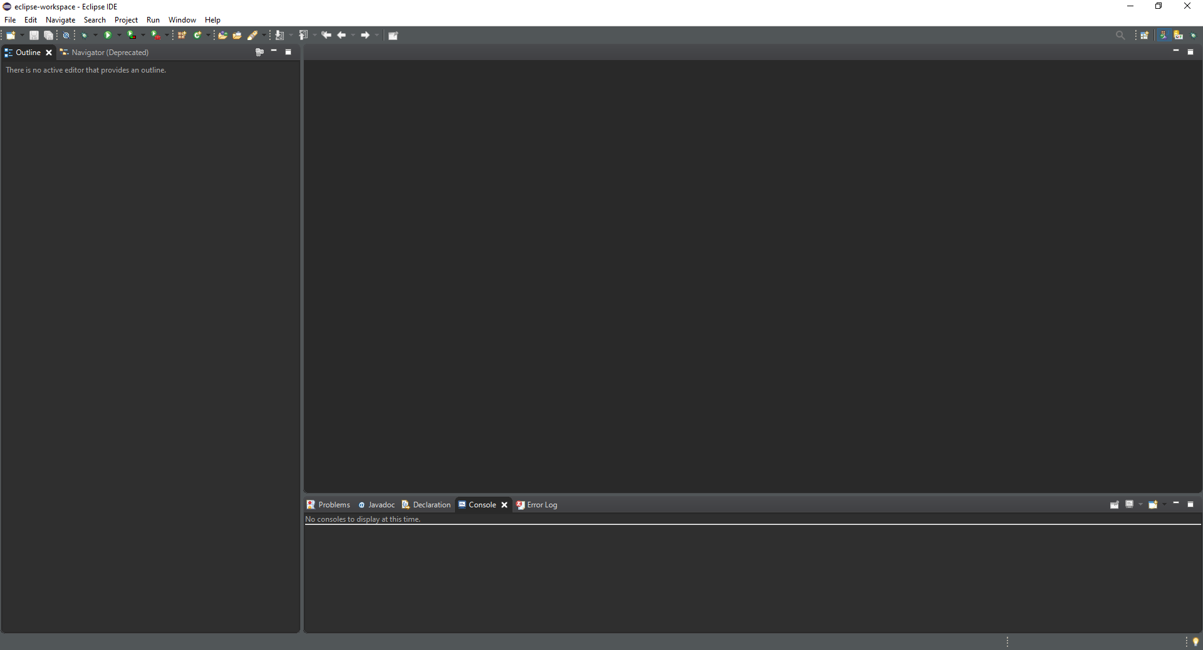
INTEGRETED DEVELOPEMENT ENVIRONMENT
Eclipse
Markup language is JAVA

Slide 2
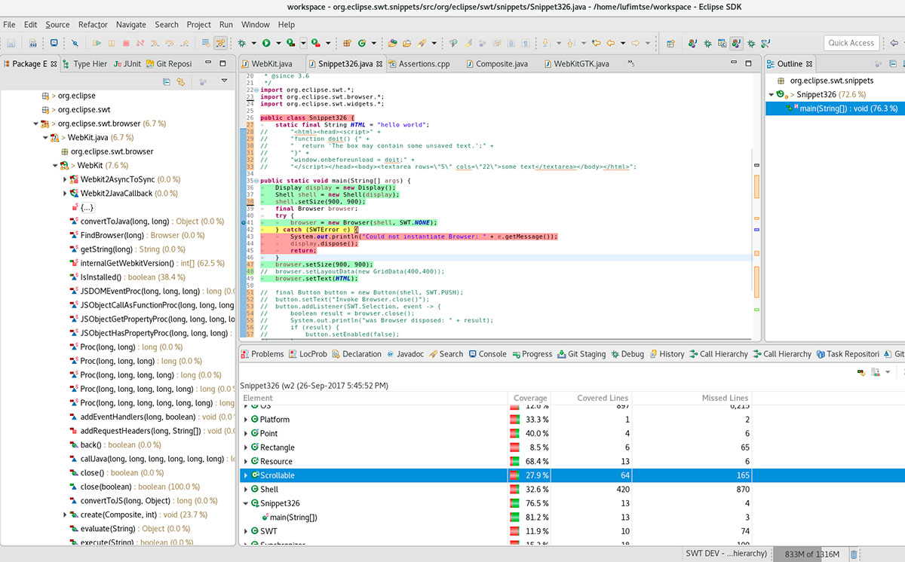
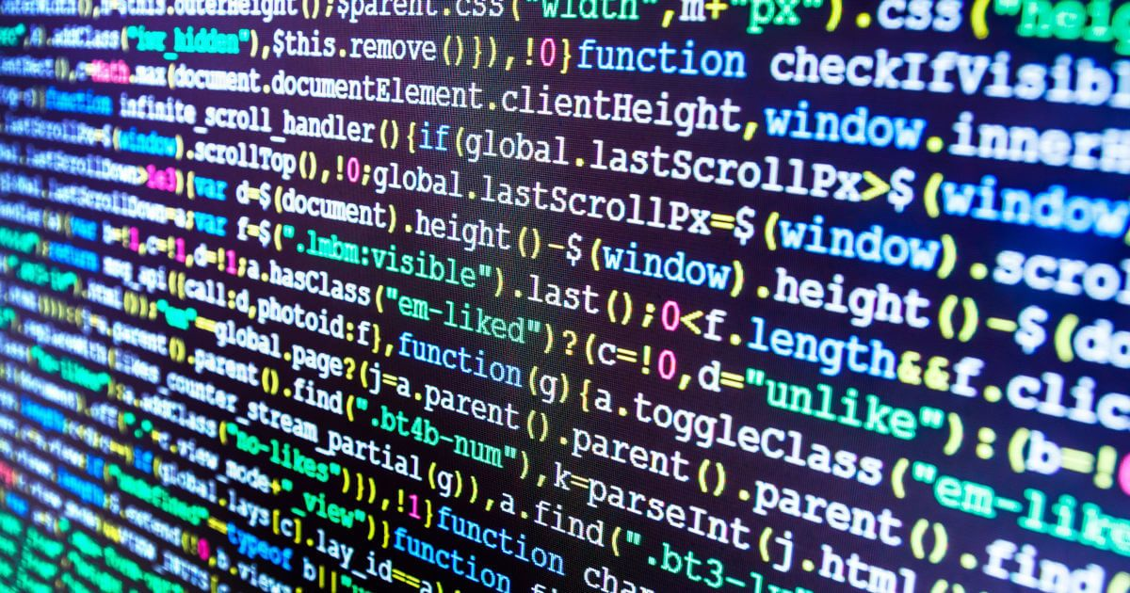

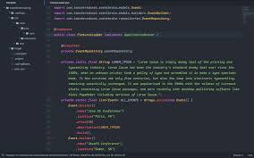
Was release in 2001 by IBM
It contains a base workspace
and an extensible plug-in system
for customizing the environment.
Everything is a plug-ins and you
can use them for programming in
other languages.
You can develop appliccation in other languages with plug-ins.

Slide 3

Eclipse is mostly use for JAVA application.
Eclipse is free and open-source software.

Slide 4
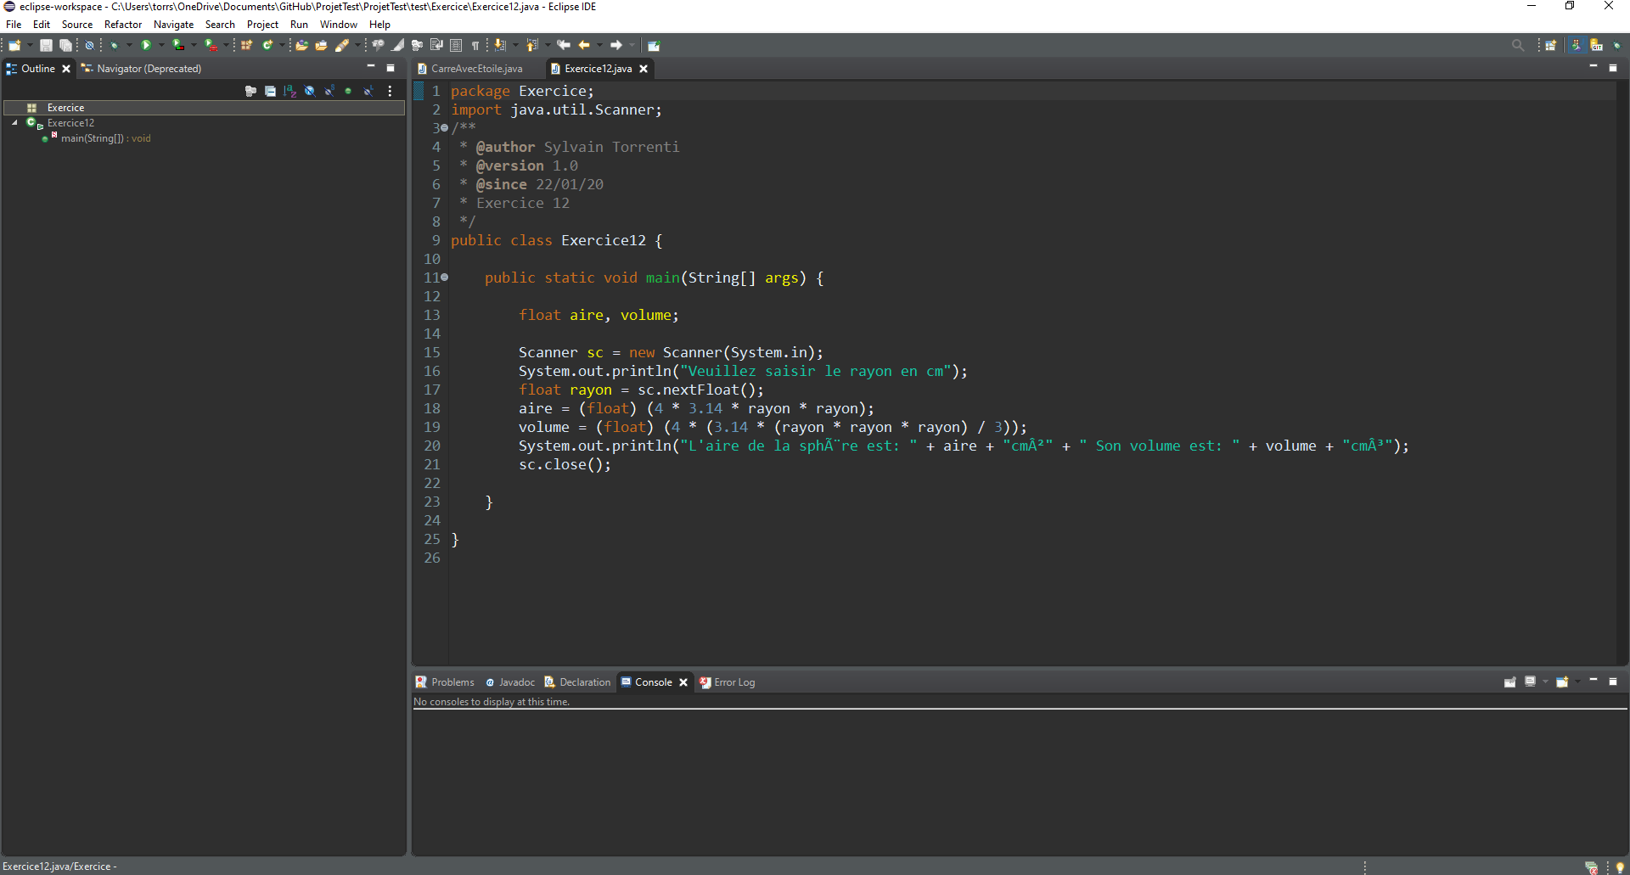
Menu bar
Tool Bar
Editor
Views

