Slide 1
MOBo Bank Web Application

Slide 2
Purpose of application
The application is intended for two kinds of users
Client (Bank Customer)
Admin (Bankuser)
Client Can do the following
Change Personal information
Get the transaction record
Get the record of logging in
Transact money from one account to another
Admin Can do the following
View a client’s transaction
View all client’s information
Modify a client’s information
View logs
Create admin account

Slide 3
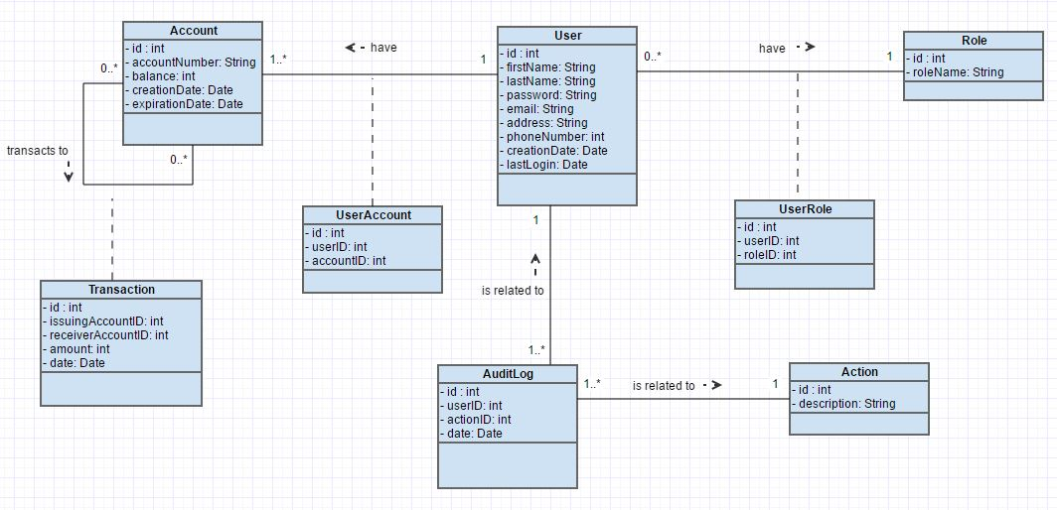
ER Diagram

Slide 4
Five USER TYPEs in Database
IBS_Data: who owns all the schema objects except the packages.The developers who create the packages never work in this schema. Therefore, they cannot accidently alter or drop application schema objects.
IBSclient_Pkg: who owns the package of client. The developer of the client package work in this schema.
IBSadmin_Pkg: who owns the package of administer. The developer of the admin package work in this schema.
IBS_admin: the banker user, who owns nothing and can only execute admin_pkg.
IBS_client : the customer user, who owns nothing and can only execute client_pkg.

Slide 5
Client package
Grant privilege to Client_Pkg
Create synonym
Package Specification
Package Body
Grant privilege to Ibs_Client

Slide 6
Client package
It contain 1 packages and 4 functions
Client_pkg contain 7 procedures
create_account
transfer_money
is_login
get_my_transaction
get_information
modify_information
get_balance
Function contain 4 functions
get_bal_by_accountid
get_bal
generate_accno
check_duplicate_account

Slide 7
Admin package
Grant privilege to Admin_Pkg
Create synonym
Package Specification
Package Body
Grant privilege to Ibs_Admin

Slide 8
Admin package
get_transaction
get_alluser
modify_user
Create_adminaccount
Get_alldatalogs
Get_datalogsbyid

Slide 9
Architecture
Oracle DB 12c
Localhost:1521
Java API
Localhost:1234
PHP FrontEnd
Localhost:80
Users

Slide 10
Api
Develop in JAVA with IDE IntelliJ Idea, compile with JDK 7.
Principle :
FrontEnd not connected directly to the DB (security issue, maintainability, mobile)
Better security with token
Trigger the modification
Treatment of pure data, send Json Object to FrontEnd

Slide 11
Front end
Develop in PHP and JQuery with SublimeText (Simple text editor) run on Apache 2.4.18 (Unix)
Dependency: PHP 5.5.38 / Jquery 1.8.3
Principle:
PHP: Talking with API / Generate page with JSON
Jquery: Trigger modification value

