Slide 1
A Novel Machine Learnt Recommendation Algorithm Using Graphs
Under the guidance of
Ms. Pallavi Karanth
Assistant Professor
Department of Computer Science
PES Institute of Technology
Team
Sandeep Raju P (1PI09CS081)
Vijay Mahantesh SM (1PI09CS118)
Vijesh M (1PI09CS119)

Slide 2
Introduction
Recommender systems or recommendation systems (sometimes replacing "system" with a synonym such as platform or engine) are a subclass of information filtering system that seek to predict the 'rating' or 'preference' that a user would give to an item (such as music, books, or movies) or social element (e.g. people or groups) they had not yet considered, using a model built from the characteristics of an item (content-based approaches) or the user's social environment (collaborative filtering approaches)
Source: http://en.wikipedia.org/wiki/Recommendation_systems

Slide 3
Problem Statement
Given a set of items, their attributes and the users’ Training data
Determine how important each attribute of the item is. (Dimensionality Reduction for items)
For each user, determine how important each attribute is.
Determine the extent to which the user follows the group behavior.
Recommend items to users based on collaborative and content based filtering.
Develop an adaptive method to determine clusters of users using the concepts of Machine Learning.

Slide 4
Overview of the Solution
Content Based Filtering
Collaborative Based Filtering
User Behavior
Dimensionality Reduction Technique for Items

Slide 5
Block Diagram
User Training Data
Relative attribute importance for items
Recommendation
System
User orientation
Relative attribute importance for individual users
Content based recommendation list
Item Dataset
Collaborative based recommendation list
Combined recommendation list

Slide 6
System Design
Two inputs
Item database (non-relational)
User training data
Outputs
Attribute importance for items
User orientation (Group or himself)
How much importance does each user give to each attribute
Given an user,
Content based recommendation list
Collaborative recommendation list
Combined recommendation list based on user’s orientation

Slide 7
Algorithm
We’ll have ‘Item DataSet’ and ‘User Training Data’.
The Item Dataset is a simple JSON file. Each line in the file represents an item and each item has a set of attributes associated with it. Items need not have the same set of attributes.
The User Training Data is also a simple JSON file. Each line in the file represents a user. Each user is associated with a list of items. If there is a notion of rating associated with each item and user, then that information is also present in the list.
We use the Graph Data Structure to represent the relation between the items. Every node in the Graph represents an item. The attributes of the items are mapped to the attributes of the nodes. An attribute is a key-value pair, in which each key can have a single value or a list of values. An edge between two nodes conveys that the two items are related. The attributes of the edges are the common attributes between the end nodes.

Slide 8
The Item Graph
attr1: [a,b,c]
attr2: [k]
attr1: [g]
attr2: [k]
attr1: [a,b,c,d,g,e,f]
attr2: [j,k,m]
attr1: [e,f]
attr2: [m]
attr1: [a,c,d]
attr2: [k,j]

Slide 9
Algorithm
We build the graph as follows:
For each line in Item Dataset, we form a JSON object (item).
We create a node n and assign a UID that is used to access the node.
For every attribute of the item, we create the corresponding attribute for the newly formed node.
At this point of time, we have one newly formed isolated node. We need to draw appropriate edges from this node to the existing graph. For every other node(n_{i}) in the graph,
Find out the common attributes between n and n_{i}
If there is atleast one common attribute
draw an edge between n and n_{i}.
the common set of attributes form the attributes of the edge.
Although this is a O(n²) algorithm (where n is the number of items), we can afford to have this algorithm since it is a one-time process. Addition of a new item involves just a single iteration of the above procedure.

Slide 10
Algorithm
Now, we use the User Training Data to deduce some of the parameters of the users and items. The user’s parameters include orientation of the user and the relative importance of attributes to the user. The item parameter includes the relative importance of the each attribute. These parameters can be used to perform dimensionality reduction of the attribute setfor the items.
For every user in the User Training Data
Initialize an empty dictionary D. It holds the attribute and the corresponding count.
Construct an induced subgraph of all the items that the user is associated with.
For each edge E in the induced subgraph,
For each attribute A of the edge E,
if D already contains the attribute
Increment the count for the attribute
Else
Add the attribute to D and initialize it to 1
Normalize the values for the attributes. The normalized values determine the relative importance of each attribute
When we are training the system, we cannot determine the orientation of a user since we do not know the group's orientation. Hence, we set the orientation parameter(alpha) to 0.5. As alpha approaches 0, it means that the user is more oriented towards the group. As alpha approaches 1, it means that the user is more oriented towards himself.

Slide 11
The Induced Sub Graph
attr1: [a,b,c]
attr2: [k]
attr1: [a,c]
attr2: [k]
attr1: [a,c]
attr2: [k]
attr1: [a,b,c,d,g,e,f]
attr2: [j,k,m]
attr1: [a,c,d]
attr2: [k,j]
attr1: [a,c,d]
attr2: [k,j]

Slide 12
Algorithm
Providing recommendations for new users:
content-based filtering
initialize the scores of all the nodes in the graph to 0
for each item in the user's history
for each neighbor of the item in the items relations graph
for each attribute of the edge
increment the score of the neighbor according to the user's score for that particular attribute.
collaborative filtering Yet to be built…
combining both based on the user's alpha value There are two approaches to combine the collaborative and content based recommendation lists: score based weighted average and rank based weighted average for each item. we then sort the items based on the combined item scores.

Slide 13
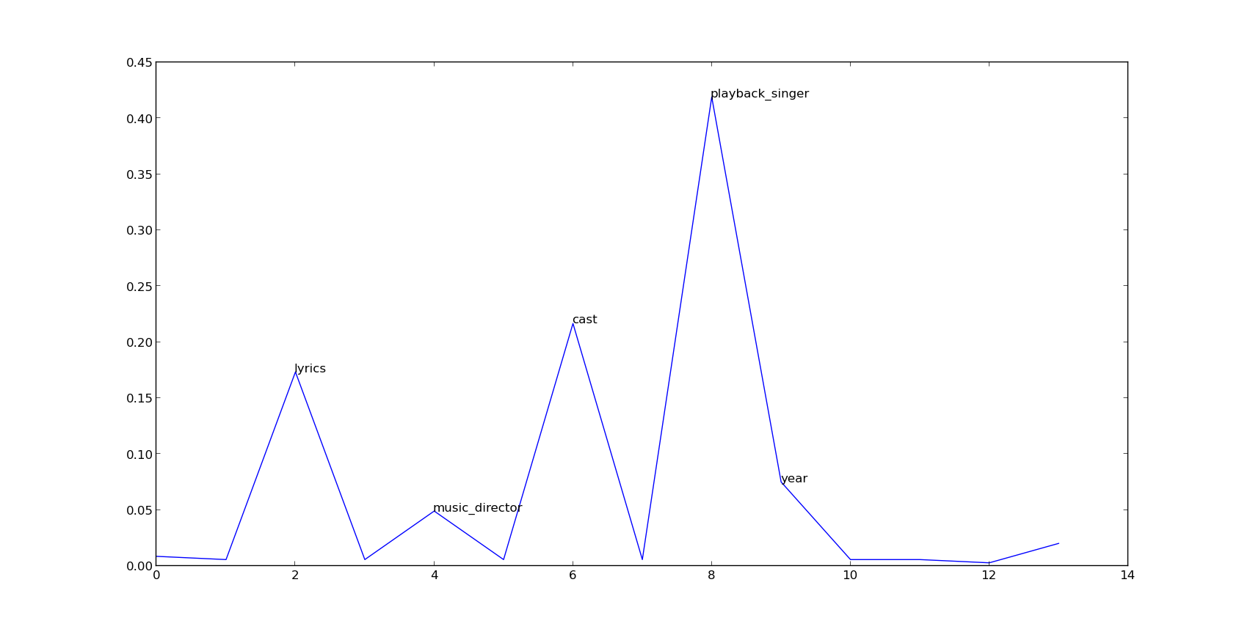
Progress so far…
Attribute importance plot for user with id 81

Slide 14
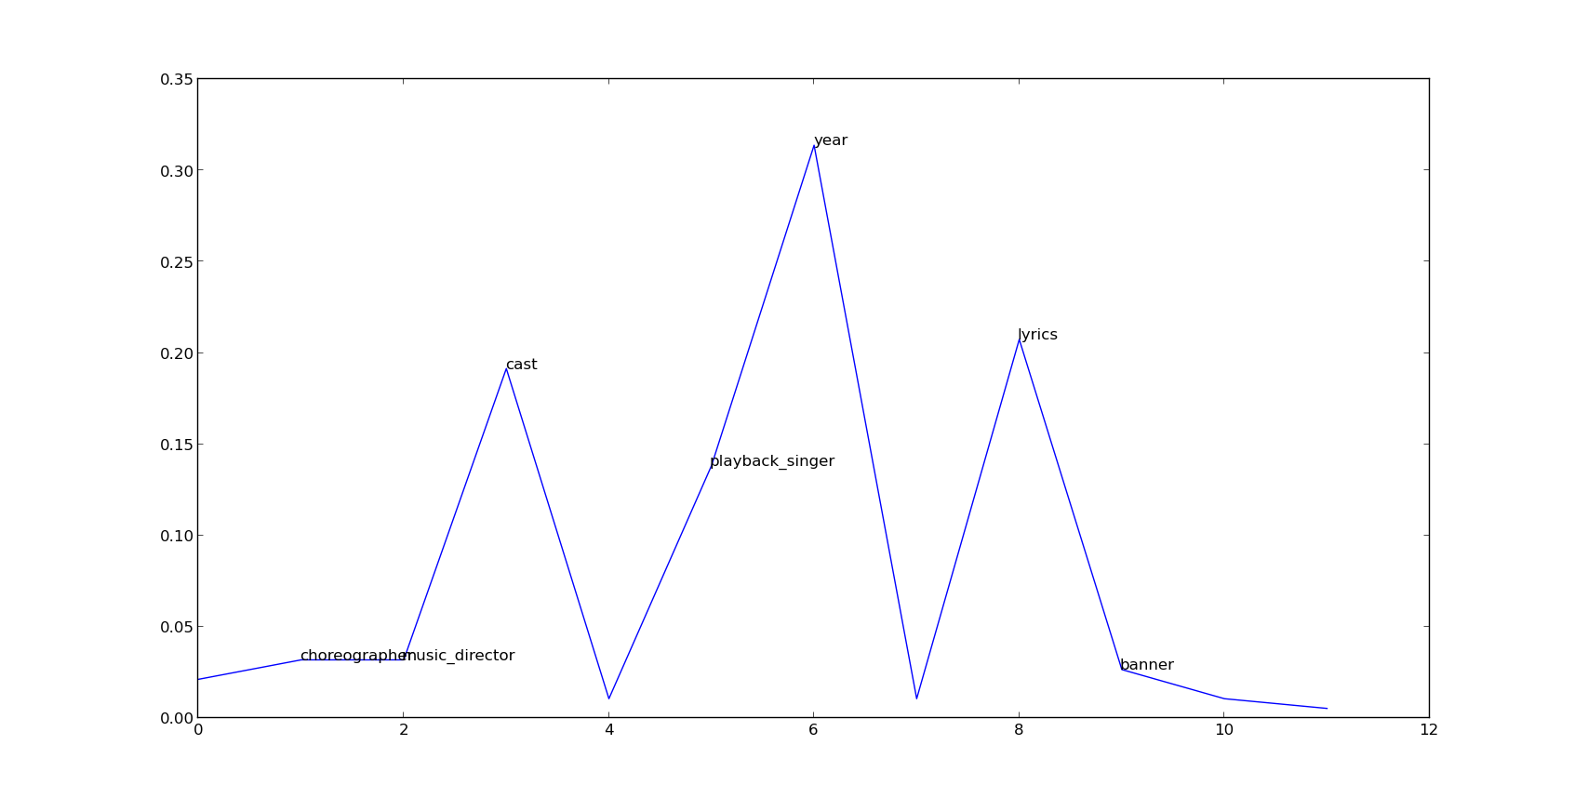
Progress so far…
Attribute importance plot for user with id 238

Slide 15
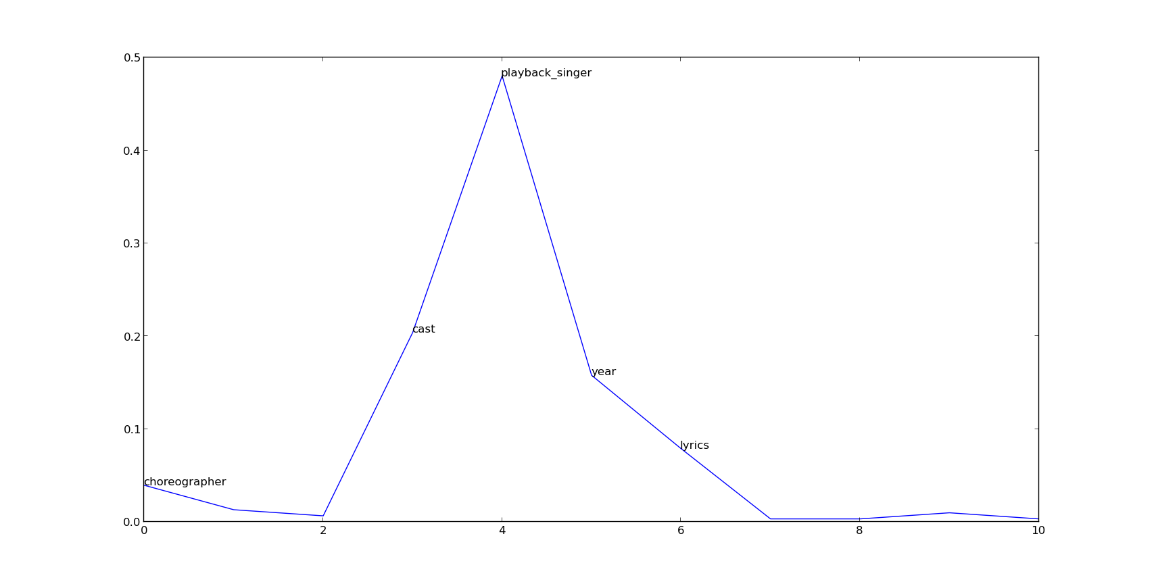
Progress so far…
Attribute importance plot for user with id 2

Slide 16
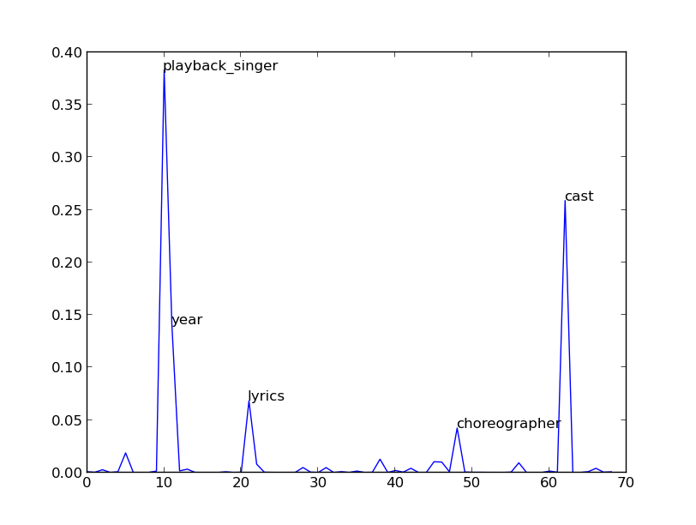
Progress so far…
Attribute importance plot for item set

Slide 17
Progress so far…
Input
Output
Hello Hum Lallan Bol Rahe Hain
Raajneeti
Yeh Jawani Hai Deewani
Ek Khiladi Ek Haseena
Aakrosh
Chamku
Raaz
Acid Factory
Fiza
Ek Tha Tiger
Is Pyaar Ko Kya Naam Doon
Shikshanacha Aaicha Gho (Remake)
Ishq Mein Pagal
Will You Marry Me?
Akadd
Jackpot
Issaq
Sargna
Dil
Roja
Yuva
Baghban
Virasat
Laawaris
Karma
Kuch Kuch Hota Hai
Ishq
Wahan Ke Log
Karma
Chameli
Go
Rowdy Rathore | 1
Om Shanti Om | 1
Agneepath | 1
Tezz | 0.958333
You Know Amrapali | 0.916667
Pyar To Hona Hi Tha | 0.916667
Housefull 2 | 0.916667
Garam Masala | 0.916667
Bol Bachchan | 0.916667
Billu | 0.916667
Players | 0.875
No Entry | 0.875
Mere Baap Pehle Aap | 0.875
L.O.C. Kargil | 0.875
Hera Pheri | 0.875
Department | 0.875
Bhagam Bhag | 0.875
Yeh Jo Mohabbat Hai | 0.833333
Vidhata Tere Khel Hai Nirale | 0.833333
Victoria No. 203 | 0.833333
Tera Kya Hoga Johny | 0.833333
Taarzan - The Wonder Car | 0.833333
Salaam-E-Ishq | 0.833333
Power | 0.833333
Phir Hera-Pheri | 0.833333

Slide 18
Up Next…
Design a collaborative filtering technique
Machine Learning techniques that involves user feedback.
Alpha tuning (there is only one function that needs to be decided)
Adaptive clustering of users for localized recommendation.
Evaluation of the performance and comparison with the existing techniques

