Slide 1

Cloud Computing
Lecture 1 : Introduction to Cloud Computing
Alpha Omar Leigh (MSC)

Slide 2
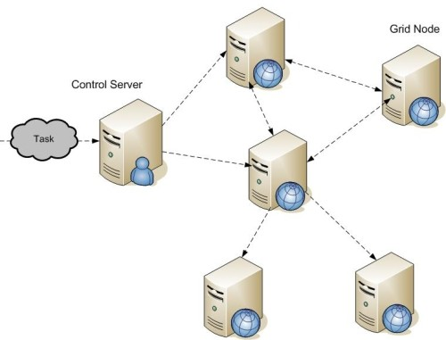
Grid Computing
Def
combination of computer resources from multiple administrative domains applied to a common task*
Core idea
●
●
distributed parallel computation
– super virtual computer
2

Slide 3
Utility Computing
Def
“The packaging of computing resources (computation, storage etc.) as a metered service similar to a traditional public utility”*
Observation
●
not a new concept
– "If computers of the kind I have advocated become the computers of the future, then computing may someday be organized as a public utility just as the telephone system is a public utility... The computer utility could become the basis of a new and important industry." - John McCarthy, MIT Centennial in 1961
●
3

Slide 4
Cloud Computing
Is cloud computing?
grid computing + utility computing ?? difficult to define
– means different things to different parties
●
●
Various definitions
NIST – National Institute of Standards and Technology
– “universally” accepted definition
●
4

Slide 5
Cloud Computing – NIST
Definition
“Cloud computing is a model for enabling convenient, on-demand network access to a shared pool of configurable computing resources (e.g., networks, servers, storage, applications, and services) that can be rapidly provisioned and released with minimal management effort or service provider interaction.
This cloud model promotes availability and is composed of five essential characteristics, three service models, and four deployment models.”*
●

Slide 6
Cloud Computing – NIST
Definition
“Cloud computing is a model for enabling convenient, on-demand network access to a shared pool of configurable computing resources (e.g., networks, servers, storage, applications, and services) that can be rapidly provisioned and released with minimal management effort or service provider interaction. This cloud model promotes availability and is composed of five essential characteristics, three service models, and four deployment models.”*
●

Slide 7
Cloud Computing – NIST
Definition
“Cloud computing is a model for enabling convenient, on-demand network access to a shared pool of configurable computing resources (e.g., networks, servers, storage, applications, and services) that can be rapidly provisioned and released with minimal management effort or service provider interaction. This cloud model promotes availability and is composed of five essential characteristics, three service models, and four deployment models.”*
●

Slide 8
Cloud Computing – NIST
Definition
“
Cloud computing is a model for enabling convenient, on-demand network access to a shared pool of configurable computing resources (e.g., networks, servers, storage, applications, and services) that can be rapidly provisioned and released with minimal management effort or service provider interaction. This cloud model promotes availability and is composed of five essential characteristics, three service models, and four deployment models.”*
●

Slide 9
Cloud Computing – NIST
Definition
“
Cloud computing is a model for enabling convenient, on-demand network access to a shared pool of configurable computing resources (e.g., networks, servers, storage, applications, and services) that can be rapidly provisioned and released with minimal management effort or service provider interaction. This cloud model promotes availability and is composed of five essential characteristics, three service models, and four deployment models.”*
●

Slide 10
NIST Essential Characteristics
On-demand self-service
●
a consumer can unilaterally provision computing capabilities without human interaction with the service provider
computing capabilities
– server time, network storage, number of servers etc.
●

Slide 11
NIST Essential Characteristics
Broad network access
capabilities are
available over the network
accessed through standard mechanisms
promote use by
heterogeneous thin or thick client platforms
●
●

Slide 12
NIST Essential Characteristics
Multi-tenancy / Resource pooling
●
provider’s computing resources are pooled to serve multiple consumers
computing resources
storage, processing, memory, network bandwidth and virtual machines
location independence
no control over the exact location of the resources
has major implications
performance, scalability, security
●
●
●

Slide 13
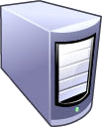


NIST Essential Characteristics
Rapid elasticity
capabilities can be rapidly and elastically provisioned unlimited virtual resources
predicting a ceiling is difficult
●
●
●

Slide 14
NIST Essential Characteristics
Measured service
metering capability of service/resource abstractions
storage
processing
bandwidth
active user accounts
OK so what happened to utility computing – pay as you go model??
more on this later when we discuss deployment models
●
●

Slide 15
Relevant Technologies
Access
heterogeneous set of thick & thin clients
PCs (enterprise, home), mobile devices, hand-held devices
high speed broadband access
wired & wireless
data centres
large computing capacity
distributed
direct access storage devices Vs. storage area networks
●
●
●

Slide 16
Relevant Technologies
Virtualization
●
decoupling from the physical computing resources
Virtualization types
hardware
emulation – VM emulates/simulates complete hardware
  QEMU
paravirtualization - software interface to virtual machines
  Xen
full virtualization - complete simulation of the underlying hardware
  VMWare, Parallels
●

Slide 17
Relevant Technologies
Virtualization types
memory virtualization
decouples volatile random access memory (RAM) resources from individual systems
aggregates these resources into a virtualized memory pool available to any computer in the cluster
storage virtualization
abstracting logical storage from physical storage
NAS - network attached storage
data virtualization
data as an abstract layer, independent of underlying database systems, structures and storage
●
●
●

Slide 18
Relevant Technologies
Virtualization types
network virtualization
virtualized network addressing space within or across network subnets
VPNs
Question?
●
how do we measure virtual resources
Amazon ECU (elastic compute unit)
  EC2 Compute Unit equals
    1.0-1.2 GHz 2007 Opteron or
    2007 Xeon processor
●

Slide 19
Relevant Technologies
APIs
required for various operations and applications
administration
application development
resource migration
no standards
●
●

Slide 20
SPI Services
SaaS (Software-as-a-Service)
●
vendor/provider controlled applications accessed over the network
characteristics
network based access
multi-tenancy
single software release for all
●
SaaS Examples
– Salesforce.com, Google Docs

Slide 21
SPI Services
SaaS (Software-as-a-Service)
●
vendor/provider controlled applications accessed over the network
characteristics
network based access
multi-tenancy
single software release for all
●
SaaS Examples
– Salesforce.com, Google Docs

Slide 22
SPI Services
SaaS & Multi-tenancy
SaaS applications are multi-tenant applications application data
– Google docs
●
●
SaaS Application Design
SaaS applications are 'net native' configurability, efficiency, and scalability SOA & SaaS
●
●
●

Slide 23
Net Native Application
Characteristics
cloud specific design, development & deployment multi-tenant data
builtin metering & management browser based client & client tools customization via configuration
●
●
●
●
●

Slide 24
SPI Services
SaaS Disadvantages
dependency on
network, cloud service provider
performance
limited client bandwidth
security
good: better security than personal computers
bad: CSP is in charge of the data
ugly: user privacy
●
●
●

Slide 25
SPI Services
PaaS (Platform-as-a-Service)
vendor provided development environment
tools & technology selected by vendor
control over data life-cycle
Advantages
●
rapid development & deployment small startup cost
required skills set
money
●
●

Slide 26
SPI Services
PaaS – Architectural Characteristics
multi-tenancy
data
native scalability
load balancing & fail-over
native integrated management
performance
resource consumption/utilization
load
●
●
●

Slide 27
SPI Services
PaaS Disadvantages
inherits all from SaaS
choice of development technology is limited to vendor provided/supported tools and services
●
●
PaaS Examples
Google app engine
– Google Site + Google Docs
●

Slide 28
SPI Services
IaaS (Infrastructure-as-a-Service)
●
vendor provided and consumer provisioned computing resources
processing, storage, network, etc.
consumer is provided customized virtual machines
consumer has control over
OS, memory storage
servers & deployment configurations limited control over network resources
●
●
●

Slide 29
SPI Services
IaaS = utility computing??
●
maybe – NIST does not talk about $$
Advantages
infrastructure scalability native integrated management
performance, resource consumption/utilization, load
economical cost
hardware, IT support
●
●
●

Slide 30
SPI Services
IaaS Examples
●
Amazon Elastic Compute Cloud – EC2

Slide 31
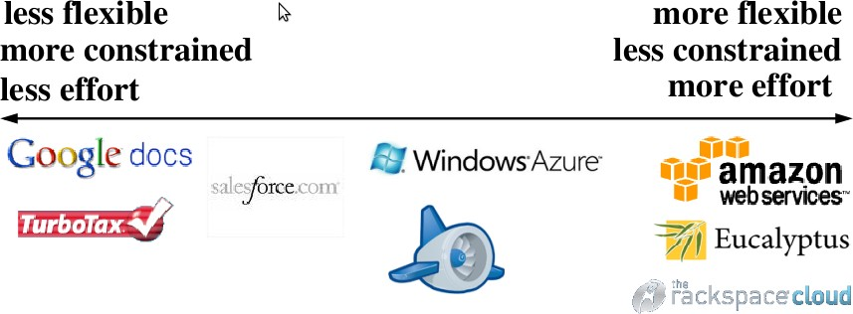
SPI Services

Slide 32







SPI Services & Control
In-house | Hosted | IaaS | PaaS | SaaS
Deployment | Deployment | Cloud | Cloud | Cloud
Data | Data | Data | Data | Data
APP | APP | APP | APP | APP
VM | VM | VM | Services | Services
Server | Server | Server | Server | Server
Storage | Storage | Storage | Storage | Storage
Network | Network | Network | Network | Network
Organization controlled
Organization & service provider share control
Service Provider controlled
[1] Visualizing the Boundaries of Control in the Cloud. Dec 2009.
http://kscottmorrison.com/2009/12/01/visualizing-the-boundaries-of-control-in-the-cloud/

Slide 33
XaaS
XaaS (Everything-as-a-Service)
composite second level services
– Security-as-a-Service
●
McAfee*
McAfee SaaS Email Archiving
McAfee SaaS Email Inbound Filtering
McAfee Vulnerability Assessment SaaS (PEN Tests)
– CaaS – Communication-as-a-Service
●
VoIP, private PBX
*http://www.mcafee.com/us/enterprise/products/hosted_security/
33

Slide 34





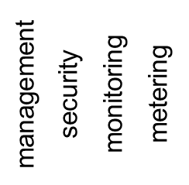






A Simple Reference Model
applications
SaaS
service service
service service
PaaS
cloud runtime
virtualization storage infrastructure
IaaS

Slide 35

XaaS
XaaS (Everything-as-a-Service)
composite second level services
– Security-as-a-Service
●
McAfee*
McAfee SaaS Email Archiving
McAfee SaaS Email Inbound Filtering
McAfee Vulnerability Assessment SaaS (PEN Tests)
– CaaS – Communication-as-a-Service
●
VoIP, private PBX
*http://www.mcafee.com/us/enterprise/products/hosted_security/
33

Slide 36
A Simple Reference Model
applications
SaaS
service service
service service
PaaS
cloud runtime
virtualization storage infrastructure
IaaS

Slide 37
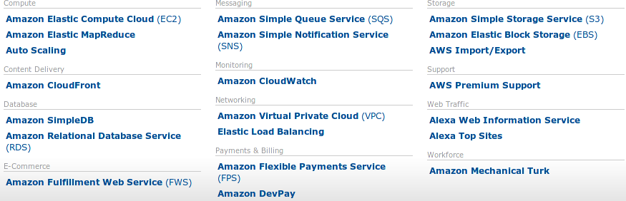
Amazon Web Services
http://aws.amazon.com/

Slide 38
NIST Cloud Deployment Models
4 Deployment Models
private cloud
infrastructure is operated solely for an organization
managed by the organization or by a third party
community cloud
supports a specific community
infrastructure is shared by several organizations
●
●

Slide 39
NIST Cloud Deployment Models
4 Deployment Models
public cloud
– infrastructure is made available to the general public
●
owned by an organization selling cloud services
hybrid cloud
infrastructure is a composition of two or more clouds deployment models
enables data and application portability
●

Slide 40
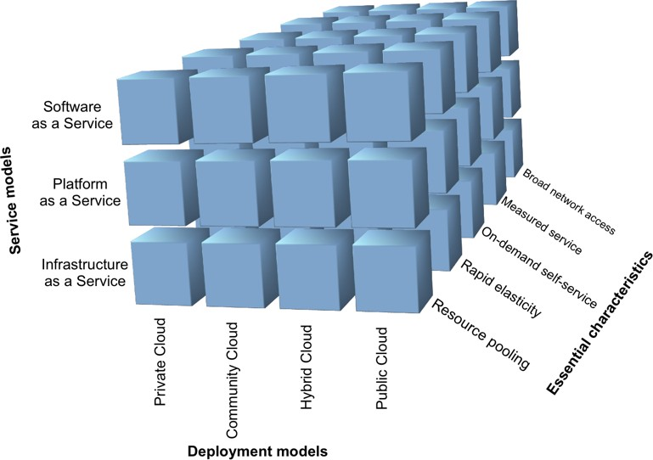
NIST Cloud Computing
http://www.katescomment.com/images/CloudCube.png
38

Slide 41
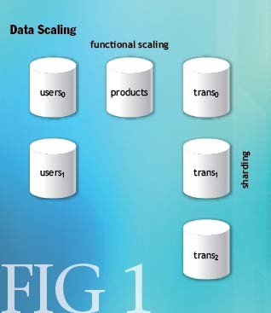
Cloud Distributed Storage
Distributed Storage
Two approaches to scaling
vertical – bigger hardware
horizontal – more hardware
●
functional partitioning
horizontal partitioning
– sharding*
http://queue.acm.org/detail.cfm?id=1394128
*http://en.wikipedia.org/wiki/Shard_%28database_architecture%29

