Slide 1
Research Progress
Advisor: Peng-shen, Chen
Student: Yu-chun, Hung
Chung-Chen University
12 March 2024

Slide 2
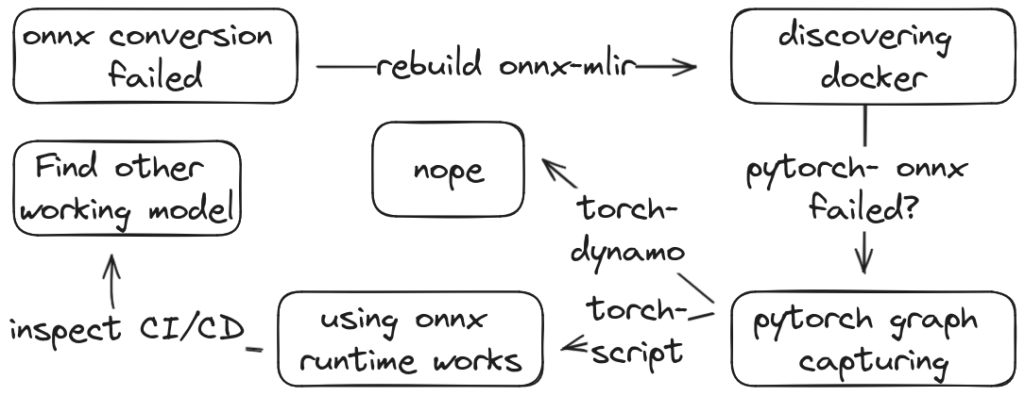
Oh no this is not working

Slide 3
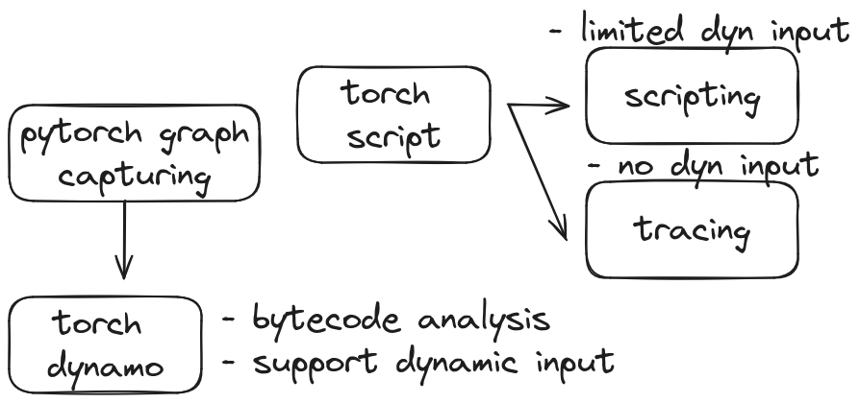
Torch graph capturing

Slide 4
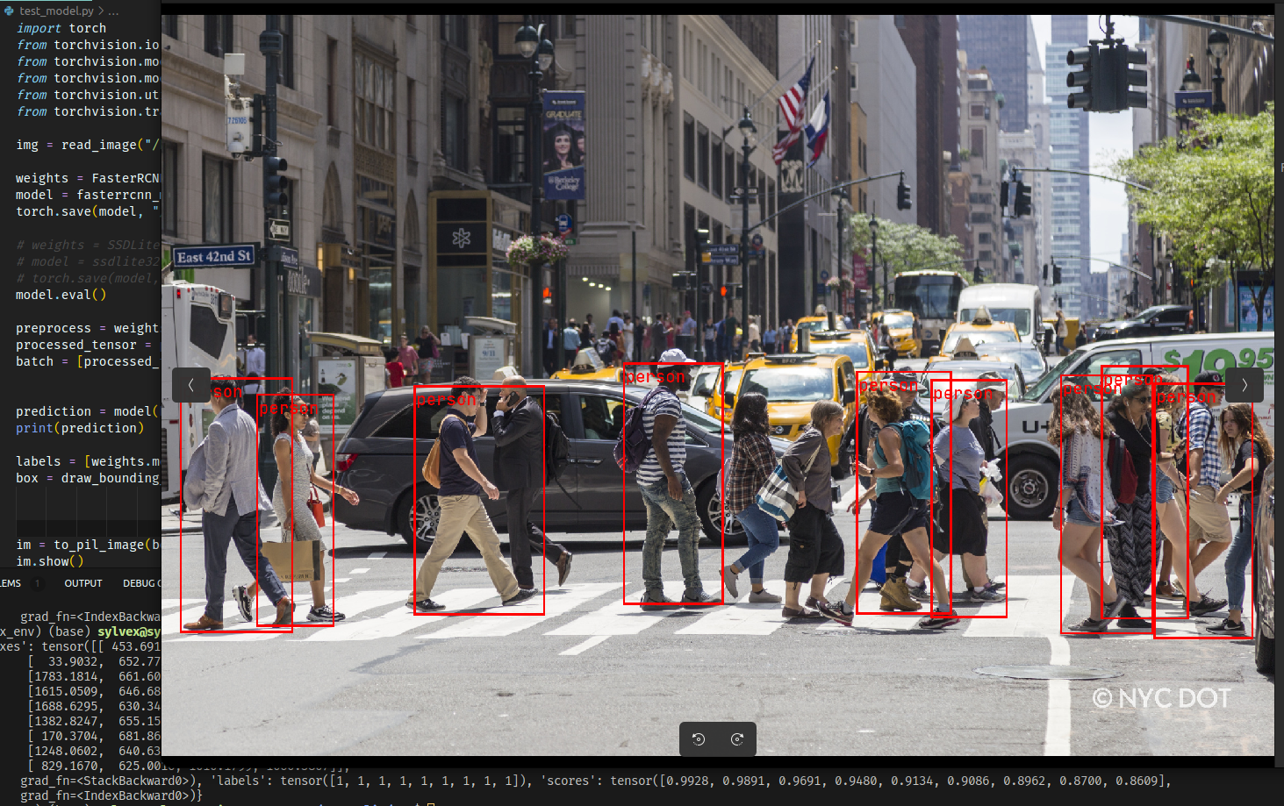
Small Demo

Slide 5
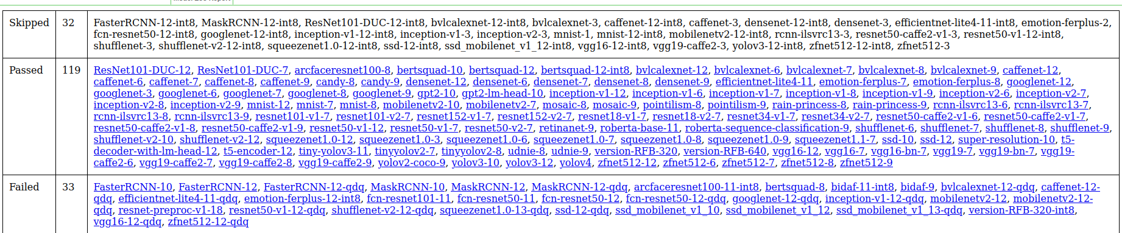
Oh no this is not working

Slide 6
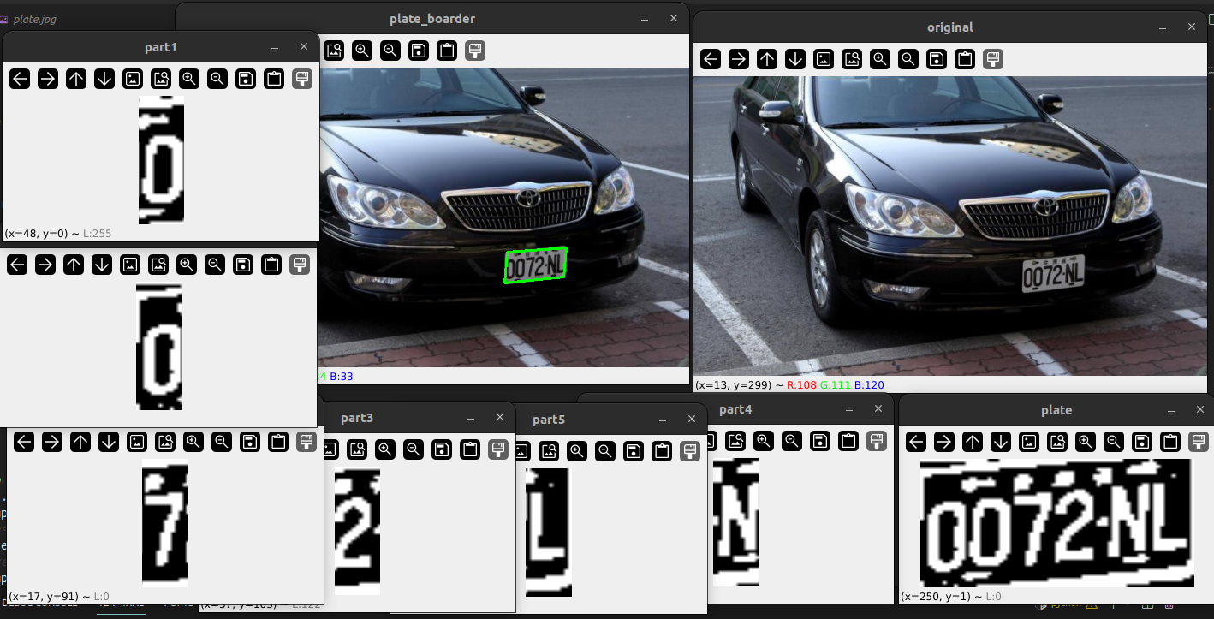
License Plate

Slide 7
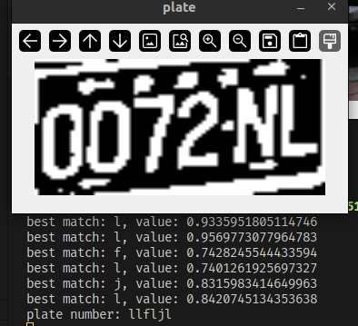
License Plate

Slide 8
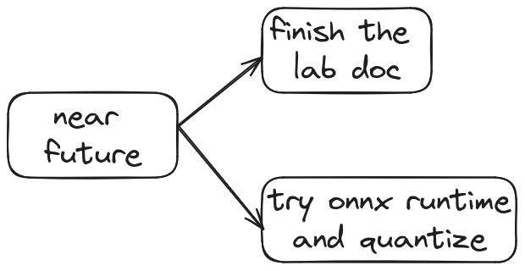
Near Future

Slide 9
