Slide 1
Research Progress
Advisor: Peng-shen, Chen
Student: Yu-chun, Hung
Chung-Chen University
19 March 2024

Slide 2
ONNX-MLIR
Current Issues:
To run a model, you need PyRuntime, which is not generated when compiling model but project building.
  Completely forget I need to export the PYTHONPATH…
Hence, you still need to cross compile the runtime.

Slide 3
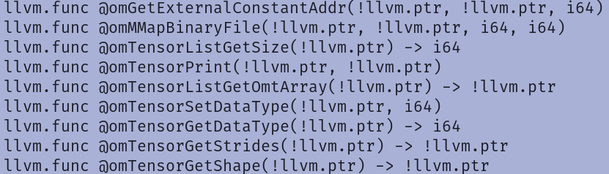
Proof

Slide 4
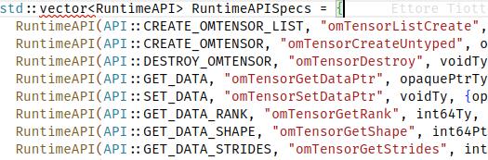
Proof(cont)

Slide 5
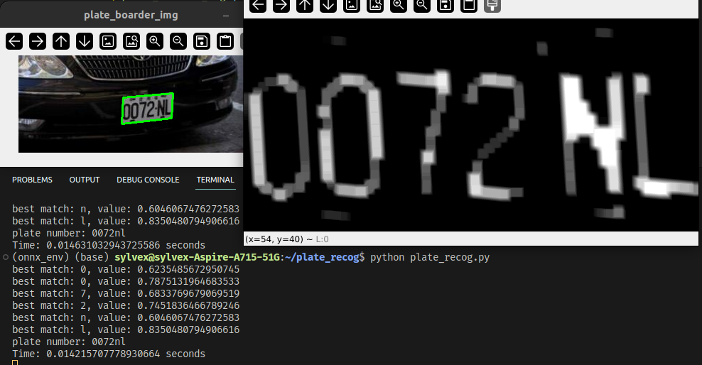
License Plate

Slide 6
License Plate
Not very robust. Only code towards only 1 image.
Using connected component to find k largest area
  K is 6 for now, can be 7 in the future
Apply 10 iteration of erode, good ways?
Bug: Implement angle sort.

Slide 7
Benchmark on CPU
ssdlite-320_mobilenet_v3_large, 320*320, i7-1260P
Pytorch: 0.0330 seconds
ONNX: 0.0117 seconds
Is the result correct?

Slide 8
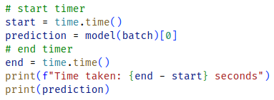
Benchmark on GPU
The following code is wrong! (0.471 seconds??)

Slide 9
Benchmark on GPU
GPU needs warm up
CUDA is asynchronous
Possible solution:
  Video Stream
  Try to separate the warm up and computation

Slide 10
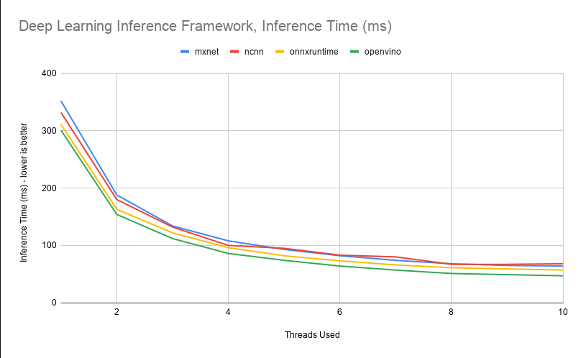
Other people’s benchmark
CPU, ResNet (link)

Slide 11
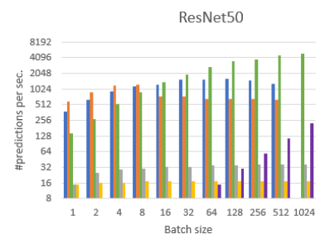
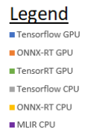
Other people’s benchmark
Paper: Deep Learning Inference Frameworks Benchmark

Slide 12
ONNX Model optimization
Quantization
Graph optimization
  Node fusion
  Memory layout optimization
End-to-End solution: Olive (link)

Slide 13
Summary & Comment
Drop onnx-mlir on arm architecture, even consider dropping on course.
Benchmark IREE
Raspberry pi deployment is to be done.
Learning how to benchmark on GPU
Want to
Complete the course tutorial document

