Slide 1
Research Progress
Advisor: Peng-shen, Chen
Student: Yu-chun, Hung
Chung-Chen University
26 March 2024

Slide 2
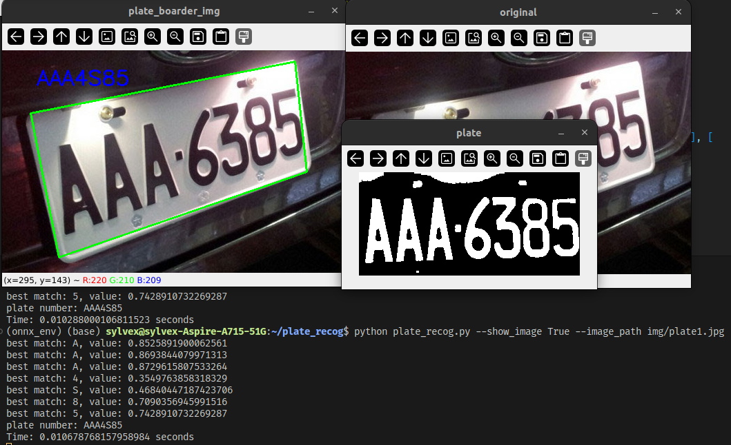
License Plate

Slide 3
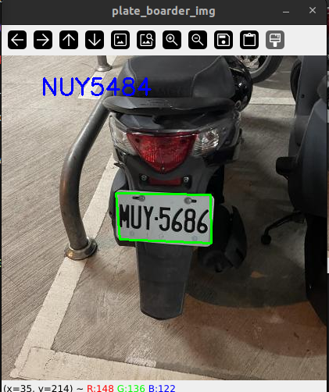
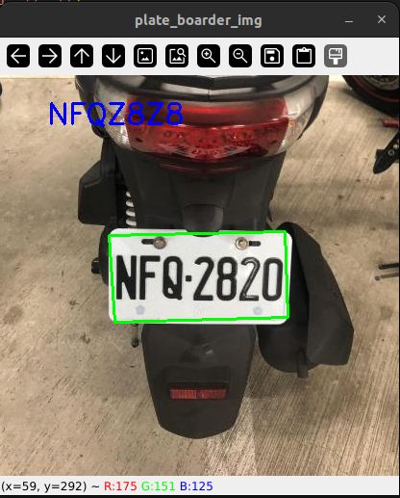
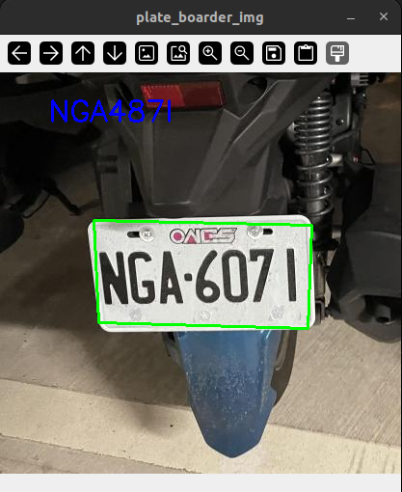
License Plate

Slide 4
License Plate
Raspi4 performance: 0.0698s
Change Log:
  OTSU threshold (good for bimodal binarization).
  Fix contour ordering.
  Refactor the code, QOL changes...
Issues:
  The template is not accurate.
  Still not implement crop horizontally.
  DOCUMENTS WHERE AAAAAAAAAAH???

Slide 5
Quantization
Dynamic quantization
  Don’t require dataset
  Suitable for transformer or RNN-based models
Static quantization
  Need dataset, for calculating the activation value.
  Suitable for CNN-based models.
  Struggle to get it work, also I have trouble getting dataset. (100GB+)

Slide 6
Pytorch
gpu/cpu/Raspi4: 0.010s /0.027s / 0.834s
Pytorch has quantization, changes frequently.
I did let GPU warm-up, but far from perfect.
  The correct way

Slide 7
ONNX
(local/raspi4, detected, model size)
Normal: 0.0098s/0.231s, 6 target, 13.5MB
quantized: 0.0244s/0.319x, 4 target, 3.9MB
Why is quantization slower??

Slide 8
ONNX
The operators in model matters. (ref)
  QlinearConv
Static is suitable for CNN models.
Floating point and hardware support also matters.
Is it worth it to integrated to posit number?

Slide 9


Slide 10
Summary & Comment
Want to try TVM with onnx
  (previous was implemented with pytorch)
  TVM may have additional optimization
Once the benchmark of pytorch, onnx, tvm is completed, it’s time to move on mlir.
DOCUMENTTTTTTTTT!

Slide 11
