Slide 1
Research Progress
Advisor: Peng-shen, Chen
Student: Yu-chun, Hung
Chung-Chen University
5 March 2024

Slide 2
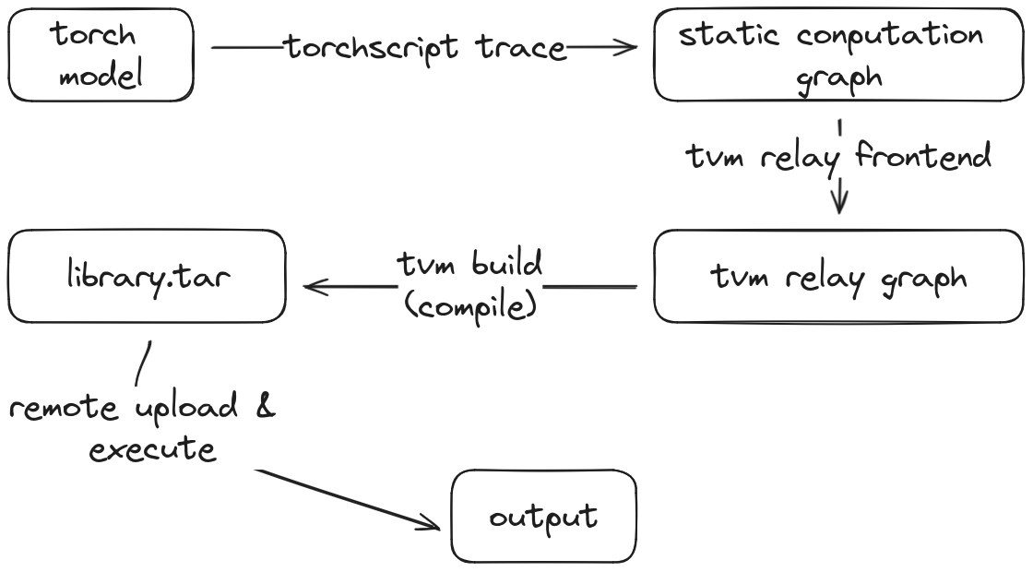
How to deploy with TVM

Slide 3
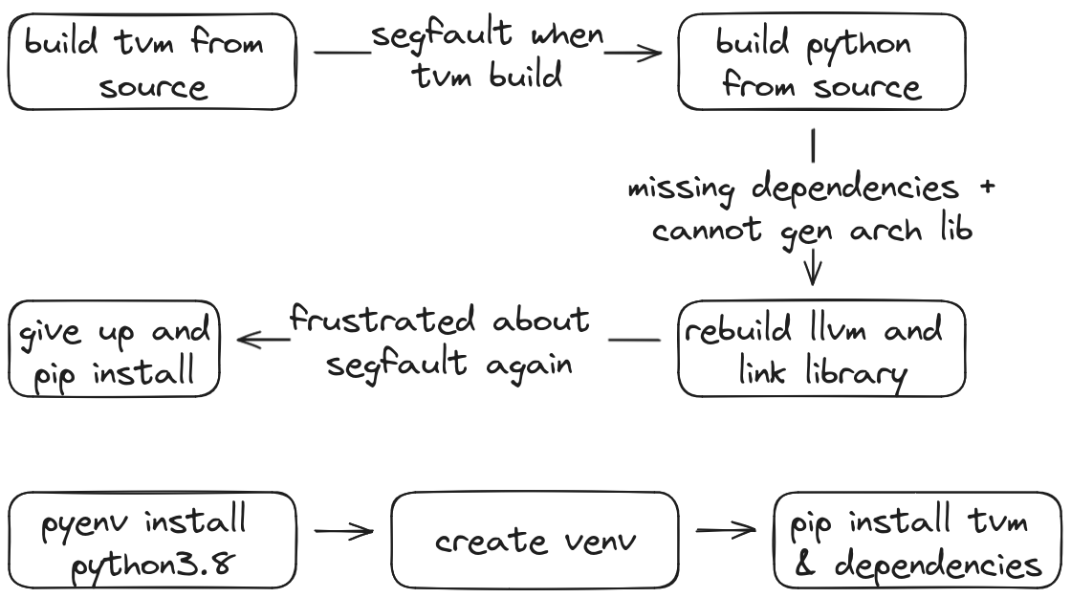
Difficulties and Solution

Slide 4
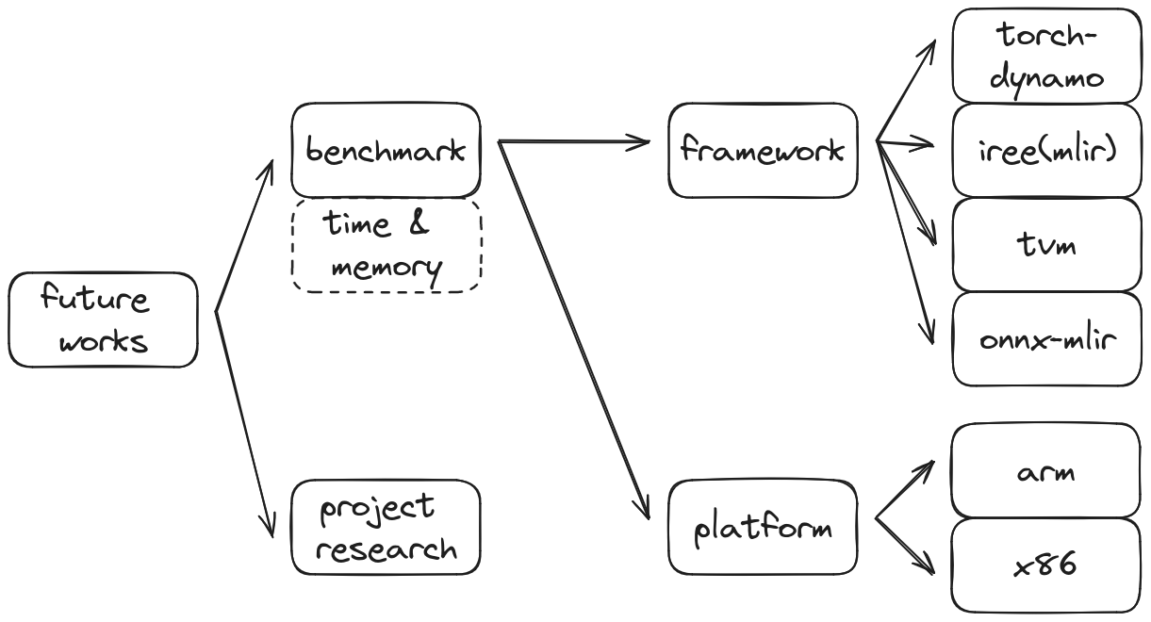
Future works

Slide 5
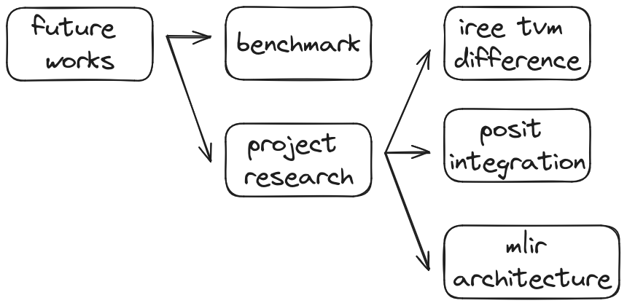
Future works

Slide 6
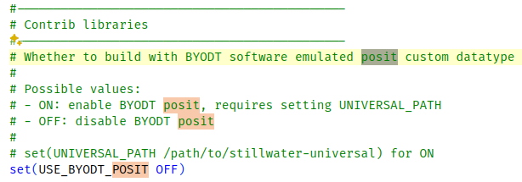
Future works

Slide 7
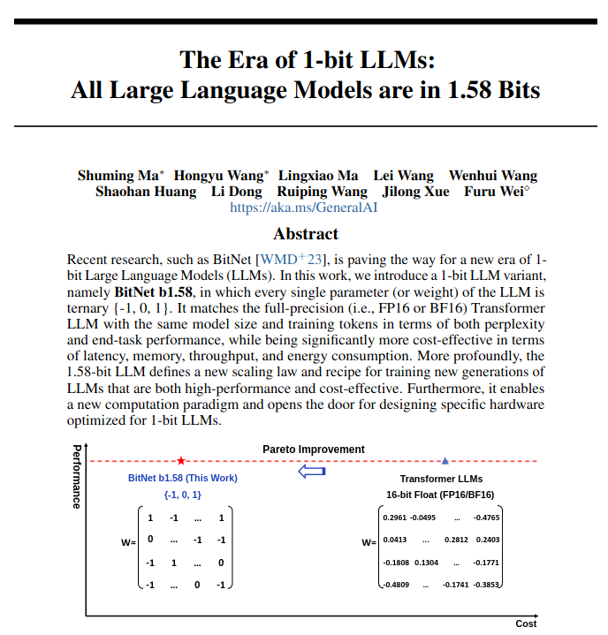
Future works

