Slide 1
Research Progress
Advisor: Peng-shen, Chen
Student: Yu-chun, Hung
Chung-Chen University
16 April 2024

Slide 2
No progress
However

Slide 3
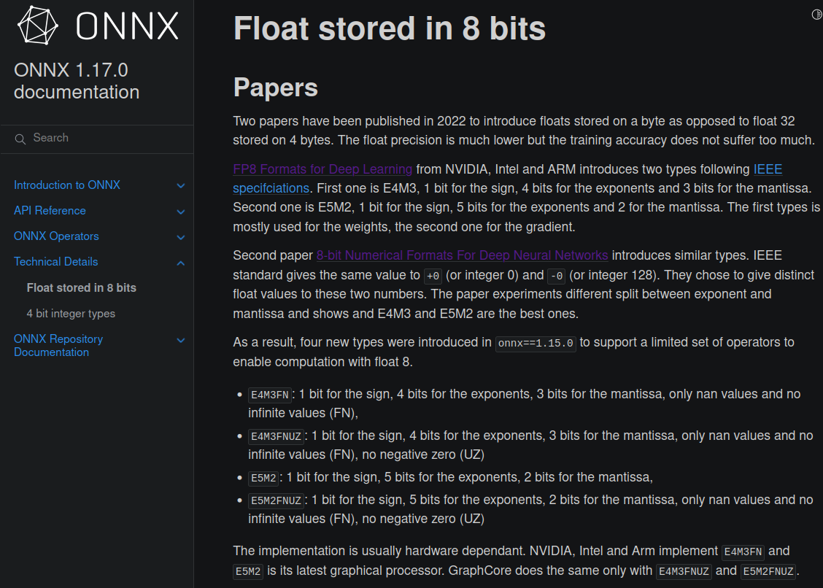

Slide 4
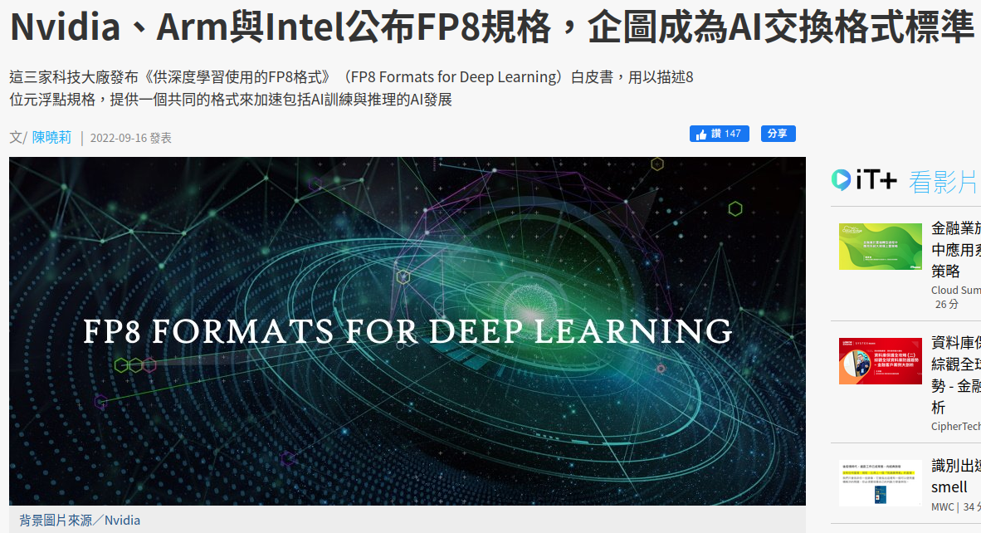

Slide 5
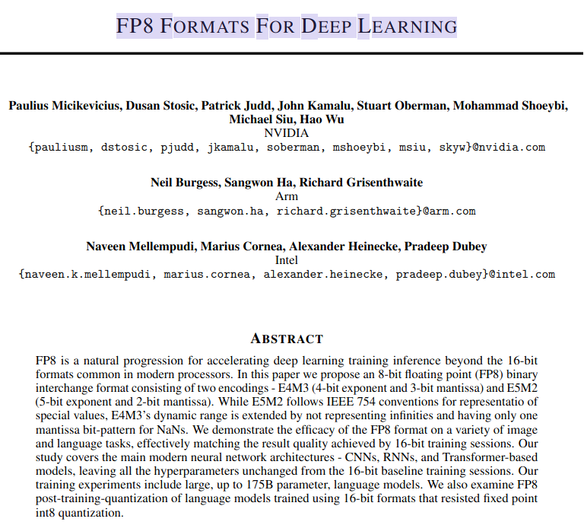

Slide 6
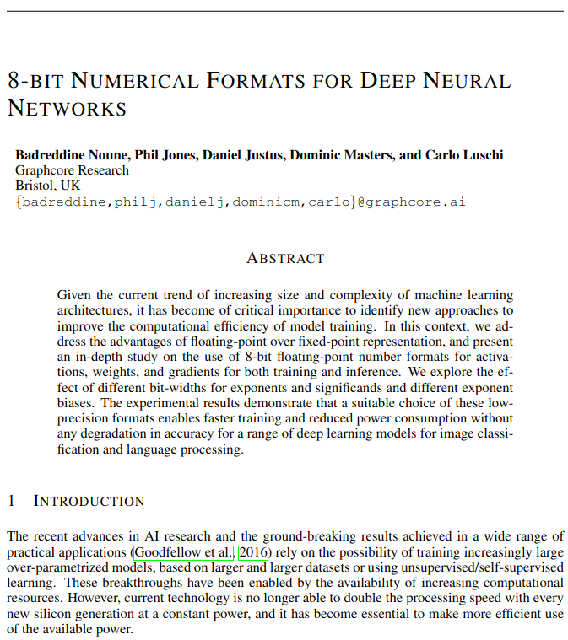

Slide 7
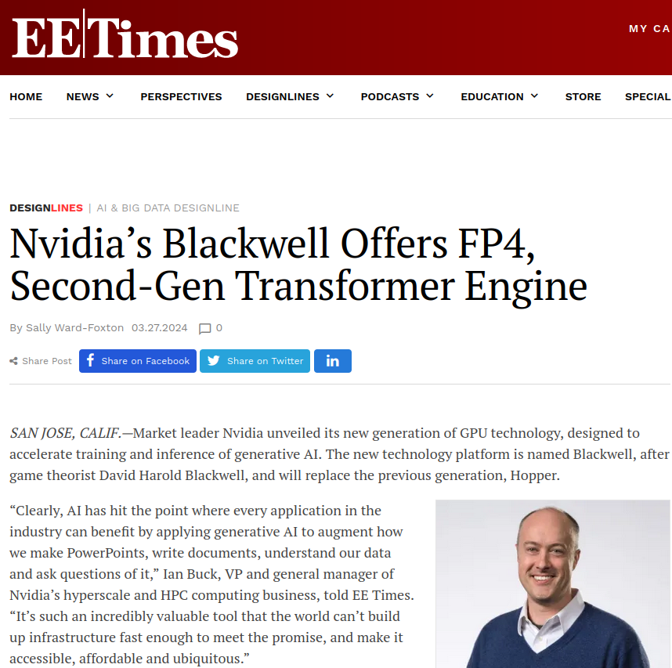

Slide 8
4/23 Report
Various trade-off between floating point with the aspect of deep learning.
Floating point design, integration & performance.
Techniques to accelerate deep learning operation.

Slide 9
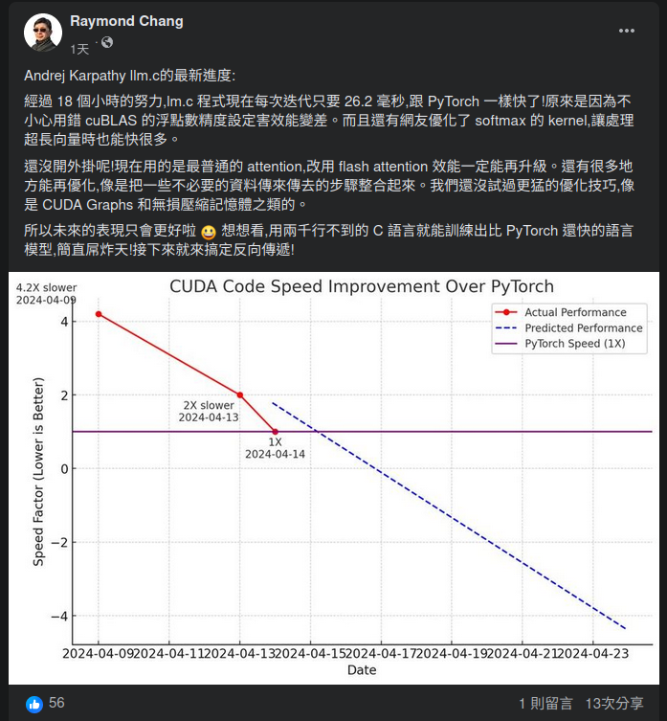

Slide 10
