Slide 1
Research Progress
Advisor: Peng-shen, Chen
Student: Yu-chun, Hung
Chung-Chen University
16 April 2024

Slide 2
4/23 Report
Currently writing course documents.
Currently focus on TVM deploy.
Uses yolort, yolo-v5 model
MaskRcnn tested
Stuck at rpc deploy.

Slide 3
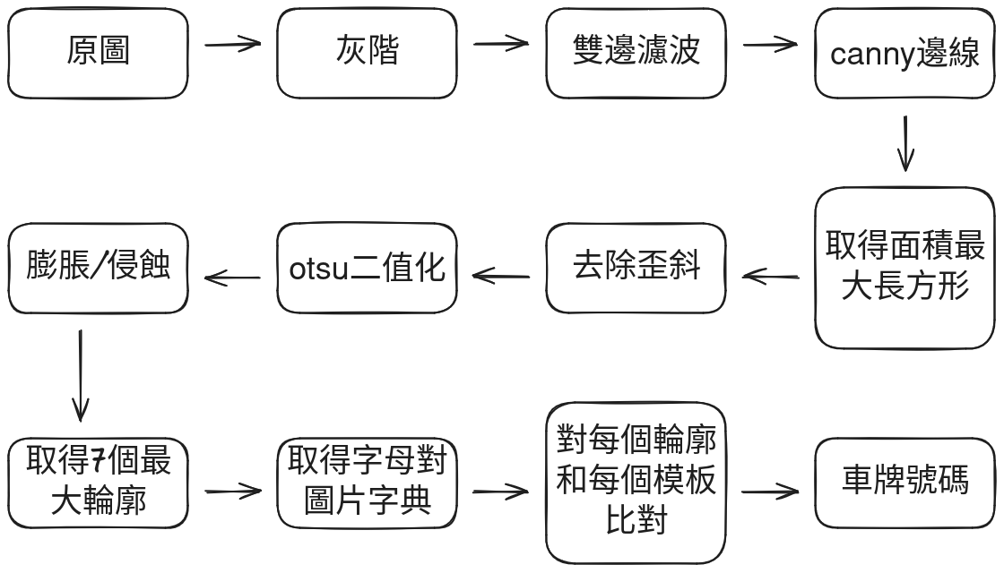
Course Document

Slide 4
Why stuck at deploy?
Can’t get over the error message
The model need to run on VirtualMachine runtime.
There’s no example code of RPC-deploying:
  Object detection model
  With VirtualMachine (all are graph_executor)

Slide 5
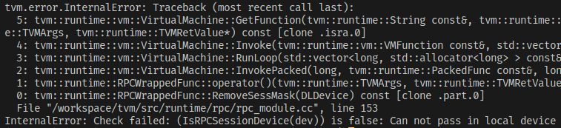
Why stuck at deploy?

Slide 6
Future Works
Try to deploy to raspberry
graph_executor & VirtualMachine runtime
rpc.connect_tracker to get the benchmark

Slide 7
llm.c
Singular file, ~2000 SLOCs, in C/CUDA
GPT-2 implementation by Andrej Karpathy.
Training on A100: llm.c:78ms/iter, PyTorch:80ms/iter
Only allocate all memory at once from the start.
Uses cuBLAs to deal with all matrix multiplication.

Slide 8
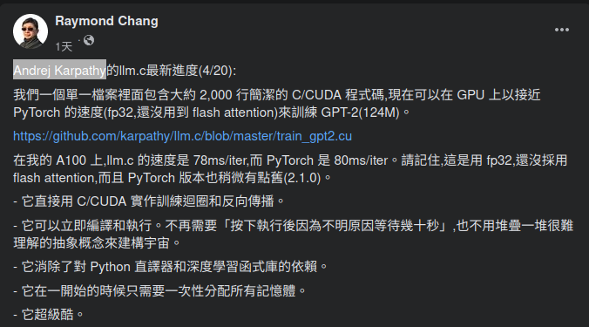
llm.c

Slide 9
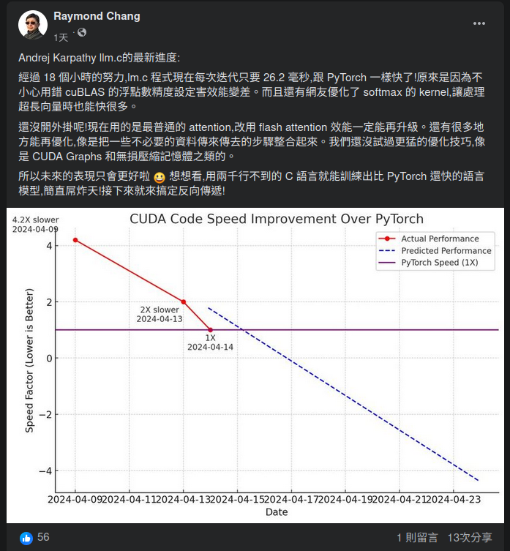

Slide 10
