Slide 1
Research Progress
Advisor: Peng-shen, Chen
Student: Yu-chun, Hung
Chung-Chen University
26 March 2024

Slide 2
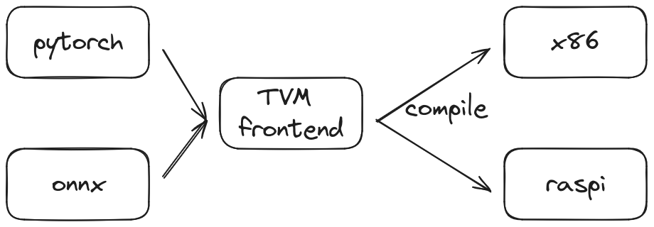
TVM path

Slide 3
TVM
Status:
  Successfully deployed resnet18 on x86, rasp
  Successfully deployed maskrcnn_resnet50_fpn on x86
  Failed deployed ssdlite_mobilenet_v3
Why?

Slide 4
TVM
Pytorch path
  ssdlite_mobilenet_v3 not supported at older version
ONNX path
  Current: Internal error: related to the output type int32
  Error in past:
    The model seemed to be dynamic, default graph executor doesn’t work, only vm works.
    TVM 0.11 does not work.

Slide 5
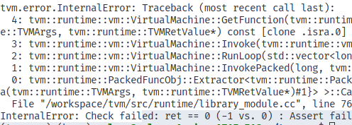
TVM error

Slide 6
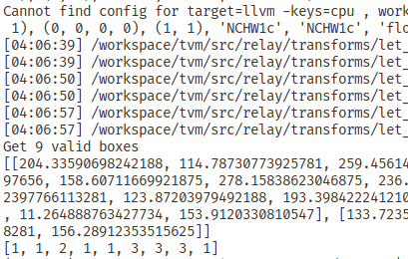
DEMO

Slide 7
Summary & Comment
TVM is hard.
For pytorch path, maybe I can save with torchscript that serialize the model.
For ONNX path:
  Problem occurs on ONNX convert, model itself, use the api wrong?
Learn to benchmark TVM.

Slide 8


