Slide 1
Research Progress
Advisor: Peng-shen, Chen
Student: Yu-chun, Hung
Chung-Chen University
30 April 2024

Slide 2
4/30 Report
Currently finished plate recognision and deep learning deployment lab document.
I forget about the pedestrian lab.
Still fight with TVM.

Slide 3
Fighting with TVM
In previous trial, we encountered the RPC deploy issue. Now we try to skip the RPC
Plan: We write to the .ro and .so file to disk, then we move the file manually.
Issue: x86 cpu works but not arm cpu.

Slide 4

Fighting with TVM
MaskRCNN and yolov5 are tested.
On local end, we can load and save from/to disk.
The raspi issue occurs to be when export the .so library

Slide 5
Future Plan & Comment
The TVM api inconsistency make everything extremely ugly.
Time to move on to the next parts,
  Give up on object detection model, try classification
  Try to benchmark the operators timing.
  Look more deeply to other DL compiler frameworks.

Slide 6
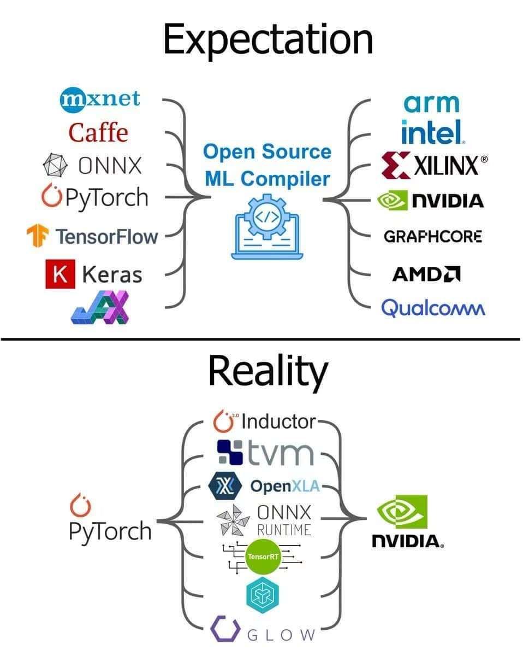
meme

