Slide 1
Research Progress
Supervisor: Peng-shen, Chen
Student: Yu-chun, Hung
Chung-Chen University
14 May 2024

Slide 2
5/14 Report
Oh My God, MLIR is HARD
What is interface.
How to write pass.
How to convert op.

Slide 3
What is interface
Interface can be inherited.
Giving the operation constraint and build op from that.
Jump into the interface to see what to be done.

Slide 4
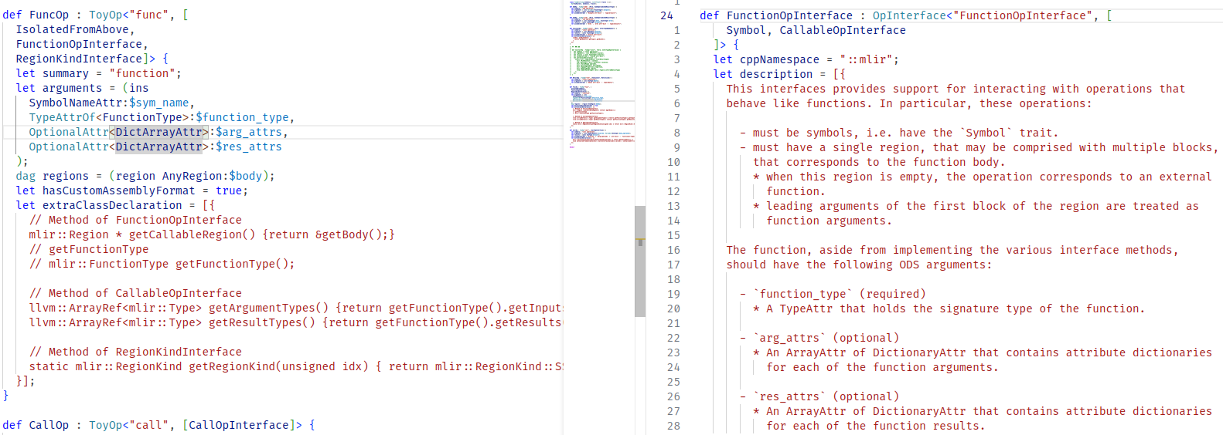
What is interface

Slide 5
How to Implement a pass
Construct a Pass at .td file, and set up constructor.
Override runOnOperation(), createXXXPass()
Implement logic at runOnOperation()
Modify data flow and control flow.

Slide 6
Implementing DCE_Pass()
Remove all Op that’s not relate to return.
Traverse all returnOp type child, populate a set, using DFS.
Traverse all Operation child, populate a vector that is not in the set.
Erase those op in the vector.

Slide 7
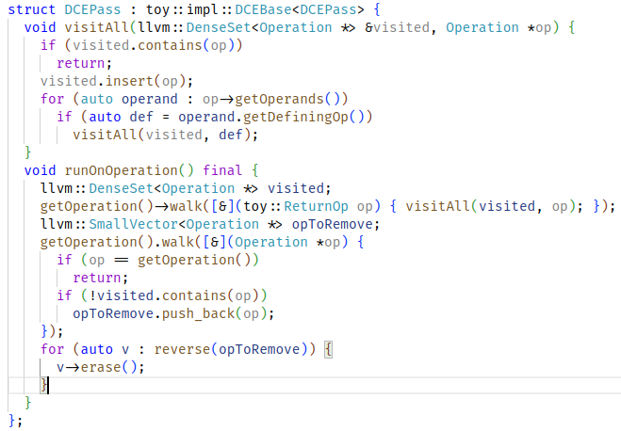
Implementing DCE_Pass()

Slide 8
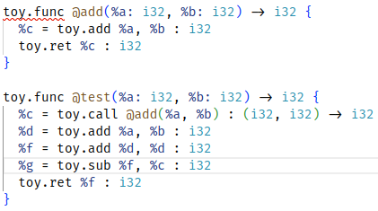
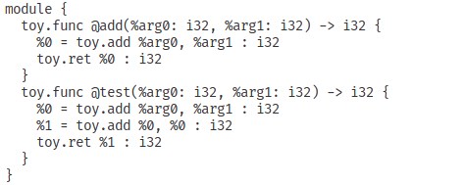
Implementing DCE_Pass()

Slide 9
Convert toy to arith dialect
Define pass at tablegen
Pattern Rewrite: (lowering)
  Override runOnOperation
    Register Arith dialect, add Ops you want
    ApplyXXX (applyPartialConversion)
  Override MatchAndRewrite
    rewriter.replaceOpWithNewOp<arith::SubIOp>

Slide 10
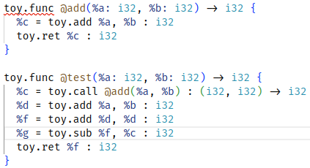
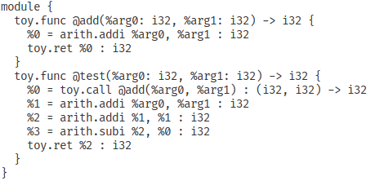
Convert toy to arith dialect

Slide 11
Comments?
Learn how to DRR to do rewrite.
Learn how to custom type.
Lots of C++ needs to be familiar with:
  Smart pointer, Iterator, lambda function, template programming, OOP in general...

Slide 12


