Slide 1
Research Progress
Supervisor: Peng-shen, Chen
Student: Yu-chun, Hung
Chung-Chen University
7 May 2024

Slide 2
5/7 Report
Course document finished?
Create separate MLIR and experiment with that.
Learning more about the MLIR concept, e.g.: adding pass, pattern rewrite, dialect conversion...

Slide 3
How to learn MLIR?
I suck at LLVM, but MLIR required the knowledge.
The official tutorial has only 7 chapters, assume you have prerequisite knowledge.
The lexer AST and lexer is even implement themselves in toy language example.

Slide 4
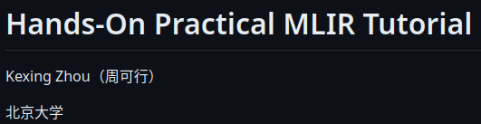
Minimum example
Consolidate the minimum to get it running and make experiment from it.
I need: dialect conversion, pattern rewrite...
I don’t need: How to implement lexer, AST

Slide 5
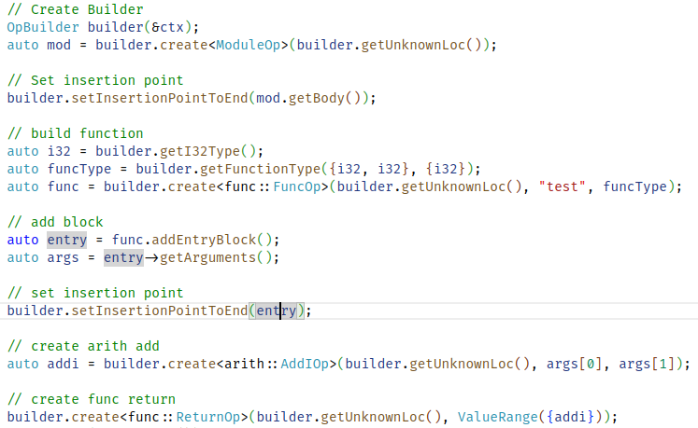
Generate MLIR

Slide 6
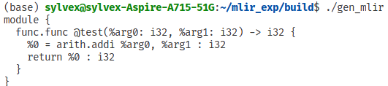
Generate MLIR

Slide 7

Pass
Pass seem to apply based on the interface.

Slide 8
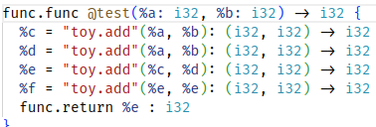
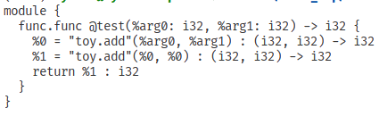
Pass
CSE pass: Eliminate common sub-expressions

Slide 9
Comments?
What does it even mean by supporting posit?
Finding what part of dialect need to convert from / to.
MLIR pass, pattern rewrite, dialect conversion, custom types...

