Slide 1
Research Progress
Supervisor: Peng-shen, Chen
Student: Yu-chun, Hung
Chung-Chen University
12 June 2024

Slide 2
6/12 Report
WRONG!!!WRONG!!!WRONG!!!WRONG!!!WRONG!!!
WRONG!!!WRONG!!!WRONG!!!WRONG!!!WRONG!!!
WRONG!!!WRONG!!!WRONG!!!WRONG!!!WRONG!!!
WRONG!!!WRONG!!!WRONG!!!WRONG!!!WRONG!!!
WRONG!!!WRONG!!!WRONG!!!WRONG!!!WRONG!!!
WRONG!!!WRONG!!!WRONG!!!WRONG!!!WRONG!!!

Slide 3
How do I even start?
After long period of code search purgatory, conclude that my strategy was not practical.
Back to posit arithmetic, making plan from atomic unit and operation.
If we were to integrate a library to a compiler, how do I interface it?

Slide 4
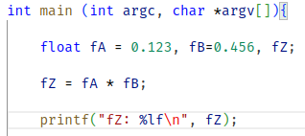
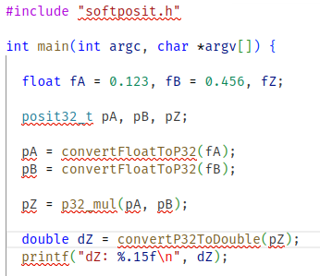
Analogy
Converted v.s Original

Slide 5
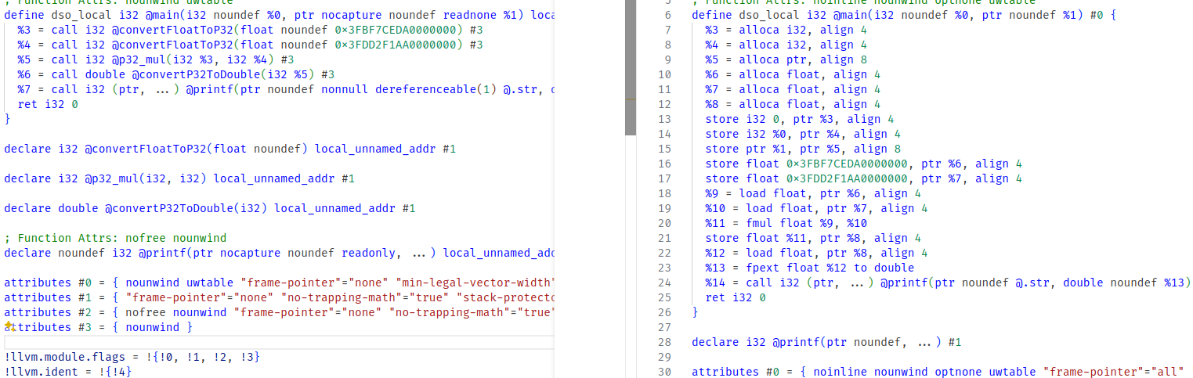
Operation Substitution?
LLVM IR

Slide 6
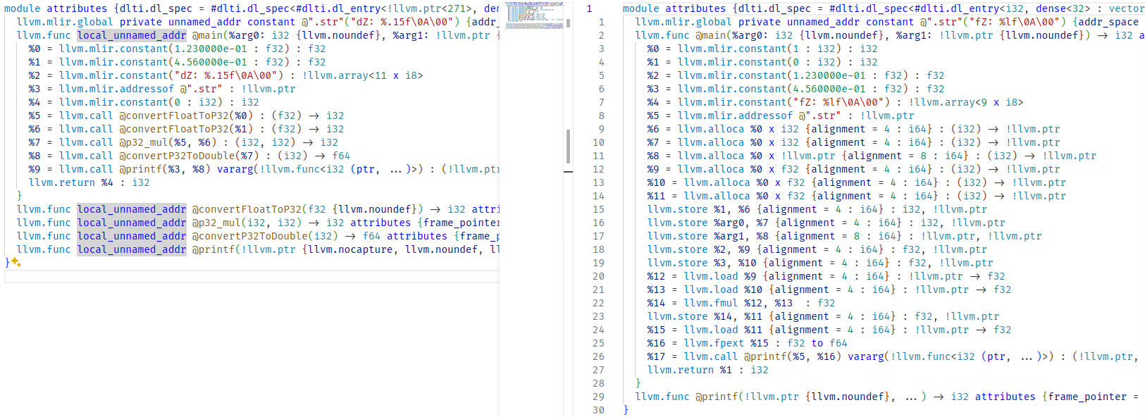
Operation Substitution?
MLIR

Slide 7
Problem Solved?
What does it means to implement to MLIR infrastructure?
  Substituting the operator as function call may works, but it just make it run like posit.
    Can’t map to function call? implement the operations by hand.
  Actually implement a framework ground up may be faster.
How to expose the posit type to modern model?
  There’s tons of passes and dialect to propagate.
  If convert posit is the endpoint, now we might need to find the starting point.

Slide 8
Starting Point?
Model format.
  torchscript, tflite, onnx, pth, pb...
For onnx-mlir, IREE, torch-mlir framework.
  Model Importer → Model compiler
    Parse the model to dialect → lowering, passes, execute.
    Target independent → Target dependent.
  Finding the dialect after the importer and before the compiler might be useful.

Slide 9
Which dialect to start?
For IREE:
  tflite → tosa.mlirbc (non-human-readable)
  torchscript → torch-mlir?
  Onnx → torch-mlir
But the architecture image state arith/linalg…
  Done in IREE compiler???

Slide 10
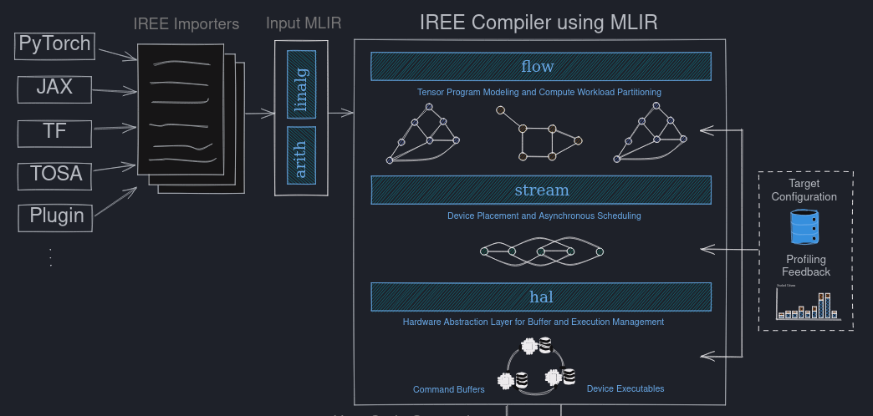
IREE Architecture

Slide 11
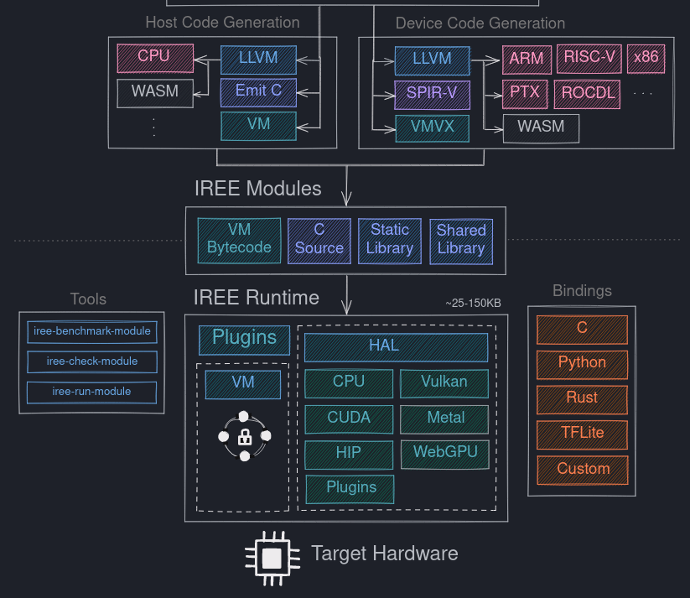
IREE Architecture

Slide 12
IREE
What about the LLVM-MLIR?
  Support posit vector operation?
  Done a lot stuff, the dialect is nothing like we see previously.
    Buffer management
    Dispatching…
  If implement the support at LLVM-MLIR, the previous optimization might not work.
  Would substitute those basic operation would make it run successfully ???

Slide 13
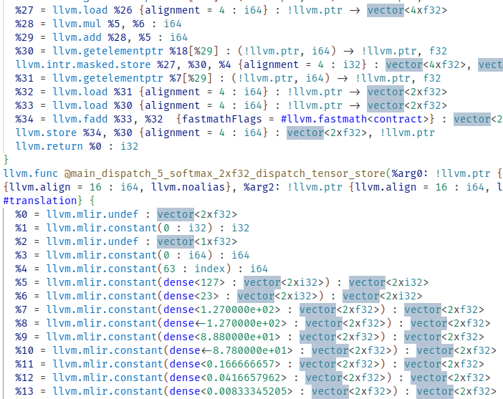
HELP

Slide 14
Foreseeable Future
Writing a simple MLP model.
Iterate type and value of model, convert to posit.
Write a posit interface that has similar trait to float to compatible to passes at dialect ODS or LLVM APFloat?
Add the posit-dialect pass before the llvm-mlir, convert to function call or implement posit arithmetic.
Evaluate the precision and performance of inference.

Slide 15
MISC-Posit
Library:
  Softposit
    Does not support for variadic regime.
  Universal number
    Headers only, well maintained. Templated parameter.
  Both does not compile at first, bruh.
I can convert llvm-ir to mlir and vice versa.
  However I cannot convert mlir to executable.

Slide 16
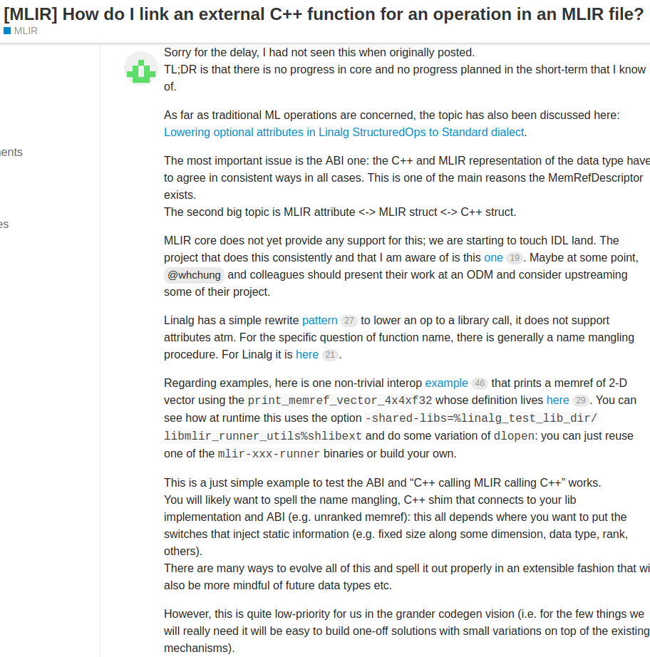
Integrate function call to mlir?

Slide 17
MISC-IREE Convert Model
TFLite:
  Working: text classification.
  Not working: posenet.
ONNX:
  Not working: ssd-mobilenetv3, ResNet50
Pytorch:
  IREE-turbine, more hassle to deal with.

Slide 18
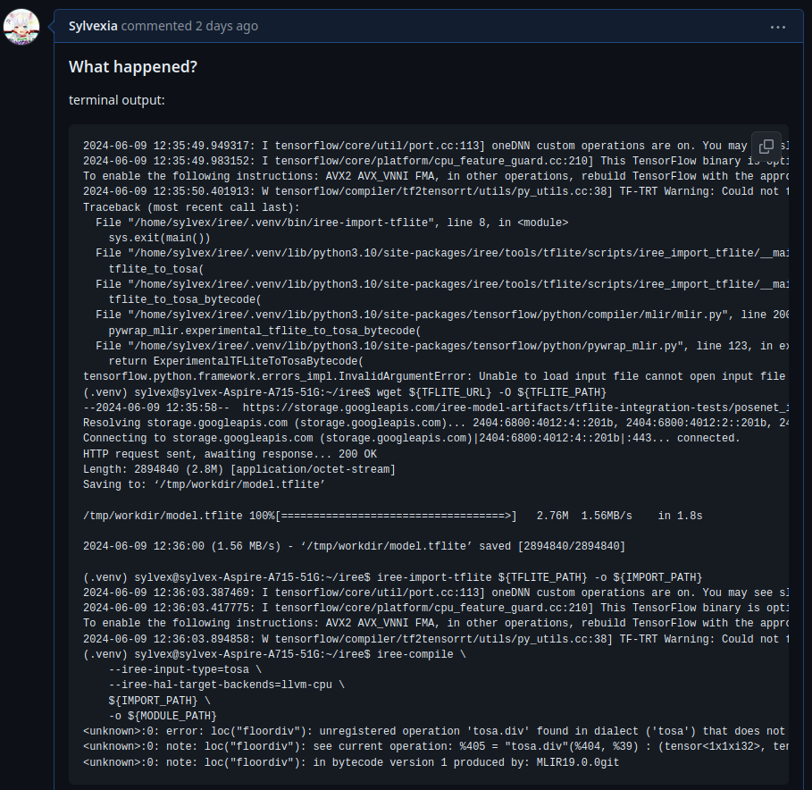
MISC-IREE Convert Model

Slide 19
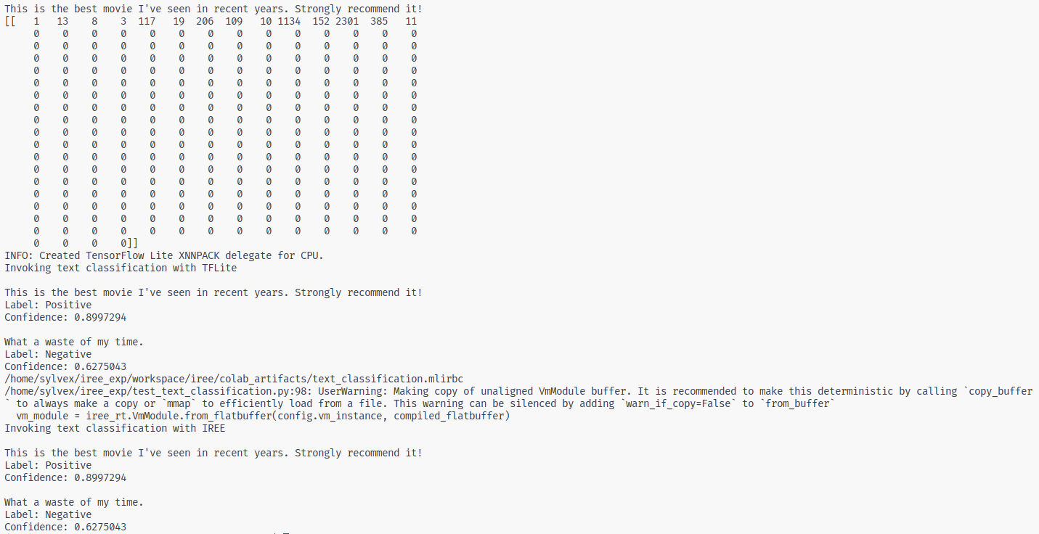
MISC - DEMO

Slide 20
Summary
I suck, I have no vision of completion.
The reason why I feel the task is so hard:
  Amount of work to be done.
  Type propagate through the entire process, hard to debug.
Finding the start point of the project.
Maybe I can simulate the pass by convert the llvm-mlir.

