Slide 1
Research Progress
Supervisor: Peng-shen, Chen
Student: Yu-chun, Hung
Chung-Chen University
9 July 2024

Slide 2
7/9 Report
久し振りだね！
Oh no, we can’t iterate all floating point instruction?
Review: the analogy of converting all add, sub, mul, div to posit library is wrong!

Slide 3
Though process
IREE LLVM Dialect too complex, code base is a nightmare to read, no need to focus performance
Try onnx-mlir, get the LLVM dialect, way easy to understand
Wait...

Slide 4
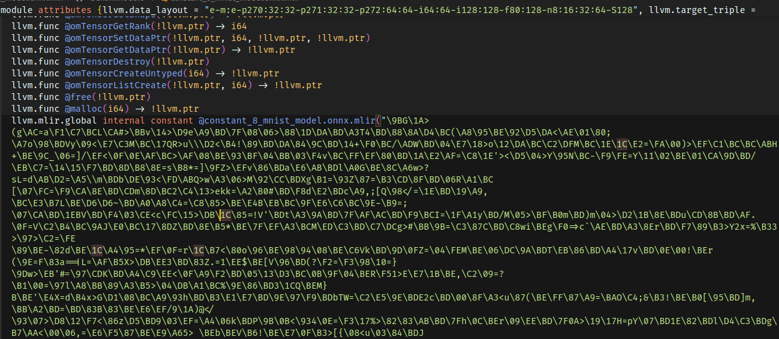
LLVM dialect

Slide 5
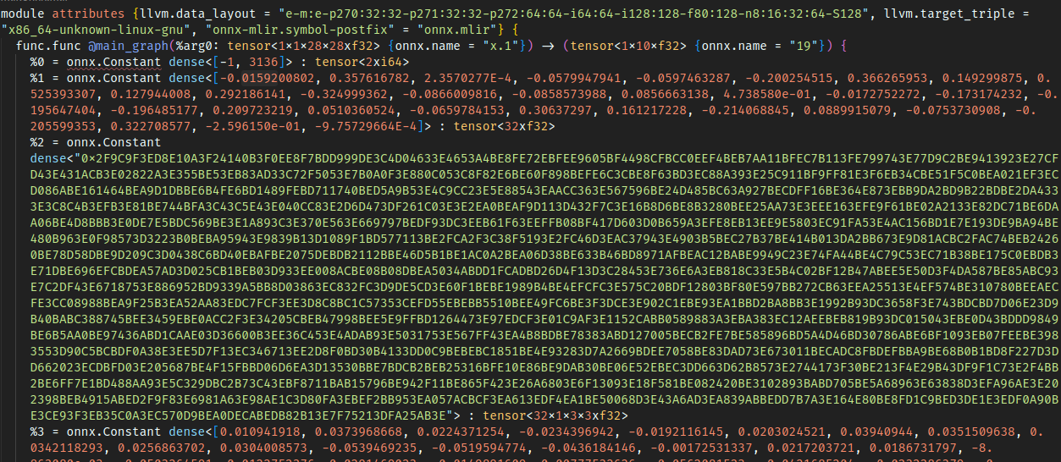
ONNX dialect

Slide 6
Matching the .mlir file to .onnx
I wrote a program to parse all the float from .onnx raw data and print them.
The .onnx data did match the Netron visualizer, which more or less shows the program correctness.
It does not match the .mlir, no matter it’s f32 or hex data, I even convert some number to hex and find it, it does not match.
When I actually trace the operands in llvm dialect, operators like mul, does not represent single value multiplication. Non of those should be bijective.
The analogy from the last presentation is wrong!! We cannot simply map the operator to posit library!!

Slide 7
Summary and thoughts so far:
Cannot map operation to posit library at llvm ir.
Difficulty: For example, I have no idea how the onnx value get packed into mlir dense object.
Which layer to convert and what dialect should I create?
Might actually need to trace the code base to find how does the onnx model get serialized.
Actually I’m out of methods, and I cannot justify why we need to implement software simulated to mlir infrastructure instead of just writing a library and make the model run.

Slide 8
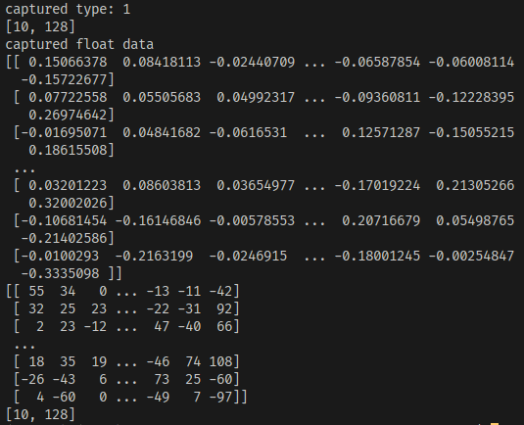
Psuedo-Quantization???

Slide 9
Modifying the float data in onnx
The weights are kept in the model.graph.initializer
Decode byte array to numpy.array.
Modify the value and type.
Encode the value back to byte array.
Since the netron visualizer number matches the encoded , the decode → modify → encode process should be correct.

Slide 10
Does it works?
No.
Basically simply get the max and min value of a node and normalize to -127~+128 does not work.
They also have special ways to quantize different operators, e.g. Conv.

Slide 11
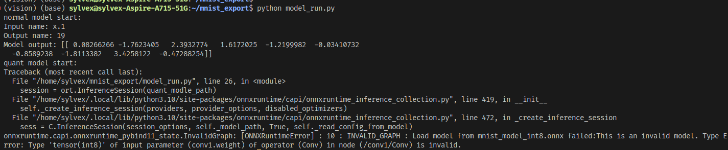
Does it works?

Slide 12
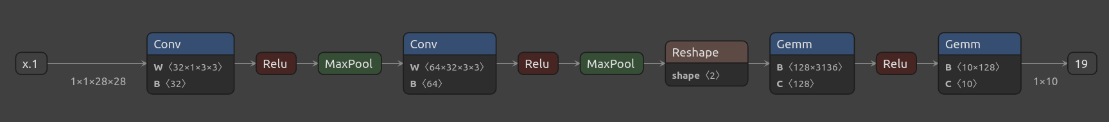
What is Netron???

Slide 13
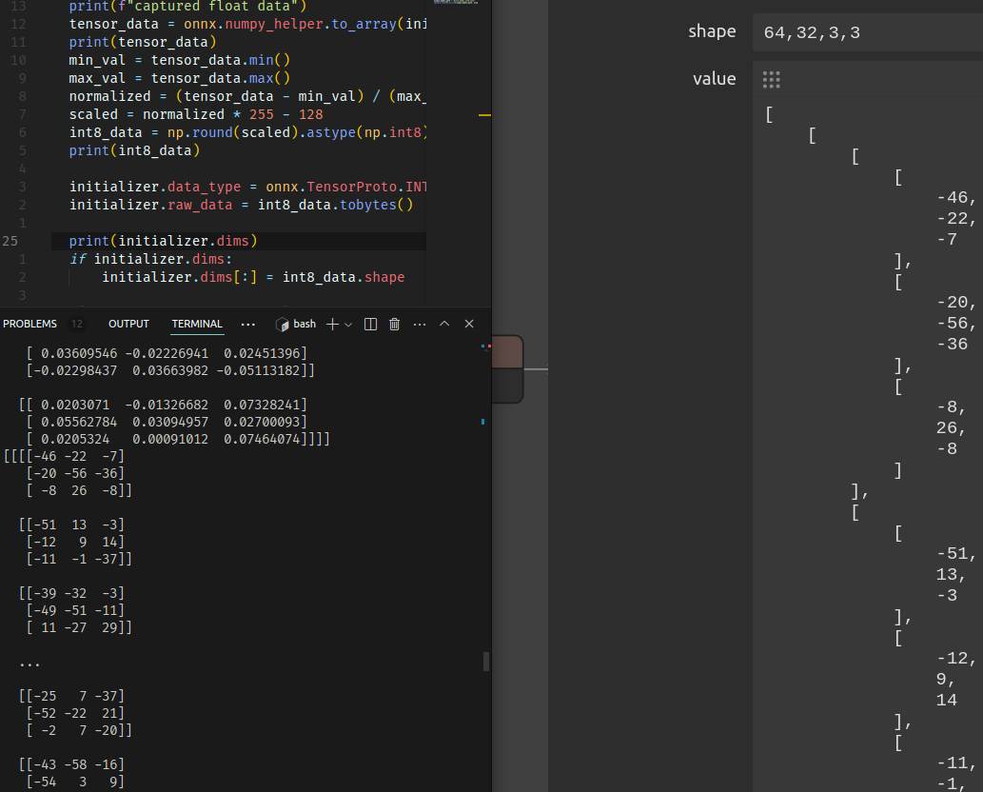
Netron demo

Slide 14
Convert the data to posit?
Universal number have variadic es bit length.
Softposit does not, but the implementation is way easier. And does not have much over-wrapped abstraction.
Convert the c function to mlir??

Slide 15
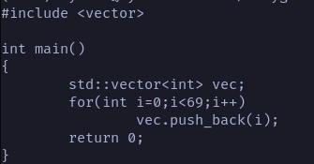
Polygeist

Slide 16
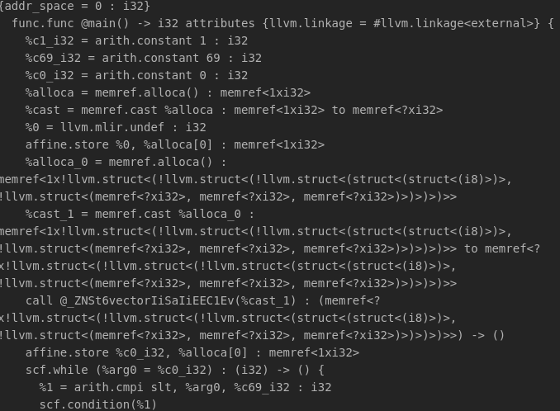
Polygeist
533 lines

Slide 17
Polygeist?
I clean up the posit conversion function and feed it into polygeist to test, it does not work.
I might need to see what I’m missing, there’s people in github issue can successfully link the external file.

Slide 18
PERCIVAL
Existing RISC-V, posit, quire, llvm solution.
They have Posit-Arith-Unit and custom posit extension on top on RISC-V.
I’ve built the project and could produce the result from their testcase, however, I cannot run it with risc-v toolchain.
If I need to create posit interface I might need to check it out.

Slide 19
Summary
There’s no way I can graduate if I just do research by myself, I need some insight and good advice. Or we just fool ourselves!
Research motivation need to be justified.
The project needs might need to touch: LLVM, MLIR, onnx-mlir, onnx, softposit... And it’s high chance cannot be complete by single person, even whole lab with 2 years of students!

Slide 20


