Slide 1
Study of Posit Numeric in Speech Recognition Neural Inference
Author: Zishen Wan, Eric Mibuari, En-Yu Yang, Thierry Tambe
Harvard University
Cambridge, MA
Advisor: 陳鵬升 教授
Presenter: 洪祐鈞

Slide 2
Intuition
Posit: A new ways to represent floating-numbers
  Good at represent the |number| close to 1
Text-to-Speech model is RNN, attention based model.
Inference: Given input to existing model and get the output.
Quantize: Fit big data to small data.

Slide 3
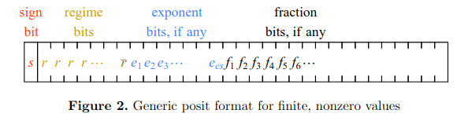
How does Posit Works?
Posit Format:
Parameter:
  Posit<total_bits, es_bits>
    Example: Posit<32,3>
      Total of 32-bit. 32-bit posit
      es: 3
        At most 3 bit of exponent
        3-bit of exponent as a pack

Slide 4
Why do I choose this paper?
My research focus is on
  Integrating posit floating point arithmetic in to MLIR infrastructure
    MLIR: Framework of Compiler Framework
  Specifically on deep learning application.
Another research topic of lab is optimizing or quantize the transformer model, a lot of operator e.g attention layer similar to this.

Slide 5

How does Posit Works?
Posit Format:
00000000: Zero
10000000: NaR (Not a Real)
useed =

Slide 6
How does Posit Works?
sign term:
  0 -> +
  1 -> -
exponent term:
  101 -> e = 5
  2e , no Bias like IEEE754
  at most es-bit
fraction term:
  1011 -> 1 + (0.5 + 0.125 + 0.0625)
  f = 1.f1f2f3f4... like IEEE754,
  but no subnormal number.

Slide 7
How does Posit Works?
regime term:
Find until the first opposite bit.
001 -> k = -2,
01 -> k = -1
10 -> 0,
110 -> k = 1,
1110 -> k = 2,
k value intuitively treat as carry of pack of exponent
Decide
__builtin_clz() -> x86 instruction LZCNT

Slide 8
Insight on posit
“0000111111111111" next posit is:
"000001000000000"
We need larger precision at smaller exponent.
  We have more fraction bit at smaller exponent.
Value close to exponent zero has shortest regime bits.
  Good at represent the |number| close to 1

Slide 9
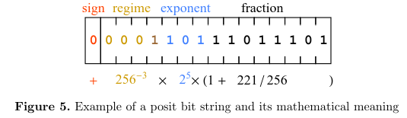
Convert from posit to real number:
Posit<16, 3>: 16-bit, es = 3
sign term: 0 -> positive -> +
regime term: 0001 -> k = -3, -> 256³
  Useed =
exponent term: 101 = 5 -> 2⁻⁵
fraction term: 1+ (0.5 + 0.25 + 0.0625 + ...)

Slide 10
Convert from posit to real number:
In Paper:
  Add check (zero, NaR..) exception
  Check regime bit length -> exp -> fraction
    exp and fraction bit may not exist.
  Multiply those sign, regime, exponent, fraction terms

Slide 11

Convert from real number to posit:
Convert 694.20 to posit<32,2>
  Es = 2
  Useed =
  694.20 = 2^9 * 1.359
  9/4 = 2 ... 1 -> k = 2, e = 1

Slide 12
Convert from real number to posit:
Convert 694.20 to posit<32,2>
  sign bit = 0 (positive)
  regime bit = 1110 (k = 2)
  exponent bit = 01 (e = 1)
  1.359 = 1 + (2⁻² + 2⁻⁴ + 2⁻⁵ + 2⁻⁷ + 2⁻⁸ …)
  fraction bit = 0101101100011001100110011

Slide 13
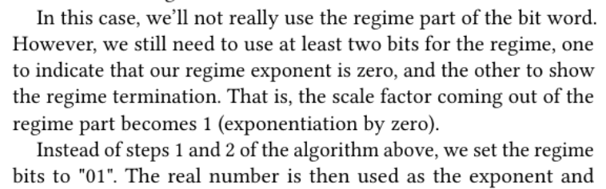
Convert from real number to posit:
This paper has an error: (useed > |value| > 1)

Slide 14
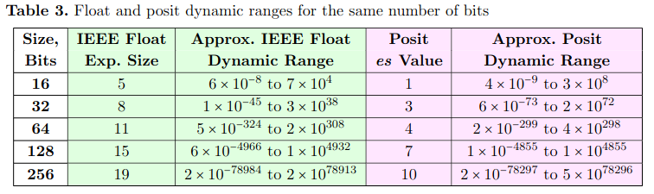
Larger Dynamic
Posit have larger dynamic range

Slide 15
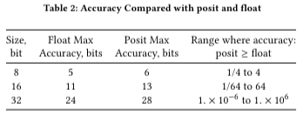
Accuracy
IEEE FP32: 23-bit fraction + 1(1.xxx fraction)
Posit 32: 32 - 1(sign) - 2(regime) - 2(exponent) + 1(1.xxx fraction)
IEEE FP16: 10-bit fraction + (1.xxx fraction)
Posit 16: 16 - 1(sign) - 2(regime) - 1(exponent) + 1(1.xxx fraction)

Slide 16
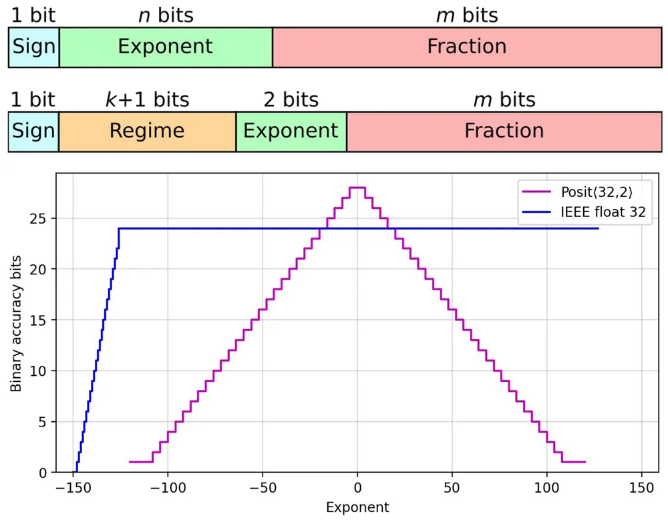
Posit(32, 2) accuracy v.s. IEEE float 32
Posit has more accuracy when the value's 2's exponent is close to 0
(ref: https://spectrum.ieee.org/floating-point-numbers-posits-processor)

Slide 17
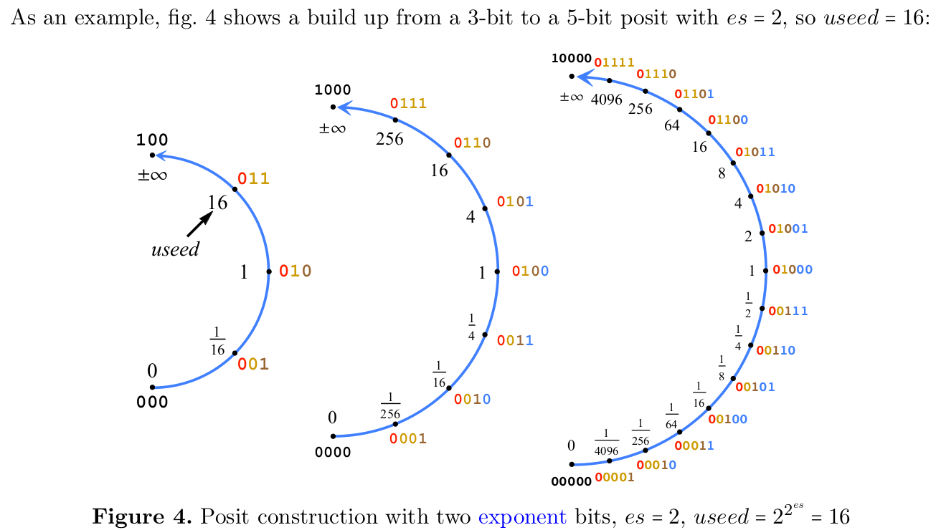
Posit Precision
Observation:
  Shorter regime bits allows more fraction bits
  Value distribution is close together exponentially around 0.

Slide 18
Paper Abstract
RNN model is huge for memory aspect.
Quantize the mode is good for deploy to edge device.
Research various kind of floating point format on speech-to-text model inference performance
Result shows posit<8,0> is the best for aggressive quantization.
Posit hardware is more efficient then fixed-point based, in terms of area and power cost.

Slide 19
Contribution
Develop a Python-based framework for converting between float, fixed-point and posit numbers.
Compare and evaluate the posit and various data types in neural speech recognition inference.
Design hardware unit of posit, fixed point and floating point.
Overall hardware prototype of speed-to-text inference.
Sad, it seems like it's not open-source

Slide 20
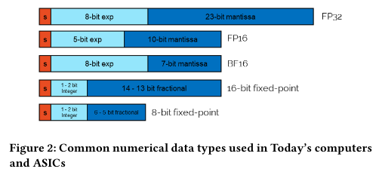
Overview of common numerical data type
In Paper comparison:
BF16: Used in Google cloud TPU and Intel AI processors.
Fixed-point: 0.1 + 0.2 != 0.30000000000000004
Low precision fixed-point arithmetic become DL quantization in inference.

Slide 21

Overview of common numerical data type
In Paper comparison:
BF16: Used in Google cloud TPU and Intel AI processors.
Fixed-point: 0.1 + 0.2 != 0.30000000000000004
Low precision fixed-point arithmetic become DL quantization in inference.

Slide 22

Other FP Format

Slide 23
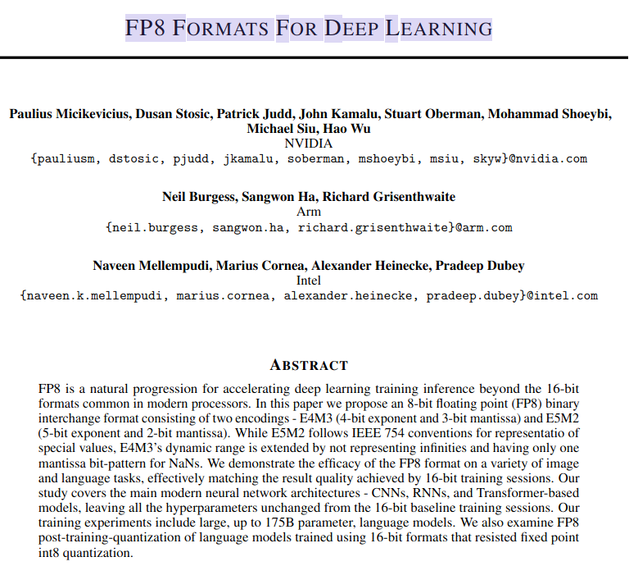
Other FP Format

Slide 24
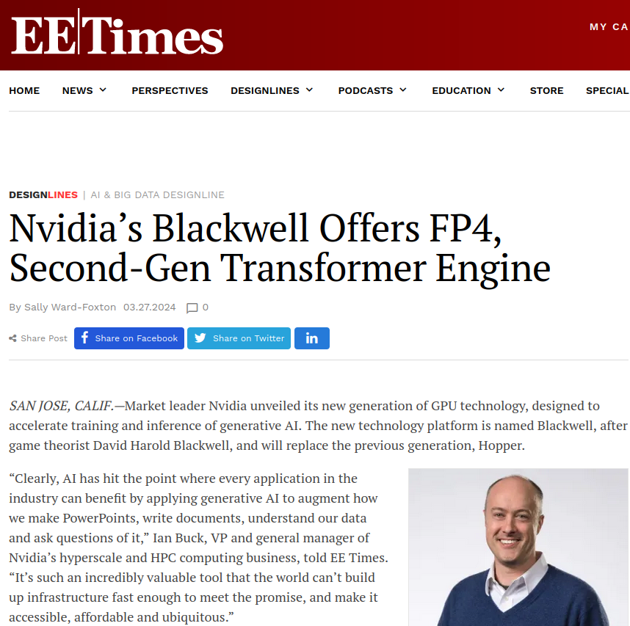
Other FP Format

Slide 25
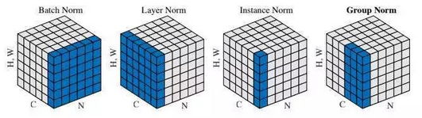
Experiment
Train 2 speech recognition model
  Framework: OpenNMT toolkit
  Dataset: LibriSpeech corpus:
  1,000 hours of audiobooks
  Model architecture follows DeepSpeech3 specifications
  Substitute batch normalization to layer normalization.

Slide 26
Experiment
Train 2 speech recognition model
  Networks were not retrained after quantization was applied
  There's no specific words describe how the quantization is done
    From the context, the conversion is based on real value.

Slide 27
Experiment
Train 2 speech recognition model
  Model 1:
    MLP attention model
  Encoder:
    4 layer of bidirectional-GRU (Gated Recurrent Unit)
      1024 hidden units
    2 downsampling pooling layer
  Decoder: 1 forward-only decoder with 512 hidden unit
    20M parameter

Slide 28
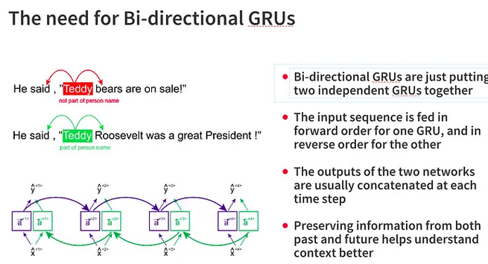
Experiment
Train 2 speech recognition model
  Model 1
    MLP attention model
  Encoder:
    4 layer of bidirectional-GRU (Gated Recurrent Unit)
      1024 hidden units
    2 downsampling pooling layer
  Decoder: 1 forward-only decoder with 512 hidden unit
    20M parameter
Ref(https://vtiya.medium.com/gru-vs-bi-gru-which-one-is-going-to-win-58a45ede5fba)

Slide 29
Experiment
Train 2 speech recognition model
  Model 2:
    General attention model
  Encoder:
    5 layer of uni-directional LSTM
    800 hidden units
    4 down-sampling pooling layer
  Decoder: 2-layer forward-only decoder with 512 hidden unit
    30M parameter

Slide 30
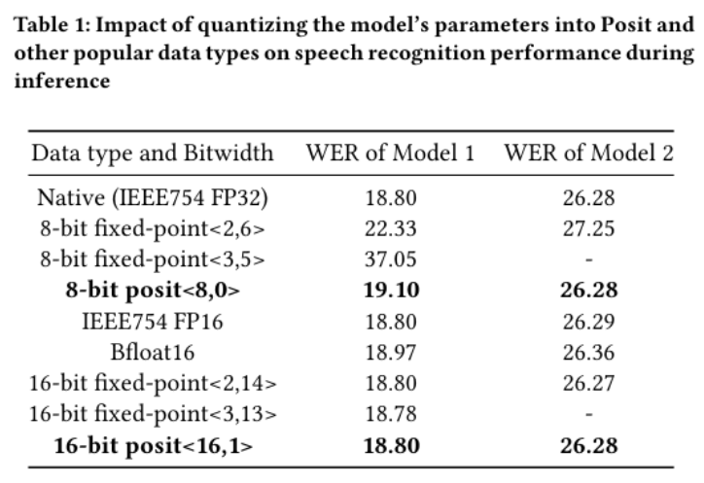
Result
WER(Word Error Rate)
  The lower, the better

Slide 31
Result
Observation:
posit<8,0> have small accuracy loss compare to original IEEE FP32
For 8-bit data type, posit<8,0> outperform others.
For all 16-bit data-type, the accuracy is about the same.
  Expected since
    weight is [-2.5, 2.5] for model 1
    weight is [-2, 2] for model 2

Slide 32
Result
Observation:
8-bit fixed-point<2,6> is not enough number > 2
  But better than fixed-point<3,5>
  Denser distribution in [-2, 2] in model 1
After 1 epoch of re-train and re-quantize
  model 1 accuracy: (19.10 -> 18.84) vs 18.80

Slide 33
Hardware Aspect
Create hardware for:
  Conversion between posit, floating and fixed point number
  MAC (Multiply Accumulate)
    a <- a+b*c
    Good for convolution, matrix operation.

Slide 34
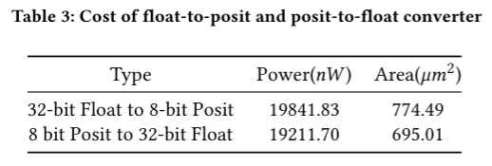
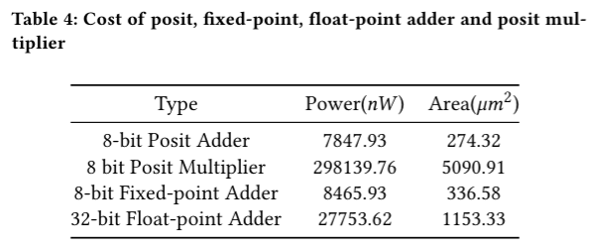
Hardware Spec
8-bit posit adder is approximately 25% of 32-bit float-point adder
Posit adder is smaller than fixed-point adder

Slide 35
Hardware Spec
90nm library. 100MHz
My 64-bit double multiplier: 5GHz, 111.2mW, 6.324um^2, 60 cycle. 16nm TSMC (No handling denormal)
Original paper does not state that it’s single cycle.

Slide 36

Hardware Spec
Not handling denormal, +20% speedup
- ref:https://developer.nvidia.com/blog/cuda-pro-tip-flush-denormals-confidence/

Slide 37
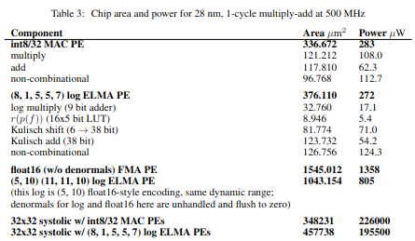
Hardware Spec
How many cycle of this hardware?
What standard of the implementation did they follow?
https://arxiv.org/abs/1811.01721

Slide 38
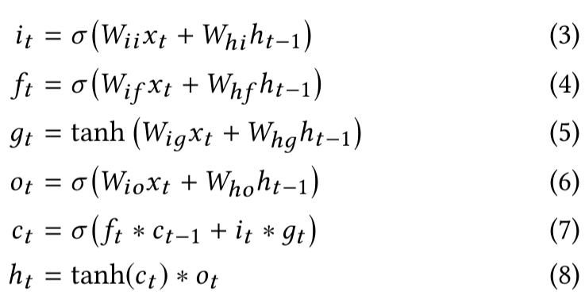
Prototype LSTM Engine Accelerator
First 4 formula is similar to fully-connected layers, just matrix multiplication and addition. Can be parallelized
Activation function is tanh and sigmoid, perform after summation of matrix multiplication
Fifth formula is cell state, depend on previous state
Last formula is for the next hidden state
x: input
w: weight
h: hidden state
c: cell state

Slide 39
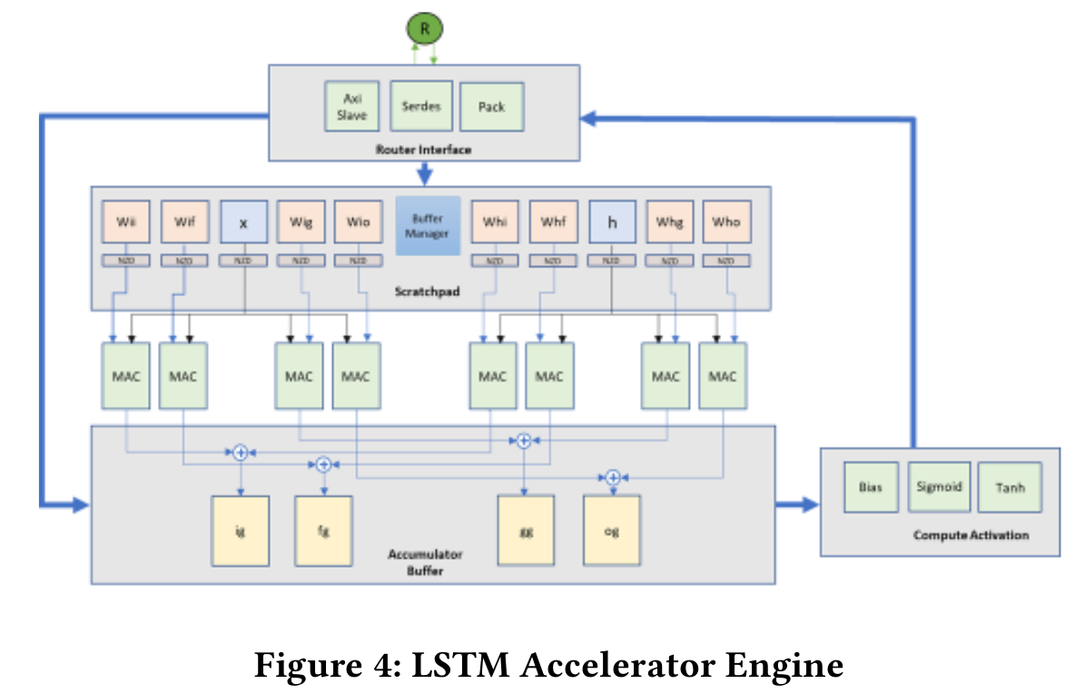
Prototype LSTM Engine Accelerator
Datapath:
  Use cache buffers for input, hidden state, and weight. use 8MACs to calculate the matrix-multiplication and 4 accumulator for addition.
  Feed 4 result to calculate activation.

Slide 40
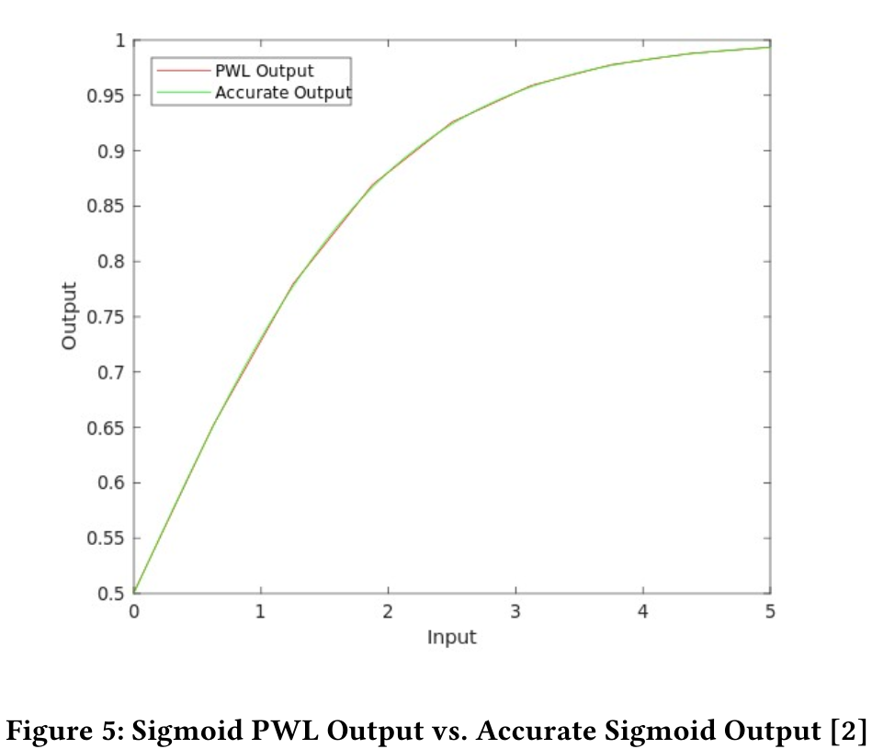
Prototype LSTM Engine Accelerator
Activation function tanh and sigma is done by piecewise approximation.
  Using straight line segment to approximate the function.

Slide 41
Summary of LSTM Engine Accelerator
Synthesized the accelerator from ststemC code to RTL in verilog and verify the result.
Bottleneck:
  Storage of weight matrices.
  Taking advantage of weight reuse across timesteps.

Slide 42
Conclusion:
posit<8, 0> is suit for speech recognition inference.
posit based hardware would have less area and power usage.
posits present as appealing solution for compress DNN on edge and warrant further studies.

Slide 43
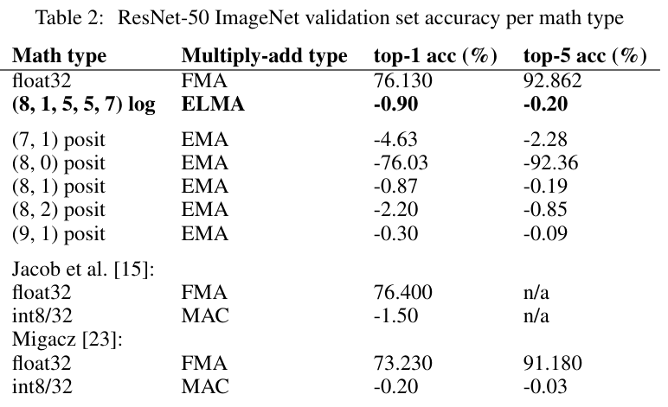
Question
Does it work on other type of model?
  ref: Rethinking floating point for deep learning
  batch normalization fused into affine layers.
  float32 parameters and network input are converted to our formats via round-to-nearest-even

Slide 44
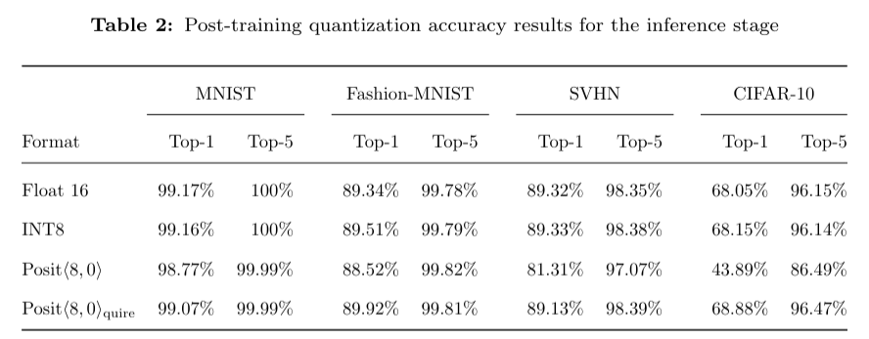
Question
Does it work on other type of model?
  ref: Deep PeNSieve: a Deep learning framework based on the Posit Number System
  Linear mapping quantization

Slide 45
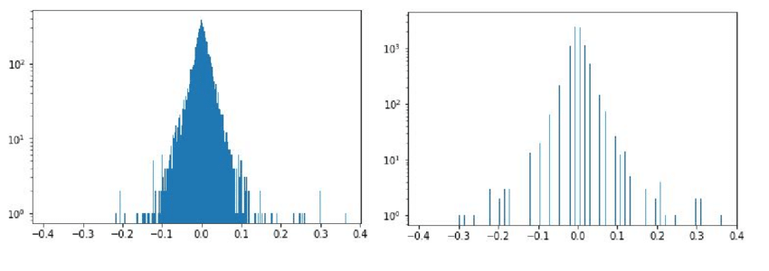
Question
Analyze different weight distribution on different operator and different model?
  - Distribution of weights of ResNet-50 neural network before the quantization procedure (left) and after it (right).
https://www.researchgate.net/publication/329798596_Fast_Adjustable_Threshold_For_Uniform_Neural_Network_Quantization

Slide 46
Question
Different quantize ways, like how it maps to uint8.
  Dynamic/Static ways. (w/ and w/o callibration)
Different hardware implementation can make the area and power have different outcome.

Slide 47
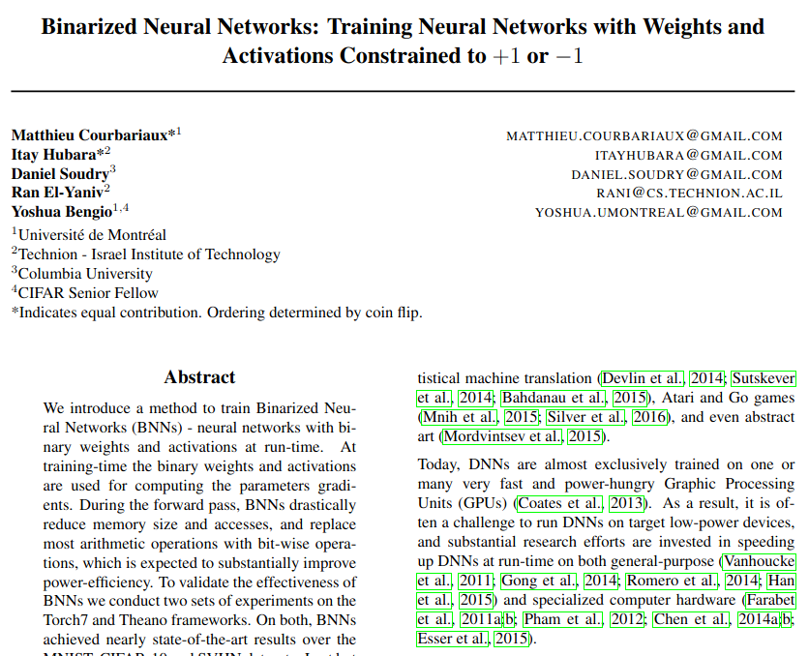
Thoughts
You can make your whole model binary as long as your network has enough number of nodes:

Slide 48
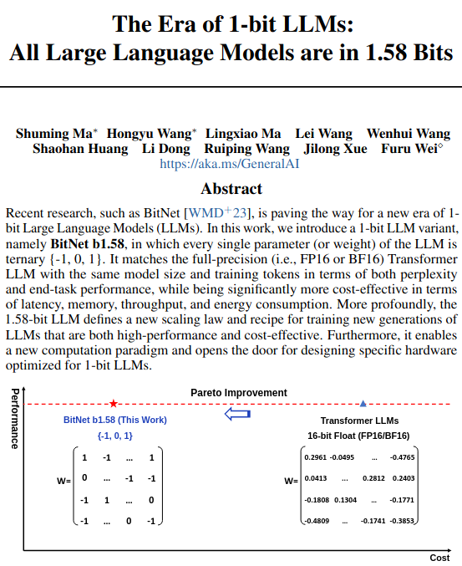
Thoughts
You can 1-bit LLM, if you do quantization every linear layer and good at math:

Slide 49
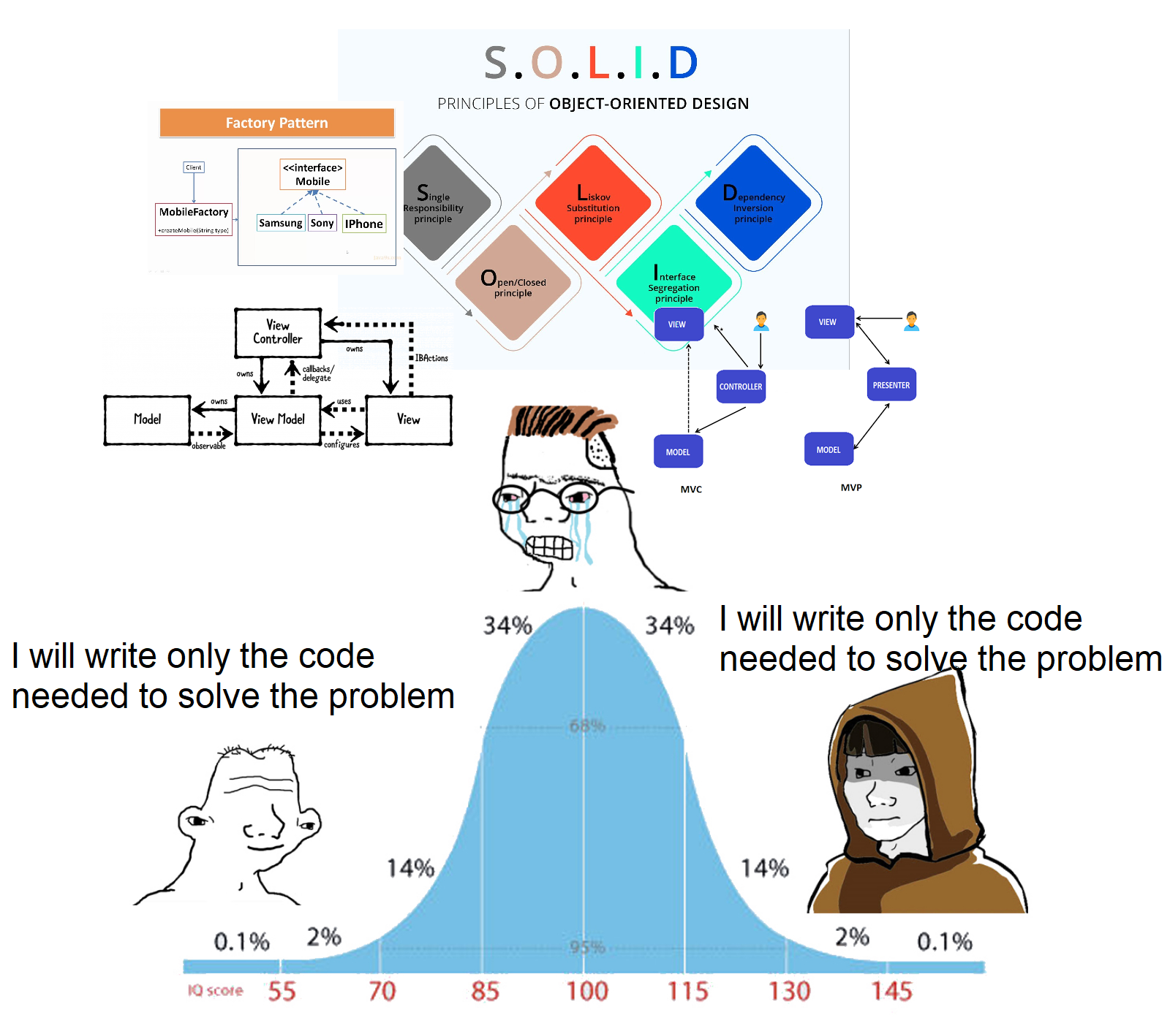
Thank You

