Slide 1
Compiling ONNX Neural Network Models Using MLIR
Author: Tian Jin, Gheorghe-Teodor Bercea, Tung D. Le, Tong Chen, Gong Su,
Haruki Imai, Yasushi Negishi, Anh Leu, Kevin O’Brien, Kiyokuni Kawachiya,
Alexandre E. Eichenberger
Advisor: 陳鵬升 教授
Presenter: 洪祐鈞
source link

Slide 2
What Does this project do?
Objective: Transform ONNX graphs into code
Approach: Utilizes LLVM/MLIR compiler technology
Focus: Inference
Goal:
  Implementation with stand-alone runtime support.
  Integration to other MLIR compilers.

Slide 3
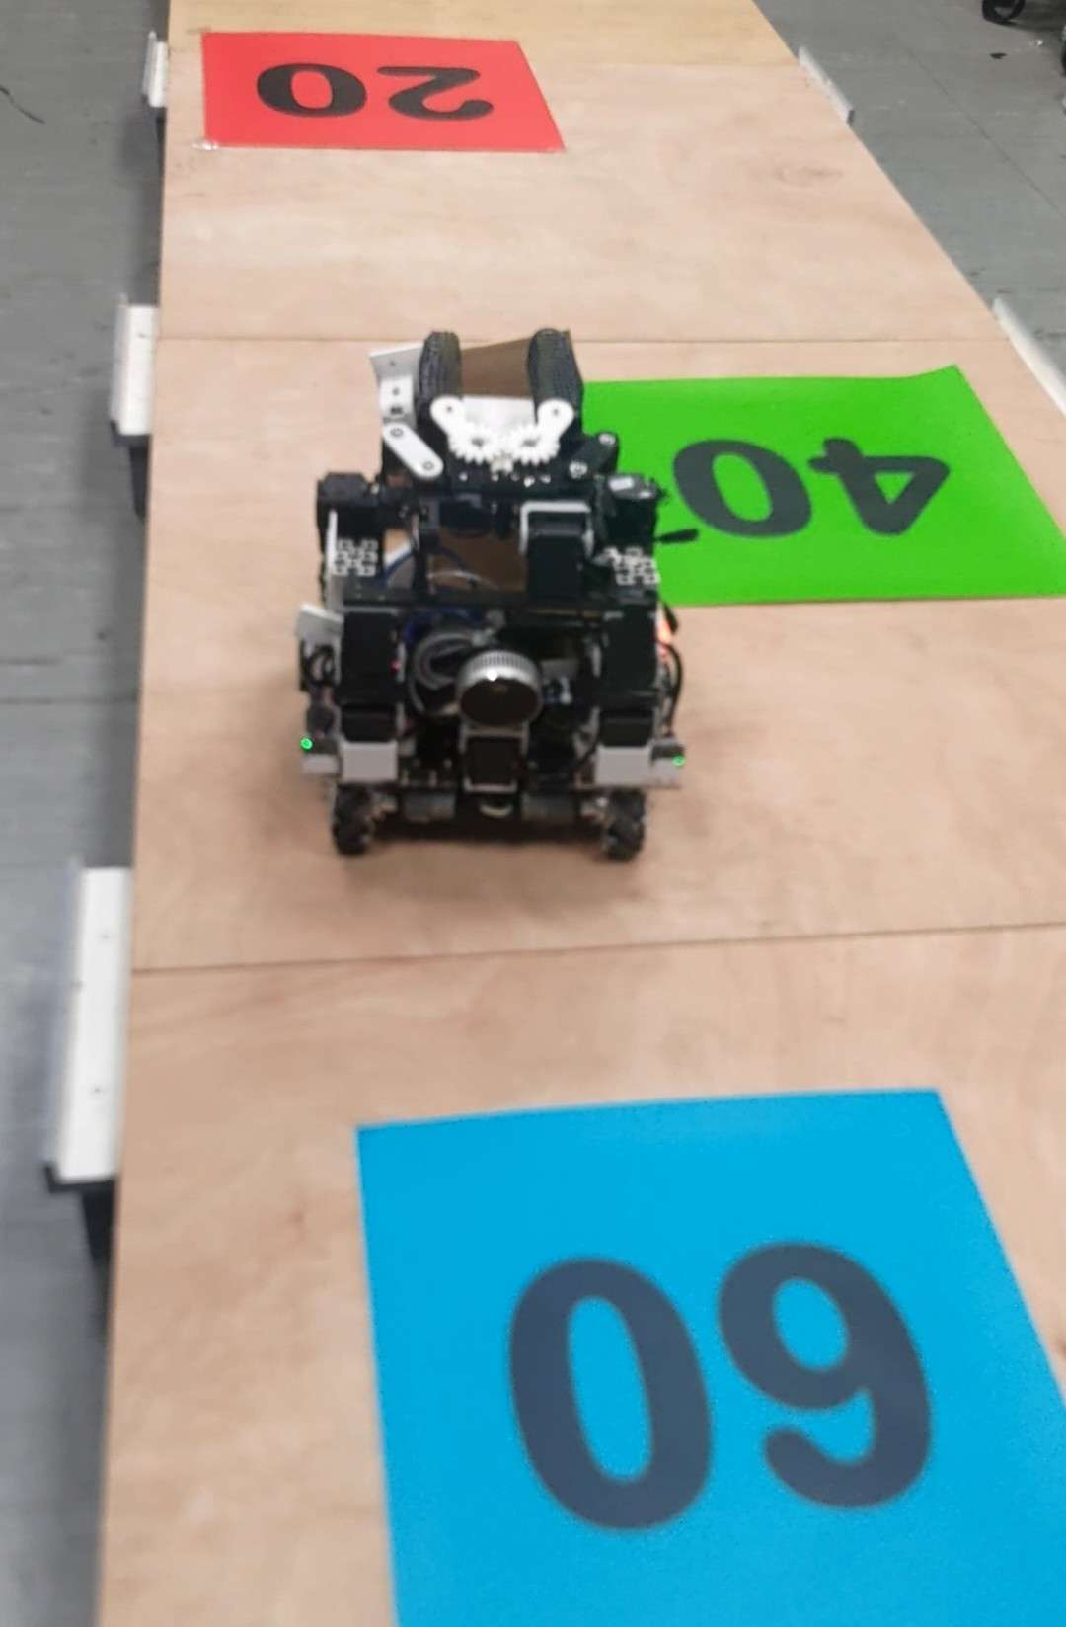
What is ONNX?
ONNX (Open Neural Network Exchange)
A common format for deep learning model.
Supported by Pytorch, TensorFlow, Caffe,…
  torch.onnx.export(model, example_input, onnx_path)
Real life example: TensorRt
  Deploy onnx model to NVIDIA GPUs.
  Optimization and acceleration on inference:
    Kernel auto-tuning.
    Precision quantization.

Slide 4
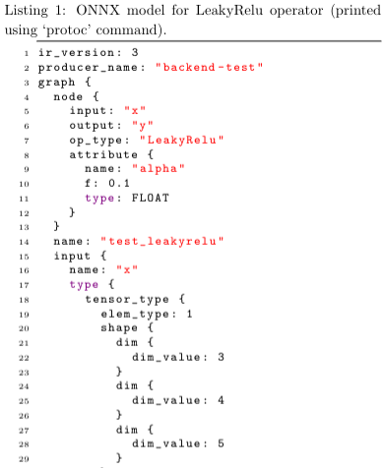
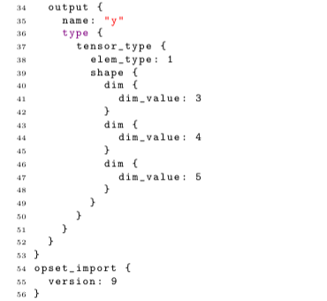
What is ONNX?
LeakyRelu Operation Example:

Slide 5

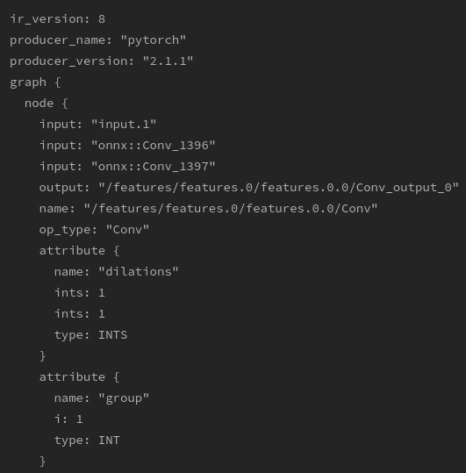
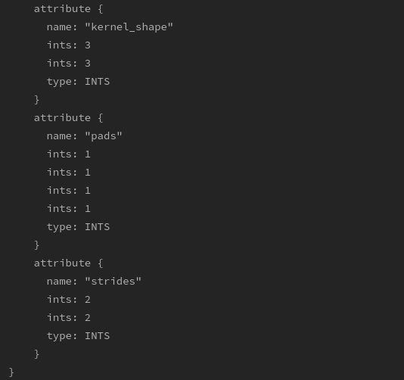
What is ONNX?
Conv Operation Example:

Slide 6
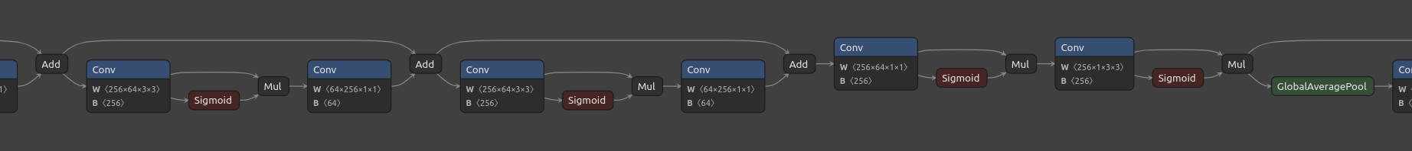
What is ONNX?
EfficientNet v1, visualized by Netron.
Input, output, dimension, weight, bias, operation,...

Slide 7
What is MLIR?
MLIR (Multi-Level Intermediate Representation)
Motivation:
  Various kind of hardware for domain specific accelerator. (DSA)
    Historically, there was scalar and static vector types, now MLIR has tensor type.
  Lowering the development cost of domain specific compiler.
  Devs usually build their own high-level IR before going to lower level.
Chris Lattner: “LLVM is a subset of MLIR”

Slide 8
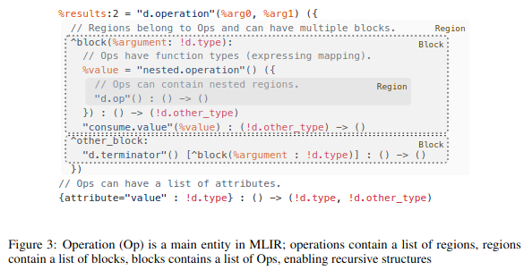
What is MLIR?
MLIR Operation (Op):
  Op is central semantic unit of mlir.
    Instruction, functions, modules,…
  Encourage users to define custom Ops
  Ops contains a list of regions.
  Regions contain list of blocks.
    In a sense of control flow graphs.
  Blocks can contain list of ops
    Allow recursive structures.
MLIR: A Compiler Infrastructure for the End of Moore’s Law

Slide 9
What is MLIR?
MLIR Dialects:
  A group of operations into a namespace.
MLIR Optimization Passes:
  Can be expressed to DRRs (Declarative rewriting Rules)
    Tablegen, C++ code
  Conversion:
    KrnlToAffine, KrnlToLLVM, ONNXToKrnl, ONNXToTOSA, ONNXToHLO
  Transformation:
    Decompose, shape infererence, ConvOpt
  Translation: Involve external representation.

Slide 10
What is MLIR?
MLIR ecosystem:
  Tensorflow: where MLIR originated
  mhlo: Part of TF, Dynamic scaled XLA (for accelerating linear algerbra)
  tfrt: TF runtime
  torch-mlir: connecting pytorch and mlir ecosystem
  circt: Hardware/Software Co-design
  iree: Deep Learning E2E compiler. Kinda like TVM

Slide 11
What does the project provide?
ONNX Dialect that can be integrated to other projects.
Compiler interfaces:
  Lowers ONNX graphs to MLIR, LLVM, C/C++, Python and Java.
  Graph-to-code transformation, stand-alone runtime environment.
Target:
  Generic CPUs. (Linux, Windows, macOS)
  IBM's Telum AI accelerator. (IBM z16)
    A server that can handle huge amount of queries.

Slide 12
What does the project provide?
What does it means?
  Easy to write optimization of CPU and custom accelerators
    MLIR
  Easy to deploy
    No libraries need, only stand-alone driver and runtime support.
  Integrate ONNX to MLIR eco-system

Slide 13
Motivation:
Many deep learning frameworks use their own optimized libraries for specific accelerators during inference.
Drawbacks:
  Number of supported accelerator of model is limited to libraries.
  Needed to install various libraries.
  The implementation varies for the same operation.
Proposed Solution: Developing a compiler that rewrites a trained model to native code for a target hardware.

Slide 14
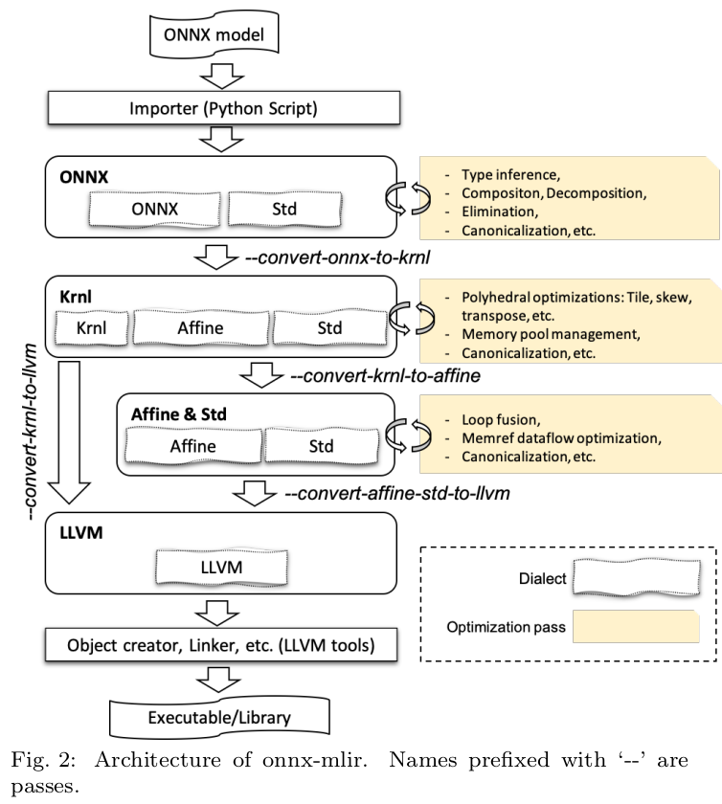
Architecture:

Slide 15
Architecture:
4 abstraction layer:
5 main Dialect:
  ONNX
  Krnl
  Std
  Affine
  LLVM

Slide 16
Architecture:
ONNX Dialect:
  Represent ONNX with mlir
  Tablegen, Generated by Python script
    In MLIR, usually you write .td file yourself.
    You can define the following in .td file:
      Dialect
      Operation
      Attribute
      Type

Slide 17
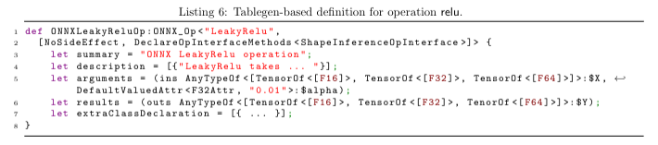
Architecture
ONNX Dialect:
  Tablegen allow to represent information to human-readable form:
    Arguments: input & attribute
    Results: output
  The ONNX and Tablegen definition are quite similar.

Slide 18
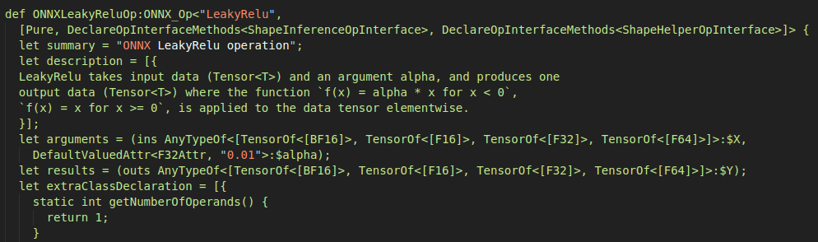
Architecture
ONNX Dialect (LeakyRelu):
  Real Example: (src/Dialect/ONNX/ONNXOPs.td.inc)
  Generated by: (utils/gen_onnx_mlir.py)

Slide 19
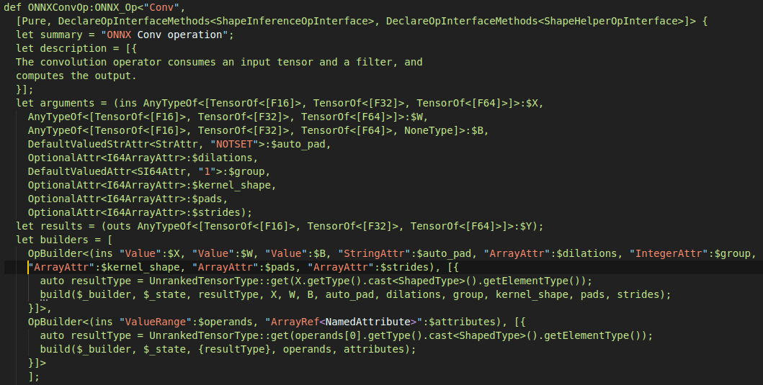
Architecture
ONNX Dialect (Conv):
  Real Example: (src/Dialect/ONNX/ONNXOPs.td.inc)

Slide 20
Architecture:
krnl Dialect:
  Bridge between onnx & affine dialect.
  Affine dialect is ready to use.
  Most computation are loop nest.
    Represent loops in polyhedral model.
      Providing optimization chances:
        Parallelism
        Cache locality.
        SIMD, vectorization

Slide 21


Architecture:
krnl Dialect:
  At left, Imagine 2 10*10 array added to each other with same array.
  Now we want to do it with tiling size 2, with a single loop.
  krnl.iterate (schedule_loop) with (original_loop).
  Separate program semantics and schedule.

Slide 22
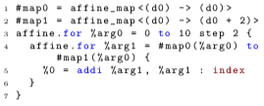
Architecture:
krnl Dialect:
  --convert-krnl-to-affine pass generates optimized affine.for based loops.
  The inner loop affine.for is iterating tile size 2.
  Skew and permutation are applied similarly, and are composable.

Slide 23

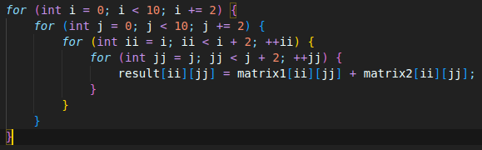
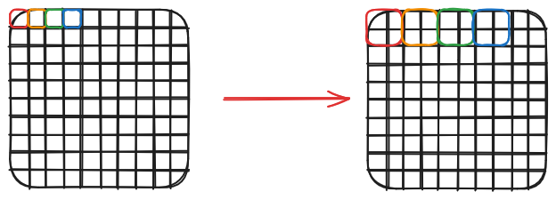
Architecture:
But, I still don’t know what just happened?
  Me, too.
  This is my speculation.

Slide 24
Architecture:
Affine Dialect:
  Mainly for:
    Actual loop transformation.
    Dependence analysis.
    Ready-to-use.

Slide 25


Architecture:
Std Dialect:
  load, store, addi, addf, absf, call...
  Obsolete
    ops are moved to other dialects.

Slide 26
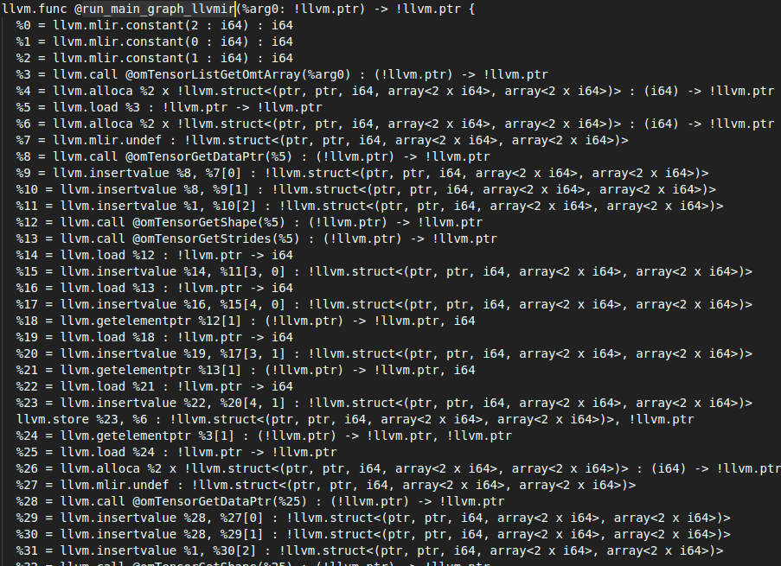
Architecture:
llvm Dialect:
  Wrapping the LLVM IR into MLIR.
  Generate bitcode.

Slide 27
Optimization Passes:
Optimization:
  Operation decomposition
  Shape inference
  Graph rewriting
  Constant propagation

Slide 28

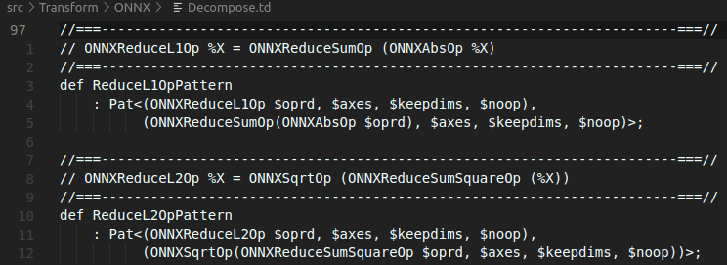
Optimization Passes:
Operation decomposition:
  Breaking down complex operations into a sequence of simpler ones
    e.g. ReduceL1 operation

Slide 29
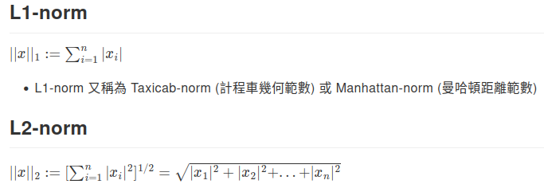
Optimization Passes:
Operation decomposition:
  Breaking down complex operations into a sequence of simpler ones
    e.g. ReduceL1 operation

Slide 30
Optimization Passes:
Shape inference:
  Traverses all operations
  Infers the shapes of tensors with unrank shapes (e.g. tensor<*xf32>)
  Propagates the ranked shapes to consuming operations
    e.g.: A output to B, A is tensor<3*4>, so B is tensor<3*4> too.
  Terminates until all tensors have ranked shapes.

Slide 31

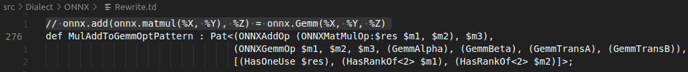
Optimization Passes:
Graph rewriting:
  Rewriting rules are conveniently represented using DRRs
  Examples: Fuse add and mul ops together

Slide 32


Optimization Passes:
Graph rewriting:
  Rewriting rules are conveniently represented using DRRs
  Examples: remove identity op

Slide 33
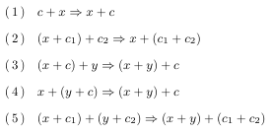
Optimization Passes:
Constant propagation:
  Compute the constant together at compile-time.
  If mixed constant and variable, normalize it:
    e.g. (onnx.Add)
      Utillize associativity, group variable and constant respectively.

Slide 34
Experiment at the time:
Support 51/139 ONNX operations.
  Now: 75/209 not supported.
Can compile MNIST and Resnet.
  I can compile efficientnet_v2 (image classification)
Can run on x86 machine, IBM power systems, system Z.
Encountered big-endian and little-endian problem.
  ONNX is little-endian, system Z is big-endian
  MLIR does not support big-endian well.
  Patch was able to resolve the problem.

Slide 35

Experiment at the time:
Benchmark: (2.3-GHz POWER9 processors)
MNIST: Graph Rewriting is applied.
ResNet50: No optimization applied.
Author believe that if polyhedral optimizations, SIMD optimization, and loop fusion is applied, the performance would be improved.

Slide 36
My Experiment:
Model: efficientnet_v2
  87.9MB
  Light weight Image Classification model
Dataset: cifar100
Compile time: 1m27.788s (single threaded)
Inference time: 0m1.738s
What can we get from this information?
  I don’t know.

Slide 37
My Experiment:
How did I experiment?
  Use ImageNet-1k pretrained weight to do transfer learning.
  Convert the pytorch model to .onnx
  Compile model with onnx-mlir to generate .so file
  Rename the PyRuntime.xxx.so to PyRuntime.so
    Link and export don’t work.
  Implement the driver.
The actually used command:

Slide 38

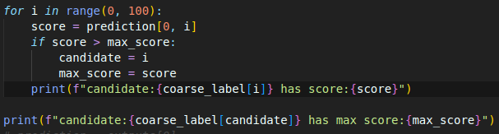
My Experiment:
How did I implement driver?
  Python Runtime.
  docs/mnist_example would help you to write c/python/java driver

Slide 39
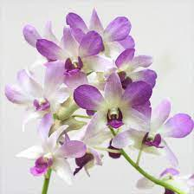

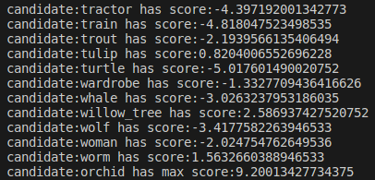
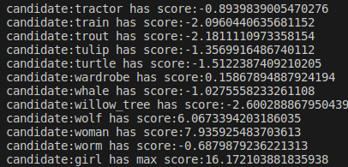
My Experiment:
Result:
  Input:
Output:

Slide 40
Paper Conclusion:
The project transform onnx graph to native code with MLIR.
Proposed Dialects: onnx, krnl
Discussed Optimizations Implemented:
  Operation decomposition, graph rewriting, constant propagation, etc
Easily integrates new optimizations thanks to MLIR
Future Optimizations:
  Polyhedral optimization, Loop fusion, SIMD optimization.
  Code generation for accelerators.

Slide 41
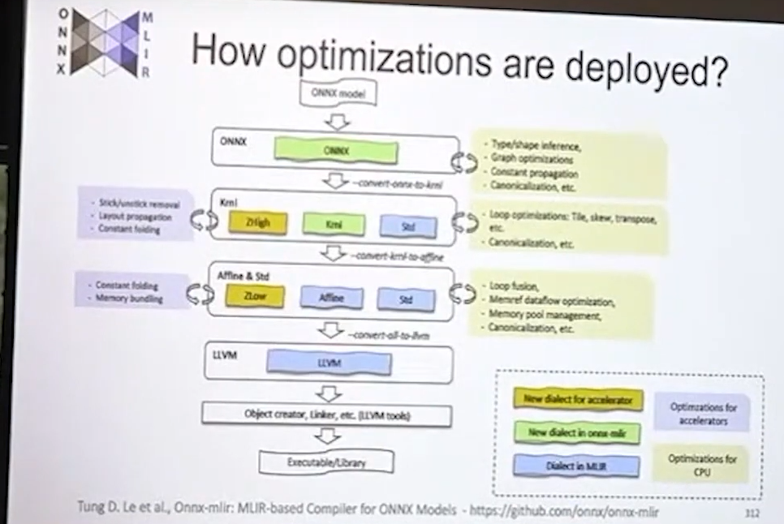
Research Opportunity:
How to add accelerator?
Onnx-mlir: an MLIR-based Compiler for ONNX Models - The Latest Status

Slide 42
Personal thought:
Prove-of-concept works, project have long way to go.
Are there optimization chance lost when:
  Conversion between dialect.
  Dialect coverage.
  Weird hardware like 1 operation complete convolution?
MLIR provide template for building compiler faster, but the core is how you redirect the problem.
Have to read more about the ecosystem if I research for MLIR.

Slide 43
Reference:
I forgot.
I’ve seemed too much stuff, forget to note them respectively.
Sorry.
Definitely not lazy.
Trust me.

Slide 44


Thank you

