Slide 1
01
FINANO
[FINANO Concept Film]
15-second brand concept opening.
[Embed intro video: pitch-deck/assets/finano_concept.mp4]

Slide 2
02
FINANO
[Behavioral Finance x Metaphysics x Multi-Agent AI]
An LLM-powered wealth co-pilot combining FBTI financial personality, Bazi-driven emotional engagement, LangGraph multi-agent analysis, and bidirectional trade replay.

Slide 3
03
Table of Contents
[Table of Contents]
Elevator Pitch & Pain Points
One-line pitch, user pain points, value proposition, and product impact.
01
Product & Tech Barrier
FBTI, MAFB, RAG Replay, AI Fund Selector, and product demos.
02
Industrial & Market Analysis
AI wealth management trends, Gen-Z market gaps, and competitive advantages.
03
Marketing & Operation Plan
4Ps, personality-card virality, channel strategy, and operating loop.
04
Management Team & Financial Plan
Pricing tiers, team equity, HKD 500K funding ask, revenue forecast, and break-even.
05
Lean Canvas & Exit Strategy
Lean Canvas, early adopters, business path, exit strategy, and Q&A.
06

Slide 4
04
Pitch Narrative Roadmap
[Roadmap]
Elevator Pitch
Pain points, value proposition, and the blend of emotional value with professional analysis.
01
Product & Barrier
The technical moat across FBTI, MAFB, Replay, and AI Fund Selector.
02
Market Analysis
AI wealth management growth, Gen-Z mindshare, and competitive differentiation.
03
Go-to-Market
4Ps, pricing tiers, viral FBTI cards, and the operating loop.
04
Team & Finance
Equity split, HKD 500K ask, use of funds, revenue forecast, and break-even.
05
Lean Canvas & Exit
Business model, key metrics, acquisition path, and SaaS scaling route.
06

Slide 5
05
Elevator Pitch & Pain Points
[Part 1]
Finano = MBTI + Metaphysics + Behavioral Finance x LLM Multi-Agent System.

Slide 6
06
Turning Wealth Management from a Task into an Interaction
[Pain Point / Value / Impact]
Traditional Tools Feel Cold and Generic
Investors struggle to translate historical lessons into present decisions, and rarely stay engaged with financial tools that lack a sense of companionship.
Pain Points
A Financial Personality System Powered by FBTI + Bazi
Behavioral finance captures real user preferences, metaphysical semantics provide emotional value, and AI agents execute professional analysis.
Value Proposition
A High-Retention Wealth Entry Point
Shareable, explainable, and replayable interactions improve conversion, retention, and repeat usage among Gen-Z investors.
Impact

Slide 7
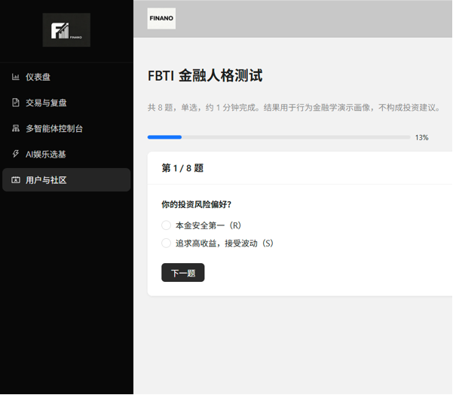
07
8 Behavioral Finance Questions, 16 Investor Personality Types
[FBTI: Finance-Based Type Indicator]
Assessment Flow
• 8 behavioral finance scenario questions, each with A/B choices
• 4 dimensions x 2 questions generate a 4-letter type code
• Maps to 16 financial personality types, such as RLDC Holder
• Adds birthday-based Five Elements derivation for a more engaging persona
• The FBTI code drives personalization across all AI modules

Slide 8
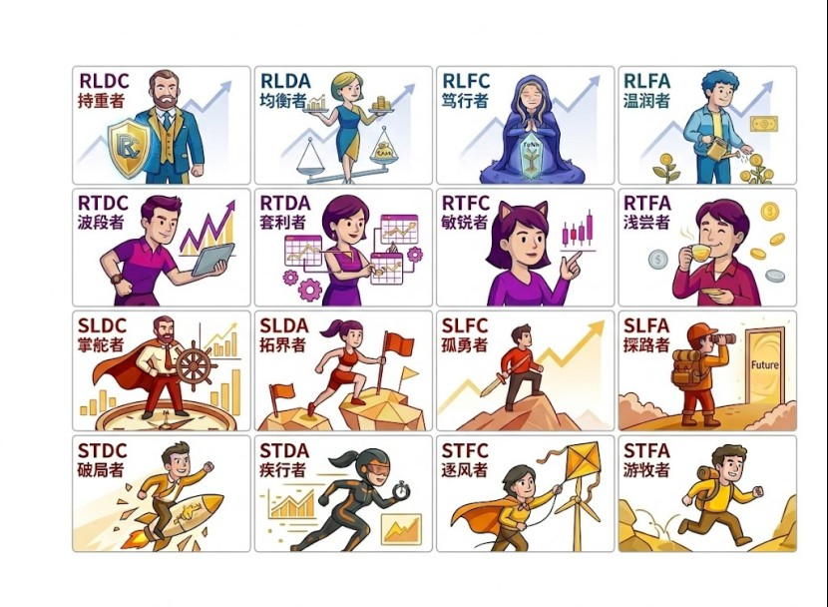
08
Visual Archive of 16 Financial Personality Types
[FBTI Personality Cards]

Slide 9
09
Four-Dimensional Personality Matrix
[Financial Personality Archive]
Conservative Long RL
RLDC Holder · RLDA Balancer · RLFC Devotee · RLFA Gentle
Conservative Short RT
RTDC Swinger · RTDA Arbitrageur · RTFC Sharp · RTFA Dabbler
Aggressive Long SL
SLDC Captain · SLDA Pioneer · SLFC Lone Wolf · SLFA Pathfinder
Aggressive Short ST
STDC Breaker · STDA Sprinter · STFC Wind Chaser · STFA Nomad

Slide 10
10
Product & Tech Barrier
[Part 2]
LangGraph 8-node state machine, 5-way parallel sub-agents, compliance interception, and strict JSON constraints.

Slide 11
11
LangGraph 8-Node Main Pipeline
[MAFB: Multi-Agent Financial Console]

Slide 12
12
The Full Output Chain from Data Preheat to Compliance Interception
[MAFB Key Designs]
Unified Preheat
Five agents share preheated data, avoiding separate quote, fundamental, and risk pulls while reducing database conflicts.
Strong JSON Constraint
Each agent outputs only agent_name / score / reason, with score strictly constrained from -2 to +2.
Rule Fallback
data_not_ready is returned only when all core features are missing; model failures fall back to the rule engine.
Final Report
weighted_total, scores, reasons, single_fund_analysis, technical_summary, risk_summary, compliance, disclaimer.

Slide 13
13
Parallel Processing, Distinct Responsibilities
[Five Sub-Agents]
Fundamental
snapshot + fundamentals + news assist; metric_hints: concentration / drift / manager / scale / sharpe / drawdown.
weight 0.24
Technical
nav_rows_for_technical, technical_retrieval, EMA / Bias / RSI / MACD; degrades when NAV data is insufficient.
weight 0.24
Risk
risk_summary, rating, drawdown, volatility, VaR95, Sortino, liquidity, correlation, and risk_warning.
weight 0.22
Attribution
Prioritizes a rule engine, performance_style_attribution, excess return proxy, and return source decomposition.
weight 0.18
Profiling
The only agent allowed to reference user_profile JSON; inputs fund_data + user_profile + risk_level to judge profile fit / mismatch.
weight 0.12

Slide 14
14
Strict Output Constraints with Professional Guardrails First
[Compliance & Prompt Engineering]
_build_score_prompt
Model Calling Strategy
• Primary: DashScope qwen-plus
• Canary: qwen3 whitelist trial + fallback
• Concurrency gate + timeout control
• Failure fallback to rule engine
• Trace: llm_try / llm_raw / agent_done / queue
Prompt Guardrail
reason must include: 1) core conclusion, 2) at least two hard factual values, 3) logic chain, and 4) score tag.
Profile Boundary
Non-profiling agents are forbidden to mention user / profile / fit, preventing personality preference from contaminating fundamental and risk judgments.
Compliance Agent
Review 5-agent output -> Flag violations -> Trigger blocked branch -> Generate disclaimer.

Slide 15
15
Use Metaphysics for Stickiness, RAG for Replay Quality
[Bidirectional Replay & Bazi Selection]
Trade -> Notes
After trade-curve features are written, cosine similarity is matched against same-user, same-fund history; hits route to history_compare.
Note -> Trades
Note vectors retrieve ReflectionEmbedding, FAISS is preferred, NumPy dot is the fallback, then trade_id / symbol / profit are reverse-looked up.
Bazi Selection
Birthday semantic parsing becomes a personalized prompt seed, while the core selection still relies on factor strategy, candidate-pool scoring, and LLM Top5 explanation.

Slide 16
16
Cross-Time Replay: From Trades to Notes, from Notes to Trades
[Trade & Replay]
New trades and notes automatically maintain vector features, and write failures do not block the main flow.

Slide 17
17
Static Diagnosis + Retrieval-Based Replay
[Two-Layer AI Analysis]
Single-Trade AI Diagnosis
POST /api/v1/ai/analyze/{trade_id}; impl: analyze_trade() in qwen_finance.py; key -> model call, no-key -> _local_analysis() rule engine.
Layer A
Replay AI with Retrieval
Impl: _llm_replay_analysis(); inputs anonymized object, similar samples, and routing result; parses direct JSON or extracts a JSON block, with fixed-advice fallback on failure.
Layer B

Slide 18
18
Natural Language -> Financial Strategy -> Function Call -> LLM Explanation
[AI Fund Selector]
Semantic Parse
Birthday, mood, and investment intent are parsed into intent / mapped_sectors / strategy_style.
Rule Candidate Pool
Factor strategy bundles drive the Top20 candidate pool, with fallback at every stage.
SSE Streaming
/fbti-select/stream pushes stage-by-stage progress, increasing trust in the AI workflow.

Slide 19
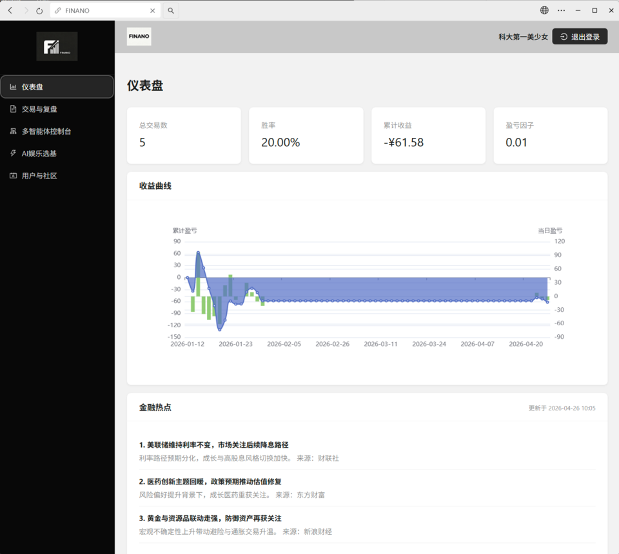
19
Core Dashboard: Returns, Curves, and Financial Hotspots
[System Demo / Dashboard]

Slide 20
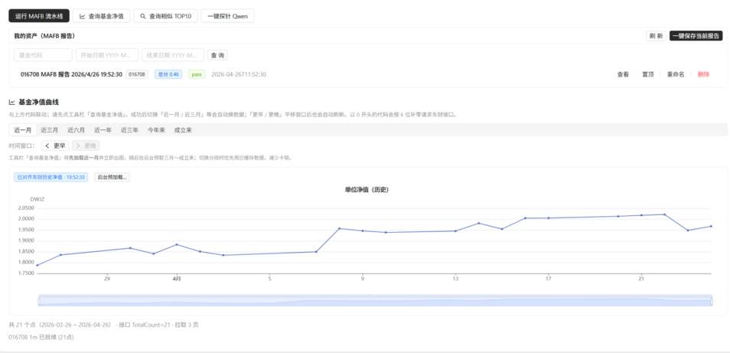
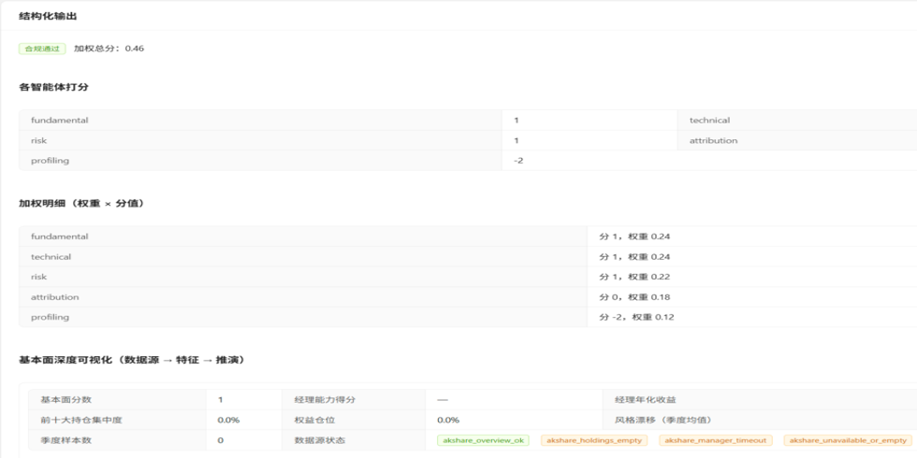
20
MAFB Results: Fund NAV Curve and Structured Output
[System Demo / MAFB Results]

Slide 21
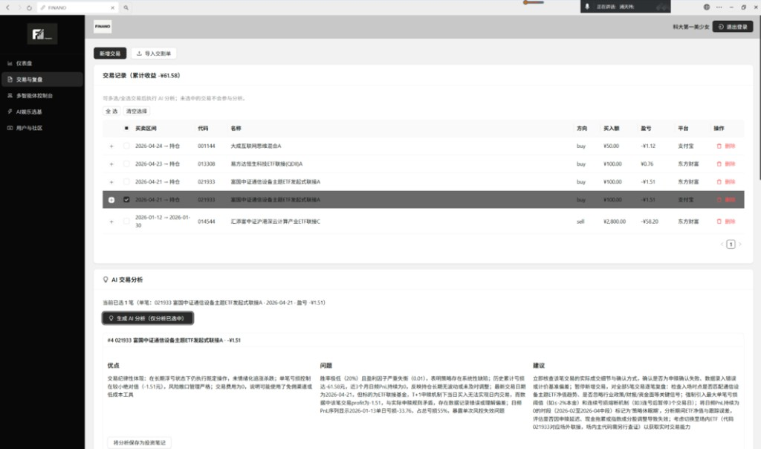
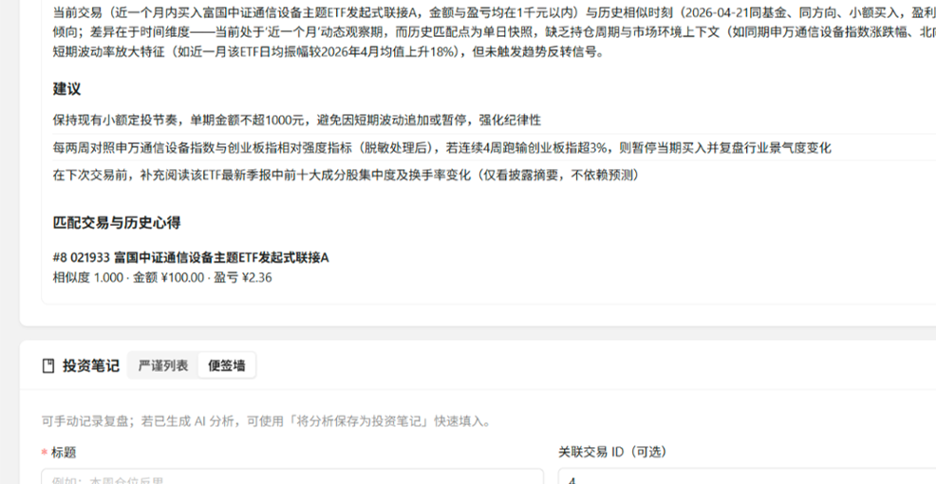
21
RAG Retrieval: Trade Replay and Historical Reflection Matching
[System Demo / RAG Retrieval]

Slide 22
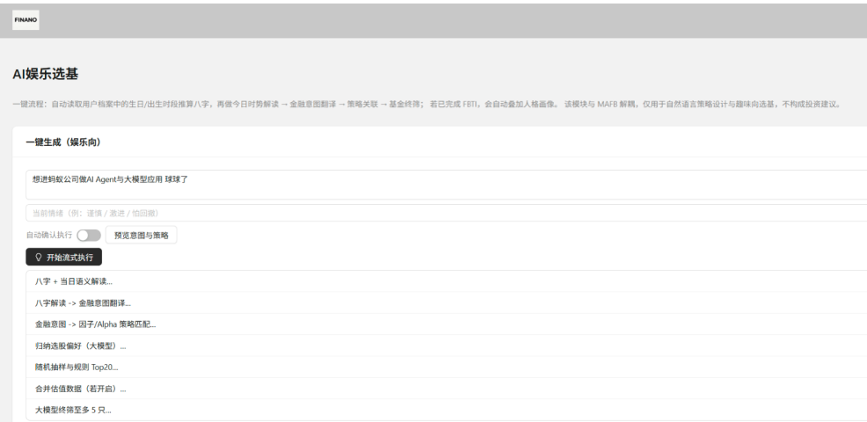
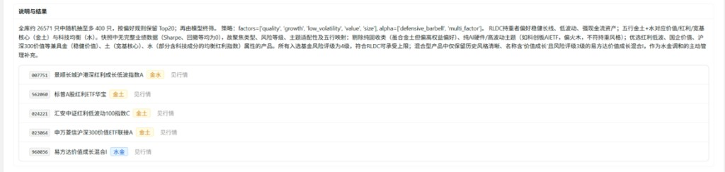
22
AI Fund Select: From Entertainment Input to Explainable Top5
[System Demo / AI Fund Select]

Slide 23
23
Technical Highlights and Course Takeaways
[Project Summary]
GitHub: github.com/Sylvia2001vck/FINANO · Open source for educational demo only, not investment advice
Technical Highlights
• FBTI personalization: 8Q -> 4D -> 16T
• Bidirectional retrieval: Trade -> Notes + Note -> Trades
• MAFB 5-way parallelism + unified preheat + compliance
• Unified Prompt Template + JSON constraint + metric_hints
• AI Fund Selector 7-stage semantic orchestration + SSE
• Full-chain fallback: no crash when any stage fails
Course Takeaways
• LangGraph State Machine + Send parallel
• Prompt JSON structuring + multi-model routing
• Multi-Agent Collaboration: differentiated data sources + unified scoring
• RAG: Local Embedding + FAISS retrieval
• React 18 + FastAPI + Docker end-to-end

Slide 24
24
Industrial & Market Analysis
[Part 3]
AI + wealth management is growing rapidly, but Gen-Z needs a more personalized and entertaining entry point.

Slide 25
25
AI Wealth Management Is Booming, but Tools for Young Users Are Missing
[Market Environment & Size]
% CAGR
Core Market Gaps
MBTI / Metaphysics / AI Native

Slide 26
26
Finano vs. Traditional Robo-Advisors vs. General LLMs
[Competitive Advantage]
Traditional Robo-Advisors
Professional in asset allocation, but shallow in personality understanding, weak in interaction, and reliant on returns rather than relationships for retention.
Finano
FBTI virality, Bazi emotional value, a professional MAFB foundation, and a bidirectional replay moat.
General LLMs
Strong expression ability, but lacking financial data sources, compliance interception, investment history, and reusable analysis pipelines.

Slide 27
27
Marketing & Operation Plan
[Part 4]
Use FBTI cards as an acquisition flywheel and replay loops for long-term retention.

Slide 28
28
From Personality-Test Virality to Subscription Conversion
[Marketing Mix: 4Ps]
Personalized AI Wealth Assistant
FBTI + MAFB + Replay + Fund Selector.
Product
Freemium + B2B API
Standard free tier, Diamond at ¥39/month or ¥369/year, plus customized institutional API licensing.
Price
Social Media + GitHub
Share personality cards and attract open-source communities to validate the architecture.
Place
Viral Promotion
Identity labels such as 'I am an RLDC Holder' lower the sharing barrier.
Promotion

Slide 29
29
Product Operating Loop
[Business Process]
Assessment -> Analysis -> Execution -> Replay -> Optimization. Every interaction strengthens the user profile and improves replay quality.

Slide 30
30
Management Team & Financial Plan
[Part 5]
AI engineering, behavioral finance, full-stack development, and an ultra-low-cost structure create early advantages.

Slide 31
31
Freemium Acquisition, Premium Monetization, B2B API Licensing
[Pricing Model]
Free
¥0
• Basic FBTI assessment
• 1 AI fund selection per day
• Personality card sharing
Standard
Subscription
¥39/mo · ¥369/yr
• MAFB 8-node deep replay
• Unlimited real-time calculations
• Personal wealth alignment insights
Diamond · Premium
/mo
/yr
B2B API
Custom annual license
• White-label FBTI + MAFB modules
• Compliance-ready agent pipeline
• Wealth community / brokerage integration
Institutional
annual license

Slide 32
32
Executive Leadership · Six-Person C-Suite
[Management Team]
Six-member C-suite: Sylvia (Founder/CEO/CTO), Wang Xinyi (CDO), Zack (CSO), Jiang Haoyu (CGO), Wu Xinze (CMO), Zhao Junyi (COO).
Sylvia
Founder, CEO & CTO
Visionary founder and core system architect. Orchestrates FINANO's long-term business trajectory while pioneering the proprietary LangGraph multi-agent framework. Fuses high-performance distributed engineering with end-to-end full-stack deployment and deep product integration.
Wang Xinyi
Chief Data Officer · CDO
Data engineering powerhouse. Architect of FINANO's automated financial data synchronization engines and real-time analytical pipelines. Controls data integrity, risk modeling storage, and database optimizations to fuel the core multi-agent ecosystem.
Zack
Chief Strategy Officer · CSO
Chief strategic architect steering Finano's institutional capital roadmap and dual-track exit strategies (M&A/IPO). Spearheads financial structuring, market positioning, and cross-border resource allocation to bridge cutting-edge AI with Tier-1 financial institutions.
Jiang Haoyu
Chief Growth Officer · CGO
Growth & market monetization strategist. Drives Finano's market penetration through deep-tier industrial intelligence and user acquisition scaling. Translates complex fintech dynamics into actionable growth vectors to capture high-yield market shares and expand brand equity.
Wu Xinze
Chief Marketing Officer · CMO
Mastermind of market mechanics and business process architecture. Structures FINANO's strategic 4P/4C marketing matrix and end-to-end service delivery workflows. Engineers adaptive, contingency-driven plans to safeguard market positioning against macro shifts.
Zhao Junyi
Chief Operating Officer · COO
Operational strategist and master BP architect. Orchestrates FINANO's comprehensive business blue-printing, commercial modeling, and cross-functional operational scaling. Bridges corporate vision with disciplined execution vectors to maximize organizational efficiency.
[Team photos included in HTML — see assets/team-*.png]

Slide 33
33
Sylvia 100% Control · 40% Team Incentive Pool
[Equity Structure]
Sylvia holds 100% control as founder. The six-person C-suite covers technology, data, strategy, growth, marketing, and operations; the 40% incentive pool remains reserved for future core hires.
• Sylvia100% Founder · CEO & CTO · Full Control
• Team Incentive Pool40% Reserved for core developers & key hires (no co-founder equity)
100%
Founder · CEO & CTO · Full Control
Reserved for core developers & key hires (no co-founder equity)
Complementary Skills
Sylvia holds 100% control as founder. The six-person C-suite covers technology, data, strategy, growth, marketing, and operations; the 40% incentive pool remains reserved for future core hires.
LLM / Agents
Data / Pipeline
Full-Stack
Strategy / Capital
Growth / Monetization
Marketing / 4P
Operations / BP
• LLM / Agents: Sylvia
• Data / Pipeline: Wang Xinyi
• Full-Stack: Sylvia
• Strategy / Capital: Zack
• Growth / Monetization: Jiang Haoyu
• Marketing / 4P: Wu Xinze
• Operations / BP: Zhao Junyi

Slide 34
34
HKD 500,000 for 10% · 12-Month Runway
[Funding Ask & Use of Funds]
Implied pre-money valuation: HKD 5.0M. Funds deploy over 12 months across compliance, acquisition, and compute reserves.
HKD raise · 10% equity offered
Runway target
Equity offered
HKD implied valuation
Use of Funds
R&D & Compute Infrastructure
Marketing & Viral Acquisition
Legal Compliance & Financial API
General Operations

Slide 35
35
Low Burn Rate, Low Break-Even Point
[Financial Plan & Initial Capital]
Cursor Pro / Pro+
Cloud Server
LLM API
RMB / month current MVP burn
Break-even
Post-funding scale: at 10,000 users with 3% Diamond conversion, monthly subscription revenue reaches ~¥11,700; two B2B API licenses at ¥2,000/month each push total recurring revenue above ¥15,700/month, covering scaled compute and ops.
0

Slide 36
36
3-Year Revenue Projection with Key Assumptions
[Revenue Forecast]
Assumptions
• Year 1: 2,000 MAU · 4% Diamond · 1 B2B API (¥8K/mo)
• Year 2: 8,000 MAU · 5% Diamond · 2 B2B APIs
• Year 3: 20,000 MAU · 6% Diamond · 4 B2B APIs + annual plans
• ARPU: ¥39/mo subscription + custom B2B licensing
• Payback: < 18 months on HKD 500K raise (base case)
Year 1
Year 2
Year 3

Slide 37
37
Lean Canvas & Exit Strategy
[Part 6]
FINANO is 16Personalities meets Wealthfront, Spotify Discover Weekly for mutual funds.

Slide 38
38
One Canvas to Explain the Business Model
[Lean Canvas Summary]
Problem
Generic advice lacks behavioral personalization; traders struggle to connect historical market contexts with current decisions; financial tools feel clinical and boring.
Solution
FBTI & Bazi Profiling, Bazi-Infused AI Fund Selection, Bidirectional Replay.
UVP
Behavioral finance + traditional metaphysics + multi-agent AI deliver hyper-personalized, interactive fund selection and strategy replay.
Unfair Advantage
16-type FBTI, Bazi routing, strict JSON prompts, and a LangGraph 8-node parallel compliance pipeline.
Customer Segments
Retail investors, investment-journal users, and Gen-Z users attracted by MBTI + metaphysics.
Key Metrics
Assessment completion, share rate, pipeline success, replay retention, and subscription conversion.

Slide 39
39
Alternatives, Channels, and Early Adopters
[Lean Canvas Details]
Existing Alternatives
Traditional robo-advisors, manual trading journals/spreadsheets, and entertainment fortune-telling apps all lack the combination of real financial data + LLM agents + personalized replay.
High-Level Concept
16Personalities meets Wealthfront; Spotify Discover Weekly for mutual funds; GitHub Copilot for retail trading.
Channels
GitHub & open-source communities, social-media FBTI card virality, finance/quant student communities, and API licensing to wealth-content communities.
Early Adopters
AI-finance metaphysics enthusiasts, quant finance students, open-source developers, and Gen-Z investors who love MBTI and investment journaling.
Customer Segments
Retail investors seeking data-driven personalization, tech-savvy traders maintaining investment journals, and young users looking for an entertaining entry point.
Core Message
An AI financial lifecycle co-pilot combining FBTI, Bazi, LangGraph multi-agent orchestration, and bidirectional RAG replay.

Slide 40
40
Investment Creates Value · Two Exit Paths
[Exit Strategy]
How HKD 500K Builds the Moat
Compliance-ready MAFB pipeline, FBTI viral acquisition, and compute reserves convert capital into defensible product velocity and broker-ready modules within 12 months.
Value Creation
Acquisition by Leading Brokerages / Financial Groups
Platforms such as Futu and Tiger need Finano's FBTI virality and metaphysical wealth modules to activate Gen-Z retail traffic.
Path A
Independent SaaS Scaling and IPO
Long-term commercialization through a high-retention financial traffic entry point, API licensing, and subscription revenue.
Path B

Slide 41
41
Is Metaphysical Fund Selection Unscientific?
[Q&A]
We are not replacing science with metaphysics. We use metaphysics to provide emotional value, while multi-agent systems execute scientific quantification.
In our system, birthday/Bazi is essentially a personalized prompt seed. The frontend presents fortune-style companionship that matches user expectations, while the underlying Fundamental Agent and Risk Agent still use serious quantitative factors such as fund financial reports, max drawdown, and Sharpe ratio.
Metaphysics solves acquisition and stickiness; AI agents safeguard professionalism and risk control. That is Finano's business moat.

Slide 42
42
Can We Afford API Compute Costs at Tens of Thousands of Users?
[Q&A]
The high call volume during development mainly came from Cursor advanced agents performing architecture refactoring and frontend-backend integration. This is a one-time R&D investment.
After launch, each request will be cache-optimized and routed to cost-efficient model APIs. The token cost of a single 5-way parallel multi-agent request can be compressed to roughly ¥0.05-¥0.10.
With elastic extra-credit packages, heavy users pay for additional usage themselves, creating a SaaS model where fixed costs are locked and variable costs are shared by paying users.

