Slide 1
Complaint Management System
1.SYLVIA ACHIENG EB1/56112/21
2.HALAN KIPROTICH EB1/56085/21
3.GLADYS BITITA EB1/56130/21
4.DUNCAN OYUGI EB1/56143/21
5.CAROLYNE MUSENYA EB1/56052/21
6.ABRAHAM LINCOLN EB1/56142/21
7.FAITH MAINA EB1/56028/21
8.VICTOR MREITHI EB1/55965/21
9.COLLINS OPUKAH EB1/56123/21

Slide 2
Statement of the problem
The absence of a formal complainant system at Chuka university presents several challenges which has led to inefficiencies in handling and resolving user complaints. This not only impacts the satisfaction levels of both employees and students but also hinders the institution ability to address issues promptly. By digitizing this process, we overcome the limitations of traditional paper-based systems, providing a more dynamic, responsive, and convenient means of registering complaints. A cornerstone of our project is the incorporation of real-time updates, ensuring complainants are kept informed of the status and progress of their submissions. This feature not only enhances transparency but also instills confidence in the responsiveness of the complaint resolution process.
Additionally, the system will implement an assignment mechanism, directing each complaint to designated administrators responsible for its timely resolution, ensuring a targeted and efficient approach. Moreover, our project emphasizes accountability by establishing a traceable process for complaint resolution. The platform will maintain a detailed record of actions taken by administrators in response to each complaint, enabling thorough performance evaluation and continuous improvement. This historical data not only contributes to accountability but also aids in shaping policies and procedures that address the evolving needs and concerns of the university community. By introducing efficiency, transparency, and accountability into the resolution process, our project aligns with the broader vision of fostering a university community where all stakeholders feel heard, supported, and valued in their pursuit of academic and professional excellence.

Slide 3
Objectives
The objectives of implementing this complaint system are;
Streamline the complaint handling process, reducing resolution times and workload for staff
Provide a clear and consistent complaint process with defined timelines and communication channels
Facilitate transparent communication between complaints, departments and administrators throughout the complaint resolution process
Improve overall experience for students and staff by addressing their concern promptly and effectively.

Slide 4
Significance of the study
The findings of this study will help improve the design of the complaint management system of Chuka University institution in a way that all or most of the complaints of the clients are handled systematically and in due time increasing the productivity of the institution since the services in the institution will run smoothly.
The findings provide valuable insights for guiding and informing the school management about the areas to address most so as to create a stable learning environment for the students and also offer appropriate services to the clients in need. This complaint management system will not only solve the complaints but also create a good relationship between both clients and Chuka management staff.

Slide 5
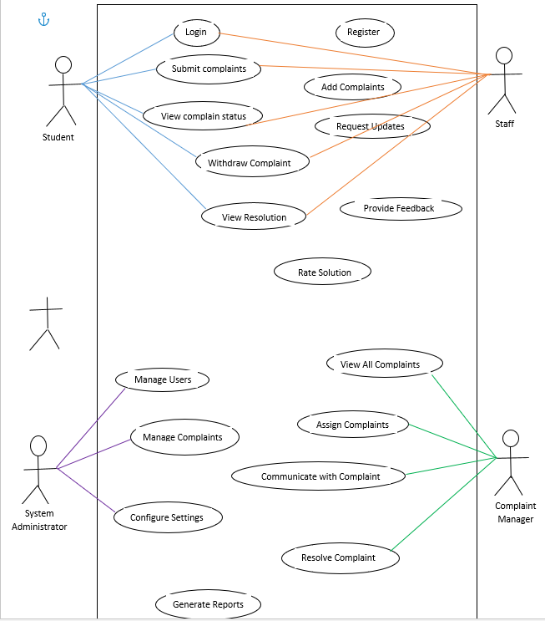

Slide 6
Use case descriptions
The complainant must have access to the complaint management system.
The complainant must be logged into their account to submit a complaint.
The complaint is successfully submitted and stored in the complaint management system.
The complainant receives an acknowledgment or confirmation of their submitted complaint.
The complainant accesses the complaint submission page within the complaint management system.
The complainant fills out the complaint form, providing details such as the nature of the complaint, relevant order or account information, and any additional context or documentation.
The complaint reviews the information provided and confirms their intent to submit the complaint.
The complaint management system validates the submitted information for completeness and correctness.
If all required information is provided and validation passes, the complaint is submitted to the system.
The system generates an acknowledge message, confirming the successful submission of the complaint, and provides the complainant with a reference number or tracking ID for future reference.
The complaint is logged into the system databases, along with relevant metadata such as submission timestamp, complainant details, and initial status.

Slide 7
Actors and their interaction with the system
Student –logs in, registers, submits complaints ,view complains.
System administrator- manages, configures , generates reports.
Staff-make complains, logs in ,view complaints, withdraws complains, registers, submit complains.
Use cases
Submit complaint-complainant submits a new complaint providing details such as category, complaint type, date of submission, department, status of complain, description, related document.
Resolve complaint-the system admin resolves the complaint by providing a solution or response to the complainant.
Generate report-admin generates reports and complaint statistics ,resolution times.

Slide 8
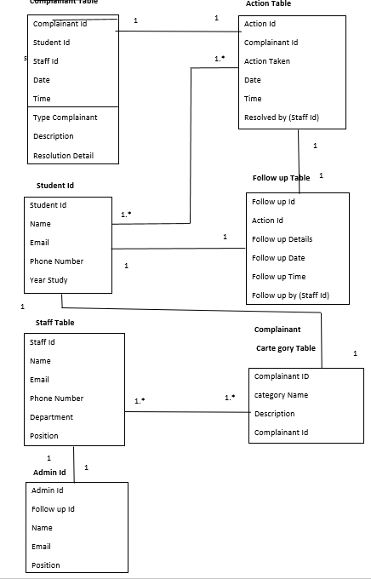

Slide 9
Complaint: Represents a single complaint filed by a user. It includes attributes such as id, title, description, status, assigned to, and created at.
User: Represents a user of the system. It includes attributes such as id, phone number, username and email. The role can be defined as an Enum or string representing the user's role in the system (e.g., admin, staff, student, non-staff).
Department: Represents a department within the organization. : Responsible for handling operations related to departments, such as retrieving all departments and getting department details by ID.
Complaint Status: Represents the status of a complaint (e.g., open, in-progress, resolved). It includes attributes such as id, name, and description.
Complaint Service: Responsible for handling operations related to complaints, such as registering a new complaint, updating complaint status, assigning complaints to users, and retrieving complaints.
Complaint category: It includes the complaint ID, category name and description.
Follow up: represents the sequential tracking of actions taken in response to submitted complaints. It includes attributes such as Follow-up ID, Complaint ID, Date, Action Taken, Responsible Staff, Status Update, Comments and follow up details

Slide 10
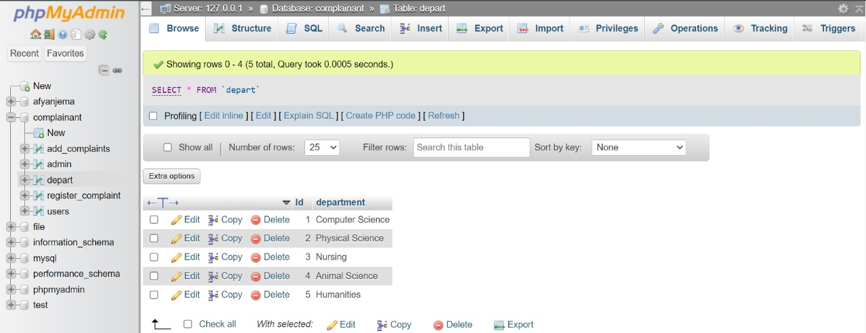

Slide 11
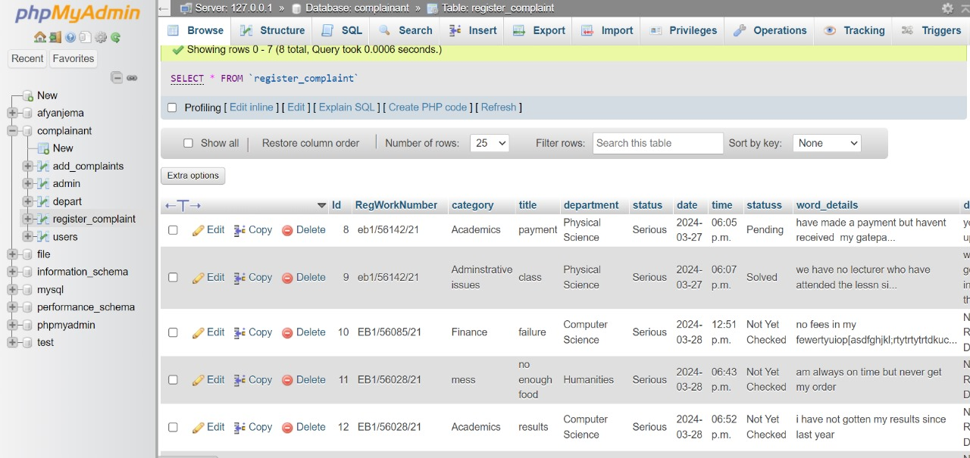

Slide 12
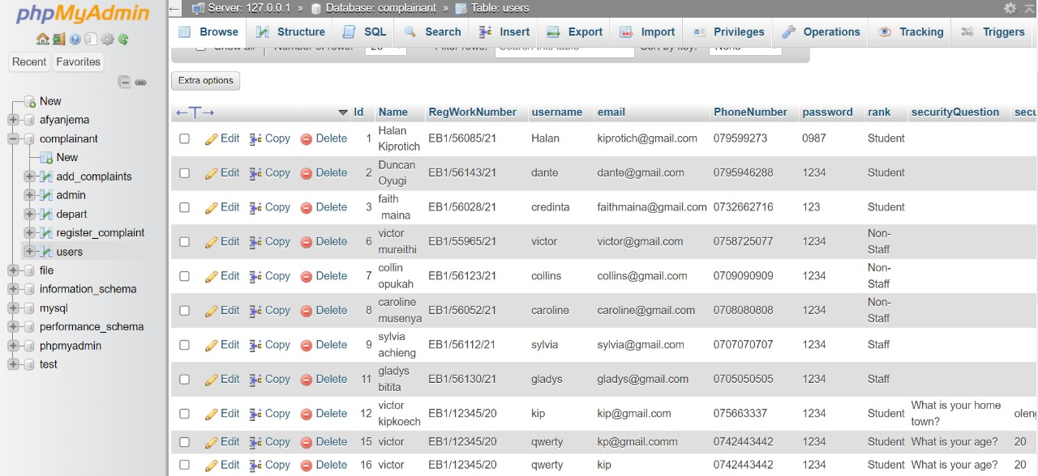

Slide 13
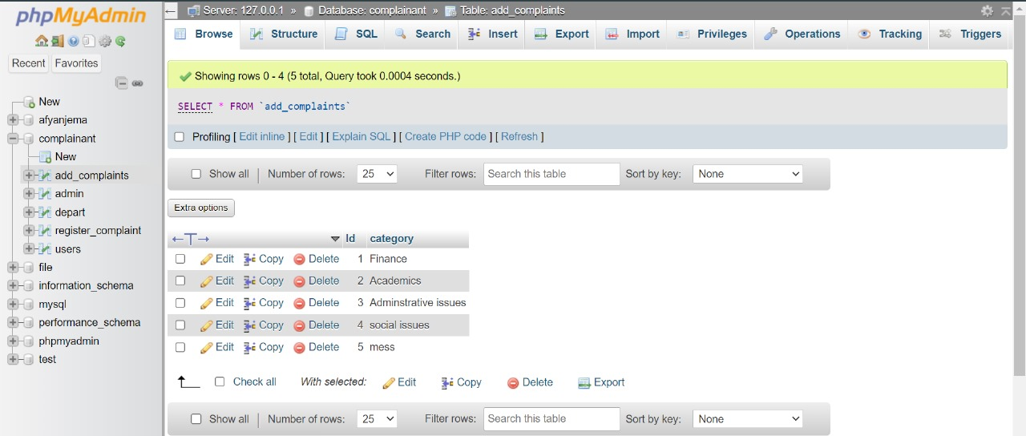

Slide 14
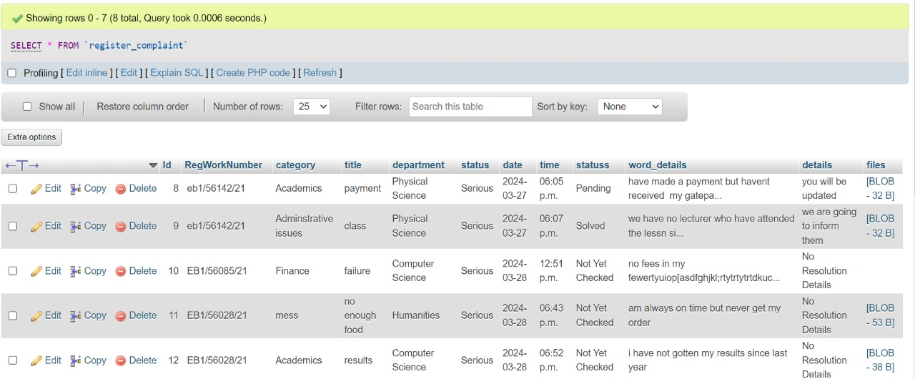

Slide 15
