Slide 1
Euclidifying Gaia
Using Machine Learning to Classify
Non-Point-Like Objects in Gaia DR3
Sylvia Zhao
Part III Astrophysics | Lent Term 2026
Supervisors: Diana Harrison, Simon Hodgkin, Vasily Belokurov
Institute of Astronomy, University of Cambridge
Notes:
Welcome. I'm Sylvia Zhao, and this is my Part III project: Euclidifying Gaia — using machine learning to classify non-point-like objects in the Gaia DR3 catalogue, with the help of higher-resolution imaging from ESA's Euclid mission.

Slide 2
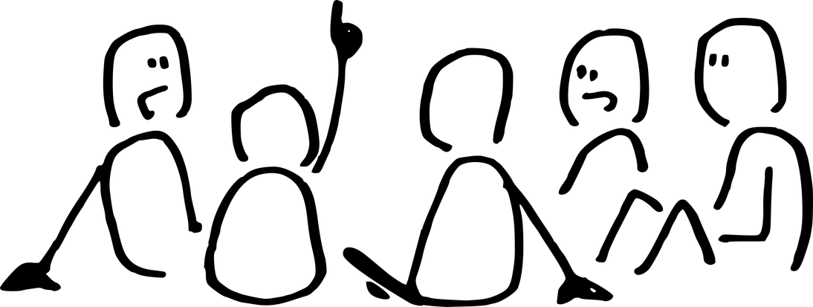
Motivation
The Challenge
Our Approach
Gaia DR3 catalogues 1.8 billion sources but has limited morphological classification
Many extended objects (galaxies, nebulae) are misclassified or unclassified as point sources
Gaia's spatial resolution (~0.1") blurs compact galaxies into star-like profiles
Euclid VIS imaging (0.1"/pixel) resolves structure Gaia cannot
Cross-match Euclid × Gaia to obtain truth labels (star vs galaxy)
Train XGBoost on Gaia-only parameters to classify all Gaia sources without needing Euclid
Key Question: Can Gaia-only parameters, trained with Euclid morphological labels, reliably distinguish stars from galaxies across the whole sky?
2
Notes:
Gaia is incredible for astrometry but struggles with morphology. Many galaxies look point-like at Gaia's resolution. Euclid, with its sharper VIS imaging, can distinguish stars from galaxies. The idea: use Euclid as a 'training teacher' — cross-match the catalogues, get truth labels, then train a classifier on Gaia parameters alone so we can classify the full Gaia sky.

Slide 3

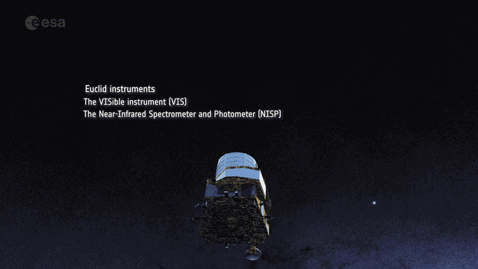
The Missions — Gaia & Euclid
Gaia
Euclid
ESA astrometry, launched 2013 — whole-sky survey of 1.8B sources
6-hour spin + 63-day precession at L2 — shutdown Mar 2025
1D scan profile only — no 2D images stored, PSF-fit as point source → no morphology
ESA dark energy mission, launched Jul 2023 — deep survey 14,000 deg²
VIS: 0.1"/pixel, step-and-stare ~70 min/field at L2
Saturation ~17.5 mag → biased toward faint/galaxies
The Bridge: Euclid resolves morphology in deep fields; Gaia sees the whole sky. ML trained on Euclid labels → classify Gaia's entire catalogue.
3
Notes:
Two complementary ESA missions at L2. Gaia is all-sky, shallow, limited morphology — the animation shows its scanning pattern with the twin telescopes. Euclid is deep but slow, covers only 14% of the sky so far — the animation shows the spacecraft with its VIS and NISP instruments. Gaia shut down in March 2025, so no new Gaia data. But Euclid is young and will provide labels for years. The key insight: Euclid's morphological information can train a classifier that works across the entire Gaia catalogue.

Slide 4
Data: Euclid ERO & Q1 Releases
ERO (Early Release Observations)
Q1 (Quarter 1 Release)
17 fields with VIS-band photometry
Morphological classifiers: class_star, spread_model
Cross-matching: spatial position (q3c) with 0.3" radius
~38,000 matched sources (Gaia G ≥ 18.5)
Highly imbalanced: ~95% stars, ~5% galaxies
4 fields with multi-band VIS + NIR photometry
PHZ pipeline: photo-z & star probability (phz_star_prob)
Pre-computed gaia_id → direct ID matching (no spatial cross-match)
~30,000 matched sources (Gaia G ≥ 18.5)
Better balanced: ~75% stars, ~25% galaxies
4
Notes:
Two Euclid data releases. ERO was first — 17 fields, single VIS band, traditional morphological classifiers. Q1 came later with multi-band coverage and the PHZ photo-z pipeline giving probabilistic star/galaxy classifications. Q1 also has pre-computed gaia_id associations, so no spatial cross-matching needed. The key difference is label quality and class balance — Q1 has much more galaxies proportionally.

Slide 5
01
Cross-Matching
Building the training set from Euclid × Gaia
Notes:
Now we move into the technical work. First up: cross-matching.

Slide 6
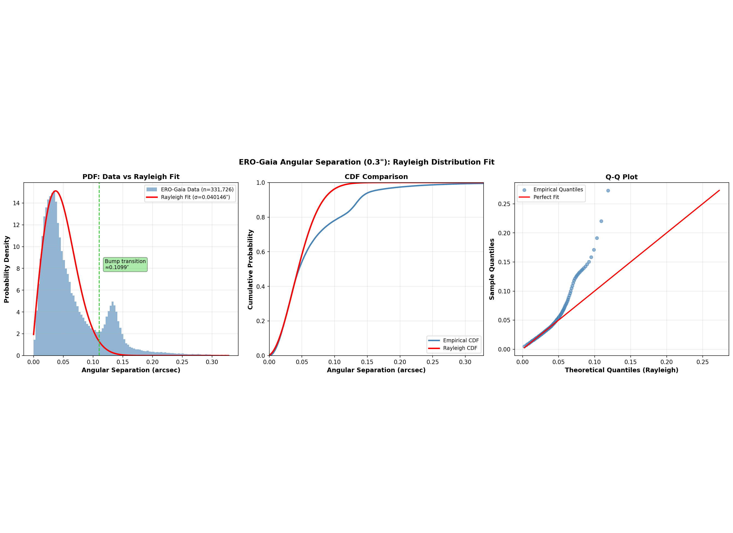
Cross-Matching Methodology
ERO: Spatial Matching
q3c library: match Euclid × Gaia by sky position
Radius: 0.3" (arcsecond) — optimized for Euclid astrometric accuracy
One-to-one pairing: nearest neighbour within radius
Q1: Direct ID Matching
Pre-computed by Euclid team: gaia_id → direct link
More reliable than spatial matching (no radius ambiguity)
Fewer contamination issues
Separation distribution (right): Most matches cluster near 0" with Rayleigh tail. Main peak = true matches; tail = spatially blended/unmatched sources.
6
Notes:
The cross-matching strategy differs by dataset. For ERO, we use q3c — a spatial-tree library — to match positions with a 0.3 arcsecond radius. For Q1, the team pre-computed gaia_ids, so we just use the direct mapping. The separation distribution plot shows how well-separated our matches are. A clean Rayleigh peak indicates good spatial matching.

Slide 7

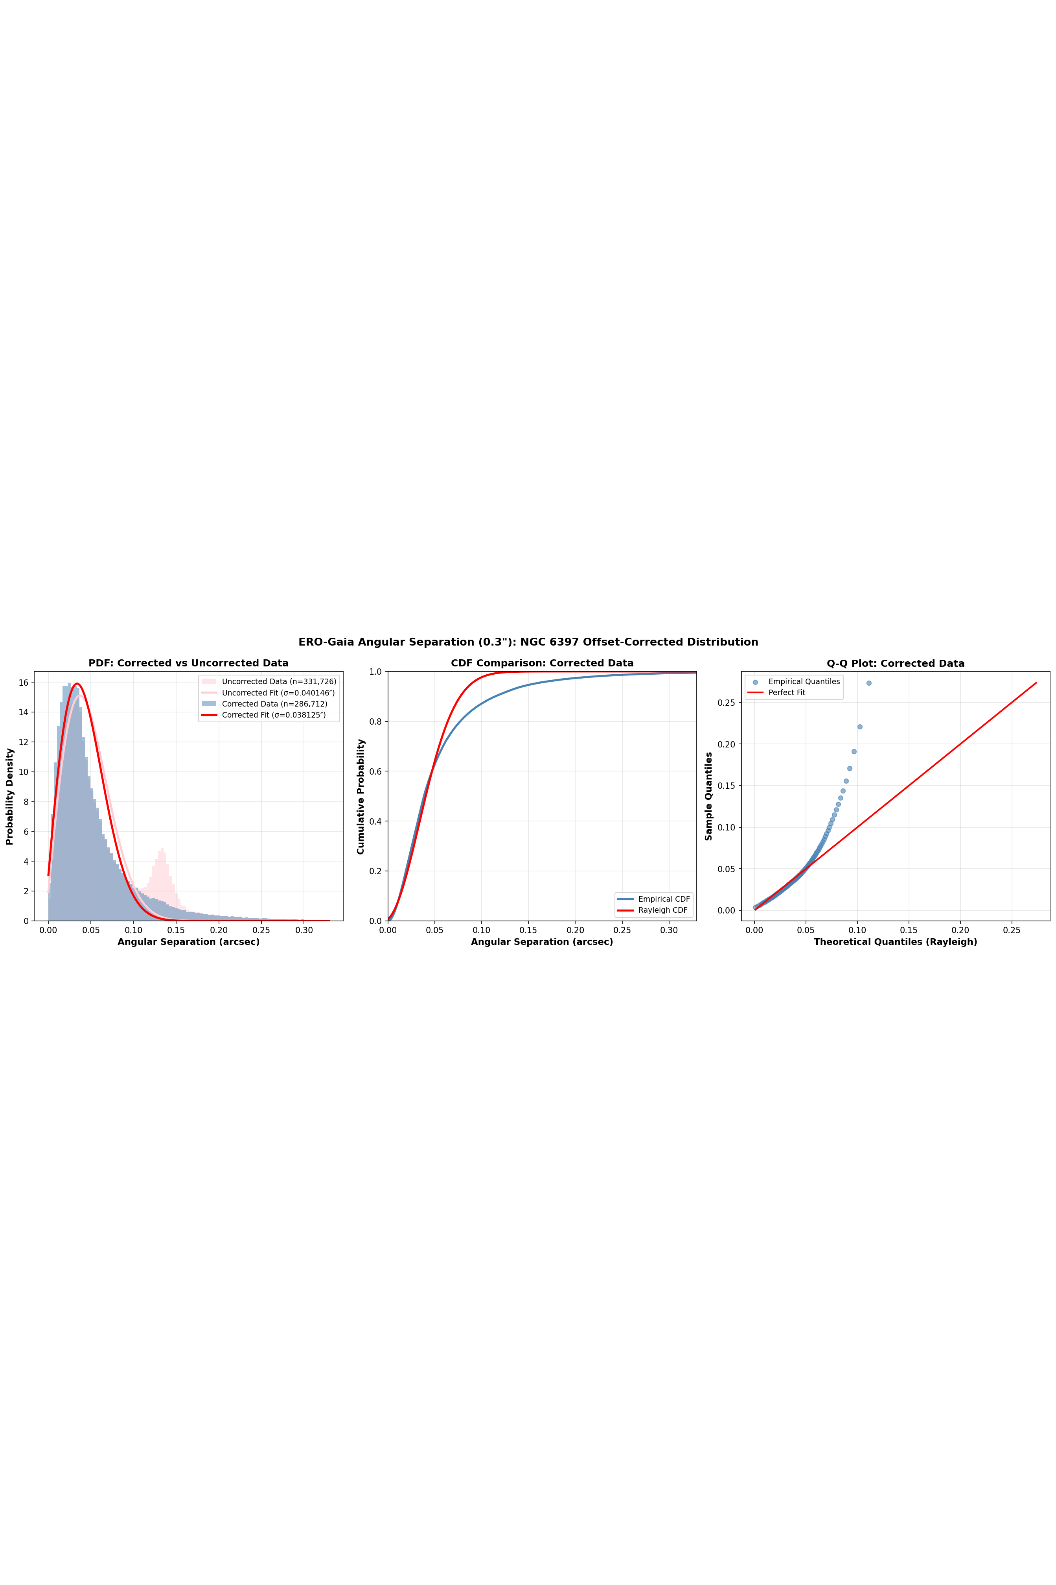
Cross-Match Validation:
NGC 6397 Discovery
Bimodal separation distribution
Angular separation at 0.3" radius showed an unexpected second peak
Root cause: NGC 6397 globular cluster members have large, coherent proper motions that shifted their epoch-2016 positions
Resolution: Applying proper motion correction collapses the second bump into the main Rayleigh peak
σ = 0.038" (corrected) vs 0.040" (uncorrected)
→ Validates the 0.3" matching radius
NGC 6397 — Euclid VIS
7
Notes:
One of the most interesting findings. When we looked at the angular separation distribution for ERO-Gaia cross-matches at 0.3 arcsec, we expected a clean Rayleigh distribution — but saw a bimodal shape. Tracing the second peak revealed it came from NGC 6397, a nearby globular cluster whose stars have large proper motions. Because Gaia positions are at epoch 2016 but Euclid observed later, the stars had moved. Correcting for proper motion fixes the distribution perfectly. This validates our matching radius choice.

Slide 8
02
Sensitivity & Visualization
Magnitude cuts and model robustness
Notes:
Finally, we explore robustness and how the model behaves across different magnitudes.

Slide 9
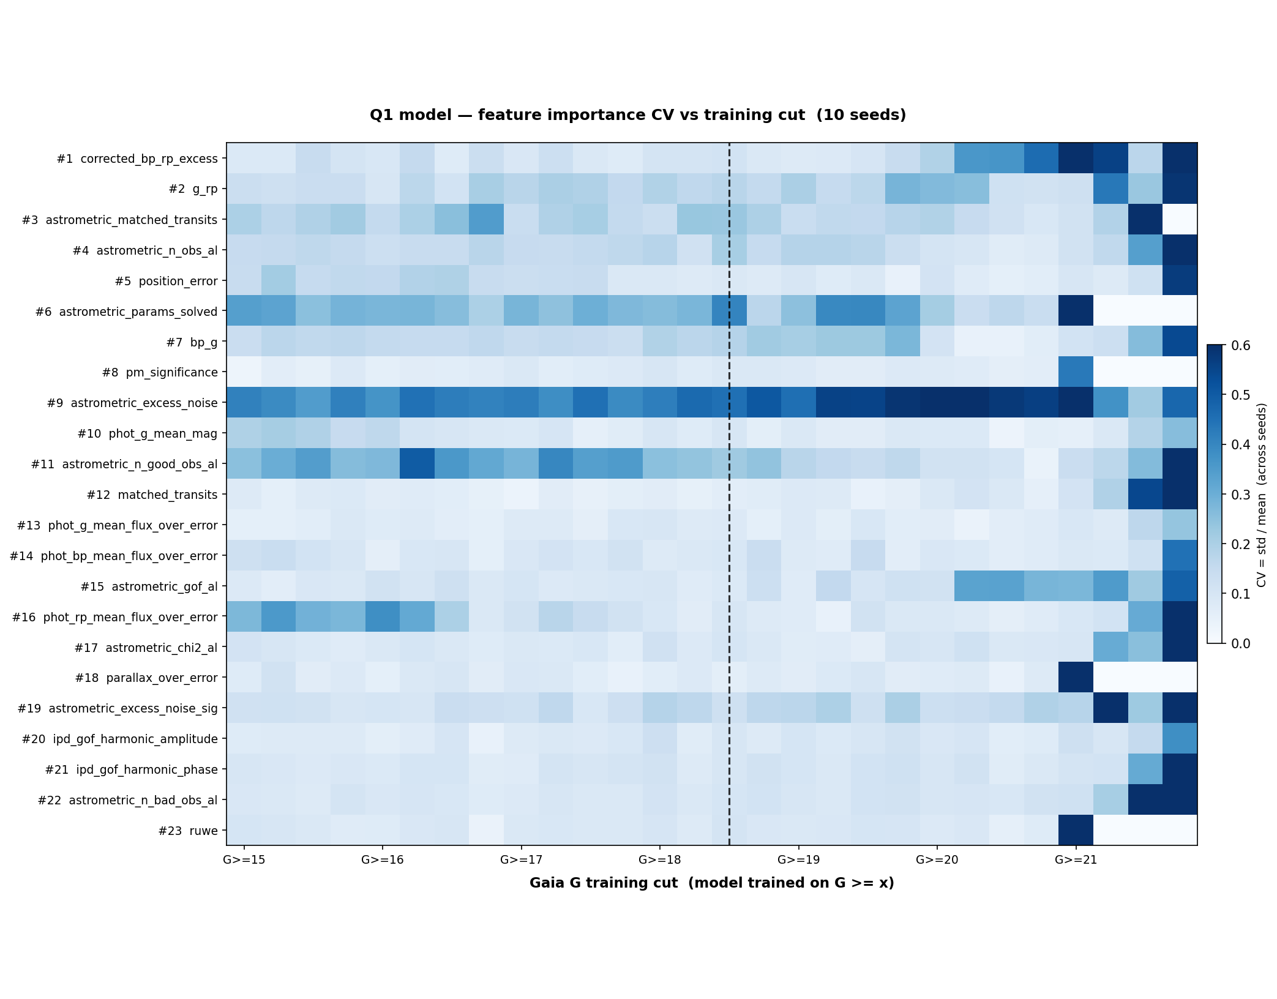

Magnitude Cut Sensitivity
Q1 cross-validation performance as a function of magnitude cut (left: heatmap, right: line plots)
9
Notes:
How sensitive are the results to the magnitude cut? The heatmap shows cross-validation performance across different lower and upper magnitude bounds. The main takeaway: performance is relatively stable for reasonable cuts, but there's a sweet spot around G >= 18.5. Cutting too bright (G >= 16) includes well-classified objects but reduces galaxy fraction. Cutting too faint loses signal-to-noise. The line plots on the right show individual metrics as functions of the cuts.

Slide 10

UMAP: Star-Galaxy Separation
in Feature Space
UMAP projection of the 23-dimensional Gaia feature space, coloured by star/galaxy label
10
Notes:
This is a UMAP dimensionality reduction of the 23 Gaia features, coloured by star/galaxy label. You can see that stars and galaxies do form somewhat distinct clusters in this feature space, which confirms there IS signal in the Gaia parameters to distinguish them. But there's also significant overlap — this overlap region is what limits our galaxy recall. The cluster structure suggests the classifier is finding real physical differences, not just overfitting.

Slide 11
Summary & Key Findings
What We Found
Next Steps
Euclid × Gaia cross-matching generates morphological training labels
Cross-match validation via NGC 6397 proper motion analysis
Magnitude cut sensitivity shows robust performance around G ≥ 18.5
corrected_bp_rp_excess is the strongest feature (physically motivated)
Q1 labels significantly more reliable than ERO labels
Settle the magnitude cut question (sensitivity analysis ongoing)
Re-examine ERO vs Q1 label quality and potential systematics
Re-run full experiments with optimized parameters once decisions finalized
Test with future Euclid releases for expanded sky coverage
Apply classifier to full Gaia DR3 catalogue
Bottom line: Gaia parameters contain real morphological signal. Currently investigating optimal magnitude cut and label quality; once settled, re-running full experiments with refined approach before finalizing results.
11
Notes:
To summarise: We've shown that cross-matching Euclid and Gaia can generate morphological training labels. The validation of our cross-matching methodology through NGC 6397 proper motion analysis confirms the approach is sound. Magnitude cut sensitivity analysis shows that performance is relatively robust, with a sweet spot around G >= 18.5. The strongest predictor is corrected_bp_rp_excess, which has clear physical motivation. However, we've identified that ERO labels have quality concerns while Q1 labels are more reliable. Our next step is to finalize the magnitude cut choice and settle the ERO versus Q1 label question, then re-run comprehensive experiments. Once complete, we'll have a validated classifier to apply across the full Gaia catalogue, potentially identifying many extended objects that are currently misclassified as stars.

Slide 12
Thank You
Questions?
Sylvia Zhao
sz423@cam.ac.uk
Institute of Astronomy, University of Cambridge
Notes:
Thank you for your attention. I'm happy to take any questions about the methodology, results, or future directions.

