Slide 1
Euclidifying Gaia
Using Machine Learning to Classify
Non-Point-Like Objects in Gaia DR3
Sylvia Zhao
Part III Astrophysics | Lent Term 2026
Supervisors: Diana Harrison, Simon Hodgkin, Vasily Belokurov
Institute of Astronomy, University of Cambridge
Notes:
- Welcome, I'm Sylvia, and this is my Part III project
- Euclidifying Gaia: using machine learning to classify non-point-like objects in Gaia DR3
- With the help of higher-resolution imaging from Euclid

Slide 2
Outline
1
Background & Data
Motivation, missions, scanning law, data releases
2
Cross-Matching
Methodology, validation, NGC 6397 discovery
3
Validating Euclid Classification
ERO & Q1 label reliability
4
XGBoost Training
Magnitude sensitivity, feature importance, UMAP
5
ERO Testing & Verification
Q1 model on ERO, cutout verification
2
Notes:
- Here's what we’ll be covering today
- Starting with the background and data
- Then cross-matching methodology and the NGC 6397 discovery
- Validating the Euclid classification labels
- Gaia completeness and XGBoost classifier
- Finally, sensitivity analysis and visualization

Slide 3
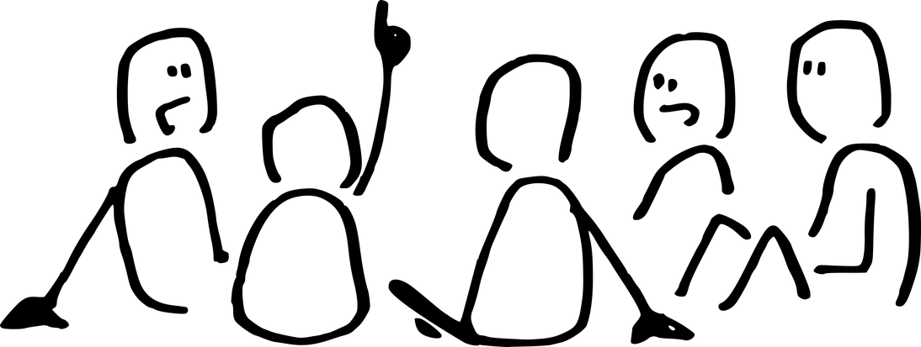
Motivation
The Challenge
Our Approach
Gaia DR3 catalogues 1.8 billion sources but has limited morphological classification
Gaia's main goal: measure properties of stars
On-board detection algorithm is optimised for point-sources
Still, any non-stellar objects are detected: nuclei of galaxies, bits of spiral arms, chunks of planetary nebulae etc.
Euclid VIS imaging resolves structure Gaia cannot
Cross-match Euclid x Gaia to obtain truth labels (star vs galaxy) for a subset of Gaia data
Train XGBoost on Gaia-only parameters to classify all Gaia sources without needing Euclid
Key Question: Can Gaia-only parameters, trained with Euclid morphological labels, reliably distinguish stars from galaxies across the whole sky?
3
Notes:
- Gaia and Euclid are two ESA flagship space observatories with cameras of similar resolution
- Gaia does not download full-frame images — objects are detected on board, only small compressed cut-outs sent to Earth
- Gaia's main goal is to measure properties of stars — on-board detection algorithm optimised for point-sources
- However, many non-stellar objects are detected: nuclei of galaxies, bits of spiral arms, chunks of planetary nebulae
- For a subset of Gaia data, we have Euclid catalogues and images
- Our approach: cross-match Euclid x Gaia to get truth labels, train a classifier on Gaia parameters alone

Slide 4


The Missions — Gaia & Euclid
Gaia
Euclid
ESA astrometry mission, launched 2013, orbit around L2
Whole-sky survey: 1.8B sources — shutdown Mar 2025
6-hour spin + 63-day precession
ESA dark energy mission, launched 2023, orbit around L2
Deep-field survey: 14,000 deg² over 6 years
Step-and-stare ~70 min per field (0.5 deg²)
The Bridge: Euclid sees deeper and resolves morphology; Gaia sees the whole sky. By training on Euclid labels, we can classify Gaia's entire catalogue.
4
Notes:
- Both missions orbit at L2 — Gaia continuously scans, Euclid does step-and-stare
- Gaia builds up a catalogue from multiple observations with 6-hour spin and 63-day precession
- Objects detected on board, only small compressed cut-outs sent to Earth — no full-frame images
- Euclid sends its enormous images (~100x larger than HST's) to the ground
- Key complementarity: Gaia has whole sky but no morphology; Euclid resolves structure but covers a fraction
- Together, Euclid labels can train a classifier that works across the entire Gaia catalogue

Slide 5
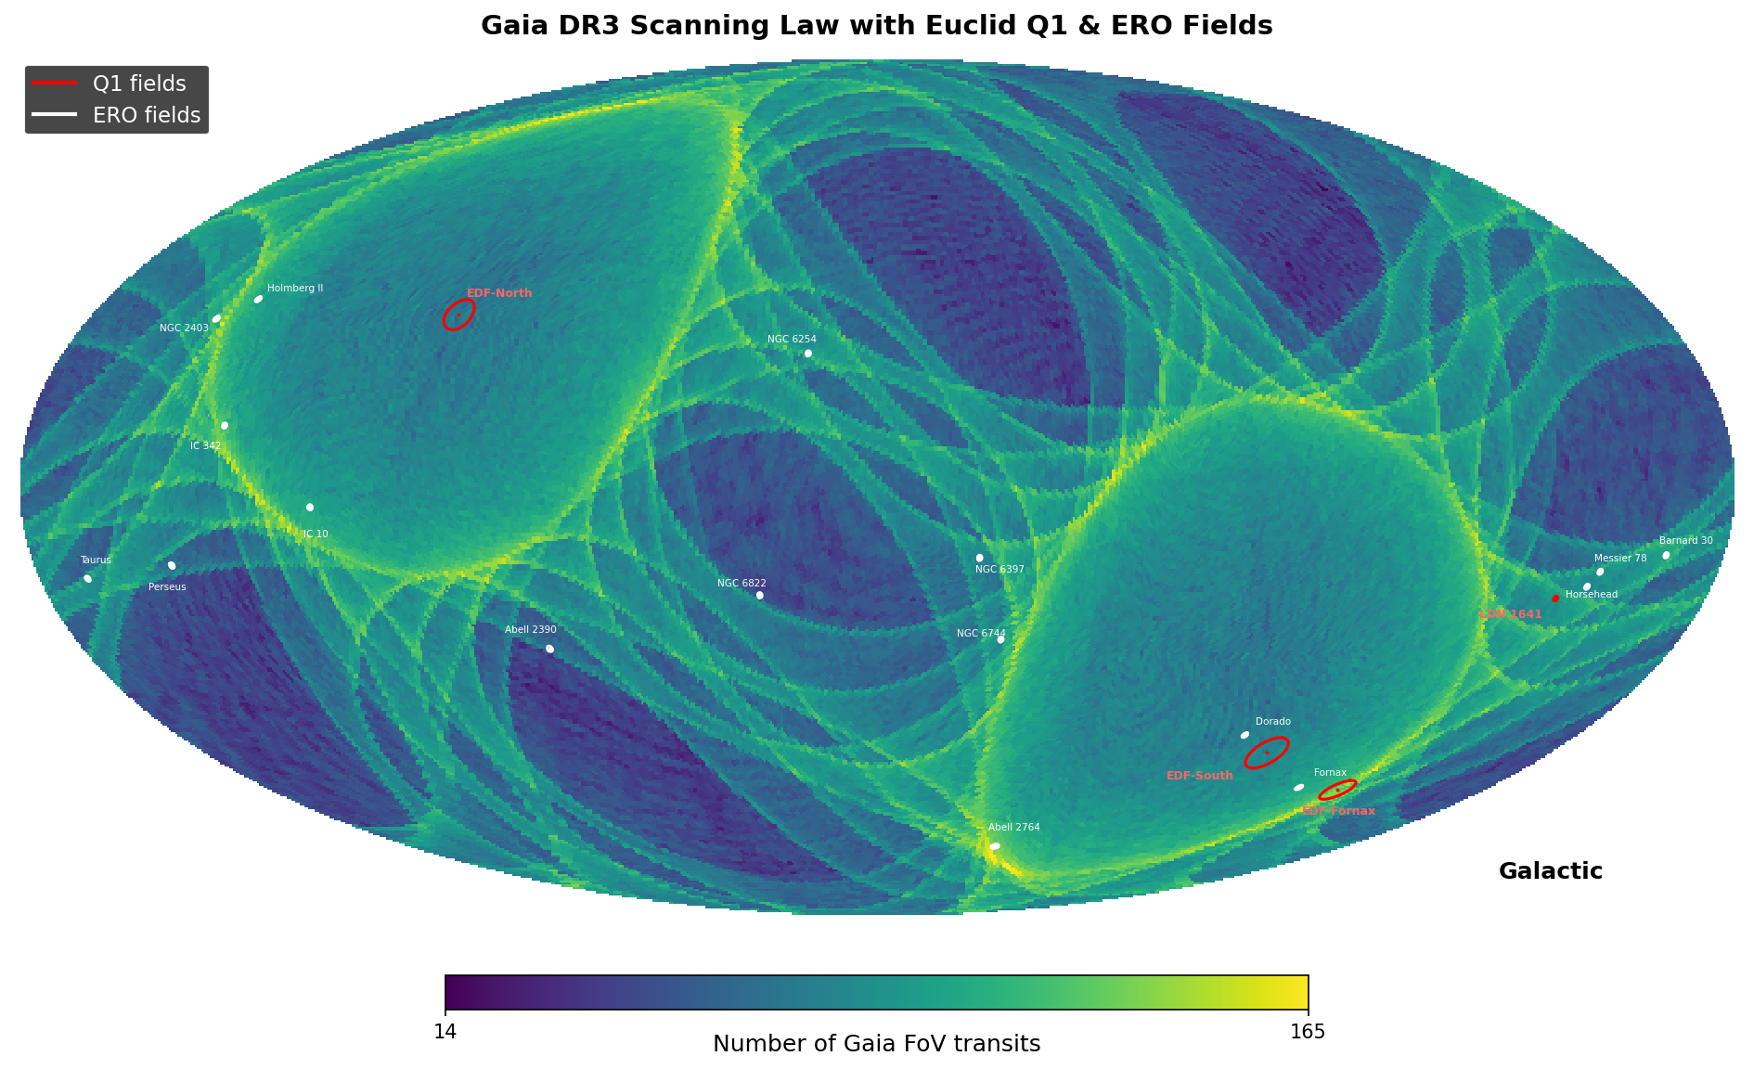
Gaia Scanning Law & Euclid Fields
Gaia DR3 scanning law (number of transits) with Euclid Q1 and ERO field footprints overlaid
5
Notes:
- This shows the Gaia DR3 scanning law — the number of times each part of the sky was observed
- Overlaid are the Euclid Q1 (4 fields) and ERO (17 fields) footprints
- You can see that the Euclid fields sample different regions of the Gaia scanning pattern
- Some fields have more Gaia transits than others, which affects the quality of Gaia parameters

Slide 6
Data: Gaia DR3 & Euclid Releases
Gaia DR3 (Data Release 3)
1.8 billion sources — full sky catalogue with astrometry, photometry (G, BP, RP), and limited morphological info
~23 features out of 153 available ones in gaia_source table selected for classification
Euclid ERO (Early Release Observations)
Euclid Q1 (Quarter 1 Release)
17 fields with VIS-band photometry
Morphological classifiers: class_star, spread_model
Cross-matching: spatial position with 0.3” radius
~12,000,000 sources in ERO catalogue
~330,000 sources matched with Gaia
Before match: ~30% stars, ~70% galaxies
After match: ~95% stars, ~5% galaxies
4 fields with multi-band VIS + NIR photometry
PHZ pipeline: probability & classification labels
Pre-computed Gaia_ID: epoch-propagated position matching
~22,200,000 sources in Q1 catalogue
~340,000 sources matched with Gaia
Before match: ~10% stars, ~90% galaxies
After match: ~75% stars, ~25% galaxies
6
Notes:
- We use three datasets: Gaia DR3 as the base catalogue, plus two Euclid releases
- Gaia DR3: 1.8 billion sources, ~23 features selected out of 153 available for classification
- ERO: 17 fields, ~12M sources total, ~330K matched with Gaia — before match 70% galaxies, after match only 5% (most galaxies have no Gaia counterpart)
- Q1: 4 fields, ~22.2M sources, ~340K matched — before match 88% galaxies, after match 22%
- Q1 uses PHZ pipeline with probability & classification labels, and sophisticated epoch-propagated position matching via pre-computed Gaia_ID
- The before/after match statistics reflect that Gaia is a stellar catalogue — cross-matching selects objects Gaia detected, which biases toward stars

Slide 7
01
Cross-Matching
Building the training set from Euclid × Gaia
Notes:
- Now we move into the technical work
- First up: how we cross-match the two catalogues

Slide 8
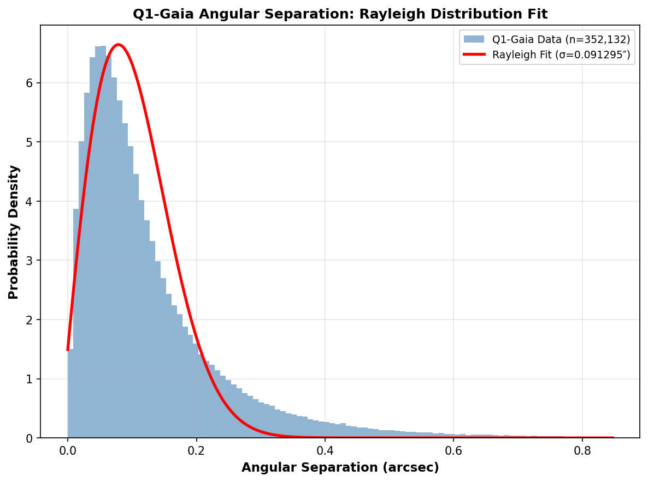
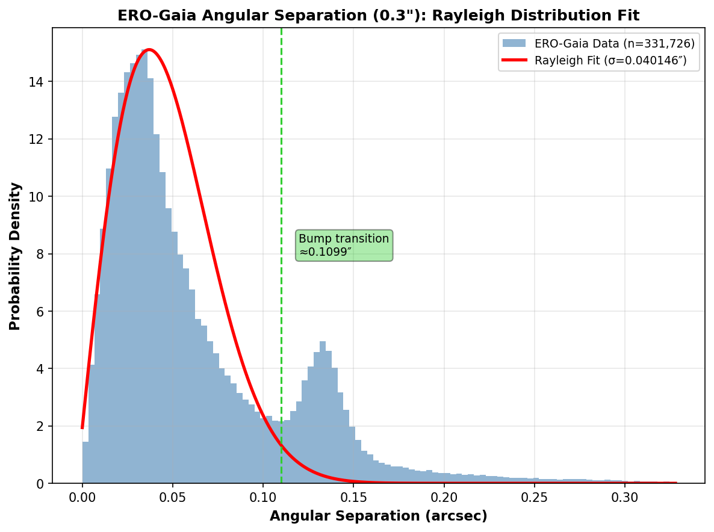

Cross-Matching Methodology
Q1: Direct ID Matching
Gaia positions propagated from DR3 epoch J2016.0 to Euclid MER reference time
Max allowed distance: 0.3" — matched GAIA_ID stored in catalogue
Angular separation distribution is near-Rayleigh → clean matches ✓
ERO: Spatial Matching (q3c)
q3c library: match Euclid × Gaia by sky position, 0.3" radius
One-to-one nearest-neighbour pairing
Separation distribution shows a bump at 0.1–0.15" — not expected!
Q1 (top): clean Rayleigh fit confirms 0.3" radius.
ERO (bottom): unexpected bump at 0.1–0.15" → what is this?
8
Notes:
- We validate cross-matching by examining angular separation distributions
- For Q1: Euclid team propagated Gaia positions from DR3 epoch J2016.0 to MER catalogue reference time
- Maximum allowed distance 0.3 arcsec, resulting distribution is near-Rayleigh — clean matches
- For ERO: we use spatial matching at 0.3 arcsec radius
- But the ERO distribution shows an unexpected bump between 0.1 and 0.15 arcsec
- This is not normal for position-based cross-matching — something interesting is happening

Slide 9
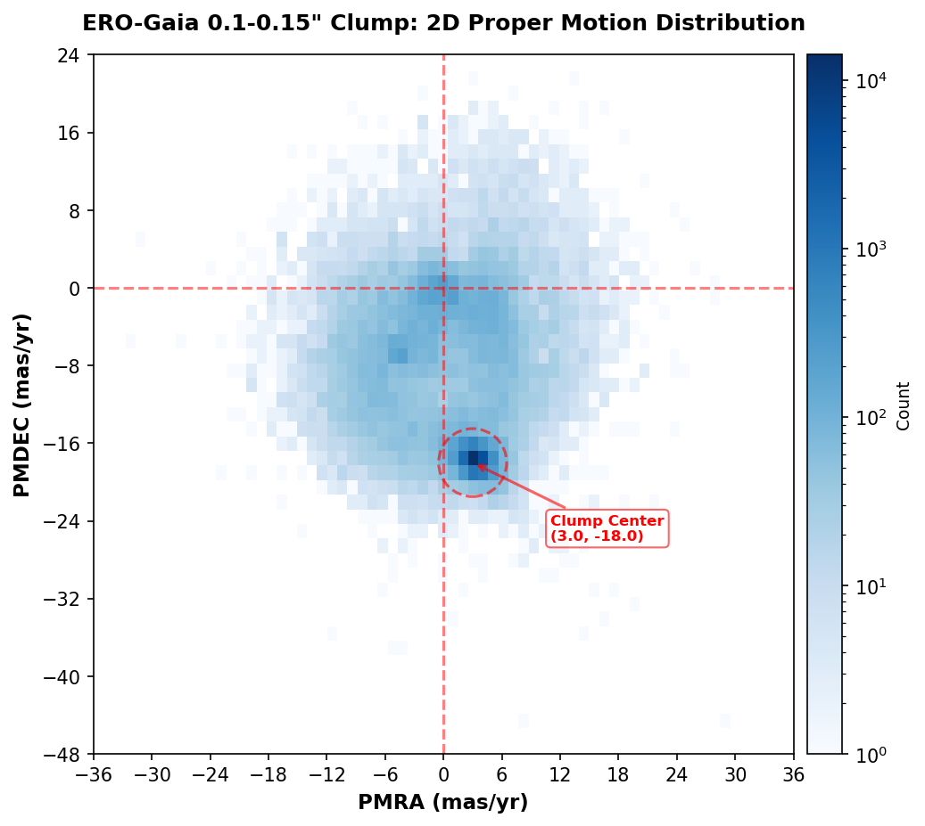


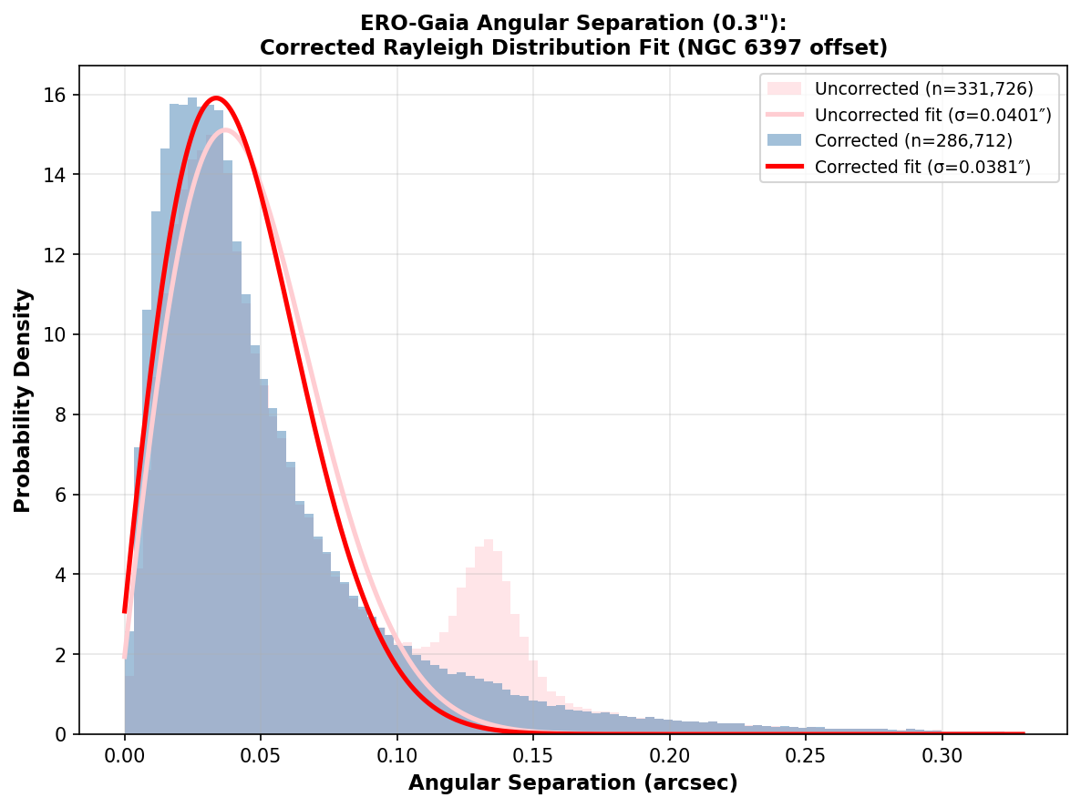
NGC 6397 Position Fixing
1 Bump at 0.1–0.15"
in ERO separation
2 Extract bump sources
→ PM analysis
3 Position offsets
→ coherent shift
4 NGC 6397!
Gaia epoch ≠ Euclid epoch
Concentrated PM clump
at (3, −18) mas/yr
All sources share
same movement
NGC 6397
5 Correct for PM → bump collapses
Validates 0.3" matching radius ✓
9
Notes:
- We extract sources in the 0.1–0.15 arcsec bump and do proper motion analysis
- The 2D PM histogram shows bump sources concentrate at PMRA ≈ 3, PMDEC ≈ −18 mas/yr
- Position offsets confirm: all sources carry the same coherent positional offset
- These are gravitationally bound — part of the same object
- Identified as NGC 6397, a nearby globular cluster (~7800 ly)
- Gaia positions at epoch J2016.0, Euclid observed years later — cluster stars had physically moved
- After correcting for proper motion, bump collapses back into main Rayleigh peak

Slide 10
02
Validating Euclid
Classification
How reliable are the training labels?
Notes:
- Before training a classifier, we need to check: are the Euclid labels themselves reliable?
- We examine both ERO and Q1 labels

Slide 11
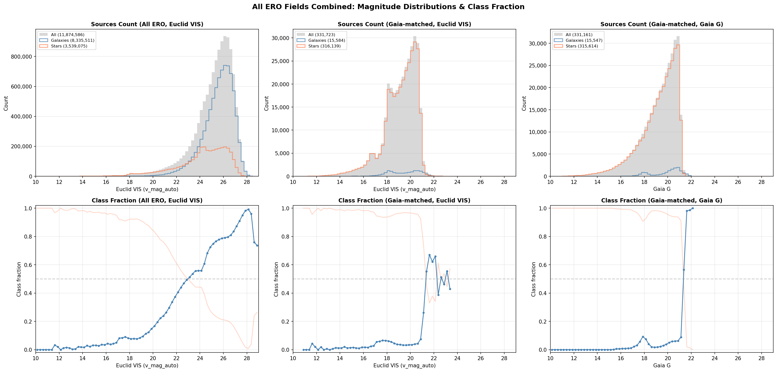
ERO Label Reliability
Distribution of ERO sources across magnitude range reveals a suspicious bump around Gaia G ~18 in the galaxy fraction after cross-matching with Gaia
11
Notes:
While examining the distribution of ERO sources across magnitude range, we discover a suspicious bump around Gaia magnitude 18 in the galaxy fraction of the matched sources. This bump is highly suspicious — it suggests some pipeline artifact rather than a genuine physical feature in the data.

Slide 12
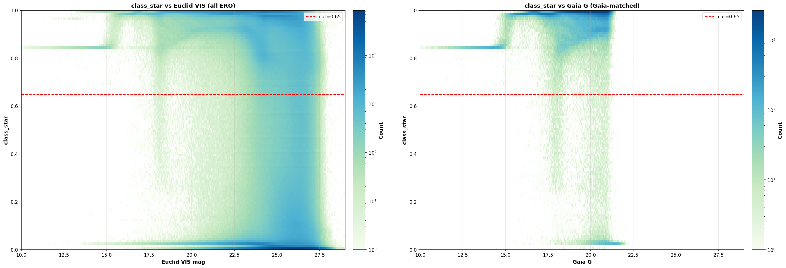
ERO class_star: Origin of the Bump
2D histogram of class_star value across magnitude clearly shows the bump in population distribution propagates from the bump in class_star itself
12

Slide 13
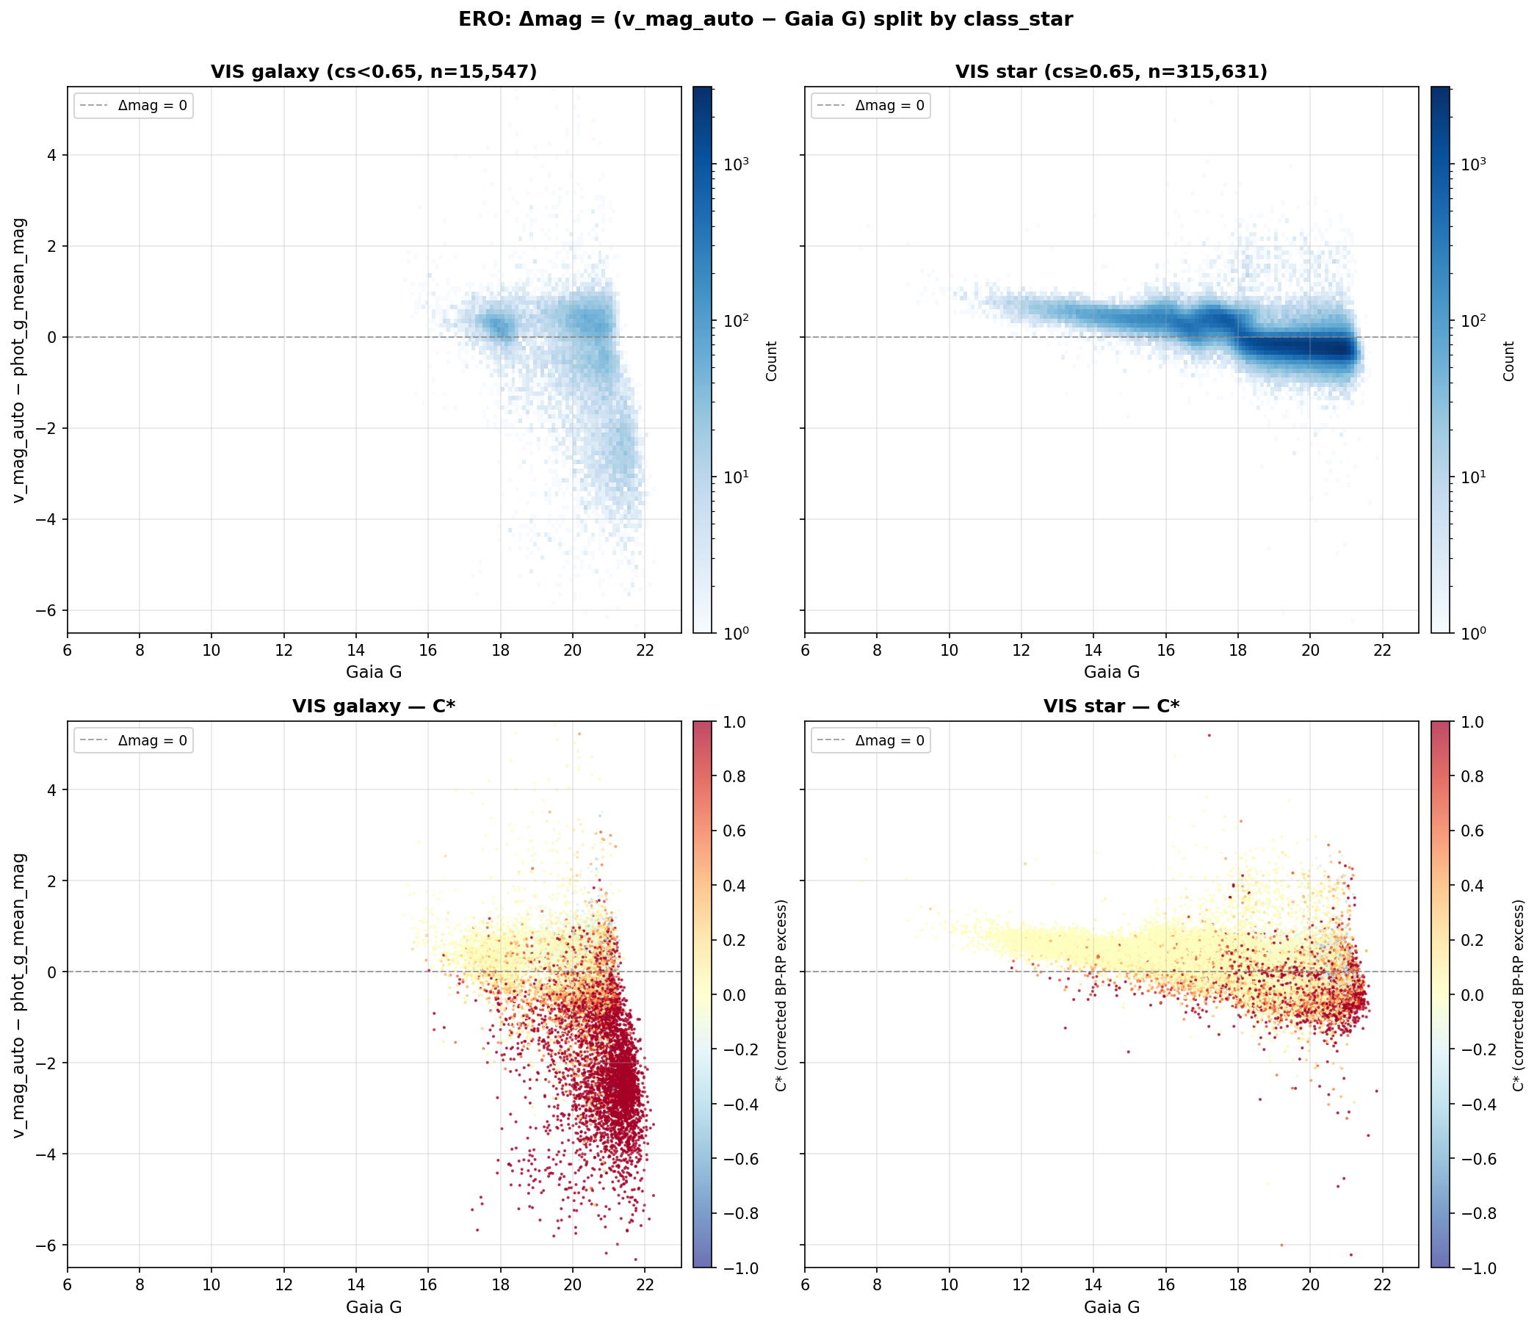
ERO Label Reliability
class_star Classification
Δmag (IE − Gaia G) vs Gaia G magnitude, split by class_star label
Stars and galaxies should occupy distinct regions
ERO class_star shows potential misclassification at bright magnitudes (~18 mag)
Tension: class_star is a traditional morphological classifier — may not be optimal for Euclid data
Key concern: ERO labels may be unreliable — particularly at bright magnitudes where class_star shows contradictory behaviour
13
Notes:
Here we examine ERO label reliability using Δmag (Euclid IE minus Gaia G) vs Gaia G
Stars and galaxies should occupy distinct regions in this space:
Expecting stars – bluer & brighter in Gaia, galaxies – redder& bright in Euclid
Need to consider this when comparing ERO-trained vs Q1-trained classifiers

Slide 14

Q1 Label Reliability
Δmag (IE − Gaia G) vs Gaia G magnitude, split by Q1 PHZ label
14
Notes:
- Q1 uses the PHZ pipeline for classification — more sophisticated than ERO class_star
- This 6-panel plot shows Δmag vs Gaia G split by PHZ label categories
- Q1 labels show cleaner separation between stars and galaxies, and roughly as expected. Bulk of galaxy lie in the region of negative magnitude difference, i.e. brighter in Euclid, and higher bp_rp excess factor. i.e. redder
- Overall Q1 labels are significantly more reliable/reasonable than ERO

Slide 15
03
XGBoost Model Training
Training on Q1 data only — ERO labels unreliable

Slide 16


Magnitude Cut Sensitivity
Q1 cross-validation performance as a function of magnitude cut
16
Notes:
How sensitive are results to the magnitude cut?
- Heatmap shows cross-validation performance across different magnitude bounds
- Performance is relatively stable for reasonable cuts
- Sweet spot around G >= 17
- Cutting too bright includes well-classified objects but reduces galaxy fraction
- Cutting too faint loses signal-to-noise
- Line plots show individual metrics as functions of cuts
Essentially we decided that a magnitude cut at >= 17 should be save for training a model on Q1 truth table.
Also we found that the importance rank is quite consistent across different magnitude cuts too -- the model has learned genuine physical signal than noise.

Slide 17
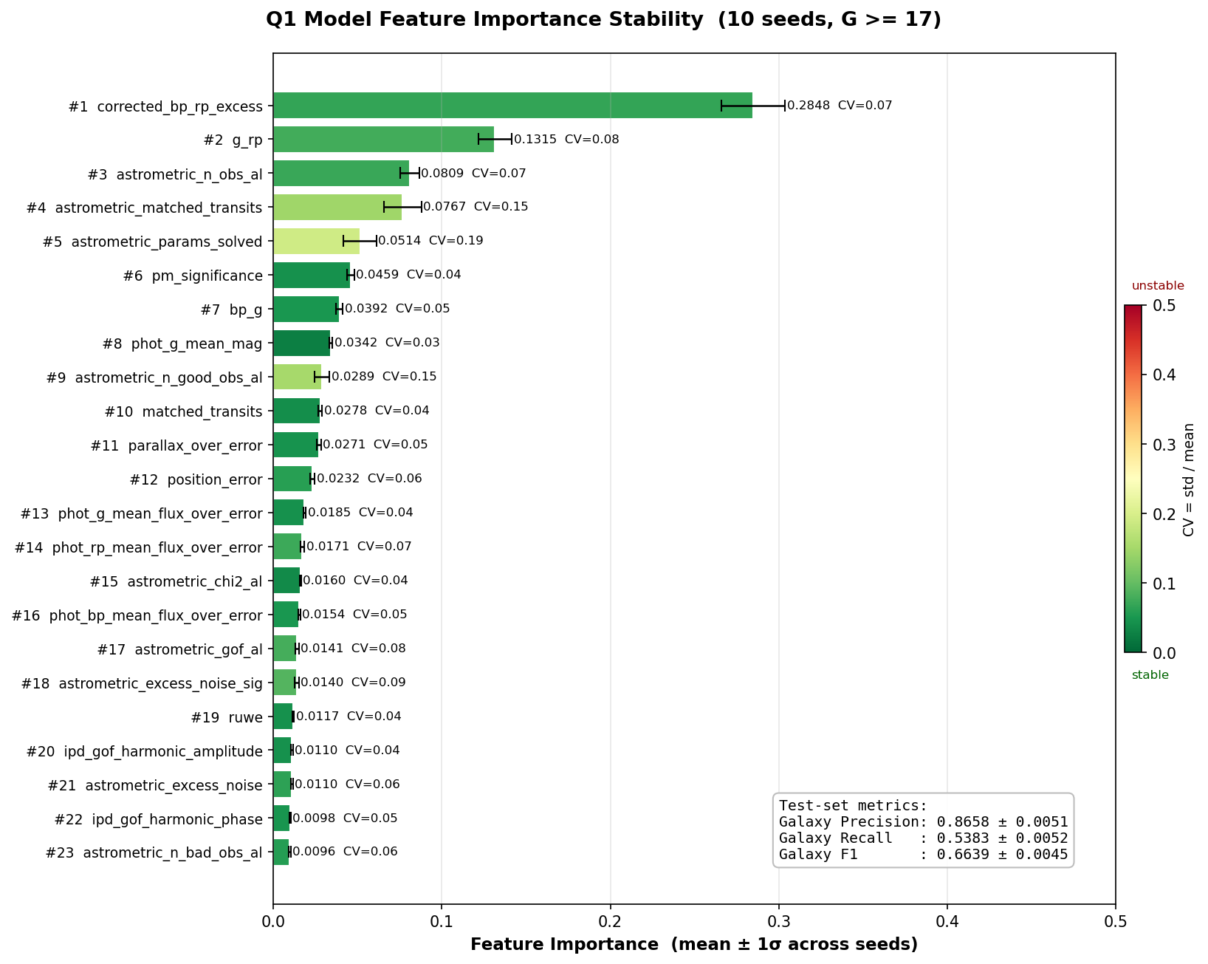
Q1 Model - Feature Importance
Top Features
corrected_bp_rp_excess is the dominant feature — physically motivated (extended sources show BP/RP flux excess)
Photometric colours and astrometric parameters also contribute
23 features total used across all experiments
17
Notes:
Feature importance from the XGBoost classifier
- corrected_bp_rp_excess is by far the strongest feature — physically motivated
- Extended objects like galaxies show excess BP/RP flux compared to point sources
- Astrometric parameters also important: galaxies have different astrometric signatures
- 23 Gaia-only features used in total
- This confirms there IS real morphological signal in Gaia parameters

Slide 18
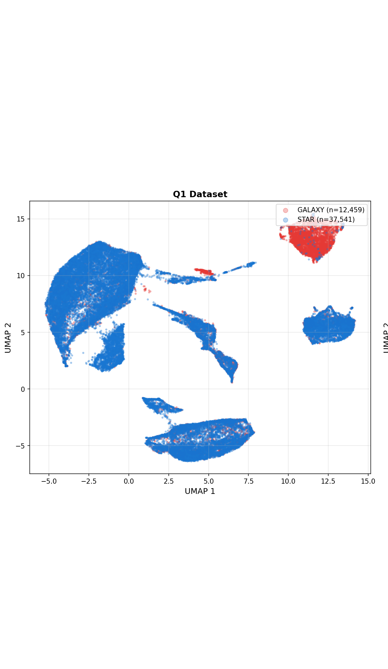
UMAP: Star-Galaxy Separation
in Feature Space
UMAP projection of the 23-dimensional Gaia feature space, coloured by star/galaxy label
17
Notes:
UMAP dimensionality reduction of the 23 Gaia features for the Q1 dataset, coloured by star/galaxy label. Stars and galaxies form somewhat distinct clusters — confirms real signal in Gaia parameters. Note: this plot will be updated later with a better version.

Slide 19
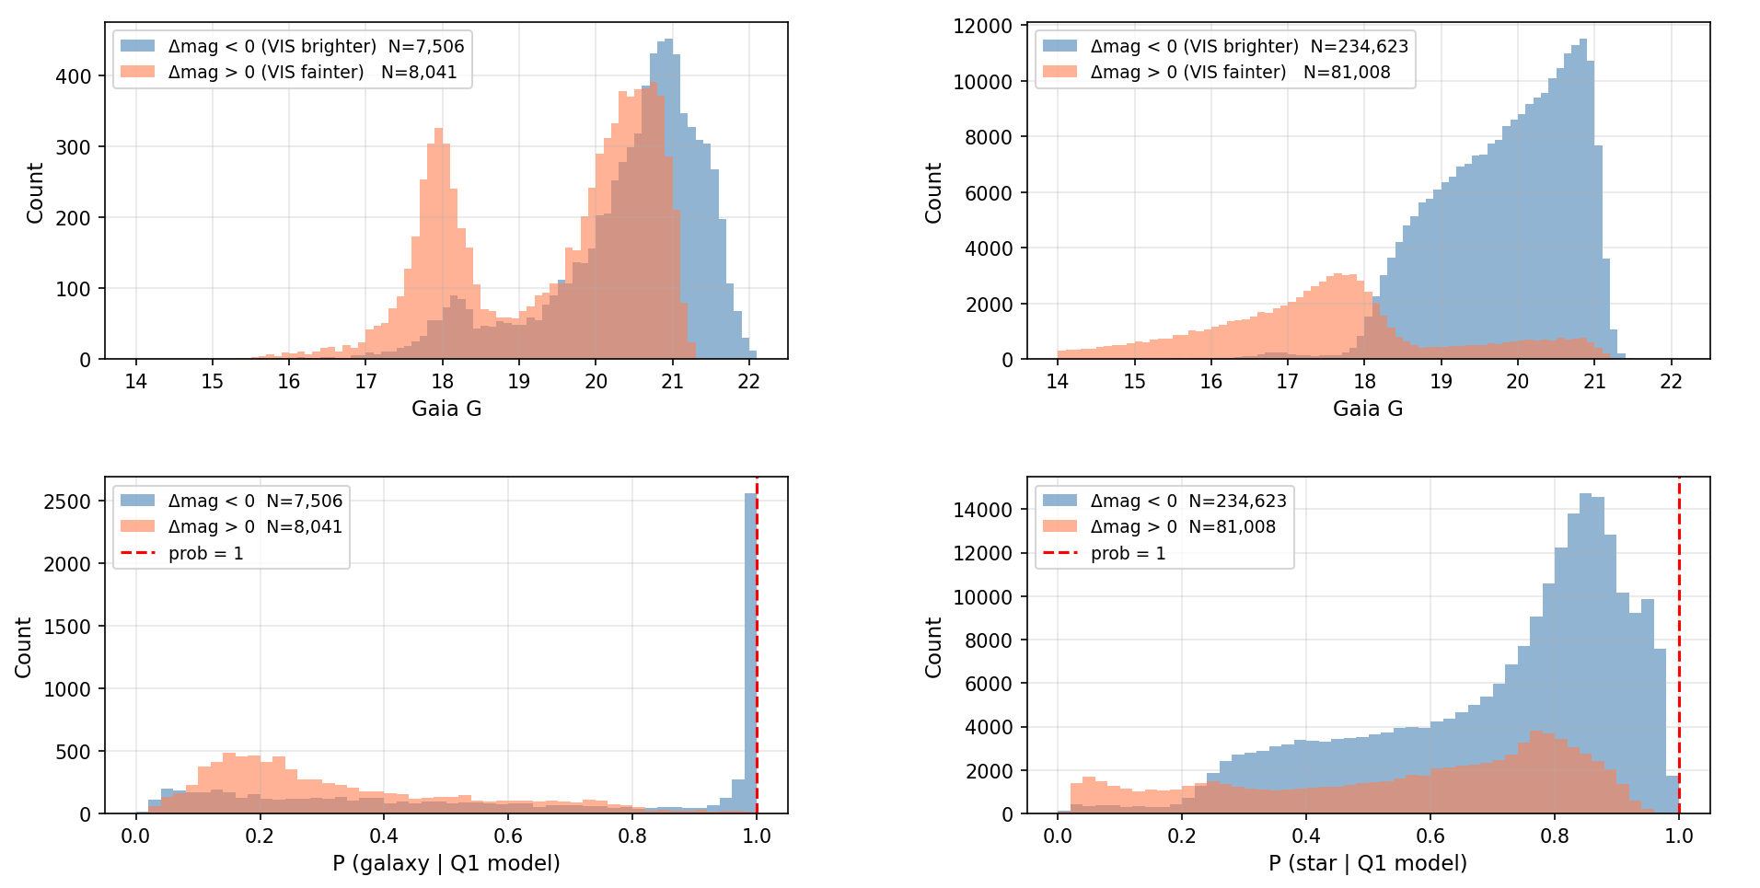
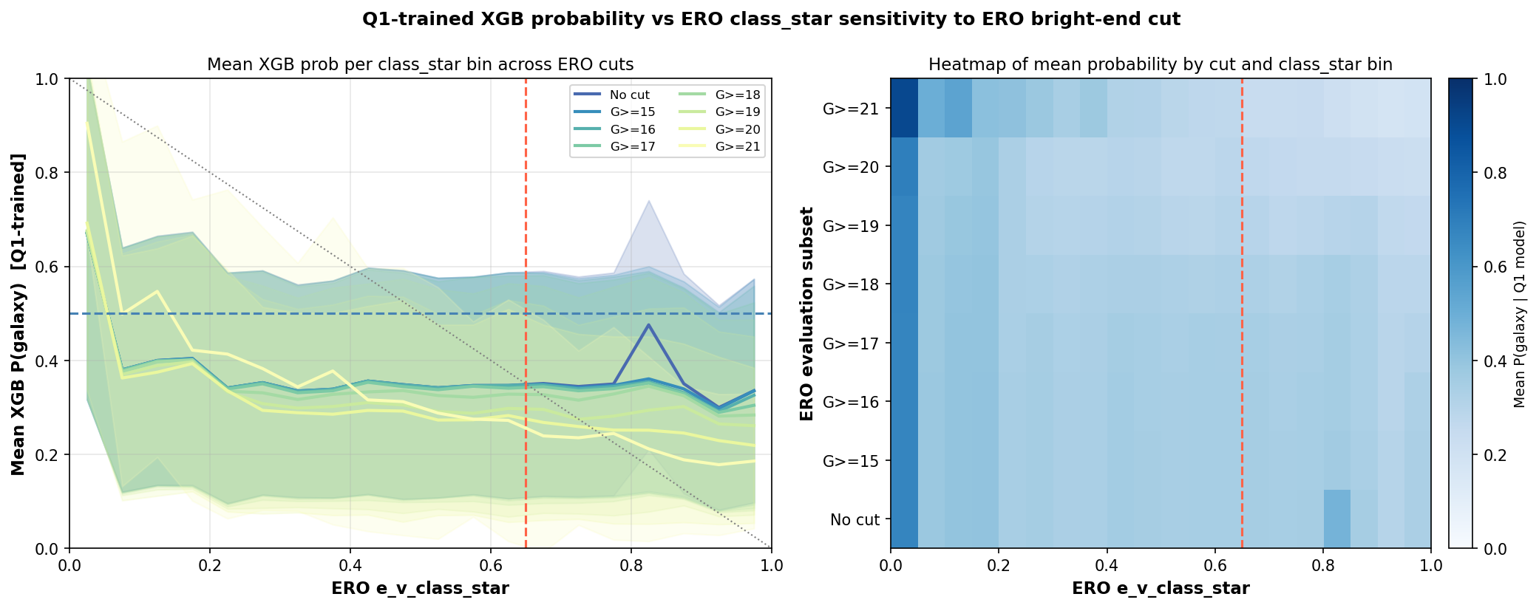
Behavior of ERO Dataset in Q1 Model
11
Notes:
When we apply the Q1-trained XGBoost model to the ERO dataset, we find significant disagreement with ERO's class_star labels. The main Δmag plot (left) shows the ERO data split by both class_star and Q1 model predictions. The probability comparison (right) shows anti-correlation between Q1 model galaxy probability and ERO class_star — further evidence that ERO labels are unreliable. We want to examine PNG cutouts to verify which label gives the true classification when there is disagreement.

Slide 20
02
Example Cutouts
Visual verification of disagreements between ERO class_star and Q1 model

Slide 21
04
Gaia Completeness
Selection effects and classifier training

Slide 22
Gaia Completeness & Selection Effects
Left: selection function. Right: Gaia completeness analysis.
13
Notes:
- Left plot shows magnitude distributions — note the galaxy fraction bump
- This inspired the completeness investigation
- Right plot shows Gaia completeness as a function of magnitude
- Gaia's detection is not uniform: faint extended objects are increasingly missed
- Selection effects must be accounted for when training the classifier
- This is important context for interpreting the class imbalance in our training sets

Slide 23
05
Summary & Conclusions
Key findings and next steps

Slide 24
Summary & Key Findings
What We Found
Next Steps
Euclid × Gaia cross-matching generates morphological training labels
Cross-match validation via NGC 6397 proper motion analysis
Magnitude cut sensitivity shows Q1 model performance robust across magnitude range
corrected_bp_rp_excess is the strongest feature (physically motivated)
Q1 labels significantly more reliable than ERO labels
Settle the magnitude cut question (sensitivity analysis ongoing)
Re-examine ERO vs Q1 label quality and potential systematics
Re-run full experiments with optimized parameters once decisions finalized
Test with future Euclid releases for expanded sky coverage
Apply classifier to full Gaia DR3 catalogue
Bottom line: Gaia parameters contain real morphological signal. Currently investigating optimal magnitude cut and label quality; once settled, re-running full experiments with refined approach before finalizing results.
18
Notes:
Add a section divider before this
- Cross-matching Euclid and Gaia generates morphological training labels
- NGC 6397 proper motion analysis validates the cross-matching methodology
- Magnitude cut sensitivity shows Q1 performance robust across magnitude range
- corrected_bp_rp_excess is the strongest predictor with clear physical motivation
- Q1 labels significantly more reliable than ERO
- Next: finalize magnitude cut, settle label quality question, re-run experiments
- Goal: validated classifier for the full Gaia DR3 catalogue

Slide 25
Thank You
Questions?
Sylvia Zhao
sz423@cam.ac.uk
Institute of Astronomy, University of Cambridge
Notes:
- Thank you for listening
- Happy to take any questions about methodology, results, or future directions

