Slide 1
Euclidifying Gaia
Using Machine Learning to Classify
Non-Point-Like Objects in Gaia DR3
Sylvia Zhao
Part III Astrophysics | Lent Term 2026
Supervisors: Diana Harrison, Simon Hodgkin, Vasily Belokurov
Institute of Astronomy, University of Cambridge
Notes:
[~30s] Hello everyone, I'm Sylvia, thank you for coming to my presentation.
This is my Part III project: Euclidifying Gaia,
which is using machine learning to classify non-point-like objects in the Gaia DR3 catalogue
with the help of higher-resolution imaging from Euclid.

Slide 2
Outline
1
Background
Motivation, missions, data releases
2
Cross-Matching
Methodology, validation, correction
3
Validating Euclid Labels
ERO & Q1 label reliability
4
Model Training
XGBoost classifier, magnitude sensitivity, feature importance, UMAP
5
Testing & Verification
Q1 model on ERO, cutout verification
6
Summary & Conclusions
2
Key findings and next steps
Notes:
[~30s] Here's roughly what we'll be covering today:
- starting with the background and motivation
- then cross-matching methodology
- validating the Euclid classification labels
- training our model using the XGBoost classifier
- testing and verifying our model
- and finally, summary and conclusions.

Slide 3
01
Background
What we’re trying to achieve, and why?
Notes:
[~5s] I'll set out by explaining what the project is trying to achieve,
what motivates it,
and the datasets that make it possible.

Slide 4



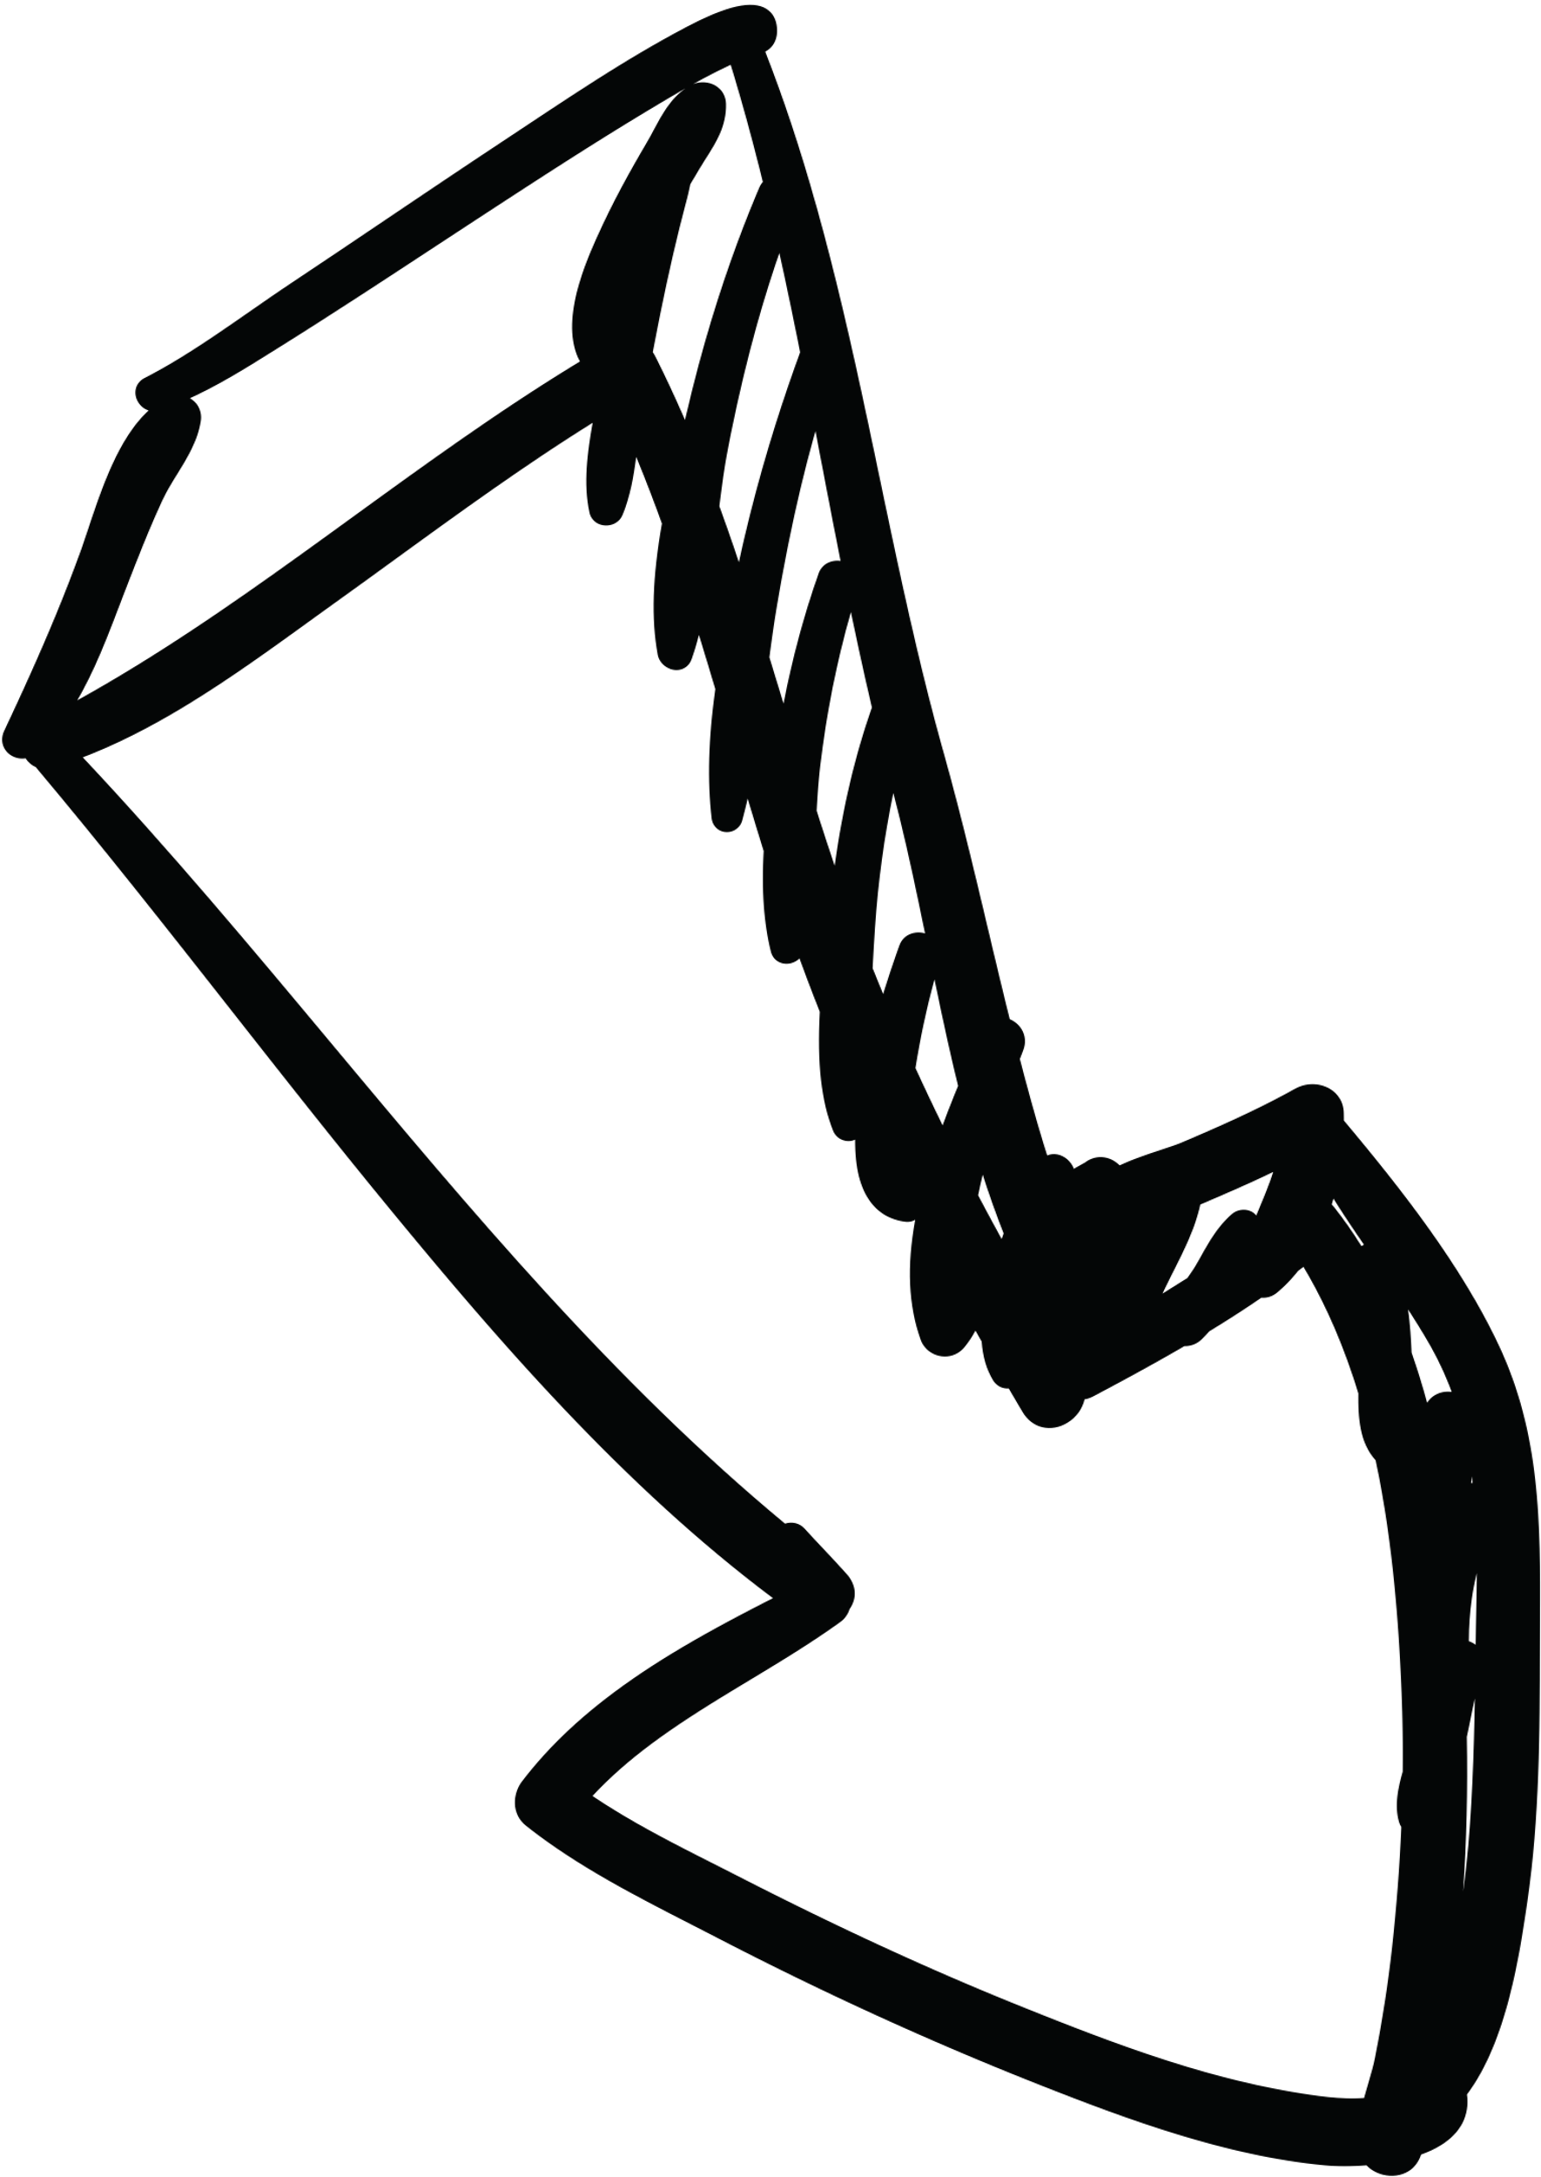
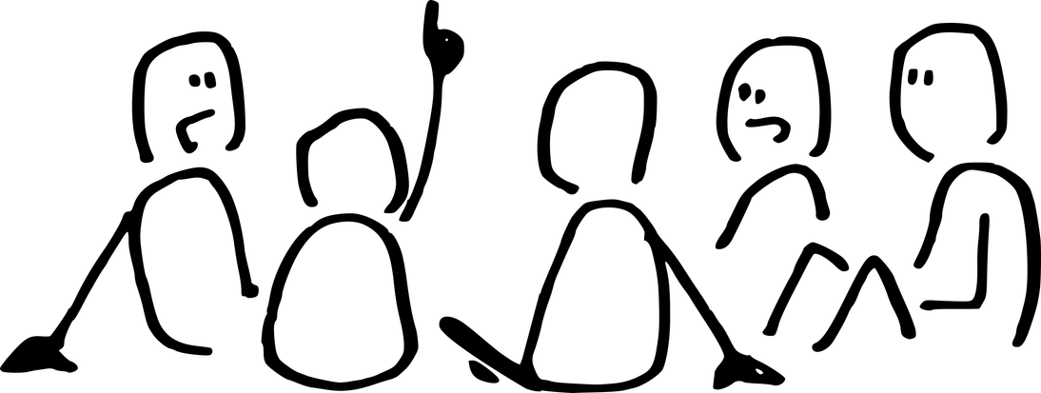
Motivation
The Challenge
Our Approach
Gaia detects billions of sources across the whole sky
But its on-board detection is optimized for point sources
It still detects some extended objects
thinking they are stars
Euclid imaging resolves structure that Gaia cannot
Cross-match Euclid x Gaia, then train on Gaia-only
features to classify the wider Gaia catalogue.
Eulcid
Gaia
Key Idea: Can we use Euclid labels to train a model on Gaia-only parameters,
that can reliably distinguish stars from galaxies across the whole sky?
4
Notes:
[~1m30s] What's the big motivation behind all this, and what are we actually trying to achieve?
So we have Gaia, this space telescope that gives us an incredible full-sky catalogue,
but its image depth is shallower, so it doesn't really tell us much about what sources look like
because it was designed mainly for stars,
so its onboard detection is optimised for point sources.
Even so, no algorithm is perfect: Gaia still detects non-stellar objects as well.
Euclid, on the other hand, can actually resolve structure.
But it only covers a subset of the Gaia data.
So the idea is: we use the subset of Gaia sources with Euclid labels, train a model based only on their Gaia information,
then we apply that model across the full Gaia catalogue,
which could help us find a lot more galaxies and other extended sources across the whole sky.

Slide 5


The Missions: Gaia & Euclid
Gaia
Euclid
ESA astrometry mission, launched 2013, orbit around L2
Whole-sky survey: 1.8B sources — shutdown Mar 2025
6-hour spin + 63-day precession
ESA dark energy mission, launched 2023, orbit around L2
Deep-field survey: 14,000 deg² over 6 years
Step-and-stare ~70 min per field (0.5 deg²)
The Bridge: Euclid gives us depth and detail; Gaia gives us scale and sky coverage.
5
Notes:
[~1m] So now that I've explained the motivation, let me briefly introduce the two missions we're combining.
Gaia is ESA's astrometry mission, launched in 2013, and it gives us an all-sky catalogue of around 1.8 billion sources.
And Euclid is a newer, deeper imaging mission, surveying smaller areas in much greater detail.
So the key point for this project is:
Gaia gives us scale,
and Euclid gives us the imaging quality needed to provide labels.
That combination is what lets us train on the overlap and then extend the classification much more broadly.

Slide 6

The Missions: Gaia & Euclid Fields
Gaia DR3 scanning law (number of transits) with Euclid Q1 and ERO field footprints overlaid
6
Notes:
[~30s] This is just a map of where our Euclid data sit relative to Gaia.
The background is Gaia's scanning law, shown as the number of transits,
and the outlined points mark the Euclid field footprints.
So basically these are the parts of the sky where we have both Gaia and Euclid, and where we can build the matched sample.

Slide 7
Data: Gaia DR3 & Euclid Releases
Gaia DR3 (Data Release 3)
1.8 billion sources — full sky catalogue including astrometric, photometric, and scan-quality information
~153 features available in the gaia_source table for potential use in classification
Euclid ERO (Early Release Observations)
Euclid Q1 (Quarter 1 Release)
17 fields with VIS-band photometry
Star-Galaxy estimators: class_star, spread_model
~12,000,000 sources in ERO catalogue
~330,000 sources matched with Gaia
Before match: ~30% stars, ~70% galaxies
After match: ~95% stars, ~5% galaxies
4 fields with multi-band VIS + NIR photometry
Classification labels: phz_classification
~22,200,000 sources in Q1 catalogue
~340,000 sources matched with Gaia
Before match: ~10% stars, ~90% galaxies
After match: ~75% stars, ~25% galaxies
7
Notes:
[~1m30s] This slide summarises the three datasets I use.
Gaia DR3 is really the base dataset here: it gives us the all-sky source list and the source parameters we ultimately want to classify on.
For ERO, the relevant star-galaxy information comes from estimators like class_star and spread_model.
For Q1, the label I use is phz_classification. PHZ means photometric redshifts, and this is one of the Euclid pipeline processing functions.
It uses the photometric information to classify sources, and those labels are already available directly in the catalogue.
And we can see very clearly in the fractions here an important Gaia selection effect.
As Gaia is a stellar catalogue, after cross-matching to Gaia,
ERO goes from roughly 30% stars to about 95%,
while Q1 goes from about 10% to about 75%.
Both matched samples bias strongly toward stars,
especially for ERO, which becomes much more star-dominated.

Slide 8
02
Cross-Matching
Building the training set from Euclid × Gaia
Notes:
[~5s] Now we move into the technical work. First up: how we cross-match the two catalogues.

Slide 9



Cross-Matching Methodology
ERO: Spatial Matching
Gaia sources matched to the nearest ERO source on the sky, within a maximum radius 0.3"
One-to-one nearest-neighbour pairing
Separation distribution shows a bump at 0.1–0.15"
→ not expected!
Q1: Direct Catalogue ID Matching
A pre-computed Gaia_ID is stored in the catalogue:
Gaia positions are propagated from DR3 epoch to Euclid reference time
Angular separation distribution is near-Rayleigh
→ clean matches ✓
Q1 (top): clean Rayleigh fit confirms reasonable 0.3" cutoff radius.
ERO (bottom): unexpected bump at 0.1–0.15" → what is this?
9
Notes:
[~1m30s] This slide compares the two matching methods.
For Q1, the match is relatively straightforward.
The catalogue already provides a Gaia_ID built by propagating Gaia positions from the DR3 epoch to the Euclid reference epoch,
and the resulting separation distribution looks clean and near-Rayleigh, which is what we expect.
It also shows that a 0.3 arcsecond cutoff is a sensible place to truncate the tail
where matches are more likely to be spurious.
As ERO is an earlier release, processed with a different ERO-specific pipeline rather than the later Q1 pipeline,
we do not have an equivalent epoch-propagated Gaia identifier.
The matching must be done directly on sky position instead.
For each Gaia source I look for the nearest ERO source within 0.3 arcseconds,
and enforce a one-to-one nearest-neighbour match.
That mostly behaves as expected,
but unlike Q1, the separation distribution shows this extra bump around 0.1 to 0.15 arcseconds.
This is not normal for position-based cross-matching.
Something interesting is happening that needs further investigation.

Slide 10
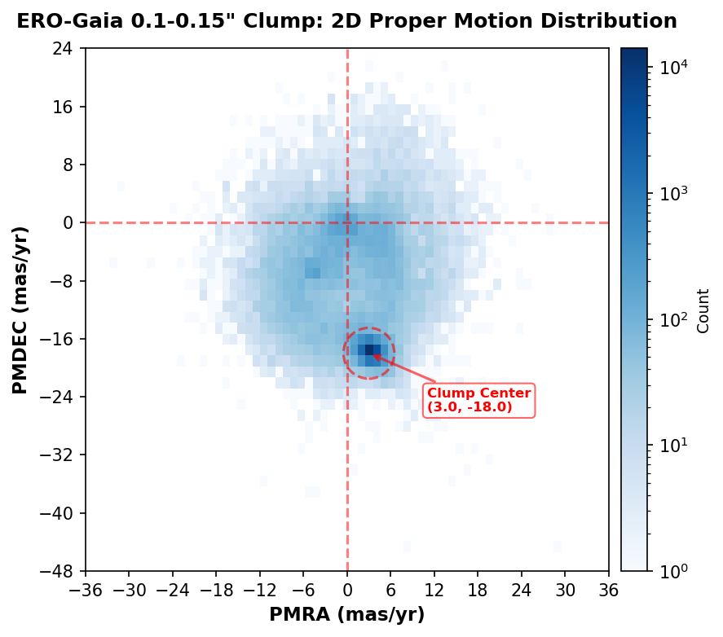


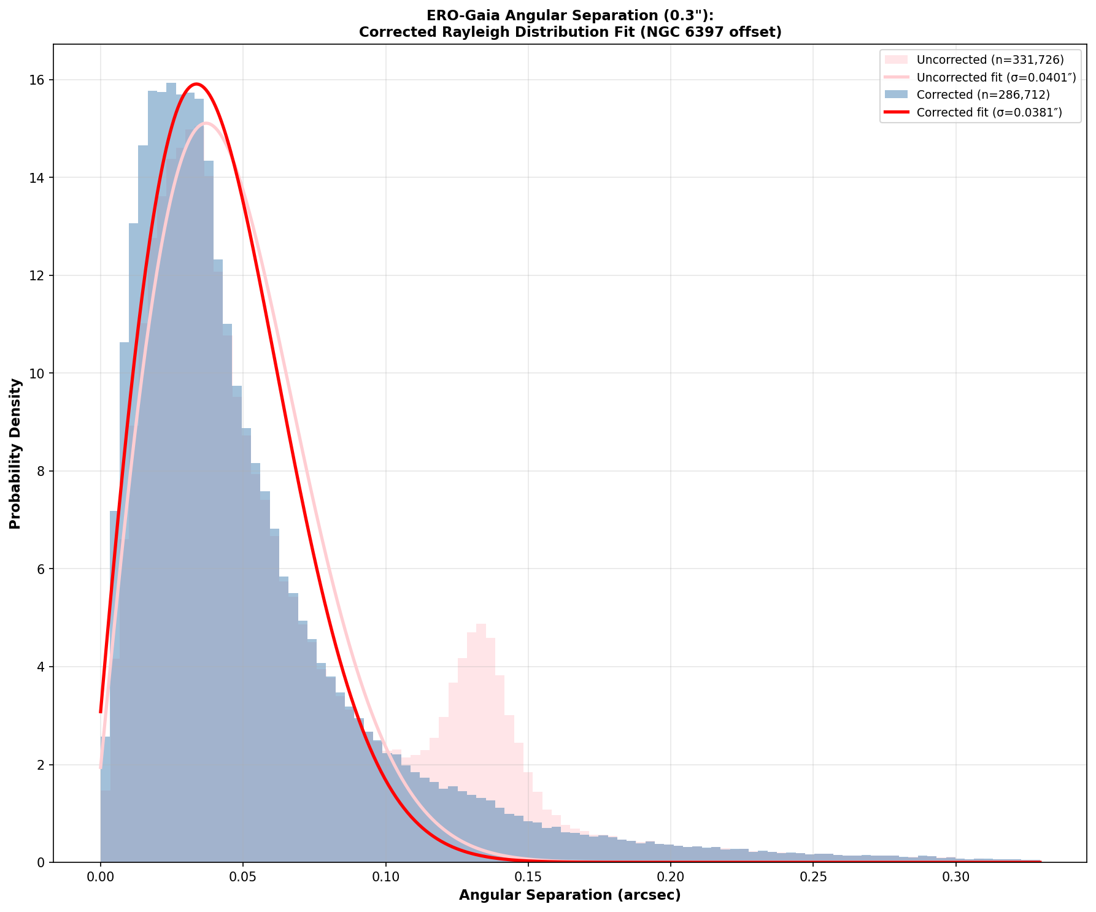
ERO Separation Bump
Proper-motion clue →
Systematic shift →
Diagnosis: NGC 6397 →
Clean Distribution by Correction
1
2
3
4
Shared motion
Coherent Offset
Cluster identified
Bump Correction
Bump sources cluster near (3, −18) mas/yr, suggesting a common population.
Their position offsets are aligned rather than random, indicating a systematic shift
Offsets traced back to NGC 6397, where epoch mismatch matters.
After correcting for proper motion, the bump in distribution collapses
10
Takeaway: the ERO anomaly is astrophysical and epoch-related, not a failure of the matching method.
Notes:
[~2m] So how do we explain the ERO separation bump?
We start by extracting the sources in the 0.1 to 0.15 arcsec bump and looking at their proper motion.
The 2D distribution shows that these bump sources cluster around a proper motion of (3, -18) milli-arcsec per year,
which suggests they are highly likely to be part of the same population.
We then trace the position offsets between the coordinates recorded by Gaia and by Euclid,
and can see that they carry the same coherent shift rather than random scatter.
This strongly suggests they are gravitationally bound and part of the same structure.
When we trace the coordinates of these position offsets back,
it points to NGC 6397, a nearby globular cluster about 7,800 light-years away.
So these sources are moving together as part of the same cluster, and Gaia and Euclid are simply seeing them at different times.
Gaia positions were recorded at epoch 2016.0, and Euclid observed years later.
The cluster stars had physically moved a noticeable distance in the intervening years.
Once we correct for the proper motion, the bump collapses back into the main Rayleigh peak.
So the conclusion is that this anomaly is astrophysical and epoch-related, not a problem with the matching method.

Slide 11
03
Validating Euclid Labels
How reliable are the training labels?
Notes:
[~5s] So now that we've built the matched Gaia-Euclid sample,
but before training any model,
we need to check: are the Euclid labels themselves actually reliable enough to use for training?

Slide 12
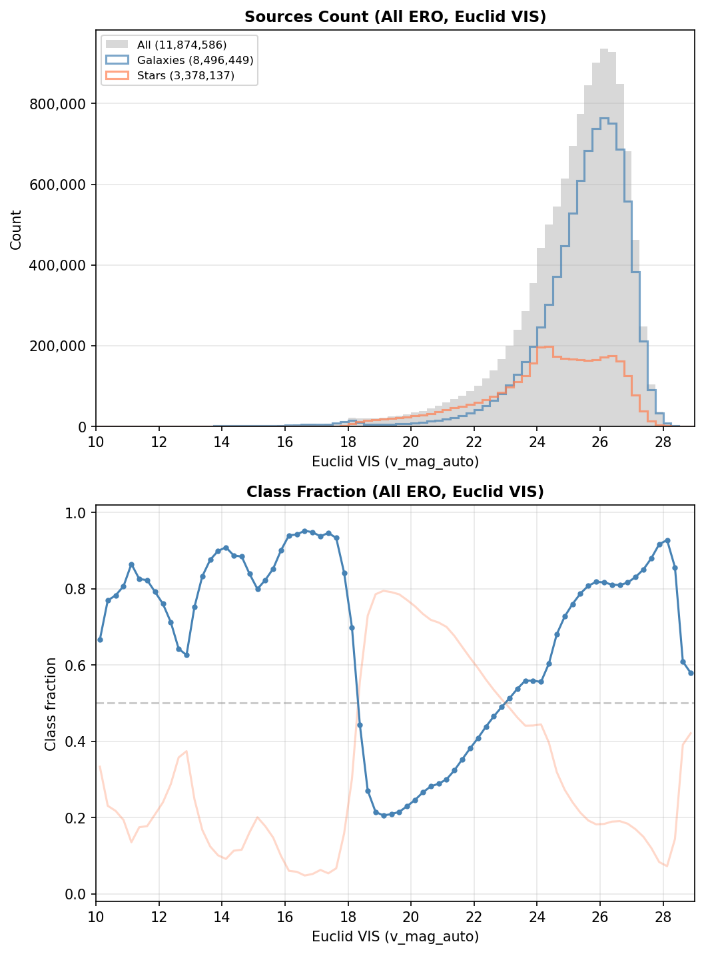
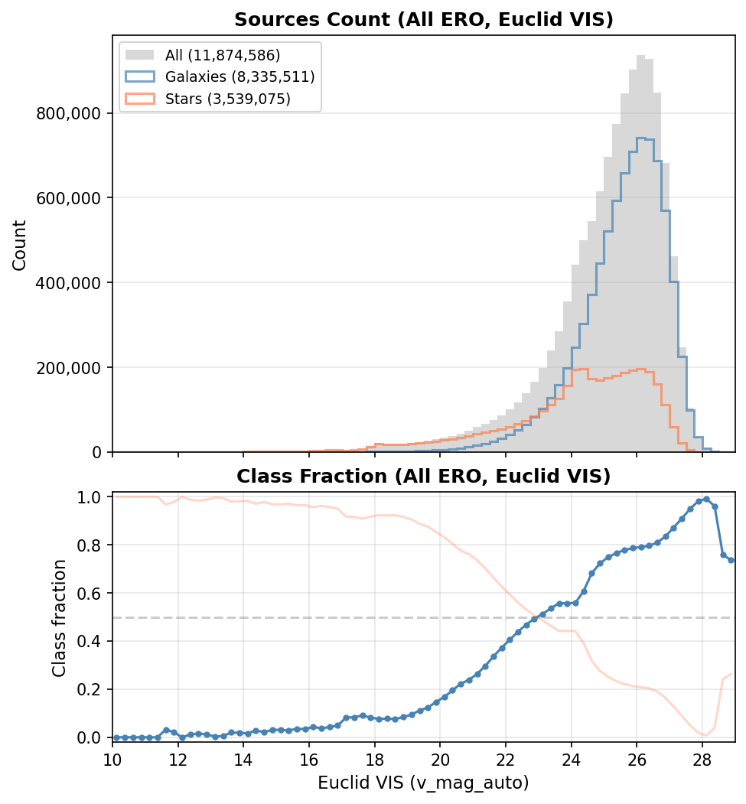
ERO Label Validation: spread_model vs class_star
spread_model
class_star
Conclusion: class_star is more reliable than spread_model for star-galaxy separation
12
Notes:
[~1m30s]
We examined the magnitude distribution by plotting the count and fraction of galaxies against magnitude for the ERO dataset.
On the left is spread_model. It shows a characteristic bumpy structure caused by magnitude-dependent systematic effects. spread_model uses an error-weighted threshold that depends on its own uncertainty, spreaderr_model. At bright magnitudes, high signal-to-noise measurements produce tight thresholds and genuinely point-like sources get misclassified as extended. At faint magnitudes, the opposite happens: low signal-to-noise loosens the threshold and extended sources get misclassified as point-like.
On the right is class_star. It shows the expected monotonic behaviour: point-like sources dominate at bright magnitudes, with the extended fraction increasing smoothly toward fainter magnitudes. This is what we would physically expect, because fainter galaxies are more numerous as they are further away and cosmological redshift shifts them to fainter magnitudes.
So we trust class_star over spread_model for the ERO classification.
Now, we look at the magnitude distribution after matching these sources with Gaia.

Slide 13
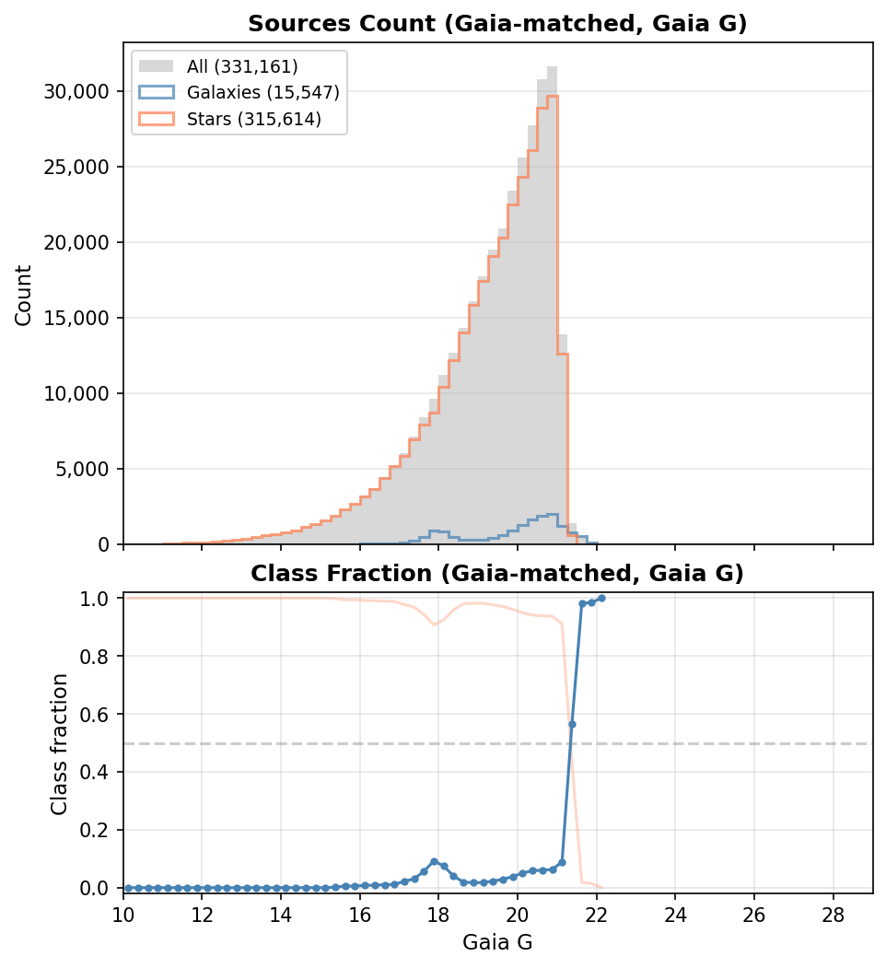
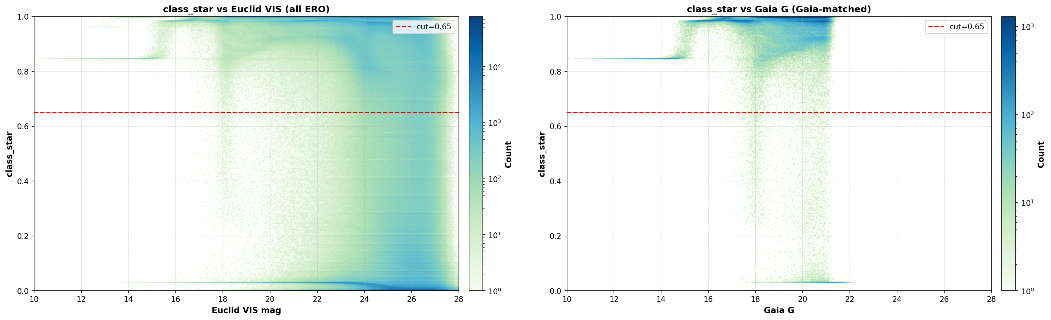
ERO Gaia-Matched Distribution
The bump in galaxy fraction at G~18 traces directly to a feature in the class_star values — suspicious pipeline artefact
13
Notes:
[~1m30s]
When we look at the distribution of ERO sources after matching with Gaia, plotted in Gaia G magnitude,
we see a suspicious bump around G magnitude 18 in the galaxy fraction of the matched sources.
To trace the origin of this bump, we plot a 2D histogram of class_star value against magnitude.
This clearly shows the bump in the population distribution propagates directly from a feature in the class_star values themselves.
This is highly suspicious and likely a pipeline artefact rather than a genuine physical feature in the data.
What is causing this? Let's investigate.

Slide 14
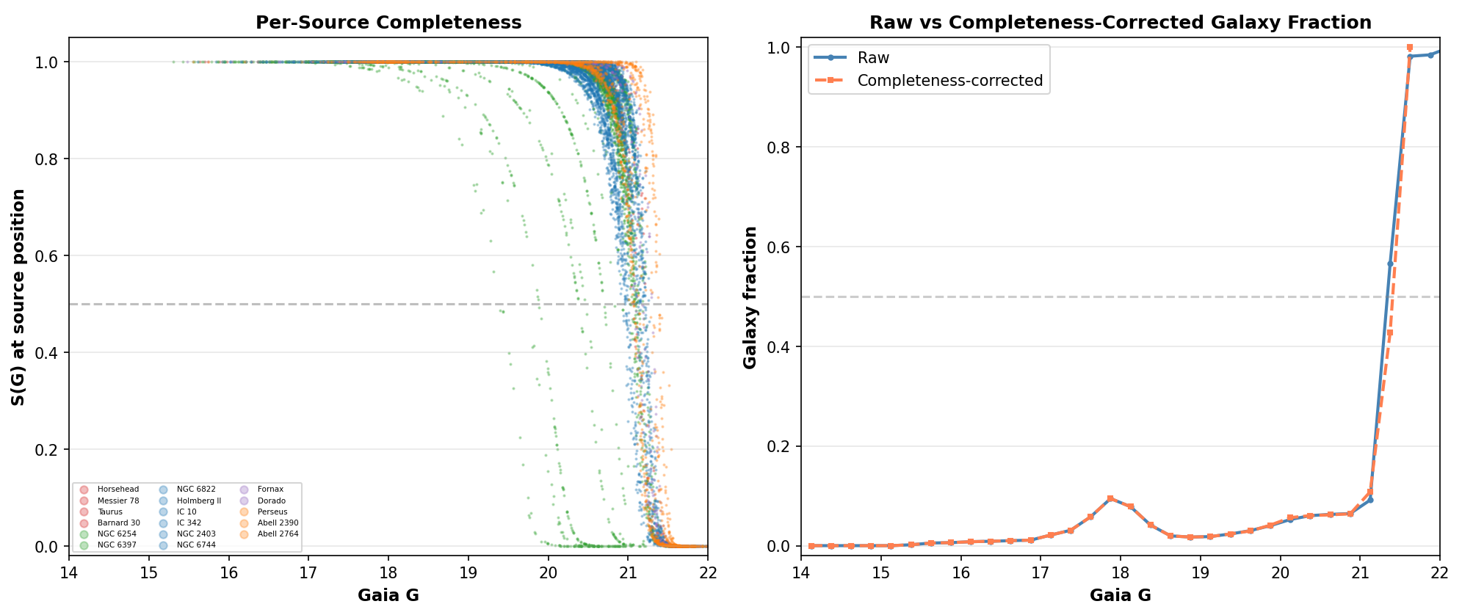
Investigating the Bump: Gaia Selection Effects
Bump appears in all 17 ERO fields. Applied Gaia DR3 selection function S(G|M10).
Conclusion: Gaia incompleteness changes faint-end counts but does not alter galaxy-vs-star balance. The bump remains unexplained.
14
Notes:
[~1m30s]
What is causing this bump? We investigate two possibilities.
First: is this caused by a single field that deviates from normal selection? We check each of the 17 ERO fields individually. The bump is present in all of them, so it is not a single-field anomaly.
Second: is this a Gaia selection effect? After all, the bump only becomes this sharp after matching with Gaia. We apply an empirical model of the Gaia DR3 selection function, S(G|M10), where M10 is the median magnitude of sources with 10 or fewer astrometric matched transits in a given sky patch.
The selection function depends on how many times Gaia observed a region and how crowded it is. If a region has many visits and low crowding, completeness is better. If it is crowded or poorly scanned, only the brighter sources make it into the catalogue.
This plot shows the raw versus completeness-corrected galaxy fraction. Gaia incompleteness clearly changes the observed galaxy counts at the faint end, but it affects stars and galaxies fairly similarly as a function of G magnitude, so it is not strongly altering the galaxy-versus-star balance.
The bump in the ERO class_star remains unexplained by selection effects alone. It is likely a genuine pipeline artefact.

Slide 15
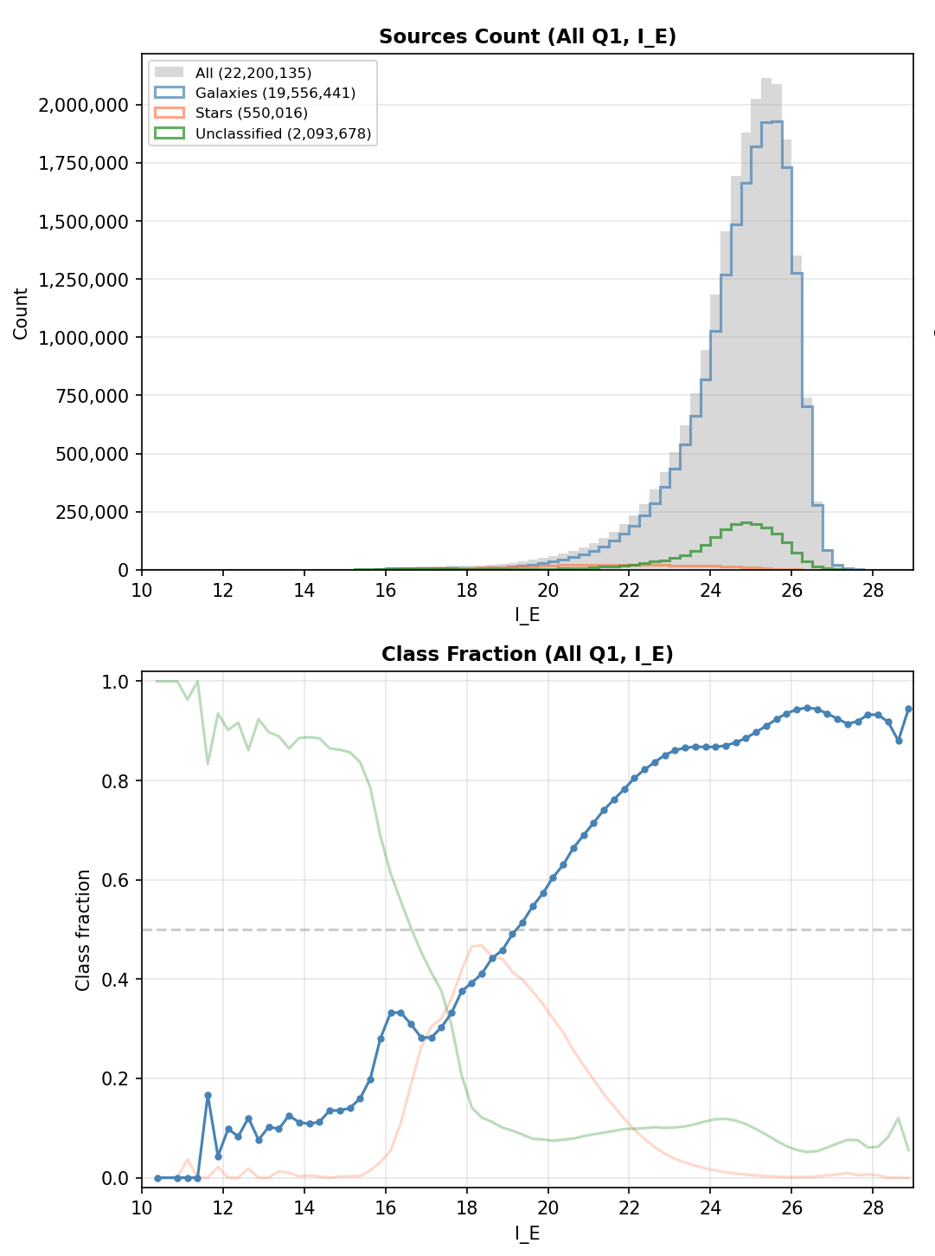
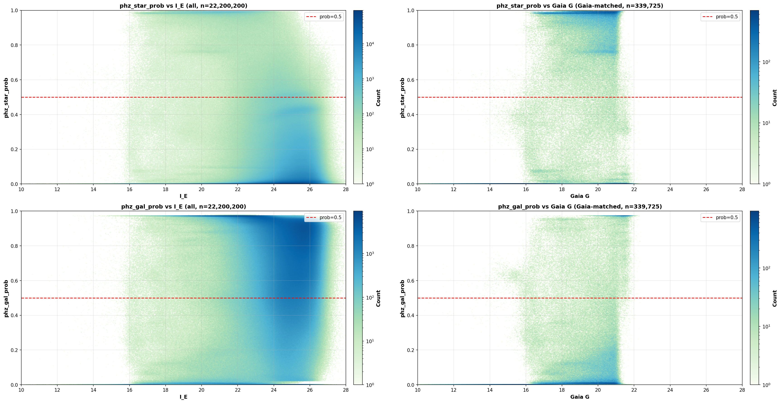
Q1 Label Comparison
Q1 PHZ Classification
Smooth monotonic distribution
2D histogram is clean (compare to ERO)
Conclusion: Q1 labels are significantly more reliable than ERO. Use Q1 for model training.
15
Notes:
[~1m]
Now we check the same with Q1 using the phz_classification labels.
The left plot shows the Q1 magnitude distribution. It has the expected monotonic increase in galaxy fraction toward fainter magnitudes, fairly smooth, and without the suspicious bumps we saw in ERO.
The right plot is the 2D probability histogram. Compare this with the ERO version: Q1's distribution is smooth and well-behaved, with no sharp features or suspicious structure.
This gives us strong confidence that Q1 labels are significantly more reliable than ERO class_star labels. This is why we choose to train our model on Q1 data only.

Slide 16
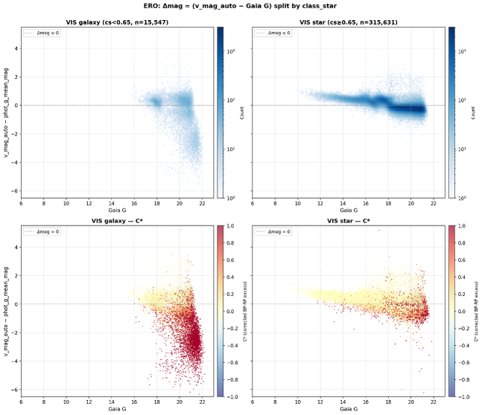

Photometric Systematics: Δmag Check
Δmag Analysis: ERO vs Q1
Δmag = Euclid mag − Gaia G magnitude
Galaxies: redder, brighter in Euclid → negative Δmag expected
Stars: bluer, brighter in Gaia → positive Δmag expected
ERO shows wiggly artefacts
Q1 shows cleaner separation; G ≥ 17 cut manages bright-end misclassification
Q1 labels are significantly more suitable for training than ERO labels
16
Notes:
[~1m30s]
Here we examine photometric systematics using delta-mag, which is Euclid magnitude minus Gaia G magnitude.
Stars and galaxies should occupy distinct regions in this space.
For galaxies: Euclid measures extended flux by adding up flux over the extent of the source, so galaxies should appear brighter in Euclid, giving negative delta-mag. Also, galaxies tend to be redder, which again means brighter in Euclid's VIS bandpass compared to Gaia's broader G band.
For stars: they are typically bluer, so they should be brighter in Gaia, giving positive delta-mag.
The ERO delta-mag plot on top shows some wiggly artefacts, consistent with what we saw in the class_star analysis.
The Q1 delta-mag plot below shows much cleaner separation between stars and galaxies.
We can manage bright-end misclassification by imposing a magnitude cut at G of about 17.
This further confirms that Q1 labels are significantly more suitable for training than ERO labels.

Slide 17
04
Model Training
Training on Q1 data only — ERO labels unreliable
Notes:
[~5s] Now we move on to model training. Based on everything we have seen so far, we train exclusively on Q1 data because the ERO labels are unreliable.

Slide 18
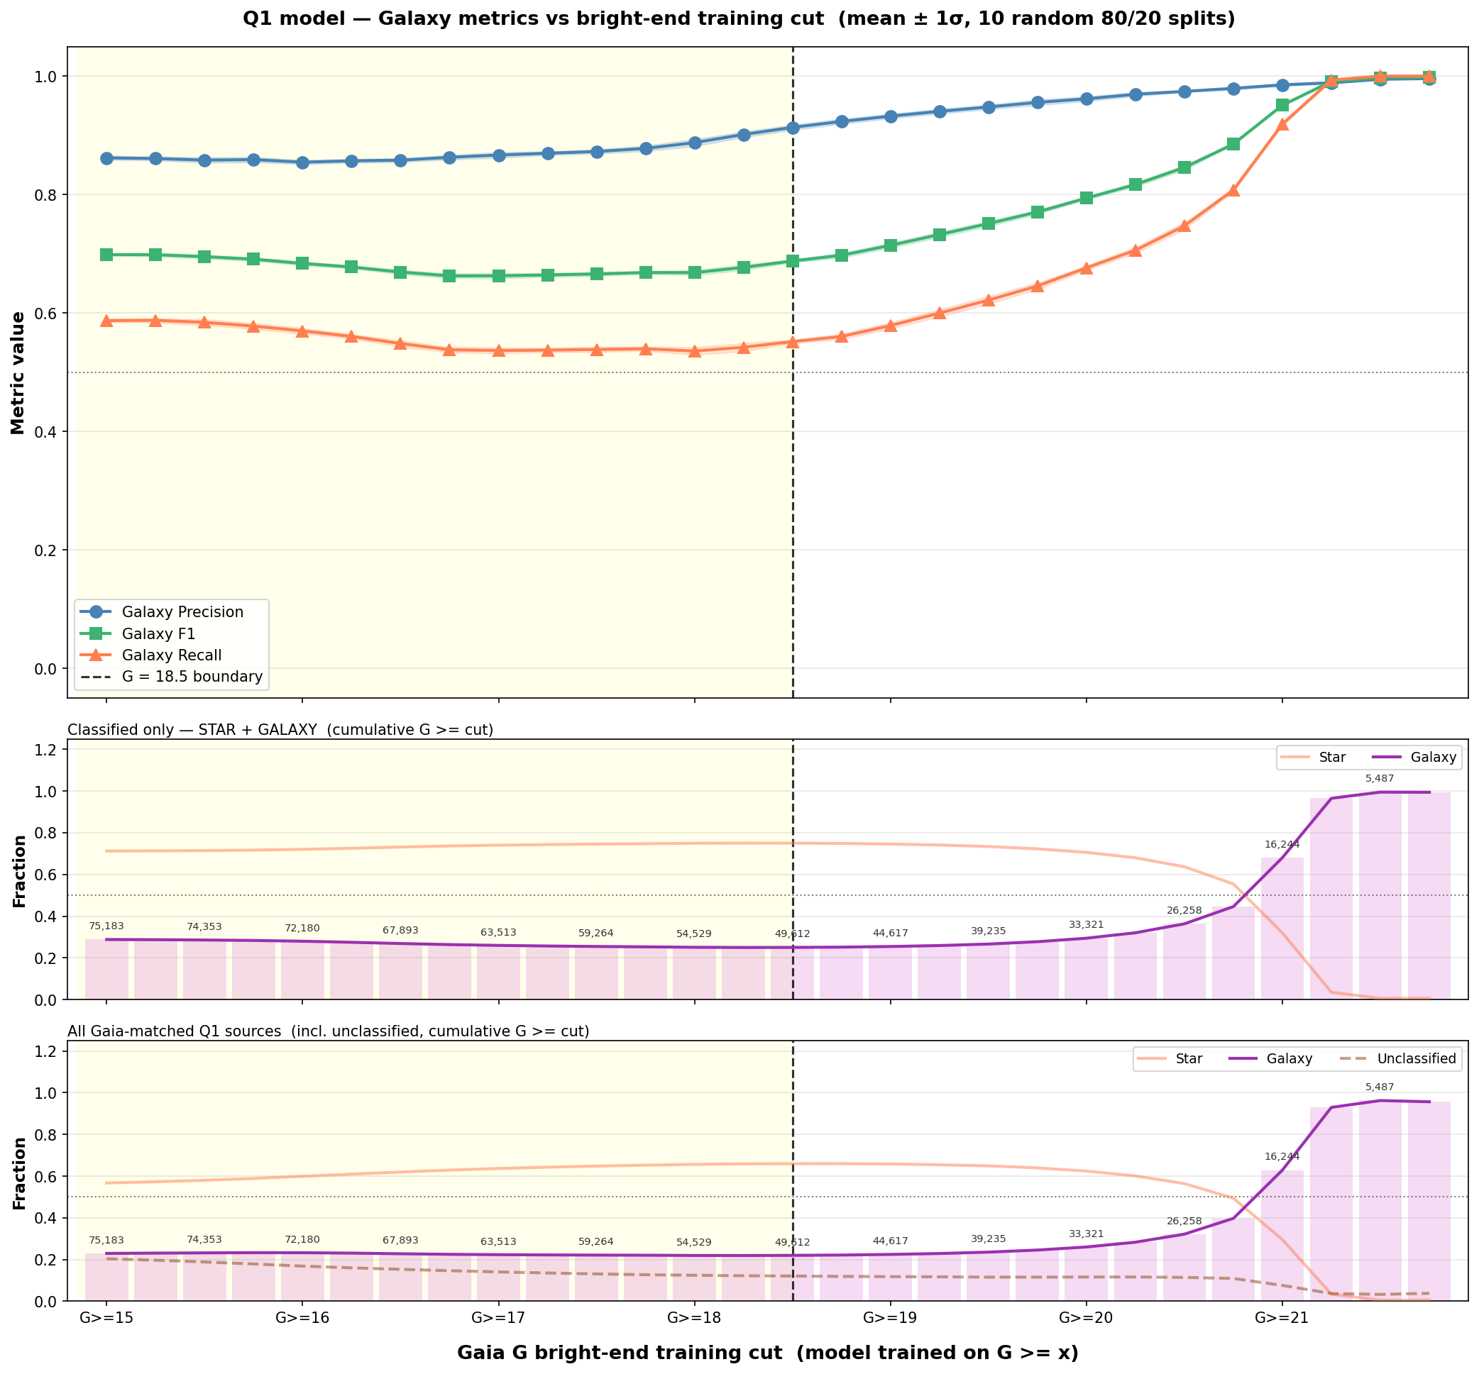

Magnitude Cut Sensitivity
Q1 cross-validation performance as a function of magnitude cut
18
Notes:
[~1m30s]
How sensitive are the results to the magnitude cut?
The heatmap shows cross-validation performance across different magnitude bounds.
Performance is relatively stable for reasonable cuts.
The sweet spot is around G greater than or equal to 17.
Cutting too bright includes well-classified objects but reduces the galaxy fraction.
Cutting too faint loses signal-to-noise.
The line plots show individual metrics as functions of the cuts.
We decided that a magnitude cut at G greater than or equal to 17 should be safe for training a model on the Q1 truth table.
Also, the feature importance ranking is quite consistent across different magnitude cuts,
which suggests the model has learned genuine physical signal rather than noise.

Slide 19
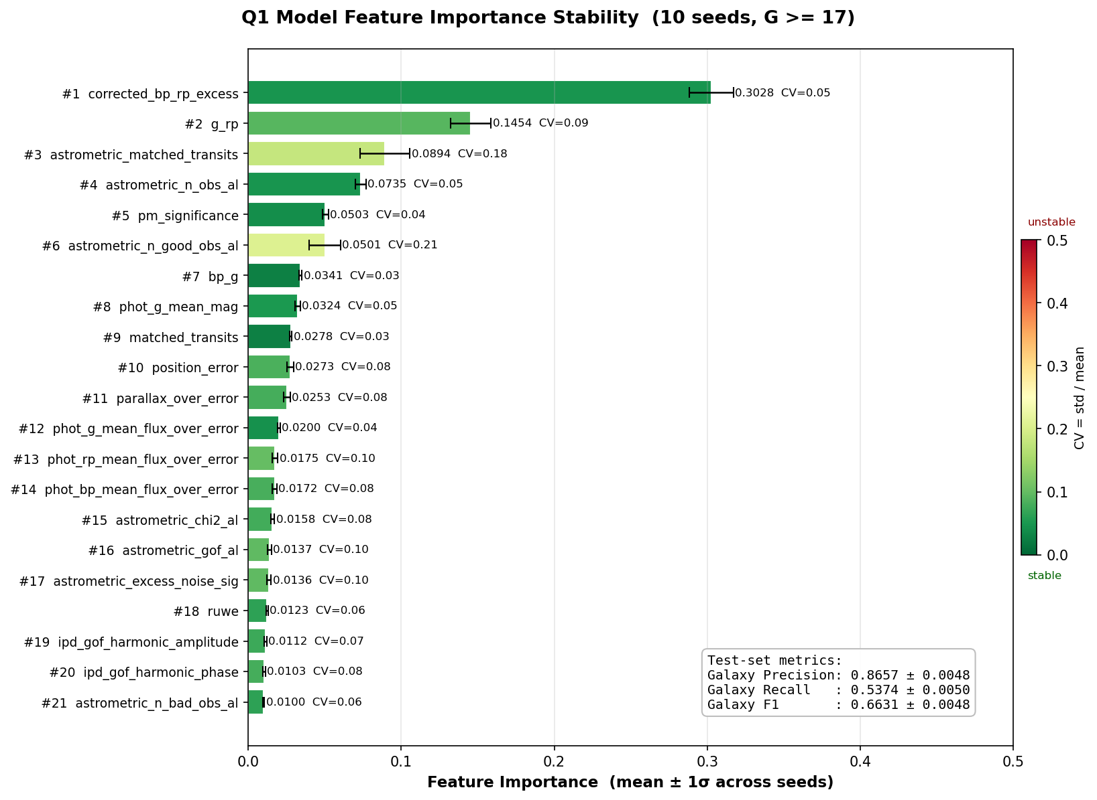
Q1 Model - Feature Importance
Top Features
corrected_bp_rp_excess is the dominant feature — physically motivated. Extended objects like galaxies show excess BP/RP flux compared to point sources
Photometric colours and astrometric parameters also contribute
23 features total used across all experiments
19
Notes:
[~1m]
Feature importance from the XGBoost classifier.
corrected_bp_rp_excess is by far the strongest feature, and this is physically motivated:
extended objects like galaxies show excess BP/RP flux compared to point sources,
because Gaia's BP and RP spectrophotometers have wider windows than the G band.
Photometric colours and astrometric parameters also contribute.
23 Gaia-only features are used in total across all experiments.
This confirms there is real morphological signal in the Gaia parameters.

Slide 20
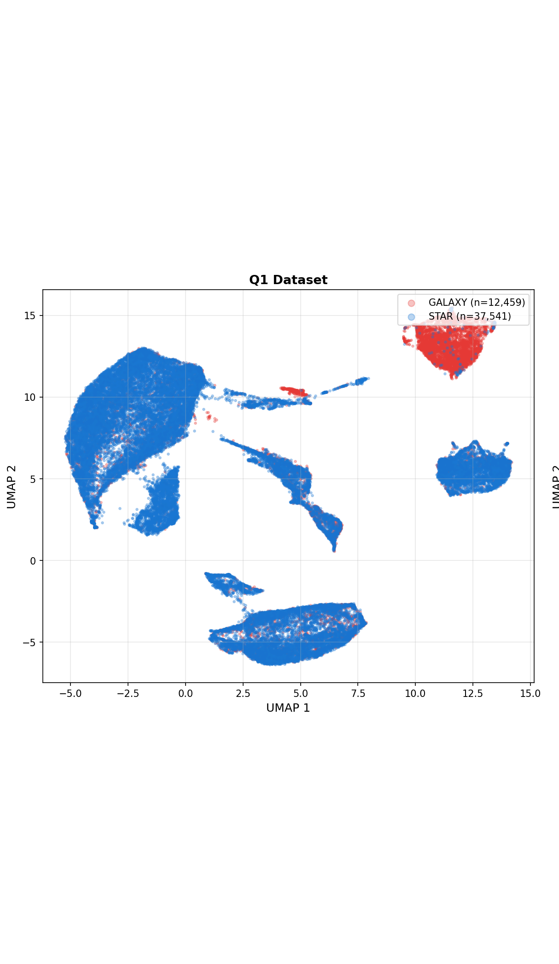
UMAP: Star-Galaxy Separation
in Feature Space
UMAP projection of the 23-dimensional Gaia feature space, coloured by star/galaxy label
20
Notes:
[~30s]
UMAP dimensionality reduction of the 23 Gaia features for the Q1 dataset, coloured by star/galaxy label.
Stars and galaxies form somewhat distinct clusters,
which confirms there is real separating signal in the Gaia parameters.

Slide 21
05
Testing & Verification
verification of disagreements between ERO label and Q1 model
Notes:
[~5s] Now we test the Q1-trained model on the ERO dataset and verify disagreements visually.

Slide 22
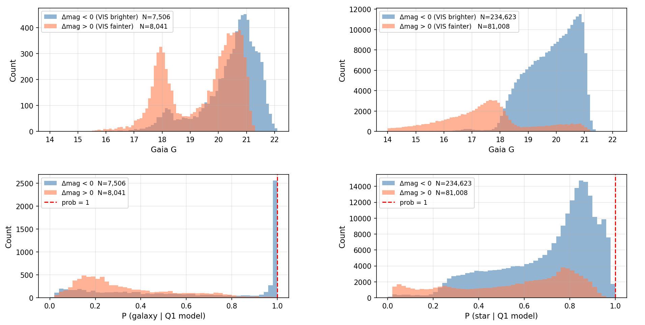
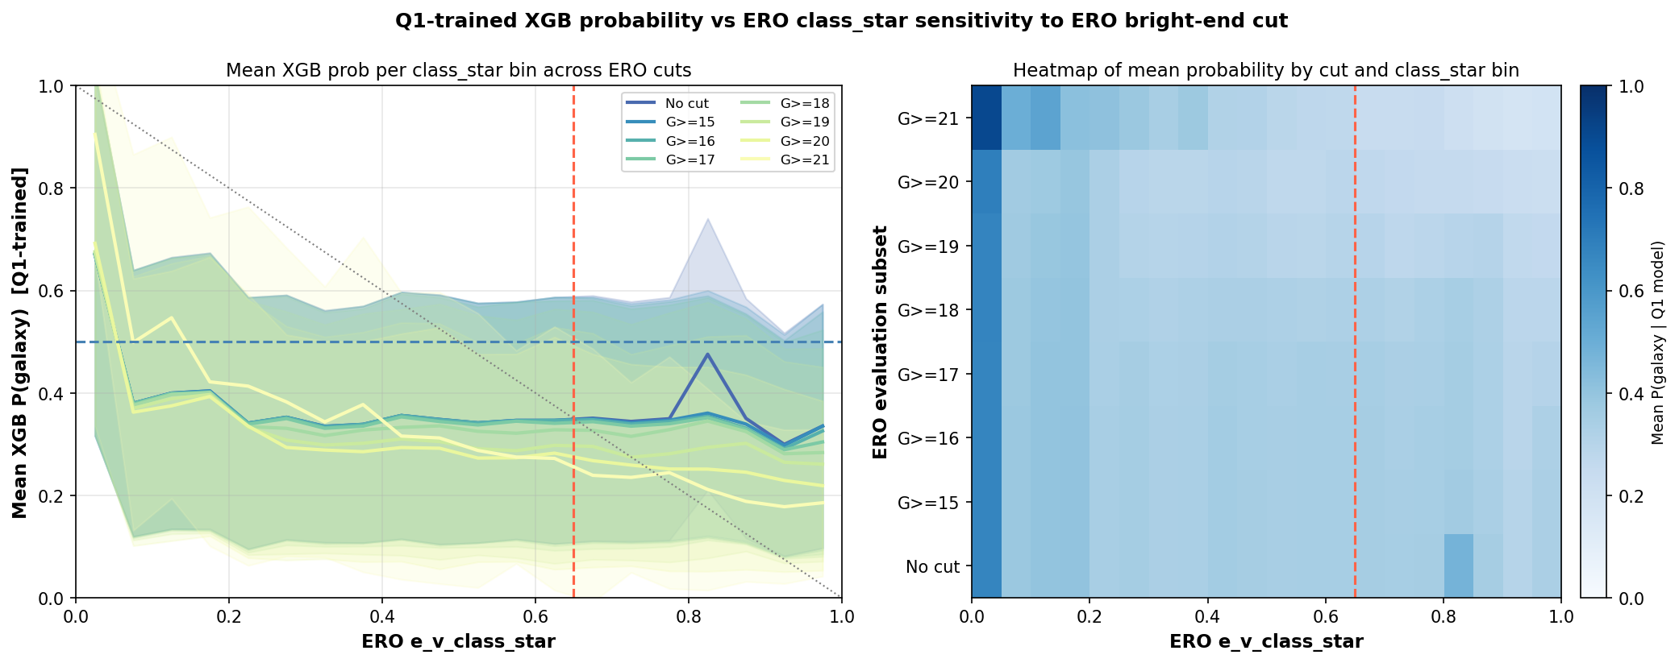
Behavior of ERO Dataset in Q1 Model
22
Notes:
[~1m]
When we apply the Q1-trained XGBoost model to the ERO dataset, we find significant disagreement with ERO's class_star labels.
The delta-mag plot on the left shows the ERO data split by both class_star and Q1 model predictions.
The probability comparison on the right shows anti-correlation between Q1 model galaxy probability and ERO class_star,
which is further evidence that ERO labels are unreliable.
We want to examine cutout images to verify which label gives the true classification when there is disagreement.

Slide 23
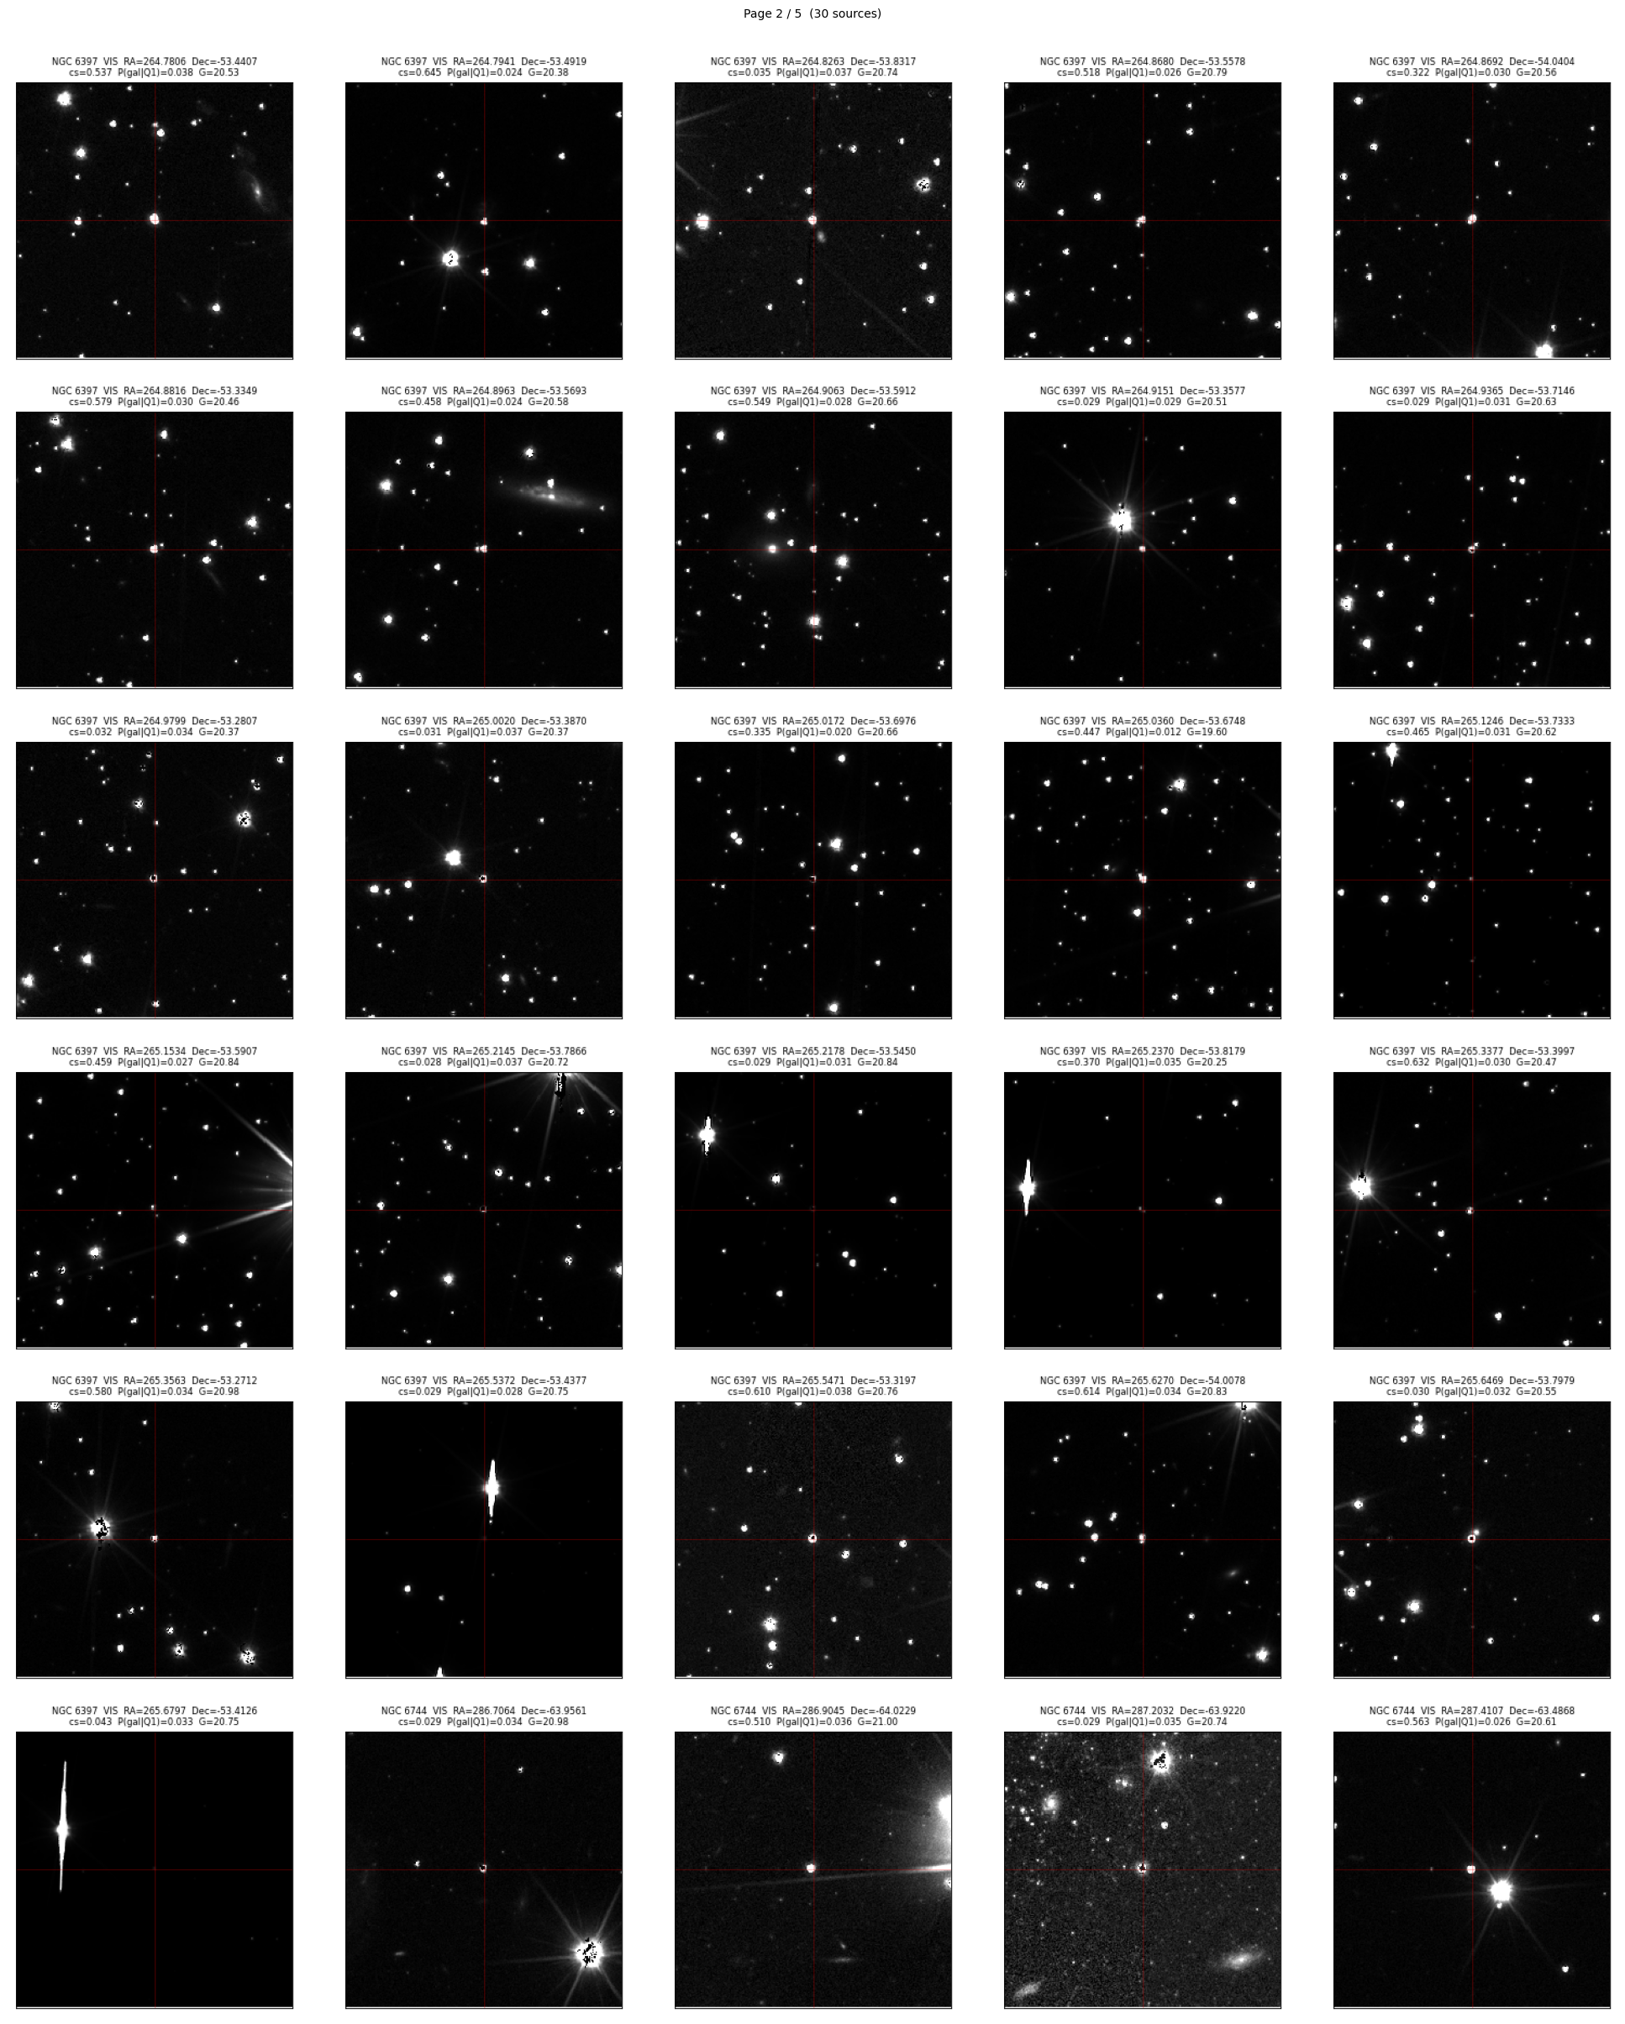
Cutout Verification: ERO Disagreements
Visual Verification
Sources where ERO class_star and Q1
model disagree on classification
Cutouts show these are clearly stellar
(point-like, no extended structure)
Q1 model correctly identifies them as
stars where ERO labels them galaxies
Conclusion: Visual inspection confirms Q1 model gives more reliable classifications than ERO class_star
23
Notes:
[~1m]
To verify which label is correct when ERO and the Q1 model disagree, we examine Euclid cutout images directly.
These are sources that ERO class_star labels as galaxies, but our Q1-trained model classifies as stars. Looking at the cutouts, these sources are clearly point-like with no extended structure visible. They are stars.
This visual inspection confirms that the Q1 model predictions are correct and the ERO class_star labels are indeed unreliable for these sources.

Slide 24
06
Summary & Conclusions
Key findings and next steps
Notes:
[~5s] Finally, let me wrap up with a summary of the key findings and discuss what comes next.

Slide 25
Summary & Key Findings
What We Found
Next Steps
Euclid × Gaia cross-matching generates morphological training labels
Cross-match validation via NGC 6397 proper motion analysis
Magnitude cut sensitivity shows Q1 model performance robust across magnitude range
corrected_bp_rp_excess is the strongest feature (physically motivated)
Q1 labels significantly more reliable than ERO labels
Settle the magnitude cut question (sensitivity analysis ongoing)
Re-examine ERO vs Q1 label quality and potential systematics
Re-run full experiments with optimized parameters once decisions finalized
Test with future Euclid releases for expanded sky coverage
Apply classifier to full Gaia DR3 catalogue
Bottom line: Gaia parameters contain real morphological signal. Currently investigating optimal magnitude cut and label quality; once settled, re-running full experiments with refined approach before finalizing results.
25
Notes:
[~5s] Let me summarise our key findings and outline the next steps.

Slide 26
Thank You
Questions?
Sylvia Zhao
sz423@cam.ac.uk
Institute of Astronomy, University of Cambridge
Notes:
[~1m]
Cross-matching Euclid and Gaia generates morphological training labels.
The NGC 6397 proper motion analysis validates that the cross-matching methodology is sound.
ERO class_star labels show artefacts: a bump at G~18 that persists across all fields and is not explained by Gaia selection effects.
Q1 labels are significantly more reliable, showing clean monotonic distributions.
Magnitude cut sensitivity analysis shows Q1 model performance is robust across the magnitude range.
corrected_bp_rp_excess is the strongest predictor, with clear physical motivation.
Next steps: complete cutout verification of ERO disagreements,
apply the validated Q1 classifier to the full Gaia DR3 catalogue,
and test with future Euclid releases for expanded sky coverage.

