Slide 1
Euclidifying Gaia
Using Machine Learning to Classify
Non-Point-Like Objects in Gaia DR3
Sylvia Zhao
Part III Astrophysics | Lent Term 2026
Supervisors: Diana Harrison, Simon Hodgkin, Vasily Belokurov
Institute of Astronomy, University of Cambridge
Notes:
[~30s]
hello everyone, my name is Sylvia, thank you for coming to my presentation.
this is my Part III project: Euclidifying Gaia
which is using machine learning to classify non-point-like objects in Gaia Data Release 3 catalogue
with the help of higher-resolution imaging from Euclid

Slide 2
Outline
1
Background
Motivation, missions, data releases
2
Cross-Matching
Methodology, validation, correction
3
Validating Euclid Labels
ERO & Q1 label reliability
4
Model Training
XGBoost classifier, magnitude sensitivity, feature importance, UMAP
5
Testing & Verification
Q1 model on ERO, cutout verification
6
Summary & Conclusions
Key findings and next steps
2
Notes:
[~30s]
Here's roughly what we'll be covering today:
starting with the background and motivation
then cross-matching methodology
validating the Euclid classification labels
training our model using XGBoost classifier
testing and verifying our model
finally, summary and conclusions

Slide 3
01
Background
What we’re trying to achieve, and why?
Notes:
[~5s]
I'll set out by explaining what the project is trying to achieve,
what motivates it,
and the datasets that make it possible

Slide 4





Motivation
The Challenge
Our Approach
Gaia detects billions of sources across the whole sky
But its on-board detection is optimized for point sources
It still detects some extended objects
thinking they are stars
Euclid imaging resolves structure that Gaia cannot
Cross-match Euclid x Gaia, then train on Gaia-only
features to classify the wider Gaia catalogue.
Eulcid
Gaia
Key Idea: Can we use Euclid labels to train a model on Gaia-only parameters,
that can reliably distinguish stars from galaxies across the whole sky?
4
Notes:
[~1m30s]
what’s the big motivation behind all this, and what are we actually trying to achieve?
So we have Gaia, this space telescope that gives us this incredible full-sky catalogue,
but its image depth is shallower, so it doesn’t really tell us much about what sources look like
because it was designed mainly for stars
so its onboard detection is optimized for point sources.
even so, no detection algorithm is perfect — Gaia still detects non-stellar objects as well
Euclid, on the other hand, can actually resolve structure
But it only covers a subset of the Gaia data
So the idea is: we use the subset of Gaia sources with Euclid labels, train a model based only on their Gaia information
then we apply that model across the full Gaia catalogue,
which could help us find a lot more galaxies and other extended sources across the whole sky.

Slide 5


The Missions: Gaia & Euclid
Gaia
Euclid
ESA astrometry mission, launched 2013, orbit around L2
Whole-sky survey: 1.8B sources — shutdown Mar 2025
6-hour spin + 63-day precession
ESA dark energy mission, launched 2023, orbit around L2
Deep-field survey: 14,000 deg² over 6 years
Step-and-stare ~70 min per field (0.5 deg²)
The Bridge: Euclid gives us depth and detail; Gaia gives us scale and sky coverage.
5
Notes:
[~1m]
So now that I’ve explained the motivation, let me now briefly introduce the two missions we’re combining
Gaia is ESA’s astrometry mission, launched in 2013, and it gives us an all-sky catalogue of around 1.8 billion sources
And Euclid is a newer, deeper imaging mission, surveying smaller areas in much greater detail
so the key point for this project is:
Gaia gives us scale
and Euclid gives us the imaging quality needed to provide labels
That combination is what lets us train on the overlap and then extend the classification much more broadly.

Slide 6

The Missions: Gaia & Euclid Fields
Gaia DR3 scanning law (number of transits) with Euclid Q1 and ERO field footprints overlaid
6
Notes:
[~30s]
So this is just a map of where our Euclid data sit relative to Gaia.
The background is Gaia’s scanning law, shown as the number of transits,
and the outline points mark the Euclid field footprints
so basically these are the parts of the sky where we have both Gaia and Euclid, and so where we can build the matched sample

Slide 7
Data: Gaia DR3 & Euclid Releases
Gaia DR3 (Data Release 3)
1.8 billion sources — full sky catalogue including astrometric, photometric, and scan-quality information
~153 features available in the gaia_source table for potential use in classification
Euclid ERO (Early Release Observations)
Euclid Q1 (Quarter 1 Release)
17 fields with VIS-band photometry
Star-Galaxy estimators: class_star, spread_model
~12,000,000 sources in ERO catalogue
~330,000 sources matched with Gaia
Before match: ~30% stars, ~70% galaxies
After match: ~95% stars, ~5% galaxies
4 fields with multi-band VIS + NIR photometry
Classification labels: phz_classification
~22,200,000 sources in Q1 catalogue
~340,000 sources matched with Gaia
Before match: ~10% stars, ~90% galaxies
After match: ~75% stars, ~25% galaxies
7
Notes:
[~1m30s]
This slide just summarizes the three datasets I use
Gaia DR3 is really the base dataset here: it gives us the all-sky source list and the source parameters we ultimately want to classify on.
For ERO, the relevant star–galaxy information comes from estimators like class_star and spread_model.
For Q1, the label I use is phz_classification. PHZ means photometric redshifts, and this is one of the Euclid pipeline processing functions.
It uses the photometric information to classify sources, and those labels are already available directly in the catalogue
and we can see very clearly in the fractions here,
an important Gaia selection effect,
as Gaia is a stellar catalogue, after cross-matching to Gaia,
ERO goes from roughly 30% stars to about 95%,
while Q1 goes from about 10% to about 75%,
both matched samples bias strongly toward stars,
especially for ERO, it becomes much more star-dominated

Slide 8
02
Cross-Matching
Building the training set from Euclid × Gaia
Notes:
[~5s]
Now we move into the technical work.
First up: how we cross-match the Euclid and Gaia catalogues.

Slide 9



Cross-Matching Methodology
ERO: Spatial Matching
Gaia sources matched to the nearest ERO source on the sky, within a maximum radius 0.3"
One-to-one nearest-neighbour pairing
Separation distribution shows a bump at 0.1–0.15"
→ not expected!
Q1: Direct Catalogue ID Matching
A pre-computed Gaia_ID is stored in the catalogue:
Gaia positions are propagated from DR3 epoch to Euclid reference time
Angular separation distribution is near-Rayleigh
→ clean matches ✓
Q1 (top): clean Rayleigh fit confirms reasonable 0.3" cutoff radius.
ERO (bottom): unexpected bump at 0.1–0.15" → what is this?
9
Notes:
[~1m30s]
This slide compares the two matching methods.
For Q1, the match is relatively straightforward
the catalogue already provides a Gaia_ID built by propagating Gaia positions from the DR3 epoch to the Euclid reference epoch
and the resulting separation distribution looks clean and near Rayleigh, which is what we expect
and it also shows that a 0.3 arcsecond cutoff is a sensible place to truncate the tail
where matches are more likely to be spurious
As ERO is an earlier release, and the data products were processed with a different ERO-specific pipeline rather than the later Q1 pipeline,
so we do not have an equivalent epoch-propagated Gaia identifier here
the matching must be done directly on sky position instead
for each Gaia source I look for the nearest ERO source within 0.3 arcseconds,
and enforce a one-to-one nearest-neighbour match.
that mostly behaves as expected,
but unlike Q1, the separation distribution shows this extra bump around 0.1 to 0.15 arcseconds.
this is not normal for position-based cross-matching
something interesting is happening that needs further investigation.

Slide 10
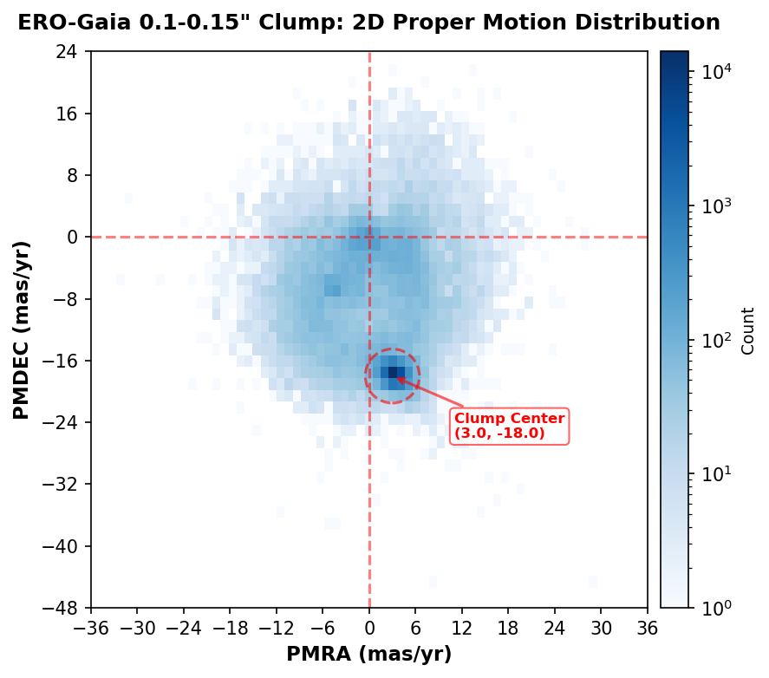


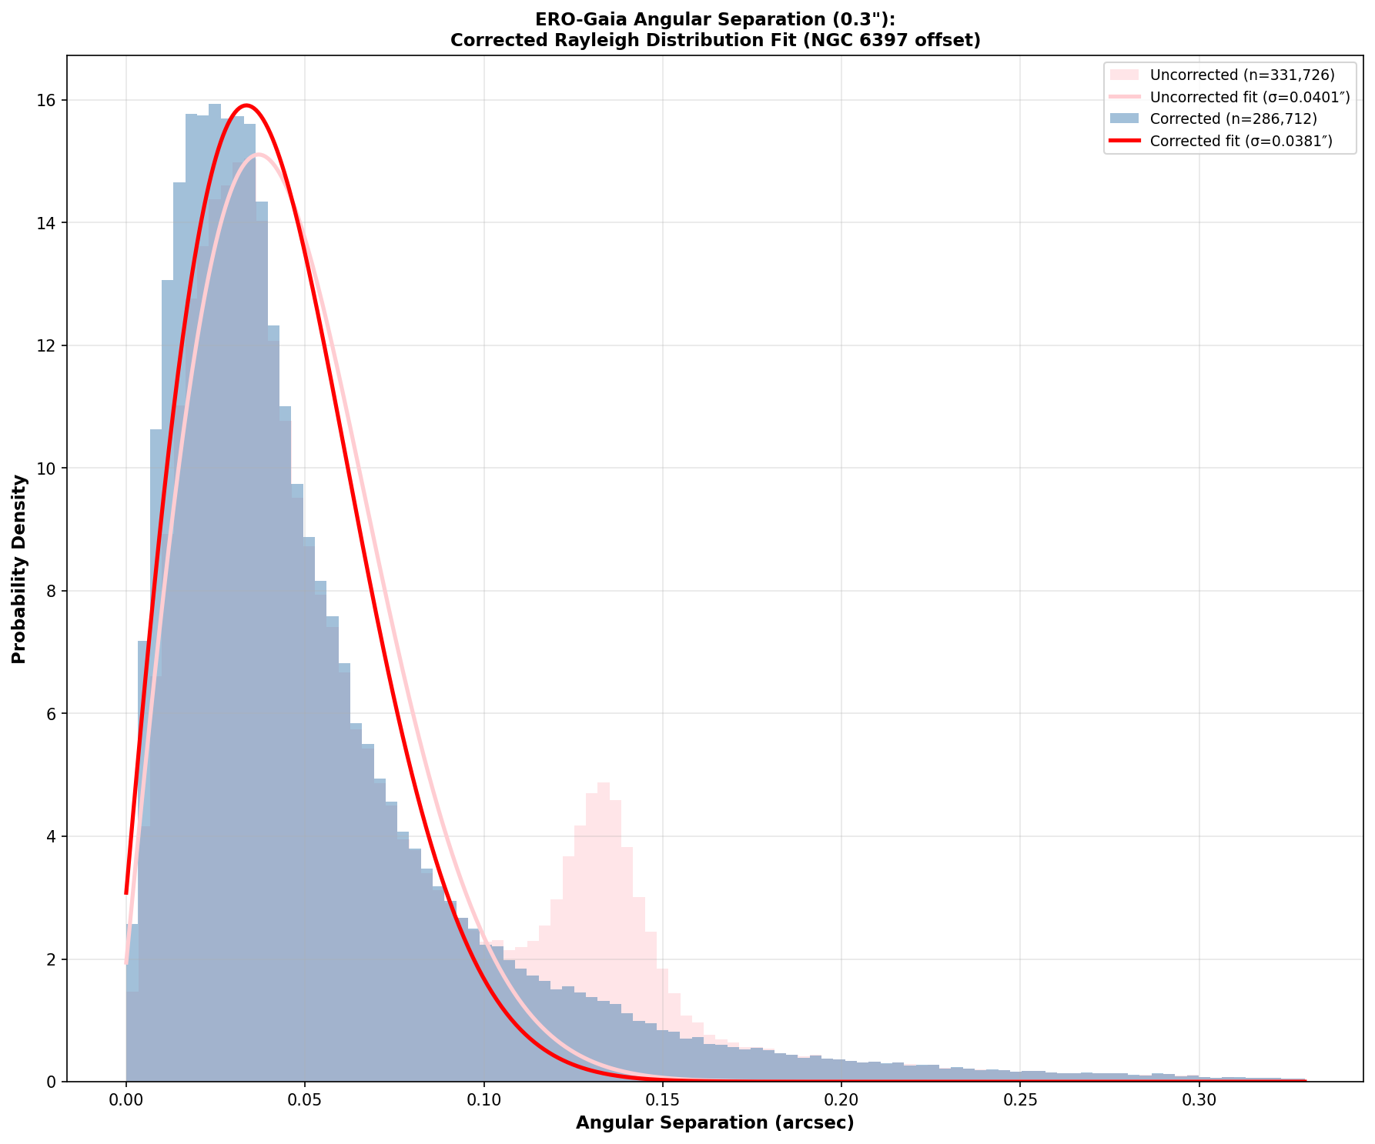
ERO Separation Bump
Proper-motion clue →
Systematic shift →
Diagnosis: NGC 6397 →
Clean Distribution by Correction
1
2
3
4
Shared motion
Coherent Offset
Cluster identified
Bump Correction
Bump sources cluster near (3, −18) mas/yr, suggesting a common population.
Their position offsets are aligned rather than random, indicating a systematic shift
Offsets traced back to NGC 6397, where epoch mismatch matters.
After correcting for proper motion, the bump in distribution collapses
10
Takeaway: the ERO anomaly is astrophysical and epoch-related, not a failure of the matching method.
Notes:
[~2m]
So how do we go about explaining the ERO separation bump?
we start by extracting the sources in the 0.1 to 0.15 arcsec bump and looking at their proper motion
the 2D distribution shows that these bump sources cluster around a proper motion of (3, -18) milli-arcsec per year
which suggests they are highly likely to be of part of the same population
We then trace the position offsets between the coordinates recorded by Gaia and by Euclid,
and can see that they carry the same coherent shift rather than random scatter
this strongly suggests they are gravitationally bound and part of the same structure
When we trace the coordinates of these position offsets back
It points to NGC 6397, a nearby globular cluster (~7800 ly away)
so these sources are moving together as part of the same cluster, and Gaia and Euclid are simply seeing them at different times.
Gaia positions were recorded at 2016.0 in Julian Date, and Euclid observed years later
the cluster stars had physically moved a noticeable distance in the intervening years
once we correct for the proper motion, the bump collapses back into the main Rayleigh peak
so conclusion is that this anomaly is astrophysical and epoch-related, not a problem with the matching method.

Slide 11
03
Validating Euclid Labels
How reliable are the training labels?
Notes:
[~5s]
So now that we've built the matched Gaia–Euclid sample
but before training any model
we need to check that: are the Euclid labels themselves actually reliable enough to use for training

Slide 12
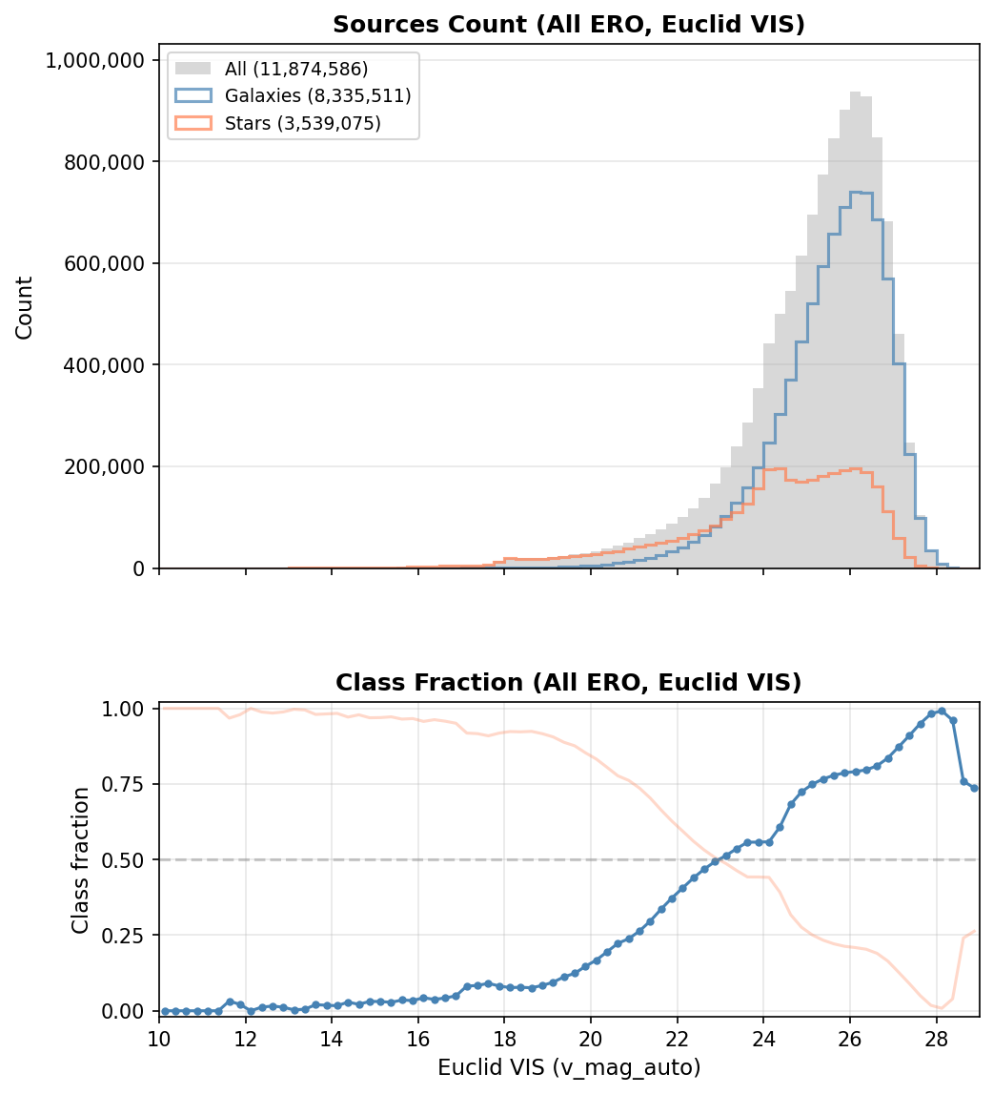
ERO Label Validation: class_star
class_star: expected monotonic behaviour
Point-like sources dominate at bright magnitudes, with extended fraction increasing smoothly toward fainter magnitudes.
Why more galaxies at fainter mag?
Fainter = further away
→ more volume surveyed
→ more galaxies
Cosmological redshift dims galaxy flux
→ pushes them to fainter bins
Galaxy luminosity function
→ many more faint dwarfs than bright giants
12

Slide 13
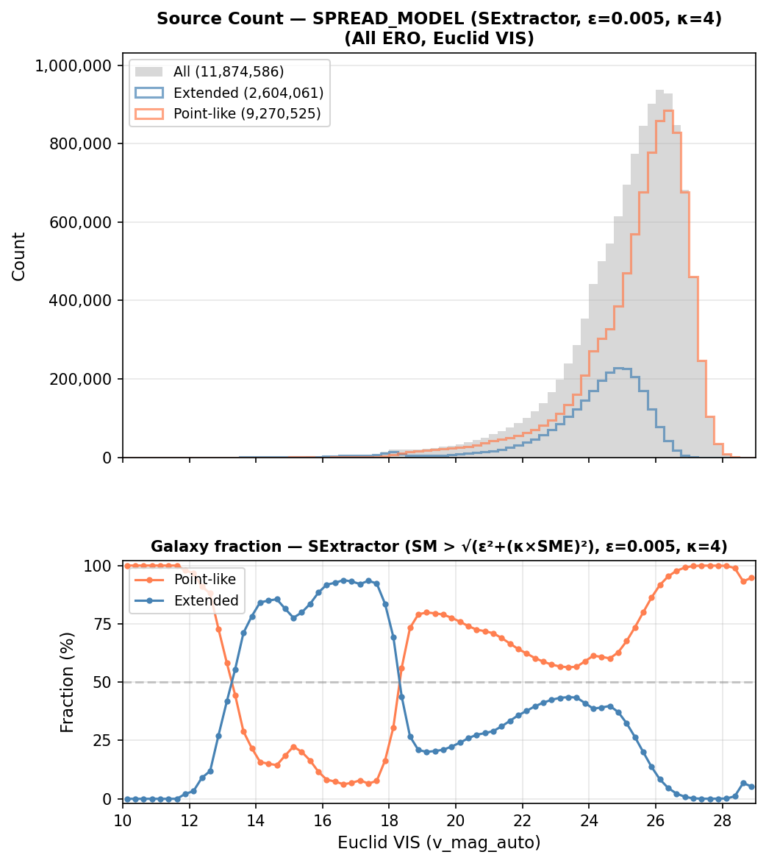
ERO Label Validation: spread_model
spread_model: systematic bumps
spread_model shows magnitude-dependent systematic bias, the bumpy structure is a characteristic artifact of the error-weighted threshold
SNR-dependent threshold bias
Threshold ∝ spreaderr_model
Bright (12-18 mag):
High SNR → low error → tight threshold
Intermediate (18-23 mag):
Temporarily reasonable classification
Faint (>23 mag):
Low SNR → high error → loose threshold
Conclusion: We trust class_star over spread_model for ERO star-galaxy classification
12
Notes:
Bright - Point sources with small +ve spread_model exceed threshold → misclassified as extended (bump 1)
Intermediate - SNR threshold effects balance out, but narrow usable range
Faint - Extended sources fall below → misclassified as point-like (bump 2)

Slide 14
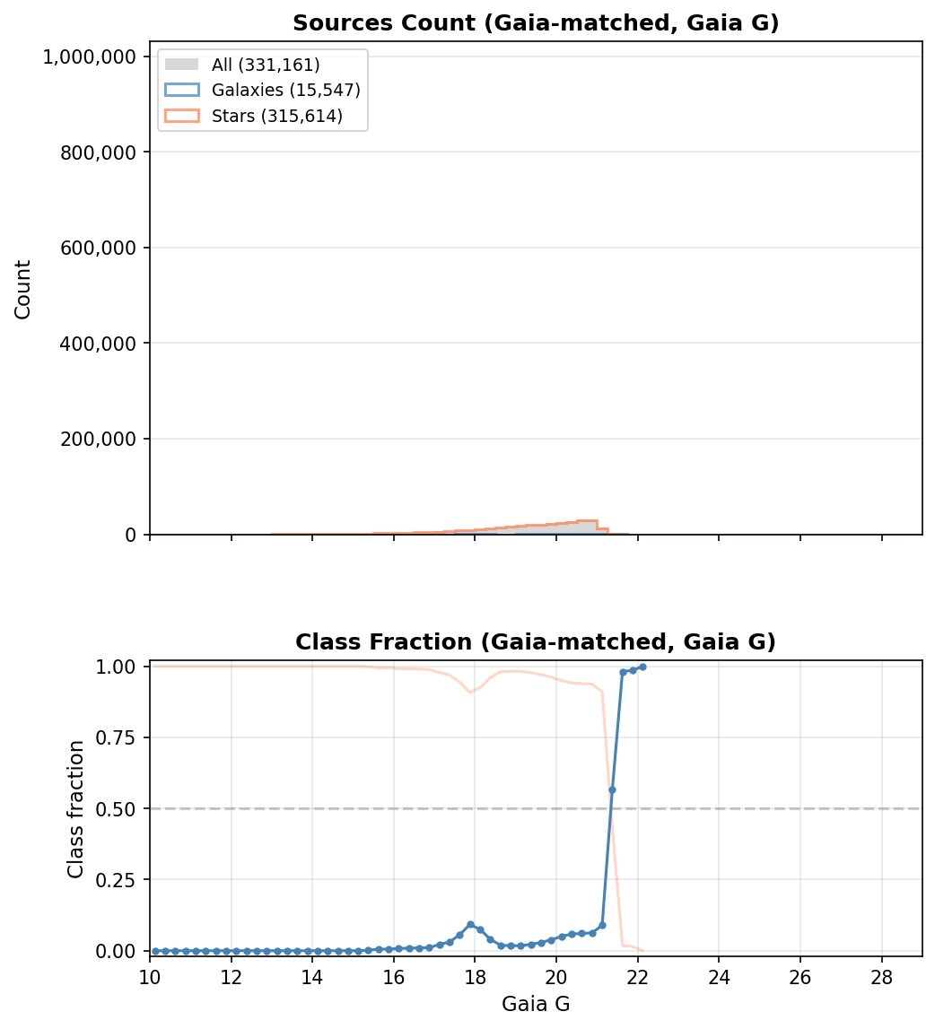
class_star: Gaia-Matched Distribution
Anomalous bump in Gaia G magnitude
After cross-matching ERO sources with Gaia, a clear anomalous bump appears in the Gaia G magnitude distribution that is not present in Euclid's own magnitude.
Top: Euclid magnitude
Smooth, well-behaved distribution
Bottom: Gaia G magnitude
Clear bump at ~20 mag
Two hypotheses:
⑴ A single deviant field?
⑵ Gaia selection effect?
⚠ Suspicious: The bump in Gaia G mag appears only after cross-matching — what is causing this?

Slide 15
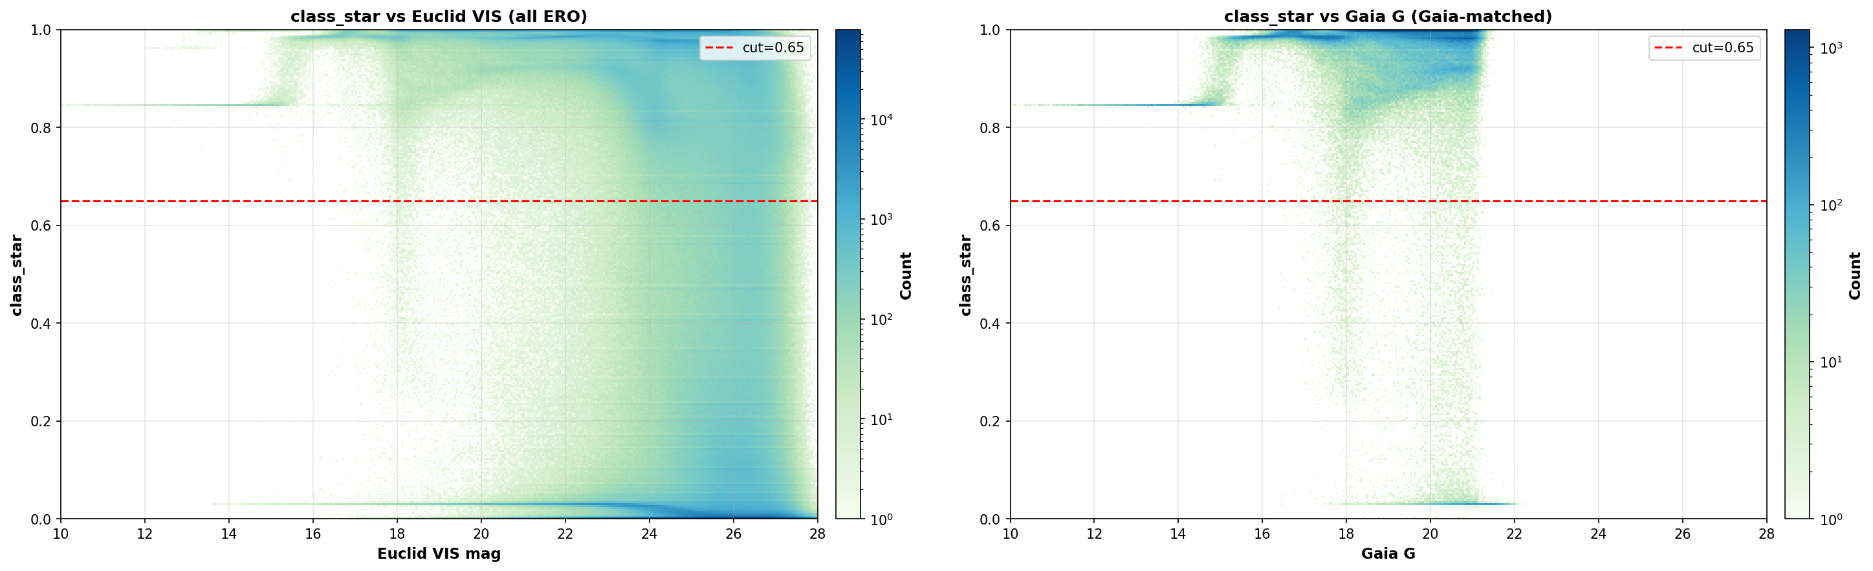
Tracing the Bump: class_star 2D Histogram
The bump comes from class_star itself
The 2D histogram of class_star vs Gaia G reveals the bump originates directly from the classification labels.
Highly likely an artifact!

Slide 16
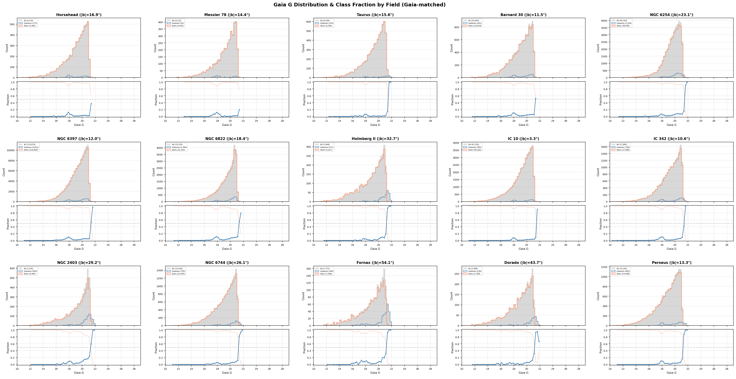
Check ⑴: Per-Field Analysis
Is it a single deviant field?
Checked each of the 17 ERO fields individually for the bump in Gaia G magnitude distribution.
Present in all 17 fields consistently → not a single-field anomaly.
Rules out hypothesis ① → bump is a systematic effect across all fields
.

Slide 17
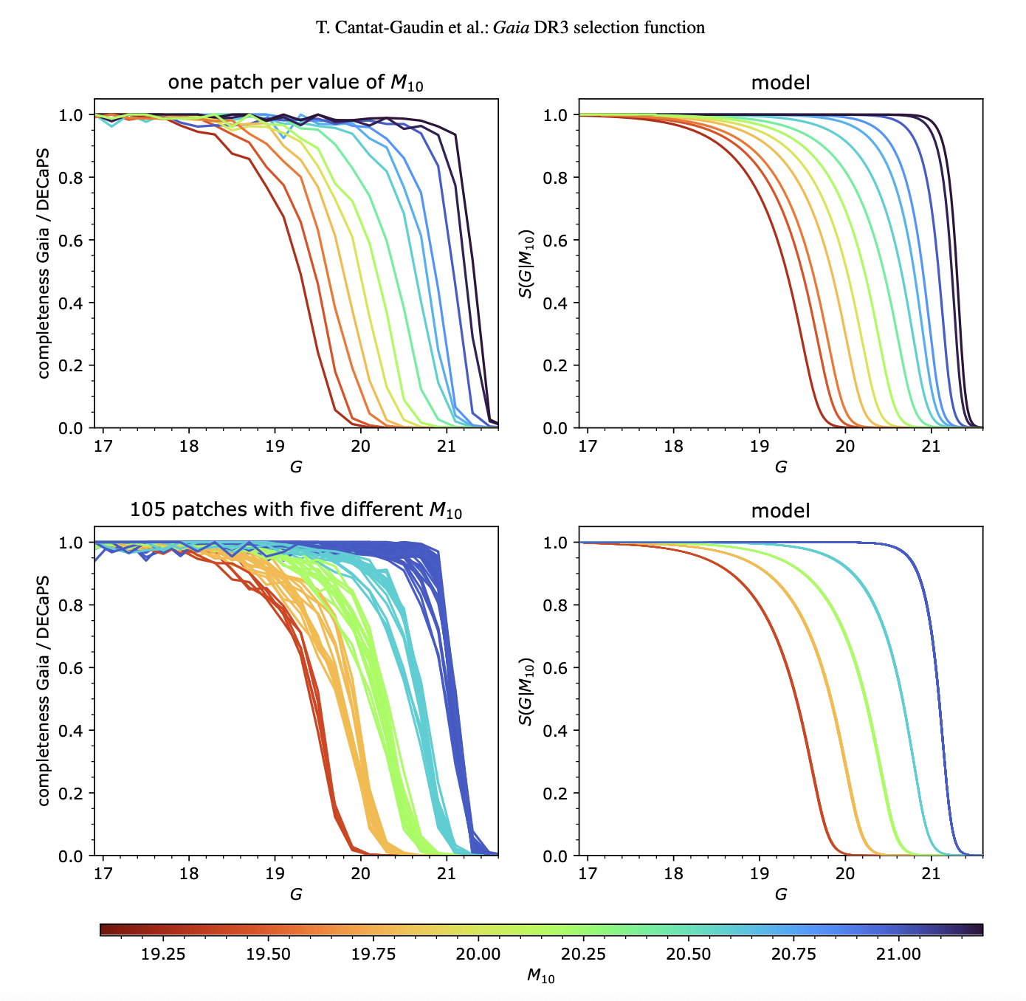
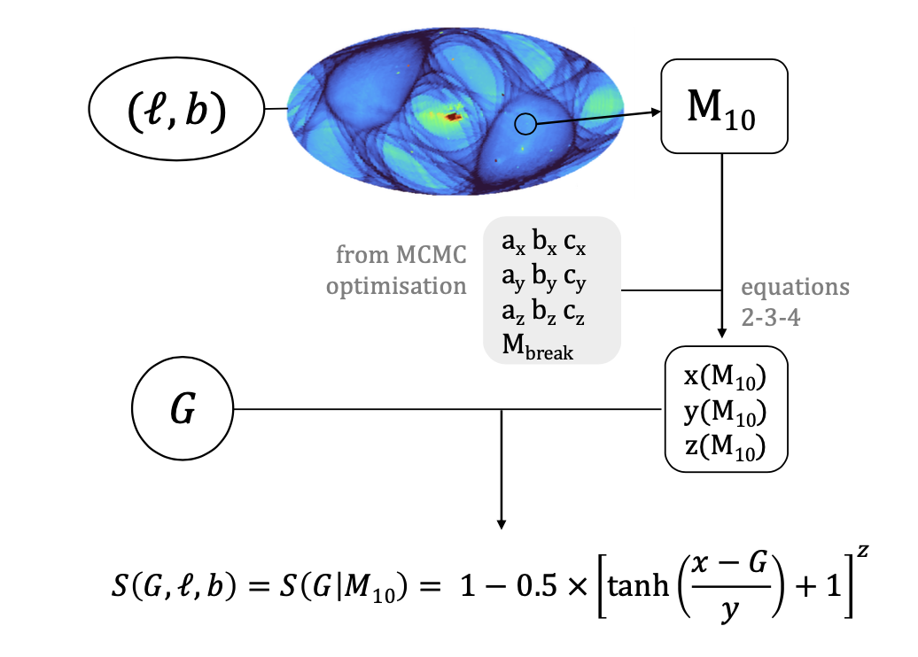
Check ⑵: Gaia Selection Function
Is it a single deviant field?
Checked each of the 17 ERO fields individually for the bump in Gaia G magnitude distribution.
S(G | M₁₀) — Cantat-Gaudin+ 2023
Empirical model of Gaia DR3 completeness as function of G mag and sky position.
M₁₀ = median mag of sources with astrometric_matched_transits ≤ 10 in a sky patch. Values typically 19–21.5 mag.
Many visits + low crowding → faint M₁₀ → better completeness
Crowded / poorly scanned → bright M₁₀ → worse completeness
The brighter the environment (bright M₁₀), the less likely faint sources are to be seen by Gaia.
Present in all 17 fields consistently → not a single-field anomaly.
Rules out hypothesis ① → bump is a systematic effect across all fields
.

Slide 18
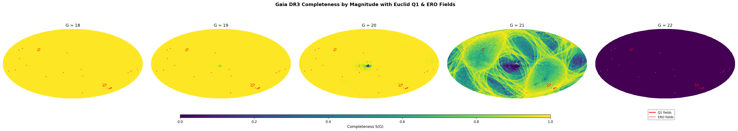
Check ②: Gaia DR3 Selection Function
S(G | M₁₀) — Cantat-Gaudin+ 2023
Empirical model of Gaia DR3 completeness as function of G mag and sky position.
M₁₀ = median mag of sources with astrometric_matched_transits ≤ 10 in a sky patch. Values typically 19–21.5 mag.
Many visits + low crowding → faint M₁₀ → better completeness
Crowded / poorly scanned → bright M₁₀ → worse completeness
The brighter the environment (bright M₁₀), the less likely faint sources are to be seen by Gaia.
per_field_class_star_map_ero_all
per_field_class_star_with_sg20
ero_selection_scorrect.png
doodle_aaa.png
Key insight: M₁₀ reflects scanning law + crowding — a single parameter captures the completeness across the sky

Slide 19
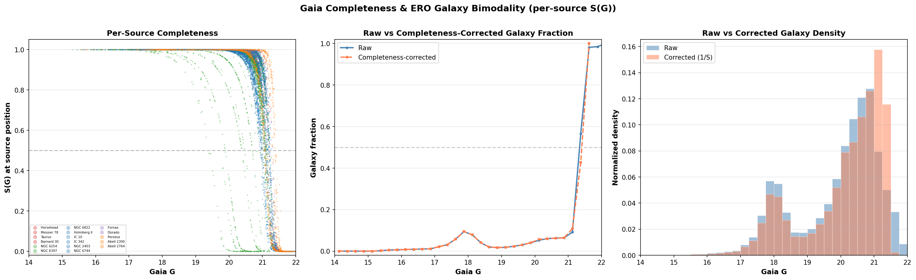
Applying the Selection Function
Corrected galaxy fraction:
f = corr_gal / (corr_gal + corr_star)
If galaxies and stars have similar S(G) at a given magnitude, the same 1/S factor hits both numerator and denominator → mostly cancels out.
Key result:
Gaia incompleteness changes observed counts at faint end
But affects stars and galaxies similarly as f(G)
Not strongly changing the galaxy-vs-star balance
q1_combined_summary_col1
q1_combined_summary_col3
q1_prob_phz_2d.png
Result: Gaia selection function does not explain the bump — the artifact is in the ERO class_star labels themselves

Slide 20
Q1 phz_classification: Comparison
col1: Expected distribution — fairly monotonic increase in galaxy fraction
col3: Bump present but does not look as artificial as ERO
2D histogram: Smooth phz probability distribution — nothing as anomalous as ERO
(compare with ero_prob_class_star_2d)
ero_dmag_vs_gmag.png
q1_dmag_vs_gmag_by_phz.png
Comparison: Q1 phz_classification is much cleaner than ERO class_star — what’s going on?

Slide 21
Δmag Diagnostics: ERO vs Q1
Δmag = Euclid − Gaia
Galaxies:
Flux: Euclid sums extended → brighter than Gaia (point-source) → −ve
Color: redder → brighter in Euclid VIS → −ve
Stars:
Flux: neighbours → could be −ve
Color: bluer → brighter in Gaia → +ve
Q1: misclassification at bright end fixable with G~17 cut
[ ero_dmag_vs_gmag.png ]
[ q1_dmag_vs_gmag_by_phz.png ]
Gaia G: 330-1050nm (UV+VIS+NIR) | Euclid VIS: 550-900nm (VIS+NIR)
Conclusion: ERO class_star shows wiggly artifacts in Δmag; Q1 is cleaner → questioning ERO label reliability

Slide 22
XGBoost: Training on Q1 Labels
Pipeline
XGBoost trained on Q1 phz_classification labels
Select Gaia parameters as input features
Coverage test → filter low-coverage features
Initial feature importance → prune non-contributing ones
~20 features of reasonable importance remain
Validation
Population distributions for top features are consistent
Magnitude cut sensitivity analysis
Model learned genuine physical signals → UMAP confirms
placeholder
[ example cutout images ]
Takeaway: Q1-trained XGBoost features are physically reasonable — model captures genuine star-galaxy separation signals

Slide 23
Summary & Next Steps
Key Findings
spread_model has systematic SNR-dependent bias — unreliable for general use
ERO class_star shows suspicious artifacts in Gaia-matched sample
Bump is systematic (all 17 fields), not explained by Gaia selection function
Q1 phz_classification is cleaner — smoother probability distributions
Δmag confirms wiggly artifacts in ERO vs cleaner Q1
XGBoost on Q1 features learns genuine physical signals
Next Steps
Test Q1-trained XGBoost on the ERO dataset
Models still not fully agreeing
Visual verification via Euclid cutouts to resolve disagreements
Determine which label is “truth” when there’s disagreement
Below: example cutouts — galaxies labeled by Euclid but low p_gal from Q1 model
[ example cutout images ]
Overall: Q1 labels are more reliable than ERO — XGBoost provides a promising path for Gaia-based star-galaxy classification

Slide 24
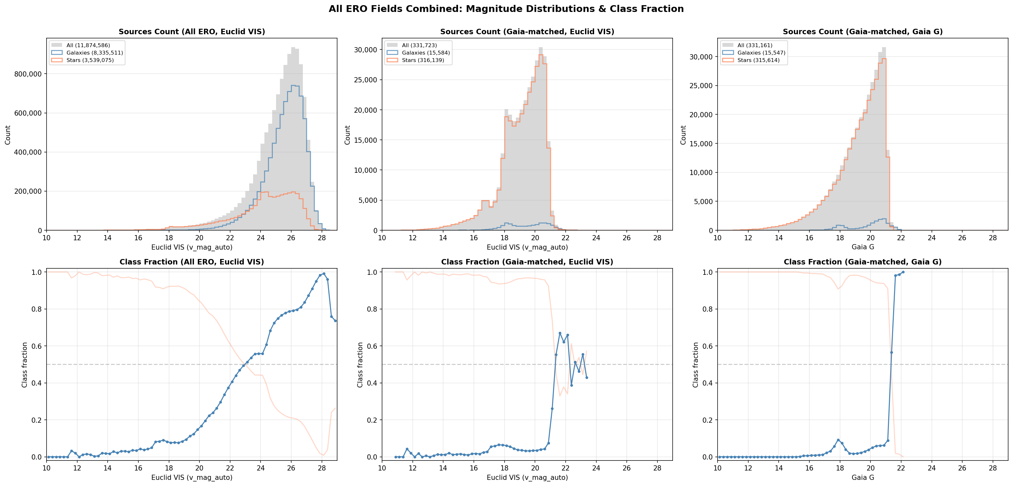
ERO Label Reliability
After cross-matching ERO with Gaia, a suspicious bump appears around G~18 in the galaxy fraction. The 2D histogram of class_star reveals this bump propagates directly from the class_star values themselves — likely a pipeline artefact.
13
Notes:
[~1m30s]
When we look at the distribution of ERO sources after matching with Gaia, we see a suspicious bump around Gaia G magnitude 18 in the galaxy fraction. To trace the origin, we plot a 2D histogram of class_star value against magnitude. This clearly shows the bump in the population distribution propagates directly from a feature in the class_star values themselves. This is highly suspicious and likely a pipeline artefact rather than a genuine physical feature.

Slide 25
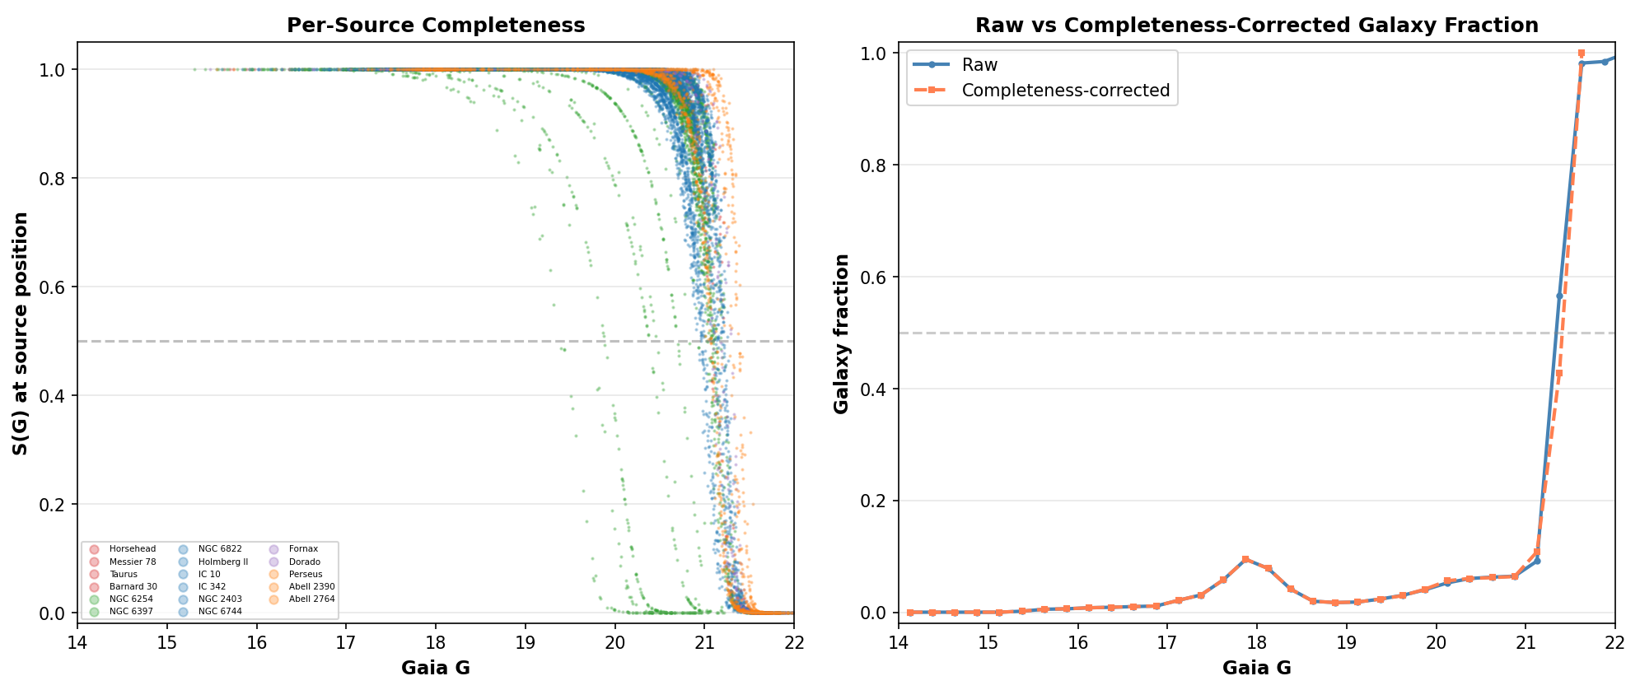
Investigating the Bump: Gaia Selection Effects
Gaia Selection Effects Analysis
Bump appears in all 17 ERO fields — not a single-field anomaly
Applied empirical Gaia DR3 selection function S(G|M10)
Result: Gaia incompleteness changes faint-end counts, but does not strongly alter galaxy-vs-star balance
The bump in class_star remains unexplained by selection effects alone
Conclusion: The ERO class_star bump is likely a genuine pipeline artefact rather than a Gaia selection effect
14

Slide 26
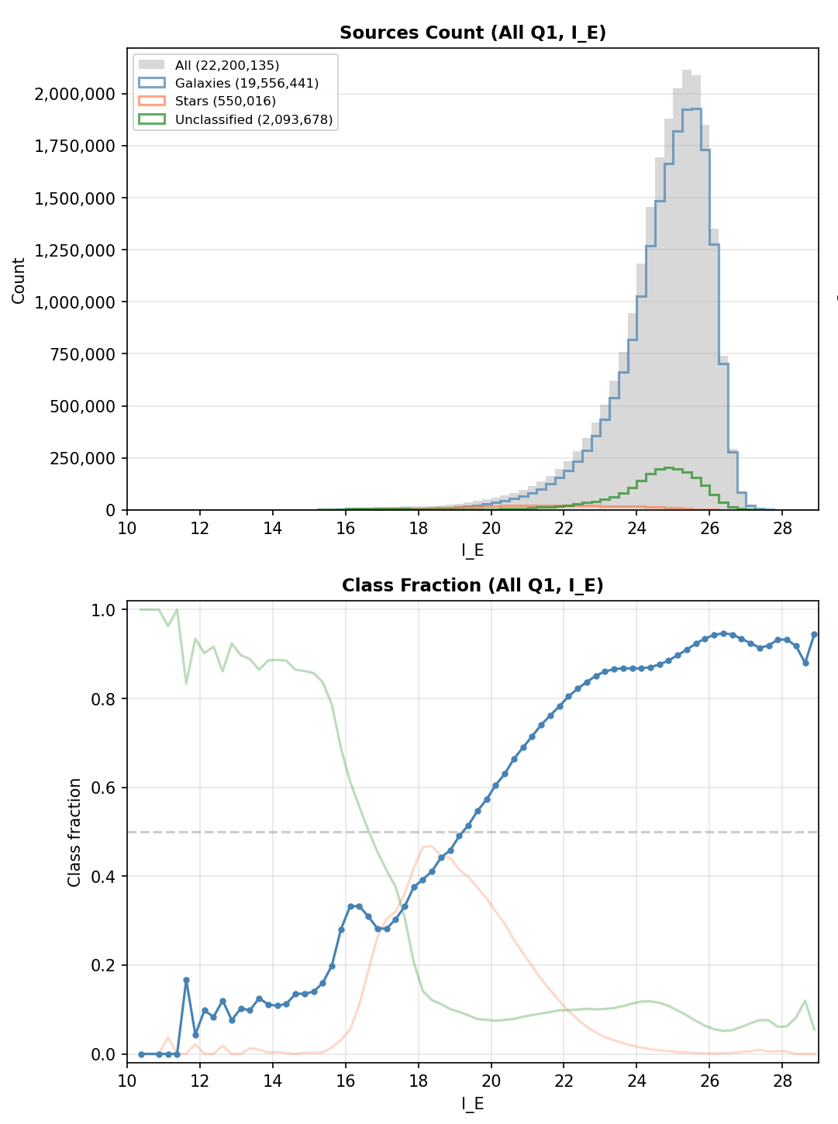
Q1 Label Comparison
Q1 PHZ Classification
Q1 PHZ classification shows expected monotonic distribution
Galaxy fraction increases smoothly toward fainter magnitudes
2D probability histogram is smooth — no suspicious features
Q1 labels significantly more reliable than ERO
Key takeaway: Use Q1 for training. Q1 labels show clean separation and no anomalies.
15

Slide 27
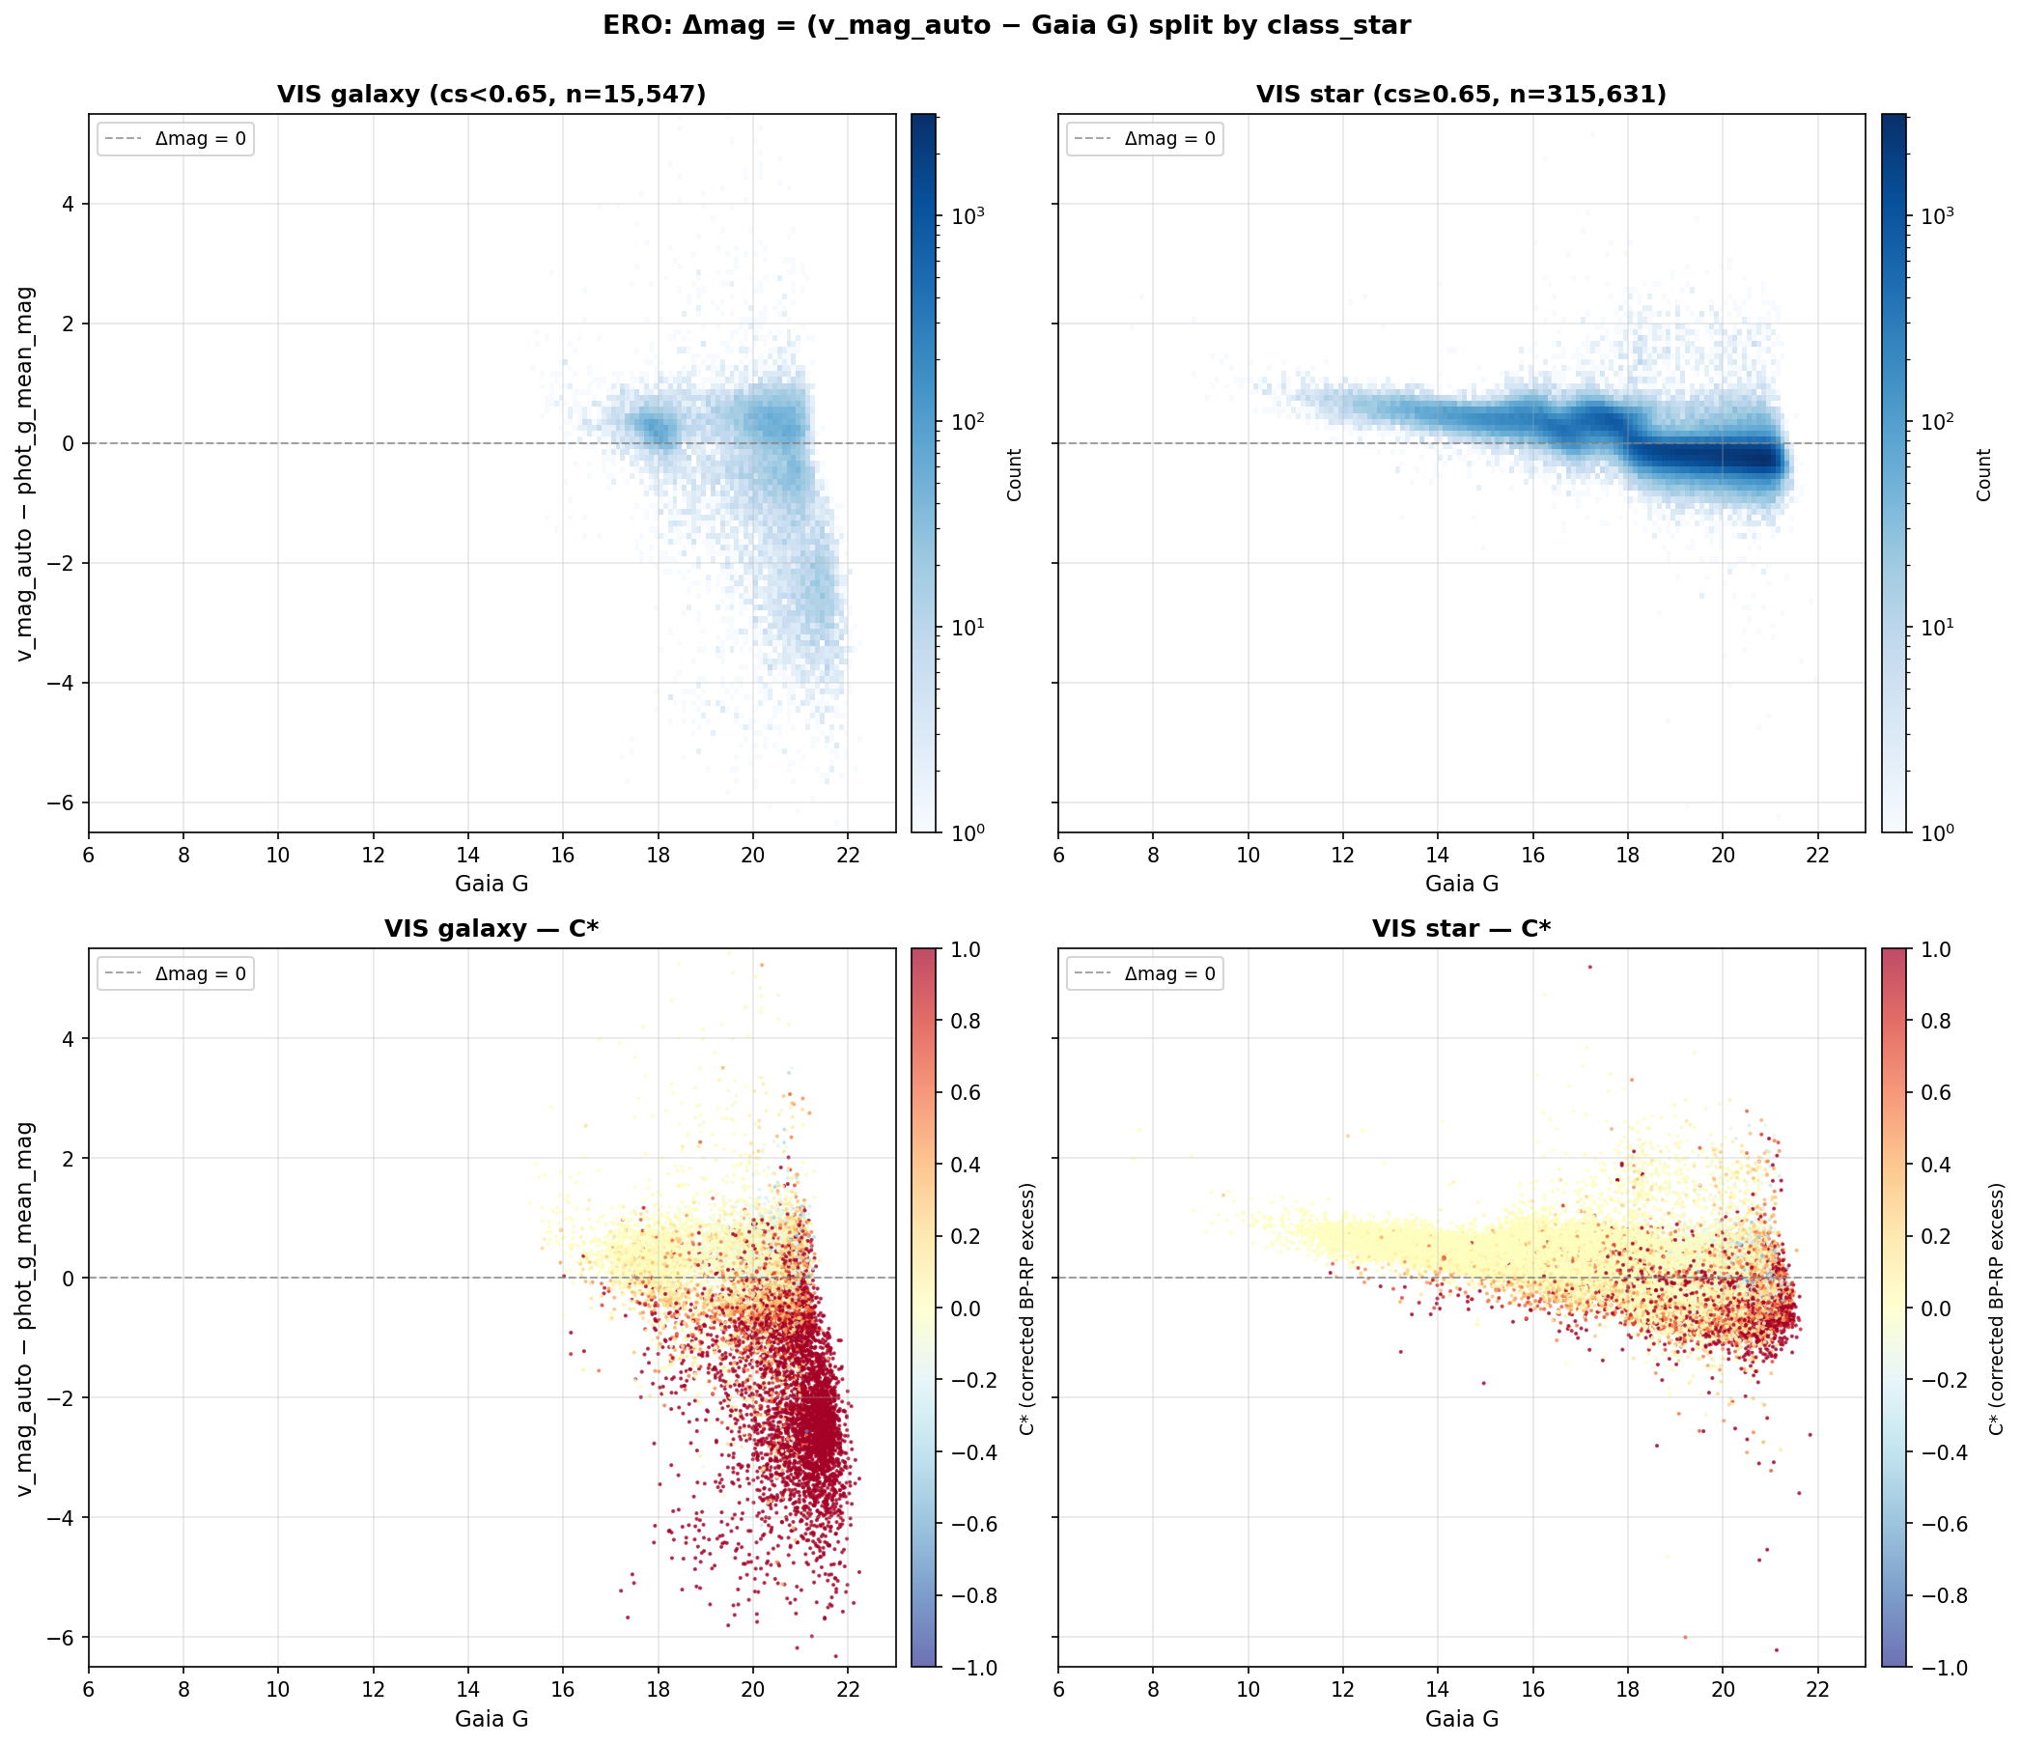
Photometric Systematics Check
Δmag Analysis: ERO vs Q1
Δmag = Euclid mag − Gaia G magnitude
Galaxies redder → brighter in Euclid → negative Δmag expected
Stars bluer → brighter in Gaia → positive Δmag expected
Q1 PHZ shows cleaner separation; G ≥ 17 cut manages bright-end misclassification
Verdict: Q1 labels are significantly more suitable for training than ERO labels
16
Notes:
Here we examine ERO label reliability using Δmag (Euclid IE minus Gaia G) vs Gaia G
Stars and galaxies should occupy distinct regions in this space:
Expecting stars – bluer & brighter in Gaia, galaxies – redder& bright in Euclid
Need to consider this when comparing ERO-trained vs Q1-trained classifiers

Slide 28
04
Model Training
Training on Q1 data only — ERO labels deemed unreliable

Slide 29


XGBoost: Features & Magnitude Sensitivity
Q1 cross-validation performance as a function of magnitude cut
18
Notes:
How sensitive are results to the magnitude cut?
- Heatmap shows cross-validation performance across different magnitude bounds
- Performance is relatively stable for reasonable cuts
- Sweet spot around G >= 17
- Cutting too bright includes well-classified objects but reduces galaxy fraction
- Cutting too faint loses signal-to-noise
- Line plots show individual metrics as functions of cuts
Essentially we decided that a magnitude cut at >= 17 should be save for training a model on Q1 truth table.
Also we found that the importance rank is quite consistent across different magnitude cuts too -- the model has learned genuine physical signal than noise.

Slide 30
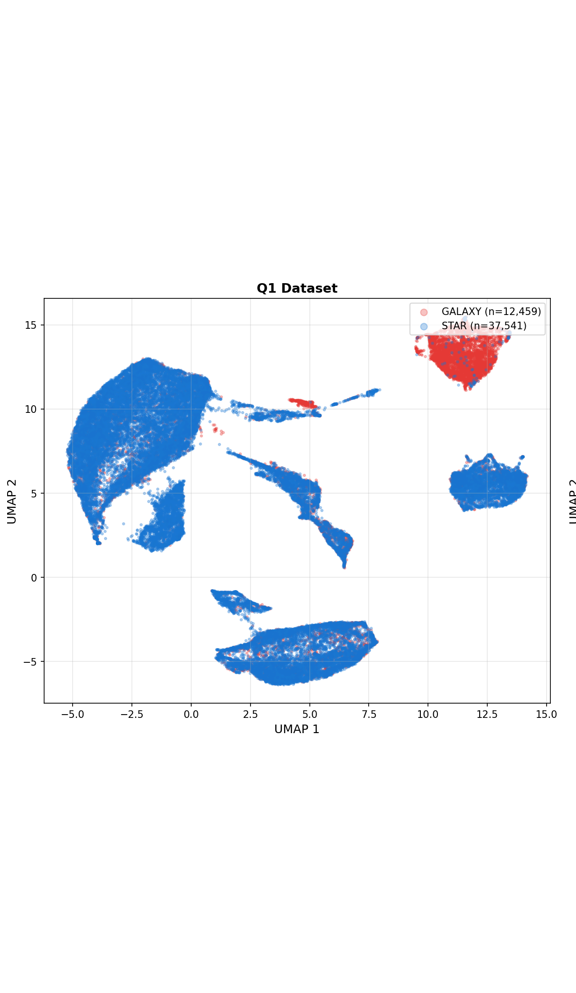
UMAP: Star-Galaxy Separation in Feature Space
UMAP projection of the 23-dimensional Gaia feature space, coloured by star/galaxy label
19
Notes:
UMAP dimensionality reduction of the 23 Gaia features for the Q1 dataset, coloured by star/galaxy label. Stars and galaxies form somewhat distinct clusters — confirms real signal in Gaia parameters. Note: this plot will be updated later with a better version.

Slide 31
05
Testing & Verification
Applying Q1 model to ERO and visual verification

Slide 32
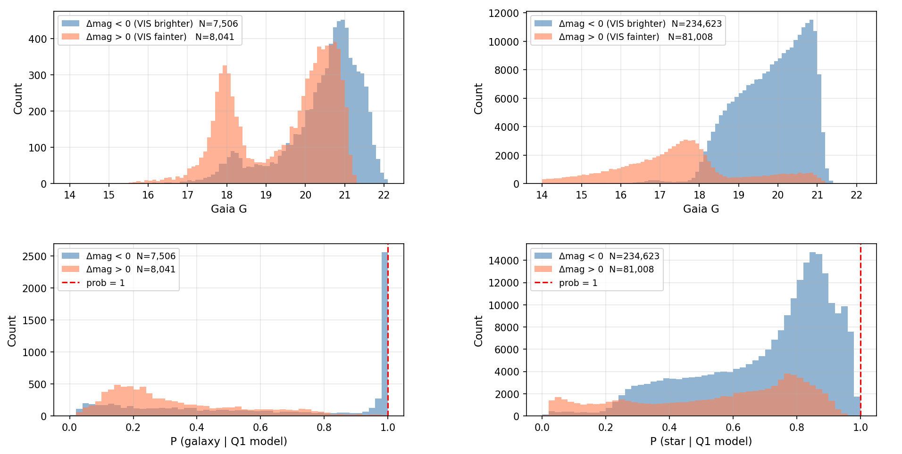
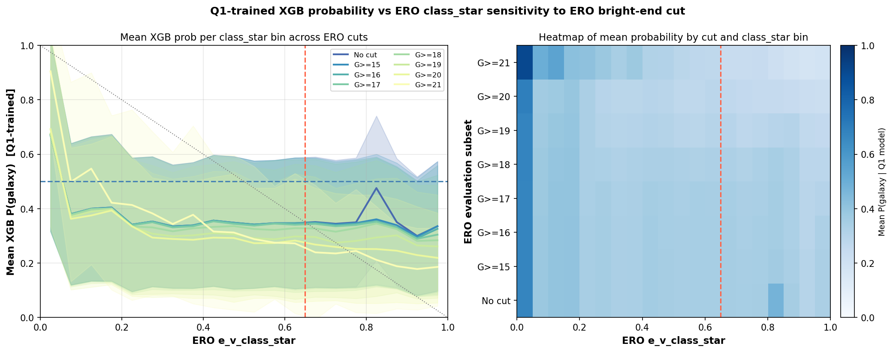
Applying Q1 Model to ERO
21
Notes:
When we apply the Q1-trained XGBoost model to the ERO dataset, we find significant disagreement with ERO's class_star labels. The main Δmag plot (left) shows the ERO data split by both class_star and Q1 model predictions. The probability comparison (right) shows anti-correlation between Q1 model galaxy probability and ERO class_star — further evidence that ERO labels are unreliable. We want to examine PNG cutouts to verify which label gives the true classification when there is disagreement.

Slide 33
06
Summary & Conclusions
Key findings and next steps

Slide 34
Summary & Key Findings
What We Found
Next Steps
Euclid ✕ Gaia cross-matching produces morphological training labels
NGC 6397 proper motion analysis validates cross-matching methodology
ERO class_star labels show artefacts; Q1 PHZ labels significantly more reliable
Gaia selection effects do not explain the ERO class_star bump
XGBoost Q1 model shows consistent feature importance — genuine physical signal
corrected_bp_rp_excess is the strongest feature (physically motivated)
Complete cutout verification of ERO disagreements
Apply validated Q1 classifier to full Gaia DR3 catalogue
Test with future Euclid releases for expanded coverage
Investigate completeness corrections for the final catalogue
Apply classifier to full Gaia DR3 catalogue
Bottom line: Gaia parameters contain real morphological signal. Currently investigating optimal magnitude cut and label quality; once settled, re-running full experiments with refined approach before finalizing results.
23
Notes:
- Cross-matching Euclid and Gaia generates morphological training labels
- NGC 6397 proper motion analysis validates the cross-matching methodology
- Magnitude cut sensitivity shows Q1 performance robust across magnitude range
- corrected_bp_rp_excess is the strongest predictor with clear physical motivation
- Q1 labels significantly more reliable than ERO
- Next: finalize magnitude cut, settle label quality question, re-run experiments
- Goal: validated classifier for the full Gaia DR3 catalogue

Slide 35
Thank You
Questions?
Sylvia Zhao
sz423@cam.ac.uk
Institute of Astronomy, University of Cambridge
Notes:
- Thank you for listening
- Happy to take any questions about methodology, results, or future directions

