Slide 1
Euclidifying Gaia
Using Machine Learning to Classify
Non-Point-Like Objects in Gaia DR3
Sylvia Zhao
Part III Astrophysics | Lent Term 2026
Supervisors: Diana Harrison, Simon Hodgkin, Vasily Belokurov
Institute of Astronomy, University of Cambridge
Notes:
[~30s]
hello everyone, my name is Sylvia, thank you for coming to my presentation.
this is my Part III project: Euclidifying Gaia
which is using machine learning to classify non-point-like objects in Gaia Data Release 3 catalogue
with the help of higher-resolution imaging from Euclid

Slide 2
01
Background
What we’re trying to achieve, and why?
Notes:
[~5s]
I'll set out by explaining what the project is trying to achieve,
what motivates it,
and the datasets that make it possible

Slide 3




Motivation
The Challenge
Our Approach
Gaia detects billions of sources across the whole sky
But its on-board detection is optimized for point sources
It still detects some extended objects
thinking they are stars
Euclid imaging resolves structure that Gaia cannot
Cross-match Euclid x Gaia, then train on Gaia-only
features to classify the wider Gaia catalogue.
Key Idea: Can we use Euclid labels to train a model on Gaia-only parameters,
that can reliably distinguish point sources from extended ones across the whole sky?
2
Background
Methodology
Methodology
Model Training
Model Training
Testing
Testing
Conclusion
Conclusion
Notes:
[~1m30s]
what’s the big motivation behind all this, and what are we actually trying to achieve?
So we have Gaia, this space telescope that gives us this incredible full-sky catalogue,
but its image depth is shallower, so it doesn’t really tell us much about what sources look like
because it was designed mainly for stars
so its onboard detection is optimized for point sources.
even so, no detection algorithm is perfect — Gaia still detects non-stellar objects as well
Euclid, on the other hand, can actually resolve structure
But it only covers a subset of the Gaia data
So the idea is: we use the subset of Gaia sources with Euclid labels, train a model based only on their Gaia information
then we apply that model across the full Gaia catalogue,
which could help us find a lot more galaxies and other extended sources across the whole sky.

Slide 4


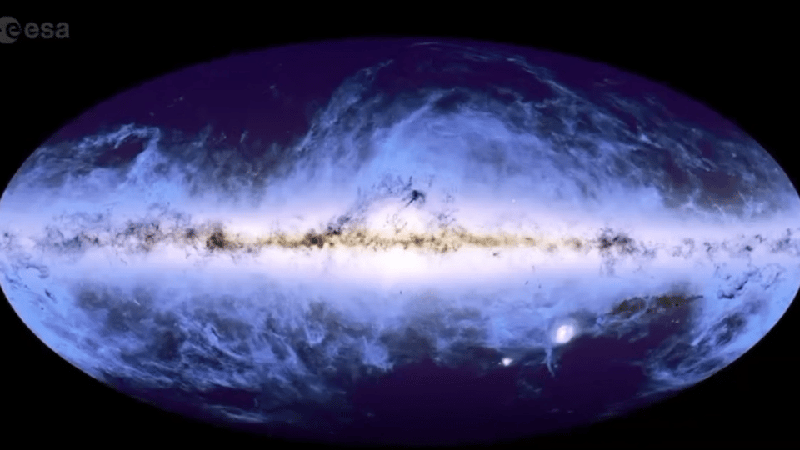
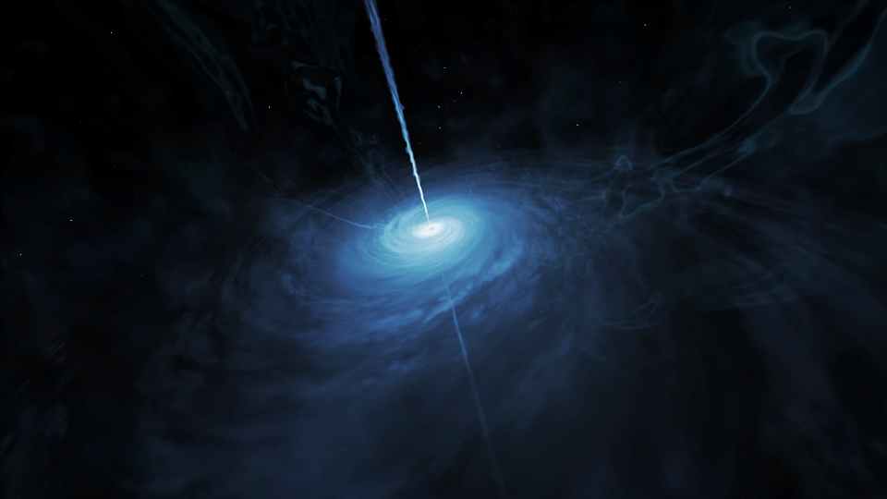
Why This Matters
Galaxies Hiding in Plain Sight
Quasars as Cosmological Probes
Gaia has 1.8 billion sources but only ~1.5 million have morphological classification
We could increase this by ~1000x by training on Euclid labels and applying across the full catalogue
Quasars act as fixed points for calibrating the celestial coordinate system
Their accretion discs emission redshifts into Euclid’s 0.55–2.0 µm (VIS+NIR) window at z≈1–5
1. Is it extended?
2. What is it? — galaxy, quasar/nucleus, binary star, star-forming region?
2
Background
Methodology
Methodology
Model Training
Model Training
Testing
Testing
Conclusion
Conclusion
Notes:
[~1m30s]
Why does this matter? Two key reasons.
First, galaxies:
Gaia has 1.8 billion sources but only about 1.5 million have any morphological classification.
By training on Euclid labels and applying across the full catalogue
we could potentially increase this by a factor of 1000.
And that’s across the whole sky
quasars: they serve as astrometric reference frames — the fixed points against which we calibrate the celestial coordinate system. A more complete quasar catalogue from Gaia would directly improve both astrometric and cosmological measurements.
Second, Quasars:
They intrinsically emit strongest in the UV/optical from their accretion discs
At cosmological redshifts (z≈1–5), this emission shifts into the near‑infrared.
Euclid’s VIS + NISP instruments cover exactly this range (0.55–2.0 µm)
making it ideal for detecting redshifted quasar light.
Because Euclid observes from space, it avoids atmospheric absorption that limit ground‑based NIR surveys
And timing matters here: Gaia exhausted its cold gas and permanently stopped science observations in January 2025. The Gaia data is now frozen — but Euclid data keeps getting better with each new release. So the opportunity to 'Euclidify' Gaia is right now.
Quasars intrinsically emit strongest in the UV/optical from their accretion discs.At cosmological redshifts (z ≈ 1–5), this emission is shifted into the NIR by the time it reaches us.Euclid’s VIS + NISP instruments cover 0.55–2.0 µm, exactly matching where high‑z quasar light appears.Working in space avoids telluric absorption and thermal background that limit ground‑based NIR surveys.Euclid’s deep NIR imaging and slitless spectroscopy provide clean photometry and efficient redshift identification.Euclid Q1 has already produced ≈3,500 quasar spectra (most newly identified), demonstrating survey power.
~3,500 quasars from one of Euclid’s data release alone (z up to 4.8) (Q1)

Slide 5


The Missions: Gaia & Euclid
Gaia
Euclid
ESA astrometry mission, launched 2013, orbit around L2
Whole-sky survey: 1.8B sources — shutdown Mar 2025
6-hour spin + 63-day precession
ESA dark energy mission, launched 2023, orbit around L2
Deep-field survey: 14,000 deg² over 6 years
Step-and-stare ~70 min per field (0.5 deg²)
The Bridge: Euclid gives us depth and detail; Gaia gives us scale and sky coverage.
4
Background
Methodology
Methodology
Model Training
Model Training
Testing
Testing
Conclusion
Conclusion
Notes:
[~1m]
So now that I’ve explained the motivation, let me now briefly introduce the two missions we’re combining
Gaia is ESA’s astrometry mission, launched in 2013, and it gives us an all-sky catalogue of around 1.8 billion sources
And Euclid is a newer, deeper imaging mission, surveying smaller areas in much greater detail
so the key point for this project is:
Gaia gives us scale
and Euclid gives us the imaging quality needed to provide labels
That combination is what lets us train on the overlap and then extend the classification much more broadly.
Get in more info about the 2 telescopes

Slide 6

The Missions: Gaia & Euclid Fields
Gaia DR3 scanning law (number of transits) with Euclid Q1 and ERO field footprints overlaid
5
Background
Methodology
Model Training
Testing
Conclusion
Notes:
[~30s]
So this is just a map of where our Euclid data sit relative to Gaia.
The background is Gaia’s scanning law, shown as the number of transits,
and the outline points mark the Euclid field footprints
so basically these are the parts of the sky where we have both Gaia and Euclid, and so where we can build the matched sample

Slide 7
Data: Gaia DR3 & Euclid Releases
Gaia DR3 (Data Release 3)
1.8 billion sources — full sky catalogue including astrometric, photometric, and scan-quality information
~153 features available in the gaia_source table for potential use in classification
Euclid ERO (Early Release Observations)
Euclid Q1 (Quarter 1 Release)
17 fields with VIS-band photometry
Star-Galaxy estimators: class_star, spread_model
~12,000,000 sources in ERO catalogue
~330,000 sources matched with Gaia
Before match: ~30% stars, ~70% galaxies
After match: ~95% stars, ~5% galaxies
4 fields with multi-band VIS + NIR photometry
Classification labels: phz_classification
~22,200,000 sources in Q1 catalogue
~340,000 sources matched with Gaia
Before match: ~10% stars, ~90% galaxies
After match: ~75% stars, ~25% galaxies
6
Background
Methodology
Methodology
Model Training
Model Training
Testing
Testing
Conclusion
Conclusion
Notes:
[~1m30s]
This slide just summarizes the three datasets I use
Gaia DR3 is really the base dataset here: it gives us the all-sky source list and the source parameters we ultimately want to classify on.
For ERO, the relevant star–galaxy information comes from estimators like class_star and spread_model.
For Q1, the label I use is phz_classification. PHZ means photometric redshifts, and this is one of the Euclid pipeline processing functions.
It uses the photometric information to classify sources, and those labels are already available directly in the catalogue
and we can see very clearly in the fractions here,
an important Gaia selection effect,
as Gaia is a stellar catalogue, after cross-matching to Gaia,
ERO goes from roughly 30% stars to about 95%,
while Q1 goes from about 10% to about 75%,
both matched samples bias strongly toward stars,
especially for ERO, it becomes much more star-dominated

Slide 8



Cross-Matching Methodology
Q1: Direct Catalogue ID Matching
A pre-computed Gaia_ID is stored in the catalogue:
Gaia positions are propagated from DR3 epoch to Euclid reference time
Angular separation distribution is near-Rayleigh
→ clean matches ✓
ERO: Spatial Matching
Gaia sources matched to the nearest ERO source on the sky, within a maximum radius 0.3"
One-to-one nearest-neighbour pairing
Separation distribution shows a bump at 0.1–0.15"
→ not expected!
7
Background
Methodology
Model Training
Testing
Conclusion
Notes:
[~1m30s]
This slide compares the two matching methods.
For Q1, the match is relatively straightforward
the catalogue already provides a Gaia_ID built by propagating Gaia positions from the DR3 epoch to the Euclid reference epoch
and the resulting separation distribution looks clean and near Rayleigh, which is what we expect
and it also shows that a 0.3 arcsecond cutoff is a sensible place to truncate the tail
where matches are more likely to be spurious
As ERO is an earlier release, and the data products were processed with a different ERO-specific pipeline rather than the later Q1 pipeline,
so we do not have an equivalent epoch-propagated Gaia identifier here
the matching must be done directly on sky position instead
for each Gaia source I look for the nearest ERO source within 0.3 arcseconds,
and enforce a one-to-one nearest-neighbour match.
that mostly behaves as expected,
but unlike Q1, the separation distribution shows this extra bump around 0.1 to 0.15 arcseconds.
this is not normal for position-based cross-matching
something interesting is happening that needs further investigation.

Slide 9
ERO Separation Bump
Proper-motion clue →
Systematic shift →
Diagnosis: NGC 6397 →
Clean Distribution by Correction
Takeaway: the ERO anomaly is astrophysical and epoch-related, not a failure of the matching method.
8
Background
Methodology
Model Training
Testing
Conclusion
Notes:
[~2m]
So how do we go about explaining the ERO separation bump?
we start by extracting the sources in the 0.1 to 0.15 arcsec bump and looking at their proper motion
the 2D distribution shows that these bump sources cluster around a proper motion of (3, -18) milli-arcsec per year
which suggests they are highly likely to be of part of the same population
We then trace the position offsets between the coordinates recorded by Gaia and by Euclid,
and can see that they carry the same coherent shift rather than random scatter
this strongly suggests they are gravitationally bound and part of the same structure
When we trace the coordinates of these position offsets back
It points to NGC 6397, a nearby globular cluster (~7800 ly away)
so these sources are moving together as part of the same cluster, and Gaia and Euclid are simply seeing them at different times.
Gaia positions were recorded at 2016.0 in Julian Date, and Euclid observed years later
the cluster stars had physically moved a noticeable distance in the intervening years
once we correct for the proper motion, the bump collapses back into the main Rayleigh peak
so conclusion is that this anomaly is astrophysical and epoch-related, not a problem with the matching method.

Slide 10
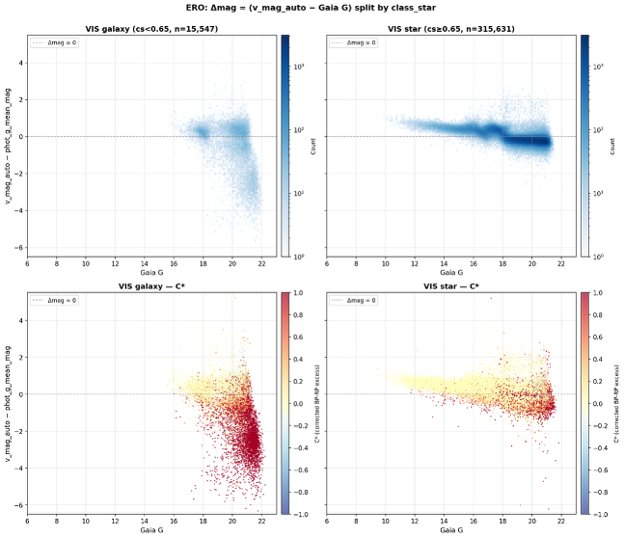

Euclid Label Reliability
ERO: class_star issues
Q1: phz_classification
The ERO class_star labels show systematic issues in the delta-mag plot. Bright-end contamination is visible where Euclid VIS photometry becomes unreliable.
Q1 labels using phz_classification are cleaner, but we still need a magnitude cut at the bright end to remove unreliable classifications.
We need to apply a magnitude cut to get rid of the bright end. Euclid is not good at classifying bright sources.
9
Background
Methodology
Model Training
Testing
Conclusion
Notes:
[~1m30s]
Before we can use Euclid labels as training data, we need to check how reliable they actually are. These plots show the magnitude difference between Gaia G-band and Euclid's bands, plotted against Gaia G magnitude. For the ERO data, we're comparing with the VIS band, and for Q1 with the photometric redshift estimates. The key thing to notice is that at the faint end, the scatter increases dramatically - this tells us the labels become unreliable for faint sources. We need to be careful about which sources we trust for training, and this motivates our magnitude cuts later.

Slide 11
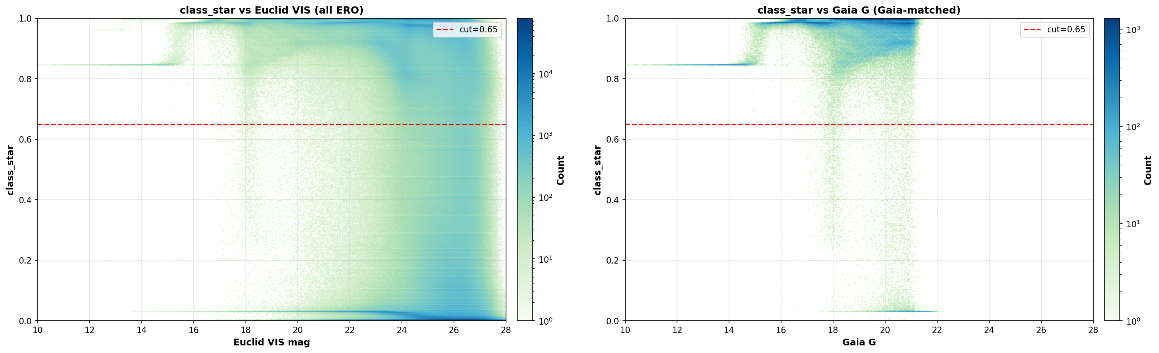
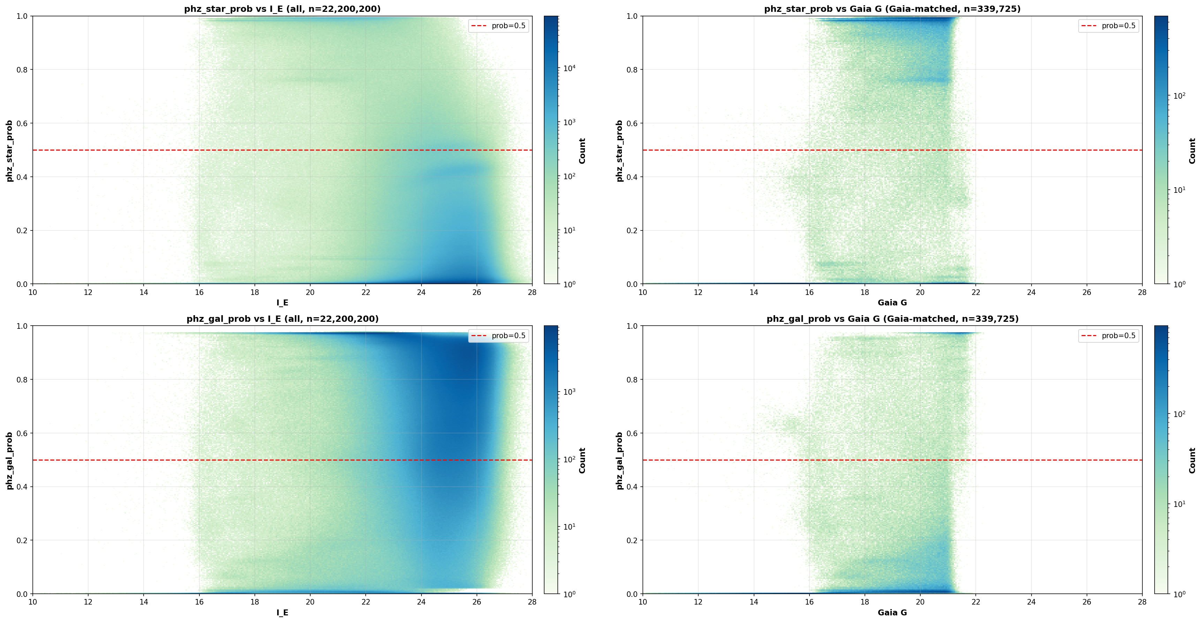
Euclid Label Comparison: 2D Histograms
ERO: class_star 2D histogram
Q1: phz_classification 2D histogram
The class_star distribution is somewhat messy at the bright end around G~18 magnitude. This bump needs careful investigation.
The Q1 phz_classification shows a much cleaner separation between stars and galaxies, with no anomalous bump at bright magnitudes.
class_star is unreliable at G~18. We train exclusively on Q1 phz_classification labels.
10
Background
Methodology
Model Training
Testing
Conclusion
Notes:
[~1m]
Here we visualize the Euclid classification probabilities in 2D, plotted against Gaia magnitude. For ERO we have the probability of being a star from morphological classification, and for Q1 we have the photometric redshift probability. You can see there's a clear bimodal structure - sources cluster near probability 0 or 1, meaning Euclid is quite confident for most sources. But there's a fuzzy region in between, especially at fainter magnitudes, where the classification is uncertain. These ambiguous sources are the ones we need to handle carefully.

Slide 12
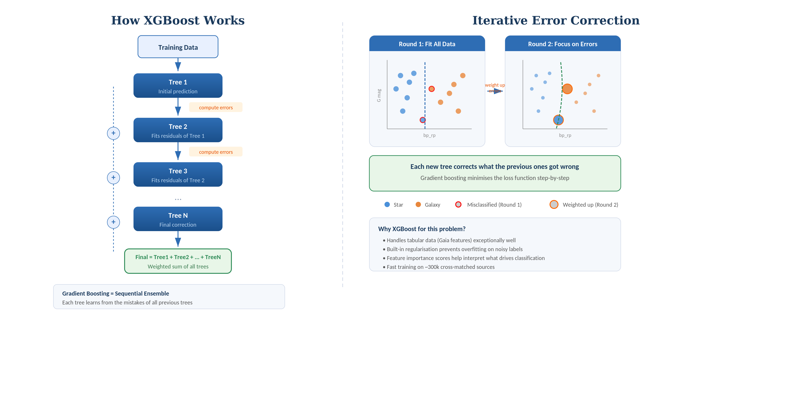
XGBoost: Gradient Boosting
XGBoost is ideal for tabular data like Gaia features: fast, interpretable, and handles noisy labels well.
11
Background
Methodology
Model Training
Testing
Conclusion
Notes:
[~1m30s]
So why XGBoost? XGBoost stands for Extreme Gradient Boosting, and it's an ensemble method that builds many simple decision trees sequentially. The left side of this infographic shows the basic idea: you start with your training data, fit a first tree, compute the errors, then build the next tree focusing specifically on the errors the previous trees got wrong. Each tree is weak on its own, but by iteratively correcting mistakes, the ensemble becomes very powerful. The right side illustrates this correction process - in round 1, the model tries to fit everything, then in round 2, the misclassified points get higher weights so the next tree focuses on them. XGBoost is particularly well-suited for tabular data like our Gaia feature catalogue, and it handles missing values natively, which is important since not all Gaia sources have all features measured.

Slide 13
XGBoost: Gradient Boosting
How XGBoost Works
Iterative Error Correction
Tree 1
Round 1: Initial Fit
Tree 1 makes initial predictions using all Gaia features
Some sources are misclassified
Round 2: Focus on Errors
Tree 2 up-weights misclassified sources and fits residuals
Errors are progressively corrected
+
initial prediction
compute errors
Tree 2
+
Each new tree corrects what the previous ones got wrong. The final prediction is a weighted sum of all trees.
Fits residuals of Tree 1
compute errors
Why XGBoost for this problem?
...
Designed for tabular data (Gaia's 23 features)
Fast training: handles millions of sources
Built-in feature importance for interpretability
Robust to noisy labels from Euclid
Final = Tree1 + Tree2 + ... + TreeN
Gradient Boosting = Sequential Ensemble
XGBoost is ideal for tabular data like Gaia features: fast, interpretable, and handles noisy labels well.
11
Background
Methodology
Model Training
Testing
Conclusion
Notes:
[~1m30s]
So why XGBoost? XGBoost stands for Extreme Gradient Boosting, and it's an ensemble method that builds many simple decision trees sequentially. The left side of this infographic shows the basic idea: you start with your training data, fit a first tree, compute the errors, then build the next tree focusing specifically on the errors the previous trees got wrong. Each tree is weak on its own, but by iteratively correcting mistakes, the ensemble becomes very powerful. The right side illustrates this correction process - in round 1, the model tries to fit everything, then in round 2, the misclassified points get higher weights so the next tree focuses on them. XGBoost is particularly well-suited for tabular data like our Gaia feature catalogue, and it handles missing values natively, which is important since not all Gaia sources have all features measured.

Slide 14
Training Strategy & Feature Selection
Step 1: Start Big
~153 features available in the gaia_source table
Astrometric, photometric, and scan-quality parameters
Step 2: Filter
Remove features with poor coverage or high null rates
Don’t confuse the model with irrelevant info
Step 3: Refine
~20 Gaia features retained after importance pruning
Train on Q1 labels only (ERO labels unreliable)
~153
available features
~20
selected features
Feature selection is critical: too many features confuse the model, too few lose discriminating power.
12
Background
Methodology
Model Training
Testing
Conclusion
Notes:
[~1m30s]
Our training strategy follows three steps. First, we start big - we take all available Gaia features, roughly 153 columns from the Gaia archive, and combine them with our Euclid-derived labels. Step two is filtering - we remove features that have too many missing values, features that are redundant, and features that don't contribute meaningful predictive power. Step three is refinement - we use feature importance from preliminary XGBoost runs to narrow down to about 20 key features. This is important because using too many features can lead to overfitting and makes the model harder to interpret. The final feature set includes things like parallax, proper motion, color indices, and various Gaia quality flags.

Slide 15
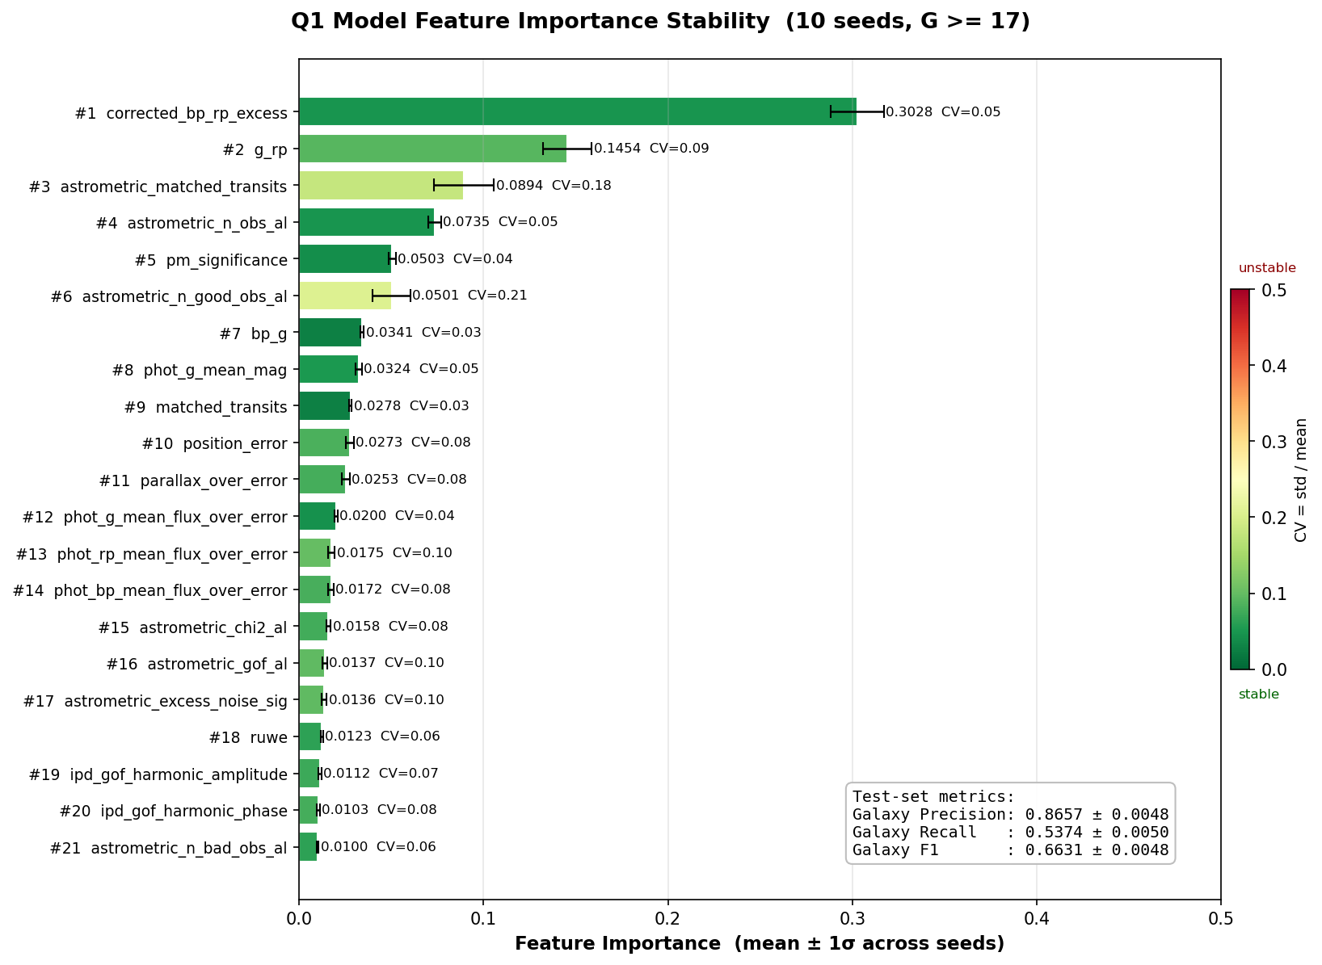
Feature Importance
Q1 Model Feature Importance Stability (10 seeds, G >= 17)
corrected_bp_rp_excess is the dominant feature — physically motivated (colour excess traces extended sources).
13
Background
Methodology
Model Training
Testing
Conclusion
Notes:
[~1m]
This plot shows the feature importance from our Q1 XGBoost model. The most important features are related to astrometric excess noise and proper motion, which makes physical sense - stars in our galaxy should have measurable proper motions and relatively clean astrometric solutions, while extragalactic sources like galaxies and quasars should have negligible proper motions but potentially noisy astrometry due to their extended or variable nature. Color information and parallax significance also rank highly, again physically motivated.

Slide 16
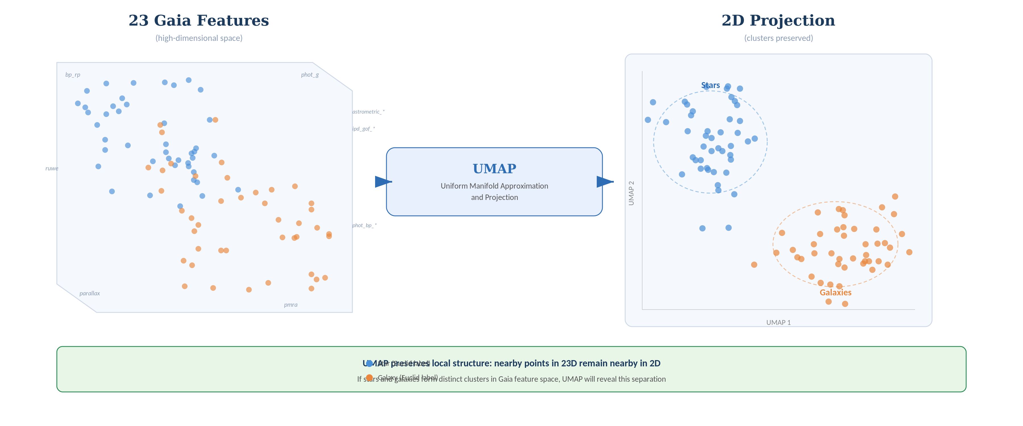
UMAP: Dimensionality Reduction
Dimensionality reduction: visualising 23 Gaia features in 2D
14
Background
Methodology
Model Training
Testing
Conclusion
Notes:
[~1m]
UMAP, or Uniform Manifold Approximation and Projection, is a dimensionality reduction technique that helps us visualize high-dimensional data in 2D. The idea is shown in this diagram - we have our 23-dimensional Gaia feature space on the left, where each source is a point in this high-dimensional space. UMAP finds a low-dimensional representation that preserves the local neighborhood structure - so sources that are similar in the original space stay close together in the 2D projection. This lets us see whether our XGBoost classifications form sensible clusters and whether different source types occupy distinct regions of feature space.

Slide 17
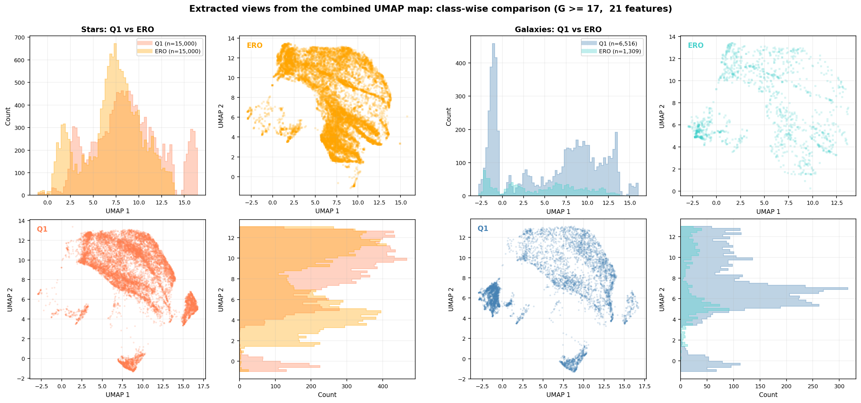
UMAP: Star-Galaxy Separation
UMAP projection of Q1 dataset, coloured by Euclid star/galaxy classification
Stars and galaxies form distinct clusters — the Gaia features alone carry strong morphological information.
15
Background
Methodology
Model Training
Testing
Conclusion
Notes:
[~1m30s]
Here's the actual UMAP visualization of our classified sources. You can see clear separation between the star cluster and the galaxy/quasar regions, which validates that our XGBoost model is learning physically meaningful patterns. The corner plots show the UMAP coordinates colored by different Gaia properties, which helps us understand what drives the separation. For instance, you can see that proper motion and astrometric noise are key discriminators, consistent with what the feature importance plot showed us.

Slide 18

XGBoost: Training on Q1 Labels
Q1 feature importance as a function of magnitude cut
16
Background
Methodology
Model Training
Testing
Conclusion
Pipeline
XGBoost trained on Q1 phz_classification labels
Select Gaia parameters as input features
Coverage test → filter low-coverage features
Initial feature importance → prune non-contributing ones
~20 features of reasonable importance remain
Validation
Population distributions for top features are consistent
Magnitude cut sensitivity analysis
Model learned genuine physical signals
Notes:
[~1m30s]
This is a key validation plot showing how our model performance depends on the magnitude cut we apply. Remember that we saw Euclid labels become unreliable at faint magnitudes. By varying where we place the faint-end magnitude cut for our training set, we can see how it affects the model's accuracy and reliability. The sensitivity analysis shows there's a sweet spot - too bright a cut means we lose too many training sources, too faint means we're training on unreliable labels. This helps us make an informed decision about the optimal magnitude limit for our training sample.

Slide 19
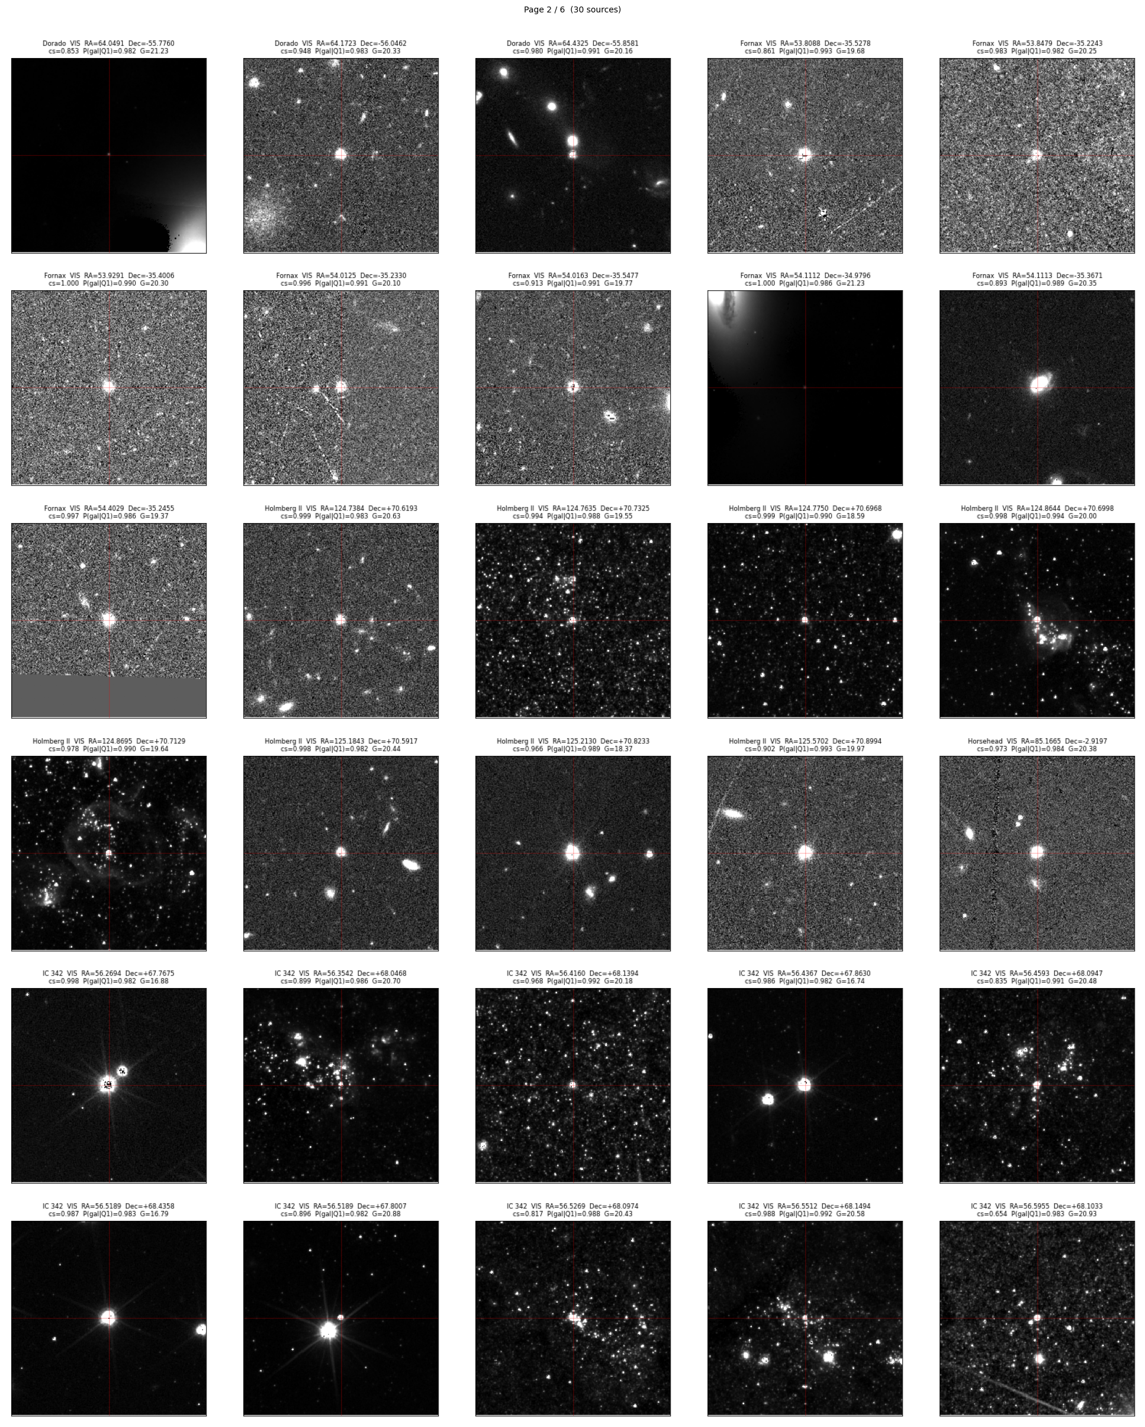
Euclid Imaging: Cutout Verification
Visual Verification
What We See
Sources where ERO class_star and Q1 model disagree on classification. We examine Euclid cutout images to verify which label is correct.
In most disagreement cases, the Euclid imaging clearly shows the object is indeed a galaxy, confirming the Q1-trained model prediction over the ERO class_star label.
We may trust phz_classification labels more — the Q1 model correctly identifies cases where ERO class_star fails.
17
Background
Methodology
Model Training
Testing
Conclusion
Notes:
[~1m]
Finally, as a sanity check, we can look at actual Euclid images of sources our model classified. This contact sheet shows cutouts from Euclid imaging for sources that our Gaia-trained XGBoost model classified as stars with high probability, but which Gaia's own classification was uncertain about. The fact that these look consistent with point sources in Euclid's high-resolution imaging gives us confidence that the model is making physically sensible predictions. This kind of visual validation complements the statistical metrics.

Slide 20
Summary & Key Findings
What We Found
Next Steps
Euclid ✕ Gaia cross-matching produces morphological training labels
NGC 6397 proper motion analysis validates cross-matching methodology
ERO class_star labels show artefacts; Q1 PHZ labels significantly more reliable
Gaia selection effects do not explain the ERO class_star bump
XGBoost Q1 model shows consistent feature importance
— genuine physical signal
corrected_bp_rp_excess is the strongest feature (physically motivated)
Complete cutout verification of ERO disagreements
Apply validated Q1 classifier to full Gaia DR3 catalogue
Test with future Euclid releases for expanded coverage
Investigate completeness corrections for the final catalogue
Apply classifier to full Gaia DR3 catalogue
Bottom line: Gaia parameters contain real morphological signal. Currently investigating optimal magnitude cut and label quality; once settled, re-running full experiments with refined approach before finalizing results.
18
Background
Methodology
Model Training
Testing
Conclusion
Notes:
[~1m]
To summarize: we've demonstrated that Euclid's morphological classifications can be used to improve Gaia's source classification. By training XGBoost on Euclid-labeled sources using Gaia features, we can extend reliable classifications to the full Gaia sky, not just the Euclid footprint. The key results are: first, the model achieves high accuracy when Euclid labels are reliable; second, the most important features are physically motivated - astrometric noise and proper motion; and third, UMAP visualization confirms the model learns meaningful structure. Future work includes extending to more Euclid data releases and exploring other classification methods.

Slide 21
Thank You
Questions?
Sylvia Zhao
sz423@cam.ac.uk
Institute of Astronomy, University of Cambridge
Notes:
[~15s]
Thank you for listening. I'm happy to take any questions. The code and data for this project are available on GitHub.

