Slide 1
Euclidifying Gaia
Using Machine Learning to Classify
Non-Point-Like Objects in Gaia DR3
Sylvia Zhao
Part III Astrophysics | Lent Term 2026
Supervisors: Diana Harrison, Simon Hodgkin, Vasily Belokurov
Institute of Astronomy, University of Cambridge
Notes:
Welcome. I'm Sylvia Zhao, and this is my Part III project: Euclidifying Gaia — using machine learning to classify non-point-like objects in the Gaia DR3 catalogue, with the help of higher-resolution imaging from ESA's Euclid mission.

Slide 2
Motivation
The Challenge
Our Approach
Gaia DR3 catalogues 1.8 billion sources but has limited morphological classification
Many extended objects (galaxies, nebulae) are misclassified or unclassified as point sources
Gaia's spatial resolution (~0.1″) blurs compact galaxies into star-like profiles
Euclid VIS imaging (0.1″/pixel) resolves structure Gaia cannot
Cross-match Euclid × Gaia to obtain truth labels (star vs galaxy)
Train XGBoost on Gaia-only parameters to classify all Gaia sources without needing Euclid
Key Question: Can Gaia-only parameters, trained with Euclid morphological labels, reliably distinguish stars from galaxies across the whole sky?
2
Notes:
Gaia is incredible for astrometry but struggles with morphology. Many galaxies look point-like at Gaia's resolution. Euclid, with its sharper VIS imaging, can distinguish stars from galaxies. The idea: use Euclid as a 'training teacher' — cross-match the catalogues, get truth labels, then train a classifier on Gaia parameters alone so we can classify the full Gaia sky.

Slide 3
Data: Euclid ERO & Q1 Releases
ERO (Early Release Observations)
Q1 (Quarter 1 Release)
17 fields with VIS-band photometry
Morphological classifiers: class_star, spread_model
Cross-matching: spatial position (q3c) with 0.3″ radius
~38,000 matched sources (Gaia G ≥ 18.5)
Highly imbalanced: ~95% stars, ~5% galaxies
4 fields with multi-band VIS + NIR photometry
PHZ pipeline: photo-z & star probability (phz_star_prob)
Pre-computed gaia_id → direct ID matching (no spatial cross-match)
~30,000 matched sources (Gaia G ≥ 18.5)
Better balanced: ~75% stars, ~25% galaxies
3
Notes:
Two Euclid data releases. ERO was first — 17 fields, single VIS band, traditional morphological classifiers. Q1 came later with multi-band coverage and the PHZ photo-z pipeline giving probabilistic star/galaxy classifications. Q1 also has pre-computed gaia_id associations, so no spatial cross-matching needed. The key difference is label quality and class balance — Q1 has much more galaxies proportionally.

Slide 4
01
Cross-Matching
Building the training set from Euclid × Gaia

Slide 5
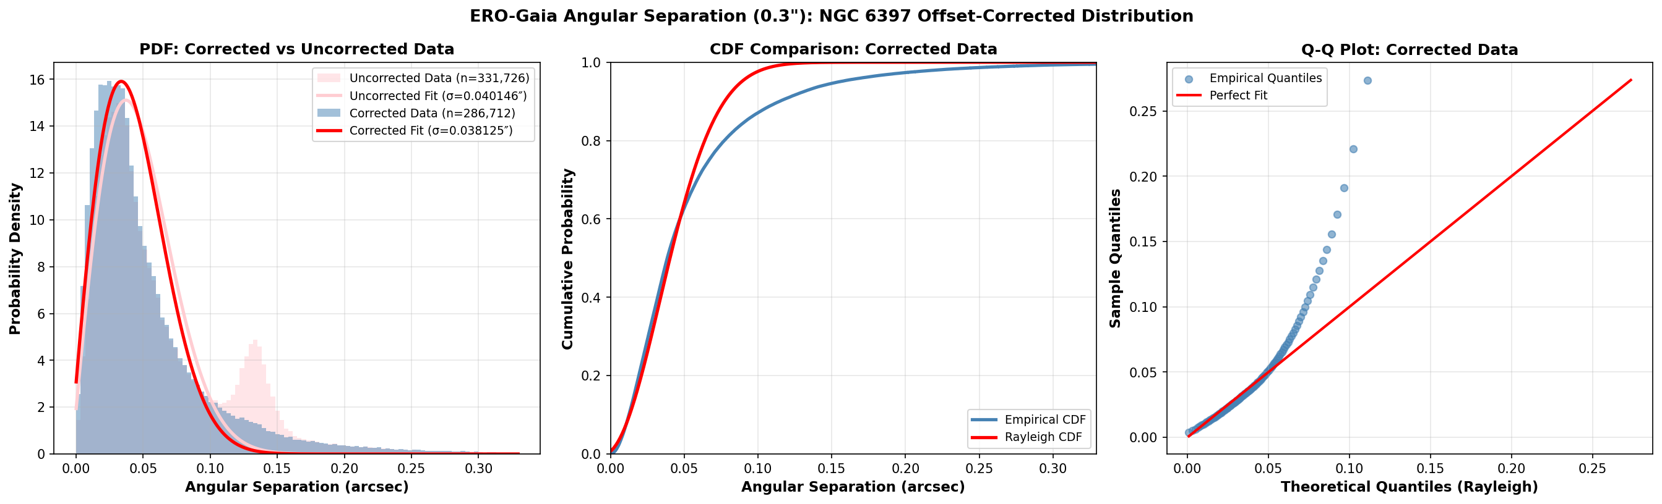
Cross-Match Validation:
NGC 6397 Discovery
Bimodal separation distribution
Angular separation at 0.3″ radius showed an unexpected second peak
Root cause: NGC 6397 globular cluster members have large, coherent proper motions that shifted their epoch-2016 positions
Resolution: Applying proper motion correction collapses the second bump into the main Rayleigh peak
σ = 0.038″ (corrected) vs 0.040″ (uncorrected)
→ Validates the 0.3″ matching radius
5
Notes:
One of the most interesting findings. When we looked at the angular separation distribution for ERO-Gaia cross-matches at 0.3 arcsec, we expected a clean Rayleigh distribution — but saw a bimodal shape. Tracing the second peak revealed it came from NGC 6397, a nearby globular cluster whose stars have large proper motions. Because Gaia positions are at epoch 2016 but Euclid observed later, the stars had moved. Correcting for proper motion fixes the distribution perfectly. This validates our matching radius choice.

Slide 6
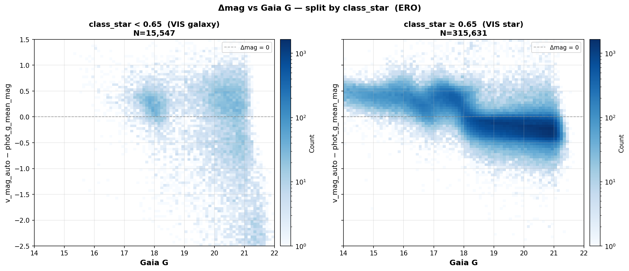
ERO Label Reliability
spread_model
SNR-dependent bias: unreliable at low signal-to-noise
Deserted early in the project
class_star
Suspicious Δmag vs class_star distributions — potential systematics
Under active investigation with supervisors
Implication: ERO labels may have higher contamination than expected, affecting any model trained on them
Ongoing work: Evaluating whether to also desert class_star labels and rely solely on Q1 PHZ-based classifications
6
Notes:
An important caveat about the ERO data. The spread_model classifier was found to be SNR-dependent — at low signal-to-noise, it gives biased results — so we abandoned it early on. Now class_star is also being questioned: when we look at delta-magnitude (Euclid minus Gaia) versus Gaia magnitude, colored by class_star, the distributions show suspicious patterns suggesting class_star may also have systematics. This is still under discussion with supervisors.

Slide 7
02
XGBoost Classification
Training strategy, feature selection & results

Slide 8
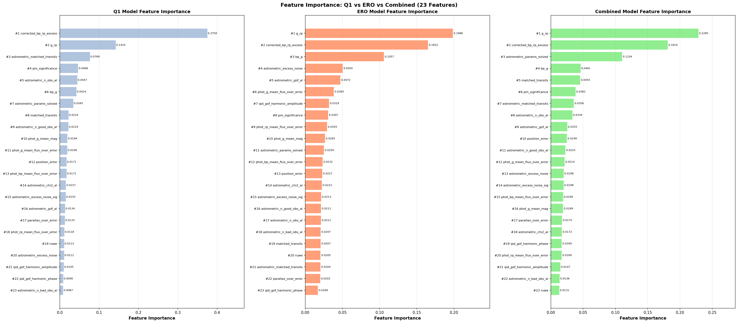
Training Strategy & Features
23 Gaia-only Parameters
Astrometric: parallax_over_error, ruwe, astrometric_excess_noise, matched_transits, ...
Photometric: phot_g_mean_mag, bp_g, g_rp, corrected_bp_rp_excess, flux SNRs
Kinematic: pm_significance, position_error
Training Strategy
3 training sets: Q1-only, ERO-only, Combined
3 test sets: Q1, ERO, Combined
→ 27 experiments (9 per training source)
Magnitude cut: Gaia G ≥ 18.5
8
Notes:
We use 23 parameters from the Gaia catalogue — all purely Gaia-based, no Euclid data at inference time. These span astrometric quality indicators, photometric measurements, and kinematic properties. The training strategy: 3 sources of labels (Q1, ERO, combined) tested against 3 test sets, giving 27 total experiments. We apply a magnitude cut at G >= 18.5 since brighter objects are generally well-classified already. The feature importance plot shows corrected_bp_rp_excess dominates — this makes physical sense as galaxies have extended emission that affects BP/RP photometry differently.

Slide 9
Classification Results
Experiment | Accuracy | Galaxy Precision | Galaxy Recall | Galaxy F1 | ROC AUC
Q1 → Q1 | 0.875 | 0.922 | 0.545 | 0.685 | 0.876
Comb → Q1 | 0.870 | 0.953 | 0.505 | 0.660 | 0.860
Comb → Combo | 0.920 | 0.929 | 0.461 | 0.616 | 0.867
ERO → ERO | 0.962 | 0.897 | 0.270 | 0.415 | 0.816
Q1 → ERO | 0.812 | 0.118 | 0.424 | 0.185 | 0.678
Key finding: Q1-trained model achieves best ROC AUC (0.876) and galaxy F1 (0.685). Galaxy recall remains the core challenge (~50-55%). Cross-domain transfer (Q1→ERO) degrades significantly, suggesting label-quality differences.
9
Notes:
Here are selected results from the 27 experiments. The best overall performance comes from Q1-trained models tested on Q1 — ROC AUC of 0.876 and galaxy F1 of 0.685. Galaxy recall is the main bottleneck, around 50-55% — meaning we miss about half of galaxies. This makes sense given galaxies are minority class and many are compact. Cross-domain transfer from Q1 to ERO is poor, likely because the ERO labels are noisier. Combined models don't outperform Q1-only, which also hints at ERO label contamination.

Slide 10
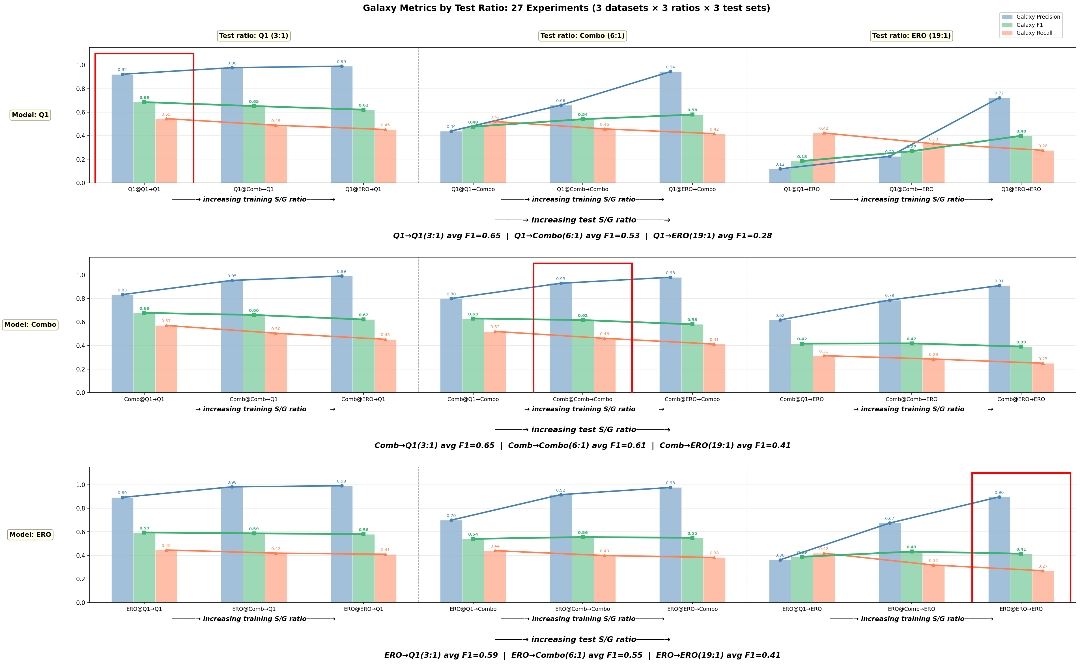
Galaxy Metrics Across Experiments
10
Notes:
This chart shows galaxy-specific metrics across all 27 experiments, grouped by test set. You can see the pattern: Q1 test set consistently gives the highest metrics, combined is intermediate, and ERO is lowest. Within each group, Q1-trained models (blue) tend to have the highest galaxy recall, while ERO-trained models (red) sacrifice recall for precision. The combined models sit in between.

Slide 11
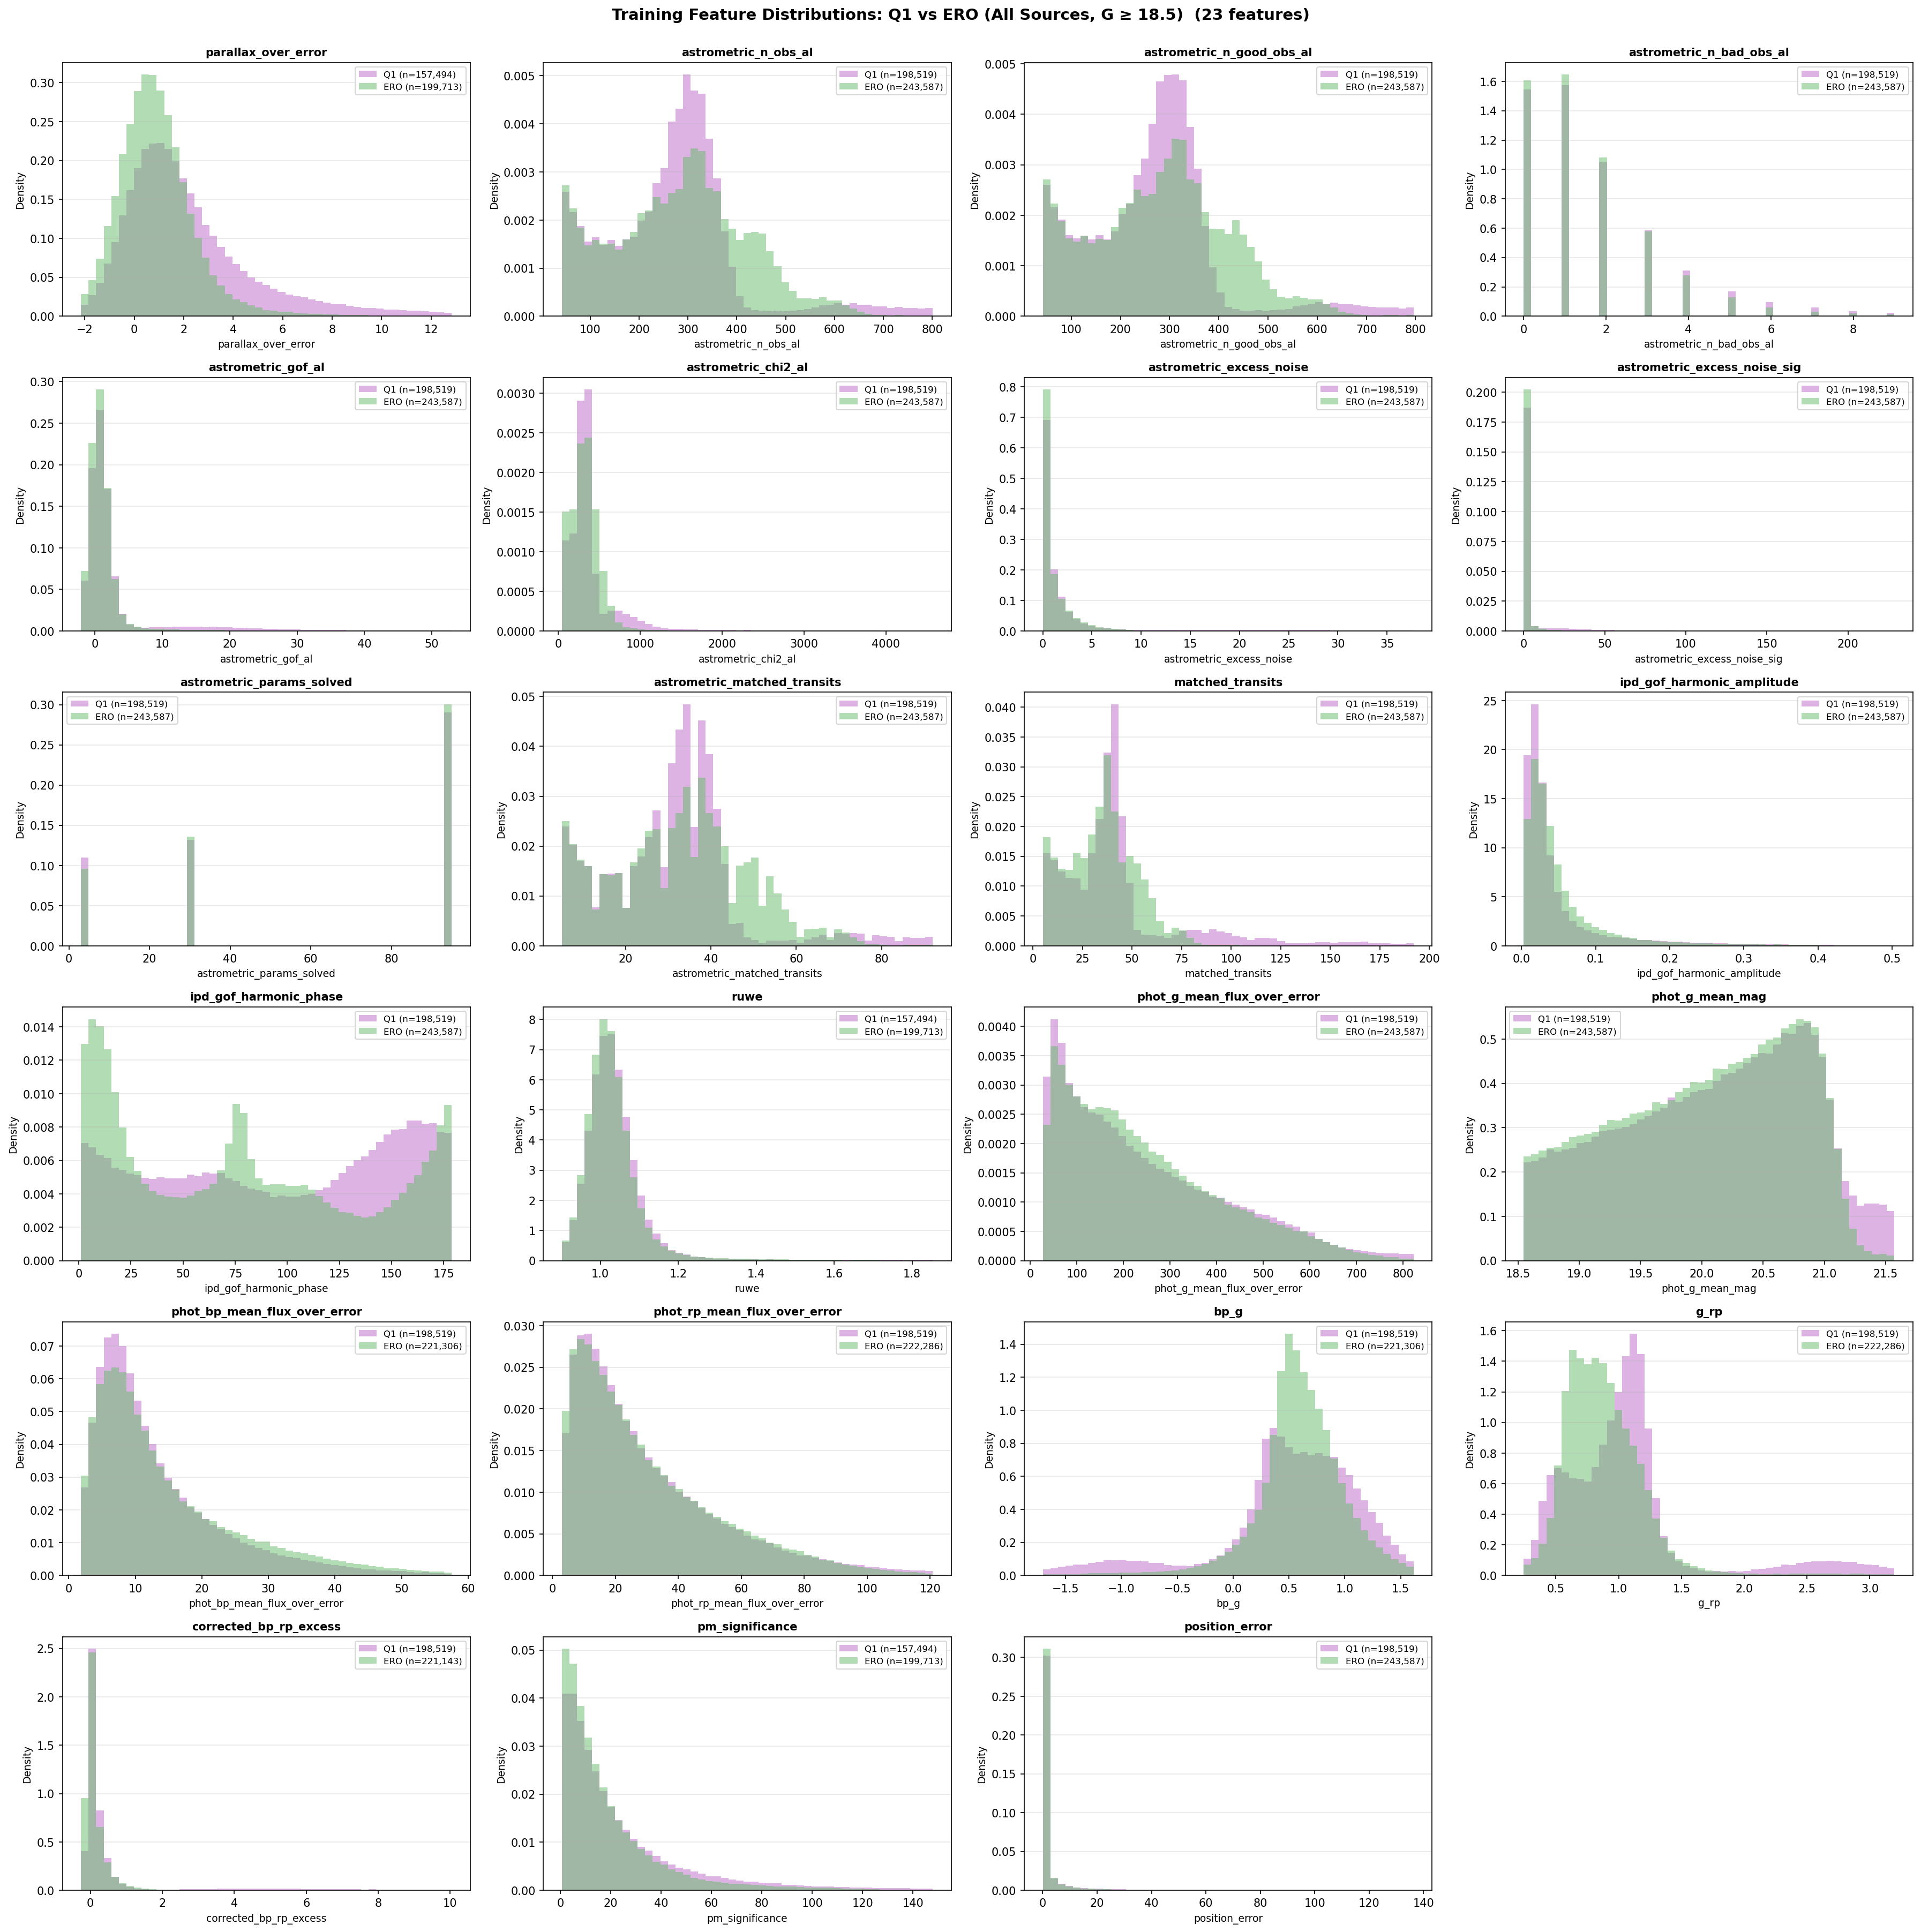
Feature Importance &
Physical Interpretation
Top discriminating features:
1. corrected_bp_rp_excess
Galaxies have extended emission → excess flux in BP/RP relative to G
2. g_rp (colour)
Galaxy spectral energy distributions differ from stellar colours
3. astrometric_matched_transits
Extended sources affect centroiding → fewer matched transits
4. ruwe
Galaxies produce poor astrometric fits → higher RUWE values
11
Notes:
The model finds physically meaningful features. corrected_bp_rp_excess is the strongest predictor — this quantifies how much flux leaks into the BP and RP prisms beyond what's expected from the G-band. Galaxies, being extended, naturally have excess flux. g_rp captures colour differences. astrometric_matched_transits reflects that extended sources have worse centroiding, leading to fewer successful transit matches. These all make astrophysical sense and give us confidence the model is learning real signal.

Slide 12
03
Sensitivity Analysis
Magnitude cuts and model robustness

Slide 13
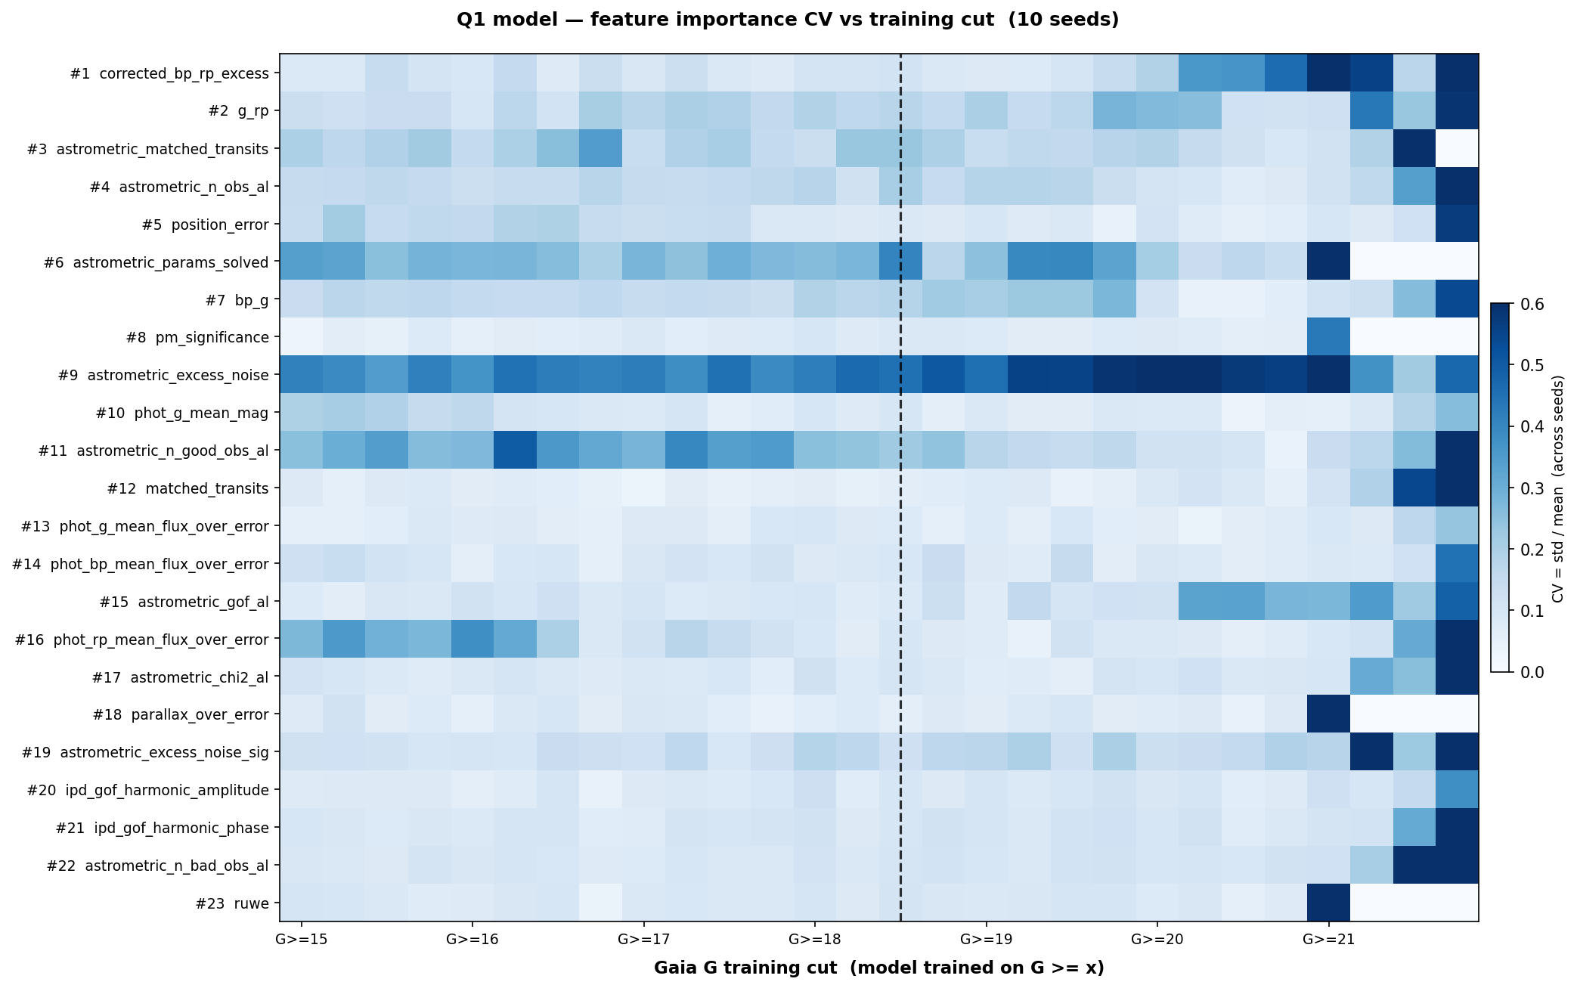
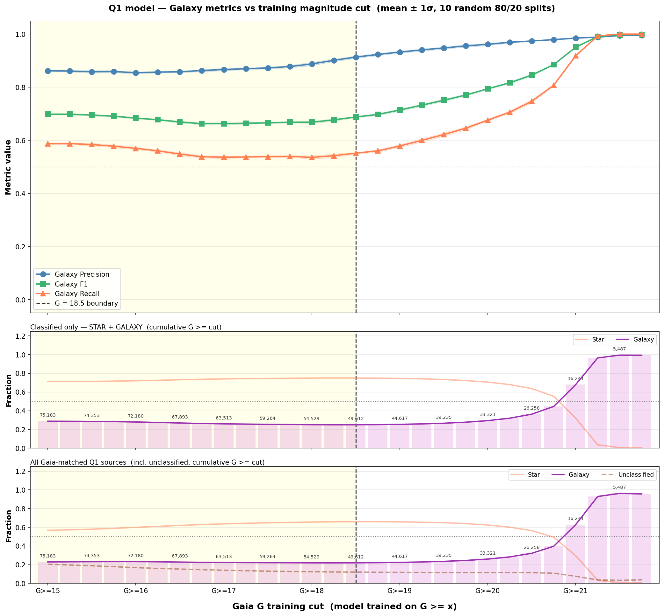
Magnitude Cut Sensitivity
Q1 cross-validation performance as a function of magnitude cut (left: heatmap, right: line plots)
13
Notes:
How sensitive are the results to the magnitude cut? The heatmap shows cross-validation performance across different lower and upper magnitude bounds. The main takeaway: performance is relatively stable for reasonable cuts, but there's a sweet spot around G >= 18.5. Cutting too bright (G >= 16) includes well-classified objects but reduces galaxy fraction. Cutting too faint loses signal-to-noise. The line plots on the right show individual metrics as functions of the cuts.

Slide 14
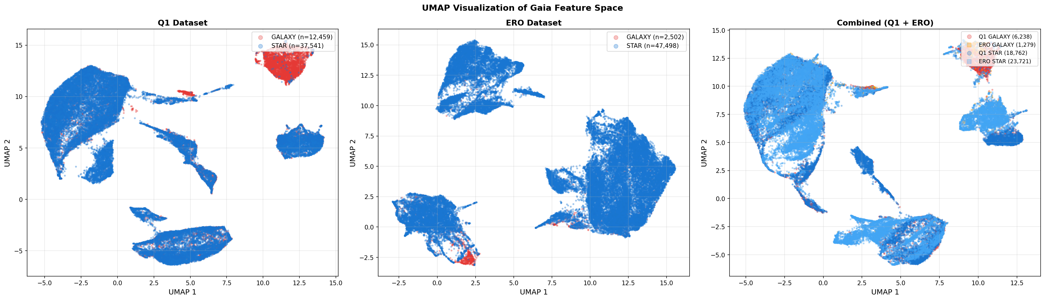
UMAP: Star-Galaxy Separation
in Feature Space
UMAP projection of the 23-dimensional Gaia feature space, coloured by star/galaxy label
14
Notes:
This is a UMAP dimensionality reduction of the 23 Gaia features, coloured by star/galaxy label. You can see that stars and galaxies do form somewhat distinct clusters in this feature space, which confirms there IS signal in the Gaia parameters to distinguish them. But there's also significant overlap — this overlap region is what limits our galaxy recall. The cluster structure suggests the classifier is finding real physical differences, not just overfitting.

Slide 15
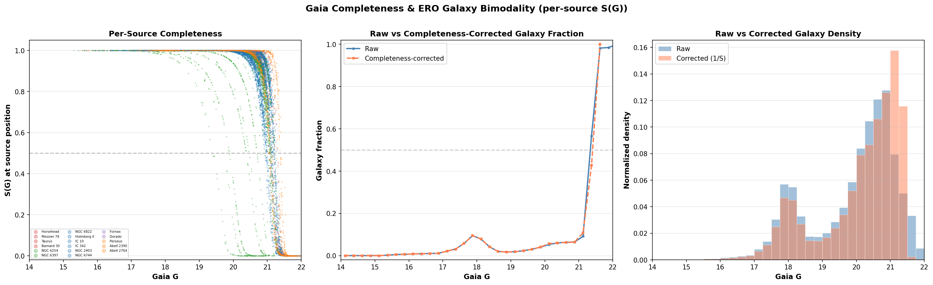
Gaia Completeness for Galaxies
Key observations:
Gaia galaxy completeness drops sharply at G > 19–20
Euclid detects many galaxies that Gaia misses entirely
Brighter galaxies (G < 19) are well-represented → classifier most reliable here
This limits the practical application of any Gaia-based galaxy classifier at the faint end
15
Notes:
An important limitation: Gaia's completeness for galaxies. At bright magnitudes, Gaia captures most of the galaxies that Euclid sees. But beyond G ~ 19-20, Gaia's completeness drops — it simply doesn't detect many faint galaxies. This means our classifier can only classify galaxies that Gaia has already observed, and it will be most reliable at the bright end where training data is plentiful.

Slide 16
Conclusions & Outlook
Key Results
Future Directions
Euclid × Gaia cross-matching successfully generates morphological training labels
XGBoost achieves ROC AUC 0.88 using 23 Gaia parameters alone
corrected_bp_rp_excess is the strongest predictor (physically motivated)
NGC 6397 proper motion correction validates cross-match methodology
ERO label quality is a concern — Q1 labels are more reliable
Investigate class_star systematics further
Test with future Euclid data releases (larger sky coverage)
Explore galaxy sub-classification (elliptical vs spiral)
Improve galaxy recall through class-weighting or threshold tuning
Apply classifier to full Gaia DR3 catalogue
Bottom line: Gaia parameters contain real morphological signal. With better labels from future Euclid releases, this approach could reliably flag extended objects across the full Gaia sky.
16
Notes:
To summarise: We've shown that cross-matching Euclid and Gaia can generate useful morphological training labels. The XGBoost classifier trained on 23 Gaia-only parameters achieves a ROC AUC of 0.88, with corrected_bp_rp_excess as the strongest predictor. Galaxy recall remains the main challenge at ~55%. ERO label quality is a concern, while Q1 labels are more reliable. Looking ahead, larger Euclid releases will provide better training data and broader sky coverage, potentially enabling a practical all-sky extended-object classifier for Gaia.

Slide 17
Thank You
Questions?
Sylvia Zhao
sz423@cam.ac.uk
Institute of Astronomy, University of Cambridge
Notes:
Thank you for your attention. I'm happy to take any questions about the methodology, results, or future directions.

