Slide 1
Euclidifying Gaia
Using Machine Learning to Classify
Non-Point-Like Objects in Gaia DR3
Sylvia Zhao
Part III Astrophysics | Lent Term 2026
Supervisors: Diana Harrison, Simon Hodgkin, Vasily Belokurov
Institute of Astronomy, University of Cambridge
Notes:
Welcome. I'm Sylvia Zhao, and this is my Part III project: Euclidifying Gaia — using machine learning to classify non-point-like objects in the Gaia DR3 catalogue, with the help of higher-resolution imaging from ESA's Euclid mission.

Slide 2
Motivation
The Challenge
Our Approach
Gaia DR3 catalogues 1.8 billion sources but has limited morphological classification
Many extended objects (galaxies, nebulae) are misclassified or unclassified as point sources
Gaia's spatial resolution (~0.1") blurs compact galaxies into star-like profiles
Euclid VIS imaging (0.1"/pixel) resolves structure Gaia cannot
Cross-match Euclid × Gaia to obtain truth labels (star vs galaxy)
Train XGBoost on Gaia-only parameters to classify all Gaia sources without needing Euclid
Key Question: Can Gaia-only parameters, trained with Euclid morphological labels, reliably distinguish stars from galaxies across the whole sky?
2
Notes:
Gaia is incredible for astrometry but struggles with morphology. Many galaxies look point-like at Gaia's resolution. Euclid, with its sharper VIS imaging, can distinguish stars from galaxies. The idea: use Euclid as a 'training teacher' — cross-match the catalogues, get truth labels, then train a classifier on Gaia parameters alone so we can classify the full Gaia sky.

Slide 3
The Missions — Gaia & Euclid
Gaia
Euclid
ESA astrometry mission, launched 2013, L2 orbit
Whole-sky survey: 1.8 billion sources
6-hour spin, 63-day precession → complex scanning pattern
Final shutdown: 27 March 2025
DR3 + future DR4 (2026), final catalogue ~2030
Key limitation: ~0.1" resolution, struggles with morphology
ESA dark energy mission, launched 1 July 2023, L2 orbit
Deep-field survey: 14,000 deg² over 6 years
Step-and-stare: ~70 min per field (0.5 deg²) → slow coverage
VIS: 0.1"/pixel, IE-band depth 24.5 AB mag
VIS saturation limit: ~17.5 mag → filters OUT bright sources, biased toward faint/galaxies
Only 17 ERO + 4 Q1 fields (~2000 deg² by Mar 2025, ~14% of total)
The Bridge: Euclid sees deeper and resolves morphology; Gaia sees the whole sky. By training on Euclid labels, we can classify Gaia's entire catalogue — potentially finding many more galaxies than Euclid could ever survey alone.
3
Notes:
Two complementary ESA missions at L2. Gaia is all-sky, shallow, limited morphology. Euclid is deep but slow, covers only 14% of the sky so far. Gaia shut down in March 2025, so no new Gaia data. But Euclid is young and will provide labels for years. The key insight: Euclid's morphological information can train a classifier that works across the entire Gaia catalogue, finding galaxies Euclid will never directly observe.

Slide 4
Data: Euclid ERO & Q1 Releases
ERO (Early Release Observations)
Q1 (Quarter 1 Release)
17 fields with VIS-band photometry
Morphological classifiers: class_star, spread_model
Cross-matching: spatial position (q3c) with 0.3" radius
~38,000 matched sources (Gaia G ≥ 18.5)
Highly imbalanced: ~95% stars, ~5% galaxies
4 fields with multi-band VIS + NIR photometry
PHZ pipeline: photo-z & star probability (phz_star_prob)
Pre-computed gaia_id → direct ID matching (no spatial cross-match)
~30,000 matched sources (Gaia G ≥ 18.5)
Better balanced: ~75% stars, ~25% galaxies
4
Notes:
Two Euclid data releases. ERO was first — 17 fields, single VIS band, traditional morphological classifiers. Q1 came later with multi-band coverage and the PHZ photo-z pipeline giving probabilistic star/galaxy classifications. Q1 also has pre-computed gaia_id associations, so no spatial cross-matching needed. The key difference is label quality and class balance — Q1 has much more galaxies proportionally.

Slide 5
01
Cross-Matching
Building the training set from Euclid × Gaia
Notes:
Now we move into the technical work. First up: cross-matching.

Slide 6
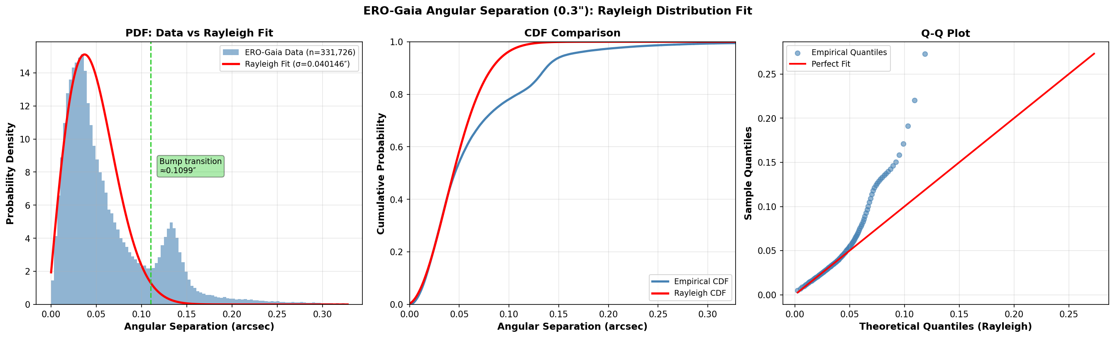
Cross-Matching Methodology
ERO: Spatial Matching
q3c library: match Euclid × Gaia by sky position
Radius: 0.3" (arcsecond) — optimized for Euclid astrometric accuracy
One-to-one pairing: nearest neighbour within radius
Q1: Direct ID Matching
Pre-computed by Euclid team: gaia_id → direct link
More reliable than spatial matching (no radius ambiguity)
Fewer contamination issues
Separation distribution (right): Most matches cluster near 0" with Rayleigh tail. Main peak = true matches; tail = spatially blended/unmatched sources.
6
Notes:
The cross-matching strategy differs by dataset. For ERO, we use q3c — a spatial-tree library — to match positions with a 0.3 arcsecond radius. For Q1, the team pre-computed gaia_ids, so we just use the direct mapping. The separation distribution plot shows how well-separated our matches are. A clean Rayleigh peak indicates good spatial matching.

Slide 7
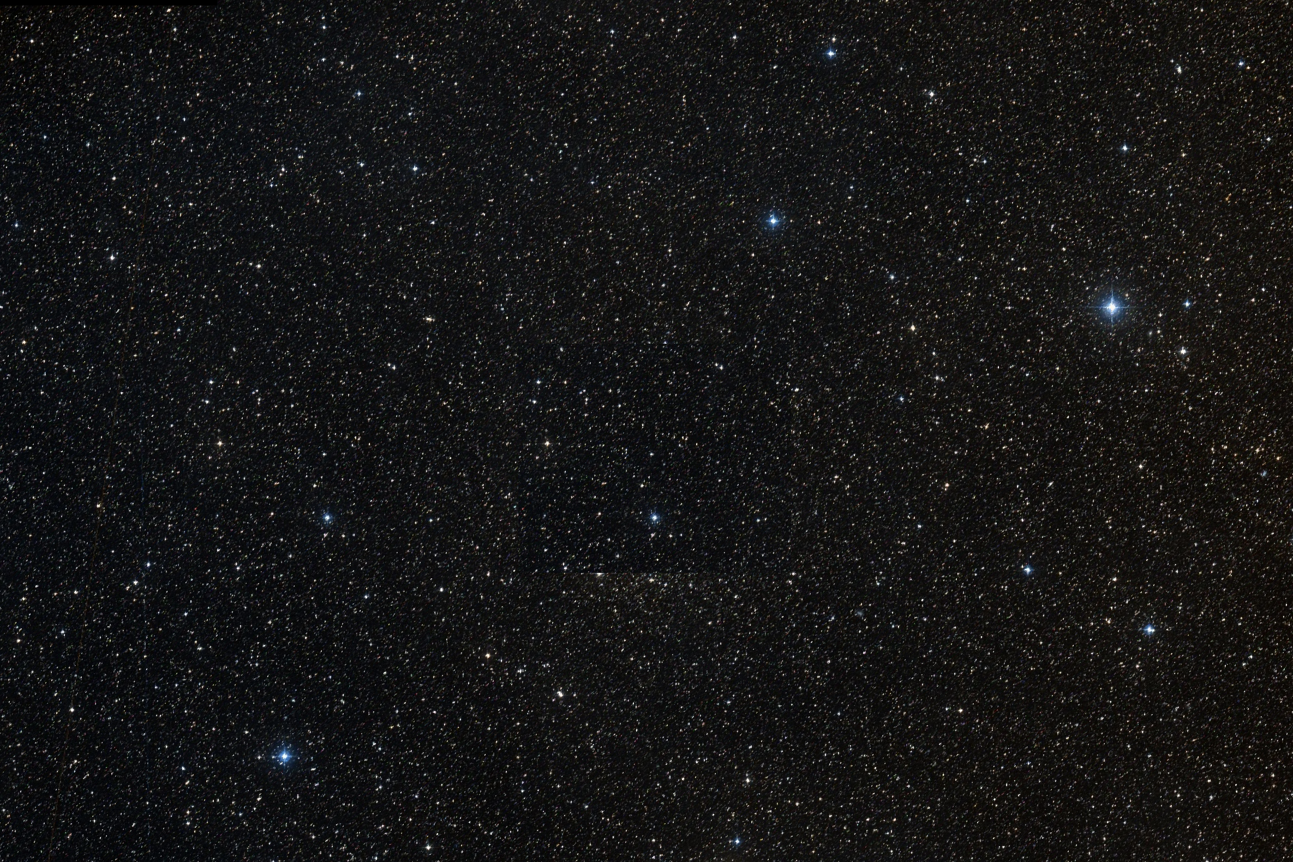
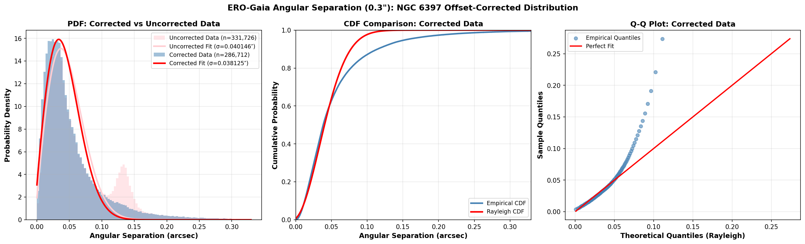
Cross-Match Validation:
NGC 6397 Discovery
Bimodal separation distribution
Angular separation at 0.3" radius showed an unexpected second peak
Root cause: NGC 6397 globular cluster members have large, coherent proper motions that shifted their epoch-2016 positions
Resolution: Applying proper motion correction collapses the second bump into the main Rayleigh peak
σ = 0.038" (corrected) vs 0.040" (uncorrected)
→ Validates the 0.3" matching radius
NGC 6397
7
Notes:
One of the most interesting findings. When we looked at the angular separation distribution for ERO-Gaia cross-matches at 0.3 arcsec, we expected a clean Rayleigh distribution — but saw a bimodal shape. Tracing the second peak revealed it came from NGC 6397, a nearby globular cluster whose stars have large proper motions. Because Gaia positions are at epoch 2016 but Euclid observed later, the stars had moved. Correcting for proper motion fixes the distribution perfectly. This validates our matching radius choice.

Slide 8
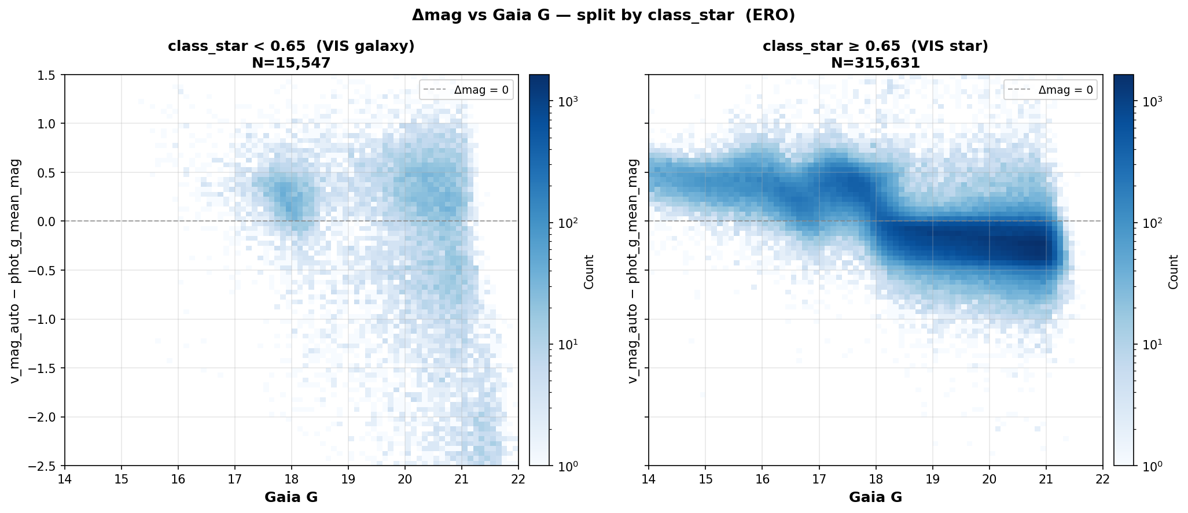
ERO Label Reliability
spread_model
SNR-dependent bias: unreliable at low signal-to-noise
Deserted early in the project
class_star
Suspicious Δmag vs class_star distributions — potential systematics
Under active investigation with supervisors
Implication: ERO labels may have higher contamination than expected, affecting any model trained on them
Ongoing work: Evaluating whether to also desert class_star labels and rely solely on Q1 PHZ-based classifications
8
Notes:
An important caveat about the ERO data. The spread_model classifier was found to be SNR-dependent — at low signal-to-noise, it gives biased results — so we abandoned it early on. Now class_star is also being questioned: when we look at delta-magnitude (Euclid minus Gaia) versus Gaia magnitude, colored by class_star, the distributions show suspicious patterns suggesting class_star may also have systematics. This is still under discussion with supervisors.

Slide 9
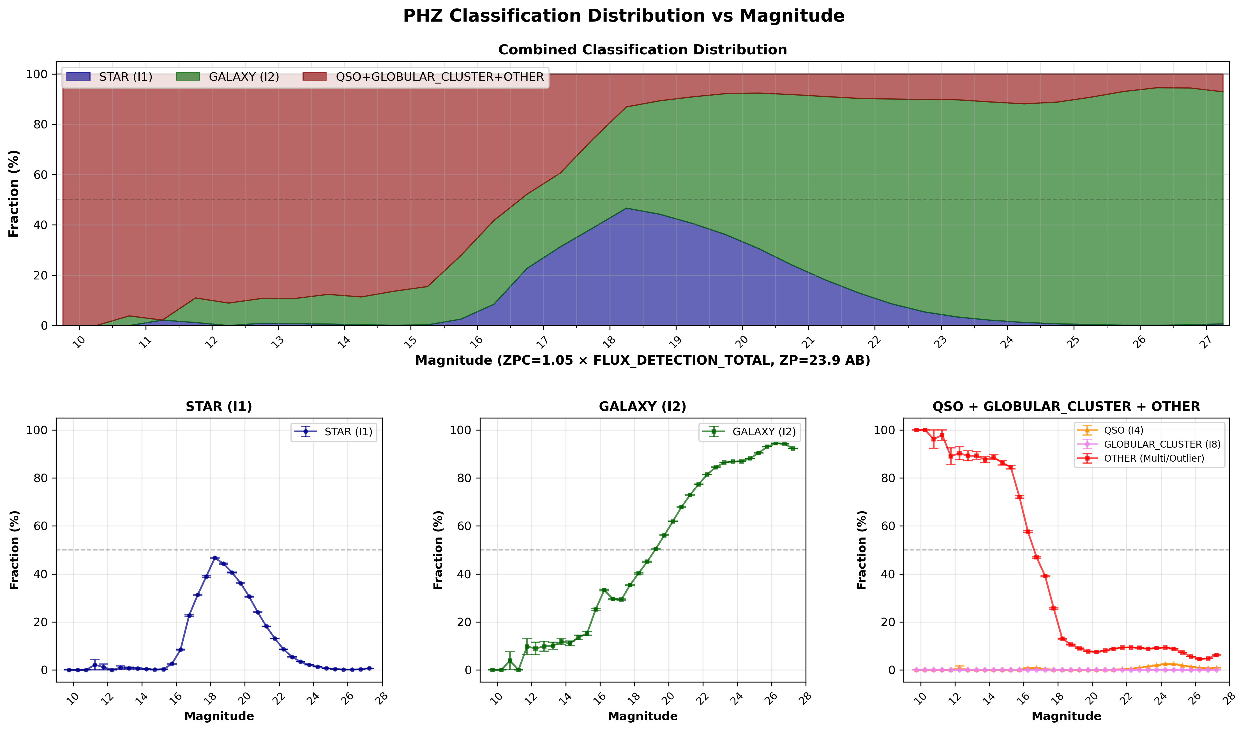
Q1 PHZ Validation
PHZ Pipeline
Multi-wavelength photometry → photo-z + classification
phz_star_prob: probability of being a star (0–1)
Probabilistic approach reduces hard classification errors
Advantages over ERO classifiers:
More reliable than morphological spread_model
Better class balance (~75% stars, ~25% galaxies)
Physics-informed: trained on SED fitting
Result: Q1 labels are of significantly higher quality than ERO. Models trained on Q1 consistently outperform ERO-trained models.
9
Notes:
The Q1 release includes the PHZ photo-z pipeline, which classifies objects using multi-wavelength photometry. Instead of relying on morphological parameters like spread_model, it uses energy distribution fitting — much more robust. The phz_star_prob gives a star-likelihood score. This approach gives cleaner labels, better class balance, and most importantly, galaxies and stars are separated by fundamental physics, not by morphology artifacts. This is why Q1 labels are so much better.

Slide 10
02
XGBoost Classification
Training strategy, feature selection & results
Notes:
Now we shift from data preparation to the machine learning model.

Slide 11
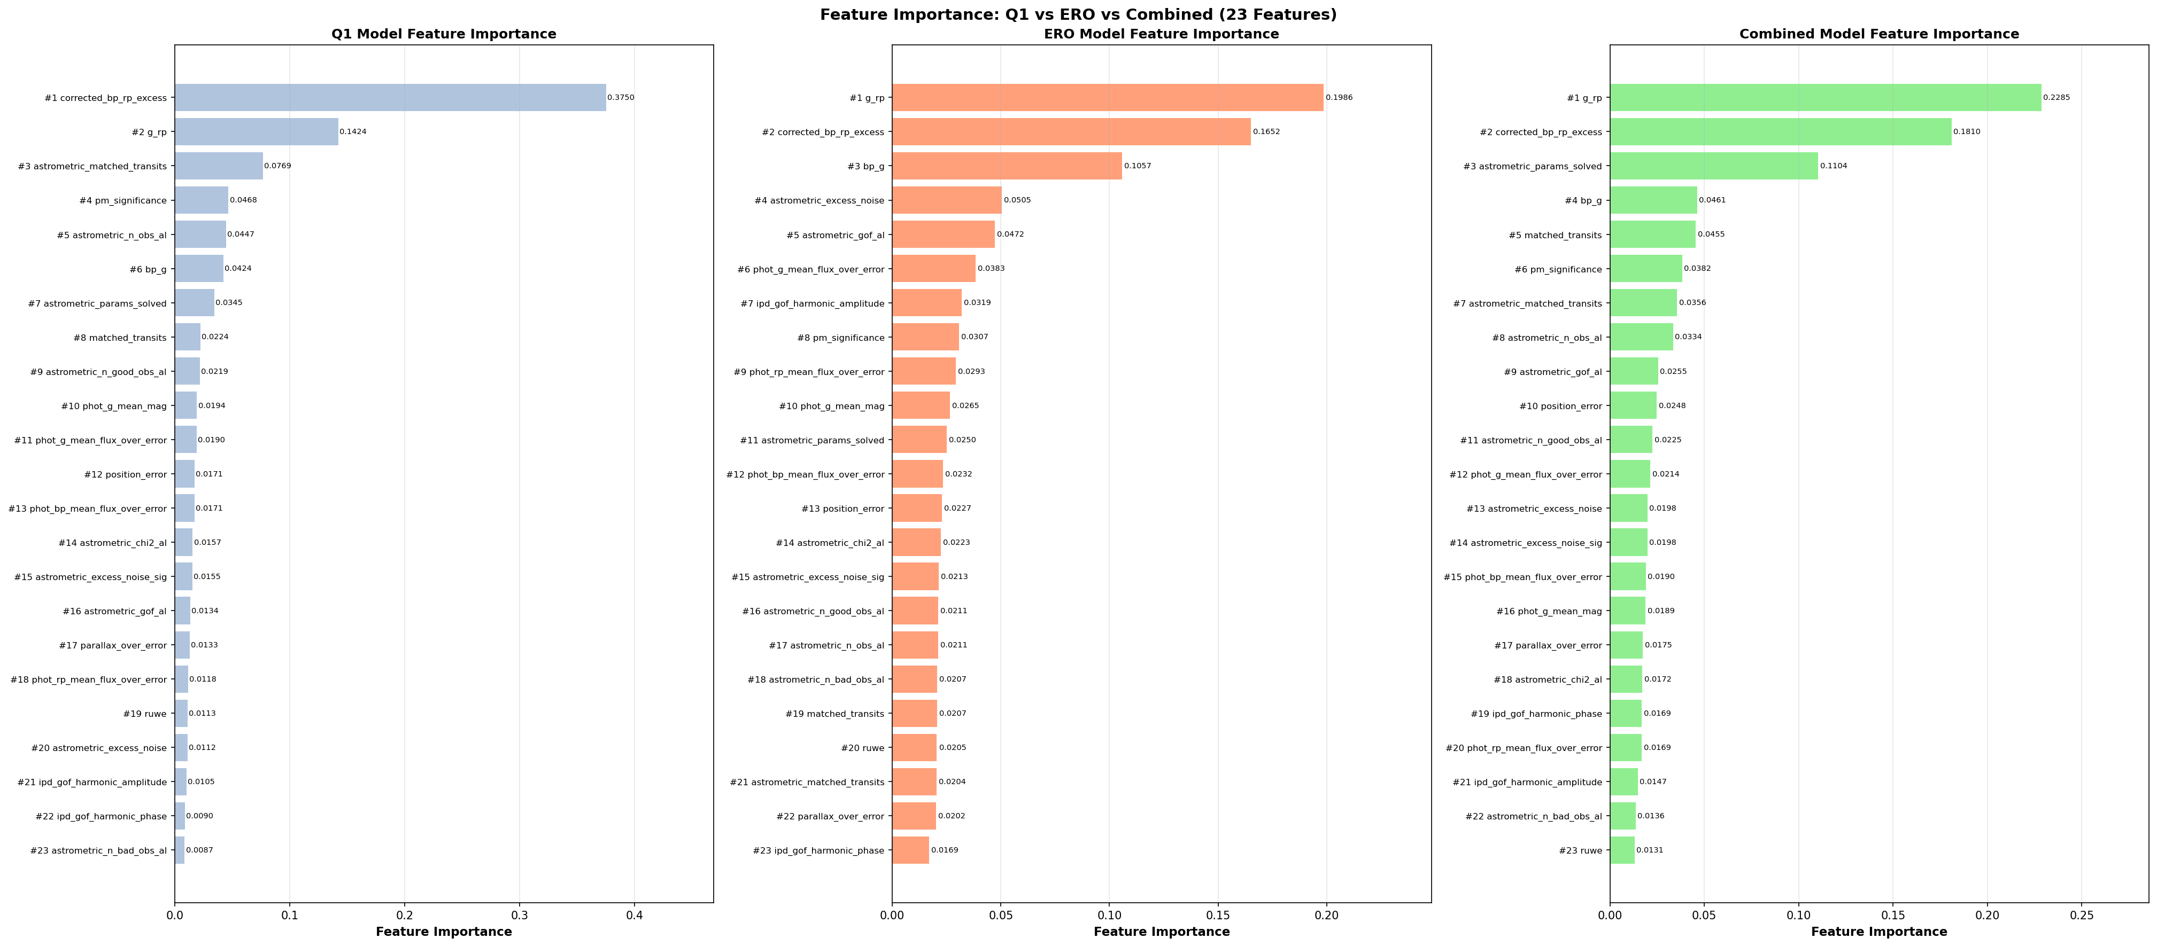
Training Strategy & Features
23 Gaia-only Parameters
Astrometric: parallax_over_error, ruwe, astrometric_excess_noise, matched_transits, ...
Photometric: phot_g_mean_mag, bp_g, g_rp, corrected_bp_rp_excess, flux SNRs
Kinematic: pm_significance, position_error
Training Strategy
3 training sets: Q1-only, ERO-only, Combined
3 test sets: Q1, ERO, Combined
→ 27 experiments (9 per training source)
Magnitude cut: Gaia G ≥ 18.5
11
Notes:
We use 23 parameters from the Gaia catalogue — all purely Gaia-based, no Euclid data at inference time. These span astrometric quality indicators, photometric measurements, and kinematic properties. The training strategy: 3 sources of labels (Q1, ERO, combined) tested against 3 test sets, giving 27 total experiments. We apply a magnitude cut at G >= 18.5 since brighter objects are generally well-classified already. The feature importance plot shows corrected_bp_rp_excess dominates — this makes physical sense as galaxies have extended emission that affects BP/RP photometry differently.

Slide 12
Classification Results
Experiment | Accuracy | Galaxy Precision | Galaxy Recall | Galaxy F1 | ROC AUC
Q1 → Q1 | 0.875 | 0.922 | 0.545 | 0.685 | 0.876
Comb → Q1 | 0.870 | 0.953 | 0.505 | 0.660 | 0.860
Comb → Combo | 0.920 | 0.929 | 0.461 | 0.616 | 0.867
ERO → ERO | 0.962 | 0.897 | 0.270 | 0.415 | 0.816
Q1 → ERO | 0.812 | 0.118 | 0.424 | 0.185 | 0.678
Key finding: Q1-trained model achieves best ROC AUC (0.876) and galaxy F1 (0.685). Galaxy recall remains the core challenge (~50-55%). Cross-domain transfer (Q1→ERO) degrades significantly, suggesting label-quality differences.
12
Notes:
Here are selected results from the 27 experiments. The best overall performance comes from Q1-trained models tested on Q1 — ROC AUC of 0.876 and galaxy F1 of 0.685. Galaxy recall is the main bottleneck, around 50-55% — meaning we miss about half of galaxies. This makes sense given galaxies are minority class and many are compact. Cross-domain transfer from Q1 to ERO is poor, likely because the ERO labels are noisier. Combined models don't outperform Q1-only, which also hints at ERO label contamination.

Slide 13
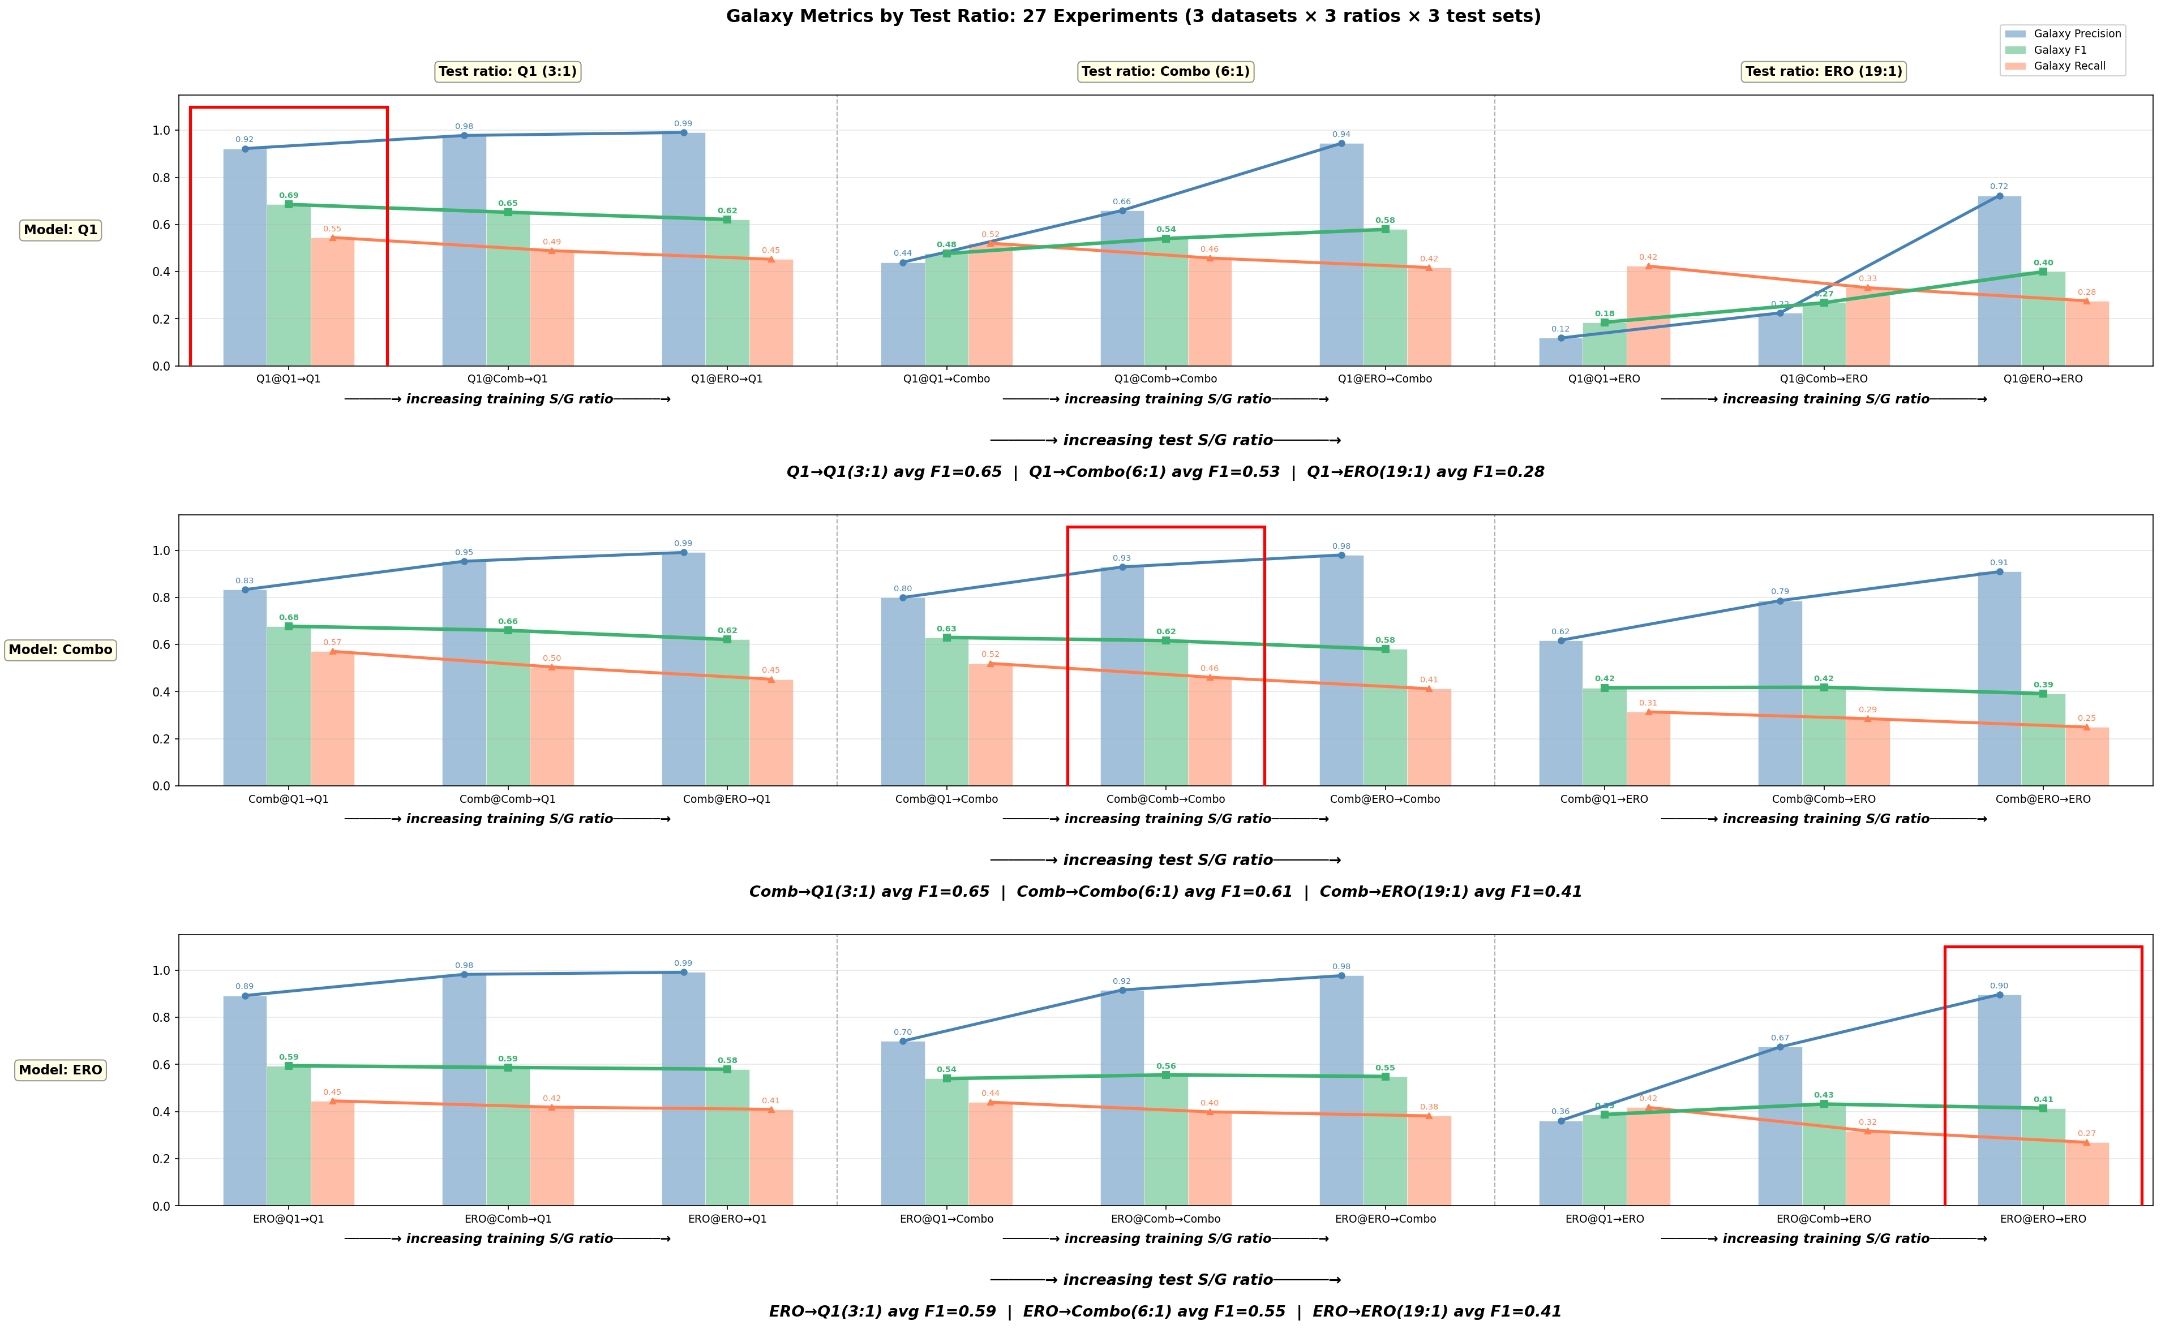
Galaxy Metrics Across Experiments
13
Notes:
This chart shows galaxy-specific metrics across all 27 experiments, grouped by test set. You can see the pattern: Q1 test set consistently gives the highest metrics, combined is intermediate, and ERO is lowest. Within each group, Q1-trained models (blue) tend to have the highest galaxy recall, while ERO-trained models (red) sacrifice recall for precision. The combined models sit in between.

Slide 14
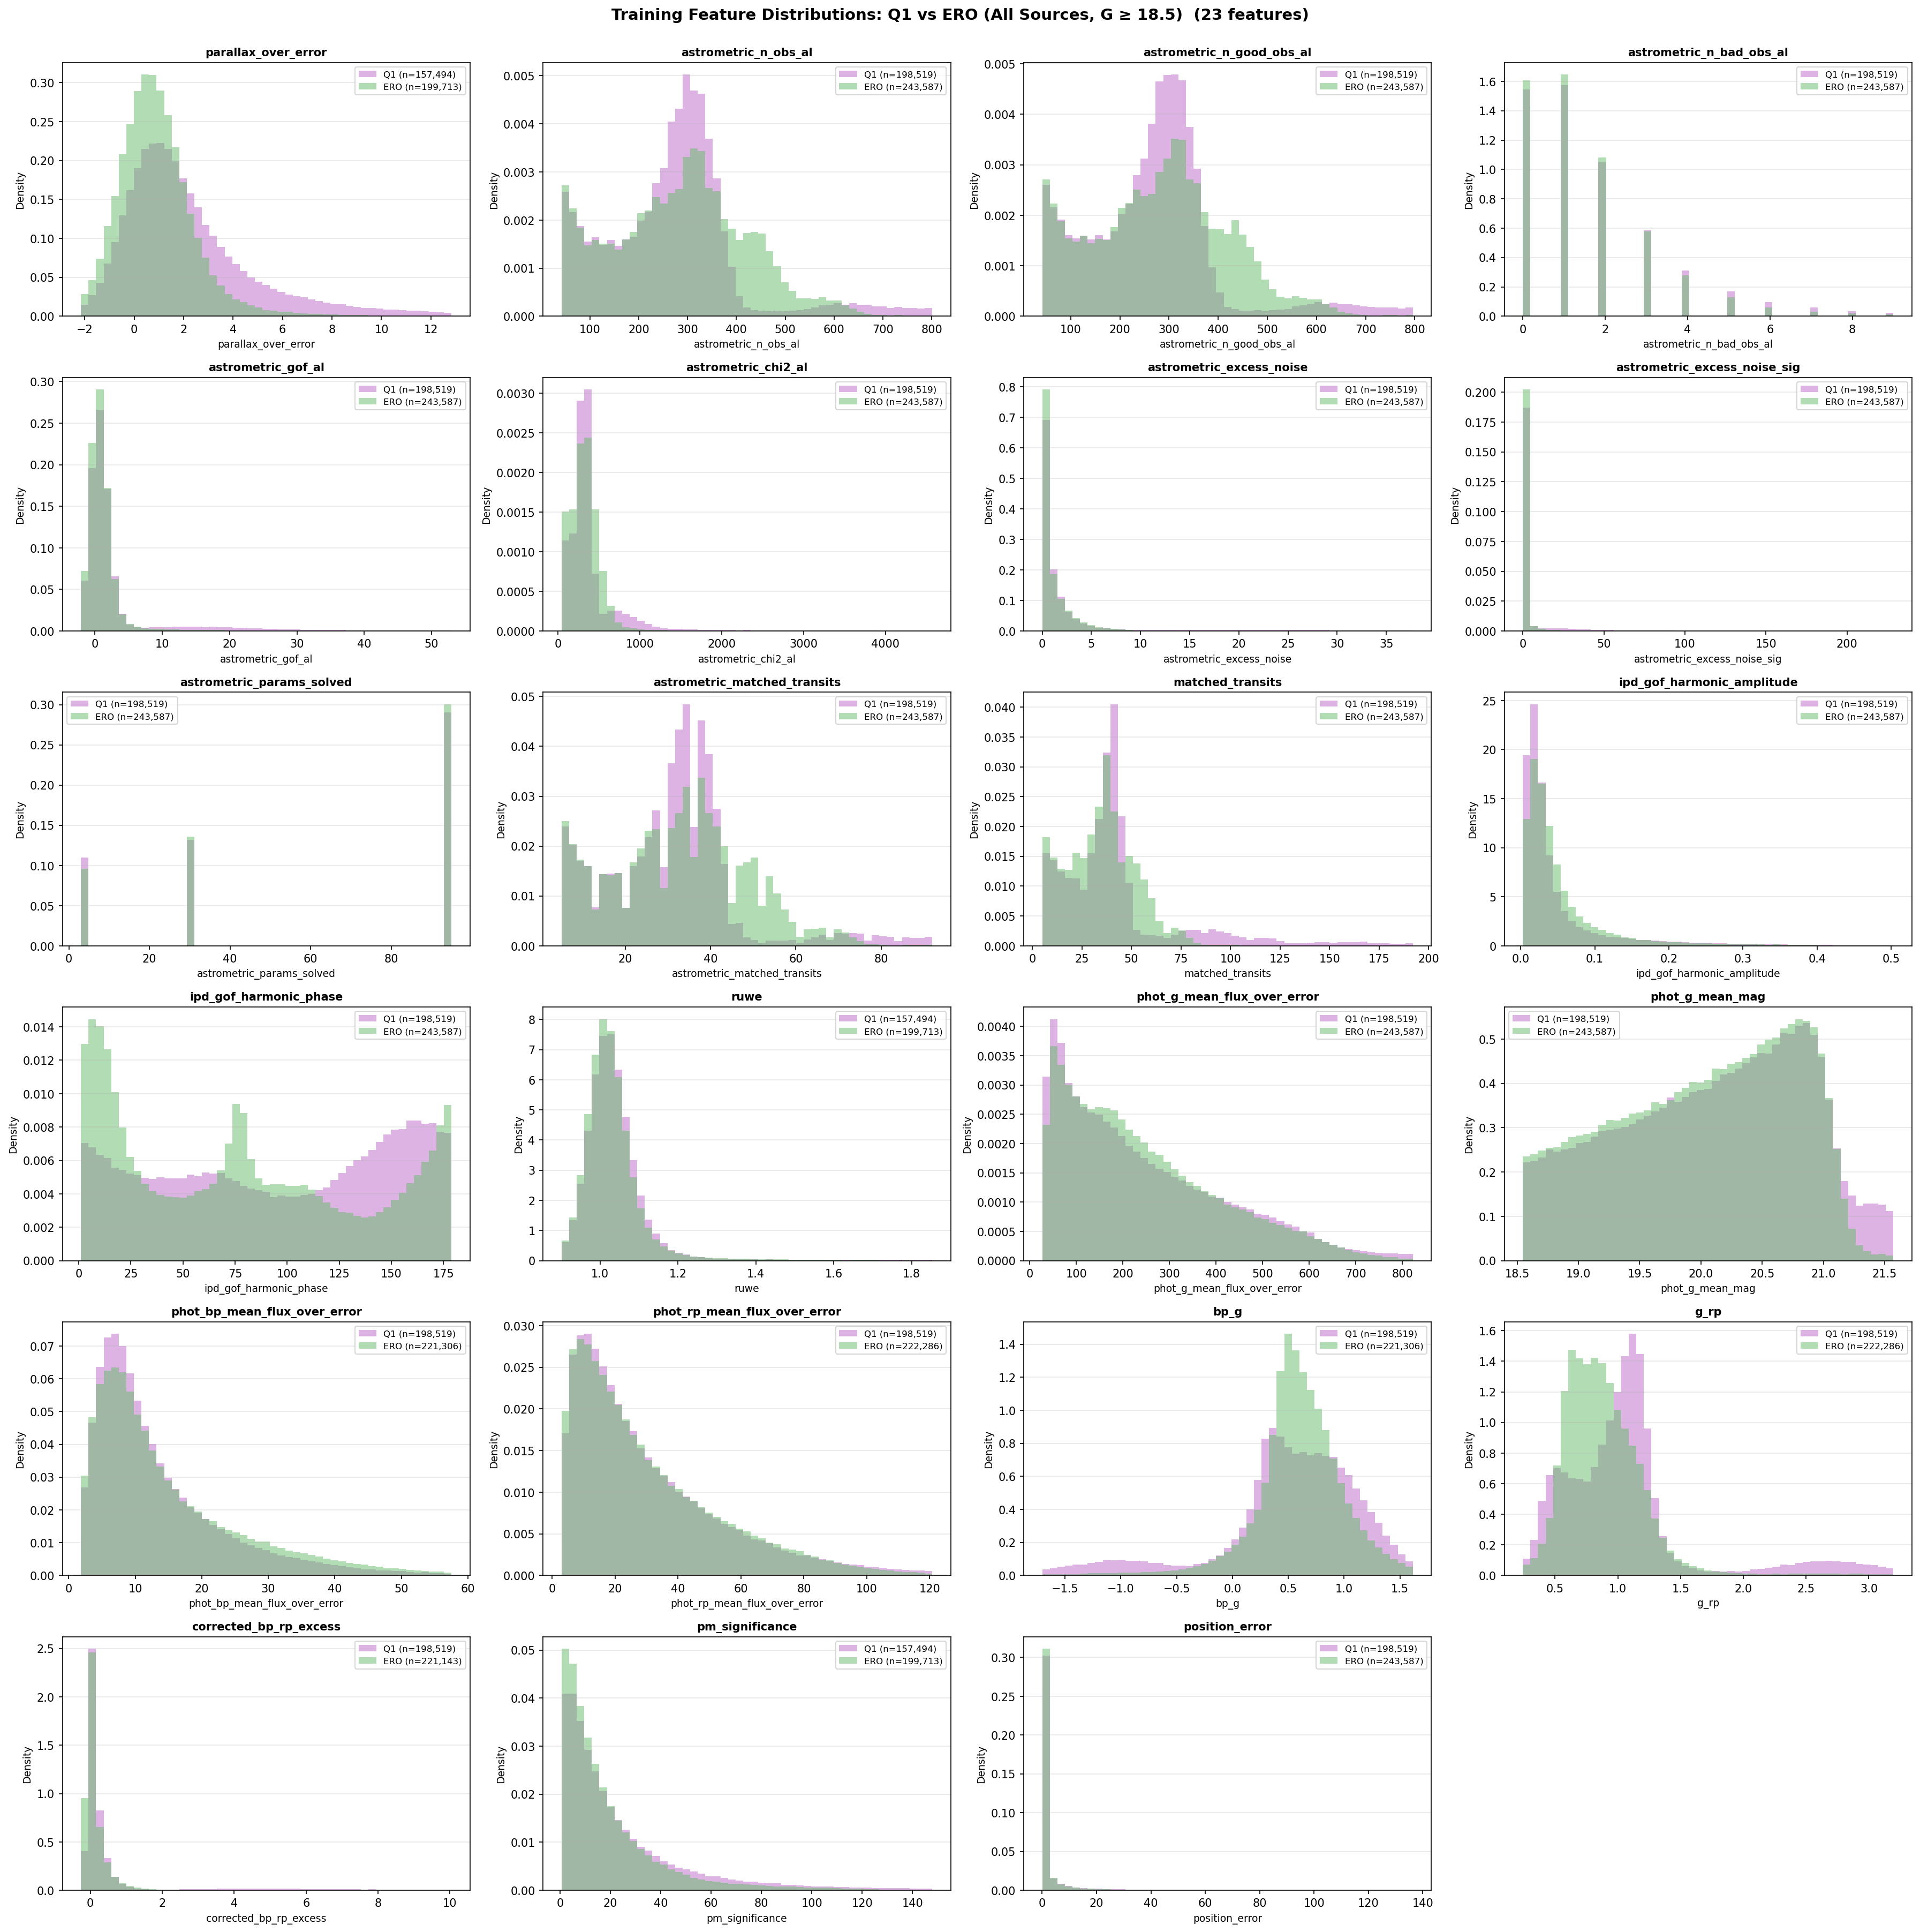
Feature Importance &
Physical Interpretation
Top discriminating features:
1. corrected_bp_rp_excess
Galaxies have extended emission → excess flux in BP/RP relative to G
2. g_rp (colour)
Galaxy spectral energy distributions differ from stellar colours
3. astrometric_matched_transits
Extended sources affect centroiding → fewer matched transits
4. ruwe
Galaxies produce poor astrometric fits → higher RUWE values
14
Notes:
The model finds physically meaningful features. corrected_bp_rp_excess is the strongest predictor — this quantifies how much flux leaks into the BP and RP prisms beyond what's expected from the G-band. Galaxies, being extended, naturally have excess flux. g_rp captures colour differences. astrometric_matched_transits reflects that extended sources have worse centroiding, leading to fewer successful transit matches. These all make astrophysical sense and give us confidence the model is learning real signal.

Slide 15
03
Sensitivity & Visualization
Magnitude cuts and model robustness
Notes:
Finally, we explore robustness and how the model behaves across different magnitudes.

Slide 16
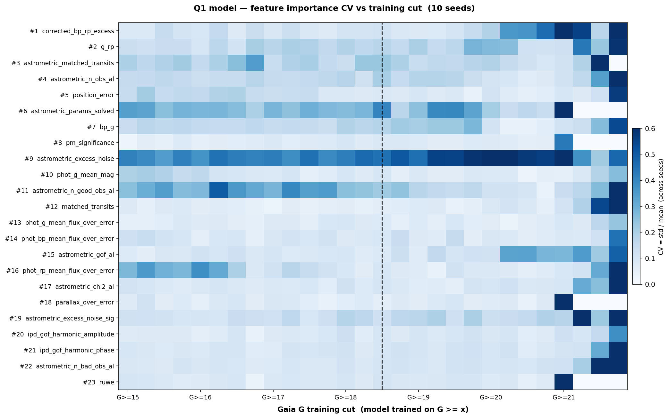
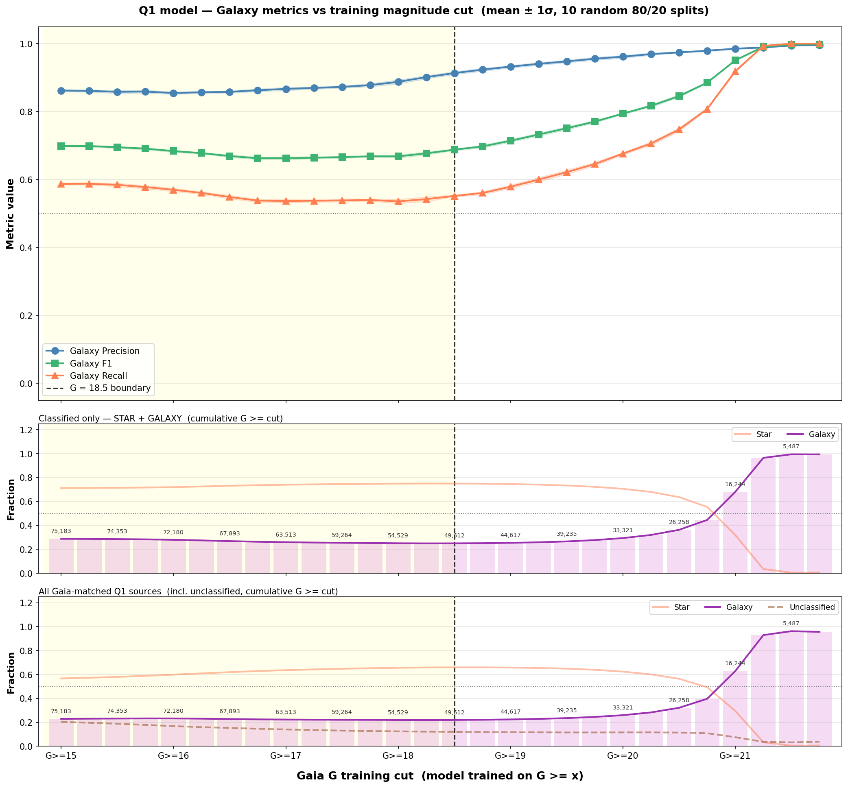
Magnitude Cut Sensitivity
Q1 cross-validation performance as a function of magnitude cut (left: heatmap, right: line plots)
16
Notes:
How sensitive are the results to the magnitude cut? The heatmap shows cross-validation performance across different lower and upper magnitude bounds. The main takeaway: performance is relatively stable for reasonable cuts, but there's a sweet spot around G >= 18.5. Cutting too bright (G >= 16) includes well-classified objects but reduces galaxy fraction. Cutting too faint loses signal-to-noise. The line plots on the right show individual metrics as functions of the cuts.

Slide 17
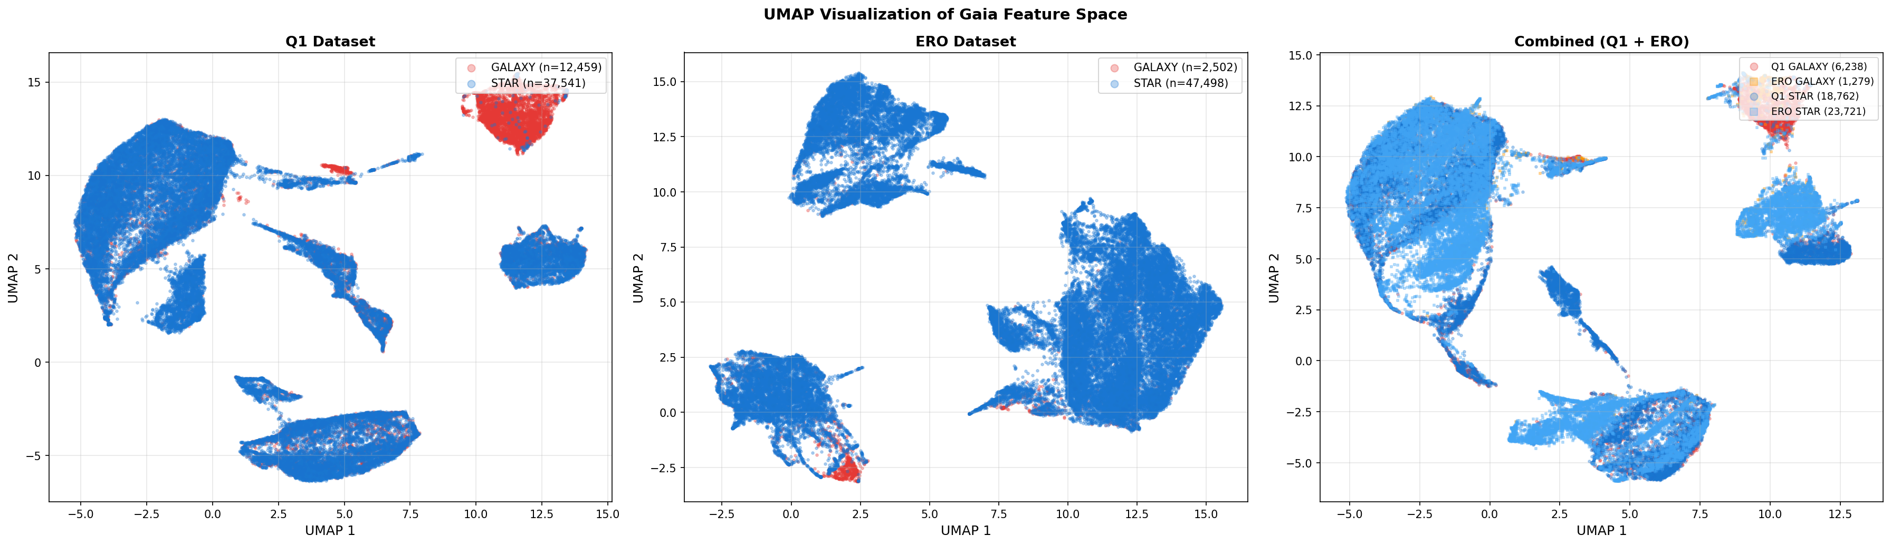
UMAP: Star-Galaxy Separation
in Feature Space
UMAP projection of the 23-dimensional Gaia feature space, coloured by star/galaxy label
17
Notes:
This is a UMAP dimensionality reduction of the 23 Gaia features, coloured by star/galaxy label. You can see that stars and galaxies do form somewhat distinct clusters in this feature space, which confirms there IS signal in the Gaia parameters to distinguish them. But there's also significant overlap — this overlap region is what limits our galaxy recall. The cluster structure suggests the classifier is finding real physical differences, not just overfitting.

Slide 18
Conclusions & Outlook
Key Results
Future Directions
Euclid × Gaia cross-matching successfully generates morphological training labels
XGBoost achieves ROC AUC 0.88 using 23 Gaia parameters alone
corrected_bp_rp_excess is the strongest predictor (physically motivated)
NGC 6397 proper motion correction validates cross-match methodology
ERO label quality is a concern — Q1 labels are more reliable
Investigate class_star systematics further
Test with future Euclid data releases (larger sky coverage)
Explore galaxy sub-classification (elliptical vs spiral)
Improve galaxy recall through class-weighting or threshold tuning
Apply classifier to full Gaia DR3 catalogue
Bottom line: Gaia parameters contain real morphological signal. With better labels from future Euclid releases, this approach could reliably flag extended objects across the full Gaia sky.
18
Notes:
To summarise: We've shown that cross-matching Euclid and Gaia can generate useful morphological training labels. The XGBoost classifier trained on 23 Gaia-only parameters achieves a ROC AUC of 0.88, with corrected_bp_rp_excess as the strongest predictor. Galaxy recall remains the main challenge at ~55%. ERO label quality is a concern, while Q1 labels are more reliable. Looking ahead, larger Euclid releases will provide better training data and broader sky coverage, potentially enabling a practical all-sky extended-object classifier for Gaia.

Slide 19
Thank You
Questions?
Sylvia Zhao
sz423@cam.ac.uk
Institute of Astronomy, University of Cambridge
Notes:
Thank you for your attention. I'm happy to take any questions about the methodology, results, or future directions.

