Slide 1
Euclidifying Gaia
Using Machine Learning to Classify
Non-Point-Like Objects in Gaia DR3
Sylvia Zhao
Part III Astrophysics | Lent Term 2026
Supervisors: Diana Harrison, Simon Hodgkin, Vasily Belokurov
Institute of Astronomy, University of Cambridge

Slide 2
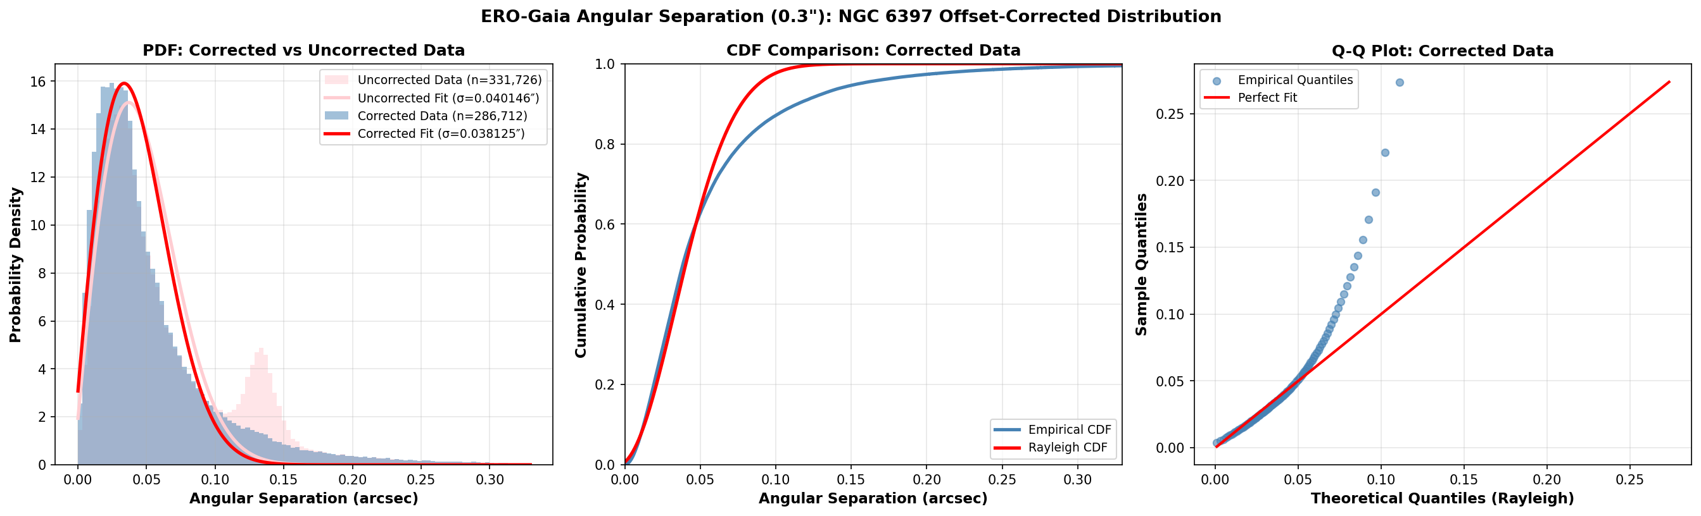
Cross-Matching Validation
ERO-Gaia Angular Separation
Bimodal distribution at 0.3" traced to NGC 6397 globular cluster members
Proper motion correction resolves the second bump — cluster stars moved together
Rayleigh fit: σ = 0.038" (corrected) vs 0.040" (uncorrected)
Validates 0.3" matching radius for ERO-Gaia crossmatch
2

Slide 3
03
XGBoost Classification
Training strategy, feature selection & results

