Slide 1

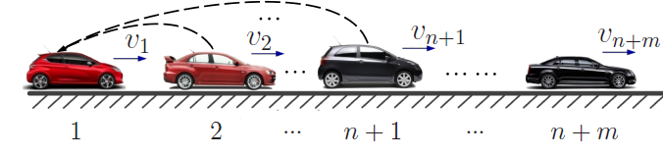

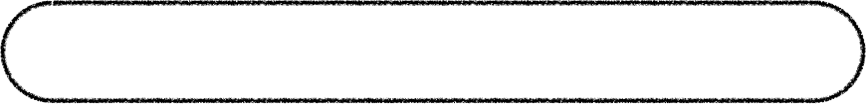
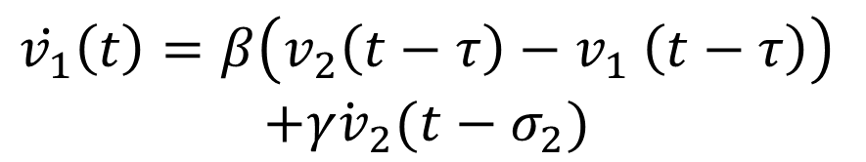
Demonstration
$$\dot{v_{1}}\left(t\right)=β\left(v_{2}\left(t−τ\right){− v}_{1}\left(t−τ\right)\right)$$
$$+\dot{γv_{2}}(t−σ_{2})$$
acceleration feedback
IRL
$$r_{F}\left({a_{F}^{t}, v}_{F}^{0},v_{L}^{t−τ},h^{t−τ}\right)=θ_{F}^{⊺}φ({a_{F}^{t}, v}_{F}^{0},v_{L}^{t−τ},h^{t−τ})$$
$$φ=−[|v^{t}−v^{t−1}|,|h^{t−τ}−h^{0}|]$$
Optimal Reward Function

Slide 2
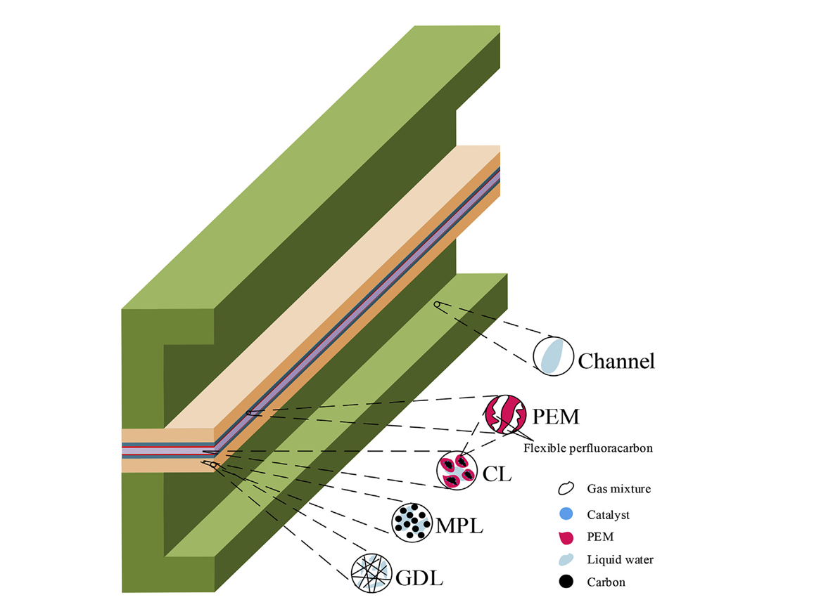
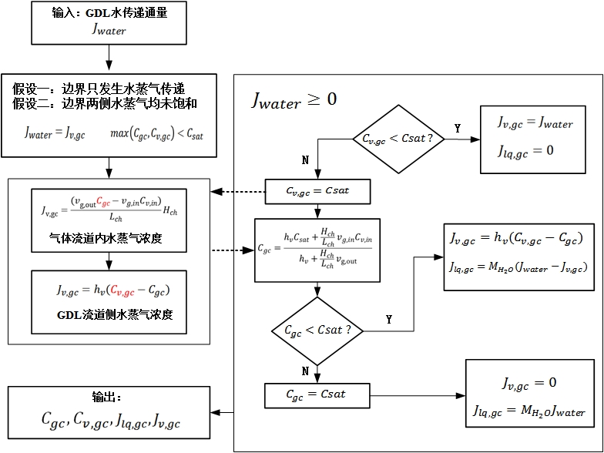
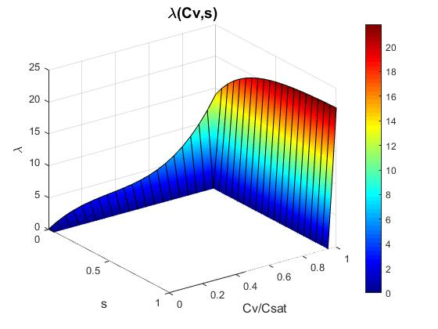
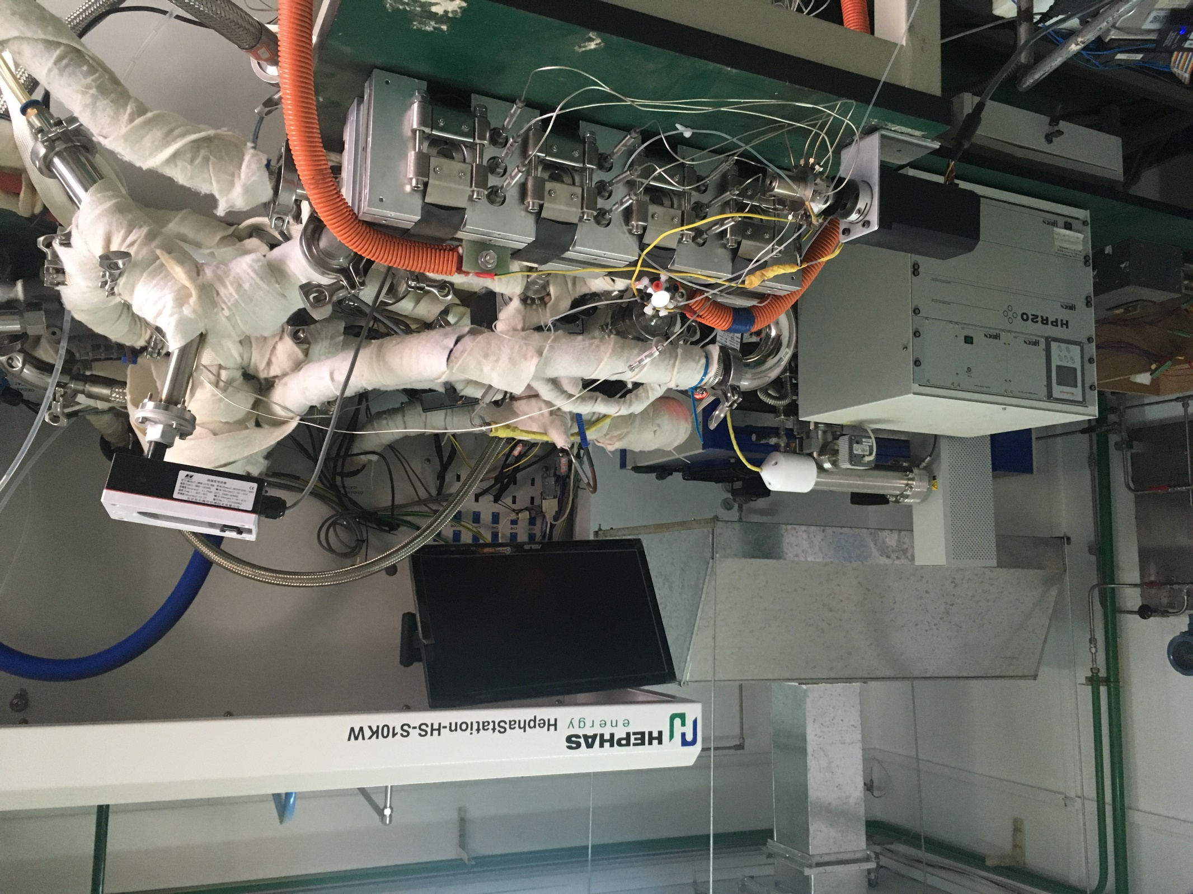
Gas Distribution
Water Distribution
Numerical Model + Experiment

